Slide 1


What is labour market information and analysis?
Introductory Training for Analysis of Labour Market Information
Makiko Matsumoto, Employment Specialist, ILO DWT-Bangkok
Ulaanbaatar, Mongolia | 22 November 2016

Slide 2

Overview and objectives
The definition of labour market information (LMI)
The importance of LMI/LMIA
LMI/A and policies
Role of tripartite partners in LMI/LMIA

Slide 3
The definition of labour market information (LMI)
The importance of LMI/LMIA
LMI/A and policies
Role of tripartite partners in LMI/LMIA

Slide 4
Definition - LMI
LMI is the information that….
  Concerns the size and composition of labour market
  Indicates the supply and demand for labour within a certain labour market
  Captures the functioning of labour markets (incl. problems and opportunities)
  Monitors labour market outcomes over time

Slide 5
What is LMI?
LMI includes all that information about two sides of the labour market: SUPPLY AND DEMAND, and how they interact with each other
Some examples:
Demand
Vacancies
Birth and death of companies
Outcome
Average wages
Unemployment
Supply
Number of young people entering the labour market
Number of graduates produced in various skills fields per year
Redundancies
Skills demand and shortages
# of training institutions
Economic growth of sectors/regions
Number of job seekers
Employment-to-population ratio
Average hours of work
Labour productivity
Offered wages
Employment by status
Analysis
Policy/institutional data
Other economic data

Slide 6
Uses of LMI analysis (LMIA)
Develop a profile of current labour market conditions (pay, working conditions, hours of work)
Understand trends in labour market (e.g. increase in vulnerable employment)
Provide outlooks (growth/decline) for different sectors and occupational groups – this can involve employment projections
Understand education and training requirements/qualifications for specific occupations

Slide 7
The definition of labour market information (LMI)
The importance of LMI/LMIA
LMI/A and policies
Role of tripartite partners in LMI/LMIA

Slide 8
Why do we need LMI? Uses
Users | Use | Items
Employment policymakers | Assessing employment problems, fixing employment targets and identifying employment generating technologies and investments | Population, labour force, employment and unemployment rate; Age, sex, industry, occupation, employment intensities of sectors; Skill shortages
Planners of education and vocational training programs | assessing the relevance of existing courses and identification of new courses for educational development | Levels of education and skills of the population, skill requirements, skill shortages and surpluses
Implementer of employment programs | Identification of implementation needs, identification of eligible beneficiaries, etc. | Unemployment by localities, lists of eligible families, etc.
Employers | Labour planning at employer level | Skills available locally, shortages, wage levels service conditions, modes of recruitments, etc
Trade unions | Programs for re-employment of retrenched workers, skills training program | Job and self-employment opportunities, wage levels and service conditions in various sectors
Job seekers | To find out about employment opportunities and their requirements | Job opportunities, wages, service conditions. Avenues of self-employment, selection procedures, plus occupational information and information on training and other program options

Slide 9
Why do we need LMI/LMIA?
Labour market information and analysis assists:
  Make informed decisions in terms of career, training and other investment choices
  Efficient allocation and use of resources (times and funds)
  Monitoring the functioning and evolution of the labour market
  Formulation and assessment of economic and employment related policies and interventions

Slide 10
LMIA in action: Korea – design and monitoring of policies
Youth unemployment rate (%), Republic in Korea
1
2
3
Source: Korea National Statistics Office.
Sharp rise in youth unemployment (GFC)
Korea announces economic stimulus measures, including internships, wage subsidies
Measures at youth employment phase out

Slide 11
LMIA in action: Korea – need for in-depth assessment of policies/programmes
Source: Korea National Statistics Office.
Recovery in the LM up to 2012
Continued slow GDP growth of around or less than 1% may be contributing to a gradual rise and persistence of high youth UER, particularly for women.
Youth employment programmes have been continuing, but important to draw lessons learned on what works/fails.

Slide 12
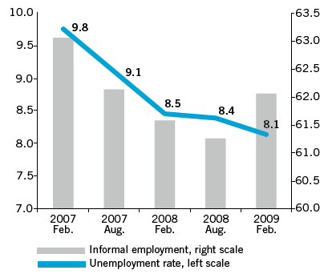
LMIA in action: Indonesia – basis for further information and analysis
Crisis: Unemployment in Indonesia continues to decrease but informal employment jumps
Need to closely monitor informal economy recognized
Source: World Bank: World Development Indicators, 2008.
Source: Statistics Indonesia.

Slide 13

LMIA in action: Viet Nam – economic recovery and structural change
Recovery in economic growth supported by recovery in manufacturing sector, employment-wise.
Continued decline in agricultural employment, though its share remains above 40%.
Wholesale & retail trade constitutes lower share of GDP, post-crisis.
But % of employment in wholesale & retail trade increasing in importance. Some concerns for productivity.
Notes:
Institute of Labour Science and Social Affairs.

Slide 14
LMIA in action: Philippines – Monitoring Employment Plan 2011-16
The strategic response on employment focused on improving access to employment opportunities by improving employment levels and improving access to employment opportunities
Notes:
Good growth on labour productivity, recording one of the highest growth rates in the last decade and a half; but progress in promoting investment has stalled, compared to the early 2000s.

Slide 15
LMIA in action: Philippines – Monitoring Employment Plan 2011-16
The strategic response on employment focused on improving access to employment opportunities by improving employment levels and improving access to employment opportunities
Notes:
Some progress in reducing youth UER, particularly for young women.
Progress on reducing vulnerable employment rate slow, particularly for women.

Slide 16
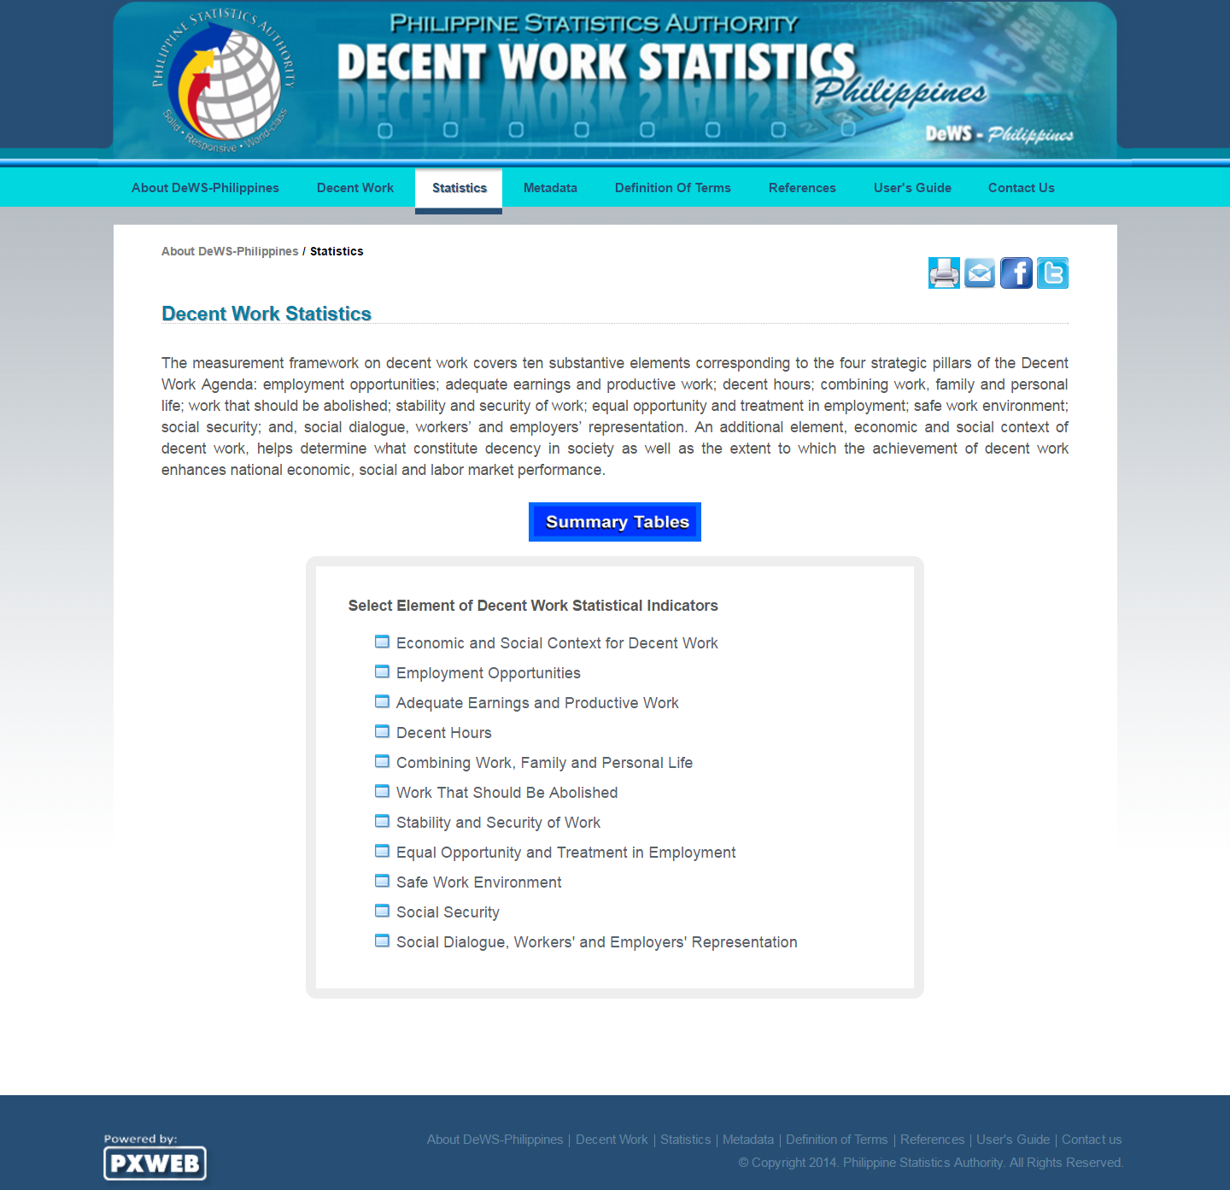
LMIA in action: Philippines – data organization and management, a portal for DWIs
Source: http://labstat.psa.gov.ph/dews/Dbase.aspx.

Slide 17
LMIA in action: Philippines – using thematic surveys for labour turnover statistics (establishment-based)
Separation rate exceeded rate of new hire only in few periods: 2010Q1 (immediately after the crisis) and 2011Q2
Rate of new hires in Metro Manila roughly mirrored the national trend in GDP growth rates, up until about 2012Q1
Potential impact of typhoons and other natural shocks, affecting overall GDP growth, whereas Manila LM less affected.
Highlights the need to examine regionally disaggregated LM trend
Source: Philippines Department of Labor and Employment
and National Statistical Coordination Board.

Slide 18
Sources of LMI for employment opportunities
Quantitative Qualitative
Employment
projections
based on
modeling
Stakeholder
forums
Focus group
discussion
Household
Survey
Enterprise
Survey
Sector/LED
analyses
Use of
Administrative
Data
Tracer study of
TVET graduates

Slide 19
LMI analysis - approaches
  Descriptive:
    Trends in indicators, including disaggregation
    Cross-sectional: single-period, comparisons across men/women, rural/urban, age groups, sectors, occupations, education + training, ethnicity, disability
    Qualitative
  More data-intensive
    Regressions: E(y | X) – very large families of empirical estimators
    Simple frameworks usually estimate associational relationships
  Analytical – causal, usually involving counterfactual distributions

Slide 20
LMI analysis – aggregation levels
  Macroeconomic – e.g.:
    National unemployment rate
    Wage share in income
  Aggregation up to a certain level – e.g.:
    Sectors & sub-sectors
    Regions, provinces, villages, districts
    Other representative sub-groups from survey data
  Microdata – e.g.:
    Individuals
    Workers
    Enterprises

Slide 21
Sources of LMI
  LMI is collected/generated from…
Individual data
Household surveys (e.g. LFS, HIES)
Employment outcomes (by gender, age, sectors, occupations, etc.)
Enterprise data
Establishment surveys
Labour cost, average wage bills
Administrative data
Registration & administrative information
Number of job seekers (by profiles of job seekers)
Monthly earnings
Hours of work
Productivity
Sectoral composition
Number of employees (regular, others)
Number of vacancies (by types of enterprises)
Number of social security beneficiaries
Labour market history (employers + job seekers)
Skills need surveys
Notes:
And other socioeconomic data, collected through other surveys, censuses, tax records, etc. that are used to compile national accounts statistics.

Slide 22
The definition of labour market information (LMI)
The importance of LMI/LMIA
LMI/A and policies
Role of tripartite partners in LMI/LMIA

Slide 23
LMI/LMIA and policies
LMIA consist of three main elements:
• collection and compilation of data and information;
• analytical capacity and tools; and
• institutional arrangements and networks to access to LMIA and disseminate.
A comprehensive labor market information analysis can:
Document the current strengths and weaknesses of the workforce
Quantify labor supply and quality
Identify unmet training needs
Define emerging employment trends and economic opportunities
Assist existing businesses in finding qualified workers
Match workers with jobs and training programs
Guide training providers in preparing the workforce for existing and emerging employment opportunities
Notes:
How comprehensive LMIA can be provided depends on the extent to which data can be collected,….
More comprehensive LMI is useful, but building the system takes enormous efforts and has to be fit for purpuposes

Slide 24
LMI/LMIA for policies: Institutional coordination
LMIA requires institutional coordination within the government, and rgw capacity to manage and analyze collected information.
ES/LMI – collect, manage, process/analyze, disseminate
NSO: survey-based data & statistics
MOL: employment dept., training dept., OSH dept., etc.
Other ministries & agencies: MoC, MoA, MoI, Investment Board, etc.
Notes:
How comprehensive LMIA can be provided depends on the extent to which data can be collected,….
More comprehensive LMI is useful, but building the system takes enormous efforts and has to be fit for purpuposes

Slide 25
The definition of labour market information (LMI)
The importance of LMI/LMIA
LMI/A and policies
Role of tripartite partners in LMI/LMIA

Slide 26
Roles of Tripartite Partners in LMI
Government:
  Survey-based information collection, analysis and dissemination
  Compilation of sector or state/local levels data to present a national data
  Dissemination of LMI to guide the training provision & employment services
Employers:
  Undertaking, and/or participating national employer survey, or sector based surveys/studies
  Providing sector-based LMI (e.g. through SSCs)
  Reflect the LMI in their own HRD/skills investment planning
Workers:
  Undertaking, and/or participating in national industry/sectoral survey and studies
  Use the information to give advice to individual workers (e.g. wages levels, changing demands of skills)

Slide 27
Summary
LMIA plays a critical role in the identification and prioritization of economic, labour and social policies
Plays an important role in informing choices, whether by young jobseekers, enterprises or others
To be useful, LMI/LMIA has to be reasonably accurate, timely, accessible and usable, however, it is more useful if it is sustainable
Strengthened capacities in analysis required

Slide 28

Thank you
Makiko Matsumoto
Employment Specialist
ILO Regional Office for Asia and the Pacific
huynh@ilo.org

