Slide 1

Sectoral Approaches on Skills for Green Jobs: Good practices in Asia
Carmela I. Torres
ILO DWT Bangkok
ILO/Japan Regional workshop on Sectoral Approach on Skills for GJ
24-25 January, 2017

Slide 2

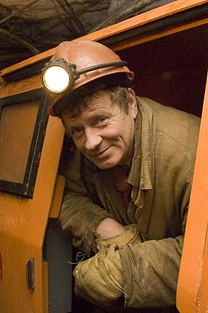
Green Sectoral Change
Additional jobs will be created.
Some employment will be substituted
Certain jobs may be eliminated without direct replacement
Many existing jobs will be redefined
New jobs created will offset those lost

Slide 3
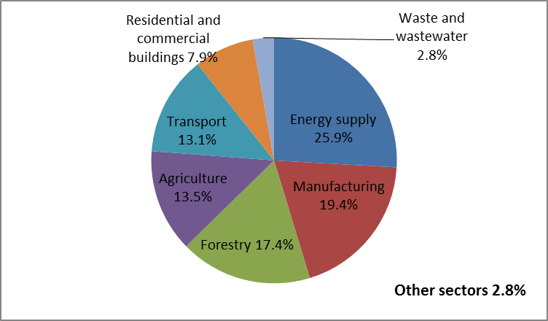
Sectors Affected and Re-training Needs
Agriculture, forestry and fisheries
Extracting industries and fossil-fuel energy generation
Emissions intensive manufacturing, in particular:
    Automotive sector and related supply chains;
    Ship-building and related marine engineering activities.

Slide 4
Challenges in Greening Economies
Weak core/ generic skills
Skills shortages hold back transitions to greener economies due to:
--Unbalanced national skills structures
--Lack of STEM skills
--Training system not responsive to changes in the economy
Shortage of qualified teachers & trainers
Lack of information
Large supply of young people in the labour market
Limited access to training for people in rural areas & informal economy
Agriculture: major sector of employing high percentage of the economic workforce

Slide 5
Role of skills
Green jobs
Skills
Green jobs and skills for green jobs form a feedback loop
Gaps open up when one of the two changes
Causes pressure for the other to change too
Green strategies need a skills component

Slide 6

Skills Shortages
Skills shortages already pose a major barrier to transitions to green economies and green job creation
In certain sectors and occupations
Particular core skills
Multi-skillling requirements

Slide 7

Why are there SHORTAGES?
Underestimated growth of some sectors, such as for green technologies
General lack of scientists and engineers
National skill structure which does not meet skills demand
Low reputation of sectors – failure to attract trainees
Poor coordination

Slide 8
Industries likely to grow and retraining needs

Slide 9
Changing and emerging occupations
Degree of Skill Change | Occupational change | Typical skills response | Examples
None | None or already quantitative | None or increased training in existing occupation | Bus driver in CNG driven buses, forester
Low | Changing occupation | On-the-job learning or short training courses | Welder in wind turbine production; organic farmer
Medium | Changing or emerging occupation | Short courses or longer continuous training | Energy consultant in building; car mechanic for electric cars or CNG cars
High | Emerging occupation | Initial training, university degree or longer continuous training | Solar energy technician; eco designer; biofuels technician;

Slide 10
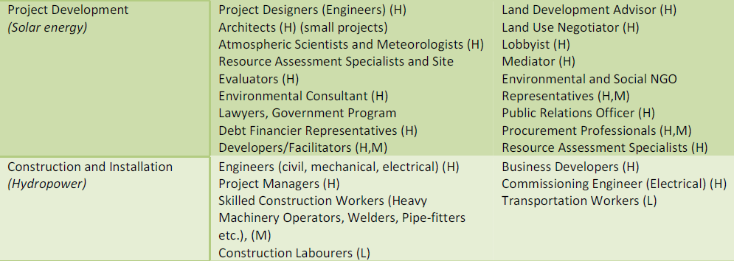
Examples of occupations in selected
RE sub-sectors by value chain

Slide 11
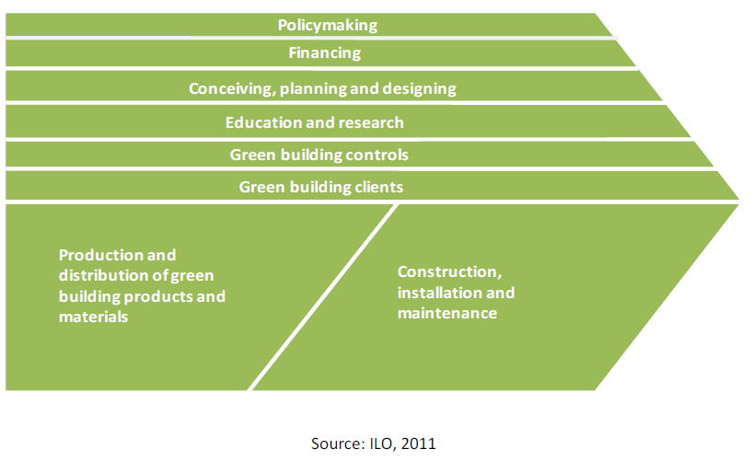
Good Practices in Asia
GREEN BUILDING
GB value chain occupations
Reduces energy and water usage in the building
Reduce the environmental impact of the building process, sourcing and manufacture of building materials and components and of demolition, reuse and recycling
Improves health and comfort of the occupants once the building is built

Slide 12
Good Practices in Asia
GREEN BUILDING: Core occupations (examples)
Conceiving, planning, designing & advising
Construction Company managers & Business functions architects and Civil/Structural/Environmental engineers
Energy and Water efficiency and Waste management analysts, Consultants and Advisors
Controlling
Energy Auditors
Inspectors, Certifiers and Quality Controllers
Enabling
Policy makers
Educators & Information providers
Urban planners
Financing

Slide 13
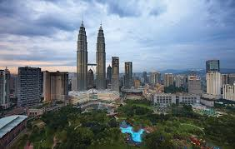
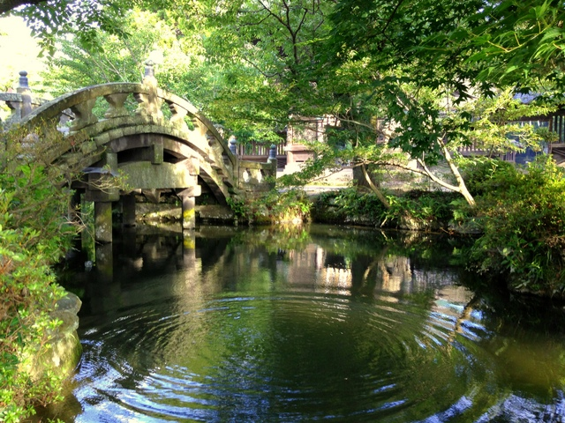
Good Practices in Asia
GREEN BUILDING: Occupations
Malaysia
Private sector has developed the Green Building Index (GBI) as a benchmark standard for energy efficiency and other sustainability criteria tailored for the Malaysian tropical climate and socio-economic context
New occupation created: GBI Facilitator
Japan
Emerging new trades where specialist heat pump installers/maintainers are becoming established

Slide 14
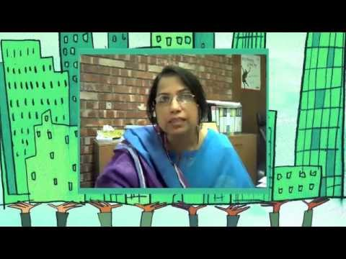
Good Practices in Asia
GREEN BUILDING: Occupations/Training
Bangladesh
Developed a national green skills development
strategy for those who require retraining in the shift
to emerging green building technology: architects,
civil engineers, designers and masons in greening
buildings
Training:
Short, OJT courses for existing construction workers:
awareness campaigns among real estate developers,
contractors and building dwellers; and forming green
jobs skills development committees representing
union and employers’ associations

Slide 15
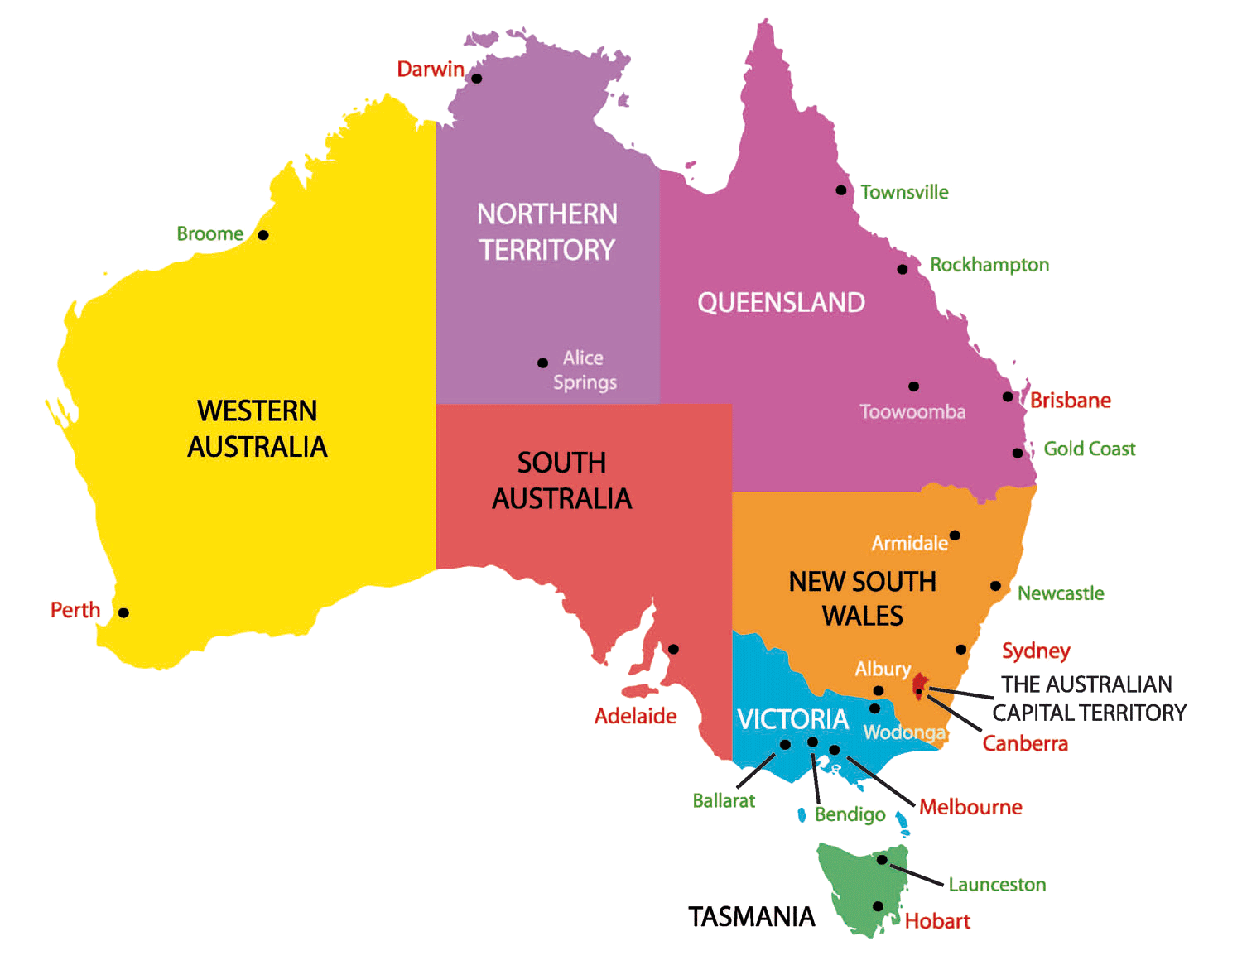
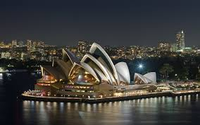

Good Practices in Asia
GREEN BUILDING: Occupation
Joint initiative of Master Plumbers Mechnical Services Association of Australia & Plumbing Trades Employees Union
Training programme is delivered through a joint employer-union training enterprise workshops
Allows plumbers to advise and inform consumers on topics like benefits of energy efficiency & water conservation
Programme has expanded to New Zealand and North America: impt role of plumbers in creating a more environmentally sustainable future
GreenPlumbers Initiative: AUSTRALIA

Slide 16


Good Practices in Asia
GREEN BUILDING: Education & Training
China
18 universities in China have initiated Green Campus Progamme in collaboration with Green Building Council to promote the concept of green building on campuses, establish standards and organize training and knowledge exchange
India
Training for urban planners in sustainability issues is increasingly available at Masters and PhD levels

Slide 17
Good Practices in Asia
RENEWABLE ENERGY: Value chain &
Occupations (examples)
Equipment Manufacture & Distribution
Project
Development
Construct-
ion & Installation
Operation & Maintenance
Cross-cutting/Enabling Activities
Five main areas of renewable energy
Wind energy: R&D engineers (computer electrical env’tal, mechanical, wind power design)
Solar energy: Atmospheric Scientists & Meteorologists; Project designers (engineers)
Hydropower: Engineers (civil, mechanical, electrical); Skilled const’n workers (heavy machinery operators, welders, etc)
Geothermal: Plant managers, Welders, Pipe fitters, plumbers, HVAC technicians
Bioenergy: Agri scientists, Biomass prod’n managers, plant breeders & foresters

Slide 18
Good Practices in Asia
RENEWAL ENERGY: Policy, Investment & Education/training
Development strategies for renewal energy industries
Act for promoting Development, Usage, Distribution of and classifies the new renewable energy into 11 fields
KOREA
$180M: to promote three energy sources: energy sources, electricity, new renewal energy (emphasis)
Busan Energy Science High School: only HS specializing in new renewable energy in Korea: developed comprehensive educational curriculum, faculty, specialized eqpt; industry partnership

Slide 19
Good Practices in Asia
RENEWAL ENERGY: Occupation and Training
CHINA: Micro wind power worker
Install, adjusts, operates and maintains micro wind power of less than 10kW per turbine
Basic knowledge of wind power generation , knowledge of reading and drawing graphics, basic theories, safely and relevant laws & regulations
Trained 120,000 (2008) to increase as improvements to the clean energy strategy are implemented

Slide 20
Good Practices in Asia
RENEWAL ENERGY: Projects & Training needs
INDIA
Energy sector: Biomass power plant in West Bengal
and winds projects in Baramsar and Soda Mada
Biomass plant: construction, installation and operation of a 6MW, grid-connected biomass power plant—generated electricity feeds into the local grid which is part of India’s Eastern regional grid
5MW wind power project has state-of-the-art wind generators at 2 locations
Identified re-training skills and needs for both projects

Slide 21

Good Practices in Asia
TOURISM: Community-based ecotourism
Deforestation a major environmental challenge
Considered a comprehensive tool to conserve biodiversity and involve local communities & organizations
Indecon: facilitated various eco-tourism site devts
Sites; Tankahan Village, Gunung Leuser national park Aceh
Training & skills devt: research & planning; destination devt; marketing; monitoring & evaluation
Empowerment at local community level, tourism developer, program manager & decision-maker
Training as eco-guides & identify exotic flora and fauna living in the park & carrying out sustainable practices & transferring knowledge to tourists

Slide 22
Good Practices in Asia
TOURISM: ILO Greener BUSINESS Asia (GBA)
Hotels going greener: effects beyond the enterprise
More organic
Food
Hotels
Tour operators & customers
More local, greener mats
Other supplies
Building design
Technology providers
Advisory service providers
Green building design
Energy Efficient AC,..
Implications in terms of new and existing occupations in other sectors, e.g.
Farmers using organic farming techniques
Architects with green building design skills
Plumbers and electricians familiar with fixing new types of equipment …
Energy auditing, green certifications

Slide 23
Good Practices in Asia
TOURISM: Assessing occupations/skills
Changes in existing occupations
General manager: leads devt of vision of a greener hotel
Housekeeper understand importance of conserving resources, applies basic resource conservation
Identifying the types of skills
Occupation-specific technical skills: hotel engineer—implementing green technology options; maintenance of green eqpt
Hotel engineer: identifies & chooses green technology options
Generic core skills: team work; communication
Core skills with environmental focus: environmental awareness; waste mgt; energy efficiency; resources conservation

Slide 24
Good Practices in Asia
TOURISM: GBA Programme- Hotel Sector
Continual improvement and greener workplaces
Changing Enterprises in a Changing World: Continual Improvement and Joint problem-Solving for Sustainability
Greener processes and workplaces
CORE TRAINING
DAY 1
Workplace relations & mechanisms of cooperation
Workplace cooperation, principles and practices
The 5S
Workplace relations, rights and equality
DAY 2
People & workplaces for service excellence
Occupational Health 7 Safety –Level 1
People for continual improvement and service excellence
Green Improvement Planning
DAY 3
Preparation of Green Improvement Plans by joint teams
Energy efficiency
Water Management
Service Quality
Waste Management & Green procurement
Occupational Safety & Health L2
Improvement action implementation by teams & Follow-up Support

Slide 25

Thank you
For further information please contact:
Carmela I. Torres
Senior Specialist on Skills & Employability
ILO Decent Work Team Bangkok
Tel No. +66 2 2881780
E mail address: torresc@ilo.org

