Slide 1



Skills Needs in Changing and Emerging Green Jobs:
Sectoral Approach
ILO/Japan Regional workshop on Sectoral Approach on Skills for GJ, 24-25 January, 2017
Olga Strietska-Ilina,
Skills and Employability Branch,
Employment Policy Department, ILO-Geneva

Slide 2



Skills for Green Jobs: A Global View
http://www.ilo.org/skills/pubs/WCMS_162799/lang--en/index.htm
ILO-EC Project:
  Skills and Occupational Needs in Renewable Energy
  Skills and Occupational Needs in Green Building
  http://www.ilo.org/skills/projects/WCMS_140837/lang--en/index.htm

Slide 3
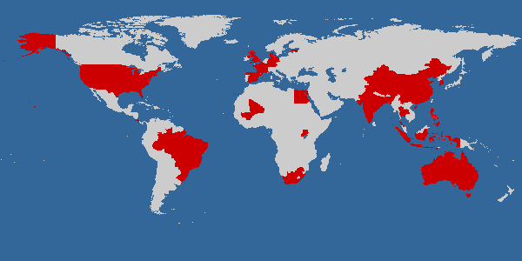
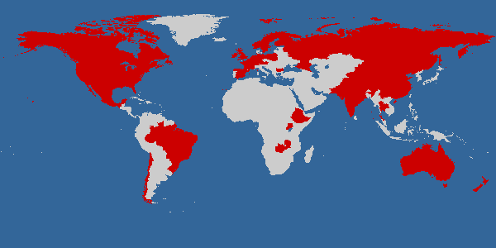
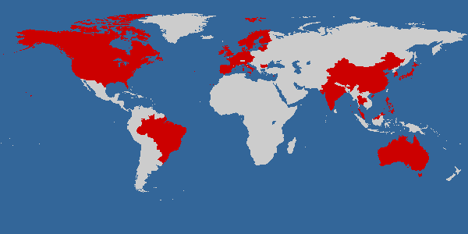
Country coverage
60% of world population
59 % of global GDP
64 % of global CO2 emissions
Many more countries covered under ILO-EC project

Slide 4

Drivers of change
Changing natural or built environments;
Environmental / climate change policy and regulation;
Green technology and innovation;
Markets for green industries and consumer habits
Notes:
The following drivers of skills and occupational change have been identified:
Changing natural or built environments; [mostly skills to adapt to consequences of climate change and environmental degradation, such as handling climate risks in agriculture, adapting to prolonged dry or rainy seasons, decline in certain sectors due to biodiversity loss – e.g. tourism, or due to deforrestation – e.g. woodcarving)
Policy and regulation; such as restrictions on use of certain materials, regulations on production processes and goods, targets in CO2 emissions reduction, incentivies through taxation etc.
Green technology and innovation; i.e. skills are needed to innovate new clean ways of production, to bring the innovation to the market, but also to adopt new technologies, maintain and repair it.
Markets for green industries and consumer habits: companies undertake initiatives beyond compliance with regulations to have a competitive advantage over others. Changing consumer preferences towards pro-environmental behaviour or e.g. good-quality organic food, also drive the market.
Depending on the stage of development of the green agenda in the country, different drivers have a different weight in skills change: at the beginning regulations and policies are the main drivers, whereas market and consumer behaviour come into play as important drivers at a more advanced stage.
The drivers of change are interrelated: changing natural or built environments is the basis for policy-decisions on environmental regulation. Regulation, in turn, can affect development and diffusion of technology. Regulation and also the availability of technology affect national and global markets. Consumer behaviour affects markets but also influences the uptake of technologies.

Slide 5
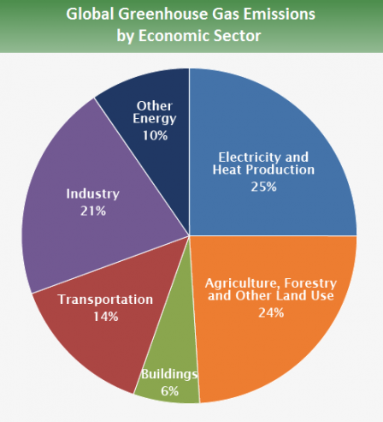
Sectors affected and retraining needs
Source: IPCC 2014
Notes:
The most affected are carbon intensive and polluting sectors, although the structural change is not limited to the green agenda. It is part of a longer-term process, where technology and innovation, global competition and the need to cut the costs of production, new market opportunities and other factors play an equally important role.
The degree of green structural change depends on the country stage of transition to a greener economy. Whereas in some countries this process started 30 years ago (e.g. Denmark, Germany) in most developing countries the process is limited to few enterprises.
The following sectors have been identified as the most affected:
Agriculture re-focused on organic food markets and on the production of bio-fuels;
Extracting industries and fossil-fuel energy generation transition to energy and resource efficiency, new green technologies, carbon capture and storage as well as feed their workforce into renewable energies with related retraining needs consequences;
Emissions intensive manufacturing, in particular:
Automotive sector and related supply chains re-focused on eco-friendly vehicles (hybrid, electric, hydrogen);
Ship-building and related marine engineering activities re-focused on off-shore renewable energy activity including the construction of wind turbines and their supply and maintenance.

Slide 6
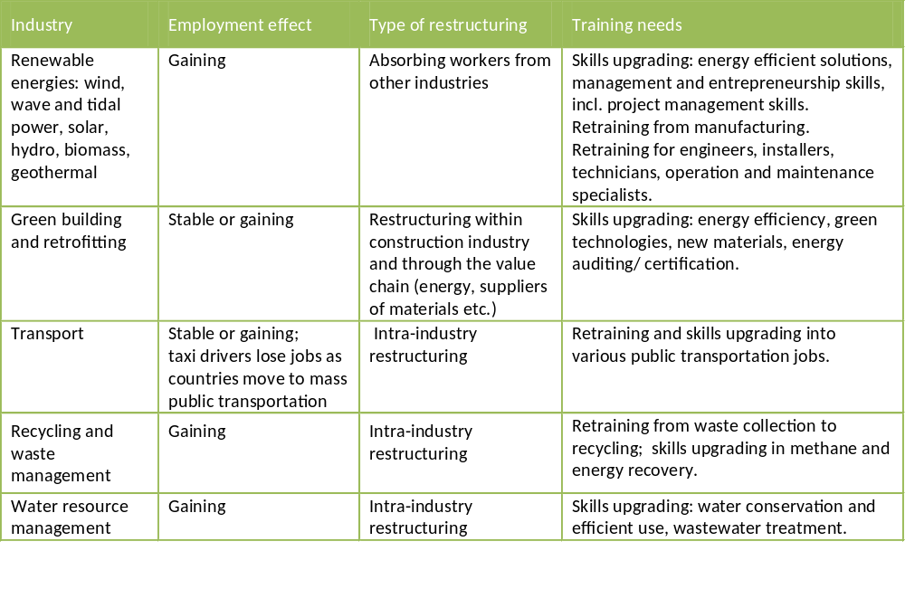
Industries likely to grow and retraining needs

Slide 7
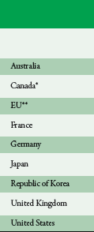
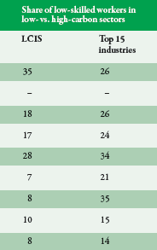
Share of low-skilled in top polluting sectors is higher than in low-carbon ones
Source: ILO 2012

Slide 8

Why sectoral approaches?
Sector is crucial to understand the key drivers of change in skills demands to have sectoral focus and perspective
Clear stakeholders
Easier to facilitate coordination among all relevant stakeholders and social dialogue
Reduce complexity and scope of interventions
Specific skills questions (e.g. gaps, occupational change) need the sort of close up examination that sectoral research enables
More chances to provide immediate results, and thus easier to ‘sell’ the idea
Linked to industrial policies, investment decisions etc.

Slide 9
Steps
Sector selection
Mapping the sector
Employment trends
Key drivers of change
Foresight
Skill needs (quality & quantity)
Skill gaps / shortages
Recommendations

Slide 10
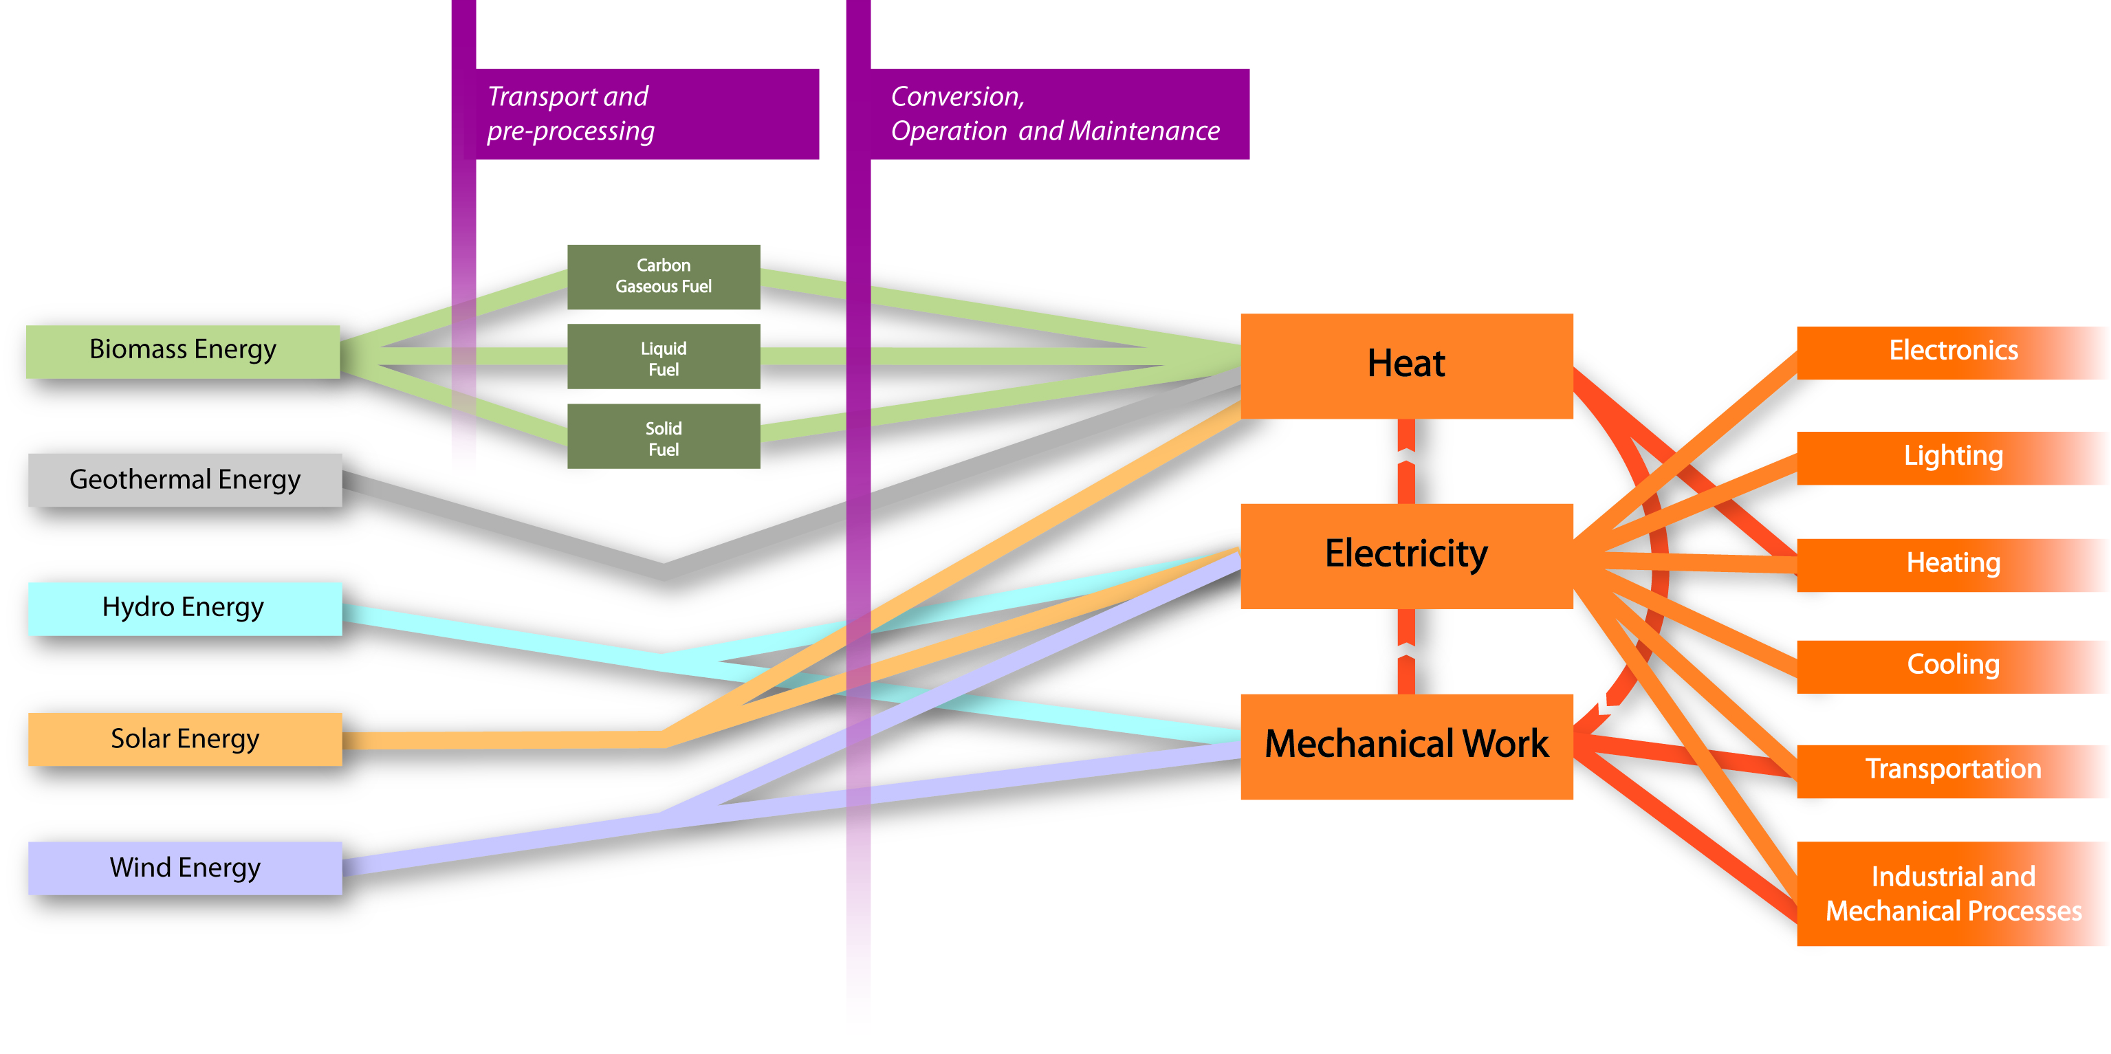
Example of a growing industry: renewable energy
*Passive Solar connects Solar Energy directly to lighting, heating, cooling through architectural design and building materials.
Notes:
Capacity to provide electricity off the grid.

Slide 11
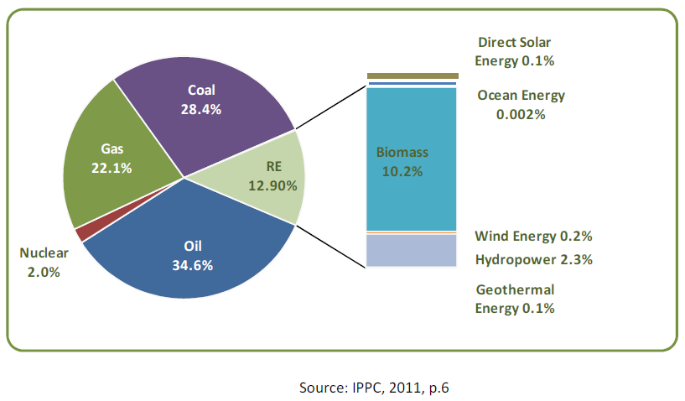
Shares of energy sources in total global primary energy supply (2008)
Notes:
E.g. – RE. Still a minor share in overall energy generation.

Slide 12
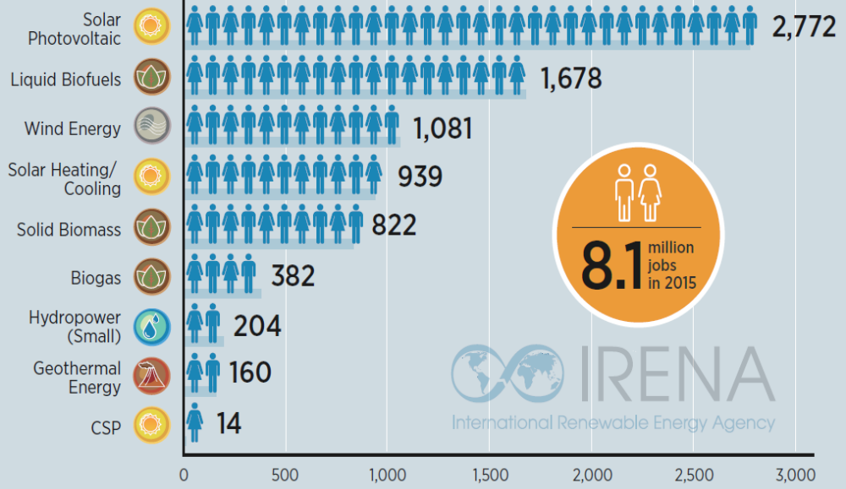
IRENA 2016 (in thousands)

Slide 13
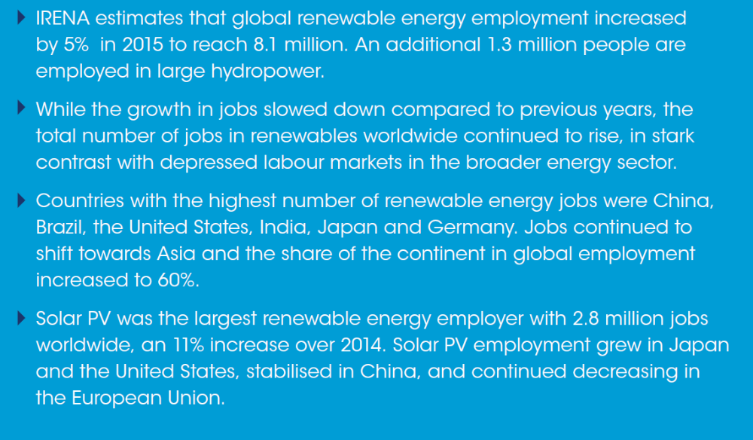
IRENA 2016

Slide 14
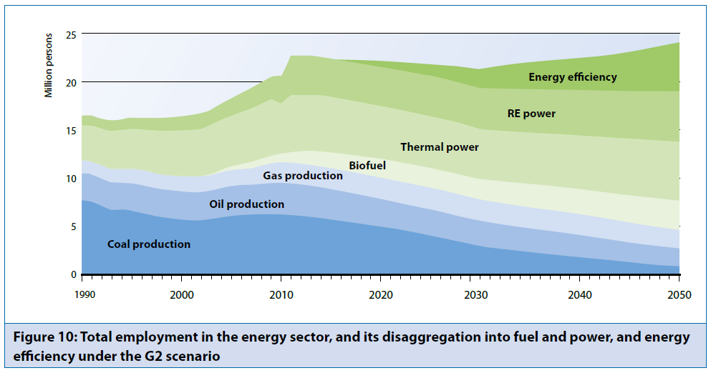
Green structural change – Energy sector
Source: UNEP(2011) Green Economy Report
Notes:
Related employmewnt restructuring in the energy sector.
Restructuring in the energy sector did not start now – it is a longer-term process which however is estimated to be further booster by new policies, regulations, targets and subsequent investments.
The recent Green Economy Report by UNEP estimates employment potential for the different energy sources over the time. The graph represents the scenario in which the energy supply sector receives additional investments of US$656 billion per year between 2010 and 2050 to expand biofuel production and power generation using renewables. We can clearly see that, under these conditions, employment will be created in areas such as energy efficiency and renewable and there will be a shift in employment from coal production to cleaner ways of producing energy and therefore retraining will play a crucial role.

Slide 15
Hand out – core occupations

Slide 16
Case study:
Navarre (Spain) goes for renewables

Slide 17
Case study:
Navarre (Spain) goes for renewables
Past
80s and 90s, Navarre suffered from economic crisis
high oil prices impaired the competiveness of the industry
unemployment level in 1993: 13%
Measures taken
The Government decides to expand its renewable energy sector by taking active industrial policy measures including worker training.
CENIFER was opened → National Centre for Renewable Energy Training for managers, technicians and operators.
Training through PES
First university program for electrical engineers in wind and solar

Slide 18

Understanding green building
reduces energy and water usage in buildings, and
reduces the environmental impact:
  of the building process,
  of sourcing and manufacture of building materials and components, and
  of demolition, reuse and recycling processes.
Buildings are
responsible
for around 20% of CO₂
Notes:
Buildings responsible for 21% of carbon dioxide on Earth

Slide 19
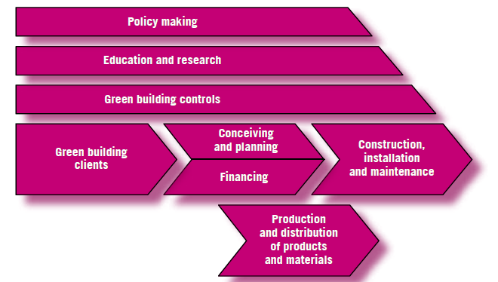

Example: GB value chain
Notes:
E.g. GB value chain and related occupations

Slide 20
Examples of skills gaps and shortages in GB occupational clusters
Conceiving, planning, designing and advising occupations
  Architects not sufficiently knowledgeable
  Advice on retrofitting (across range of occupations)
Construction, installation and maintenance occupations
  “Green plumber” and “green electrician”
  Insulation skills
  Management skills
  Limited additional training required where existing construction skills base is strong
  Challenge: synchronizing skills development with green building initiatives
Notes:
e.g. – skill shortages in only 2 occupational clusters related to GB value chain.

Slide 21
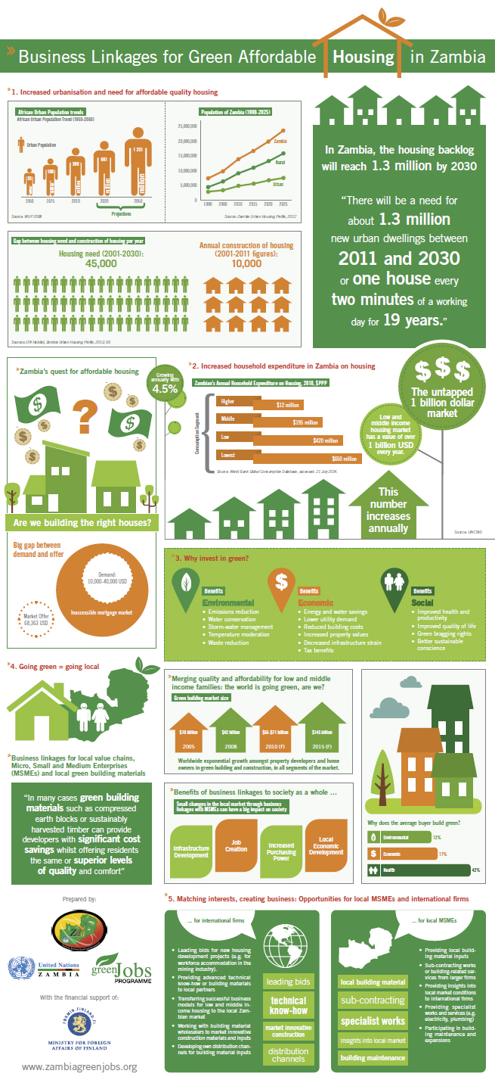
Green building and jobs : Zambia
10 years of double digit growth with no effect on poverty alleviation and employment
Addresses youth employment
Entrepreneurship facility
Clear business linkages (investors)
Training in OSH
Upgrading TVET provision
Increasing relevance of training through involving private sector in the training provision
More than 2500 jobs in MSMEs created in 4 provinces : both building and retrofitting

Slide 22
Quiz time!
Types of occupational change

Slide 23


Quiz 1
Exhibit A
Exhibit B
What is the difference between Exhibit A and Exhibit B?
Which one is ‘green’ if any?
Do the design differences between A and B require radically different sets of skills for their installation and repair by a plumber?
Notes:
Q1) Exhibit A is a traditional (high-flow) toilet. Exhibit B is a water-conserving low-flow toilet.
The tank in Exhibit A holds about 20 to 25 liters of water. The tank in Exhibit B, by
law, can hold no more than about 6 liters.
Q2) Exhibit B is considered “green” (environmentally-friendly) in that it is supposed to conserve
water.
Q3) The skills required of a plumber to install or repair the toilet in Exhibit A are no different
than those required to install and service the one in Exhibit B. (Except, perhaps, for completing
paperwork to verify that new construction is law compliant.)
Q4) Employment for plumbers is driven more by population growth, increases in building
permits for the construction of new residential and commercial structures, and the age and
condition of existing (legacy) structures in the community.

Slide 24




Quiz 2
Exhibit B
Exhibit A
Do the design differences between A and B require radically different sets of skills for their installation and repair by a plumber?
Notes:
Conventional vs Solar Water heating systems.
The Solar Water Heating System is used in private housing http://en.wikipedia.org/wiki/Solar_water_heating
Ground source heat pumps
Ideal if you’re building or renovating your own home, our Greenstore ground source heat pumps (GSHPs) take solar energy stored in the ground and use it to meet the heating and hot water needs of an entire household. This technology also replaces the need for a boiler and is a perfect partner for under-floor heating and radiators.
Skills requirements change for plumbers:
General understanding of the system work
Additional technical work – installation, maintenance
Marketing skills (spare parts)
Special paper work – compliance with standards etc.

Slide 25

Green plumbing USA Sacramento – news piece
Notes:
http://www.youtube.com/watch?v=r_e0DgJD7N0

Slide 26

GreenPlumbers® initiative - Australia
Developed by:
  the Master Plumbers – the largest and the oldest Australian plumbing association (since 1891)
  the Plumbing Trade Union
  local authorities
Financial sponsorship:
  plumbing industry
  the Australian Greenhouse Office
Successful completion → certified as a GreenPlumber™
Plumbers are in a better position to advise and inform consumers on:
  the benefits of energy efficiency,
  water conservation,
  the most appropriate and cost effective appliances to suit individual needs
This program was expanded to New Zealand and North America.

Slide 27


Quiz 3
Which occupations deal with installation and repair of these?
Notes:
The Solar Water Heating System is used in private housing.
The PV panel is used in both private housing and in solar farms but it's is not for water heating, it's to create electricity.
Solar panel installers, ‘solarteurs’
Installing solar panels in residential housing requires overlapping skills similar to those of both roofers and electricians, or even television satellite dish technicians.
In solar farming, required skills resemble those of civil engineering technicians, crane operators, plumbers and pipefitters and boilermakers. The tasks relate to the construction and precise aligning of mirrors.
In Europe, solarteur training programme, which now involves 5 countries, train qualified electricians, plumbers, roofers, tin-smiths, cooling technicians etc. to design, install and service energy production systems powered by renewable energy sources.
But, not only developed countries can benefit from presence of renewable energies and related skills.

Slide 28
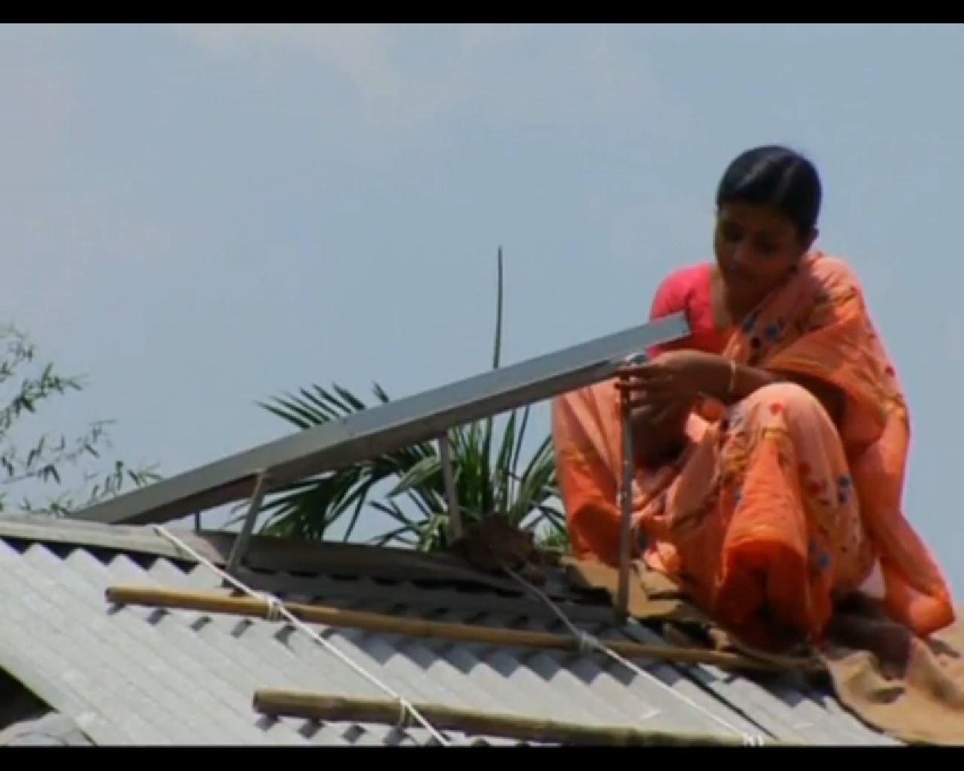
Case study: Grameen Shakti
(“Rural bank”)
Notes:
Run until 6:05 mins

Slide 29
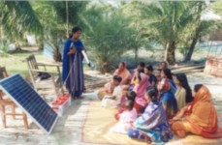
Case study: Bangladesh
Grameen Shakti
Micro credit
Targets poor rural population and especially women
More than 220,000 rural households installed solar home systems (SHS).
Several thousand young people and women have already been trained as certified technicians in the repair and maintenance of PV systems
Indirect jobs → new business such as community TV shops, solar-changed mobile phone centres and electronic repair shops
Notes:
http://www.gshakti.org/training.html
In Bangladesh 70% of the population have no access to electricity. Improving their livelihoods and income opportunities requires an economically viable alternative to the current grid system.
This has been one of the fastest-growing photovoltaic programs in the world, expected to install 1 million systems by 2012

Slide 30
Case study: Grameen Shakti (continued)
ILO-Aus Aid partnership
Strong support to REs from the government:
  Calls for 1,5 mio SHS by end 2012, i.e. 100 000 SHS per month
  Huge demand for solar technicians and entrepreneurs
Institutionalising training for SHS:
  Training in assembling, installation, trouble shooting, maintenance
  Standardised curriculum (incl. OSH), competency standards and occupational profiles
  Integration into NTVQF
  Training of trainers
  Work through a PPP with Grameen Shakti and the Bureau of Manpower Employment and Training
Notes:
SHS – solar home systems
NTVQF – National Technical and Vocation Qualification Framework
PPP – Public-Private Partnership

Slide 31

Cross-sectoral issues:
Portable skills
Strategic and leadership skills for policy-makers and business executives
Adaptability and transferability skills,
Environmental awareness and attitude and willingness to learn about sustainable development;
Co-ordination, management and business skills;
Systems and risk analysis skills;
Entrepreneurial skills;
Innovation skills;
Communication and marketing skills;
Consulting skills to advise consumers;
Networking, IT and language skills.
Notes:
• Strategic and leadership skills for policy-makers and business executives – to set the right incentives and create enabling conditions to advocate for cleaner production
• Adaptability and transferability skills – to enable workers to learn and utilize new technologies and processes
• Environmental awareness and attitude and willingness to learn about sustainable development
• Co-ordination, management and business skills – for holistic and interdisciplinary approaches incorporating all dimensions of sustainable development
• Systems and risk analysis skills – to assess, interpret and understand the need for changes and measures
• Entrepreneurial skills – to seize the opportunities of low-carbon technologies
• Innovation skills – to identify opportunities opportunities and create new strategies (e.g. leasing products instead of selling them)
• Communication and marketing skills – to promote greener products and services
• Consulting skills to advise consumers – to spread the use of green technologies
• Networking, IT and language skills – to perform in global markets.

Slide 32
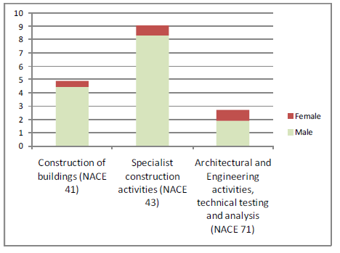
Cross-sectoral issues: inclusiveness
Women are underrepresented in STEM studies in all countries
Translated into the technology divide in jobs
Women are overrepresented in recycling and waste collection (low income and poor working conditions)
But women are interested in eco-occupations (e.g. in Thailand women are overrepresented in eco-tourism, in Uganda- in organic farming)
Notes:
There is quite strong gender dimension: women are underrepresented in science and technology studies in all countries. The technology divide in jobs is also the case – with the exception of solar energy technicians in India and Bangladesh that are mostly women, as the result of targeted training.
At the same time women are overrepresented in recycling and waste collection where jobs have low income and poor working conditions. On the other hand women already have a higher representation in occupations related to eco-tourism (Thailand).

Slide 33
Good practice of inclusive action
Targeted training:
  e.g. Indian Barefoot College: solar tech training for the illiterate and women;
  e.g. targeted shares of trainees in “Working for Water” Programme in South Africa (women 60 %, youth 40% and people with disabilities 5%)
  e.g. Youthbuild –for youth at risk in the US
Social dialogue, roundtables and PPPs:
  e.g. SSCs in retraining,
  e.g. the US round table on “Strategies for Including People with Disabilities in the Green Jobs Talent Pipeline”
Complex measures:
  e.g. “A woman’s guide to green jobs in the United States”: jobs and training opportunities, child care etc.;
  e.g. Grameen Shakti: microcredit + training + guidance

Slide 34
Institution building:
Sectoral bodies
Sectoral bodies are sector-based organisations whose overall objectives are:
to ensure that training in their sector meets the needs of employers and government;
and to promote skills development in their sector.

Slide 35
Incentives: how to engage industry
Government subsidies for training in the sector (trainees wages, matched funding, compensation of costs)
Make sectoral bodies in charge of distribution / collecting / monitoring of training funding:
  Allow them to tap on national training funds (Ghana, India, Australia, Botswana),
  tax low paid/low-skilled labour (Singapore )
  sectoral levy funds:
    imposed on all sectors – Brazil, S.Africa,
    or in selected sectors – Hong Kong, Australia,
    100 bipartite sectoral funds in Netherlands through a levy which varies in size and is based on the consensus,
(Seed) funding for sectoral bodies’ functioning from Government

Slide 36
Incentives: continued
Involve industry in defining occupational standards, competency frameworks, qualification profiles (decreases information asymmetry and increases trust in training outcomes)
Entrust decisions on which studies on skills to fund
Entrust decisions on training delivery (SENAI in Brazil, the Kenniscentra in the Netherlands, CET centres in 23 sectors of Singapore)
RPL (may increase unions buy-in, especially where non-certified training is widespread)
Learning from best practices within the sector (learn from each other)
All in all, sectoral bodies must be useful for the industry!

Slide 37
Success factors of sectoral institutional mechanisms
Clearly defined functions and objectives
Led by industry towards achieving its vision
A shared vision for the industry (observatories in France, SENAI’s’Antenas Thematicas in Brazil)
Facilitate broader economic/development goals (Canada – restructuring, Singapore – new industries and high-tech products; developing countries – broader development and poverty reduction goals)
Capacity to analyse and use LMI, and implement resulting policies and measures
Maximise the use of financial incentives
Make different elements of the system work hand in hand (complement central, sectoral and sub-national levels)
Monitoring and evaluation

Slide 38
Case study:
The role of sectoral strategies in policy coherence in France

Slide 39
Case study: Policy coherence in France
Study by Boston Consulting Group (2009):
green growth in France could secure 600 000 jobs by 2020
Grenelle de l’Environnement
5 parties: government, unions, employers, NGOs and local authorities.
Social dialogue!!
  National Strategy for Sustainable Development 2009-2012
  Training is included!!
  Mobilization Plan for Green Jobs
  The same 5 parties
  But mobilzed at State, Industry and Territory levels Coordination!!
  Eleven Sectoral Committees: analysis on skills and training needs in the green economy . Identification of core green trades and training needs
Notes:
France – a stand alone case. A comprehensive policy framework

Slide 40
Case study (continued):
Roles of levels in the Mobilisation Plan
  Mobilisation of the State (national level)
    Identify quantity and quality of skills for GJs, inlc. Observatory (tbc)
    Promote these trades
    Adjust training provision, incl. that for teachers and trainers
  Mobilisation of industries and businesses
    Developing green competencies and portable skills
    Access for disadvantaged groups
    Green enterprise creation
  Mobilisation of territories
    part of preparation of regional plans for development of training created by Law on Career Guidance and LLL of June 2011

Slide 41
Case study (continued):
National Observatory of employment and trades for the green economy
Collects, shares and coordinates information and analyses
Identifies and assesses: green growth → employment impact at macro and sectoral levels → implications for jobs→ implications for recruitment and training
A shared diagnosis among all members:
  Ministry for SD, Ministry of Employment,
  National statistical agencies, PES, national financial, environmental and energy agencies,
  CEREQ (Research Centre on Qualifications),
  AFPA (association for adults’ training),
  professional branches,
  National Centre for the Management of Territorial Service, OREFs (regional observaotries of employment and training)

Slide 42

Successful skills sectoral strategies
Coordinated and coherent: complemented by national /other sectors / territories strategies and measures; Combines top-down and bottom-up approaches
Mainstreamed through education and training including in TVET and ALMPs
Collaborative (social dialogue)
Forward looking
Targeted
Includes cross sectoral issues (e.g.portable skills)
Notes:
At different llevels:
Enterprise level response comes first as the training need is felt there the most prominently. Depending on the national system of skills development, this either gets translated into education and training systems or not.
If the training need is recognised across industry, industry is active in finding solutions (through associations of employers, sector skills councils, joint bipartitie or tripartite initiatives)
Government solutions come mostly through the formal education and training system, sometimes through line ministries or PPPs.
Universities usually responsive, both private and public, and training providers. General eduication is also catching up but TVET response is week
NGOs and donors deliver skills where formal systems don‘t reach out – mostly the case in developing countries.
Effective skills response is:
Collaborative, coordinated and coherent: includes industry in designing and in delivery of the training measures, coherent multi-level responses, combining top down approach through policy, regulations, strategies and targets with a bottom up approach which supports community based initiative, public private partnerships, regional and sectoral strategies
Policy coherence is also very important because it brings an opportunity for a right policy mix: For instance, the International Labour Institute on the basis of the review of previous evidence calculated that the overall employment effect from policies may be positive to neutral and depends on how revenues from taxing and pricing mechanisms (e.g. carbon tax or cap-and –trade) are used: if they are used to reduce taxes on labour, it would in turn stimulate demand for labour and increase employment. The measure so much needed in the current economic crisis context! Such policy mix in turn needs to include HRD policy measures to meet the increased demand for reskilling.
Forward looking, i.e. based on anticipation of skill needs and formulation of pro-skills economic, industrial, development, employment and sectoral policies where skills are considered an important driver of green change
Targeted response measures: to make sure that the transition to a greener / low carbon economy is just and that disadvantaged groups get access to training opportunities and to decent and green job
Portable skills are important to include to provide the workforce with this in-kind employment insurance (e.g. communication, IT or language skills one can take and apply across many occupations and jobs). Environmental awareness has become one of those core skills which increases employabilities of individuals but also ultimately generates demand for a green production and consumption and pushes the green transition forward. Environmetal awareness therefore has to be provided at all levels and types of education and training – starting from an early childhood to training governement and business leaders.

Slide 43
The Guidelines for a just transition towards environmentally sustainable economies and societies for all (ILO 2015)
Policy coherence and institutional arrangements for mainstreaming sustainable development and ensuring stakeholder dialogue and coordination between policy fields
Establishing mechanisms for social dialogue throughout policy-making processes at all levels
Employment-centred macroeconomic and growth policies
Environmental regulations in targeted industries and sectors
Creating an enabling environment for sustainable and greener enterprises
Skills development to ensure adequate skills at all levels to promote the greening of economy
Occupational safety and health policies to protect workers from occupational hazards and risks
Social protection policies to enhance resilience and safeguard workers from the negative impacts of climate change, economic restructuring and resource constraints
Labour market policies that actively pursue job creation, limit jobs loss and ensure that adjustments related to greening policies are well managed

Slide 44

Further reading:
Further Reading: list to circulate!
- The global synthesis report “Skills for GJs”,
- the European synthesis report,
- 21+ background country reports,
- Policy brief: http://www.ilo.org/skills/
Three ILO-EC reports:
- Methods of Identification of skill needs, and
- Skills and Occupational Needs in Renewable Energy and
- Green Building
- Research Briefs http://www.ilo.org/skills/projects/WCMS_140837/lang--en/index.htm
Notes:
Also Policy and Research Briefs are available

Slide 45
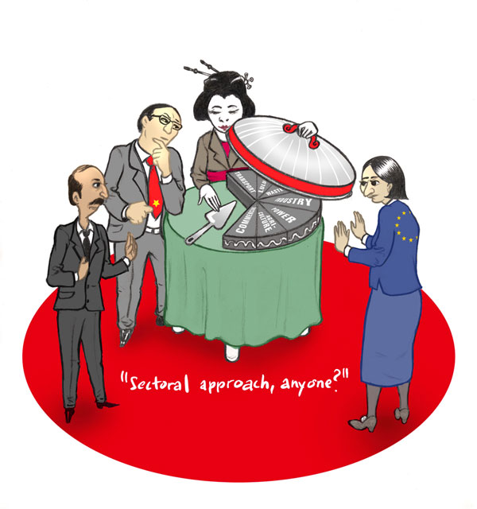
Thank you!

