Slide 1

Introducing Human Resources Development Policies Experiences Relating to the Environment in Japan（Sectorial Approach）
－ Skills for Green Jobs Experiences in Japan －
January 2017
Human Resources Development Bureau of the Ministry of Health, Labour, and Welfare
Overseas Cooperation Office

Slide 2
Today's Topics
I The Background of Necessity on Skills for Green Jobs in Japan
II Frameworks of Human Resources Development（HRD） policies supporting Skill Development for Green Jobs
1. Basic Plan for HRD
2. Public Vocational Training
3. Development of Training Courses reflecting Training Needs
III HRD Experience of Training Courses meeting the Needs of Green Jobs（Building Sector）
1. Smart Ecosystem Course
2. Living Environment Planning Course
IV Summary and Future Challenges

Slide 3
I The Background of Necessity on Skills for Green Jobs in Japan

Slide 4
I The Background of Necessity on Skills for Green Jobs in Japan
According to "survey results on the market size of the environmental industry" by the Ministry of the Environment, the market size of the environmental industry and the size of employment, etc. have grown significantly compared to 2000.
○Market size: Approximately 93 trillion yen
(Approximately 1.6 times larger than that of 2000: Approximately 58 trillion yen)
(Percentage of all industries: 2000: 6.2% -> 2013: 10.1%)
○ Size of employment: Approximately 2.55 million people
(Approximately 1.4 times larger than that of 2000: Approximately 1.78 million people)
(Percentage of all industries: 2000: 2.8% -> 2013: 4.0%)
○ Export value: Approximately 10 trillion yen
(Approximately 6 times larger than that of 2000: Approximately 1.7 trillion yen)
(Percentage of all industries: 2000: 3.3% -> 2013: 14.3%)
○ Import value: Approximately 3.2 trillion yen
(Approximately 6 times larger than that of 2000: Approximately 0.5 trillion yen)
(Percentage of all industries: 2000: 1.2% -> 2013: 3.9%)

Slide 5
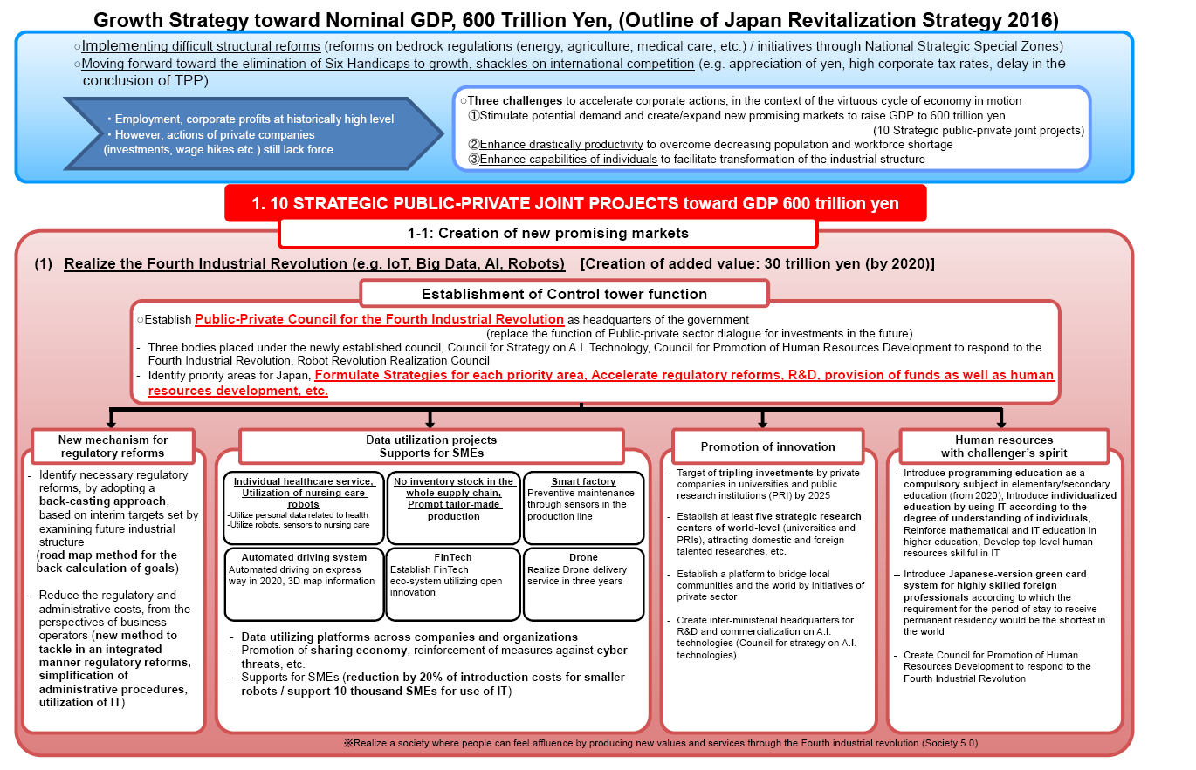

Slide 6
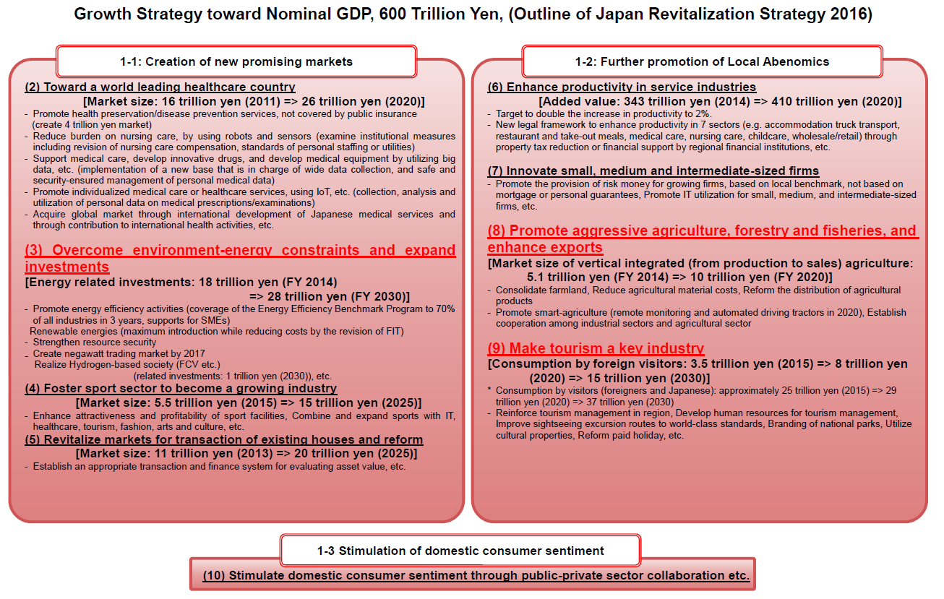

Slide 7
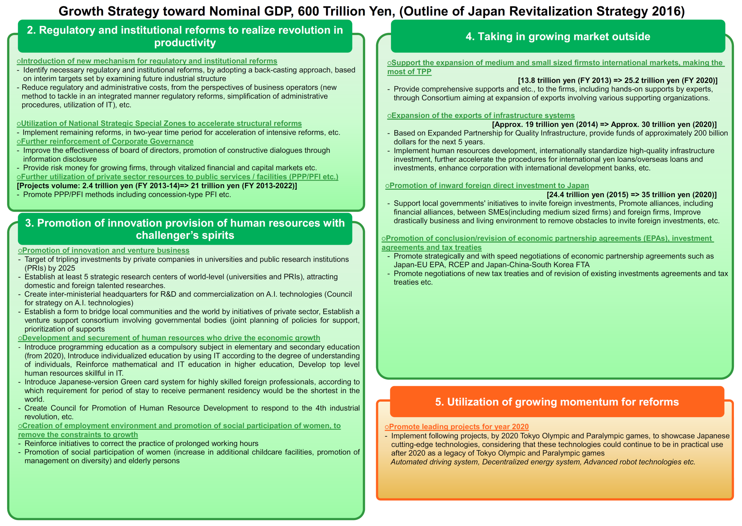

Slide 8
II Frameworks of HRD policies supporting Skill Development for Green Jobs

Slide 9
The 10th Basic Plan for Human Resources Development (FY 2016 - FY 2020) - Human Resources Development Strategy for Productivity Improvement -
With population decline, the progression of globalization, A.I., big data, etc. as a background, during a time when the business environment and working environment are changing, the basic direction of human resources development policies has been set as "Human Resources Development Strategy for Productivity Improvement" to realize a full-participation society in which people's abilities can be improved and fully displayed in conjunction with the optimal deployment of those human resources, and resulting in the growth of the Japanese economy in terms of both volume and quality.
Future Direction
Development of Basic Policies of Human Resources Development for the Future
Enhancement of Human Resources Development for Productivity Improvement
○ Consideration of the IT area's course expansion in the technical and practical training and education benefits systems, and promotion of vocational training regarding the IT area, etc.
○ Quality guarantee and specialty improvement of career consultants who have national qualifications, promotion of introducing Self-Career Dock, dissemination of training and education benefits systems, etc.
○ Securing of training opportunities by the career formation subsidy/career development subsidy for development of global human resources, support for companies working on introduction of leave systems for education and training, and encouragement of utilizing accredited vocational training systems, etc.
Effectively utilizing education and training resources of a country, companies, private education and training organizations, or schools radically enhances human resources development in the entire country
Human Resources Development Strategy for Productivity Improvement
[Chapter 3-1]
[Chapter 4-1]
Promotion of increasing vocational ability of all people toward "accelerating realization of the full-participation society"
〇 Establishment of short time training courses which enable trainees to balance study and childcare, provision of childcare support service when taking the training courses
〇 Support of work experiences for children and students, promotion of Japanese version of a dual system and employment-type training to young people who don't have much work experiences, and reinforcement of support for NEETs (Not in Education, Employment, or Training) or high-school dropouts in local youth support stations
〇 Career development while in office and reemployment support for middle-aged workers
〇 Training implementation according to individual characteristics or needs of disabled people
〇 Support for non-regular employees by career development subsidy or employment-type training, etc.
Toward accelerating realization of the "full-participation society" in which all human resources including women/young people/middle-aged and elderly workers/disabled people can fully display their ability, providing opportunities to develop their vocational ability according to individual characteristics or needs improves ability of each and every person.
[Chapter 3-2]
[Chapter 4-2]
Promotion of human resources development utilizing needs of industrial sectors or ingenuity of local areas
〇 Formation of local consortiums collaborated by government, industry and academia, and development/verification of vocational training courses that increase the possibility of finding a job
〇 Support for developing new human resources development programs to meet the various needs of companies or local areas
〇 Grasp of various industrial needs in local training councils, and establishment of conducting areas and sizes of vocational training that reflects needs of industrial sectors and local areas
〇 Enhancement of cooperation by dispatching vocational training instructors to education and training organizations, etc.
Organic networks connect various entities, and implementing human resources development that reflects area characteristics and industrial needs at an local area level
[Chapter 3-3]
[Chapter 4-3]
Strategic development of the labor market infrastructure in order to realize optimal deployment of human resources
〇 Grasp of human resources needs by foreseeing medium-to-long term changes of Japan's industrial/occupational structures
〇 Formulation of comprehensive training plans, consideration of introducing e-learning in vocational training, and human resources development handling cutting-edge technological innovation or globalization
〇 Establishment of trade skill tests valuing interpersonal service areas, and establishment of vocational ability evaluation systems by dissemination and promotion of accredited in-house certification
〇 Promotion of utilizing Job-Card
〇 Promotion of investing for human resources development at companies
〇 Function enhancement of prefectural labor offices as bases of human resources development government in local areas, etc.
In order to maximally utilize ability of each worker while optimally deploying human resources, strategically developing the labor market infrastructure that has both vocational training systems and vocational ability evaluation systems as important elements
[Chapter 3-4]
[Chapter 4-4]
In addition, implementing policies relating to promotion of skills, promotion of international cooperation/collaboration (relocation of skill evaluation systems, implementation support of vocational training, appropriate and smooth promotion of a technical intern training system), as well as setting a goal to promote policies based on this plan, and grasping its progress status.

Slide 10
Outline of Human Resources Development Policies (the Underlined Sentences are Green Jobs-Related)
Development/Improvement of Vocational Ability
Implementation of Vocational Training
○Public vocational training (unemployed people, employed people, recent graduates)
<Implementation entity: the national government (Japan Organization for Employment of the Elderly, Persons with Disabilities and Job Seekers), prefectural governments>
Implementation of training in training facilities and training by private institutions
Implementation of vocational training to disabled people
○Vocational training by the support system for job seekers (unemployed people)
<Implementation entity: private education and training organizations>
Vocational training for the people who are not able to receive employment insurance benefits and support such as benefits in the training period
○Job-Card System
Provision of practical vocational training opportunities including combination of detailed career consulting, training at companies and classroom study to the people with little experience of working as a regular worker such as part-time workers
Promotion of Education and Training Implemented by Employers
Career formation subsidy
Accredited vocational training systems
Creation of a plan for human resources development within the business
/Selection of a human resources development promoter
Support for Career Development of Workers
Support for voluntary human resources development: training and education benefits systems, career formation subsidy (support through employers)
Counseling assistance: dissemination/promotion of career consulting
Professional Independence Support for Young People Including NEETs
Local youth support station business
Development/Improvement of Vocational Ability
Vocational Ability Evaluation Systems
Trade skill tests and accredited in-house certification
Formulation of vocational ability evaluation standards
Promotion of Skills
Promotion of various skills competition (skills festival, etc.) and recognition of an outstanding technician (a contemporary master craftsman), etc.
International Cooperation
Technical Intern Training System
Inter-governmental technical cooperation and technical cooperation through international organizations

Slide 11
FY 2016 Career Formation Subsidy
Subsidizing costs of training or wages during training to employers who implement vocational training, and effectively promoting workers' career formation
(For the courses with ☆) Regarding approved employers based on the youth employment promotion law or the companies introducing the Self-Career Dock system, each subsidy rate is raised from 1/2 to 2/3, and from 1/3 to 1/2

Slide 12
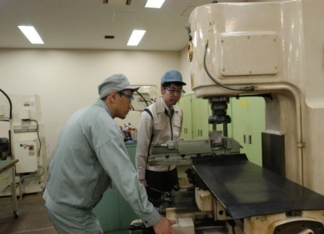
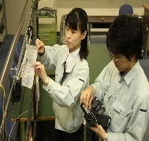
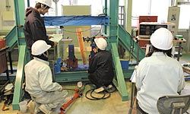
Outline of Public Vocational Training
The national and prefectural governments implement public vocational training to unemployed people, employed people, and recent graduates.
* Responsibilities of the National and Prefectural Governments: The National and Prefectural Governments shall endeavor "to provide vocational training
for workers who intend to change their jobs and other persons who need special assistance for the development and improvement of their vocational abilities,"
"to provide the vocational training required in light of the situation of vocational training provided by employers and employers' organizations."
(Paragraph (2) of Article 4 of the Human Resources Development and Promotion Act)
Training for Unemployed People
Training for Employed People
Training for Recent Graduates
(1) Target: job seekers who register to Hello Work (free of charge (actual costs including textbooks are charged))
(2) Training Period: for approximately 3 months to 1 year
(3) Examples of main training courses
(Examples at the Japan Organization for Employment of the Elderly, Persons with Disabilities and Job Seekers)
〇Training in a facility
Living environment planning course
Smart ecosystem course, etc.
〇Commissioned training [Commissioned by prefectural governments]
Care giving service course, information processing course, etc.
(1) Target: people who are already employed (fee-charged)
(2) Training Period: for approximately 2 days to 5 days
(3) Examples of main training courses
(Examples at the Japan Organization for Employment of the Elderly, Persons with Disabilities and Job Seekers)
・NC lathe practical techniques
・Practical construction techniques for home electrical workpieces
・Practical techniques for barer-free housing design, etc.
(1) Target: high school graduates (fee-charged)
(2) Training Period: 1 year or 2 years
(3) Examples of main training courses
(Examples at the Japan Organization for Employment of the Elderly, Persons with Disabilities and Job Seekers)
[Special Course]
Electrical energy control course, manufacturing technology course, electronic information technology course, etc.
[Application Course]
Manufacturing electrical system technology course, manufacturing machine system technology course, etc.

Slide 13


3 Development of Training Courses Reflected Training Needs (1)
Development of training courses are being developed based on training needs after clarifying them by interview surveys from employers.
Surveys on Human Resources Needs
Quality Improvement
(1) Interview surveys
(2) Situations of job openings and job applicants
(3) Basic data in regions (the number of offices, the number of employees, the number of people who joined a company, the ratio of hired people who changed jobs, and others)
質の向上
Surveys on human resources needs
Follow-up Surveys
Follow-up Surveys
(1) Surveys on changes in attitudes of trainees
(2) Surveys on company's evaluation toward alumni
Companies
Training for recent graduates (finding a job)
Training for employed people

Slide 14
4 Development of Training Courses Reflected Training Needs (2)
The training courses are reviewed by repeating a PDCA cycle.
Plan
Grasp of training needs, establishment of training courses (curriculum)
1 Grasp and analysis of human resources needs
(Job offer forms, employment statistics, employers/employers' organizations, Hello Work, etc.)
2 Formulation of training course plans depending on human resources needs
3 Screening and approval by external experts
* Public administration, organizations of employers and workers, education and training organizations, experts, etc.
Act
Modification of curriculum
Implementation of effective training
Do
1 Modification of curriculum to be added/changed based on problems (insufficient knowledge/skills)
1 Guidance for trainees depending on their acquisition situation by using textbooks, etc.
2 Implementation of supplementary classes as needed
Check
Evaluation of effect and grasp of problems
1 Follow-up surveys for improvement/reviews
2 Verification by a method of training charts

Slide 15
III HRD Experiences of Training Courses meeting the Needs of Green Jobs

Slide 16
Smart Ecosystem Training Course Outline, etc.
Background of Training Course Setting
(Environment that surrounds this Course)
Targeted Trainees
Trainees who are interested in the energy-saving methods or the energy-creating equipment
Specific Example of Human Resources
(Example after Taking the Course)
Acquired knowledge regarding wooden houses and electrical equipment, and skills regarding electrical installation, and being able to do proposals, sales, design support, and installation work of energy-saving and energy-creating equipment.
Kinds of Available Occupations
Adviser for energy-saving of housing equipment in the construction industry and the equipment installation industry.
Trainees who are interested in housing equipment such as lighting
Trainees who aim to be a skilled workers is in the equipment installation industry
Design supporter of equipment installation, construction skilled worker, and proposal-based sales person, etc.
In the society where energy is more efficiently consumed, there is a growing need for the human resources who can handle construction, maintenance/inspection of energy-saving equipment and energy-creating equipment.

Slide 17
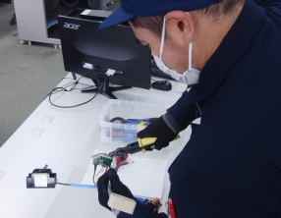
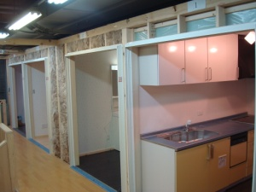

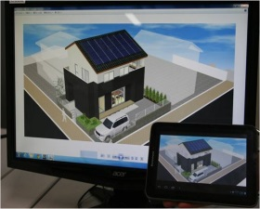
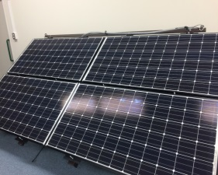
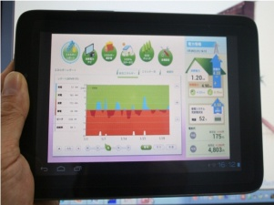
Example of Training Settings
Smart Ecosystem Course
Training Period
6 months
Overview of Training
(1) Based on knowledge regarding housing structure and energy-saving, trainees can acquire skills of CAD and related knowledge.
(2) While visualization of electricity is progressing, trainees can acquire skills of construction/sales/design support regarding electrical equipment.
Training Items
Electricity Basics
Housing Structure and Electrical Work
Information Utilization Skills
CAD Utilization Skills
Housing Eco-Friendly Electrical Equipment
Housing Electricity Management System
Trainees learn basic electrical terms, concepts of electrical circuits, and measurement methods. In addition, they learn the basics of cable work including indoor wiring, an important part of electrical work.
In order to implement planning and proposal about housing equipment, knowledge from the housing side is required. Therefore, trainees learn the basic knowledge of housing.
Construction methods of piping works using metal pipes and synthetic resin pipes can be acquired.
Knowledge regarding bookkeeping required for clerical work, data processing using computer software, and skills of planning and proposal can be acquired. The content at the level 3 of bookkeeping certification is included.
Reading and making skills of housing drawing and electrical wiring can be acquired by using CAD (Jw_CAD). In addition, picking up components from graphic symbols, and the basics of integration can be learned.
Knowledge/skills of housing eco-friendly electrical equipment including solar power generators, home security, and full electrification can be acquired.
The content at the second class of electrical work is included.
Knowledge/skills of energy management systems using the latest technique, HEMS, Home Energy Management System, (visualization of electricity) and networks can be acquired.
Assumed Main Employment Areas
Electrical Design Engineer
Construction Work of Electrical Equipment
CAD Operator
Sales of Electrical Equipment

Slide 18
Living Environment Planning Training Course Outline, etc.
Background of Training Course Setting
(Environment that surround this Courses)
The needs such as energy-saving measures and response to the super-aged society are further required in housing in the future. Therefore, the situation requires the human resources who have wide knowledge/skills of building work and who can also propose housing renovation (coordination) corresponding the above needs.
Targeted Trainees
Trainees who are interested in building work methods, understanding of environment/equipment toward energy-saving, and barrier-free measures for the super-aged society
Specific Example of Human Resources
(Example after taking the course)
Being able to understand a living environment and propose an optimal living environment plan to clients while cooperating with building work specialists.
Kinds of available occupations
Interior finish worker/renovation adviser, interior coordinator, marketing/sales/installation of housing equipment, etc.

Slide 19
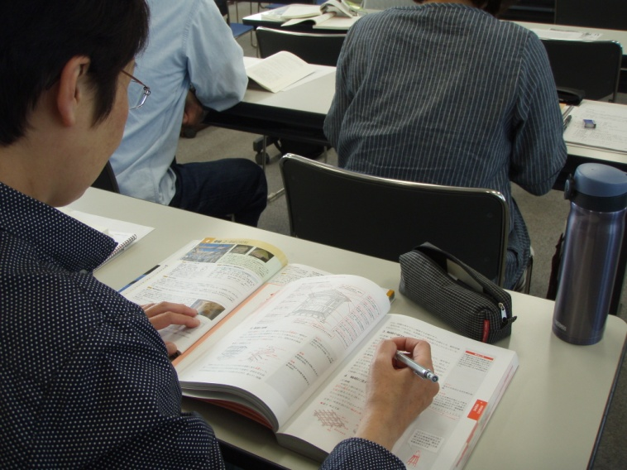
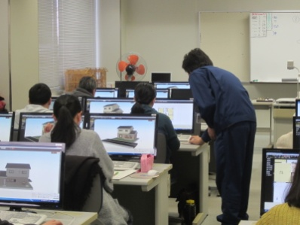
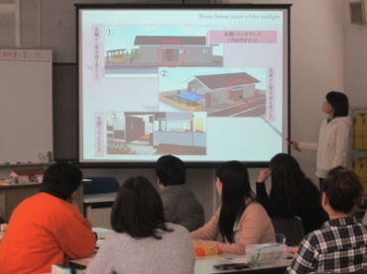
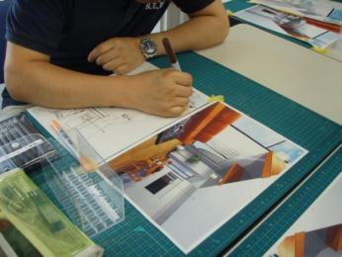
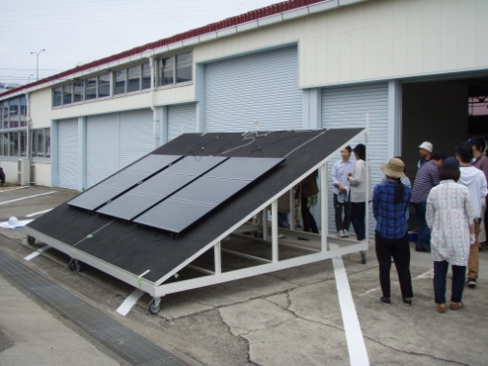

Example of Course Settings
Living Environment Planning Course
Training Period
6 months
Overview of Training
        Trainees aim at being a sales persons or advisers for housing, and acquire knowledge/skills such as from building-related knowledge, interiors/equipment, to interior coordination in order to plan/propose living space which is optimal for clients.
Training Items
Living Environment Improving Plan
Building CAD and 3D simulators
Improvement Proposal for Living Environment
Regarding Interior Coordination and Housing Environment for Elderly and Disabled People
Housing Equpment work Construction
(Electricity and Water Supply and Drainage)
Interior Finish of Homes
Construction/Repair
Trainees learn basics regarding an overview of constructions including mainly wooden construction (a conventional construction method). In addition, they understand the Building Standards Act related knowledge and acquire the knowledge regarding living environment plans.
Trainees acquire the skills of drawing plane views, elevation views, and various detailed views (section views, sectional detail drawing, etc.) by using Jw_cad.
The skill of creating 3D simulation drawing is acquired by using software, My Home Designer.
Trainees acquire skills of parse creation and a method of model creation for presentation.
Methods for proposing living environment to clients can be learned by group works or planning drills.
Trainees learn kinds and sizes of furniture, fixtures and lighting required for interior coordination. In addition, they learn the way of drawing and coloring interior design. Besides, they learn repairing housing materials such as structure materials, floors, walls, and sanitary appliances considering aged people.
Trainees learn basic execution techniques in electrical work through practice.
Trainees learn principles of housing eco-friendly equipment
Trainees learn knowledge of water supply and sewerage systems and plumbing equipment.
Trainees learn joining methods of metal pipes and resin pipes.
Trainees learn about construction of a home with high heat insulation and airtightness.
Trainees learn about construction of interior materials (vinyl cloth).
Main Employment Areas
Sales/clerical personnel at a construction company/builder
Marketing/Sales personnel at a building material trading company/equipment instrument distributor
Sales personnel/advisor for housing renovation

Slide 20
IV Summary Regarding HRD Experiences in Japan meeting the Needs of Green Jobs
[Policy Determination]
(1) Presenting drafts from experts of the government and public vocational training facilities, and reflecting opinions of a representative of people with relevant knowledge and experience, a representative of workers and a representative of employees
(2) Clarifying training needs by interview surveys from employers, developing training courses based on the training needs, and reviewing the training courses by using a PDCA cycle
[Public Vocational Training]
(3) Implementing training courses of the environmental area based on training needs
(4) Setting up a standard curriculum regarding the training courses in the environmental area
[Support for Employers' Training]
(5) Subsidies for vocational training regarding the environmental area implemented by employers
[Vocational Ability Evaluation Standards]
(6) Establishing the vocational ability evaluation standards of the environmental area
[Efforts of Other Ministries] (7) Certification of a "Manager of energy/environment" by certifying human resources in the areas of energy/environment, introduction of success examples of environmental business. Additionally, promotion of environmental education in order to raise people's consciousness toward environmental conservation

Slide 21
Future Challenges
(1) Enhancement of HRD for productivity improvement by enhancement and acceleration of IT human resources development
(2) Promotion of increasing vocational ability of all people according to individual characteristics such as being female or needs toward "accelerating realization of the full-participation society"
(3) Promotion of HRD utilizing needs of industrial sectors or ingenuity of local areas
(4) Strategic development of the labor market infrastructure in order to realize optimal deployment of human resources
2 Cooperation with Other Ministries
The cooperation among relevant ministries needs to be further promoted because there are neither ministries nor organizations that direct the whole thing regarding skills for Green Jobs.
1 The 10th Basic Plan for HRD (FY 2016 - FY 2020)

