Slide 1



Industries and Workplaces for Sustainable and Inclusive Growth
Through tripartite dialogue and Sharing of
tools, practices and knowledge

Slide 2
I. ILO Japan Projects: GBA and InSIGHT
II. Share key results of previous phases

Slide 3


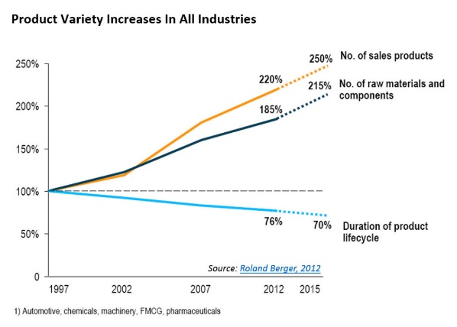
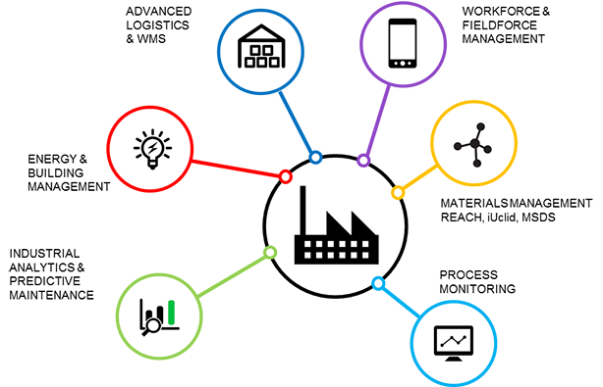

Drive towards greener economies
Economic Sustainability
The triple bottom line
+
Social Sustainability
Environmental Sustainability

Slide 4


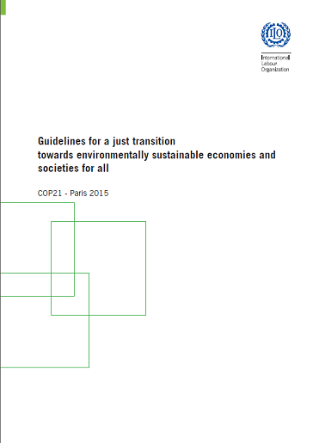

Recent Commitments towards Global Transformation

Slide 5
Green is up on the agenda of industries (and why it is there to stay)
Resource efficiency = cost savings= increased competitiveness
Market forces: new opportunities
Market forces: buyer/consumer requirements
Need to protect finite environmental assets upon which business and society depend
Prepare for new env./climate change regulations
Prepare for addressing climate change impacts/mitigation
Enterprises as part of systems & community: extended responsibility

Slide 6
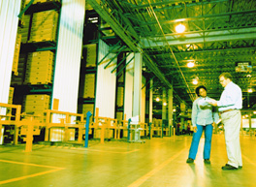
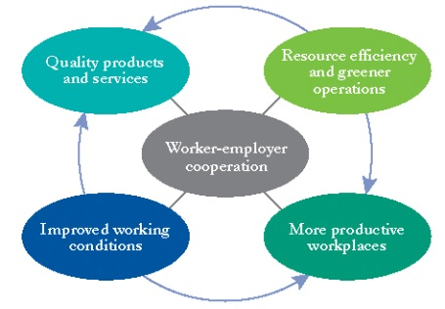

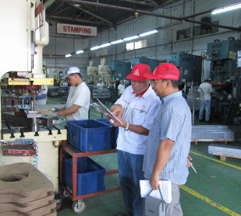

Industry Component tools and approaches from previous ILO-Japan projects
Building capacity to achieve greener, safer workplaces and sustainable enterprises through a model of worker-employer cooperation
*Enterprise-Level Assistance
*Green Improvement Teams
2010-2012 | 2013-2014
Autoparts & Hotels
National Wages & Productivity Commission (PH)
Prince Songkla University (TH)
Social Partners
Training Package
CORE (Foundational) Sessions
TECHNICAL (Deepening) Modules
Expert Advisory Services
Assessments | Baseline
Hands-on guidance, implementation advise & action-learning

Slide 7
Thematic Scope
Industries & Workplaces for Sustainable Inclusive Growth
Through Tripartite Dialogue and Sharing of Tools, Practices and Knowledge
I
OSH +
Workplace
Conditions
Green
Business
Practices
Industrial Relations
Tripartite
Cooperation
Bipartite

Slide 8

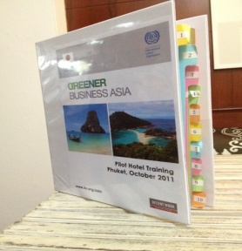
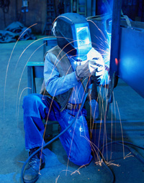
Industry – Enterprise Component
Development and pilot testing of practical tools and resources to help enterprises adopt more sustainable and responsible practices
Main target: medium-size hotels (Thailand) + SMEs in the auto sector (Philippines )
Pilot locations: Phuket (Thailand) + Calabarzon & Coron (Philippines)

Slide 9
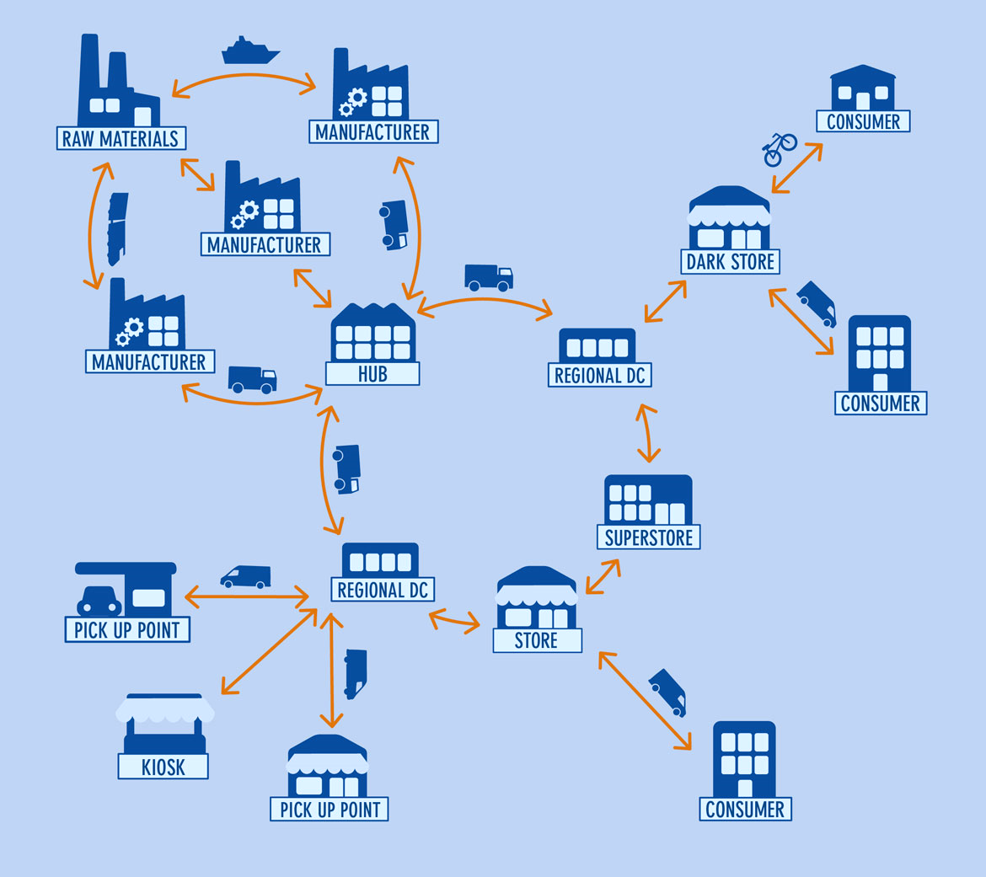



Implementation Mechanics:
Tripartite consultations at the onset of the initiative; active support
Direct engagement with enterprises in the sector
Supply chain leader – act as a champion
Engage supply chain members to share core values and principles and participate in the program
Area-based: link up with association

Slide 10
Auto-sector: Participating companies engaged by ‘Champions’
Toyota
Suzuki
Kawasaki
Mitsubishi
Yazaki Torres manufacturing, Inc.
Yazaki
Cirtek Electronics
1st Tier Supplier
Fujitsu Ten Corporation
Laguna Carparts Manufacturing Inc.
*Daiwa Seiko (Ph.)
Atmel TSPIC
Thermax Industrial products
*Temic Automotive, Ph. Inc.
Metalcast Corporation
Metals Engineering Resources Corp.
Miyasaka Polymer (Ph.) Inc.
Vishay Philippines
2nd Tier Supplier
*TRP Inc.
Daiho (Ph.) Inc.
*Valerie Prods Mfg Inc.
Sumitsu Spring & Metal Enterprises
APO Chemicals & Manufacturing Corp.
*Torres Technology Centre Corp
Toyota Boshuku Phils. Corp.
*Tri-R Allied Group
Multiflex RNC
Special Construction Products Inc.
*YTM Component
Associated Wire Corporation of the Philippines
Karlast Industries Inc.
*Toptech Parts Mfg Inc
Philippine Auto Components, Inc.
Nanbu Philippines
Yokohama Tires Sales (Ph.) Inc.
Tsuchiya Kogyo Philippines, Inc.
Imarflex Battery
BES Technical Works & Services Inc.
Philippine Parkerizing Inc.
*Aichi Forging Company of Asia
Universal Mould Design
3rd Tier Supplier
Paint Marketing Corporation
*Fabricator Philippines Inc.
*AGC Automotive Philippines Inc.
*Suburbia Automotive Ventures Inc.
3M Philippines
BOPI Manufacturing
MBPstar Corp
*Famous Steel Manufacturing Inc.

Slide 11

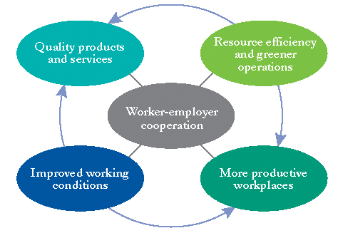
Building capacity to achieve greener workplaces and sustainable enterprises through a model of worker-employer cooperation
*Enterprise Capacity Building
*Company Green Improvement Teams
Training Package
CORE (Foundational) Sessions
TECHNICAL (Deepening) Modules
On-site Expert Advisory Services
Assessments | Baseline
Hands-on guidance, implementation advise & action-learning

Slide 12
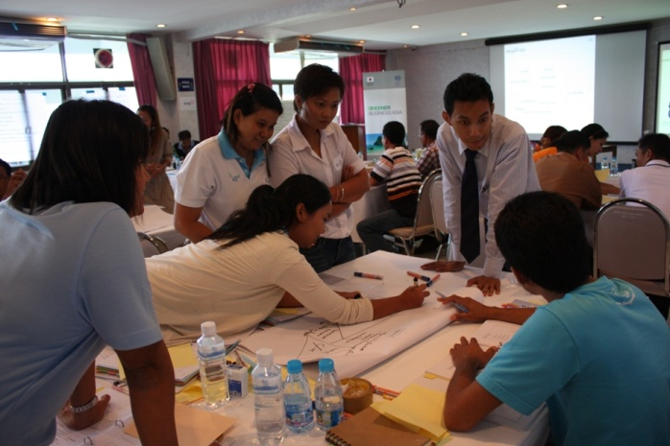
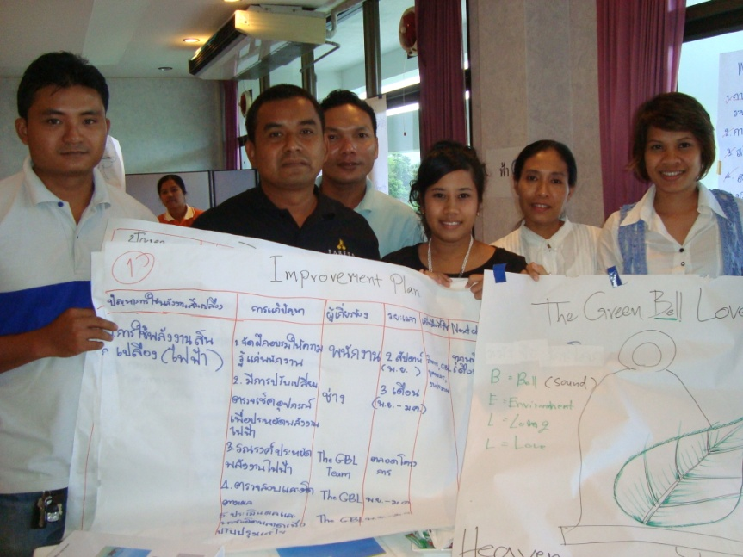
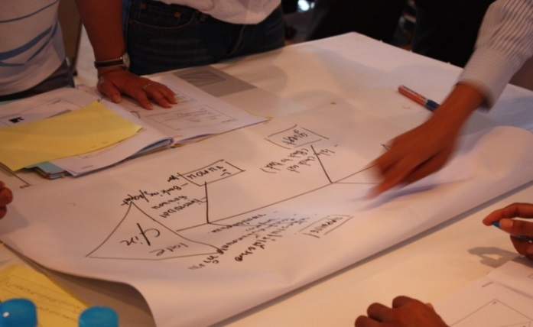
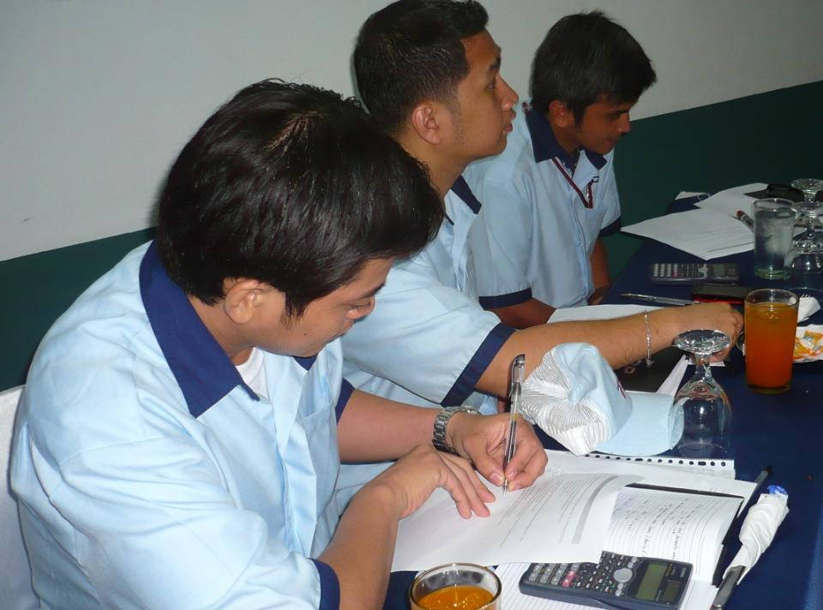
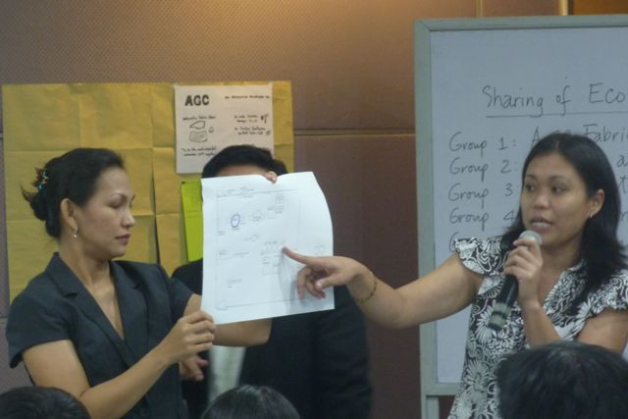
Training for enterprises
Notes:
Methodology:
Participatory and highly interactive
Teambuilding exercises

Slide 13
TNA (FGD) RESULT
Rank | Human Resource & Labor | Efficiency & Environment |  |  | Environ-mental- Common | Occupational Health & Safety | Quality Management System
 |  | Efficiency Related | Energy Related | Water Related
1st | Welfare and Benefits | Better Practices/Processes | Energy Saving measures: Better Practices/ Process | Water Conservation: better practices/ processes | Environmental Management System | Identification of the OHS Hazards | Quality Management System
2nd | Skill Level of Employees | Good Housekeeping [Gen] | Energy Saving Measures: Technology Option | Water Conservation: Technology Options | Monitoring systems & indicators | Working Condition | Fool Proof System
3rd | Workplace Condition | Process Reduction/ Automation | Energy Savings: Regulations/ Gov’t Incentives | Water Conservation: regulations/ Gov't incentives & Schemes | Envt'l regulations and policies - General | OHS Management System | Customers Feedback Gathering and Analysis
4th | Salary and Work Promotion | Product Redesign | Renewable and Alternative Energy: Technology Option | Waste Water: Technology Options | Energy use, water use, chemical use & discharge | Training of First Aiders | Parts /Product Design Specification
5th | Recognition and Incentives |  | Energy Saving measures: Better Practices/Process | Waste Water : regulations/ Gov't incentives & Schemes | Envt'l regulations and policies - Sector Specific | Facilities Condition | Statistical QC Techniques
1st | Solid Waste Related | Waste: recycling options
2nd |  | Waste: regulations, Gov't schemes & incentive

Slide 14
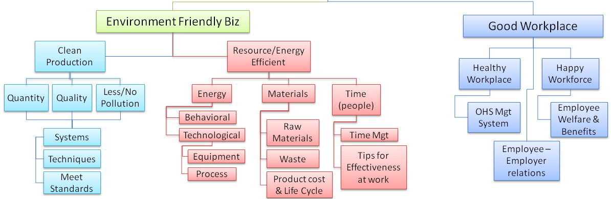
Greener Business - Better Workplace
Why?
GREEN BUSINESS FEATURES
Topic 1. PRIMING SESSION: The Auto Industry, Social Role, Environment, Problem Solving Tools
Topic 2. Cleaner Production
Topic 3. Efficiency Improvement
Topic 4 Healthy & Climate Resilient Workplace
Core
Module 1. Management Systems for Cleaner Production
Module 2. Energy Saving Measures
Module 3: Green Inputs & Life Cycle Assessment
Module 4: Materials Management
Module 5: Healthy & Climate Resilient Workplace
Deepening
Notes:
Presentation of Framework (5 min)
The framework of this training module is based on the 2 main features of a green business: (1) Environment Friendly (2) Safe & Climate Resilient workplace. The sessions are divided into two:
Core
Deepening

Slide 15

Enterprise Training and Advisory Services Program –
“Greener Business |Better Workplace”
Philippines (Auto-parts Sector)
CORE Training Sessions
Competencies:
Green, Environmental Awareness, Eco-Efficiency
Climate Change Mitigation practices
Technical skills: energy, materials, processes, etc.
OSH
Problem solving, planning, cooperation, innovation
Monitoring, Communication
Key tools and techniques for productivity, continuous improvement and joint problem solving & their application for a greener, better workplace
Workplace Cooperation & Problem Solving | Eco-mapping | Identifying impacts & aspects
DAY 1
DAY 2
Resource efficiency : (a) Energy, (b) Water (c) Materials
Cleaner Production | Eco-Efficiency |Energy Conservation| Analyzing flow of Materials in the production process
Workplace issues and the environment
Occupational Safety & Health | Climate change impacts on businesses operations | Workplace Relations | Action Plans for Greening Business and Improving Working Conditions
DAY 3
  Green Improvement Teams
  Action Plans
Technical / Thematic Modules
Healthy and Climate Resilient Workplace
Energy Management for Energy Efficiency
Module 1
Module 2
Resource Eco-Efficiency & Cleaner Production
Triple Bottomline Performance Indicators & Sustainability Reporting
Module 3
Module 4
  Improvement Actions
  Progress Monitoring
Onsite Expert Advisory Services

Slide 16
GBBW Program – Hotel Sector
Continual improvement and greener workplaces
Changing Enterprises in a Changing World: Continual Improvement and Joint problem-Solving for Sustainability
Greener processes and workplaces
CORE TRAINING
TOPICS
Workplace relations & mechanisms of cooperation
Workplace cooperation, principles and practices
The 5S
Workplace relations, rights and equality
People & workplaces for service excellence
Occupational Health / Safety –Level 1
People for continual improvement and service excellence
Green Improvement Planning
Preparation of Green Improvement Plans by Green teams
Energy efficiency
Resource Efficiency
Service Quality
THEMATIC
SESSIONS
Green procurement & Local Sourcing
Occupational Safety & Health
Improvement action implementation by teams & Follow-up & Advisory Support

Slide 17
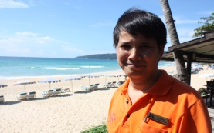
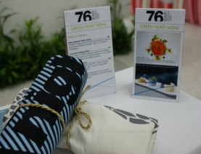
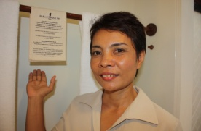

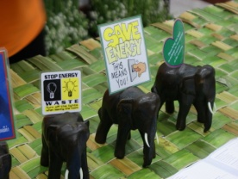
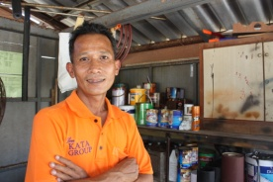
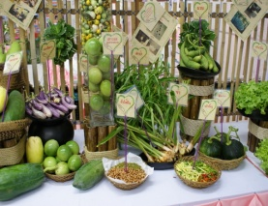
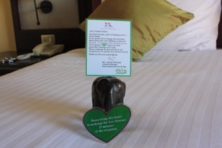
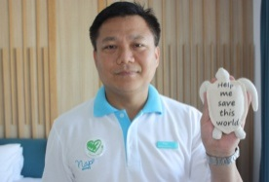
Framework for implementing actions
Notes:
To outline that this is a bottom-up approach which utilises the input of workers, team work and worker-employer cooperation to achieve and drive continual social, environmental and economic improvements

Slide 18
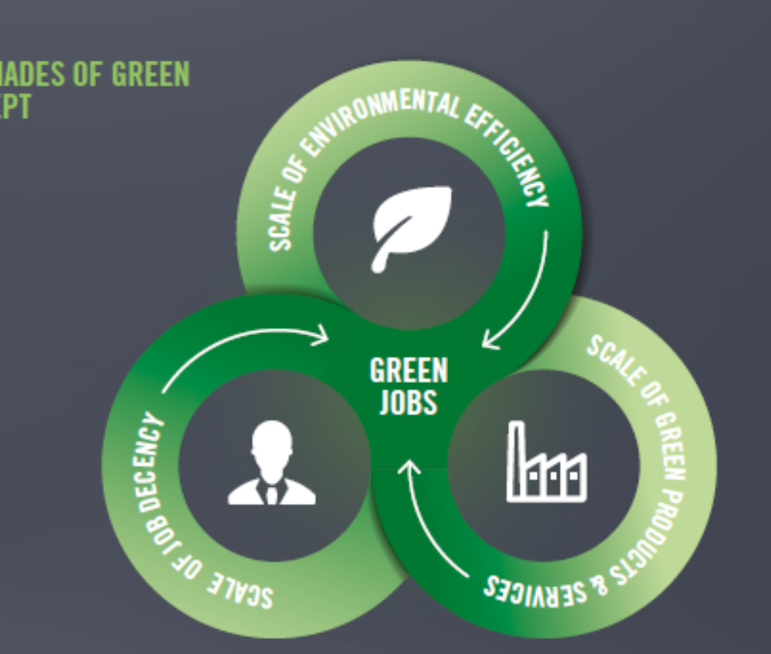
Green Jobs: ‘Shades of Green’

Slide 19
Automotive Industry
Notes:
Methodology:
Participatory and highly interactive
Teambuilding exercises

Slide 20
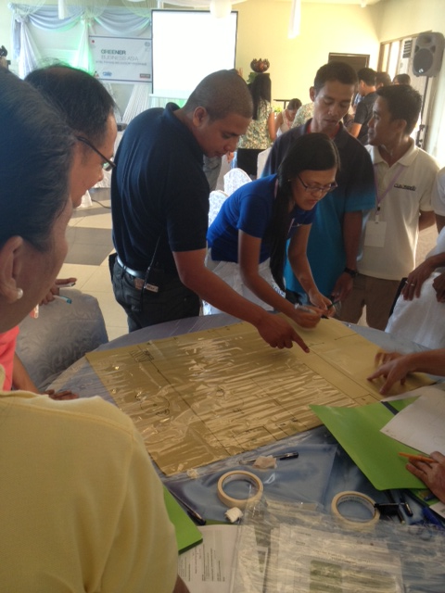
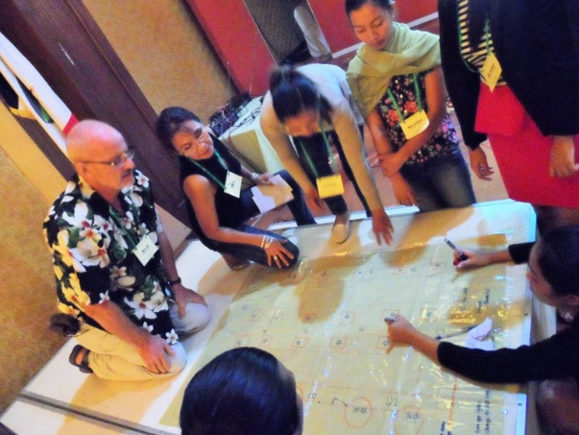
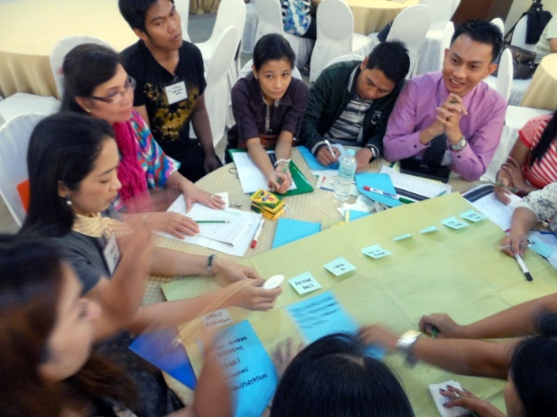
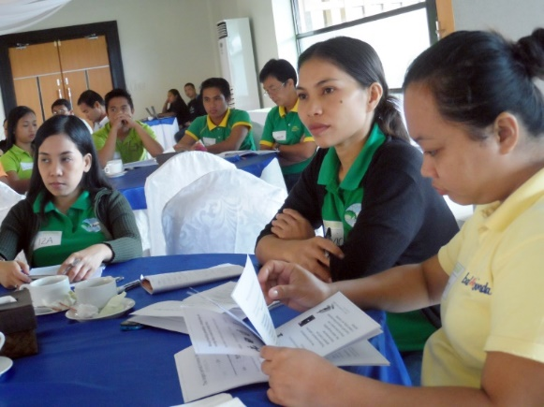
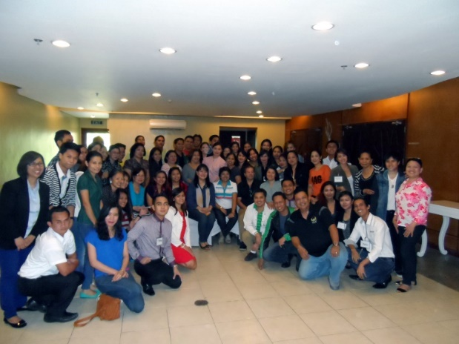
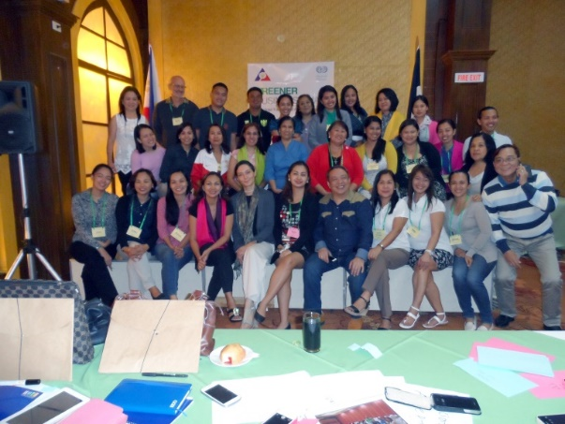
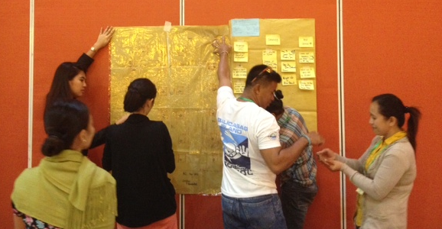
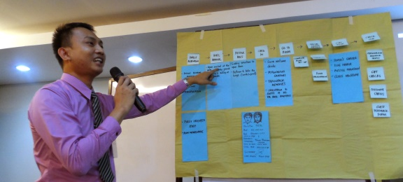
Hotel & Accommodations Industry
CORON, Palawan |15 hotels/resorts
Full Program roll-out demonstration Core training & Elective session, May - Oct 2014
BOHOL | 13 hotels/resorts
TAGAYTAY | 25 hotels/resorts
NWPC-led replication
GBA CORE training

Slide 21

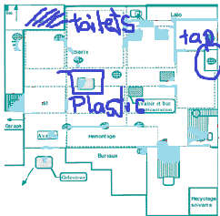

Tools & Methods used:
Brainstorming
Ecomaps
Cause and effect (“Fishbone”)
A
B
C
D
Diagrams

Slide 22
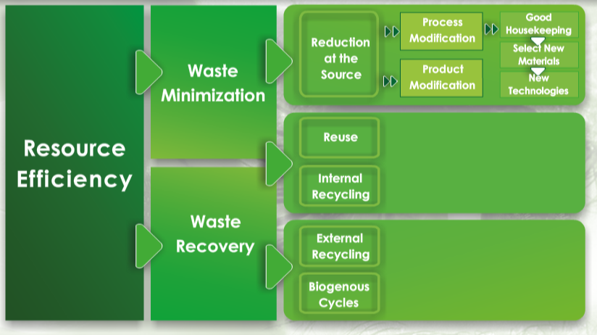
Tools and Methods:
Prioritization of Options / Solutions

Slide 23
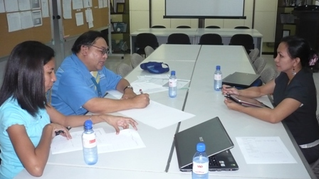
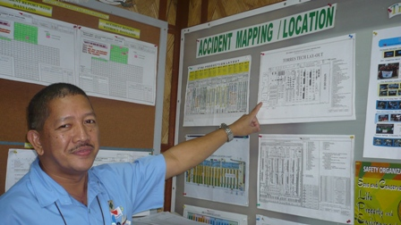
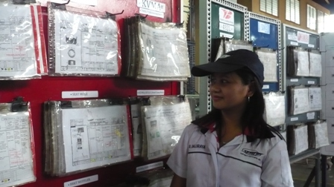
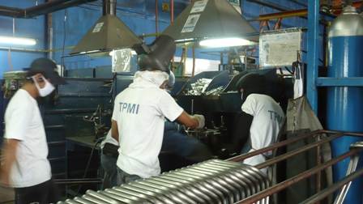
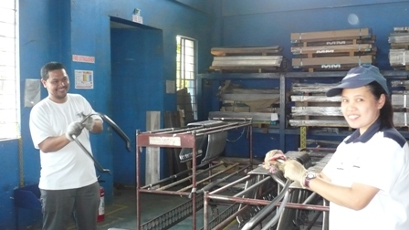
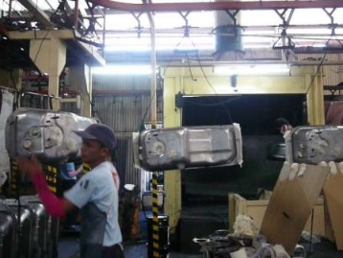
Series of Activities
Joint Training & Action learning
Green Teams
Plans for
in-house projects
Overall improvement in the workplace

Slide 24
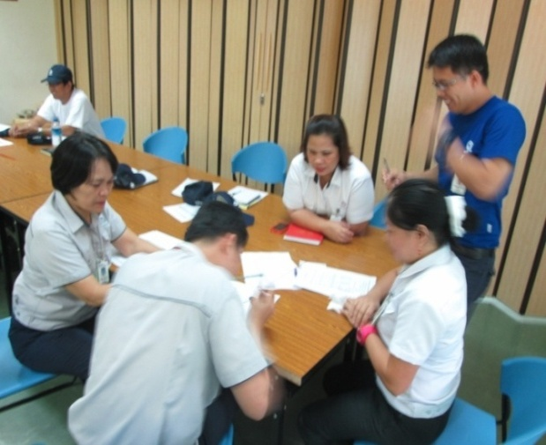
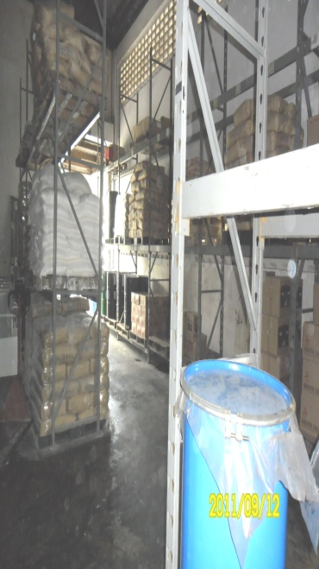
Some Initiatives by Green Teams in Auto sector
Introduction of chemical hazard identification, training and monitoring
Warehouse Area Improvement for energy efficiency and safe material storage
Remedial measures for managing heat leading to improved workplace environment and energy efficiency

Slide 25
Action Plans created by participating companies
AGC Automotive Phils:
Enhance OSH Mgt System to include climate change hazards
Valerie Products Mfg :
Energy Management
Improvement : spot welding & painting area
Aichi Forging Company of Asia :
Sustaining EMS
Waste water sludge
Daiwa Seiko :
Energy Management
Workers Productivity in Production Lines
Famous Secret Precision Metals Inc:
Initiating EMS
Improve Layout/flow
Toptech Parts Mfg:
Energy Management
SAVI:
Energy Management
Improve process flow, OSH, resource efficiency
Tri-R Allied :
Energy Management
Improve OSH – welding area, 5S-GHK revival
TEMIC:
Energy Management
Fujitsu:
Workplace Cooperation to sustain green improvement programs
TRP , Inc:
Energy Management – program launch for the whole company
YTMCI:
Green Jobs promotion
Quantified savings from Green options
Torres Tech Center:
Energy Management
Green Skills for workers

Slide 26
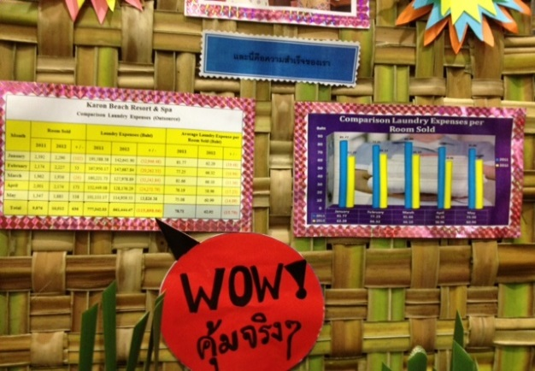
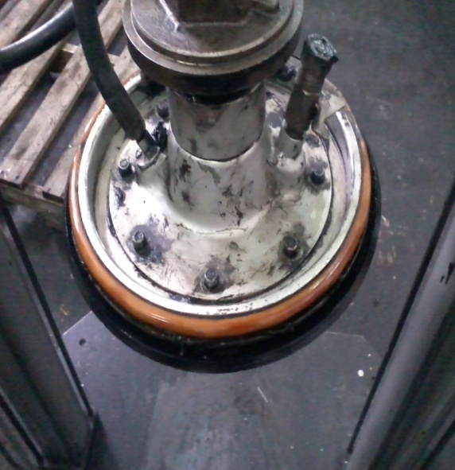
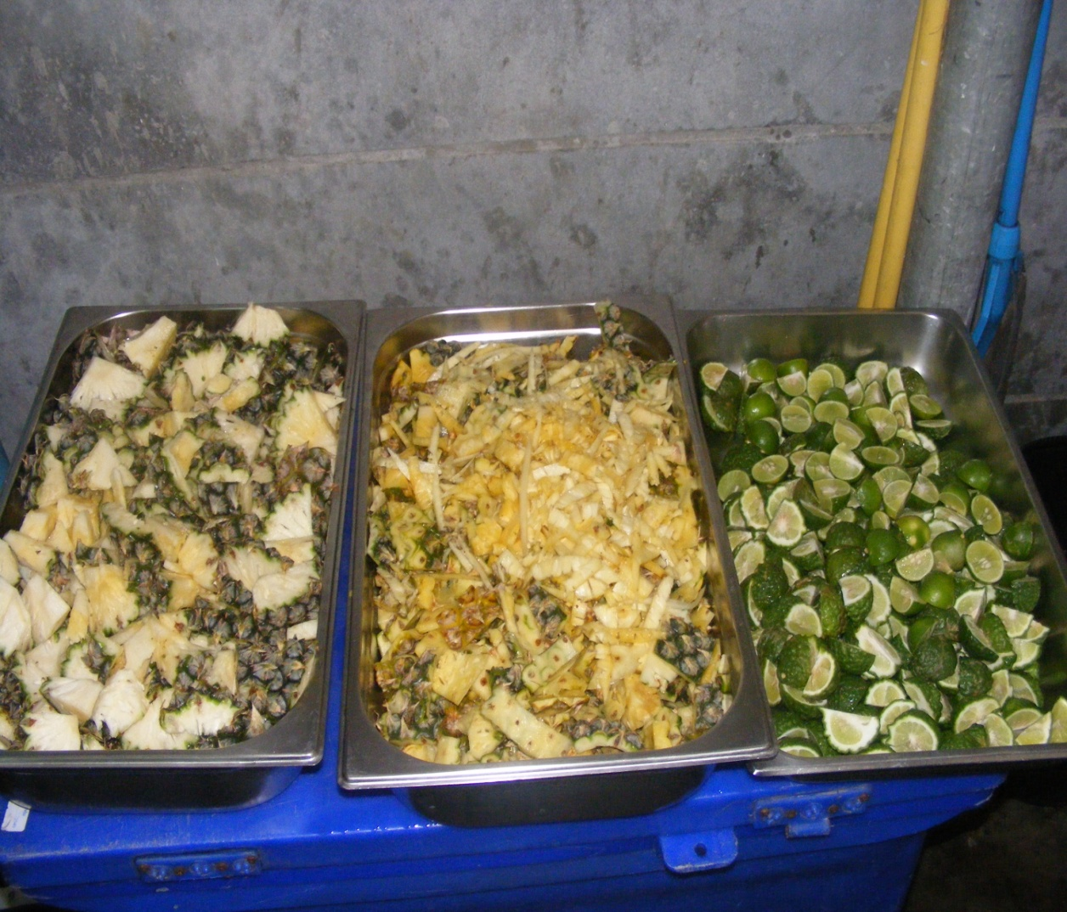
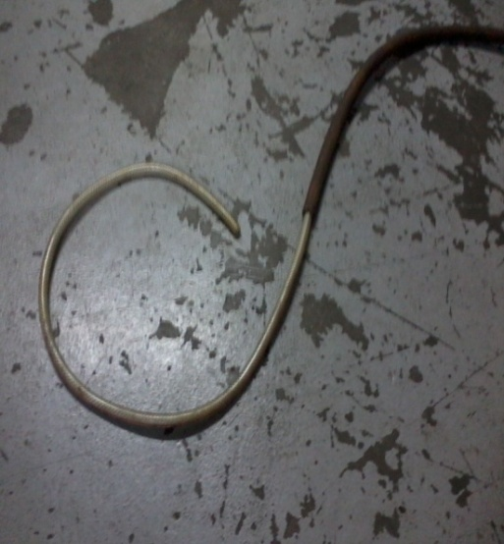
Joint problem solving, better communication, improved work environment
Scrap Hose Suggestion =
USD 100 savings
Resource Efficiency & process control
Suggested improvements from workers get points and cash incentives from management

Slide 27
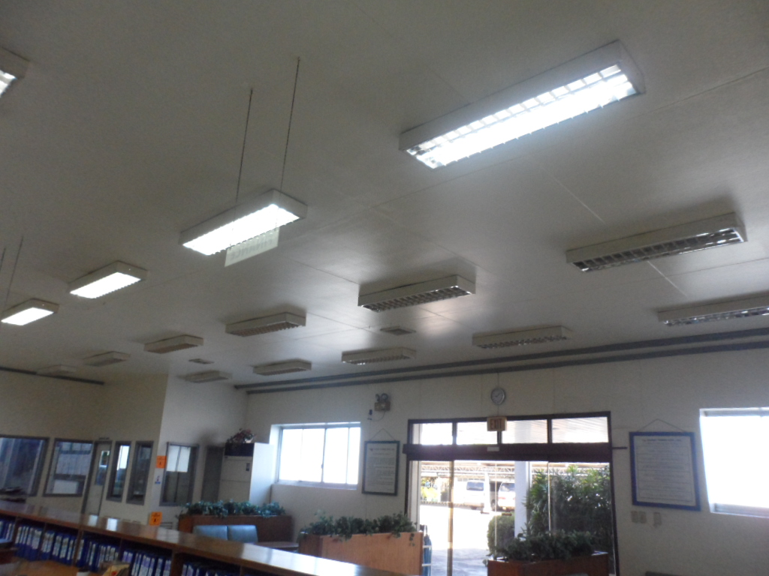
Reduction of CO2 Emission thru Conservation of Electrical Energy by shutting off FL bulbs at office Lobby
= 22,080 watts / month( 22.1 kw)
CO2 emission = 129.2kgs/year
( 0.13ton)/year reduction
Savings = P 4,223.5/month x 12
= P 50,681.5/year ( $ 1,178.6)

Slide 28
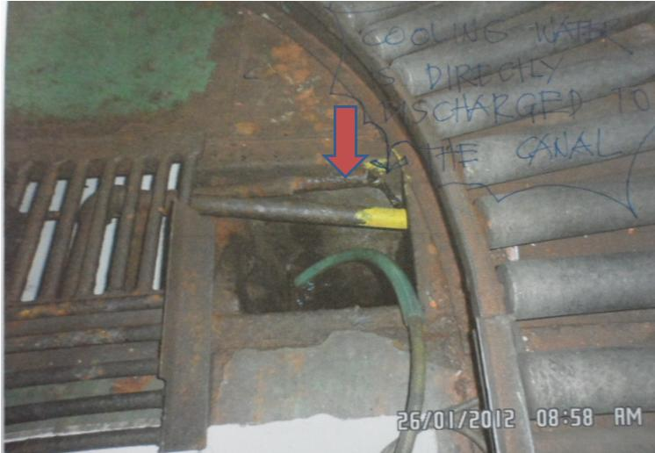
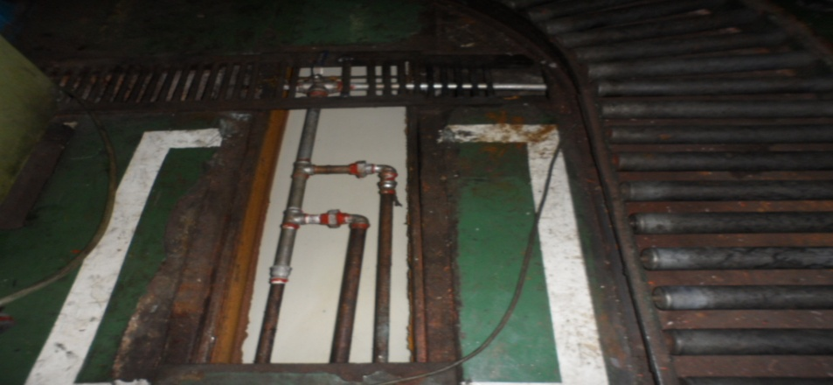
WATER CONSERVATION BY REDUCTION OF WASTE
COOLING WATER GENERATED FROM WIRE DRAWING
MACHINE( Modification of piping and re-use of waste water)
I. Present Condition
II. Improvement
Estimated waste cooling water = 30,584 liters
No. ITEM AMOUNT (Peso)
1
Cost for fabrication
P 170,000
TOTAL COST
P 170,000
Note:
CO2 EMMISSION :
1 liter of water = 0.001 cubic meter
Estimated waste cooling water = 30,584 liters/day
= 703,432 liters@23 days /month
Reduction of 28.13 kgs of CO2 emission/month
or 337.64 kgs/year
Savings
Reduction of waste cooling water = 30,584 liters/day = 703,432 liters@23 days /month

Slide 29


Improvements and results are within reach – examples from GBA Phase I
Improvements and results by hotels that participated in the piloting of the GBA training package:
  - Innovative strategies for guest engagement: laundry expenses reduced by 18% (over 10,000 USD savings per year)
  - Process control and workers’ participation measures >> 30% energy savings
  - Food audit introduced >> 42% reduction in food waste

Slide 30


Sectoral support:
Philippines: Trainers of Trainers
National Wages and Productivity Council
Participants from NWPC, DOLE; Department of Tourism, Bohol Tourism Association, Green Choice, ProGed

Slide 31





Sectoral support:
Thailand: Trainers of Trainers
Tourism Association
Dialogue among representatives from businesses, workers organizations, government and educ. institutions
High quality training according to participant feedback (4.5 out of 5 score)
First hand experience on tools for continual improvement and joint problem solving
Action-oriented training, with individual action plans developed
Principles of worker-employer cooperation integrated in all content and practical exercises
Applied learning to ensure relevance

Slide 32



Enterprise level results
Participating companies demonstrated improved relations (among peers and between employees and management) and workplace conditions, plus an overall improvement in operational efficiency & productivity

Slide 33

Experience sharing among enterprises:
Initiatives supported by Co-Workers
Improvements in their work areas
Removal of hazards
Better work/task procedures

Slide 34

Experience sharing among enterprises:
Initiatives supported by Management
Cost Savings
In-house Training
Recognition / Awards / incentives

Slide 35

Good results to share!
Creation of Green Teams to drive change
Better cooperation and coordination within and across departments & work units
Improvement in workplace conditions and workspace organization
Renewed focus on occupational health and safety and having a ‘greener business’
Notes:
Case study examples

Slide 36


7th Regional Tripartite Seminar on IR (Sept 2016)
Elements of
Good Industrial Relations
Mutual Trust & Respect
Good Faith on both sides
Open communication
Dialogue
Knowledge on IR
Roles & Mandates
Cooperation
Sound Legal framework

Slide 37
To conclude:
‘Green’ issues are a good starting point for joint-action
With the experience of working together (under joint-teams) to towards positive results, such as environmental awareness, energy efficiency, resource efficiency and health & safety, reinforces cooperation and collaboration, which are fundamental elements of better IR relations
The approach also introduces and encourages social dialogue mechanisms
Those that take active role in the initiative have acquired new skills from the program- analytical, technical (energy, resource efficiency/waste management) and leadership (sustainable development & climate change)
Involving partners such as government, workers and employers including industry associations, can escalate these initiatives at the sector level.
Capacity building programs aimed towards skills for green jobs will not only result to improved environmental sustainability, and productivity if coupled with these approaches that contribute to enhancing industrial relations at the enterprise level.

Slide 38



GOVERNMENT
Policy Environment
Support Mechanisms
Programs
EMPLOYER
Investment
Capital
Technology
WORKERS
Labor market
Skills
Innovation
Social Dialogue
Tripartite
Joint goals
Decent Work
Quality jobs
Skills development
Responsible Business practices
Social Investments
Local economic dev & wealth creation
Social inclusion
Diversity & equality
Labor standards & Industrial Harmony
Governance
Safety and Health
Socio-environmental impacts
Resilience Building & Risk Management
Income & growth
Business model viability
Productivity
Transparency
Eco-efficiency & Resource Productivity
Eco-innovations
Energy & resource use
Green jobs
Waste management
Emissions/Effluents mgt
Ecosystems, biodiversity & Natural Resource Mgt
GHG, Climate Impacts
Industrial Relations
Bipartite
Wokplace Cooperation
Areas for Action
Socially Responsible Labour & Sustainable Business Practices

Slide 39


Greening enterprises and workplaces –
  Integrated approach to improvement
  Focus on concrete changes
  Workplace cooperation for effective change

Slide 40

Thank you

Slide 41




    Capacity building for Green Jobs =
    overall improvements in industries

Slide 42
Yasuo Ariga | Chief Technical Adviser
Georginia Pascual |Project Technical Officer
ILO/Japan Multi-bilateral Programme
ILO Regional Office for Asia and the Pacific
Bangkok, Thailand

