Slide 1
Towards a better future for women and work: Voices of women and men
#womensday #IWD2017 #ILOGallupWomen

Slide 2
Gallup World Poll

Slide 3
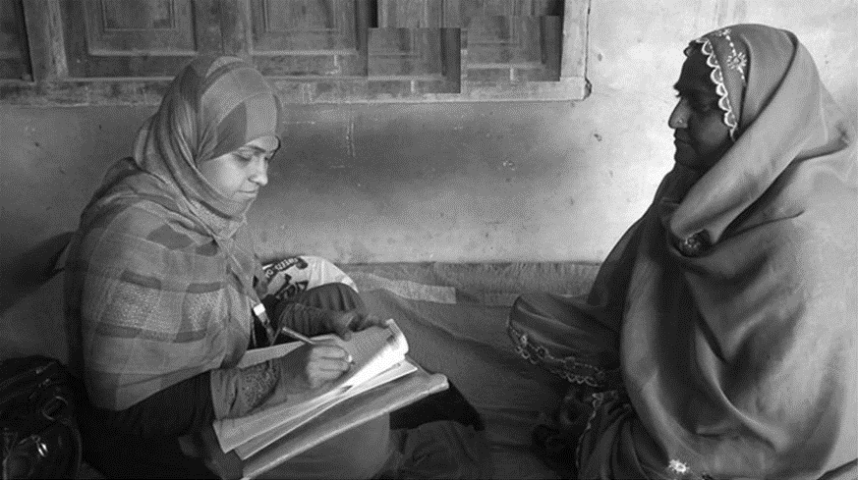
Data gathered in 142
countries and territories

Slide 4
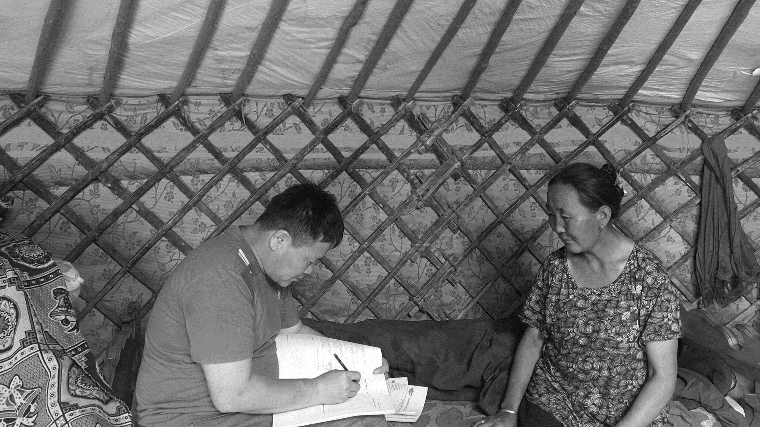
We collected data from nearly
149,000 adults

Slide 5
Regions with biggest gaps in labour force participation
We know that if women are in the workforce and employed at full capacity (either working full time for an employer or part time and not wanting want full time)
they are more likely to rate their lives positively than those who don’t have these jobs or aren’t in the workforce at all
and actually this positive effect on life evaluations is the same or even bigger for women than it is for men in similar employment situations
Source: 2016 Trends Econometric Models, International Labour Organization
Copyright © 2017 Gallup, Inc. and the International Labour Organization. All rights reserved.

Slide 6
Women in the world of work: Measuring women’s and men’s preferences
Asked of female respondents: Would you prefer to work at a paid job, or stay at home and take care of your family and the housework, or would you prefer to do both?
Asked of male respondents: Would you prefer that the women in your family work at paid jobs, or they stay at home and take care of your family and the housework, or would you prefer that they do both?
Copyright © 2017 Gallup, Inc. and the International Labour Organization. All rights reserved.

Slide 7

Majorities of men and women worldwide would prefer that women work at paid jobs and take care of the family
70%
Women
66%
Men
Copyright © 2017 Gallup, Inc. and the International Labour Organization. All rights reserved.

Slide 8
66 percent of men and women would prefer women to have a paid job and take care of the family
■ Work at paid job | ■ Both | ■ Stay home | ■ Don’t know/Refused
Copyright © 2017 Gallup, Inc. and the International Labour Organization. All rights reserved.

Slide 9
Regardless of employment status, majorities of women want to work
■ Work at paid job | ■ Both | ■ Stay home | ■ Don’t know/Refused
Copyright © 2017 Gallup, Inc. and the International Labour Organization. All rights reserved.

Slide 10
In a few regions, there is large a gap between women's and men's desires for women to work at a paid job
Central and Western Asia
Northern
Africa
Copyright © 2017 Gallup, Inc. and the International Labour Organization. All rights reserved.

Slide 11
Views about the acceptability of work for women
Now, I want to ask you about what is acceptable in your family. Do you agree or disagree with the following statement? “It is perfectly acceptable for any woman in your family to have a paid job outside the home if she wants one.”
Copyright © 2017 Gallup, Inc. and the International Labour Organization. All rights reserved.

Slide 12
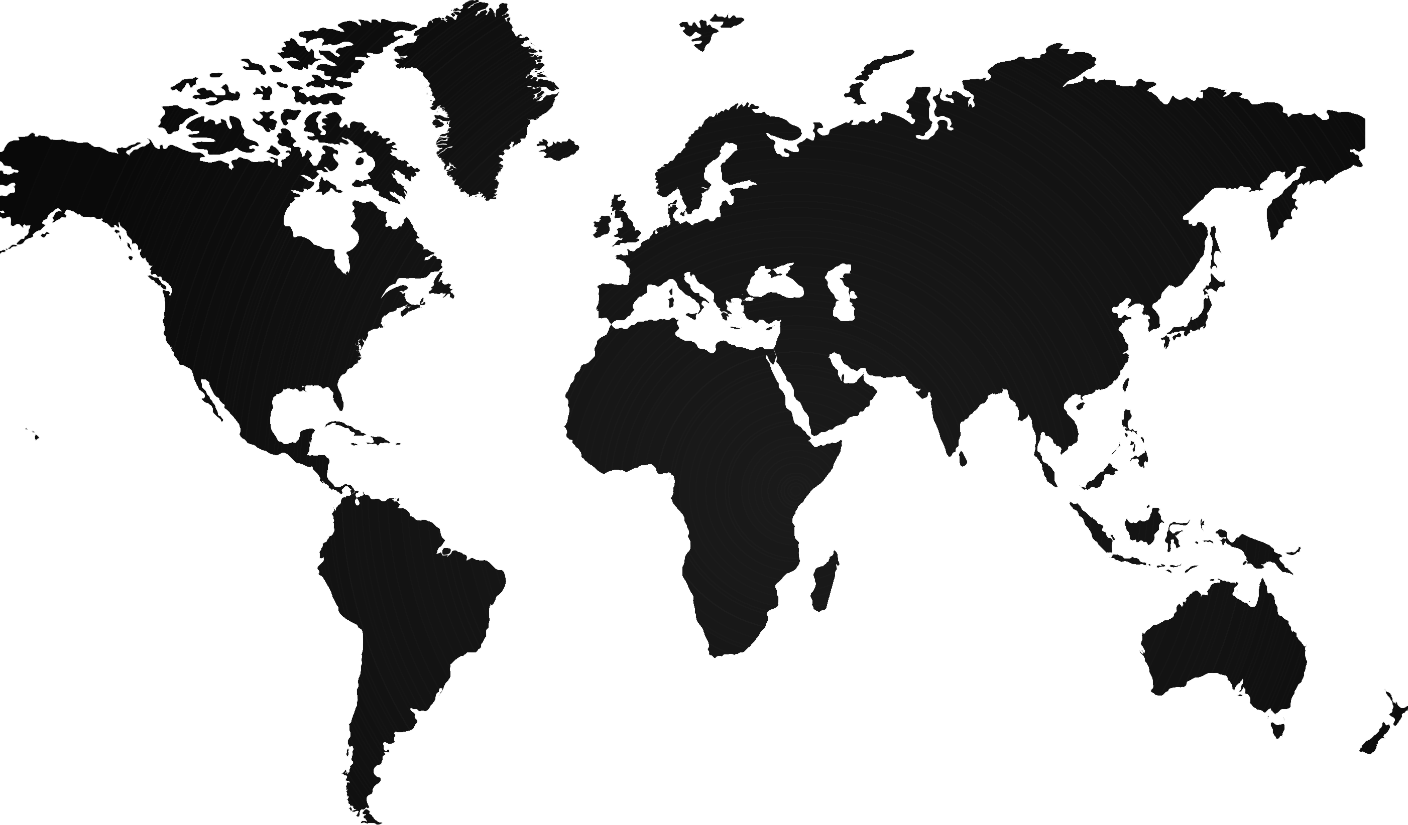
Most men and women find it perfectly acceptable for women in their families to have a paid job outside of the home
83%
Women
77%
Men
Copyright © 2017 Gallup, Inc. and the International Labour Organization. All rights reserved.

Slide 13
Regions with largest divides between men and women about acceptability of women working
% saying it is not acceptable
Percentage-point gap:
Copyright © 2017 Gallup, Inc. and the International Labour Organization. All rights reserved.
Notes:
Transition (cultural norms, consistency) – any observations about the data thus far Susan?

Slide 14
Family influence over work preferences for women
Responses among women only: The chart depicts a crosstabulation of preferences for women to work at paid job, stay home or both by the belief that it is acceptable for women to have a paid job
Copyright © 2017 Gallup, Inc. and the International Labour Organization. All rights reserved.

Slide 15
The equal-opportunity search for good jobs
If a woman has similar education and experience to a man, does she have a better opportunity, the same opportunity or a worse opportunity to find a good job in the city or area where you live?
Copyright © 2017 Gallup, Inc. and the International Labour Organization. All rights reserved.

Slide 16
Men and women share similar views on women’s employment opportunities
■ Better opportunity | ■ Same opportunity | ■ Worse opportunity | ■ Don’t know/Refused
Copyright © 2017 Gallup, Inc. and the International Labour Organization. All rights reserved.

Slide 17
Working women’s financial contributions to their household income
Asked of employed respondents: Please think about what you earn at your job and how it contributes to your household's income. Would you say it is the main source, a significant source or a small source of your household's income?
Copyright © 2017 Gallup, Inc. and the International Labour Organization. All rights reserved.

Slide 18
Working women provide at least a significant source of their household income
Copyright © 2017 Gallup, Inc. and the International Labour Organization. All rights reserved.

Slide 19
The biggest challenges for women in paid jobs: In women’s and men’s words
Please think about women who work at paid jobs in your country/territory today. What do you think is the biggest challenge these women face?
-balance between work and family or home/no time to spend with family;
-lack of affordable care for children or relatives;
-unfair treatment at work/abuse/harassment/discrimination;
-lack of flexible work hours/appropriate, suitable work hours;
-lack of good-paying jobs;
-unequal pay for doing similar work as men (or work of equal value);
-family members don’t approve of women working;
-lack of transportation/lack of safe transportation;
-people prefer to hire or promote men;
-lack of skills, experience or education.
Copyright © 2017 Gallup, Inc. and the International Labour Organization. All rights reserved.

Slide 20
Challenges shift with development level
World
Northern America
Sub-Saharan Africa
Work/Family balance
Affordable care
Unfair treatment
Lack of flexible hours
Lack of good-paying jobs
Unequal pay
Do not approve of women working
Safe transportation
Unequal pay
Work/Family balance
Unfair treatment
Affordable care
Lack of good-paying jobs
Do not approve of women working
Lack of flexible hours
Safe transportation
Unfair treatment
Work/Family balance
Affordable care
Lack of good-paying jobs
Do not approve of women working
Lack of flexible hours
Unequal pay
Safe transportation
Copyright © 2017 Gallup, Inc. and the International Labour Organization. All rights reserved.

Slide 21
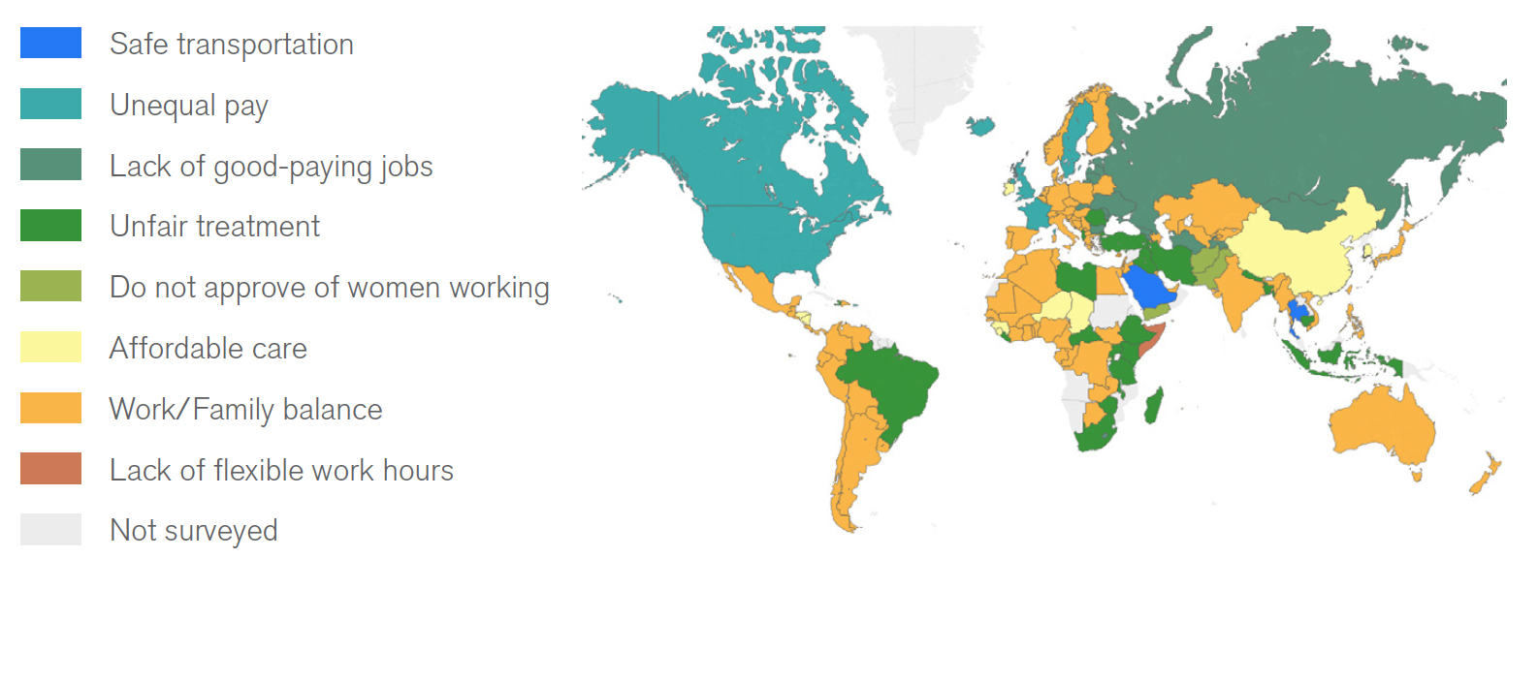
Biggest challenge for working women first most frequently mentioned
Copyright © 2017 Gallup, Inc. and International Labour Organization. All rights reserved.

Slide 22
Key Takeaways
Social norms and traditions are important backdrops – but we survey responses are pointing to a shift in attitudes globally
Processes and structural barriers need to be challenged to facilitate change and to allow women’s full economic participation
Holistic approach is needed with a well-balanced policy mix to use shifting social norms to influence lifting the barriers.
Copyright © 2017 Gallup, Inc. and the International Labour Organization. All rights reserved.

