Slide 1
Overview of the 19th ICLS
“Resolution concerning statistics of work, employment and labour underutilization”:
Changes and main implications
Tite Habiyakare, Senior Statistician
ILO Regional Office for Asia and the Pacific
habiyakare@ilo.org

Slide 2
Contents
Why the 19th ICLS
Concept of Work and Forms of Work Framework
Employment and labour force status classification
New concept of labour underutilization
Implication for employment & unemployment
Implications for measurement

Slide 3
Why revising the existing standards on employment and unemployment statistics?

Slide 4
Why the need for revision?
18th ICLS and 39th session of UNSC (2008)
In response to calls to address limitations of unemployment statistics to address changing economic contexts (2003 job crisis; 2008 financial crisis)
Improve comparability of statistics due to inconsistency of practices based on the previous standards
Provide measures of labour underutilization, beyond unemployment
Recognize and provide framework for measurement of all work, paid and unpaid
Update previous old standards on
  Statistics of the economically active population, employment, unemployment and underemployment (13th ICLS, 1982)

Slide 5
Scope of new standards
Forms of Work framework and operational definitions
  Employment, Own-use production work, Volunteer work, ...
Measures of Labour underutilization
  Unemployment, time-related underemployment, potential labour force
Classifications of working age population
  By labour force status; by main form of work
Data collection programmes
  Pop. coverage, Age limits, Sources, Periodicity of collection / reporting
Indicators, tabulations
  To select minimum national set, including headline indicators
Evaluation, communication, dissemination & international reporting
  Phased adoption of new standards (parallel series)

Slide 6
Work and
Forms of Work Framework

Slide 7
Concept of work (1): why define work?
To meet demands and resolve issues identified in the existing framework (1982 standards)
  Define employment more narrowly
  Still able to measure labour inputs for SNA purposes by identifying other forms of work
  Defining ‘work’ allows other forms of work to be defined and measured

Slide 8
Work (§ 6)
1st international statistical definition
  “Any activity performed
  by persons of any sex and age
  to produce goods or to provide services
  for use by others or for own use”
  Para 6, Resol. I. (19th ICLS, 2013)
Irrespective of legality, context and person status
Consistent with the scope of productive activities
  Within the SNA General production boundary
  Complete accounts (“national” and “satellite” accounts)

Slide 9
Work and the 2008 SNA
Aligned with General production boundary (2008 SNA)
  Activity must result in production of goods or services (e.g. stealing not included)
  Activity must fulfill 3rd person criterion: i.e. it must be possible for someone else to perform the activity on one’s behalf (e.g. sleeping)
Can be performed in any kind of economic unit
  Market units (i.e. for profit units, such as corporations, quasi-corporations and household unincorporated market enterprises)
  Non-market units (i.e. government & non-profit institutions)
  Households producing goods or services for own final use
Irrespective of formal, informal nature or legality of activity
Enables coherence between work statistics and economic statistics

Slide 10
Forms of Work Framework (1): classification
Own-use production work
  Activities to produce goods & services mainly for own final use by household
Employment work
  Activities to produce goods & services [for others in exchange] for pay or profit
Unpaid trainee work
  Activities to produce goods & services for others performed without pay in order to acquire workplace experience or skills
Volunteer work
  Non-compulsory activities performed without pay to produce goods and services for others
Other work activities
  E.g. Compulsory activities performed without pay to produce goods & services for others

Slide 11
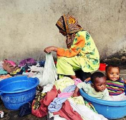
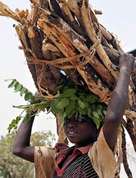
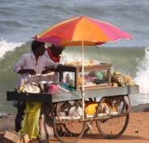

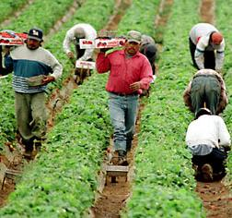
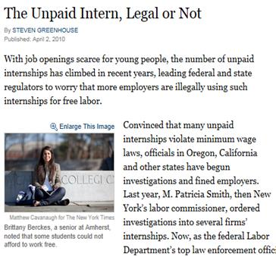
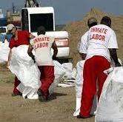

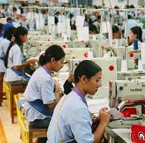
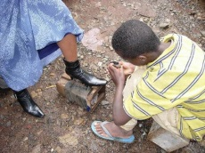
Forms of Work Framework (2):
By main intended destination & transaction type
Work
(i.e. ALL activities to produce goods and services)
For own final use
(by households)
For use by others (i.e. other units)
For remuneration (i.e. for pay or profit)
Without remuneration
Unpaid trainee work
Other work activities (e.g. unpaid compulsory work)
Volunteer work
Own-use production work
Employment
(work for pay or profit)
Services
Goods
Services
Goods
S
G
S
G
G
S
SNA labour input

Slide 12
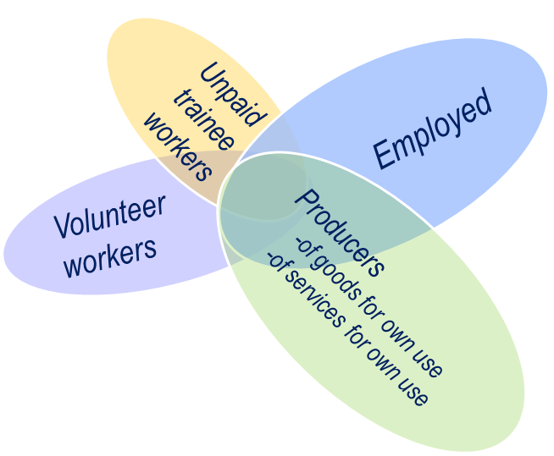
Forms of work framework (3)
People can be engaged in multiple types of work activities at the same time
  E.g. Employed but also engaged in volunteer work
  Under previous framework you were employed or not employed

Slide 13
Employment and Labour Force Status Classification

Slide 14
Form of work: Employment
(by main intended destination & transaction type)
Work
(i.e. ALL activities to produce goods and services)
For own final use
(by households)
For use by others (i.e. other units)
For remuneration (i.e. for pay or profit)
Without remuneration
Unpaid trainee work
Other work activities (e.g. unpaid compulsory work)
Volunteer work
Own-use production work
Employment
(work for pay or profit)
Reference concept for Labour Force statistics
Services
Goods
Services
Goods
S
G
S
G
G
S
SNA labour input

Slide 15
Persons in employment
Operational definition -19th ICLS (§ 27-32)
* Two groups:
  Employed, at work: Worked for pay or profit for at least 1 hour
  Employed, not at work:
    Worked already in the job, but not at work due to:
      Working time arrangement (shift work, flexitime)
      Temporary absence (expects to return within short period)
      * New guidance to establish main intended destination of activity:
      For sale versus for own final use (only or mainly).
Working age persons who in the reference week / last 7 days were engaged in any activity to produce goods or provide services for pay or profit

Slide 16
Labour force
Concept
“Refers to the current supply of labour
for the production of goods and services
in exchange for pay or profit”
  Para 11, Resol. I. (19th ICLS, 2013)
  Now focuses on work transacted for pay or profit
  When measured over a short reference period it provides snap-shot picture of labour market at a given point in time
  Serves to monitor labour market responses to economic cycles
Labour force = Employed + Unemployed

Slide 17
Labour force status classification
Classifies the population of working age
  According to its relation to the labour market
  In short reference period
Based on
  Activity principle
    What the person did in the reference period
  Priority rule
    Employment over other activity
    Employment over unemployment
    Unemployment over outside the labour force
  1-hour criterion

Slide 18
Labour force status classification
Activity principle + priority rule + 1 hr. criterion
Working age population (a + b + c)
In short reference period,
Employment for 1+ hours
NOT EMPLOYED
(without work for pay/ profit)
Y
N
With job for pay / profit, not at work
Seeking work for pay/profit
1st
N
Y
2nd
N
Y
Available
Y
N
a. Employed
3rd
b. Unemployed
Labour force (a + b)
c. Outside the labour force
ILO Department of Statistics
18
ILO Department of Statistics
18

Slide 19
New concepts of labour underutilization and potential labour force

Slide 20
Labour underutilization (1)
“Refers to mismatches
between labour supply and demand,
which translate into an unmet need for employment among the population”
  Para 40, Resol. I. (19th ICLS, 2013)
In reference to employment (work for pay or profit)
Focuses on issues of insufficient labour absorption
For an improved monitoring of labour markets

Slide 21
Labour underutilization (2)
Working age population
Labour force
Employed
Unemployed
Outside the labour force
Time-related underemployed
Potential
Labour Force
- seeking, not available
- available, not seeking
Want employment
but not seeking,
not available
Do not want employment
Labour underutilization
(unmet need for employment)

Slide 22
Unemployed persons:
A more strict operational definition
Working age persons who were:
  Not employed in
    last 7 days / reference week
  Carried out activities to seek employment in
    last 4 weeks / reference month
  Available to start job/business
    In reference week OR
    In short subsequent period (up to 2 weeks)
Must fulfil ALL three criteria to be classified as unemployed

Slide 23
Time-related underemployment
Scope & relevance
Reflects a situation when
the working time of persons in employment
is insufficient in relation to alternative employment situations they are willing and available to engage
Para 40, Resol.I, (19th ICLS, 2013)
Significant component of labour underutilization
To be disseminated together with unemployment rate
Does not capture other dimensions of underemployment due to skills mismatches or low remuneration

Slide 24
Potential labour force (1)
Potential labour force is defined as all persons of working age who, during the short reference period, were neither in employment nor in unemployment and:
  (a) carried out activities to “seek employment”, (but) were not “currently available” … (i.e. unavailable jobseekers); or
  (b) did not carry out activities to “seek employment”, but wanted employment and were “currently available” (i.e. available potential jobseekers).
Para 51, Resol. 1, (19th ICLS, 2013)

Slide 25
Potential labour force (2): scope
Sub-group of persons outside the labour force
With expressed interest in employment (desire to work)
Relevant in contexts with
  Limited labour market, job opportunities
  Limited channels to seek employment
Relevant for groups
  With other responsibilities (women, students)
  Environment limits their capacity to seek / be available for work

Slide 26
Population outside labour force by labour market attachment
Seeking employment, but not available
Not seeking employment, but want and available to work
Not seeking, Not available but want employment
Does not want employment
Labour market attachment
Based on SAME questions used to identify the unemployed

Slide 27
Discouraged workers (Para 52, 19th ICLS)
A particular group of interest
People who want, are available but are not looking because they don’t believe the work is available
  Education related reasons (don’t think they are qualified enough)
  Age related reasons (employers don’t want people their age)
  Geographic reasons (no jobs available in the area)
Measured by including a question on reasons for not seeking work

Slide 28
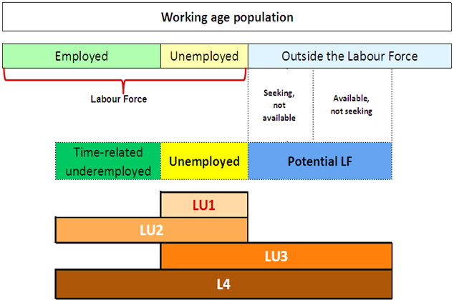
Labour underutilization: new measures (LU1-LU4)
LU4

Slide 29
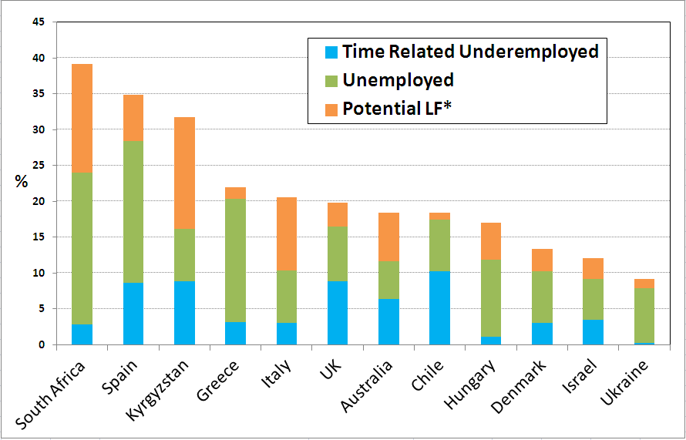
Illustration: Labour underutilization
Composite indicator (LU4)
Source: ILO calculations based on national data (2011)

Slide 30
Implications for employment and unemployment statistics

Slide 31
Employment & unemployment statistics as per previous standards....
Above minimum age ... :
ALL OTHERS, whether or not:
ALL who work for pay
-Provide services for own final use
ALL who work for profit
-Volunteer providing services for households
ALL who produce goods for
own final use
“Not employed”
ALL who work for training
ALL who volunteer for organizations
Who volunteer to produce goods for households
Seeking work AND / OR available for work
Yes
No
Employed
Unemployed
Inactive
Currently active pop. (employed + unemployed)

Slide 32
Employment & Unemployment as per the NEW standards
ALL OTHERS > age, whether or not:
Above minimum age ... :
-Provide services for own final use
-Volunteer providing services for households
ALL who work for pay
-Work unpaid for training
ALL who work for profit
- Employers
- Own account workers in market units
- Contributing family workers
- Members of market producer cooperatives
-Produce goods for own final use
-Volunteer through / for organizations
Volunteer producing goods for households
“Not employed” (for pay/profit)
Seeking AND available for work for pay/profit
Yes
No
Persons in employment
(work for pay / profit)
Unemployed
Outside the labour force
Labour force
Underutilized labour
(with unmet need for employment, for pay/profit)

Slide 33
250
Working Age Population (WAP)
Employed
Employed
Not employed
In paid employment
Producers of goods
for own final use
100
14
Volunteer workers
Self-employed in market units
5
Unpaid trainee workers
30
1
100
Unemployed
Outside
labour force
Unemployed
Outside
labour force
5
15
20
80
 | 13th ICLS (1982)
Employed | 150 | 60.0%
Unemployed | 20 | 11.8%
Labour force | 170 | 68.0%
Outside labour force | 80 | 32.0%
NEW 19th ICLS (2013) |  | Change
130 | 52.0% | ↓
25 | 16.1% | ↑
155 | 62.0% | ↓
95 | 38.0% | ↑
Notes:
The new definition of employment will therefore affect mostly countries with high levels of producers of goods for own final use, that were previously included in employment; and countries with strong employment training programmes that were previously included in employment.

Slide 34
Implications for measurement

Slide 35
Identification in labour force surveys
0+
Module I: Household Roster & Demographic Characteristics
n+
Module II: Education & training
WAP
Module III: Participation in the Labour Market
Identification of persons in employment
Y
1st
N
Persons in employment
Persons NOT in employment
-Characteristics of main job
-Characteristics of other jobs
2nd
-Job search & availability
-Previous employment experience
3rd
Module IV: Participation in Own use production of goods
Optional Work modules:
Unpaid trainee work
Volunteer work
Provision of services for own final use

Slide 36
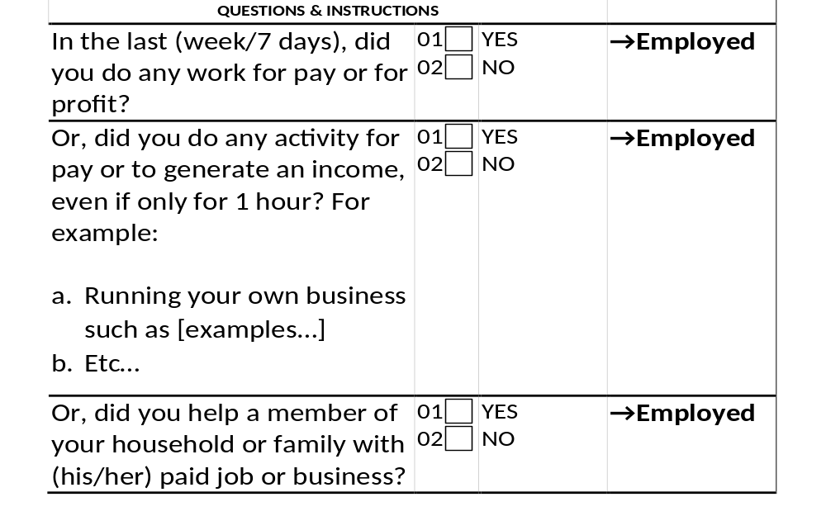
Work for pay or profit – typical approaches

Slide 37
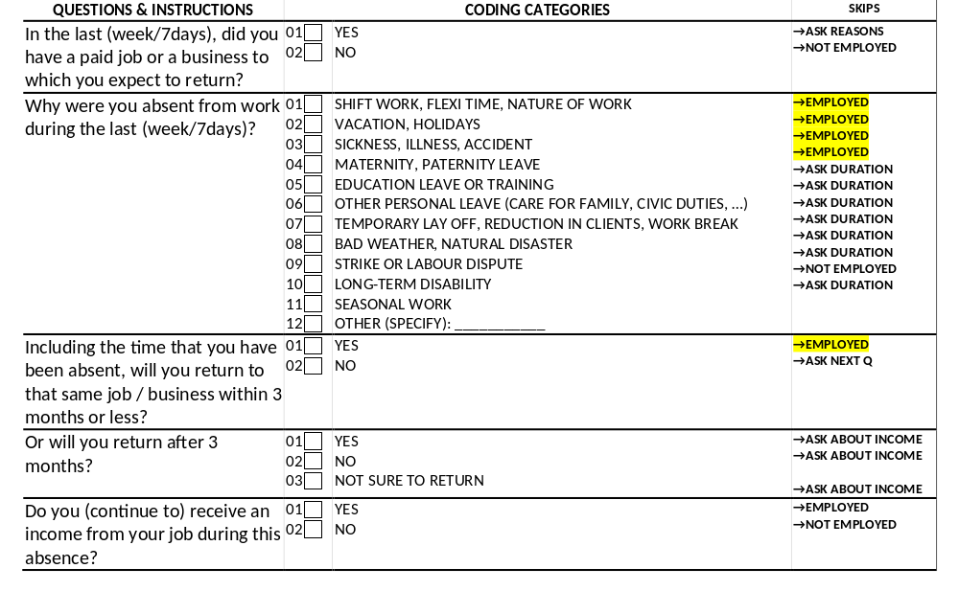
Temporary absence from employment

Slide 38
Main intended destination:
For market / For own use
For people working in agriculture/fishing – key issue = boundary between employment and own use production
Main intended destination
  Essential to establish that the production is intended mainly for use by other units (i.e. market-oriented)
  Even if products are not sold / bartered (e.g. bad season)
Why intention?
  Different forms of work can be distinguished by the purpose for doing that work at the time.
  E.g. Employment is work intended to generate pay/profit even if no payment is eventually received
  Own use production work complicated where there are mixed uses
Notes:
The example would be asked to persons reporting having worked in their own business activity in agriculture, fishing, hunting or gathering; or helping unpaid a household member in such activities.
Response options 1 and 2 are considered as employment (i.e. work for pay or profit).
Response options 3 and 4 would constitute own-use production of goods and hence, would not be included in employment.
Countries should further evaluate response option 3 to ensure its adequacy in the national context.

Slide 39
Main intended destination:
Possible approach
QUESTIONS & INSTRUCTIONS | CODING CATEGORIES |  | SKIPS
Was this work in...? (Mark only one) | 01 02 03 | READ farming or rearing animals fishing other type of activity | →EMPLOYED
Thinking about the products you worked on, were they mainly intended for sale or for family use? | 01 02 03 04 | ONLY FOR SALE MAINLY FOR SALE MAINLY FOR FAMILY USE ONLY FOR FAMILY USE | →EMPLOYED →EMPLOYED →NOT EMPLOYED →NOT EMPLOYED
Notes:
The example would be asked to persons reporting having worked in their own business activity in agriculture, fishing, hunting or gathering; or helping unpaid a household member in such activities.
Response options 1 and 2 are considered as employment (ie. work for pay or profit).
Response options 3 and 4 would constitute own-use production of goods and hence, would not be included in employment.
Countries should further evaluate response option 3 to ensure its adequacy in the national context.

Slide 40
Time related underemployment (1)
Time Related Underemployment
  Questions needed for all respondents in employment
  Generally after other characteristics of employment such as occupation, industry, status in employment
  Need questions on desire to work more hours in return for more pay and availability in next two weeks
  Question should refer to working time in all jobs
  Can be usual or actual working time

Slide 41
Time related underemployment (2)
M4G06 | During the last (month/4 weeks/30 days), that is from [DATE] up to [DATE/yesterday], did (NAME) look for additional or other paid work? | 01 02 | YES NO
M4G07 | Would (NAME) want to work more hours per week than usually worked, provided the extra hours are paid? | 01 02 | YES NO | →M4G10
M4G08 | Could (NAME) start working more hours within the next two weeks? | 01 02 | YES NO | →M4G10
M4G09 | How many additional hours could (NAME) work? | ______________________ (NUMBER OF HOURS)

Slide 42
Unemployment and potential labour force
Need questions on job search, desire for work (if not seeking) and availability
Also reasons for not looking or not being available of interest and duration of unemployment
Core questions to identify unemployment and potential labour force can be as little as 3 questions but testing useful to establish what is needed
10 questions can get a wide range of information

Slide 43
Sequence of job search and availability questions
1 | During the last (month/4 weeks/30 days), that is from [DATE] up to yesterday, did you do anything to find a paid job or to start a business? | YES NO | →3
2 | Or did you do anything to find any kind of work to generate income, even small or casual jobs? | YES NO | →5
3 | What did you mainly do in the last (month/4 weeks/30 days) to find a job or start a business? | APPLY TO PROSPECTIVE EMPLOYERS PLACE OR ANSWER JOB ADVERTISEMENTS STUDY OR READ JOB ADVERTISEMENTS REGISTER WITH (EMPLOYMENT CENTER) REGISTER WITH PRIVATE RECRUITMENT OFFICES ETC…
4 | For how long have you been without work and trying to find a paid job or start a business? | LESS THAN 1 MONTH 1 MONTH TO < 3 MONTHS 3 MONTHS TO < 6 MONTHS 6 MONTHS TO < 12 MONTHS 1 YEAR TO < 2 YEARS 2 YEARS OR MORE | →8 →8 →8 →8 →8 →8
5 | Would you want to work if a job or business opportunity became available? | YES NO | →NEXT SECTION
6 | What is the main reason why you did not try to find a paid job or start a business in the last (month/4 weeks/30 days)? | ALREADY FOUND JOB TO START IN THE FUTURE WAITING FOR RESULTS OF A PREVIOUS SEARCH AWAITING RECALL FROM A PREVIOUS JOB WAITING FOR THE SEASON TO START TIRED OF LOOKING FOR JOBS, NO JOBS IN AREA NO JOBS MATCHING SKILLS, LACKS EXPERIENCE CONSIDERED TOO YOUNG/OLD BY EMPLOYERS IN STUDIES, TRAINING FAMILY / HOUSEHOLD RESPONSIBILITIES IN AGRICULTURE / FISHING FOR FAMILY USE DISABILITY, INJURY, ILLNESS OTHER SOURCES OF INCOME OTHER (SPECIFY):_________________ | →8 →8 →8 →8 →8 →8 →8 →8 →8 →8 →8 →8
7 | When do you expect to start working in this job? | 1 MONTH OR LESS > 1 MONTH AND UP TO 3 MONTHS > 3 MONTHS
8 | If (a/the) job or business opportunity had been available, could you have started working last week? | YES NO | →NEXT SECTION
9 | Or could you start working within the next two weeks? | YES NO | →NEXT SECTION
10 | What is the main reason why you are not available to start working in the next two weeks? | AWAITING RECALL FROM A PREVIOUS JOB WAITING FOR THE SEASON TO START IN STUDIES, TRAINING FAMILY / HOUSEHOLD RESPONSIBILITIES IN AGRICULTURE / FISHING FOR FAMILY USE RETIRED, PENSIONER DISABILITY, INJURY, ILLNESS OTHER (SPECIFY):_________________
Future starters
Availability
Job search and duration of unemployment
Desire for work
Discouraged jobseekers

Slide 44
Thank you

