Slide 1
Conceptual framework for statistics on the work relationship:
ICSE-18 proposal for the 20th ICLS
Tite Habiyakare, Senior Statistician
ILO Regional Office for Asia and the Pacific
habiyakare@ilo.org

Slide 2
Contents
Why a proposal on ICSE-18?
Statistics on the work relationship, concepts
Classification criteria
New classification categories
Proposal for measurement in surveys
Proposals for testing

Slide 3
Why revising the existing standards on the classification of employment relationship?

Slide 4
Why the need for revision of ICSE-93?
As a follow-up to the 19th ICLS resolution on work statistics:
  Need to go beyond a classification of status in employment,
  Advise a classification of broader work relationships;
In response to increased complexity of economic production and economic activities:
  Emerging new forms of work relationship;
  New forms of economic organization such as uberisation, share economy, etc.;
Increased forms of home-based work;
Update previous old standards on
  International Classification of Status in Employment, ICSE (15th ICLS, 1993).

Slide 5
Proposal on the work relationship (1)
Conceptual framework for statistics on the work relationship
  defines the key concepts and classification schemes to be included in the standards
Classification of Status in Employment alternative hierarchies
  a relatively detailed set of categories on the basis of
    the type of authority that the worker exercises over the economic unit in which he/she works and
    the type of economic risk to which the worker is exposed

Slide 6
Proposal on the work relationship (2)
Classification of Status of Worker
  Extension of the classification of Status in Employment to cover all forms of work, including own-use production work, volunteer work and unpaid trainee work, as well as employment
A set of cross-cutting variables
  Information on degree of stability and permanence of the work
  Definitions and categories for types of arrangement that cut across several status categories
  Important variables in ownership rights (in some cases also required to derive status in employment categories).

Slide 7
Statistics on the work relationship, concepts

Slide 8
Statistics on work relationship, scope
Aim to describe:
  (a) the relationships between persons who work and the economic units in which or for which the work is performed, and
  (b) the contractual or other conditions in which the work is performed.
Relate to all forms of work defined by the 19th ICLS, i.e.
  own-use production work,
  employment,
  unpaid trainee work,
  volunteer work
  other forms of work,
Cover the concept of work as defined by the 19th ICLS, i.e. any activity performed by persons of any sex and age to produce goods or to provide services for use by others or for own use.

Slide 9
Economic units
The concept of economic unit used in the framework is aligned with that defined in the System of National Accounts (SNA 2008) which distinguishes between:
  market units (i.e. corporations, quasi-corporations and household unincorporated market enterprises);
  non-market units (i.e. government and non-profit institutions serving households); and
  households that produce goods or services for own final use (domestic households).

Slide 10
Units of analysis/classification
Statistics on work relationships refer primarily to characteristics of jobs or work activities in particular economic unit(s);
A job or work activity is defined in the 19th ICLS resolution as a set of tasks and duties performed, or meant to be performed, by one person for a single economic unit;
  The term job is used in reference to employment,
  When relating to own-use production work, unpaid trainee work, and volunteer work, the term is referred to as work activity;
A person may therefore have as many work relationships as he/she has jobs or work activities in various economic units.

Slide 11
Classification criteria & derived classifications

Slide 12
Classification criteria, classifications
The framework uses two aspects of the work relationship as criteria to differentiate categories of jobs and work activities according to status:
  the type of authority that the worker is able to exercise in relation to the work performed and,
  the type of economic risk to which the worker is exposed;
A relatively detailed set of mutually exclusive categories of work relationship is defined on the basis of these criteria, to form the new Classification of Status of Worker;
  The subset of these categories that relate to employment form the Classification of Status in Employment.

Slide 13
Type of authority
The control that the worker has over the organization of his or her work,
The authority that he or she exercises over the economic unit in which the work is performed, including its activities and transactions,
The extent to which the worker is dependent on another person or economic unit for organization of the work and/or for access to the market.
used to classify jobs and work activities as independent workers and dependent workers.
Since workers may, in practice, have greater or lesser degrees of authority and dependence, there is to a certain extent a continuum between dependent and independent work.

Slide 14
Operational dependence and economic dependence
Operational dependence refers to:
  whether the person has control over when and how the work is done,
  can make the most important decisions about the activities of the business,
  or is accountable to or supervised by another person or economic unit;
Economic dependence refers to whether the worker or another person or economic unit controls access to the market, raw materials and capital items.

Slide 15
Independent and dependent workers
Independent workers
control the activities of the economic units in which they work, either entirely independently or in partnership with others
make the most important decisions about the activities of the economic unit and the organization of their work
are not supervised by other workers
are not dependent on a single other economic unit or person for access to the market, raw materials or capital items
may work on their own account or in partnership with other independent workers and may or may not provide work for others.
Dependent workers
  do not have complete authority or control over the economic unit in which or for which they work;
include:
  employees,
  family helpers
  workers employed for profit who are dependent on another economic unit for access to the market, raw materials and capital items, or whose work is organized or supervised by a single main client.

Slide 16
Type of economic risk
The extent to which the worker may
  (1) be exposed to the loss of financial or other resources in pursuance of the activity and
  (2) experience unreliability or non-existence of remuneration in cash or in kind in return for the work performed, including the circumstances in which a job or work activity may be terminated.
Used to classify workers as employed for pay or employed for profit
Measured operationally by considering:
  the nature of the remuneration for the work performed,
  the circumstances in which the job or work activity may be terminated, and
  the extent to which income may be protected in the event the person is unable to work due to circumstances such as sickness, accident, or termination of the job.

Slide 17
Employment for pay or for profit
Workers are classified as employed for pay or employed for profit based primarily on the nature of the remuneration for a particular job;
  Work activities in forms of work other than employment may also be exposed to varying degrees of economic risk, but this concept is of less relevance to the determination of specific groups of workers in these forms of work.
The aspects of the nature of the remuneration taken into consideration include whether or not:
  the work is performed for profit (and therefore also entails the risk of loss);
  a wage or salary is received or expected;
  payment is made in cash or in kind;
  the worker is paid for the time worked or for the goods or services produced.

Slide 18
New classification(s) categories

Slide 19
Classification of Status in Employment
The subset of the Status of Worker categories that relate to employment (for pay or profit)
Can be aggregated according to two alternative hierarchies
The first hierarchy is based on the type authority
  Dichotomy between dependent workers and independent workers
The second hierarchy is based on economic risk
  dichotomy between employment for pay and employment for profit,
  analogous to the traditional distinction between paid employment and self-employment.

Slide 20
More detailed categories of status in employment
Sub-categories for employees to allow the identification of employees with non-standard employment arrangements
  Permanent employees
  Fixed-term and seasonal employees
  Casual and short-term employees
Separate category for Owner-managers of incorporated enterprises
  statistics on employment by institutional sector, wages and income, labour market characteristics and work place relations, as well as for input to the national accounts.
Separate category for Dependent contractors
  Provide labour to others but have contractual arrangements similar to self-employment OR
  Own and operate a business but do not have full control or authority over their work
Suppression of separate category for Members of producers’ cooperatives

Slide 21
Classification of status based on type of authority/ dependency
Independent workers
Employers
  Owner-managers of corporations with employees
  Employers in household market enterprises
Own-account operators of enterprises
  Operators of corporations without employees
  Own-account workers in household enterprises
Dependent workers
Employees
  Permanent employees
  Fixed-term and seasonal employees
  Casual and short-term employees
Dependent contractors
Contributing family workers

Slide 22
Classification of status based on type of economic risk
Workers in employment for profit
Employers in household market enterprises
Own-account workers in household market enterprises
Dependent contractors
Contributing family workers
Workers in employment for pay
Owner-managers of corporations
  Owner-managers of corporations with employees
  Operators of corporations without employees
Employees
  Permanent employees
  Fixed-term and seasonal employees
  Casual and short-term employees
ILO Department of Statistics

Slide 23
ICSW-18 versus ICSE-18
I Independent workers
1 Employers*
11 Owner-managers of corporations with employees
12 Employers in household market enterprises
13 Employers in own-use production of services
14 Employers in own-use production of goods
15 Volunteers employing others
2 Own-account workers*
21 Operators of corporations without employees
22 Own-account workers in household market enterprises
23 Own-account workers in own-use production of services
24 Own-account workers in own-use production of goods
25 Own-account volunteers
D Dependent workers
3 Dependent contractors*
30 Dependent contractors
4 Employees*
41 Permanent employees
42 Fixed-term and seasonal employees
43 Casual and short-term employees
5 Contributing family workers
51 Contributing family workers*
52 Family helpers in own-use production of services
53 Family helpers in own-use production of goods
6 Unpaid apprentices, trainees and interns
60 Unpaid apprentices, trainees and interns
7 Dependent volunteers
70 Dependent volunteers
9 Other workers
90 Other workers
Employment (*)
Four forms of unpaid work
5 Family helpers*

Slide 24
Status of Worker
Three level hierarchical classification
An extension of Status in Employment to cover all forms of work
20 mutually exclusive categories at 3rd level
  defined on the basis of
    the type of authority that the worker is able to exercise in relation to the work performed,
    the type of economic risk to which the worker is exposed.
Covers all jobs and work activities in all forms of work, including own-use production work, employment, unpaid trainee work, volunteer work and other forms of work.
Each detailed Status of Worker group relates to only one form of work
Aggregate categories are based on the type of authority.

Slide 25
Status of worker – Aggregate categories
I Independent Workers
D Dependent Workers
Independent workers with employees (Employers)
Independent workers without employees (Own-account workers)
  3 Dependent contractors
  4 Employees
  5 Family helpers
  6 Unpaid apprentices, trainees and interns
  7 Dependent volunteers
  9 Other workers

Slide 26
I Independent workers
1 Employers
  11 Owner-managers of corporations with employees*
  12 Employers in household market enterprises*
  13 Employers in own-use production of services
  14 Employers in own-use production of goods
  15 Volunteers employing others
2 Own-account workers
  21 Operators of corporations without employees*
  22 Own-account workers in household market enterprises*
  23 Own-account workers in own-use production of services
  24 Own-account workers in own-use production of goods
  25 Own-account volunteers

Slide 27
D Dependent workers (1)
3 Dependent contractors
  30 Dependent contractors*
4 Employees
  41 Permanent employees*
  43 Fixed-term and seasonal employees*
  44 Casual and short-term employees*
5 Family helpers
  51 Contributing family workers*
  52 Family helpers in own-use production of services
  53 Family helpers in own-use production of goods

Slide 28
D Dependent workers (2)
6 Unpaid apprentices, trainees and interns
  60 Unpaid apprentices, trainees and interns
7 Dependent volunteers
  70 Dependent volunteers
9 Other workers
90 Other workers

Slide 29
Concepts to be covered by a series of complementary variables
Duration of contract
Duration of current job
Reason for non-permanent employment
Contract type
Form of remuneration
Seasonality (e.g. seasonal or not)
Full-time/part-time status
Place of work
Domestic workers
Homeworkers and outworkers
Workers in triangular employment arrangements
Social insurance
Paid annual leave
Paid sick leave, etc.

Slide 30
Proposal for measurement in surveys

Slide 31
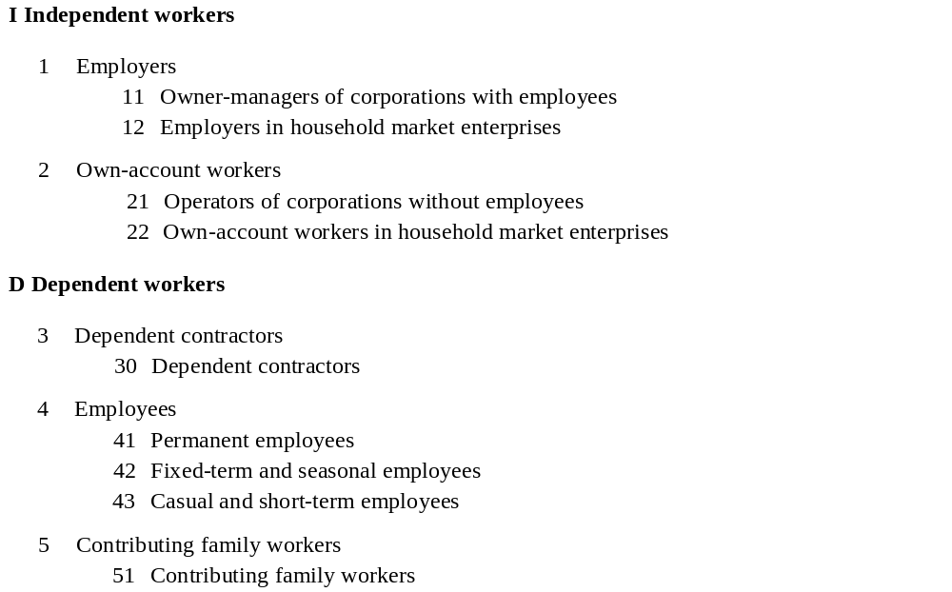
Current proposal focus on ICSE-18

Slide 32
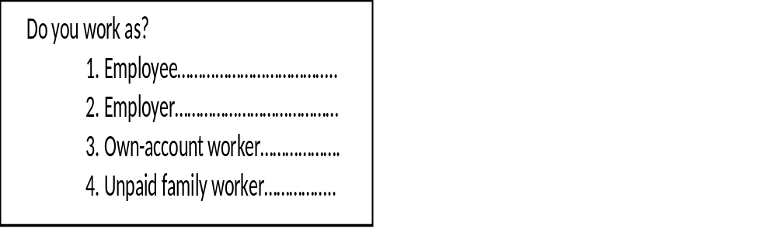
Current practice with ICSE-93
Most countries collects ICSE-93 by using one or two questions (Self-identification)
  Different categories, and wordings

Slide 33
The proposed approach
Builds upon the current widespread practice of using a self-identification question but...
Focuses on establishing the boundaries between the different categories
  Identify key characteristics of the different employment status that can be turned into questions
Module based approach to create flexibility.

Slide 34

First step Self-identification module
  As a minimum capture self-identified:
    Self-employed
    Employees
    Contributing family workers
  Filter respondents to the relevant classification modules
  Do not classify the employment status per se

Slide 35
Three steps structure
s
Self-identified status in employment:
Captures at least the 3 categories:
Self-employed, employees, CFW
Classification module -
Self-employed
Classification module -
Employees
Classification module -
CFW
Sub-classification module
Sub-classification module

Slide 36
Self-employed -Classification module
Self-identification module
Second level categories
Third level categories
Incorporated
Owner managers of corporations with employees
> 0 employees
Employer
Unincorporated
Employers in househod market enterprises
= 0 employees and (incorporated) or (unincorporated and do controll price setting)
Self-employed
Incorporated
Operators of corporations without employees
Own-account operators of enterprises
Unincorporated
Own account workers in houshold market enterprises
= 0 employees and unicorporated and do not controll price setting
Dependent contractor (Partly)
No third level categories

Slide 37
Employees -Classification module
Self-identification module
Second level categories
Do recieve wage/salary or is not responsible for payment of tax/insurance
Employee
Employee
Option 1. Do not recieve wage/salary and is responsible for payment of tax/insurance
Dependent contractor (partly)
Option 2. No contribution to social insurance and outworker

Slide 38
Employees – Sub classification module
Second level category
Third level categories
Guaranteed minimum amount of hours and open-ended agreement
Permanent employees
Guaranteed minimum amount of hours and fixed term contract >= 4 weeks
Employee
Fixed term and seasonal employees
No guaranteed minimum amount of hours or fixed term contract < 4 weeks
Casual and short-term employees

Slide 39
CFW-Classification module
Self-identification module
Second level categories
Third level categories
Are not paid wage or salary and do not take operational decisions
Contributing family worker
Contributing family worker
Are paid wage or salary
Contributing family worker
Classification module for SI employees
Are not paid wage or salary and do take operational decisions
Classification module for SI Self-employed

Slide 40
Current proposals for testing

Slide 41
Assessment strategy
Overall aim
  To test the validity of the ICSE-18 proposal
    Can it be measured?
    Are the categories meaningful?
    How should it be operationalised?
  To develop guidelines and best practices that can be used as inspiration when countries should implement ICSE-18

Slide 42
Different levels of tests
Different levels of testing
  The complete measurement approach
  Specific modules
  Specific key characteristics
  Specific questions
It depends on the specific possibilities and interests from the country in question
It can be carried out based on interest in itself or in combination with other planned testing.

Slide 43
Identification of dependent contractors SI Self-employed
Target group SI Self-employed without employees and unincorporated
Need to create a boundary between Own-account workers in household enterprises and Dependent contractors
Four different possible operationalization's of the key-characteristic:
  Control over setting the price for goods or services produced
  Exercise of operational authority over the work by one single separate entity
  Sharing of profit with a third party
  If the client or intermediary provides the material input (raw materials, capital items or clients)

Slide 44
Identification of dependent contractors, from SI employees
Target group: employees without wage or salary
Two different options depending on national situation
Option 1: Responsibility for social insurance or income tax
  Might be problematic to include when measuring informality
Option 2: Actual contribution of social insurance and place of work
  Might me more feasible option in countries with a high share of informal employees

Slide 45
Family workers vs entrepreneurs
Is it necessary to create a boundary between contributing family workers and entrepreneurs?
The ILO pilot tests shows that there are a significant share of ”co-operators” that should be defined as either employers, own-account workers or dependent contractors;
Might be of high relevance in countries with a high share of family workers.

Slide 46
Thank you

