Slide 1
ILO Pilot Studies – overview and main results
Tite Habiyakare, Senior Statistician
ILO Regional Office for Asia and the Pacific
habiyakare@ilo.org

Slide 2
Contents
Overview of ILO pilot studies
Main findings to date
Next steps
Other countries’ experience

Slide 3
Overview of ILO pilot studies

Slide 4
ILO pilot study project:
Objectives and scope (I)
To develop model question sequences and guidance for LFS
  Aligned with new 19th ICLS standards
  Based on existing good practice AND new evidence
Scope focuses on measurement of
  Employment (as work for pay or profit)
  Measures of Labour Underutilization
  Persons in own-use production work (and working time)
    Of goods (including in agriculture, fishing, hunting and gathering)
    Of Services (in particular housework, adult dependent care, child care)
(*) Measurement of Volunteer work, Unpaid trainee work and Other forms of work to be researched in the future

Slide 5
ILO pilot study project:
Objectives and scope (II)
Additional topics evaluated
  Main activity
    For future development of a classification by main activity as self-reported
    As possible starting point to identify persons employed
    As additional variable to check consistency
  2. Status in employment
    As input to support current review of ICSE-93
    Boundary issues
      Contributing family workers / Apprentices;
      Employers / Own-account workers
    Identification of new (sub)-groups
      Co-operators in family businesses; Dependent self-employed; Employees

Slide 6
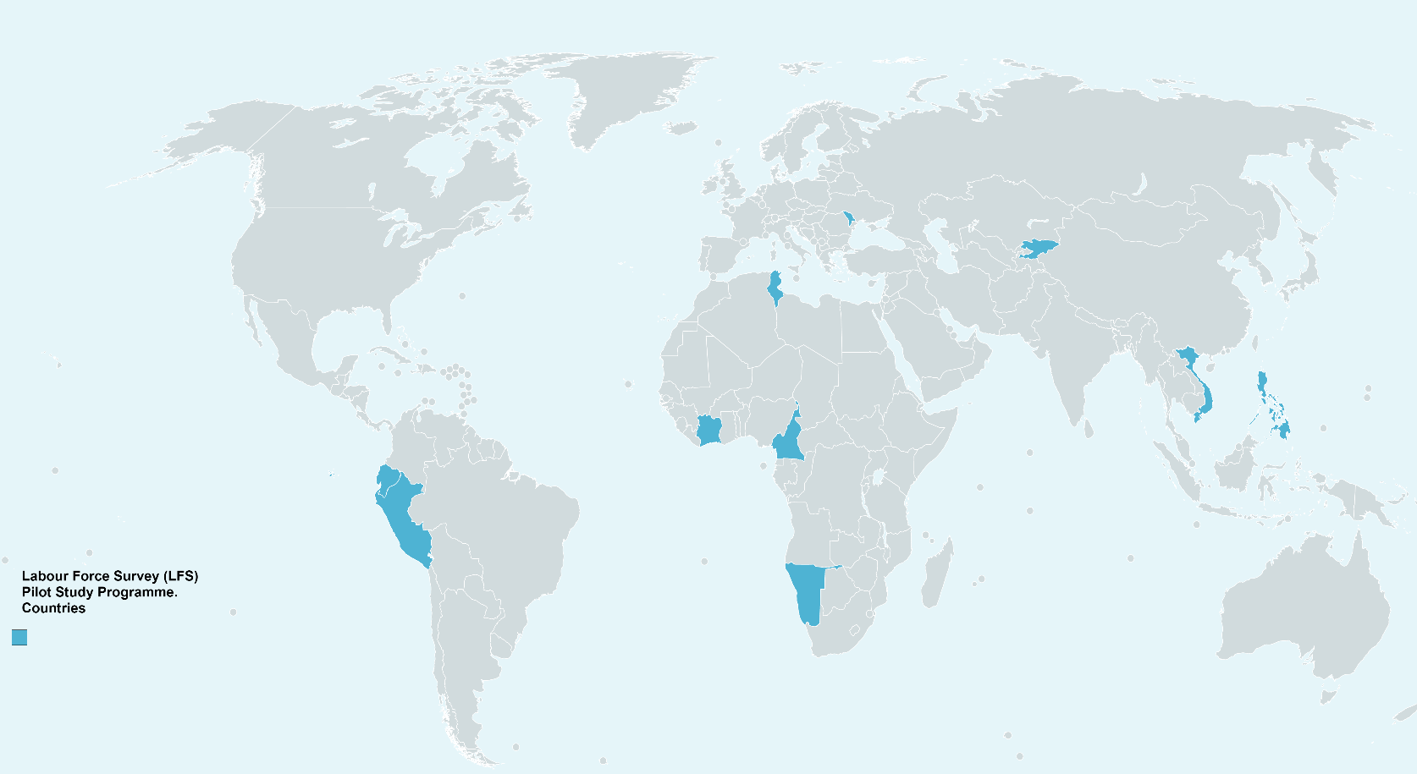
Phase 1: Pilot Countries & Partners
Pilot countries (10)
Africa
  Cameroon
  Ivory Coast
  Namibia
  Tunisia
Americas
  Ecuador
  Peru
Asia
  Philippines
  Vietnam
Eastern Europe & Central Asia
  Kyrgyz Republic
  Moldova
Funding partners
  ILO
  UN foundation

Slide 7
Expected outputs
Phase 1 pilot study protocol
Technical documents (cognitive protocols, survey questionnaires, interviewer instructions)
Final reports of pilot studies
Qualitative & Quantitative (country & cross-country)
LFS practical guidelines
Manuals, practical LFS tool kit
Training course and training materials
LFS Academy (ITC-Turin, Italy)
+ other short courses

Slide 8
Pilot study design
Global level
  5 questionnaire types as per most common LFS national practices
  Qualitative and quantitative evaluation
Country level
  2 model questionnaires (1 as per national practice, 1 alternative)
Qualitative evaluation
Cognitive test
-Specification errors
-Design effects
Quantitative evaluation
Quantitative evaluation
Field test
Wave 2
-Reliability
-Coherence
-Operational issues
Field test
Wave 1
-Reliability
-Coherence
-Operational issues

Slide 9
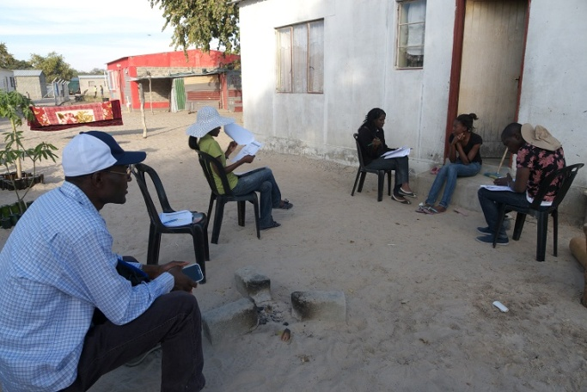
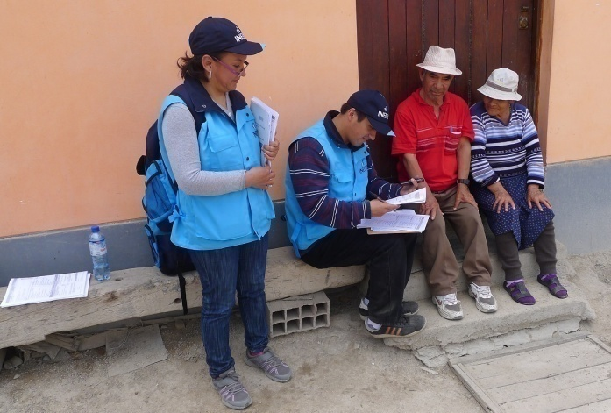
Pilot study design:
Focus of each stage
Cognitive tests:
  Qualitative evaluation of selected question sequences
  Evaluates problems of comprehension, recall, judgment
  Identify changes to be made before the field tests
Field tests, round 1 and 2
  Quantitative and operational evaluation of the questionnaires
  Evaluate possible identification and classification problems
  Evaluate stability of measurement criteria for boundary between employment and own-use production work
  Evaluate impact of proxy responses and respondent burden
(*) NO evaluation of indicators at this stage

Slide 10
Model Questionnaires:
5 developed & tested
M1
Work in agriculture starting approach
M2
Main activity approach
Common in population censuses
M3
Worked for pay or profit approach
Traditional in LFS
M4
Employment type approach
M5
Has job / business approach
For settings with widespread agriculture
Common in Southern Africa & Asia
Suggested in Europe to address problems with absence q.

Slide 11
Model questionnaires:
Similarities and differences
Similarities
Differences
Cover the same topics
  Employment
  Unemployment
  Underemployment
  Potential labour force
  Own use production work
    Goods
    Services
  Self-perceived Main activity
Order of modules / questions
Mode of implementation (self reporting v read out lists)
Measurement approach
  Employment
  Boundary between employment and own use production of goods
  Potential labour force (need / desire)
Level of detail
Reference periods

Slide 12
Basic structure of model questionnaires
Model 1
Model 2
Models 3, 4 and 5
Work in agriculture / fishing
Main activity / situation
Employment
For market production
For market production
1st & 2nd job
Job search
Employment
Employment
Main activity / situation
1st & 2nd job
Job search
1st & 2nd job
Job search
Main activity / situation
Own use production work
Own use production work

Slide 13
Main differences: models 3, 4 & 5
Identification of persons employed
Model 3
Model 4
Model 5
Worked for pay or profit
Worked for pay,
1+ hours
Has work for pay
Y
Y
Y
N
N
Has business
Y
N
Worked for profit, 1+ hrs
Did something to generate income, 1+ hours
Y
N
Y
Last week, did something to generate income, 1+ hours
N
N
Family helper
Y
N
Y
Family helper
Y
Family helper
Short
Absence
N
N
N
Short Absence
For market production
Short Absence
For market production
Y
Y
Y
Y
Y
N
N
Y
Main job
N
N
Y
Job search
Main job
Job search
Main job
For market production
Job search

Slide 14
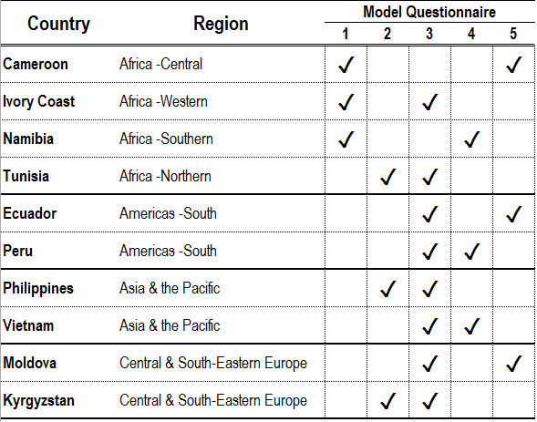
Models assigned by country / region
Choice based on:
-Economic context
-National practice
-Regional comparisons

Slide 15
ILO pilot study project:
Progress to date
Cognitive tests completed between July and October 2015
Field tests took place between November 2015 and October 2016.
Analysis workshop was held with pilot countries in November 2016 to discuss main conclusions

Slide 16
Main findings from ILO pilot studies

Slide 17
Main findings – employment (I)
Tested 5 different approaches to capturing employment
Different question wording and order

Slide 18
Main findings – employment (II)
The different questionnaire designs could yield similar results for employment
  Necessary to have some common elements
  Recovery questions to capture different types of employment important (e.g. contributing family workers, casual workers)
  If subsistence work is common it’s important to have extra questions to identify if a person is employed or an own use producer of goods
  National adaptation, translation and testing very important
    Different words had very different meanings/interpretations across cultures: e.g. profit, household, business
    Also useful to have national examples for things like casual jobs

Slide 19
Example – sequence of employment questions
1 | In the last (week/7days),that is from [DATE] up to [DATE/yesterday], did you do any work for a wage, salary, or any other pay, even if only for one hour? | YES NO | →EMPLOYED
2 | In the last (week/7days), did you run or do any kind of business, farming or other activity to generate income, even if only for one hour? READ ONLY IF NEEDED: For example: growing produce for sale, making things for sale, buying and reselling things, providing services for pay, raising or catching animals or fish for sale | YES NO | →7
3 | In the last (week/7days), did you help a member of the household or family with his/her paid job or business? | YES NO | →7
7 | Was this work that you mentioned in...? (Mark only one) | READ farming or rearing animals fishing other type of activity | →9 →9 →EMPLOYED
8 | In the last (week/7 days) did you do any work in farming, rearing animals or fishing? | YES NO | →NOT EMPLOYED
9 | Thinking about the products you worked on, are they mainly intended for sale or for family use? | ONLY FOR SALE MAINLY FOR SALE MAINLY FOR FAMILY USE ONLY FOR FAMILY USE | →EMPLOYED →EMPLOYED
4 | In the last (week/7days), did you have a paid job or a business to which you expect to return? | YES NO | →8
5 | Why were you absent from work during the last (week/7days)? | SHIFT WORK, FLEXI TIME, NATURE OF WORK VACATION, HOLIDAYS SICKNESS, ILLNESS, ACCIDENT MATERNITY, PATERNITY LEAVE EDUCATION LEAVE OR TRAINING OTHER PERSONAL LEAVE (CARE FOR FAMILY, CIVIC DUTIES, …) TEMPORARY LAY OFF, REDUCTION IN CLIENTS, WORK BREAK BAD WEATHER, NATURAL DISASTER STRIKE OR LABOUR DISPUTE LONG-TERM DISABILITY SEASONAL WORK OTHER (SPECIFY): ___________ | →7 →7 →7 →7 →8
6 | Including the time that you have been absent, will you return to that same job / business within 3 months or less? | YES NO | →7 →8
PRIMARY EMPLOYMENT QUESTIONS
TEMPORARY ABSENCE QUESTIONS
CHECK FOR MARKET ACTIVITY

Slide 20
Main findings – unemployment and labour underutilization
Questions to capture job search, availability and desire appeared to work well
Cognitive tests showed no major problems with understanding
One set of questions on job search appeared to work slightly better than the other
Important to include wording which helps people to think about small activities and casual jobs

Slide 21
Example – sequence of job search and availability questions
1 | During the last (month/4 weeks/30 days), that is from [DATE] up to yesterday, did you do anything to find a paid job or to start a business? | YES NO | →3
2 | Or did you do anything to find any kind of work to generate income, even small or casual jobs? | YES NO | →5
3 | What did you mainly do in the last (month/4 weeks/30 days) to find a job or start a business? | APPLY TO PROSPECTIVE EMPLOYERS PLACE OR ANSWER JOB ADVERTISEMENTS STUDY OR READ JOB ADVERTISEMENTS REGISTER WITH (EMPLOYMENT CENTER) REGISTER WITH PRIVATE RECRUITMENT OFFICES ETC…
4 | For how long have you been without work and trying to find a paid job or start a business? | LESS THAN 1 MONTH 1 MONTH TO < 3 MONTHS 3 MONTHS TO < 6 MONTHS 6 MONTHS TO < 12 MONTHS 1 YEAR TO < 2 YEARS 2 YEARS OR MORE | →8 →8 →8 →8 →8 →8
5 | Would you want to work if a job or business opportunity became available? | YES NO | →NEXT SECTION
6 | What is the main reason why you did not try to find a paid job or start a business in the last (month/4 weeks/30 days)? | ALREADY FOUND JOB TO START IN THE FUTURE WAITING FOR RESULTS OF A PREVIOUS SEARCH AWAITING RECALL FROM A PREVIOUS JOB WAITING FOR THE SEASON TO START TIRED OF LOOKING FOR JOBS, NO JOBS IN AREA NO JOBS MATCHING SKILLS, LACKS EXPERIENCE CONSIDERED TOO YOUNG/OLD BY EMPLOYERS IN STUDIES, TRAINING FAMILY / HOUSEHOLD RESPONSIBILITIES IN AGRICULTURE / FISHING FOR FAMILY USE DISABILITY, INJURY, ILLNESS OTHER SOURCES OF INCOME OTHER (SPECIFY):_________________ | →8 →8 →8 →8 →8 →8 →8 →8 →8 →8 →8 →8
7 | When do you expect to start working in this job? | 1 MONTH OR LESS > 1 MONTH AND UP TO 3 MONTHS > 3 MONTHS
8 | If (a/the) job or business opportunity had been available, could you have started working last week? | YES NO | →NEXT SECTION
9 | Or could you start working within the next two weeks? | YES NO | →NEXT SECTION
10 | What is the main reason why you are not available to start working in the next two weeks? | AWAITING RECALL FROM A PREVIOUS JOB WAITING FOR THE SEASON TO START IN STUDIES, TRAINING FAMILY / HOUSEHOLD RESPONSIBILITIES IN AGRICULTURE / FISHING FOR FAMILY USE RETIRED, PENSIONER DISABILITY, INJURY, ILLNESS OTHER (SPECIFY):_________________
Future starters
Availability
Job search and duration of unemployment
Desire for work
Discouraged jobseekers

Slide 22
Other findings
Working time and time related underemployment
  Questions worked relatively well
  Working time in other forms of work can be more difficult (e.g. childcare)
Can be useful to capture information on main activity – questions on this were updated after cognitive testing but then worked well
  Analyse by the labour force status to see people who may have employment but a different main activity (e.g. caring for family)
  Careful wording needed and better to read response categories – see example

Slide 23
Main activity - illustration
Version before cognitive testing:
‘What is your main activity or situation at present?’
Version after cognitive testing
‘Which of the following best describes what you are mainly doing at present? ‘
Read out:
Studying or training
Work in farming or fishing
Working in a sector other than farming or fishing
Looking for work
Engaged in household or family responsibilities
Long-term illness, injury or disability
Retired or pensioner

Slide 24
General recommendations
Allow sufficient time to develop and test the questionnaire
Use questionnaires from other countries or ILO as a guide but national adaptation should be done
Testing can be done in multiple different ways and periods depending on resources available
Can design the questionnaire to generate information to compare with old standards while applying the new standards
  Potentially useful for data users to understand differences

Slide 25
ILO pilot study project:
Next steps
ILO continuing analysis of results
Preparing reports from the pilot studies to publish in coming months
Reports will include the results from the pilot studies and recommendations for questionnaire content based on those results
Once results are published ILO will work on additional guidance and tools to support country implementation
Additional pilot tests to be done with interested partners on specific issues
Reporting to the 20th ICLS in October 2018
Main results to be on ILO web site at:
http://www.ilo.org/stat/Areasofwork/Standards/lfs/lang--en/index.htm

Slide 26
19th ICLS: other countries’ experience
A number of countries have standards already aligned with the 19th ICLS:
  Australia, Japan, Korea, New Zealand (most of OECD countries);
Some countries were able to revise with minor changes;
Countries with no previous data series, or with irregular data collection, can implement immediately:
  Brunei, Lao PDR, Myanmar, Nepal, etc;
Countries currently piloting/ planning to pilot in line with Para 92, Resol. I of the 19th ICLS:
  Mongolia, Philippines, Sri Lanka, Vietnam, etc.

Slide 27
Thank you

