Slide 1
Supervision of the Application of
International Labour Standards
Alain Pelcé
Senior International Labour Standards Specialist
ILO Decent Work Technical Support Team - Bangkok

Slide 2
Supervision of the Application of
International Labour Standards
The ILO monitors the application of its standards
One of the most advanced international supervisory mechanisms
Consists of regular supervision and special procedures

Slide 3
Supervision:
Regular Supervision
Annual report on ratified Conventions
« Each of the Members agrees to make an annual report to the International Labour Office on the measures which it has taken to give effect to the provisions of the Conventions to which it is a party. These reports shall be made in such form and shall contain such particulars as the Governing Body may request. »
Article 22 of the Constitution of the ILO

Slide 4
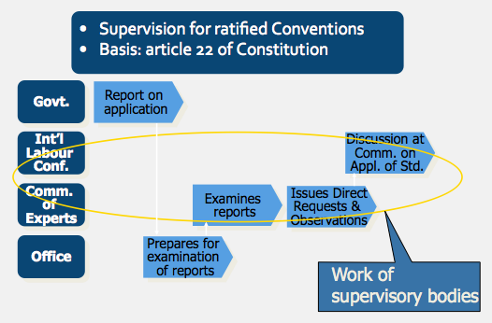
Supervision:
Regular Supervision

Slide 5
Supervision:
Special Procedures
“Representations” by employers’ or workers’ organizations (art. 24-25)
  Can be made by any organization, even without direct interest in the issue
  Minimal formal requirements
  If receivable, examined by a tripartite committee set up by the Governing Body
  Conclusions and recommendations adopted by the Governing Body, can be published
  Often, follow-up by the Committee of Experts

Slide 6
Supervision:
Special Procedures
“Complaints” by member States or delegates to the ILC (art. 26 to 34)
  Lodged by a member State bound by the same Convention / or a delegate to the Conference
  Governing Body may set up a Commission of Inquiry of 3 independent members
  Recommendations must either be fulfilled or challenged before the International Court of Justice
  Failure to comply may lead to action under article 33 of the ILO Constitution

Slide 7
Supervision:
Special Procedures
Complaints to the Committee on
Freedom of Association
  Not a constitutional procedure
  Can be lodged even in the absence of ratification of relevant Conventions
  By an employers 'or workers 'organization demonstrating a direct interest in the matter
  Examined by the CFA, a tripartite 9 member committee of the Governing Body
  Conclusions and Recommendations adopted by the Governing Body
  Follow up of issues of a legal nature by the Committee of Experts

Slide 8
Beyond Supervision:
Reporting on unratified
Conventions and Recommendations
  Constitutional obligation to report on the effect given to instruments chosen by the Governing Body
  Reports due before end of February
  Basis for the General Surveys
  Subject matters aligned with the recurrent discussions under the 2008 Declaration on Social Justice for a Fair Globalization

