Slide 1

Employment and decent work for peace and resilience
Revision of the Employment (Transition from War to Peace) Recommendation, 1944 (No.71)
International Labour Conference, 106th Session – 5-16 June 2017

Slide 2
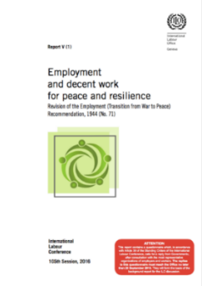
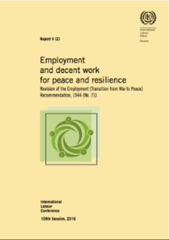
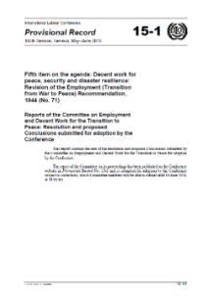
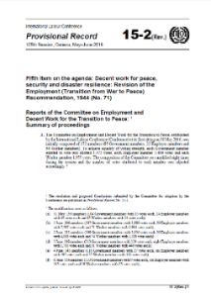
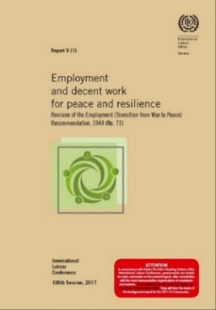
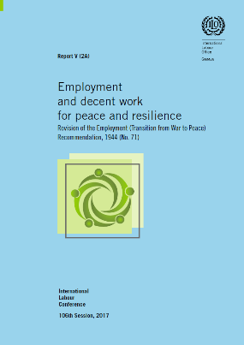
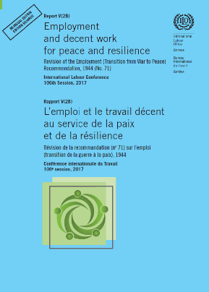
Revision of R.71: Double standard-setting discussion
ILC 2016
Reports for first discussion
Reports of first discussion
ILC 2017
Reports for second and final discussion

Slide 3

Revision of R.71:
4 rounds of formal consultations and 4 drafts
2 rounds inviting all member States and 2 ILC discussions:
replies to white report questionnaire (2015)
comments on brown report (2016)
4 successive drafts:
yellow report (first draft)
Conclusions adopted at ILC 2016 (second draft)
brown report (third draft)
Fourth draft
of the instrument

Slide 4
Outline of the proposed Recommendation
Preamble
I. Objectives and scope
II. Guiding principles
III. Strategic approaches
IV. Employment generation
V. Rights, equality and non-discrimination
VI. Education, vocational training and guidance
VII. Social protection
Labour law, labour administration and labour market information
Social dialogue and role of employers’ and workers’ organizations
X. Refugees and returnees
XI. Prevention, mitigation and preparedness
XII. International cooperation
XIII. Other provisions
Annex

Slide 5
I. Objectives and scope (Paragraphs 1-5: 7 provisions)
R.71
Proposed Recommendation
international conflict
international and non-international armed conflicts
disasters
guidance on
employment and skills
updated guidance on employment and skills
other elements of the Decent Work Agenda
focus on
recovery and reconstruction
prevention, preparedness and resilience in addition to recovery and reconstruction

Slide 6
I. Objectives and scope (Paragraphs 1-5: 7 provisions)
New terminology: (UN General Assembly Resolution A/RES/71/276)
  disaster (biological, environmental, geological, technological etc.) - 2(a)
  resilience - 2(b)
Focus on employment and decent work dimensions of crisis response - 2(c)
Non-binding and updated guidance of interest to all member States

Slide 7
II. Guiding principles (Paragraph 6: 13 provisions)
Provisions that apply to measures on employment and decent work in response to crisis arising from conflicts and disasters
III. Strategic approaches (Paragraphs 7-8: 17 provisions)
Multitrack approach including stabilization, local economic recovery, sustainable employment and decent work
Engaging governments, employers and workers in needs assessment, employment impact assessment and in risk management and prevention planning processes

Slide 8
IV. Employment generation (Paragraphs 9-13: 16 provisions)
Comprehensive employment strategy to promote full, productive, freely chosen and decent employment for women and men
Employment-intensive investment
Local economic recovery
Sustainable enterprises
Just transition towards an environmentally sustainable economy
Transition to formality

Slide 9
IV. Employment generation (Paragraphs 9-13: 16 provisions)
Public sector / Public-private partnerships
Multinational enterprises
Active labour market policies
Employment for youth
Socio-economic integration
Internally displaced persons

Slide 10
V. Rights, equality and non-discrimination
(Paragraphs 14-16: 13 provisions)
Equality of opportunity and treatment
Combating child labour
Combating forced or compulsory labour

Slide 11
V. Rights, equality and non-discrimination
(Paragraphs 14-16: 13 provisions)
Special attention to:
  populations groups that have been made particularly vulnerable by the crisis (also in Parts II, III, IV, VII)
  single-headed households
  women
  persons belonging to minorities
  indigenous and tribal peoples
  migrant workers

Slide 12
VI. Education, vocational training and guidance
(Paragraphs 17-19: 8 provisions)
Provision of education for all children
Second chance programmes
Adapting programmes to emerging skill needs for recovery and reconstruction
Adapting curricula to promote peace and resilience
Training, retraining and economic empowerment in rural and informal economies
Equality and opportunity for women and girls

Slide 13
VII. Social protection (Paragraphs 20-21: 4 provisions)
Basic income security
Social security schemes and social protection mechanisms
Basic social services
Social protection floors
VIII. Labour law, labour administration and labour market information (Paragraph 22 (a-g): 7 provisions)
Labour legislation supporting the generation of employment opportunities
Labour administration, including labour inspection
Labour market information
Public employment services

Slide 14
IX. Social dialogue and role of employers’ and workers’ organizations (Paragraphs 23-24: 6 provisions)
  Gender-inclusive social dialogue for reconciliation, recovery and resilience
Enabling environment for employers’ and workers’ organizations
Cooperation with civil society organizations
Business continuity planning
Assistance to workers and enterprises
Collective bargaining

Slide 15
X. Refugees and Returnees (Paragraphs 25-33: 16 provisions)
Refugee access to labour markets
New text taking into account international and ILO discussions on the subject after ILC 2016
Voluntary repatriation and reintegration of returnees
Relevance of all guidance contained in Parts IV-IX

Slide 16
XI. Prevention, mitigation and preparedness
(Paragraph 34 (a-c): 3 provisions)
Engagement of ILO tripartite constituencies in risk management and planning at the national level

Slide 17
XII. International cooperation (Paragraphs 35-41: 7 provisions)
Strengthening cooperation among Members through bilateral or multilateral arrangements, exchange of information, good practices…
The need for a central focus on employment, decent work and sustainable enterprises in crisis response
Promoting development assistance and private sector investment
Cooperation and coherence among international organizations within respective mandates
ILO leading role with respect to employment and decent work
Close coordination and complementarity of crisis responses, across humanitarian and development assistance

