Slide 1



EU-India
Cooperation and Dialogue on
Migration and Mobility
This project is financed by the European Union

Slide 2

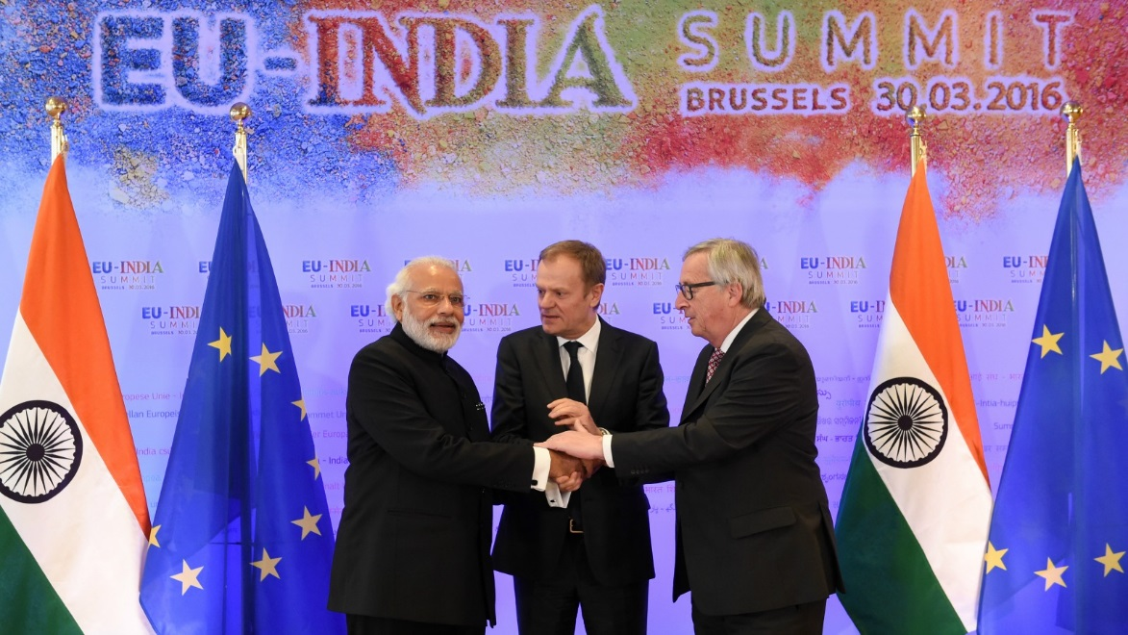
Background: EU-India Summit March 2016

Slide 3
Few outcomes from the Summit
2016
Summit Outcomes
Agenda for 2020
Broad based Trade and Investment Agreement (BITA)
Common Agenda for Migration and Mobility (CAMM)
G20 Skills Strategy
Joint Declaration on Counter-terrorism
India-EU Science and Technology Cooperation Agreement

Slide 4
Common Agenda for Migration and Mobility (CAMM)
Four Pillars
Better organising legal migration, and fostering well-managed mobility
Preventing and combatting irregular migration, and eradicating trafficking in human beings
Maximising the development impact of migration and mobility
promoting international protection, and enhancing the external dimension of asylum

Slide 5
Partnership project to support the CAMM
Implementing partners

Slide 6
Objectives of the project:
OVERALL OBJECTIVE
To contribute to a better governance of migration and mobility between the EU and India, as well as to prevent and address the challenges related to irregular migratory flows.
SPECIFIC OBJECTIVE
To support the EU-India High Level Dialogue on Migration and Mobility (HLDMM) and the implementation of the Common Agenda for Migration and Mobility (CAMM) and its annex of actions.
.

Slide 7
Expected Results
Result 1: Dialogue on labour migration and mobility between India and the EU strengthened
Result 2: Knowledge base on migration flows between India and the EU improved
Result 3: Institutional capacity on the governance and management of labour migration enhanced
Result 4: International standards and best practices on migration governance implemented

Slide 8
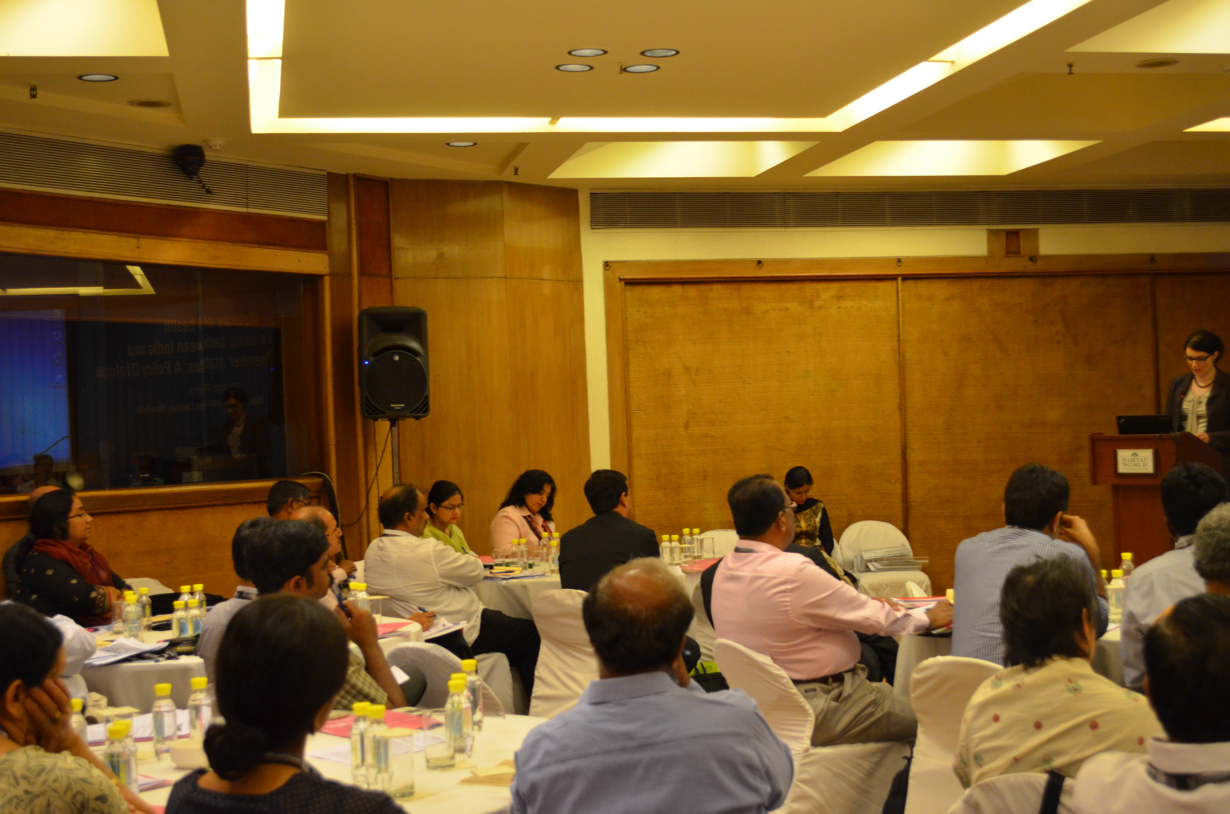
Indicative Activities
Seminar/ meetings/ workshops/ training - 61
Studies, research papers, guidelines, -25
Study visits - 6
Attendance at global conference - 6
Information materials – 25
Awareness campaigns -3

Slide 9
Beneficiaries of the Project
Direct – 4000+
  officials, elected representative, experts, diaspora members, recruitment agents, returnees, students, tourists
Indirect - 1 million +
  employers, workers, diaspora, refugees, general public.

Slide 10
Budget and Time line
3 million Euros
1st September 2017 -31 August 2020

Slide 11
Support Requested from Member States
Participation in events – workshops, meetings, etc
Sharing of information –labour market changes, legal changes, bilateral agreements, projects etc.
Technical guidance/requests
Collaboration for study tours, meetings

Slide 12
Thank you !
For further information, please contact:
Seeta Sharma
EU-India Cooperation and Dialogue on Migration and Mobility
International Labour Organization
India Habitat Centre, 3rd Floor, Core 4B
Lodi Road, New Delhi 11003
T: +91 -11-4750-9233
sharma@ilo.org
http://www.ilo.org/newdelhi

