Slide 1


Occupational Safety and Health within Sustainable Sourcing Policies of Multinational Enterprises
Summary of research findings focusing on agriculture and textile
Labour Administration, Labour Inspection and Occupational Safety and Health Branch
GOVERNANCE Department

Slide 2
Background and hypothesis
Context
Research project on OSH in global supply chains (2016-17).
Research question: what are the drivers and constraints for OSH improvement in global supply chains?
Among the identified drivers for OSH improvement, one hypothesis was that downstream pressure from global buyers was a possible source of influence.
Multinational enterprises (MNEs) at the top of global value chains might influence producing practices through setting sustainable sourcing criteria and certification requirements under private compliance initiatives (PCIs) for some or all of their imported products. These requirements aim for a trickle-down effect on working conditions along the value chain.
However the extent of this effect remains poorly documented and seems to vary considerably from one case to another.
In order to test that hypothesis, the research sought to understand the relative importance of OSH within global buyers’ sustainable sourcing policies.

Slide 3
Qualitative research process
Desk review
Semi-structured interviews
Benchmark
Group discussion
35 MNEs involved in agriculture and textile supply chains
16 Private compliance initiatives standards
10 auditing firms in the field
Workplace observations, key informant interviews and focus group discussions in Colombia, Indonesia, Madagascar and Myanmar
15 private compliance initiative certification standards against ILO OSH-2001 guidelines
Multistakeholder knowledge-sharing event on improving OSH practices beyond the first tier of suppliers
Literature review
Review of the sustainable sourcing policies of 45 MNEs involved in agriculture and textile value chains

Slide 4
OSH in sustainable sourcing policies of MNEs
1

Slide 5
Drivers for the adoption by MNEs of sustainable sourcing policies including OSH
Source: Interviews

Slide 6
Importance of OSH in sustainable sourcing policies
OSH was included in all the sustainable sourcing policies reviewed, to a different degree
OSH objectives or requirements are featured in the social (and labour) chapters of policies or related to environmental chapters
Requirements are usually broadly formulated
The importance of OSH requirements in a firm’s sourcing decisions varies but overall, sourcing criteria remains largely driven by price
Linkages between the nature and extent of OSH requirements and the type of business:
Entering markets with strict regulations on food safety and agrochemical residues
Organiza-tional culture of safety and health within companies
Business model

Slide 7



Implementation tools
Direct engagement and support with suppliers below tier one
Code of Conduct and audits of first tier suppliers
Purchase of certified products

Slide 8
Challenges identified by the respondents
OSH requirements and the fight against child labour
Defining hazardous child labour.
Identifying control measures to eliminate hazardous child labour.
Discussing hazardous child labour with involved parties.
Reaching suppliers beyond tier one: OSH requirements and SMEs
Traceability: difficult to define the supply base.
Organization: small actors are less likely to be unionized / organized in cooperatives.
Price and cost structure: investments required in order to comply with buyer requirements may be too high.
Going beyond the verification of OSH checklists
Recurrent non-compliance reports focusing primarily on the use of personal protective equipment (PPE) by workers in audited workplaces.
Continuous use of chemicals, especially in the agriculture sector.
Difficulty to identify less visible but persistent forms of OSH hazards and risks in the workplace, such as sexual harassment and other psychosocial risks.

Slide 9
Challenges
Social audits
Perceived limitations of social audits (including PCIs) by global buyers
Source: Interviews

Slide 10
OSH in selected private compliance initiatives and certification standards
2

Slide 11





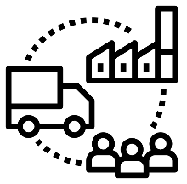
Private Compliance Initiatives (PCIs) and certifications
What are PCIs?
PCIs are voluntary mechanisms for monitoring compliance with established public (laws or regulations) or private (codes of conduct, etc.) standards.
Key characteristics:
private, voluntary character
assessment of behaviour against defined standards
Scope of application:
PCI certifications aim to provide assurance to the end consumer or global buyer about the social and environmental production practices of a certain product.
Types of PCIs:
  Self-assessment (management systems)
  Auditing (internal and external)
  Certification and labelling
  Public reporting
  Combination of the above
Single product
Single site
Single or multiple production sites
Group of producers
Whole chain of custody
Notes:
Transparency to the end consumer is obtained by means of certification-based logos and/or labelling.

Slide 12
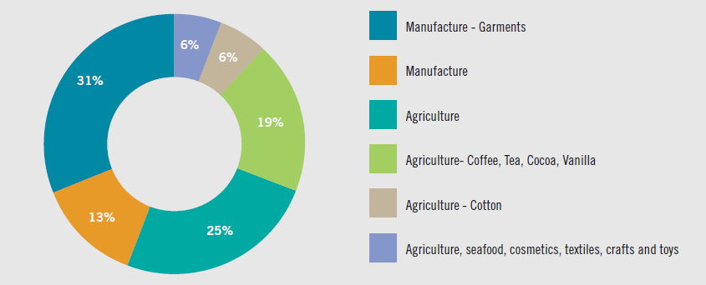
Scope of the benchmark
The 15 PCIs were selected as they represent those most used for agriculture and garment value chains and these two are also the focus of the ILO-EU joint research project on OSH in global supply chains (under the OSH-Global Action for Prevention Flagship Programme) as well as the Vision Zero Fund Initiative.
All the benchmarked PCIs focusing on agriculture are product certification standards (aimed at providing assurance to the end consumer about the social and environmental production practices of a certain product).
Except for one, the benchmarked PCIs concentrating on manufacturing are workplace certifications providing transparency to purchasing brands and/or contractors instead of end consumers, their scope does not include the entire chain of custody of the product.

Slide 13















Methodology – Phase 1: data collection
Desk review of 15 PCIs
Agriculture and textile
Extracted public information on:
  Governance
  OSH provisions
  Verification mechanisms
Complemented by interviews
Notes:
The 15 PCIs were selected as they represent those most used for agriculture and garment value chains and these two are also the focus of the ILO-EU joint research project on OSH in global supply chains (under the OSH-Global Action for Prevention Flagship Programme) as well as the Vision Zero Fund Initiative. This choice also corresponds to PCIs operating in the manufacturing and agricultural sectors that are a strategic priority for the ILO (in particular the Strategic Outcome on the Rural Economy and the Better Work Flagship Programme). There are 10 priority policy outcomes under the ILO Programme and Budget, including Policy Outcome 5: Decent work in the rural economy.

Slide 14

Methodology – Phase 2: benchmark
The collected data was benchmarked against:
ILO OSH 2001 Guidelines on Occupational Safety and Health Management Systems
Chapter 3: guidelines on workplace OSH management systems
Policy
Planning and implementation
Action for improvement
Organizing
Evaluation
International Labour Standards on working conditions known to influence OSH outcomes
Notes:
e.g. working hours, payment systems, maternity protection, access to sick leave, medical care and compensation in the case of occupational accidents and deaths

Slide 15
Results at a glance
PCIs systematically refer to ILO Fundamental Principles and Rights at Work and the ILO’s eight core conventions
Nearly half include an exhaustive list of ILO Conventions and Recommendations
None of the benchmarked PCIs mention ILO OSH 2001 or are closely aligned to it
PCIs however include sections on specific OSH hazards in a prescriptive manner

Slide 16
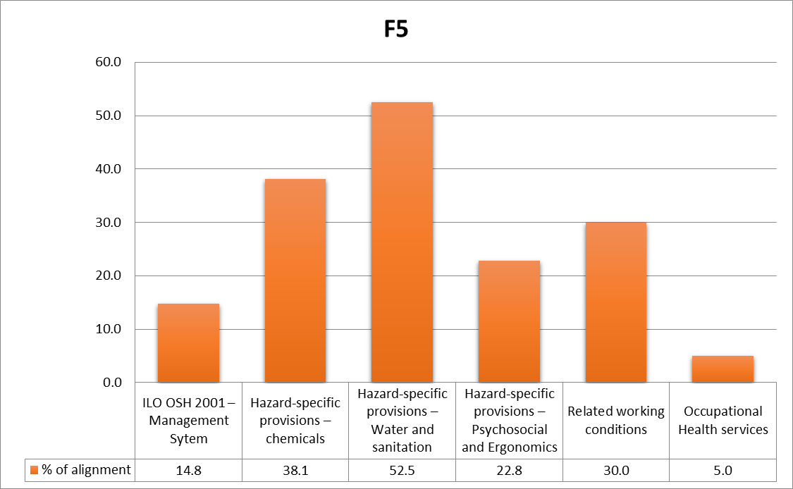
Results – OSH provisions in selected PCIs
Alignment of PCIs requirements with benchmark criteria
Application of requirements varies depending on size of producers - requirements are lower for smallholders
Alignment of PCIs with national legislation:
Nearly all PCIs require require compliance with national law when it is more stringent than PCI requirements
However, this is often a general requirement stated without much detail, so when auditors are not fully aware of local labour laws, identification of non-compliance might be missed
Source: authors

Slide 17
Results – OSH provisions in selected PCIs
Alignment with ILO OSH 2001 guidelines
Low alignment scores:
None of the benchmarked PCIs require a formal OSH management system with a continuous improvement approach in line with ILO OSH 2001 Guidelines
Requirements set out in PCIs may not always refer to specific national legislation or policies on OSH
OSH requirements concentrate on visible OSH practices
OSH requirements often focus on controlling and reducing pre-identified hazards and risks and thus may not contribute to building a culture of prevention in the workplace
Source: authors
Notes:
OSH requirements concentrate on visible OSH practices: i.e. none of the benchmarked PCIs address the issue of psychosocial and ergonomic factors in their risk assessments
OSH requirements often focus on controlling and reducing pre-identified hazards and risks and do not contribute to building a culture of prevention in the workplace, in line with the guidance provided by ILO Tripartite Constituents. Only 3 PCIs include provisions concerning occupational health services at the workplace in addition to the local legar requirements.

Slide 18


Provisions on verification mechanisms in selected PCIs
The wide variety of combination of verification mechanisms does not allow a robustness scale.
Verification processes:
6 months to 5 years
Only 1/3 of PCIs perform unannounced audits
Initial audit
Follow up audit
Verification audit
Re-certification audit
1-5 years
Stratified sampling method
Non-compliance: corrective action plan or breach of zero tolerance policy resulting in the suspension of the certification
Document checks, site inspections, worker and manager interviews are common practices
Specific hazard exposure checks and measurement (dust, noise, etc.) or analysis (chemicals testing samples) are not required
Common challenges:
Independence, impartiality and proper training of auditors
Certification bodies are not connecting with the national OSH system

Slide 19



Impact of PCIs on OSH outcomes
A limited body of evidence
Impact studies are context specific and limited in scope
Positive impact of PCIs on OSH in existing impact studies include:
Limited impact of PCIs on OSH:
PCIs concentrate efforts on improving best practices in areas that are accepted industry parameters such as visible OSH practices
There is no evidence of spill-over effects
PCIs often fail to address root causes of OSH deficit
Improved health of certified farmers
Reduced illnesses and acute reactions to pesticides
Increased earnings resulting from a reduced work-time loss due to work-related illnesses and injuries
Fail to address rights based issues
Fail to address rights based issues
Fail to address rights based issues
PCIs are disconected from local and national policy processes and institutions
PCI mechanisms are externalized or conducted on the side of market models
Current verification systems do not create a culture of prevention, especially amongst lower tier suppliers
Notes:
Benchmark shows low alignment with ILO guidelines on OSH
But what impact do PCIs have in practice?

Slide 20
Entry points for improvement
Entry points for action
OSH is present in most sustainable sourcing policies and strategies of MNEs and receives increased attention
A central tool for the implementation of these strategies is the purchase of certified products.
Certification schemes (workplace or product) are managed by private compliance initiatives that:
  Reach actors at the bottom of supply chains that individual companies would have difficulties reaching on their own
  Reach actors with limited access to institutional support in countries where public resources are constrained
Alignment of private standards as part of the promotion of ILO OSH 2001 in national OSH systems
Adequate training of auditors
Provision of additional support to suppliers on OSH management systems, beyond auditing
Linkages with national OSH systems
Labour inspection in case of serious violations
Occupational Health Services

Slide 21


Thank you!
This research benefited from funding from the European Commission through both the Joint ILO-EU project on OSH in Global Supply Chains under the ILO’s Global Action for Prevention on Occupational safety and Health flagship programme and the Vision Zero Fund.
Alice Faudot-Miguet – faudotmiguet@iloguest.org
Lou Tessier – tessier@ilo.org
Labour Administration, Labour Inspection and Occupational Safety and Health Branch
GOVERNANCE Department, ILO

