Slide 1

Towards gender equality in the future of work
Guy Ryder, Director General
International Labour Office
G20 Labour and Employment Ministerial Meeting
6-7 September 2018, Mendoza

Slide 2
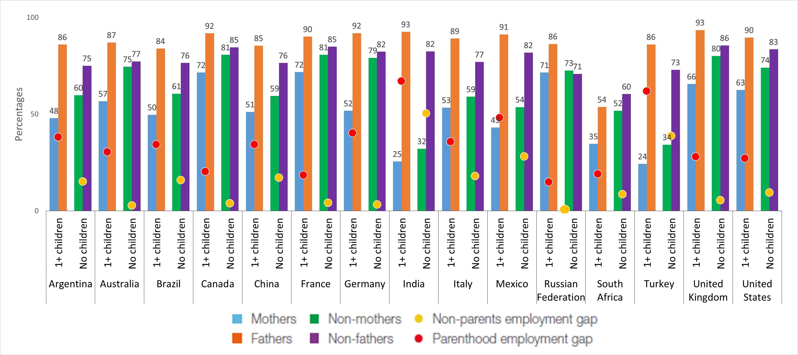
Mothers of young children are considerably less likely to be employed than fathers
Employment-to-population ratios
Source: ILO. Care work and care jobs for the future of decent work. ILO, 2018.

Slide 3
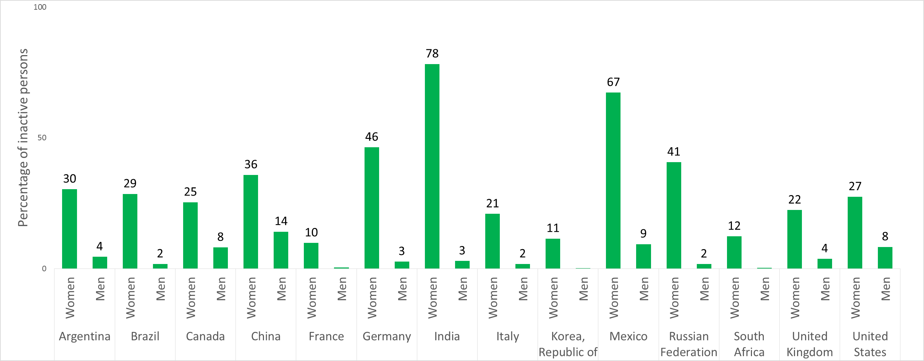
Unpaid care work is one of the main reasons for women being outside the labour force
Source: ILO. Care work and care jobs for the future of decent work. ILO, 2018.

Slide 4
When women are employed, they work shorter hours than men and they spend more time in domestic chores and care work
Time spent daily in unpaid care work, paid work and total work, by sex, latest year
Source: ILO. Care work and care jobs for the future of decent work. ILO, 2018

Slide 5
The motherhood wage penalty
 | Motherhood gap | Fatherhood gap
South Africa | 1.1 | -16.4
Canada | 1.2 | -3.4
United States | 3.7 | -8.1
United Kingdom | 4.3 | -18.8
Australia | 5.0 | -7.3
Mexico | 5.8 | -3.4
Brazil | 7.7 | -7.0
China | 10.4 | 0.1
Argentina | 10.5 | -0.3
South Korea | 12.6 | -26.0
Russia | 14.7 | 2.0
Turkey | 29.6 | 2.4
Source: ILO estimates using latest national surveys (about 2015); estimates are provisional.
Notes:
A positive motherhood gap means that non-mothers have higher hourly wages than mothers.
A negative fatherhood gap shows that fathers have higher hourly wages than non-fathers
In all G20 economies for which we have estimates, mothers are penalized and fathers obtain a premium; with respect to the latter, China and Argentina are the exceptions where fathers and non-fathers are almost equally remunerated per hour worked

Slide 6
Managing parenthood, unpaid care work and paid employment more smartly
Quality child and elder care services and infrastructure
Family-friendly, flexible working time arrangements
Maternity and paternity leave and shared parental leave
Care-friendly and gender-responsive social protection systems
Lifelong learning adapted to the workers’ changing care responsibilities over the life course
Fair remuneration to «women’s» jobs

