Slide 1
DECENT WORK IN PORTUGAL
2008-18 from crisis to recovery
ILO report key findings
16 October 2018

Slide 2
Outline of the presentation
Quick overview of economic trends and prospects
The labour market situation
Key policy questions

Slide 3
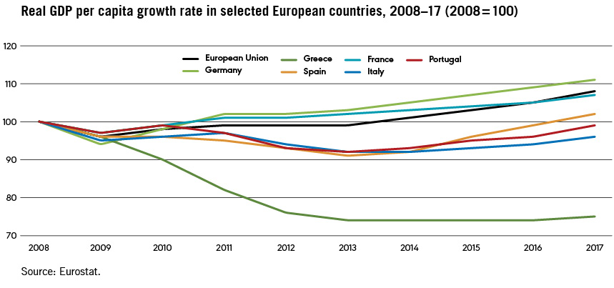
A1. Portugal’s recovery is on a firm ground

Slide 4
A2. It is driven by a variety of factors
External policy and cyclical factors
ECB monetary policy
strong growth of the economies of Portuguese trading partners
Domestic structural factors some of which predate the crisis
Fast-rising education and training levels
Good infrastructure
Public sector restructuring
Business environment and labour market changes
Exporters had already started to adjust to competition from new EU entrants and Asia
Domestic policy shifts
A countercyclical fiscal stance at the start of the crisis in 2008-2009
Austerity and Troika-driven reforms during 2011-2014
Since then, an approach that seeks to maintain a balance between a credible commitment to gradual public debt reduction combined with the need to support incomes, investment and job creation

Slide 5
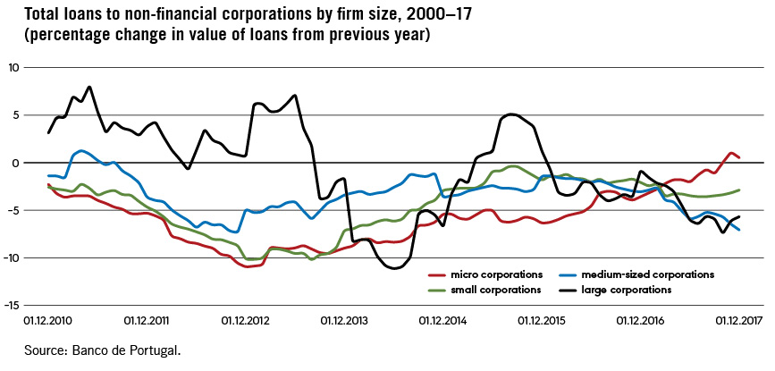
A3. Legacies from the financial and debt crisis are still lingering
External debt is high (but interest rates are low and the capital account positive)
Gross domestic capital formation still low (but domestic banks are returning to profitability)
Annual rate of change of loans granted by the domestic financial sector to non-financial corporations

Slide 6
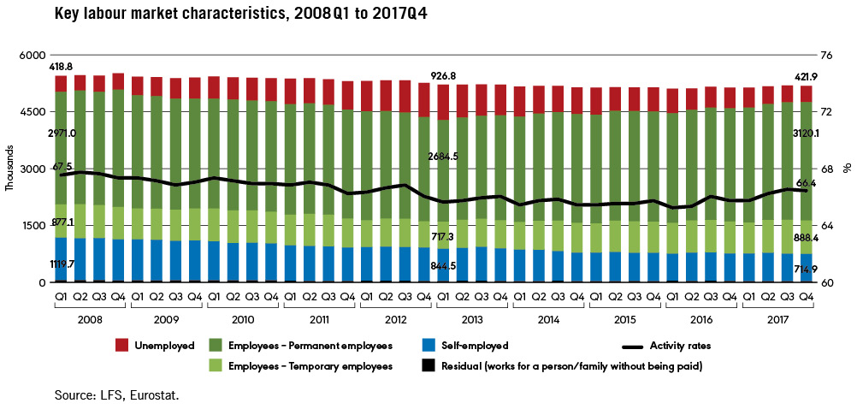
B1. Cyclical and structural labour market trends

Slide 7
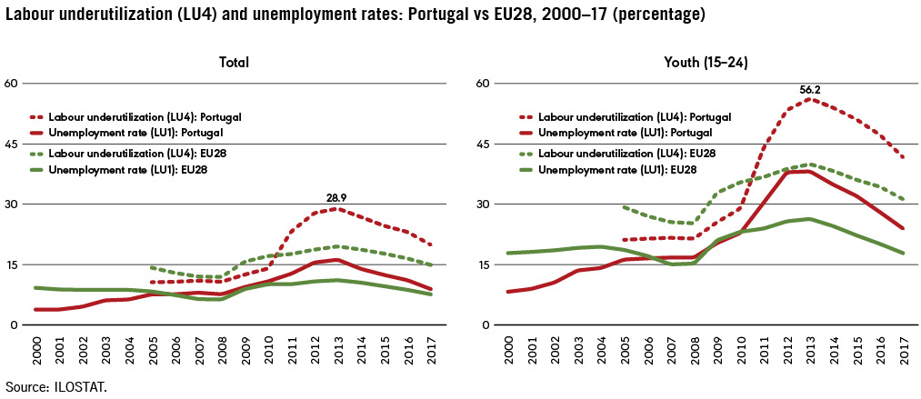
B2. Rapidly declining unemployment and labour underutilization

Slide 8
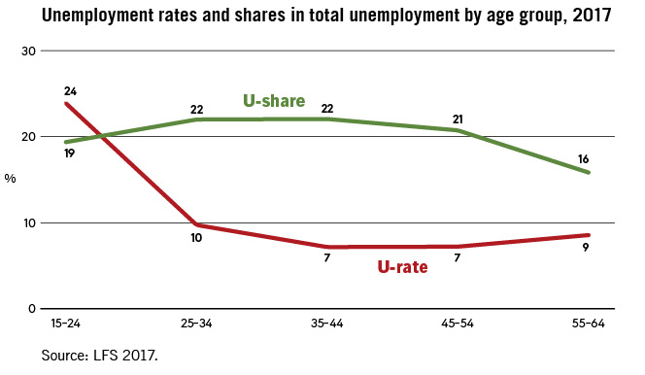
B3. School-to-work transitions remain difficult

Slide 9
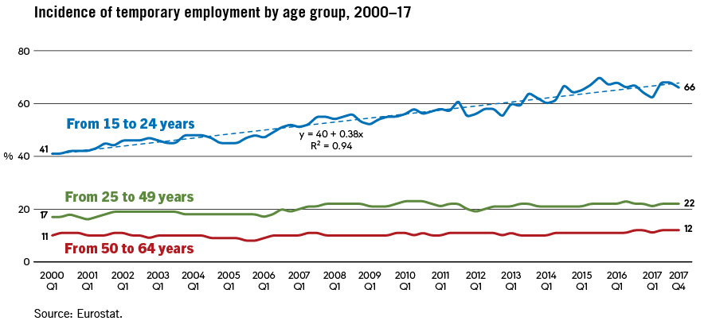
B4. The share of temporary employment remained stable, except for the youth

Slide 10
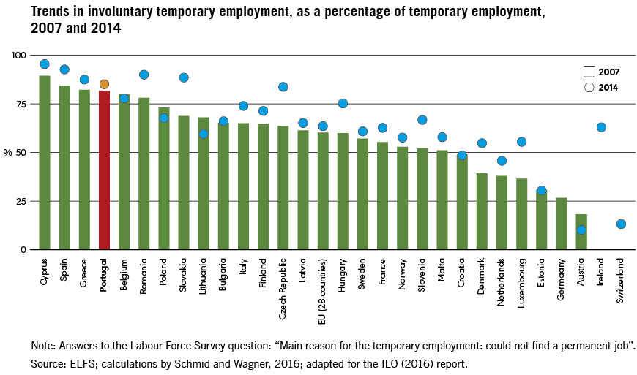
B5. Temporary employment highly involuntary

Slide 11
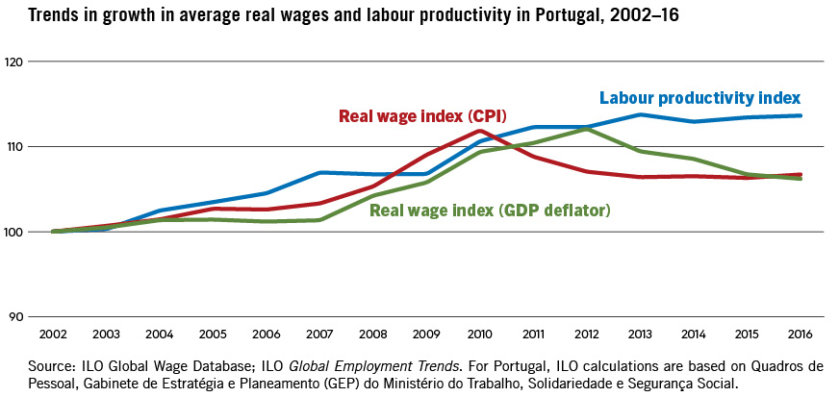
B6. Moderate wage growth, failing to catch up with productivity

Slide 12
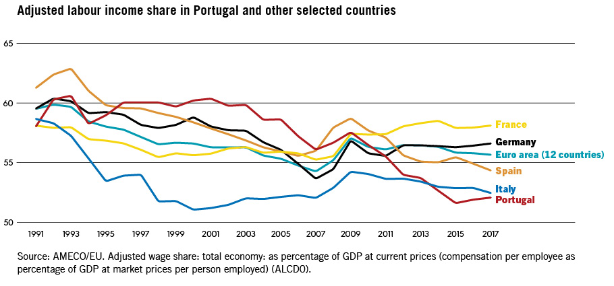
B7. A sharp decline in the labour share

Slide 13
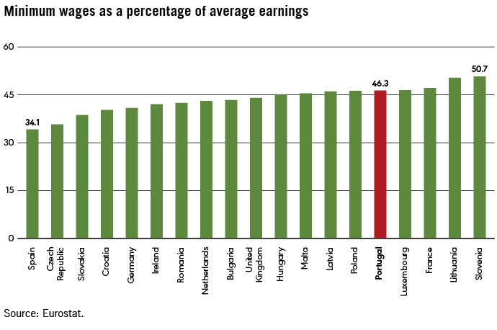
B8. Minimum wage increases
Notes:
Wages: Almost one quarter of workers are paid the minimum wage, one-third of them have secondary education/vocational training or more; four-out-of -ten are men and almost nine-out-of ten are more than 25 years old
So min wages are not paid just to the youth, those with low skills or women (“secondary workers”)

Slide 14
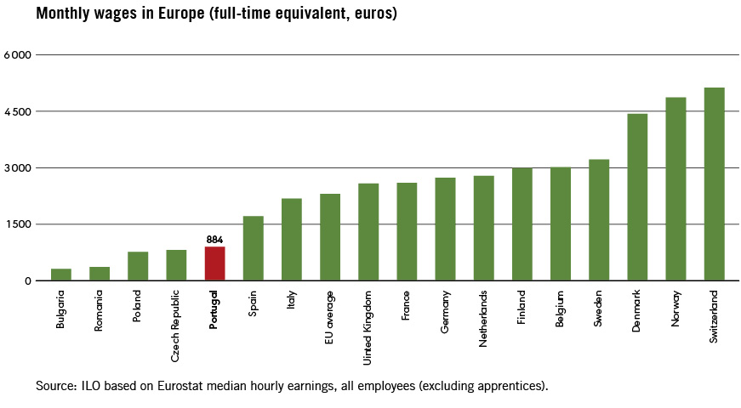
B9. Average wage relatively low

Slide 15
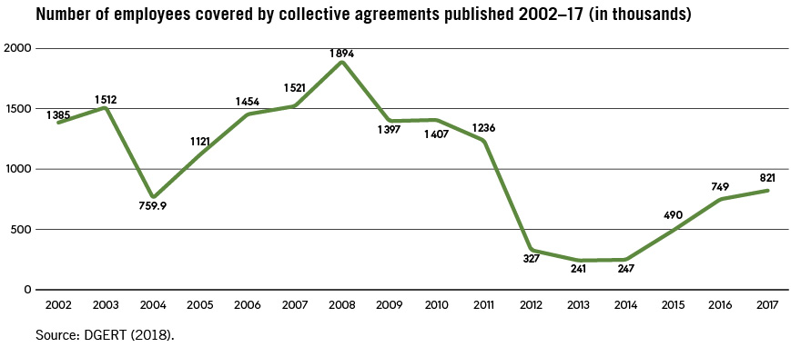
B10. Collective bargaining is regaining ground

Slide 16
C1. Strengthening economic growth, job recovery and decent work
Supporting aggregate demand
Responsible fiscal expansion - to support incomes and public and private investments
A growth strategy to raise investment, productivity and skills
Focused support to key economic sectors and niches, aimed at diversifying, innovating and getting closer to the technological frontier
A coherent decent work policy mix
Well-designed labour market policies and institutions can complement economic and sectoral policies in achieving inclusive and sustained growth and decent work
Notes:
Responsible= reasonable and controlled

Slide 17
C2. Adapting ALMPs to new unemployment realities
Strengthen PES institutional capacity
  Create dedicated Units for the activation of young NEET and long-term unemployed
  Improve monitoring and evaluation of the long-term sustainability of the placements
  Stronger customer service approach – yes to go online, but also more face-to-face.
Increase registration rates with PES among low-educated youth and NEET
  30% of young jobseekers are not registered at all
  Ad-hoc strategies to reach vulnerable youth – e.g. social media campaign, job fairs at training premises
  Expand the offer of “second-chance” education curricula
  Strengthening the linkages between upper-secondary schools and the apprenticeship system
Activating jobseekers through an integrated approach to entrepreneurship
  Further strengthen start-up incentive schemes, focussing on integrated approach, which combines financial aid, business counselling, and entrepreneurship training

Slide 18
C3. Addressing the wage-productivity linkage
The low labour share suggests some possible scope for wage adjustments through collective bargaining – to align wage growth with productivity, to support aggregate demand and incomes at the bottom end, to pressure firms to invest in technical progress
It would be important to monitor the effects of the minimum wage on employment - particularly on youth employment, due to the relatively high minimum wage compared to median and average wages.
A sustained effort to tackle the gender pay gap - Ideas include combatting gender-based stereotypes, strengthening policies on maternity and paternity as well as parental leave, and advocacy for better sharing of family responsibilities. Equal pay at the enterprise level also requires job evaluation methods free from gender bias.
Sustained attention to access to education and policies to increase the skills of the labour force – This, particularly for those at the bottom of the distribution, could also contribute to higher wages.

Slide 19
C4. Containing job insecurity linked to labour market segmentation
Limiting abuses in the use of Fixed-term Contracts (FTCs) - Valid reasons; renewals; regulations of very short contracts
Improving transitions to regular jobs - through tax (dis)-incentives, incentives for training and skill improvement of temporary workers; enhancing portability of social benefits and severance pay
Improving work quality across the contracts - equalizing working conditions, making sure FTCs are not used with the purpose of undercutting labour standards, addressing overall labour cost gaps
Other measures - greater role to collective bargaining; enhancing internal rather than external flexibility

Slide 20
C5. Improving working time arrangements and labour inspection
Avoiding a “race to the regulatory bottom - Data suggests that national law is more than elastic enough to provide for working hour flexibility in the labour market.
More attention to working time arrangements - This might help with productivity, rather than increase working hours through deregulation
Making the “right to disconnect” operational
Strengthening labour inspection
  ACT needs to continue its recruitment efforts, especially on support staff and lawyers for the legal instruction of sanctioning procedures
  Operationalise IT interconnectivity to enable automated reporting on compliance, scoreboards and other tools to help management to plan strategically.
  Analyse effectiveness of Law 63/2013 and assess the impacts of recent amendments introduced by Law 55/2017.

Slide 21
C6. Taking full advantage of collective bargaining
Maintain a system of extensions while monitoring the impacts of the newly adopted criteria - Extension has proven as a key tool in promoting collective bargaining and reducing inequality
Uphold certain principles in order to avoid capture by minority interests at the expense of all enterprises and workers - This includes the need for “sufficient representativity”; discretionary rather than automatic extension; and that those affected by the extension have opportunity to submit observations and objections.
Examine ways to make the content of collective agreements more dynamic - beyond wages and working hours
Consider better articulation and coordination between different sectoral and geographic agreements - This is particularly important in light of the dominance of small firms in the economy.

Slide 22
C7. Looking forward: Lessons for the EU?
Limits of one-size-fits-all EU monetary policy
Making fiscal rules more flexible and less procyclical
Need to strengthen financial stabilization instruments
Review conditionality – imposing labour market hyper-flexibility can actually result in increased dualization

Slide 23


