Slide 1

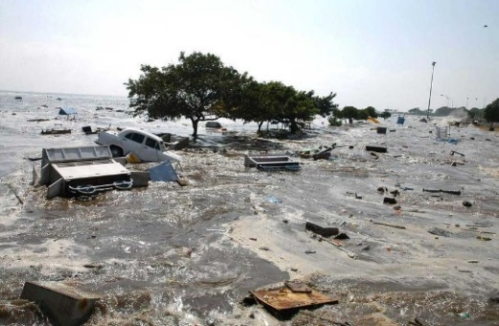
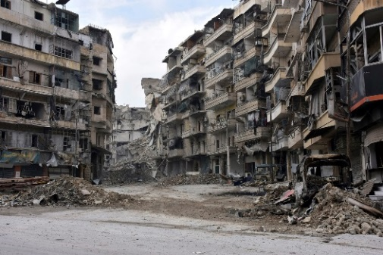
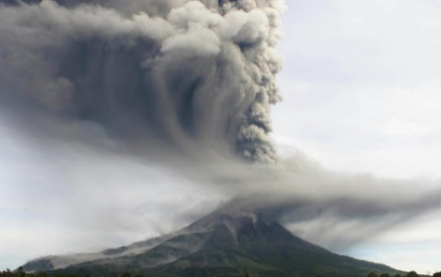
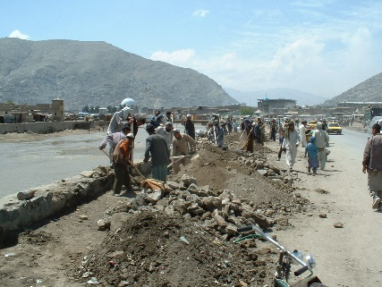
Employment and decent work
for peace and resilience Recommendation, 2017 (No. 205)

Slide 2
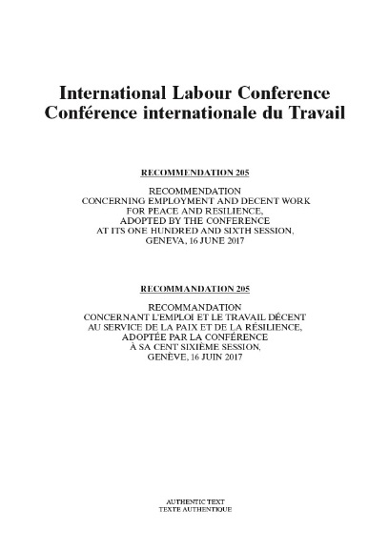

What is Recommendation No. 205?
An up-to-date international labour standard for ILO constituents to address employment and other world of work issues in crisis situations arising from conflict and disaster
The latest normative instrument of the ILO, adopted by the International Labour Conference in June 2017 following a two-year process of standard setting and tripartite consultations
Notes:
The new Recommendation No. 205 is a landmark instrument for the world of work in addressing concerns that are at the crossroads of humanitarian and development assistance. It provides guidance to ILO’s member States on the measures to be taken to generate employment and decent work for the purposes of prevention, recovery, peace and resilience with respect to crisis situations arising from conflicts and disasters.
Recommendation No. 205 was adopted in June 2017 by the International Labour Conference.

Slide 3
Main features (1/2)
R205 revises and replaces the Employment (Transition from War to Peace) Recommendation, 1944 (No. 71):
  expanded scope: conflicts + disasters
  broader focus: recovery and reconstruction + prevention, preparedness and resilience
  updated guidance that takes into account:
    other elements of the Decent Work Agenda, besides employment
    the contemporary global context and the evolving nature of crises
    the new responses developed by the ILO and the international community over the last decades
  latest internationally agreed terminology
Notes:
Recommendation No. 205 stems from the 2-year process of revision of the Employment (Transition from War to Peace) Recommendation, 1944 (No. 71) and offers updated guidance on the role of employment and decent work in response to some of the most pressing challenges of our time, namely, conflicts and disasters.
Recommendation No. 205 expands the scope of the earlier Recommendation to include also internal conflict and disasters, in addition to international conflicts.
Moreover, it broadens the earlier focus on recovery and reconstruction to include measures for prevention, preparedness and resilience.
Furthermore, it expands the original guidance concerning employment promotion measures for the transition to peace taking into account :
a- new approaches to promote full, productive and freely chosen employment and livelihoods opportunities and other elements of the Decent Work Agenda that are especially relevant in crisis contexts, such as rights, social protection and social dialogue;
b- the complexity of the contemporary global context and the multidimensional nature of crises;
c- the experience gained by the ILO and the international community in crisis response and the new strategies and approaches developed since 1944.

Slide 4
Main features (2/2)
And also:
awareness of the diversity of national circumstances and priorities
strong gender perspective
special attention to population groups that have been made particularly vulnerable by crisis: children, persons belonging to minorities, indigenous and tribal peoples, internally displaced persons, persons with disabilities, migrants and refugees…
Notes:
At the same time, the new Recommendation acknowledges the diversity of national circumstances and priorities.
A strong gender perspective is embedded in numerous provisions.
Special attention is paid, throughout the instrument, to population groups that have been made particularly vulnerable by crisis. This includes, but is not limited to, children, persons belonging to minorities, indigenous and tribal peoples, internally displaced persons, persons with disabilities, migrants and refugees.

Slide 5
Content
Preamble
I. Objectives and scope
II. Guiding principles
III. Strategic approaches
IV. Employment and income-generation opportunities
V. Rights, equality and non-discrimination
VI. Education, vocational training and guidance
VII. Social protection
Labour law, labour administration and labour market information
Social dialogue and role of employers’ and workers’ organizations
Migrants affected by crisis situations
Refugees and returnees
XII. Prevention, mitigation and preparedness
XIII. International cooperation
XIV. Final provision
Notes:
The text of the Recommendation can be divided in 3 sections:
1. The first section includes a preamble (which recalls ILO’s foundational and constitutional principles and considers the specific impact of crises on the world of work), sets out the objectives and scope, and illustrates the principles and strategies that should inspire Members in their responses to crisis.
→ The recommendation applies to all workers and jobseekers, and to all employers, in all sectors of the economy directly or indirectly affected by crisis situations. It concerns also workers and persons in volunteer work engaged in crisis response, including in the immediate response.
→ The 14 guiding principles recognize the need to promote full, productive, freely chosen employment and decent work, and to respect, promote and realize the fundamental principles and rights at work as well as other human rights and relevant international labour standards. They emphasize the importance of good governance, social dialogue, national reconciliation, and a just transition to an environmentally sustainable economy. They highlight the need to respect national laws and use local knowledge, capacity and resources. They affirm the need to combat discrimination and pay special attention to population groups and individuals who have been made particularly vulnerable by the crisis. They call for international solidarity, burden- and responsibility-sharing and cooperation, and for close coordination and synergies between humanitarian and development assistance.
→ Members should adopt a phased multi-track approach in implementing crisis response strategies, including emergency immediate measures as well long term measures.
2. The second section contains practical guidance for designing and implementing crisis prevention and response measures in a range of policy areas, while acknowledging the diversity of national circumstances and priorities. In particular, it elaborates on measures for employment, and income generation and for sustainable enterprises in Part IV, rights, equality and non-discrimination in Part V, education, vocational training and guidance in Part VI, social protection in Part VII, labour law, labour administration and labour market information in Part VIII, and social dialogue and role of employers’ and workers’ organizations in Part IX. It also provides guidance on migrants affected by crises in Part X and on refugees and returnees in Part XI.
More in detail:
Part IV on employment and income generation provides guidance on a range of measures for the promotion of full, productive, freely chosen employment, which are vital to promoting peace, preventing crises, enabling recovery and building resilience.
Part V on rights, equality and non-discrimination, places a strong emphasis on measures responding to discrimination and to combating child labour and forced or compulsory labour arising from or exacerbated by conflicts or disasters.
Part VI emphasizes the key role played by education and vocational training and guidance in preventing and responding to crisis.
Part VII calls on member States to seek to ensure as quickly as possible basic income security for those whose jobs or livelihoods have been disrupted by crisis, and highlights the importance of establishing or maintaining social protection floors.
Part VIII on labour law, labour administration and labour market information focuses on re-establishing essential labour market institutions.
Part IX calls on member States to take into account the importance of social dialogue and the vital role of employers’ and workers’ organizations in crisis response.
Part X and Part XI include, respectively, guidance on Migrants affected by crises and on Refugees and Returnees, and aim to promote the labour market access of these population groups in host countries while fully taking into account a wide range of national circumstances.
3. The third section includes guidance regarding actions to prevent, mitigate and prepare for crises in ways that support economic and social development and decent work (Part XII), and emphasizes the need for strengthened international cooperation and for closer coordination and synergies between humanitarian and development initiatives (Part XIII). It explicitly calls on the ILO to take a lead on crisis responses centred on employment and decent work.

Slide 6
Implementation (1/2)
  Objectives of the implementation strategy:
  Support ILO constituents in developing and implementing local, national and regional strategies and measures to give practical effect to the guidance of the Recommendation
  Advocate ILO’s core mandate and values
  Lead on employment and decent work initiatives in contexts of crisis prevention and response through invigorated cooperation and joint initiatives among international and regional organizations
Notes:
According to most recent estimates, about 2 billion people today live in countries affected by conflict, violence and fragility. These countries are also more vulnerable to internal or external shocks such as economic crises, demographic changes, climate change and sudden-onset disasters.
Conflict, disasters and fragility aggravate poverty, unemployment and informality. In turn, lack of employment opportunities, unemployment and underemployment, and inequalities can equally be catalysts for conflict and instability. Indeed, fragile countries generally face higher levels of poverty and under- and unemployment, and larger decent work deficits. Building peace and resilience is thus a prerequisite for economic, social and environmental development.
The proposed strategy for Office follow-up on Recommendation No. 205 aims primarily to support constituents in the development and implementation of local, national and regional strategies and measures that will give practical effect to the guidance.
It also aims to use this exceptional normative platform to advocate ILO’s core mandate and values and to lead on employment and decent work initiatives in contexts of crisis prevention and response through invigorated cooperation and joint initiatives among international and regional organizations.

Slide 7
Implementation (2/2)
  Components of the implementation strategy:
  awareness raising and advocacy
  knowledge development and dissemination
  policy advice, technical cooperation and capacity development
  international cooperation and partnerships
Notes:
The strategy consists of four complementary and mutually reinforcing components. It builds on extensive Office work in crisis response over the last decades and proposes to scale up, reorient as needed ongoing initiatives, promote synergies with planned activities and initiate new work in line with the updated guidance of Recommendation No. 205. Specific activities and outputs will be sequenced over the period of three biennia, starting with the 2018-2019 biennium.
Components:
awareness raising and advocacy
In view of the complexity of crises and responses, the comprehensive range of issues covered by the R205 and the novelty for the ILO’s constituents of some of the concepts and terminology, the Office will dedicate a great deal of effort to promotional briefings and information sessions.
A systematic awareness-raising and advocacy campaign at global and country level will be developed to promote understanding of how the guidance contained in the Recommendation can be put into effect in different contexts. The campaign will aim to reach ILO’s tripartite constituents as well as the wider community engaged in peacebuilding and in crisis prevention, response and recovery.
policy advice, technical cooperation and capacity development
Within the available resources, the Office will support governments, employers’ and workers’ organizations in crisis-affected countries in the design, implementation and monitoring of national strategies and policies drawing on the guidance of Recommendation No. 205. This will be done in at least 8 countries per biennium in the next 6 years.
Programmatic synergies will be secured with relevant ILO Flagships, in particular the Jobs for Peace and Resilience programme, and other relevant initiatives in countries prioritized by regions.
Capacity-development actions will include:
a) The replication and intensification of relevant training courses delivered through the ITC-ILO, such as the new dedicated annual training course on “Employment in fragile States”, based on the guidance of Recommendation No. 205 and on the guide Employment and Decent Work in situations of fragility, conflict and disaster, the session on “Fragile-to-Fragile Cooperation” within the South-South and Triangular Cooperation Academy, the annual training on “Private sector development in fragile and conflict-affected situations” and the academy on “Promoting decent jobs in fragile and conflict affected settings;
b) The development of dedicated modules on Recommendation No. 205 for a systematic integration into all relevant regular annual courses and academies at the ITC-ILO;
c) Distance-learning courses, including a dedicated MOOC (Massive, Online, Open Course);
d) The design and delivery of dedicated activities for employers and workers organizations in respective priority areas, in consultation with ACT/EMP and ACTRAV (also building on the existing courses “Prevention and Resolution of Violent and Armed Conflicts for Trade Unions organisations” and “Multi-hazard Business Continuity Management: Guide for small and medium enterprises”);
e) The organization of tailored activities to meet the specific needs of different regions and constituents with respect to Recommendation No. 205. It is expected that at least one tripartite training activity per biennium will be offered in the regions most affected by conflicts and disasters.
knowledge development and dissemination
The development and dissemination of practical knowledge on what works in different contexts will be essential to support country-level action towards peace consolidation and resilience building.
New research and tools will be developed along four streams of work: a) focus on key policy areas or specific target groups covered by R205; b) analysis of intervention models, policy combinations, technical guidance and implementation modalities that leverage employment and decent work tools to positively impact on peace- and resilience-building; c) data collection and monitoring in countries affected by conflicts and disasters; and d) impact assessment.
These knowledge products will be published in various formats, as relevant: technical and policy briefs, country reports, guides and toolkits, comparative analyses of good practices, research studies and impact-assessment tools. These will be widely disseminated in various languages, including through the capacity-development initiatives.
international cooperation and partnerships
Cooperation will be strengthened and new activities developed with current partners (UNHCR, UNISDR, g7+, IFRC…)
Ongoing joint initiatives will be expanded (ILO/UNDP/PBSO/WB, PDNA, Global Initiative on Decent Jobs for Youth…)
Opportunities for collaborations with new partners will be explored
contribution to the realization of SDGs 8 on full, productive employment and decent work, 1 on ending poverty, 13 on climate change, and 16 with respect to the promotion of just, peaceful and inclusive societies.
focus on prevention as a crucial aspect for preserving stability and sustaining peace and resilience, in line with the recent paradigm shift of the UN and its member States. In this context, R205 provides a unique and timely platform for advocating human rights, including fundamental rights, employment and decent work as critical ingredients focussing to tackle root causes of crises.
promotion of the South-South and Triangular cooperation and Fragile-to-Fragile cooperation

Slide 8
Impact
  The only international normative framework providing guidance for building peace and resilience through employment and decent work
  Landmark instrument for dealing with situations that are at the crossroads of humanitarian, peacebuilding, disaster response and development initiatives
  Reaffirmation of ILO’s foundational and constitutional principles and of the central role of employment and social justice in responding to crises and promoting lasting peace
  Clear mandate and greater coherence and coordination among multiple actors at international, regional and local levels
Notes:
The Recommendation is an important instrument for both ILO constituents and actors and institutions of the international community engaged in crisis response in the humanitarian and development fields.
Besides being relevant to ILO’s core mandate in contexts of crisis, the Recommendation represents an exceptional platform to invigorate cooperation and joint initiatives among international and regional organizations operating in the fields of humanitarian and development assistance with a focus on employment and decent work in crisis response. This has been acknowledged also by several UN agencies that expressed their support for the Recommendation, such as UNHCR, UNISDR, OCHA, OHCHR, UNDP, UNESCO, UNOG, the WB.

Slide 9
Thank you!

