Slide 1




Slide 2
The story of 100 years towards safer & healthier work
The story of 100 years towards safer & healthier work
Mega Trends in the world of work
Responding to the OSH challenges and opportunities
Notes:
Chapter 1 of the report focuses on the story of 100 years towards safety and healthier work
Chapter 2 gives an idea about the mega trends in the world of work
Chapter 3 reflects on ways to respond to the OSH challenges and opportunities

Slide 3
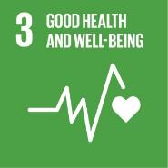
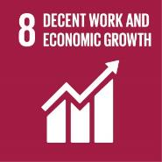
Introduction
2030 Agenda for Sustainable Development
Sustainable Development Goals 3 and 8
Notes:
Safety and health at work can be key to sustainable development and investment in OSH can help contribute to the achievement of the 2030 Agenda for Sustainable Development, and especially to the achievement of Sustainable Development Goal (SDG) 3, to ensure healthy lives and promote well-being for all at all ages and SDG 8, to promote inclusive and sustainable economic growth, employment and decent work for all – in particular Target 8.8, to protect labour rights and promote safe and secure working environments for all workers, including migrant workers, in particular women migrants, and those in precarious employment.

Slide 4
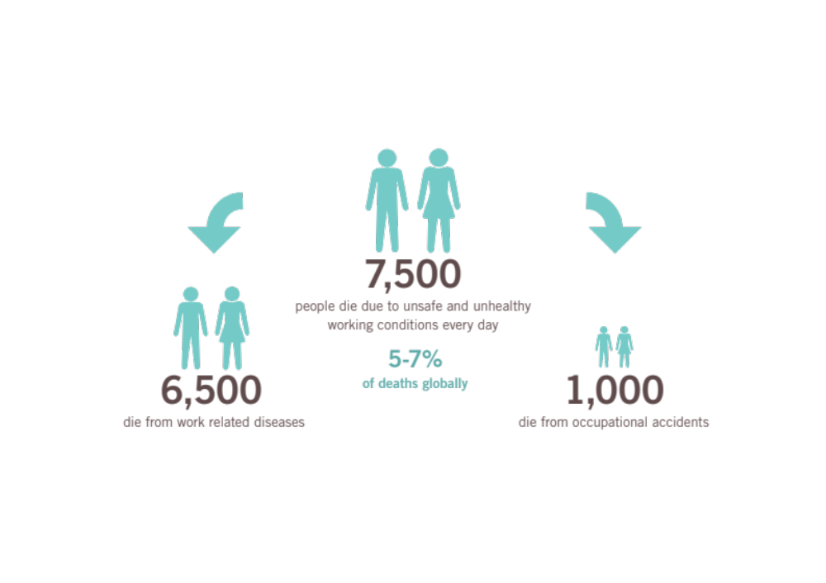
Notes:
Global trends in safety and health: The picture today
Occupational accidents and work-related diseases have a major impact on individuals and their families, not only in economic terms, but also in terms of their physical and emotional wellbeing in the short- and long-term. Furthermore, they can have major effects on enterprises, affecting productivity, leading to potential disruptions of production processes, hampering competitiveness and reputation of enterprises along supply chains, and impacting on the economy and society more widely.

Slide 5
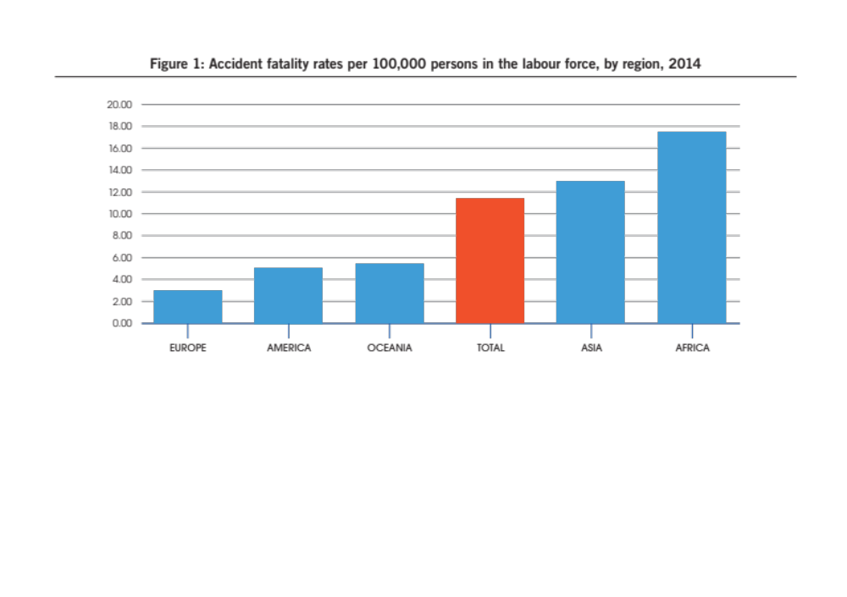
Notes:
Regional differences
According to estimates, the burden of occupational mortality and morbidity is not equally distributed across the world. About two-thirds (65 per cent) of global work-related mortality is estimated to occur in Asia, followed by Africa (11.8 per cent), Europe (11.7 per cent), America (10.9 per cent) and Oceania (0.6 per cent). This reflects the distribution of both the world’s working population and hazardous work, as well as differing levels of national economic development. The rates of fatal occupational accidents per 100,000 workers also show stark regional differences (Figure 1), with those in Africa and Asia between 4 and 5 times higher than those in Europe (Hämäläinen et al, 2017).

Slide 6
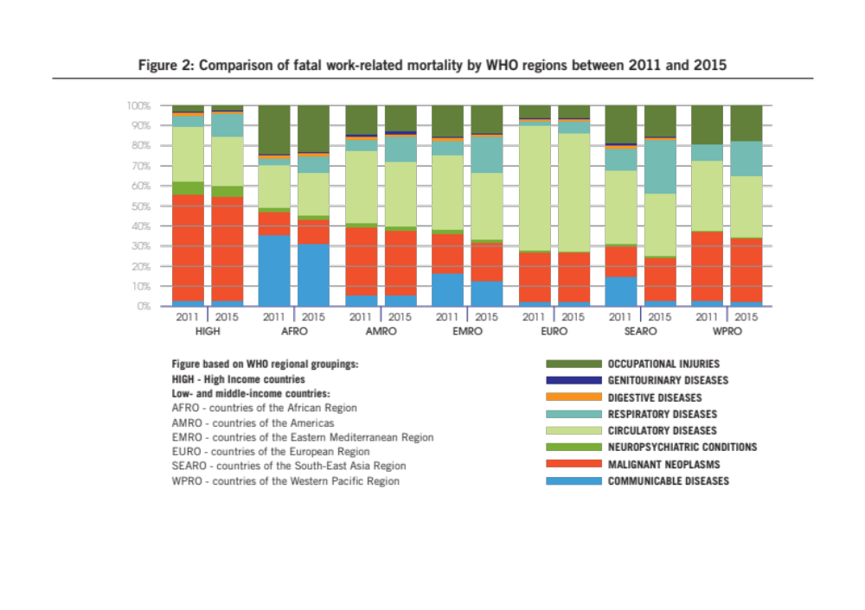
Notes:
There are also differences in relative contributions of various causes of work-related mortality by region (Figure 2)
These regional differences in work-related deaths and diseases reflect the multiple and multi-faceted national, social, political, demographic and occupational differences between countries and regions globally. They also reflect different capacities to manage health and safety issues in workplaces and different capacities of national governments to effectively put in place and enforce health and safety rules. While there has been a long-term fall in occupational accidents, in global terms this has been offset by the increase in occupational injury fatalities as a result of the growing share of production to rapidly industrially progressing countries, particularly in Asia (Takala et al, 2014).
Occupational accidents and work-related diseases have a substantial global impact. While underreporting of OSH data often undermines its reliability, the data here suggests that this impact varies according to where workers live and work, reflecting inequalities in their exposure to risks.

Slide 7
Chapter 1
100 years of safety and health at work
^{Chapter 1}
100 years of safety and health at work
Notes:
This chapter of the report presents an outline of the developments concerning safety and health at work and the role played by the ILO and its constituents in relation to these over the last 100 years. It provides a chronological overview of the expansion of the field of safety and health and the improvement in the understanding of causes of work-related death, injury and disease and their prevention since the establishment of the ILO in 1919.

Slide 8
1. Why the world needed to respond to accidents and diseases at work 100 years ago
A historical perspective
18th, 19th and 20th Centuries: Industrialization
Early 20th Century
  1919: creation of the League of Nations & International Labour Organization
Notes:
The challenge of OSH has existed for as long as people have worked or been employed in workplaces. However, growing awareness of the widespread occurrence of injuries, diseases and deaths at work dates from the industrial revolution that took place in Europe, the United States and some European colonies in the eighteenth and nineteenth century.
League of Nations and International Labour Organization were created in 1919
By the early twentieth century, prominent social reformers, lawyers, representatives of labour and enlightened industrialists, along with the networks they created, such as the International Association for Labour Legislation, had already achieved some success with international efforts to address labour issues in which safety and health were prominent — including the 1906 Berne Conventions preventing the use of White Phosphorous and night work for women (Moses, 2018).
While the First World War disrupted these early efforts to achieve international OSH standards, at the same time it drew attention to OSH issues. Industrial support for the war efforts of different countries led to a common increase in production of war related materials and their associated hazards. Increased exposures to toxic and explosive materials led to better understandings of the health effects and the need for improved safety measures. Finally, the end of the War provided stimulus to further international efforts to secure lasting arrangements for world peace, social justice and prosperity, through the creation of the League of Nations and the International Labour Organization as part of the Treaty of Versailles.

Slide 9
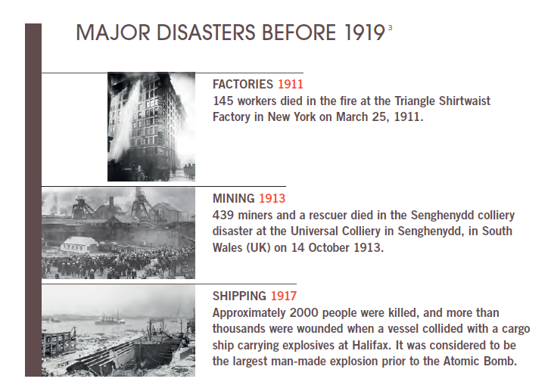
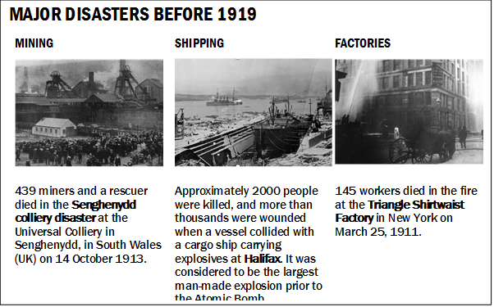
Notes:
The table gives examples of the Major Disasters Before the establishment of ILO in 3 different sectors: Factories, Mining and Shipping.

Slide 10
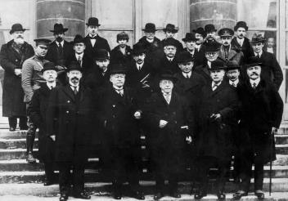
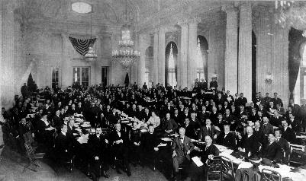
2. The ILO: Founded on the concept of safe and healthy work
The very first session of the International Labour Conference in 1919:
Instruments of OSH and the Tripartite Structure
Notes:
The International Labour Organization was founded in the aftermath of the First World War as an agency of the League of Nations, both creations of the Treaty of Versailles in 1919, to give expression to growing international concern for social, labour and economic reform.
At the very first session of the International Labour Conference (ILC), held in Washington in 1919, the ILO adopted instruments setting OSH standards, such as the Anthrax Prevention Recommendation, 1919 (No. 3); Lead Poisoning (Women and Children) Recommendation, 1919 (No. 4); and White Phosphorus Recommendation, 1919 (No. 6).
In 1920, the ILO established the Industrial Hygiene Section (IHS). The IHS was founded to act as a repository of information on occupational medicine and hygiene, along with its position as a focus for exchange among scientists, hygienists and occupational physicians. In 1921, the Industrial Safety Section (ISS) was also established.
This led to the decision to create the ILO Encyclopedia which contributed greatly to the establishment of the multidisciplinary field of OSH. The first edition was published in 1930, and it has been regularly updated with new editions and contributions from thousands of experts over the years, up to the present on-line version which was first launched in 2012. It is the most widely distributed ILO publication and a fundamental reference for OSH programming -- for example, the “First Supplement to the Encyclopedia of Hygiene, Pathology and Social Welfare” included a reference to asbestos and cancer as early as 1938.
In the case of asbestos, for example, while the first reference in the ILO Encyclopedia was in 1938, it was almost 50 years until the adoption of the ILO Asbestos Convention, 1986 (No. 162).

Slide 11
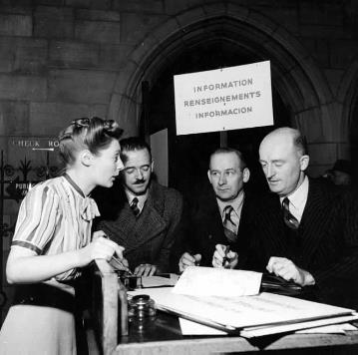
3. Post-Second World War: An increasingly global perspective on OSH
Declaration of Philadelphia, 1944 regarding the health of workers:
“ The Conference recognizes the solemn obligation of the International Labour Organization to further among the nations of the world programmes which will achieve […] adequate protection for the life and health of workers in all occupations.”
Notes:
The world in the aftermath of the Second World War was very different to the way it had been before. New political and economic allegiances and trading patterns were developing. New global institutions, such as the United Nations (UN) and the World Health Organization (WHO) were established post-War. While people in all countries continued to experience risks to their safety and health arising from their work, the new international order had significant impact on the ways in which organizations like the ILO worked to improve working conditions and OSH globally.
Declaration of Philadelphia, 26th Session of the ILC in 1944. The Declaration concerning the aims and purposes of the ILO (Declaration of Philadelphia), adopted at the 26th session of the ILC in 1944, is often seen as heralding this change.
The Declaration, which was made an integral part of the ILO’s revised Constitution in 1946, reasserted the ILO’s principles that labour was not a commodity; freedom of expression and of association were essential to sustained progress; poverty anywhere constituted a danger to prosperity everywhere; argued that the war against want needed to be carried out with unrelenting vigour (in which worker and employer representatives joined government in discussion and in making democratic decisions) and placed a strong emphasis on the importance of ensuring the place of human rights in social and economic policies. Regarding the health of workers, the Declaration states that:
“The Conference recognizes the solemn obligation of the International Labour Organization to further among the nations of the world programmes which will achieve […] adequate protection for the life and health of workers in all occupations”

Slide 12
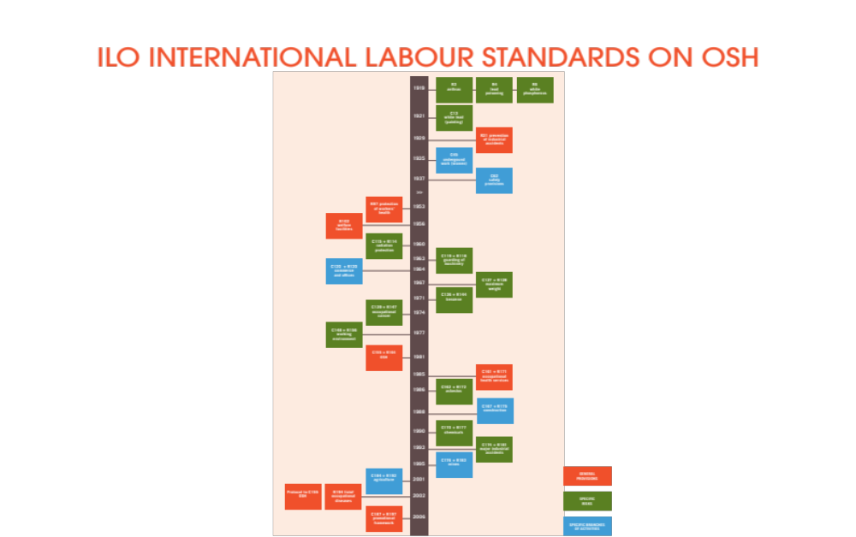
Notes:
ILO International Labour Standards on OSH from 1919 to 2006 (Timetable)

Slide 13
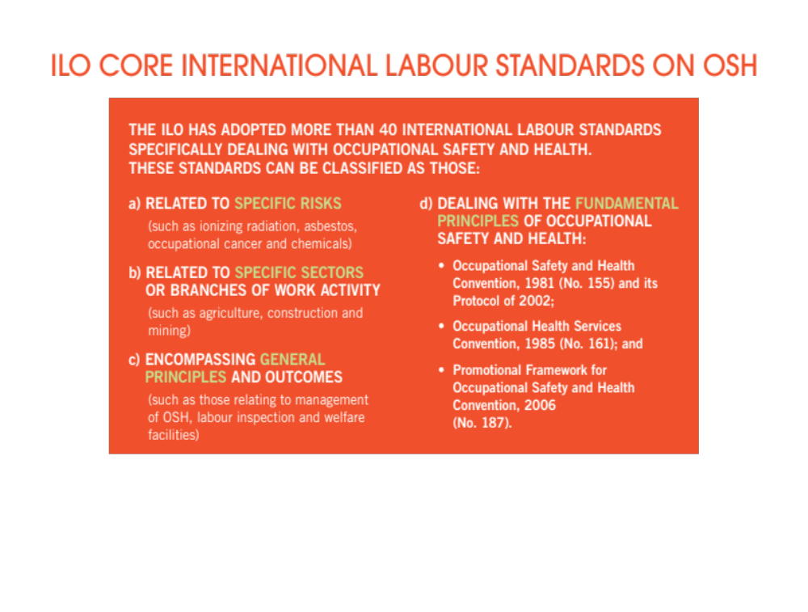
Notes:
ILO International Labour Standards that are created after the Second World War

Slide 14

Notes:
Another prominent feature of the ILO’s post-war work has been the development of ILO Codes of practice and guidelines on OSH. ILO Codes, which are generally tripartite negotiated, are neither legally binding, nor replace national laws and regulations, but provide guidance as to what is required to be done to meet acceptable standards of practice, including those required by regulation. Since they were introduced in the 1950s, they have provided OSH guidance in various economic sectors (e.g. construction, opencast mines, coal mines, iron and steel industries, non-ferrous metals industries, agriculture, shipbuilding and ship repairing, forestry), on protecting workers against various hazards (e.g. radiation, lasers, visual display units, chemicals, asbestos, airborne substances), and on recording and notification of occupational accidents and work-related diseases. ILO guidelines are also the outcome documents of tripartite meetings of experts. The two key guidelines on OSH are the guidelines on OSH management systems (ILO-OSH 2001) and ethical guidelines for workers’ health surveillance.
umerous Codes of Practices and 2 Guidelines on OSH since its establishment.

Slide 15
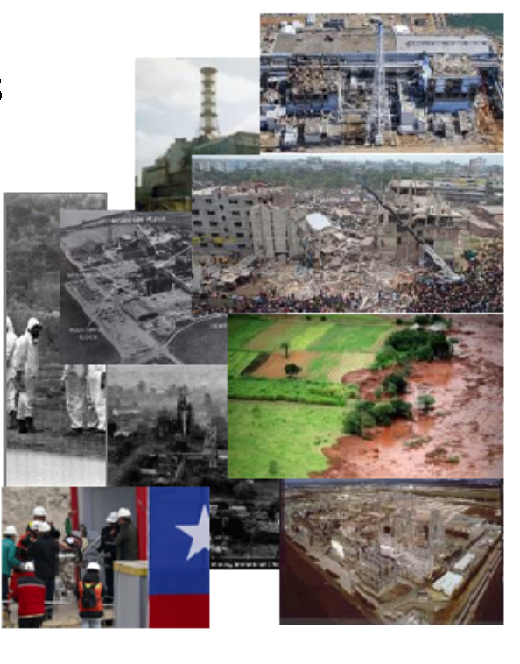
3. Post-Second World War: An increasingly global perspective on OSH
Major Industrial Accidents after 1919
Flixborough Disaster 1974
Seveso 1976
Bhopal 1984
The Philips Disaster 1985
Chernobyl 1986
Chile Mining Rescue 2010
Fukushima 2011
Rana Plaza 2013
The Vale Dam Disaster 2019

Slide 16
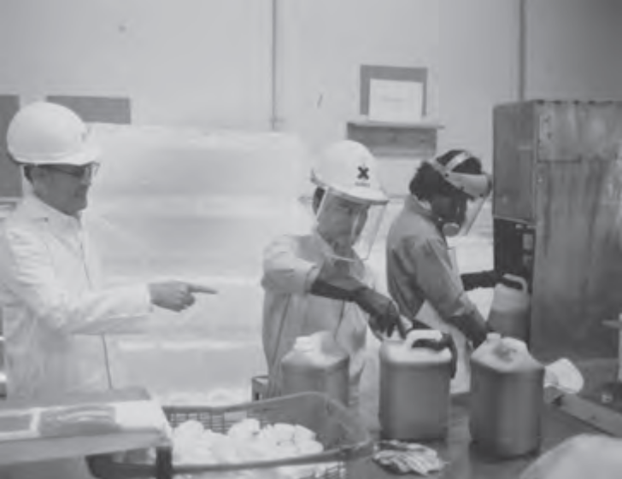
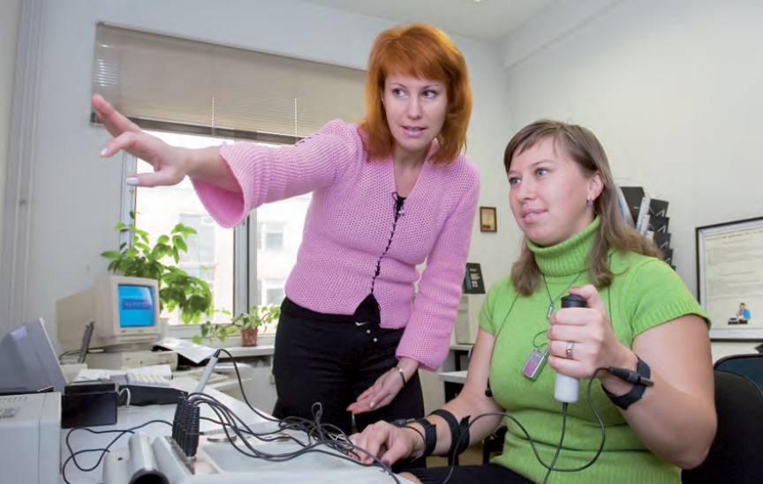
4. Towards a culture of prevention
After Chernobyl: New emerging concept of Safety Culture
Notes:
The concept of a “safety culture” emerged in the aftermath of the Chernobyl nuclear disaster in 1986. Several recent inquiries and reports into major incidents have considered weaknesses in safety culture as an underlying issue when trying to establish the causes of the incidents. The global political economy underwent significant change during the last quarter of the twentieth century, shifting towards market liberalism (Hughes and Haworth, 2011). At the same time, in the world of OSH policy there was a growing recognition that rapidly changing technologies, shifting patterns of work and industry, and change in the demography of the labour market required a new response. It was increasingly accepted that alternatives to the traditional single OSH issue or single economic sector approach were required to provide more holistic national policies to address increasingly divergent challenges of OSH. Inquiries at national levels concluded that such prescriptive regulatory approaches were both too narrowly focused and ill-suited to the needs of employers and workers.
The influence of the thinking behind these reforms was both reflected and advanced by the Occupational Safety and Health Convention, 1981 (No. 155) and its accompanying Recommendation (No. 164), adopted at the 67th session of the ILC. The Convention set out the basic principles for a national and enterprise level policy and strategy for the implementation of OSH preventive and protective measures.
This holistic view embracing safety and health at work was reinforced with the adoption of the Occupational Health Services Convention, 1985 (No. 161) and its accompanying Recommendation (No. 171) which were designated to ensure the implementation of OSH policy and relevant preventive and control measures.
In 2001, the ILO published Guidelines on safety and health management systems (ILO-OSH 2001). These were the result of a tripartite discourse and the Guidelines pay regard to leadership, its accountability and the representation of workers’ interests in OSH. These developments helped to embed the systems-based approach to OSH management in global OSH policies at both national and workforce levels.
Globalization and market liberalism in the late twentieth century were reflected in the changing structure and organization of work and employment, including business re-engineering, downsizing, outsourcing, the growth of micro, small and medium-sized enterprises and the increased importance of supply chain relations, creating new challenges for the effective protection of labour rights including OSH.

Slide 17
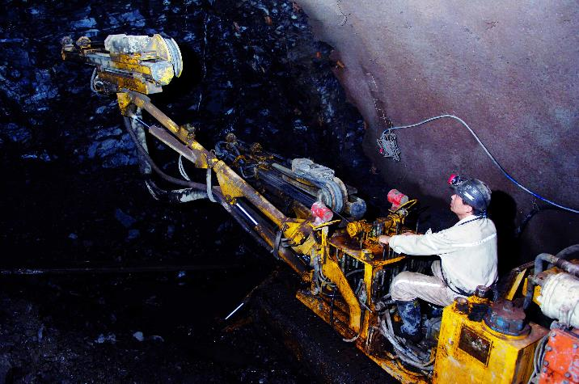
5. ILO and safety and health at work in the new millennium
Notes:
The response of the ILO to the need for less prescriptive approaches towards regulation and control of OSH were evident in Convention No. 155 and Recommendation No. 164, as well as the Protocol to the Convention, adopted in 2002, which addressed requirements to improve OSH governance at national levels.
As identified in the resolution of the 60th session of the ILC, in 1975, circumstances called for national and workplace level policies on OSH. This call found expression in the adoption of Convention No. 155 and the Promotional Framework for Occupational Safety and Health Convention, 2006 (No. 187) and its accompanying Recommendation (No. 197).
Prior to the adoption of these conventions, a renewed global approach to OSH was already in evidence at the ILO. The ILO’s Global Strategy on Occupational Safety and Health was adopted during the 91st Session of the ILC in 2003 and confirms international labour standards as a central pillar for the promotion of OSH, calling for integrated action to better connect standards with other means of action to maximize impact.

Slide 18
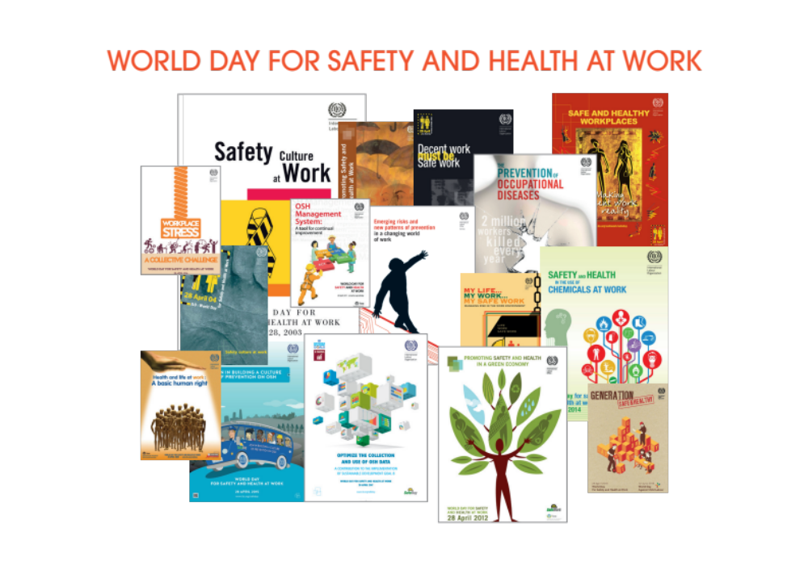
Notes:
Held each year on the 28th of April, the World Day for Safety and Health at Work focuses international attention on the need to prevent deaths, injuries and diseases caused by work.
The World Day brings tripartite strength to the International Commemoration Day for Dead and Injured Workers organized worldwide by the trade union movement since 1996 and coordinated by the International Confederation of Free Trade Unions (ICFTU). The ILO World Day focuses international attention on the magnitude of the global problem of death, disease and injuries arising out of work and how promoting and creating a safety and health culture can help to prevent this tragedy. Each year a different topic has been highlighted.
The World Day promotes the creation of a global preventative safety and health culture involving all stakeholders. In many parts of the world, national authorities, trade unions, employers’ organizations and safety and health practitioners organize activities to celebrate this date. Each year the ILO chooses a topic to draw attention to and produces a thematic report, as well as related materials for use by participating countries for their campaigns, which may be for the day, week, month, or the entire year.

Slide 19


Slide 20

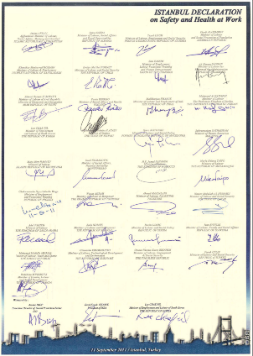
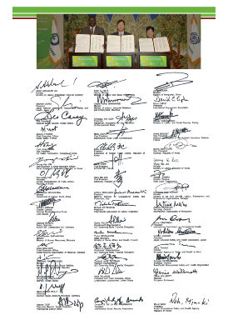
WORLD CONGRESS ON SAFETY AND HEALTH AT WORK
Notes:
The ILO is involved with host national authorities and the International Social Security Association in the organization of the World Congress on Safety and Health at Work. This event brings together researchers, regulators, OSH practitioners and other stakeholders in OSH. It also provides the opportunity for the ILO to hold Ministerial Summits to get agreement and buy-in from a wide range of stakeholders on the adoption of new Declarations concerning OSH, such as the Seoul Declaration of 2008 and the Istanbul Declaration of 2011. The Seoul Declaration, signed by 46 global OSH leaders, calls for a preventative safety and health culture, which gives the right to a safe and healthy environment and which is respected at all national levels.
While much progress has been made over the last 100 years, the challenge of creating safe and healthy work for all remains today. While many effective OSH instruments have been developed, too often they have not been ratified or effectively implemented in practice, in order to deal with persistent safety and health risks. Furthermore, new and emerging safety and health risks in an ever-changing world of work will create new challenges, as well as opportunities, for governments, employers, workers and other key stakeholders in ensuring safe and healthy working environments.

Slide 21
^{Chapter 2}
A safe and healthy future of work:
^{Challenges and opportunities}
Notes:
Patterns of deaths, injuries and diseases related to work are constantly changing across the world. These changes may be incremental or revolutionary, but have implications for the safety, health and wellbeing of workers, both positive and negative. This section provides a brief overview of some of the major transformations that are changing the world of work, and in turn, safety and health at work.
This chapter focuses on four main transformations – technology, demographics, sustainable development including climate change and changes in work organization. The report discusses the implications of these changes on the future of safety and health at work and the challenges and opportunities that may arise.

Slide 22

2.1 Technology
Notes:
Developments in technology affect all aspects of work, from who or what performs the work, how and where work is performed and the work that is performed, the ways in which work is organized and the terms of its performance, and the safety and health of workers. These changes and developments are accelerating; they already have a great impact on the working conditions and safety and health of workers and are expected to continue to do so in the future.
This section briefly outlines three interrelated key areas of development for OSH: digitalization and ICT, automation and robotics, and the use of nanotechnology.

Slide 23

Digitalization and ICT
Replicating human thinking: AI
Virtualization of work
Telework, working remotely
Human-machine interfaces
Smart technology and wearable smart devices
Increasing OSH skills, training and inspection
Notes:
The development, use and communication of digitized information are key technological developments which are driving the ‘fourth industrial revolution’
People are increasingly connected to digital information anywhere and at any time and this has implications for safety and health at work .
The trends and drivers of change indicate that by 2025 ICT-ETs such as 3D and 4D printing and bio-printing, autonomous vehicles (including drones), robotics (including collaborative robotics), AI, VR and AR, will increasingly be used for work purposes, and, moreover, that innovation in these technologies will continue. Developments in robotics, AI, autonomous systems and the IoT, among other technologies, will have a fundamental effect on the nature of work. Robots will increasingly become uncaged, mobile, dexterous, collaborative and increasingly intelligent, moving beyond their traditional strongholds to bring automation to previously inaccessible tasks. Even jobs not replaced by robots will change considerably as human workers will work in close proximity with, use and interact with a wide range of digital technologies. Highly developed sensors already make it possible for people and robots to work together in ever closer proximity, as machines are becoming able to register their users’ behaviours with ever greater precision, thanks to technologies allowing better speech and image recognition, emotion detection and the registration of eye movements and gestures, and this trend will continue. Robots will also increasingly be equipped with self-optimising algorithms, enabling them to learn from their human colleagues.
The use of robots can be expected in many different sectors and settings, such as in care, hospitality, agriculture, manufacturing, industry, transport, defence, customer-facing jobs such as services and administration, inspection bodies, etc.
Most of the discussions around robotics are about job quantity, but they should also be about job quality, and OSH is an important aspect of that.”
[“Foresight on new and emerging occupational safety and health risks associated digitalisation by 2025 — Final report” European Agency for Safety and Health at Work, ISSN: 1831-9343, 2018 ]

Slide 24
Digitalization and ICT
Opportunities
Challenges
Possible reduction in some psychosocial risks
Removing people from hazardous environments
Health promotion
Improved prevention measures
Reducing inequality
Possible Increase in some psychosocial risk
Increased risk to security and privacy
Exposure to new chemical or biological risks or electromagnetic fields
Increased risk of incidents and exposures
OSH management and outcome challenges
Notes:
digitalisation AND ICT: OSH Opportunities and challenges
Opportunities
Possible reduction in some psychosocial risks from:
Improved work-life balance due to telework
Reduction of stress associated with commuting
Removing people from hazardous environments
Reduced need for work-related travel
Increased worker control over work-life balance
Reduced need for real-world trial of prevention measures
Real-time monitoring of exposure to hazards
Health promotion
Real-time monitoring of physiology and ‘nudges’ towards behaviours such as taking a break from computer use
Improved prevention measures
Increased understanding of human behaviour and its underlying mechanisms
Improved communication of OSH practice
New opportunities for OSH research, development and learning
Improved collection and sharing of accurate OSH records
Reducing inequality
Cost-effective way for developing countries to keep pace with progress in OSH
Improved and widened access to education and training (including for OSH itself)
Challenges
Possible Increase in some psychosocial risk from:
A perceived need to be ‘available’ at all time, poorer work-life balance
Isolation (remote working and lack of social interaction)
Performance monitoring
Job insecurity
Cyber-bullying, -aggression and -attacks
Technostress and technology addiction and overload
Can lead to:
Increased pressure to ‘cut corners’ (taking fewer breaks, taking risks, using performance enhancing drugs etc.)
Increased risk to security and privacy from:
the collection and recording of sensitive personal information
the loss of jobs and roles
Increased ergonomic risk:
From increasing use of mobile devices and sedentary work
Leading to increased risk of associated health problems (MSDs, visual fatigue, obesity, heart disease etc.)
Exposure to new chemical or biological risks or electromagnetic fields
Electromagnetic fields
Increased risk of incidents and exposures:
From lack of risk assessment in remote workspaces, particularly public places (cafes, transport systems etc.)
OSH management and outcome challenges related to:
A more diverse (because of widened access to employment) and dispersed (because of remote working) workforce

Slide 25
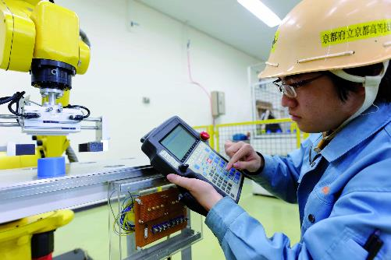
Automation and robotics
Human interaction with AI and robotics
Robotics and AI and their role in decreasing musculoskeletal disorders or mental health risks.
Ergonomic risks
Cybersecurity risks
Psychological risks
Automation's threat on employment
Notes:
Automation and robotics are not new to the workplace. What is changing today is the pace of their development and use in an increasing range of situations. For example, Amazon’s use of warehouse robots grew from 1,400 to 30,000 in a period of less than two years (Frey et al, 2016). Alongside AI, it is increasingly possible to automate more cognitive tasks previously only possible for humans. Machine learning processes make it possible for decisions to be made by AI autonomously. Robots (known as ‘cobots’) are also increasingly involved in working in collaboration with humans as well as in a fully autonomous capacity. Robotics provide opportunities to remove workers from hazardous situations. However, there are also concerns regarding their OSH impact in terms of human-machine interaction.

Slide 26
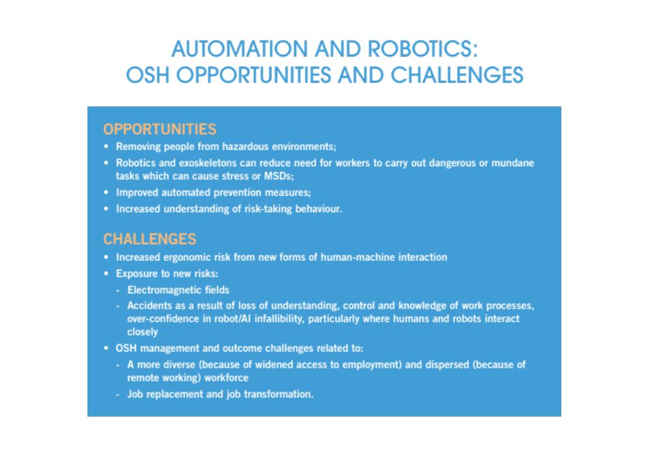
Notes:
This table summarizes the opportunities and challenges that come with automation and robotics.

Slide 27
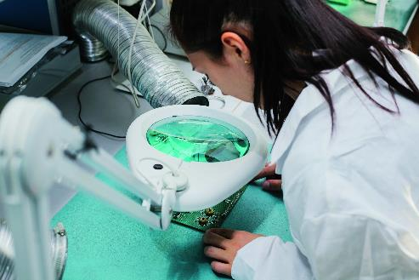
Nanotechnology
Nanomaterials
Unique health hazards
Lungs, oxidative stress, inflammation and tissue damage, fibrosis and tumor generation
ILO Occupational Safety and Health Convention, 1981: Necessary Further Training, lifelong learning
Notes:
The early decades of the 21st century have seen continued developments in the introduction of new materials and processes, with implications for the identification and control of risks arising from their use. One key example is in the development, production and use of nanomaterial. Nanomaterials are generally defined as those containing materials with one or more external dimension between 1 and 100 nanometres (European Commission, 2018). The unique properties of nanomaterials may result in highly desirable behaviour leading to such varying applications as more efficient consumer products and faster electronics.
In most countries, worker involvement in health and safety issues is mandatory. Article 19 of the ILO Occupational Safety and Health Convention, 1981 (No. 155) stipulates that workers and their representatives in the undertaking should be given appropriate training in occupational safety and health. Convention No. 155 goes on to state that there should be a national policy to provide information and education and implement training for workers, including necessary further training, qualification and motivation of persons involved, in one capacity or another, in the achievement of adequate levels of safety and health. The importance of worker training on emerging workplace risks and hazards, such as the example of engineered nanomaterials, should be a key element within social dialogue on adaptive approaches for lifelong learning initiatives.

Slide 28
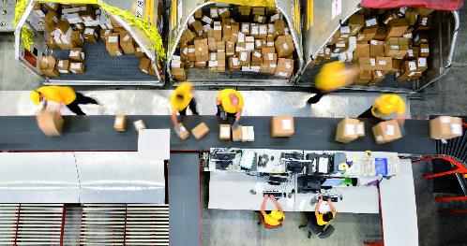
2.2 Demographics
Changing global workforce
Expanding young and old population in different parts of the world
Gender gaps in labour market
Notes:
The global workforce is constantly changing, in relation to age and gender, and in terms of related issues such as migration. It is important that the implications of demographic change in relation to OSH are taken into account to help build effective policies and strategies for all workers in the present and future.
In some parts of the world youth populations are expanding, while in others, populations are ageing. These effects place pressure on labour markets and social security systems, yet also present new opportunities for inclusive, active, safe and healthy societies.

Slide 29

Young workers and aging worker populations
Notes:
Young workers
Some regions, such as Africa and Southern Asia, have very large young populations entering the labour force and this has implications for the workforce. Younger people (those aged under 25) are much more likely to be unemployed or underemployed. Globally, rates of youth unemployment are about three times that of older adults, at 13 per cent (compared to 4.3 per cent) (ILO, 2018d).
Critically, young workers experience significantly higher rates of occupational injury compared to older workers. According to recent European data, the incidence of non-fatal injury at work was more than 40 per cent higher among young workers age 18 to 24 than among older workers (EU-OSHA, 2007). In the United States, the risk that young workers between the ages of 15 and 24 will suffer a non-fatal occupational injury is approximately twice as high as that for workers age 25 or older (CDC, 2010).
An effective response to the challenge of improving OSH for young workers should focus on at least the five main areas highlighted during the ILO 2018 Campaign on OSH for Young Workers (ILO, 2018f):
• Improving the collection and analysis of data and information on OSH and young workers;
• Developing, updating and implementing laws, regulations, policies and guidelines to better protect the safety and health of young workers;
• Capacity building aimed at helping governments, employers, workers and their organizations address the OSH needs of young workers;
• Integrating OSH into general education and into vocational training programs, to build a safer and healthier generation of workers; and
• Strengthening advocacy, awareness and research on young workers’ vulnerability to OSH hazards and risks.
Aging worker populations
Global population growth is expected to slow substantially (ILO, 2018d). Between 1980 and 2017, the world’s population grew by an estimated 65 per cent, but between 2018 and 2050 growth is expected to fall to around 35 per cent. This reflects declining birth rates combined with increasing life expectancies, both of which are occurring most rapidly in developing countries.
Changes in physical ability associated with ageing vary by gender, and can particularly affect the capacity of older women to work. Vertical and horizontal segregation in the labour market exposes women, and older women specifically, to different risks from those of men. Women on average live longer than men and the workplace risks encountered will affect women’s health throughout the course of their working lives. Musculoskeletal disorders, osteoarthritis and osteoporosis are diagnosed more frequently in women than in men and are age-related. To combat work-related health risks throughout a worker’s life, employers should integrate both age and gender into workplace risk assessment, in order to promote healthy working conditions that match the unique challenges of ageing workers.
In addition, to better manage health among ageing worker populations, occupational physicians will need to draw upon the principles and experience of geriatric medicine towards the promotion of adaptive prevention strategies. For ageing workers to stay and thrive in work as they age, OSH systems must evolve to their needs, including investment in lifelong learning opportunities that favour a human-centred approach to decent work and well-being.

Slide 30

Gender
Resisting gender gaps in the labour market
Women are 26.0 percentage points less likely to be employed
Gender employment gap has shrunk last 27 years, less than 2 percent points during the last 27 years.
Notes:
Across the world, gender gaps in the labour market persist in both developed and developing countries. In 2018, women were still 26.0 percentage points less likely to be employed than men. Over the past 27 years, the gender employment gap has shrunk by less than 2 percentage points (ILO.2019b).
Women are less likely to find a job when they do participate; and when they do work it is more likely to be in non-standard work arrangements (ILO, 2018d; 2016a). For example, although women account for less than 40 per cent of total employment, they are involved in 57 per cent of part-time work (ILO, 2016b).
If future health promotion policies are to be effective for both women and men, they must take into account the evolving relationships between safety, health and well-being, and gender roles. Strategies for the improvement of women workers’ safety and health should be developed within national OSH policy, particularly in sectors where women are more heavily concentrated. As more and more women join the workforce globally, specific trends of employment and exposure to emerging risks – both physical and psychosocial – must be actively monitored in order to develop effective prevention frameworks.
In addition, in a labour market where increasing trends of platform work have blurred the lines between formal and informal establishments, it is essential to consider that gender equality, and particularly how it relates to safety and health, truly begins within the home. In this regard, governments and social partners should work together to design policies that promote the sharing of care and domestic responsibilities between men and women, as well as the development and expansion of leave benefits which encourage both parents to share care responsibilities equally.

Slide 31
Migrant workers
Accounted for 164 million of the world’s approximately 277 million international migrants.
86.5 per cent of migrants are between 20 to 64 years of age.
The complexity and diversity of circumstances throughout the various dimensions of the migration cycle may render them highly vulnerable to poor physical and mental health outcomes.
High skilled jobs vs. “D” jobs (dirty, dangerous and demeaning)
Notes:
ILO (2018h) global estimates on migrant workers, covering 2013 to 2017, show migrant workers accounted for 164 million of the world’s approximately 277 million international migrants. Even when employment is not the primary driver of the initial movement, it will normally feature in the migration process at some point, given that 86.5 per cent of migrants are between 20 to 64 years of age.
Migrant workers typically commence the migration process as healthy individuals. However, the complexity and diversity of circumstances throughout the various dimensions of the migration cycle may render them highly vulnerable to poor physical and mental health outcomes. While some migrant workers hold high-skilled jobs, most migrants are employed in the three “D” jobs (dirty, dangerous and demeaning) in often informal and/or unregulated sectors such as agriculture, construction or domestic work with little respect for labour and other protections. Such work is of intensive and temporary or seasonal nature, with significantly higher occupational hazards.
This has implications for workers’ health safety and wellbeing. Migrant workers often have poorer safety and health at work and suffer a lack of decent working conditions, frequently associated with employment in non-standard forms of employment (see Section 2.4). They are also often less eligible for social protection coverage (ILO, 2016a; ILO, 2018d; Quinlan et al., 2001; Quinlan and Bohle, 2008).

Slide 32
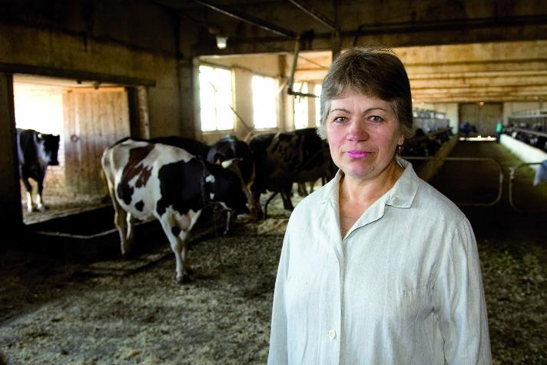
2.3 Sustainable development and OSH
Notes:
The working environment is not a closed system isolated from the natural environment. OSH risks that give rise to a deterioration in the working environment are also among the main causes of the deterioration in the natural environment and vice versa (ILO, 1987). Air pollution from coal mining and coal burning, for example, directly impacts the health of coal miners, but also indirectly affects workers’ health in other industries around them.
Climate change is a current and future environmental OSH hazard. Nevertheless, the impacts of climate change on OSH have received little political or public attention. This may be because increasing heat stress levels at work are mostly invisible compared to chemical exposures or air pollution. This invisible threat, however, is just as dangerous and over certain thresholds can become lethal. Climate hazards also have the potential to interact, including in ways we cannot yet anticipate (Keifer et al, 2016; Fogarty et al, 2010; WHO, 2012; Sumner and Layde, 2009).

Slide 33
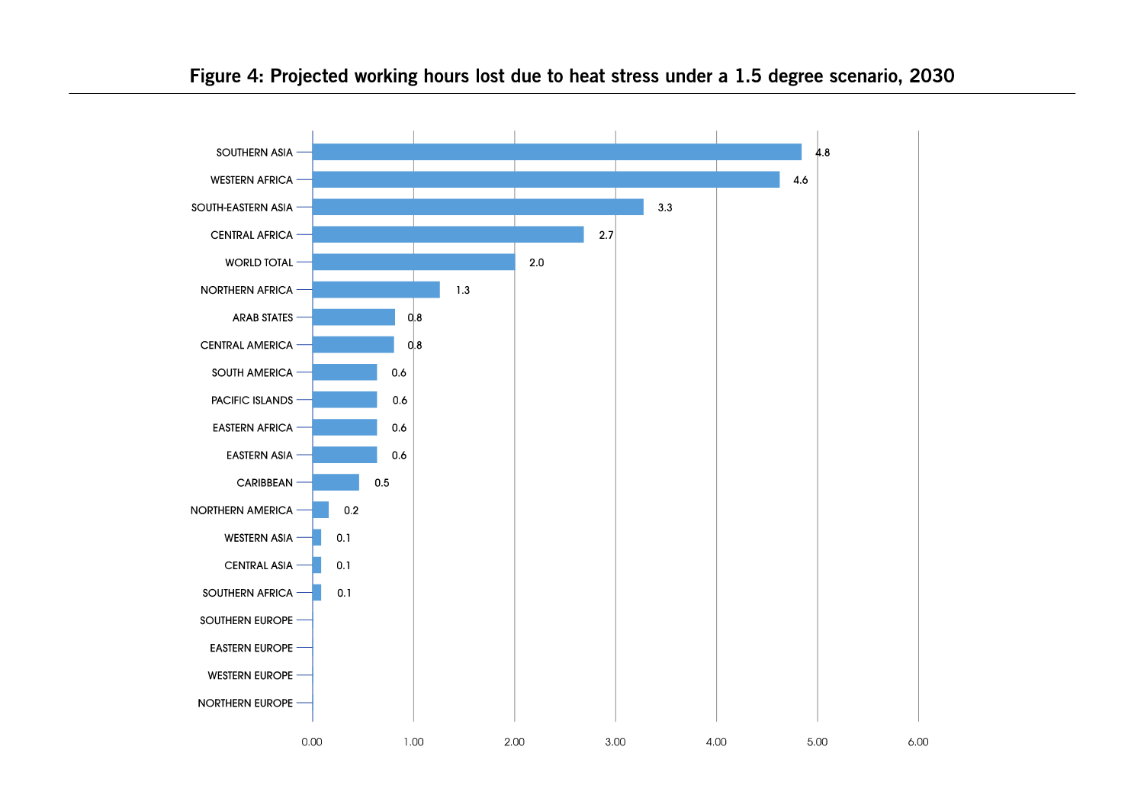
Climate change, air pollution and environmental degradation
Effects: 4 billion are among the poorest and also work outdoors, in agriculture.
Southern Asia and Western Africa
Exposure to sun is a risk
Notes:
It is estimated that a projected increase in the global temperature of 1.5°C by the end of the twenty-first century will render 2 per cent of all work hours as too hot to work by 2030, representing a loss of 72 million full-time jobs (ILO, 2018c).
The figure represents a future forecast of 2030, the areas where the working hours are mostly lost because of the heat stress. The most affected places in the world will be Southern Asia and Western Africa.

Slide 34
HIGHER TEMPERATURES AND OSH
HIGHER TEMPERATURES CAN AFFECT WORK AND WORKERS, ESPECIALLY IN HOT AREAS
Reduction in areas where work is possible
Increase in related health effects
Heat related health effects
Heat related OSH risks
The performance of physically demanding work
Migrant workers, informal workers and day-labourers
The health burden related to climate change
Extreme weather events also affect workers involved in emergency, rescue and clean-up work
Notes:
higher temperatures and osh
Higher temperatures can affect work and workers, especially in hot areas:
Reduction in areas where work is possible (because of heat, rising sea levels etc.) and in people’s work capacity. For example, areas in the Middle East are already too hot to work outside. The number of these areas are expanding and will accelerate.
Increase in related health effects: heat stroke, heat exhaustion, poorer chemical tolerance, fatigue, poorer cognitive function, increased risk of injury or safety lapses, altered responses to exposure to chemical and biological hazards, dehydration, increased burden of respiratory and cardiovascular diseases, cataract, skin and eye cancer and weakened immune function.
Heat related OSH risks will be exacerbated by workplaces with poor ventilation, lack of cooling systems, work involving heat-generating processes and the need to wear PPE, which workers may be less likely to (correctly) use.
The performance of physically demanding work notably outdoors will be severely compromised.
Migrant workers, informal workers and day-labourers may be particularly affected because they are often over-represented in occupations, such as construction and agriculture which are strongly affected by rising temperatures. This may also be exacerbated by non-work-related issues, such as inadequate housing and lack of air conditioning. They often also have little or no recourse to representation or social dialogue in the workplace to claim rights at work.
The health burden related to climate change may be greater for workers in low- and middle- income countries in tropical areas or areas with frequent exposure to extreme weather events and high temperatures, where there are typically fewer resources available for mitigation, adaptation and risk response
Extreme weather events also affect workers involved in emergency, rescue and clean-up work, who may be at (increased) risk of: exposure to chemical and infectious agents, risk of injuries, hazards related to recovery of bodies, crowd control, assault and associated psychological and psychiatric disorders

Slide 35
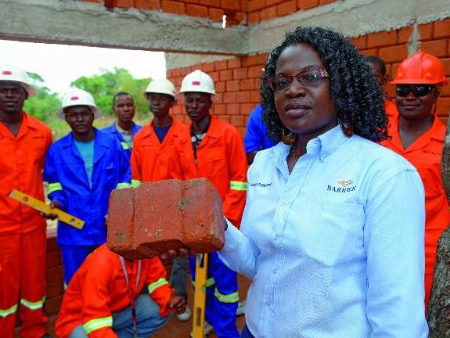
The green economy
Notes:
Green industries, such as renewable energy production, water services, green transportation, waste management, green buildings, sustainable agriculture and forestry, recycling and the development and use of low-carbon technologies, are seeing substantial growth (Pollack, 2012). In addition, some traditional industries, such as construction, are seeing a transition toward ‘green activities’, such as retrofitting buildings for energy conservation (Schulte, 2010). Patterns and structure of employment, therefore, are also changing (Niera et al, 2010). Jobs and occupations will be shifting, for example, from coal mining towards renewable energy production.
While some jobs with high OSH risks, such as mining, will decline, ‘green jobs’ that are created are not necessarily safe and decent jobs. This is partly because OSH policy and practice can sometimes be reactive, rather than seeking to prevent new risks (ILO, 2018c). Emerging risks, often associated with new technologies, will affect workers in the new industries or occupations.

Slide 36
GREEN TECHNOLOGIES AND OSH
Health and safety aspects of green technologies arise in all stages of their lifecycle: from the extraction of the necessary raw materials, the manufacturing of technological devices, to their transport, installation, operation, decommissioning and disposal. They can occur across different countries and regions, involving many different groups of workers.
WORKERS IN ‘GREEN’ INDUSTRIES MAY FACE RISKS :
In the wind turbine sector
In the solar energy industry and the later recycling of its parts
In the manufacture of fluorescent light bulbs
In recycling
Risks as a result of substitution for more environmentally friendly substances
Notes:
GREEN TECHNOLOGIES and osh
Health and safety aspects of green technologies arise in all stages of their lifecycle: from the extraction of the necessary raw materials, the manufacturing of technological devices, to their transport, installation, operation, decommissioning and disposal. They can occur across different countries and regions, involving many different groups of workers.
Workers in ‘green’ industries may face risks including, for example:
In the wind turbine sector: exposure to epoxy resins, styrene, solvents, harmful gases, vapours and dusts, physical hazards from moving parts, manual handling, dust and fumes from fibreglass, hardeners, aerosols and carbon fibres (Common health related problems include dermatitis, dizziness, sleepiness, liver and kidney damage, blisters, chemical burns, and reproductive effects); as well as risk of falls from heights, musculoskeletal disorders, awkward postures, physical load, electrocution, and injuries from working with rotating machinery and falling objects
In the solar energy industry and the later recycling of its parts (such as photovoltaic panels): exposure to cadmium telluride and gallium arsenide
In the manufacture of fluorescent light bulbs: exposure to mercury poisoning
In recycling: risk of acute injury, elevated exposures to heavy metals, polybrominated diphenyl ethers, and flame retardants, increase in symptoms likely related to organic dust exposure, exposure to biological agents
Risks as a result of substitution for more environmentally friendly substances, for example: the substitution of solvent-based for water-based paints has included the addition of biocides, and the substitution of hydro-chlorofluorocarbons for chlorofluorocarbons has increased the risk of exposure to carcinogens, as well as to fire hazards
However, coal mining deaths, injuries and diseases may be reduced as fossil fuels are replaced with renewable energy, not least as mining has always been a particularly hazardous occupation and one that is often carried out in the informal sectors of developing economies by vulnerable groups of workers. Similarly, farm workers’ exposure to pesticides and other agrochemicals may come down as organic farming expands.

Slide 37


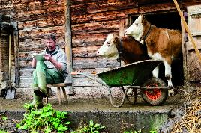
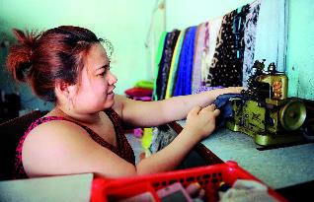
2.4 Changes in work organization
Excessive hours of work
Non-standard forms of employment
Working time arrangements
The informal economy
The example of digital labour platforms
Notes:
The changing world of work has also been characterized by a shift away from permanent formal employment, particularly in developed countries where permanent employment was seen as the standard working arrangement. As discussed in this chapter, many of the changes associated with technology, demographics and climate change have in turn had impacts on work organization. This is particularly significant for ensuring safety and health at work.
Excessive hours of work:
Increased risks of non-communicable diseases are linked to excessive working hours, with a higher observed risk in women – suggesting that employers should consider how to better manage the demands of balancing work and family life of women and men workers. While other factors (such as autonomy, pressure to work overtime and low rewards) also contribute to such risk factors, in general reducing excessive working hours can contribute to improved OSH outcomes. The 2019 report of the ILO Global Commission on the future of work states that: “Limits on excessive working hours will reduce occupational accidents and associated psychosocial risks” (ILO, 2019a).
Non-standard forms of employment:
While long and erratic hours can affect the OSH outcomes of workers, those in NSE have even higher risk of having their safety and health adversely affected at work. At least four categories of risks are associated with these forms of work organization: injury-related risks and accidents, psychosocial and harassment risks, exposure to poorer working conditions and hazards, and fatigue issues.
Working time arrangements:
With the emergence of new technology, working-time arrangements such as telework, ICT-mobile work (ICTM) and flexitime have become more common. While employers often require a more flexible workforce, changing lifestyles and family structures have meant many workers also demand more flexible working arrangements. Flexible working arrangements can help workers to find a better work-life balance, particularly for women and men with families, and help workers to remain economically active who may not be able to do so otherwise, including older workers or workers with disabilities. However, they often result in the erosion between the borders of work, leisure and other activities, can intensify work and time-related stress and lead to psychosocial health risks.
The informal economy:
Workers in the informal economy may not have a regular income and are likely to have little or no legal or social protections, no access to union or other forms of representation, collective bargaining or social dialogue, and their work often falls outside the remit of labour inspectorates, making them effectively invisible from the point of view of OSH regulation and control. Improving safety and health and working conditions of employers in the informal economy entails a transitional strategy to formalize workers in the informal economy. Nevertheless, measures to improve safety and health at work for workers in the informal economy, such as measures to improve working conditions and increase productivity of micro and small-sized enterprises in addition to capacity building programmes can help immediately improve outcomes for informal workers (ILO, 2014).
The example of digital labour platforms:
One major development of the past decade in the world of work has been the emergence of digital labour platforms. Digital labour platforms include web-based platforms, where work is outsourced to a geographically dispersed crowd of workers (known as “crowdwork”) and location-based applications (or “apps”) where work is targeted at a specific geographical area (ILO, 2018e). Digital labour platforms are now found in virtually all sectors, and operate regionally, nationally and internationally. They also include a very wide range of working arrangements and relationships.
Digital platform work may be able to generate safety and health opportunities, such as increasing a worker’s control over the hours they work and their work-life balance and moving work normally carried out in the informal economy into the formal sector, where there may be enhanced safety and health regulation and protection (Garben, 2017; ILO, 2018b).
However, it can also lead to a number of OSH challenges and suffer from a lack of safety and health protection. Platform workers may experience worse OSH management of the workplace, including poor risk assessment. Furthermore, workers often have little or no access to traditional contractual benefits (holiday and sick pay, OSH information, training, services and support) or to employer-provided workplaces, equipment and personal protective equipment (PPE) (with workers’ own homes and supplies unlikely to meet ergonomic, environmental and OSH standards). In fact, in many cases workers are responsible for their own OSH and for other factors such as insurance (Garben, 2017; EU-OSHA, 2015). It may be difficult to regulate OSH in platforms that are operating globally, highlighting the increased need for governance at the international level.

Slide 38
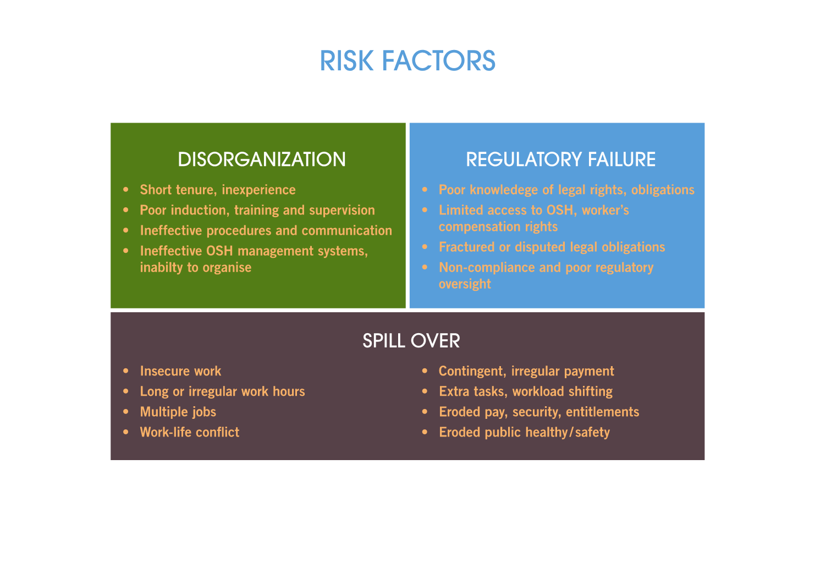
OSH RISK FACTORS IN NON-STANDARD EMPLOYMENT ARRANGEMENTS
Notes:
OSH risk factors in and its risks can be the OSH risk factors in non-standard employment arrangements. non-standard forms of employment.

Slide 39
OSH OPPORTUNITIES AND CHALLENGES IN PLATFORM WORK
OPPORTUNITIES
CHALLENGES
Removing people from hazardous environments.
Greater control over work-life balance.
Shift of work previously carried out in the informal economy into the formal sector.
Reduced security, decreased regulatory visibility and increased risks
Atypical employment and working arrangements
Challenges in applications of OSH and employment regulations
Little or no access to traditional contractual benefits
Poor workplace OSH management
Lack of clarity and specificity in tasks
Non-appropriate certification, knowledge etc.
Notes:
Another example can be the OSH opportunities and challenges for the platform work employees.
PLATFORM WORK: OSH OPPORTUNITIES AND CHALLENGES31
OPPORTUNITIES
• Removing people from hazardous environments.
• Greater control over work-life balance.
• Shift of work previously carried out in the informal economy into the formal sector.
CHALLENGES
• Reduced security, decreased regulatory visibility and increased risks.
• Atypical employment and working arrangements (which can include clauses stating that there is no employment relationship between the platform and the user, that workers are independent contractors, and that the platform is an intermediary and so not liable).
• Platform operators may challenge the applicability of OSH and employment regulations.
• Workers often have little or no access to traditional contractual benefits (holiday and sick pay, OSH information, training, services and support) or to employer-provided workplaces, equipment and PPE (with workers’ own homes and supplies unlikely to meet ergonomic, environmental and OSH standards).
• Workplace OSH management may be poorer – for example, risk assessment is often infrequent or non-existent.
• Lack of task clarity and specificity is common.
• Appropriate certification, knowledge or understanding of the relevant regulations is less common.
• Workers are in effect responsible for OSH and for other factors, like insurance.

Slide 40
^{Chapter 3}
Responding to the safety and health challenges and opportunities of the future of ^{work}

Slide 41
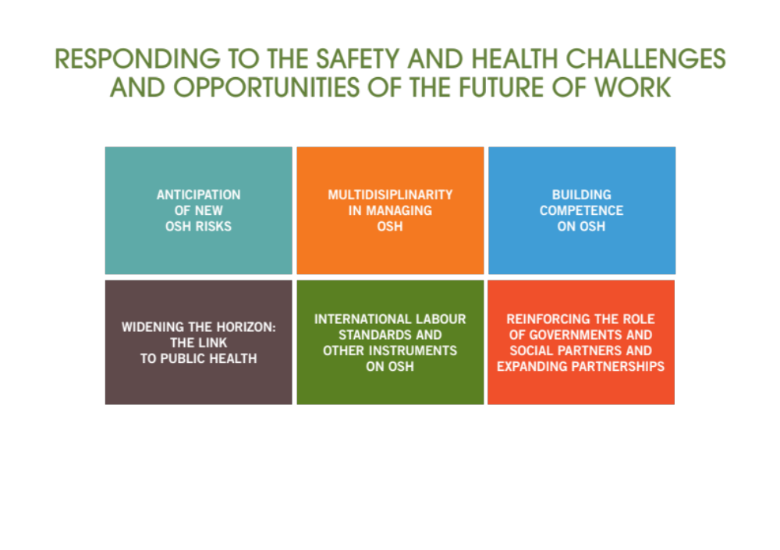
Notes:
While the changes shaping the future of work are creating new challenges for prevention, it is worth noting that these changes also create new opportunities to improve prevention efforts. This Chapter aims to reflect on how the field of occupational safety and health is effectively rising to the challenge. This can only happen by bringing together all key stakeholders at global and national levels. Governments, employers and workers form the foundation for building a safe and healthy future of work.

Slide 42

Anticipation of new OSH risks
New and emerging work-related safety and health risks
New trends in work organization = autonomous work or away
Concept of well-being, safety and health at work
Traditional risks across the world should be kept in mind still
Notes:
With new technologies, shifting demographics, climate change and different patterns of employment and work organization shaping the world of work, it has and will become more important than ever to anticipate new and emerging work-related safety and health risks. Anticipating risks is a crucial first step to effectively managing them and to building a preventative OSH culture in an ever-changing world.
New trends in work organization, where workers increasingly work autonomously or away from their employer’s premises require a rethink of current OSH management, laws, policies and programmes. In these cases, including the example of platform work, there may or may not be an established employment relationship or the worker may be self-employed.
Well-being is a further concept that relates to all aspects of working life. This includes the safety and health conditions of the working environment, but also how workers feel about their working environment, the climate of work and work organization. Worker wellbeing is an important determinant of the long-term effectiveness of an organization.
While the anticipation of new and emerging risks is becoming increasingly important in a rapidly changing world of work, this should not draw focus away from the persistence of traditional risks across the world, which vary in terms of geography and economic sector.

Slide 43
Building competence on OSH
Multidisciplinarity in managing OSH
OSH professionals in the future = multidisciplinary
Consideration and application of new skill sets in in the field.
Continuing education
Lifelong learning
In the 2019 report, Work for a brighter future, the ILO’s Global Commission on the Future of Work proposes “a universal entitlement to lifelong learning that enables people to acquire skills and to reskill and up skill” (ILO, 2019a).
Notes:
Multidisiplinarity in OSH links to the future of OSH professionals and the question of what it will mean to be an OSH professional in the future. The nature and role of OSH professions has altered in many countries, in keeping with changes in the structure of the economy. For example, occupational hygienists have become less of a professional presence and less influential in those economies in which manufacturing, heavy industry and mining have declined, while more general OSH practitioners may have grown in numbers and influence. The position of OSH professionals is not static but rather is subject to change.
There is a growing need to mainstream OSH into the core of general education for everyone before they enter the world of work and continuing throughout their working lives. There are some signs of the growing awareness of this need among OSH policy-makers but there is some way to go before it becomes a reality for society at large.
In the 2019 report, Work for a brighter future, the ILO’s Global Commission on the Future of Work proposes “a universal entitlement to lifelong learning that enables people to acquire skills and to reskill and upskill” (ILO, 2019a). This forms part of a strategy to invest in people’s capabilities, alongside supporting people through transitions, a transformative agenda for gender equality and strengthening social protection. Lifelong learning spans formal and informal learning, through childhood and basic education to all adult learning. Including OSH education and training in lifelong learning can help workers and employers adapt to new, emerging, and persistent safety and health risks and improve OSH outcomes at work.

Slide 44


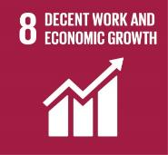
Widening the Horizon: The Link to Public Health
Notes:
The link between public health and OSH can be recognized in the need to promote healthy work environments (including work practices) that support health and prevent diseases through organizational improvements. Issues such as nutrition (access to affordable and healthy food during working hours), increased physical activity, good sleep, addressing psychosocial hazards, preventing substance abuse and other addictions can all be positively influenced by our working environment. There is therefore a strong bridge among various mechanisms (occupational health services and public/private health services) to support the health of workers.
For most workers, the norm is no longer to work for a single employer. Instead, a worker’s lifecycle encompasses many employers and potentially several jobs and careers of various forms. The lifecycle of a worker also spans from education, to training, to work, to managing various responsibilities, to social protection and to retirement. Lifelong learning is increasingly part of the worker lifecycle. Therefore, the safety and health of an individual as a human being as well as a worker, is crucial to public health and OSH, as it is a constant factor in all forms of work.
a worker and the workforce is affected not only by occupational risk factors but also personal risk factors, social and economic risk factors. These factors can have an impact on health outcomes and potentially influence one another. This work life approach links to the “human-centred agenda for the future of work”, as called for by the ILO’s Global Commission on the Future of Work, which requires investment in people’s capabilities, enabling them to acquire and update skills and supporting them through the transformations they undergo in their life course (ILO, 2019a).
Aiming to strengthen global capacity for evidence synthesis and disease burden modelling in occupational health, the ILO and the WHO have joined efforts for estimating the global burden of work-related disease and injury. Building on existing robust methodologies to estimate the occupational burden of disease for 39 pairs of occupational risk factors and health outcomes, the new methodology will allow for estimating
The health of the burden of 13 additional occupational risk factor-outcome pairs including:
• occupational exposure to solar ultraviolet radiation and skin cancers and cataract;
• occupational noise and cardiovascular disease, and
• long working hours and Ischaemic heart disease, stroke, depression and alcohol use disorders.
These estimates will also serve as useful indicators across SDGs 3 and 8.

Slide 45
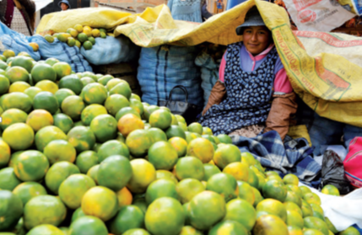
International labour standards and other instruments on OSH
National OSH legislation and management
Governance of OSH
Notes:
In an ever-changing world of work, the ILO’s OSH instruments are still extremely valid and relevant. Not only are conventions and recommendations reviewed to ensure they are robust and responsive to changing demands, they are drafted in such a way as to be resilient to the changing OSH challenges.
While the Occupational Safety and Health Convention, 1981 (No. 155), was adopted almost 40 years ago, it contains a number of provisions that make it ever-relevant.
The role of international labour standards was emphasized in the ILO’s 2003 Global strategy on occupational safety and health, which reaffirmed international labour standards as a central pillar for the promotion of OSH and called for integrated action to better link standards and other means of OSH action to increase their impact. This approach remains relevant and applicable in the changing world of work today.

Slide 46
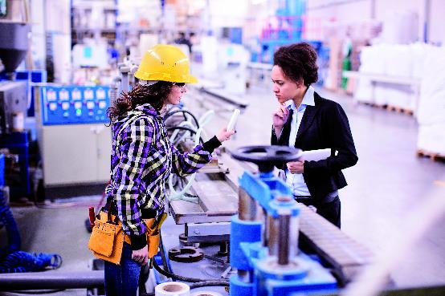
Reinforcing the role of governments and social partners and expanding partnerships
Notes:
Governments, workers’ and employers’ organizations are still the leading partners to implement the objective of safe and healthy working environments. Nevertheless, the ILO tripartite constituents have been increasingly collaborating with civil society institutions, OSH institutes, and active non-governmental organisation on OSH, public and private institutes and universities in the area of OSH. The link between OSH and public health has further implications on expanding partnerships to achieve the 2030 Agenda for Sustainable Development. For example, INTEROSH34 is a global database on agencies, institutions and organizations engaged in knowledge development, capacity enhancement and dissemination of information in the technical domain of OSH. INTEROSH aims to improve knowledge and information sharing around the world and support the development of new collaboration between stakeholders on priority topics of interest, including those relevant to the future of work and the topics discussed in this report.

Slide 47
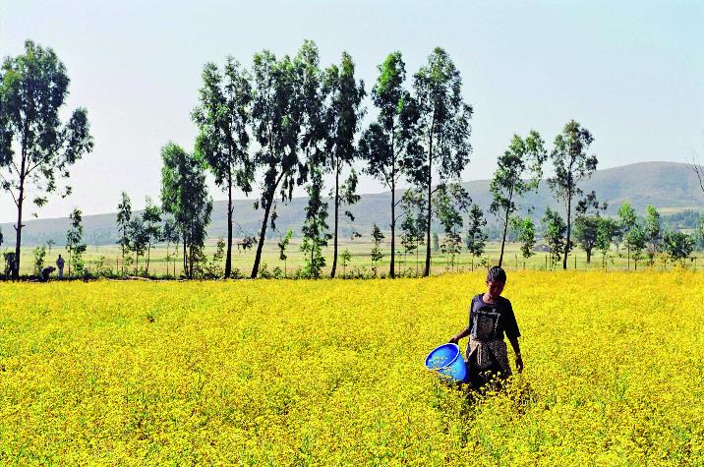
Concluding remarks
Notes:
The world of work is undergoing profound changes, not least the transformative effect of new technology, changing demographics and climate change and the shift towards the green economy. These changes will bring about new challenges and opportunities for the safety and health of the world’s workers.
In January 2019, at the beginning of the ILO’s centenary celebrations, the ILO Global Commission on the Future of Work called for a Universal Labour Guarantee, including fundamental workers’ rights, an “adequate living wage”, limits on hours of work and ensuring safe and healthy workplaces. The Commission also called for the recognition of safety and health at work as a fundamental principle and right at work.
While the road ahead presents many new challenges to safety and health at work, it is important for governments, employers and workers, and other stakeholders to seize the opportunities to create a safe and healthy future of work for all.

Slide 48
Thank you

