Slide 1
ILO 100 years:
Journey for Social Justice and Shaping Future of Work
Changhee Lee and Valentina Barcucci
ILO Country Office for Viet Nam
Notes:
Ladies and gentlemen, we had brilliant speeches from DPM Vu Duc Dam and DDG Deborah Greenfield as well as opening remark of MOLISA Minister Dang Ngoc Dung in the first session. Now we would like to recap key milestones of ILO and Vietnam’, and also introduce ILO’s new Centenary Declaration on Future of Work.

Slide 2
Historical Trajectories of the ILO
Ho Chi Minh, Viet Nam and ILO
Shaping Future of Work
Notes:
Let us then look at historical trajectories of the ILO 100 years.

Slide 3

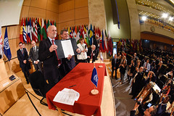
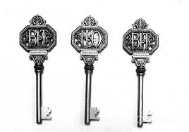
Milestones
ILO 1919: Working on the constitution
ILO 1944: The Philadelphia Declaration
(25 years)
ILO 1969: The Nobel Peace Prize
(50 years)
Centenary Declaration
(100 years)
Tripartism
Notes:
Our journey began 100 years ago, with adoption of Constitution at the Paris Peace Conference in 1919. Ever since then, ILO, together with tripartite partners, worked tirelessly for social justice, setting key milestones during our first 100 years.

Slide 4
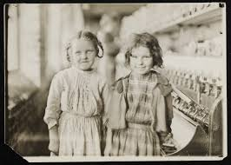
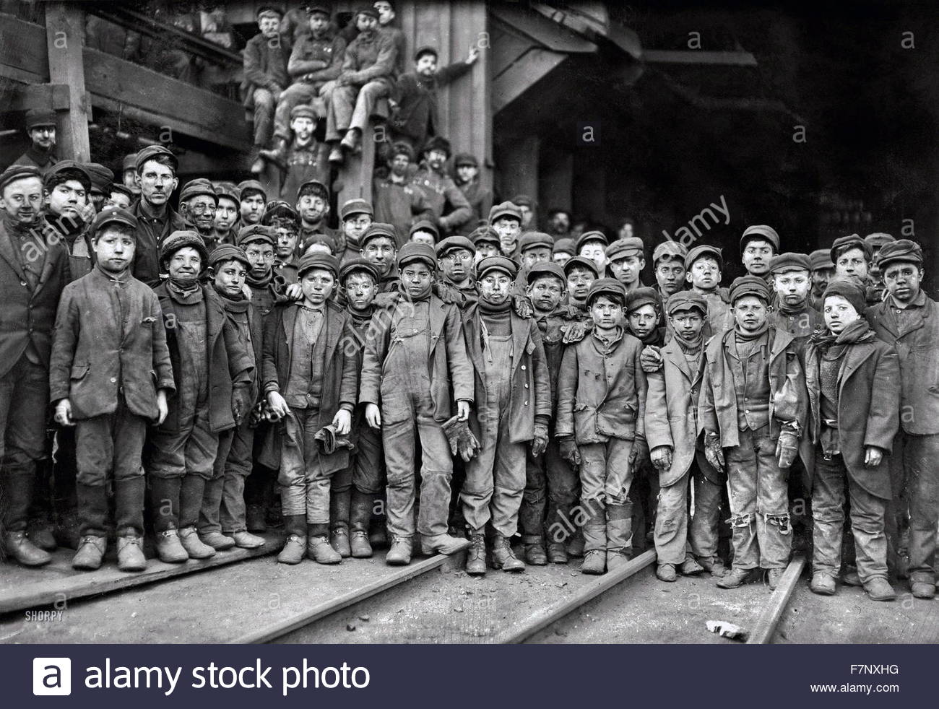
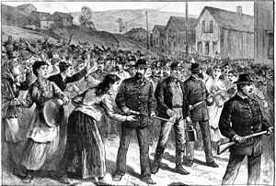
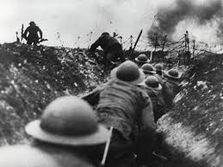
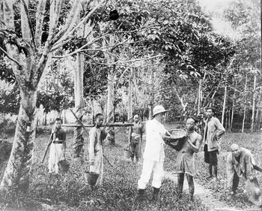
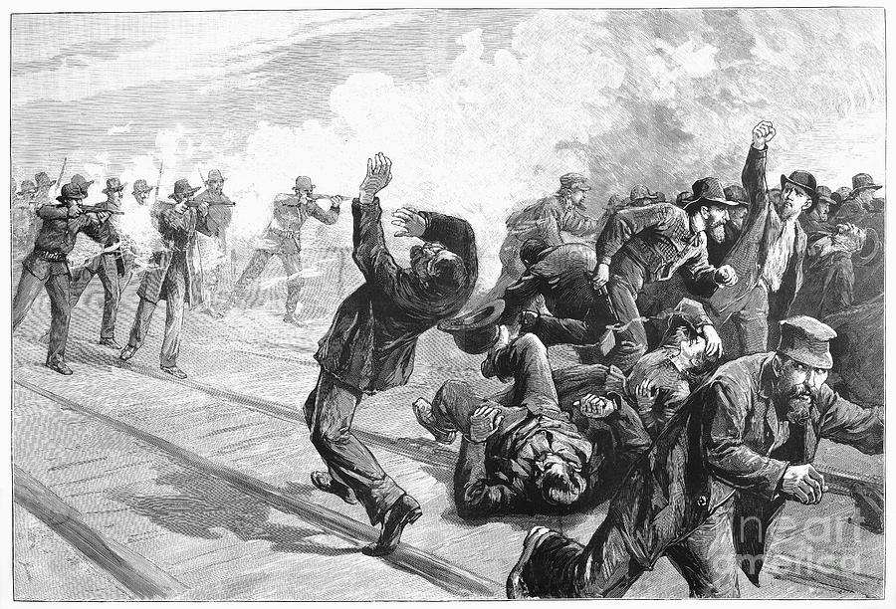
Industrial Revolution 1.0 and its social consequences
Notes:
Industrial revolution 1.0 in 19th century created enormous potential for improved welfare for people by dramatic increase of productivity. Yet, in the absence of social protection and recognition of workers’ voice, it created grave social consequences where children even at the age of 7 or 8 were hired for factory work, workers often worked exceedingly long hours., workers right to organize and bargain collectively were denied. It led to widespread discontents and social unrest, leading further to the devastating 1st World War.

Slide 5

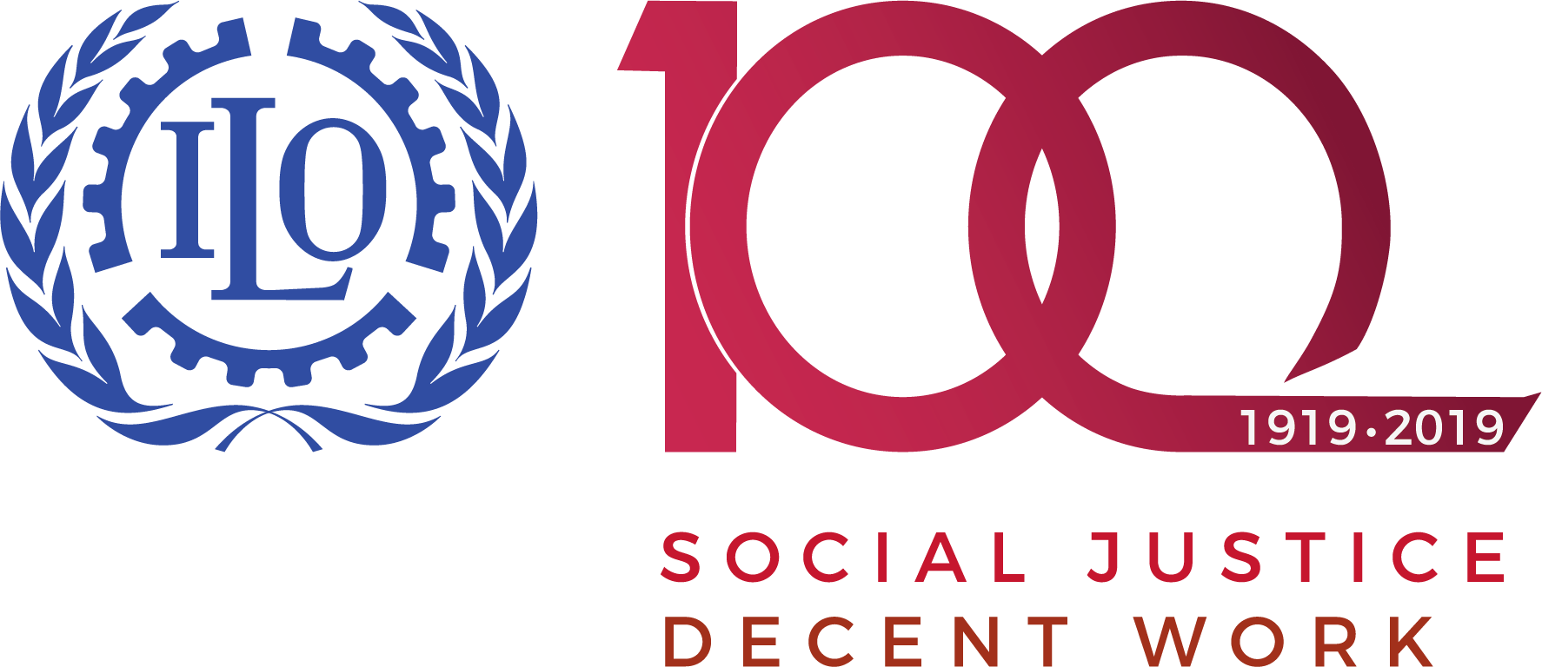
ILO 1919 began its quest for social justice
“Whereas universal and lasting peace can be established only if it is based upon social justice”
Tripartism
“Who had ever heard of Governments getting together to raise the standards of labor on an international plane? Wilder still was the idea that the people themselves who were directly affected – the workers and the employers of the various countries – should have a hand with the government in determining these labour standards. Now 22 years have passed. The ILO has been tried and tested”. – Franklyn Roosevelt
Notes:
Against this backdrop, ILO was created on a shared conviction that “whereas universal and lasting peace can be established only if it is based upon social justice”. A remarkable innovation took place when ILO constitution give equal voices to workers’ and employers’ with the government, creating unique tripartite governance structure of the ILO.

Slide 6
Trajectories of the ILO
Philadelphia Declaration (1944): a new world order based on rights of people to decide their own future and rights of working people, “irrespective of race, creed or sex, to pursue both their material well-being and their spiritual development in conditions of freedom and dignity, of economic security and equal opportunity”, serving as a model for UN Charter and Universal Declaration of Human Rights
Nobel Peace Prize on the occasion of 50 years anniversary (1969)
Adoption of ILO Declaration on Fundamental Principles and Rights at Work (1998)
  Free from forced labour, child labour and discrimination at work, and freedom of association and collective bargaining
  Becomes an integral part of new generation of FTA and CSR in global supply chains
Notes:
On 25th years anniversary, ILO adopted Philadelphia Declaration, which paved a new world order based on rights of people to decide their own future and rights of working people, irrespective of race, creed or sex, to pursue both their material well-being and their spiritual development in conditions of freedom, dignity, of economic security and equal opportunity”. It served as a model for UN Charter and Universal Declaration of Human Rights.
ILO was awarded Nobel Peace Prize for its contribution to peace on its 50th anniversary.
In 1998, ILO adopted another historic declaration on Fundamental Principles and Rights at Work, requiring all ILO member states’ commitment for elimination of forced and child labour, non-discrimination at work, and freedom of association and collective bargaining. It has become integral part of new generation of FTA and CSR in global supply chains.

Slide 7
Historical Trajectories of the ILO
Ho Chi Minh, Viet Nam and ILO
Shaping Future of Work

Slide 8
Partnership for decent work for all men and women
Vietnam rejoined the ILO in 1992. Partnership with MOLISA, VGCL, VCCI and VCA deepens and widens, with trust and mutual respect,
ILO Viet Nam, established in 2003, is the youngest country office of the ILO, but now the 2nd largest one
Joins Vietnam’s journey towards upper middle income country and full realization of SDGs by supporting social and economic upgrading for decent work for all men and women
Notes:
In 1992, Vietnam rejoined the ILO as it embarked reform of Doi Moi. ILO Country Office for Viet Nam is the youngest country office of the ILO, established in 2003. It has now grown to become 2nd largest country office of the ILO, demonstrating its relevance and impacts through deeper and wider partnership with MOLISA, VGCL, VCCI and VCA. We join Vietnam’s journey towards upper middle income country and full realization of SDGs for decent work for all men and women, through social and economic upgrading.

Slide 9
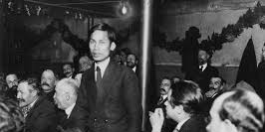
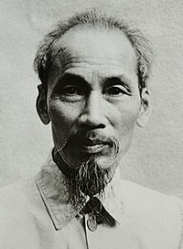
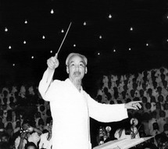
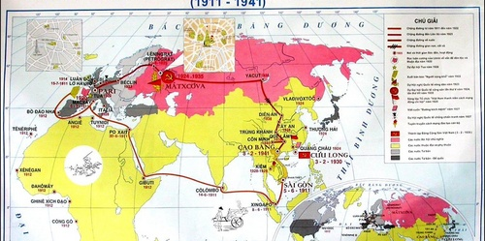
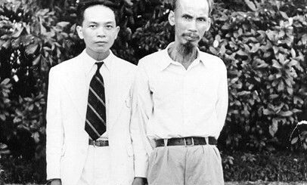
Ho Chi Minh (Nguyen Ai Quoc) at 1919 Paris Peace Conference
Presented ‘List of demands of Vietnamese people’ to Paris Peace Conference delegations
  Influenced by US President Wilson’s 14 points with proposal for self-determination of nations
  Demands self determination, freedom of association, and right to education, opening of technical and occupational education establishments, which resonates with Preamble of the ILO Constitution
Notes:
Yet our shared history goes back 100 years ago.
It is remarkable that we can find almost same languages in the Preamble to 1919 ILO Constitution and Ho Chi Minh’s letter to delegations of the Paris Peace Conference in demanding “freedom of association, and right to education, opening of technical and occupational education establishments”. This is beginning of ILO and beginning of modern labour policy of Vietnam. We were intertwined from the beginning.
President Ho Chi Minh was most globalized leader or human being of his time. Just name countries where he lived and worked, not just visiting, he lived and worked in US, UK, France, Soviet Union, China, Thailand and of course Vie Nam. He spoke languages of all those countries. He was internationalist as well as nationalist, he was humanist as well as communist. He is source of inspiration.

Slide 10
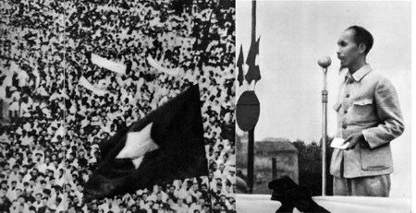
Viet Nam, ILO and Industrial Relations
Labour Ordinance No 29 in 1947 (on defining relationships between employers and workers) set legal framework for industrial relations based on full recognition of freedom of association and collective bargaining
It preceded adoption of Convention 87 on Freedom of Association and Protection of Right to Organize (1948) and Convention 98 on Right to Organize and Collective Bargaining (1949)
In 2019, Viet Nam has reached its the final stage of labour code revision, while having recently ratified C. 98, ready to bring principles of C. 98 and 87 into law and practices
Notes:
Again remarkable to find the parallel between C. 87 & 98 of ILO on the one hand and Labour Ordinance 29 Ho Chi Minh’s government adopted in 2917. The Labour Ordinance 29 set legal framework of industrial relations in independent Vietnam in recognition of freedom of association and collective bargaining. It preceded C. 87 and C. 98 of ILO. Two months ago, Viet Nam ratified C. 98, and Viet Nam is now at its final stage of labour code revision, which will bring principles of C. 98 and 87 in law and practices in gradual but systematic manner.

Slide 11
Historical Trajectories of the ILO
Ho Chi Minh, Viet Nam and ILO
Shaping Future of Work
Notes:
Now let us turn to future. As we talk about future, I would like to invite our young but experienced labour economist, Ms Valentina Barcucci, who represents future.

Slide 12
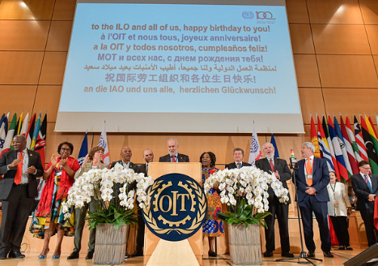
Shaping the Future of Work
108th ILC
Centenary Declaration for the
Future of Work
Notes:
This year in June, in Geneva ILO constituents, including our distinguished delegation from Viet Nam, marked history by adopting the Centenary Declaration for the Future of Work. Why did our constituents choose to come together and discuss this theme, this year of the Centenary? This is a reflection of their interest and also concerns regarding the changes that they witness in the world of work. Technological progress, climate change, demographic shifts, and many others seem to be forces coming all at the same time to influence profoundly the world of work. I think we can confidently say that few countries are experiencing change – and expecting more of it – on their labour markets like Viet Nam.

Slide 13
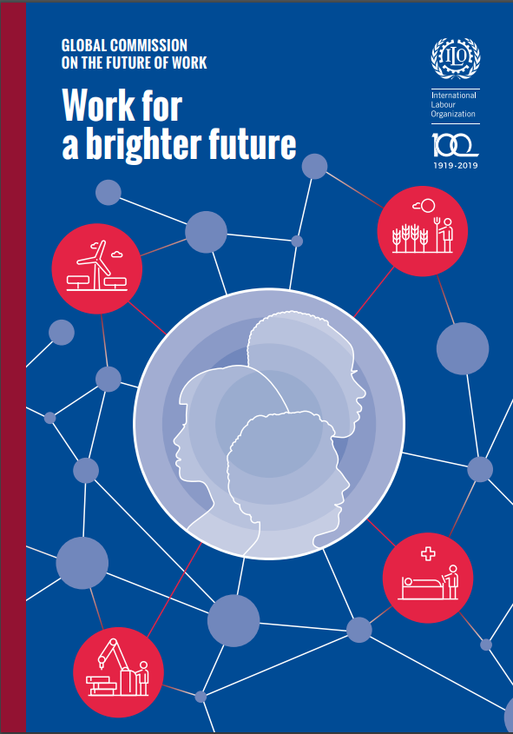
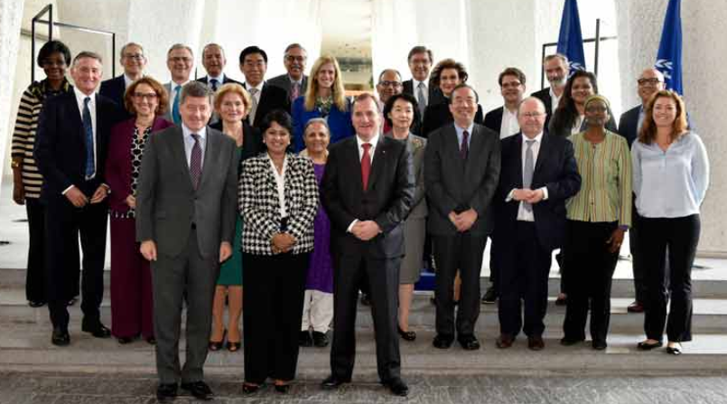
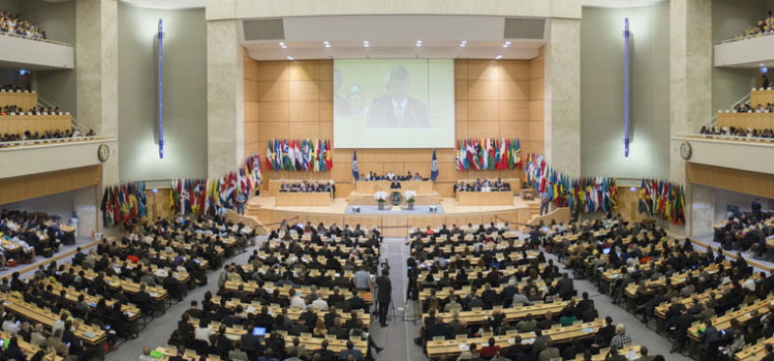
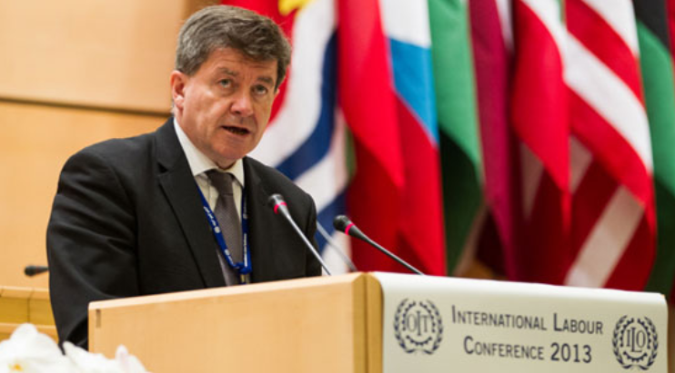
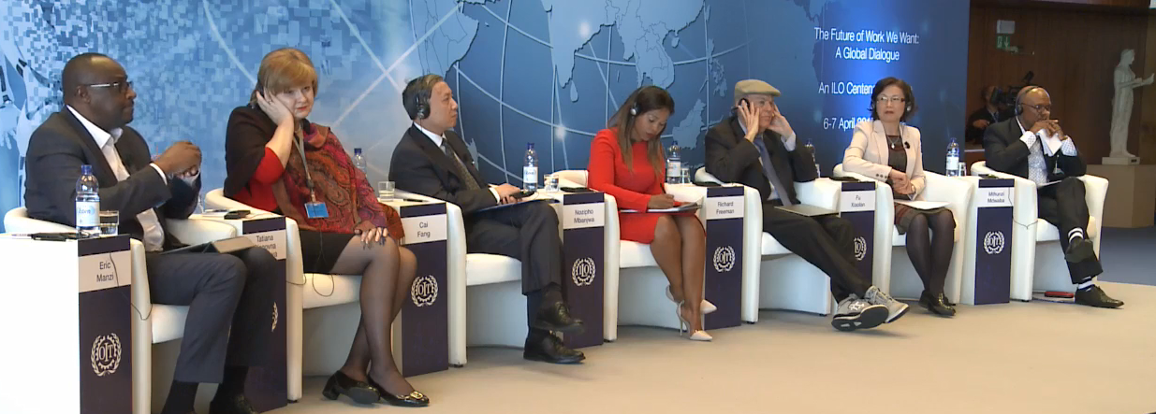
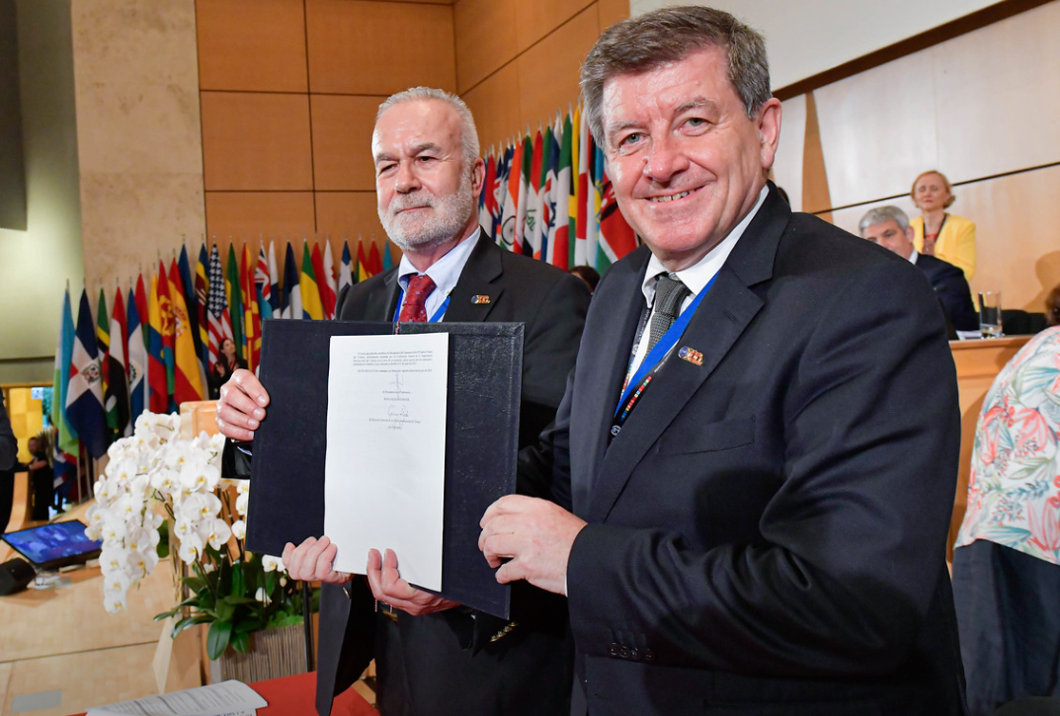
Shaping the Future of Work
2019
2015
Report of
Global Commission on FoW
Centenary initiative adopted
108th ILC
Centenary Declaration for the FoW
2017
2013
Global Dialogue:
The FoW we want
Centenary initiative on FoW
Notes:
These are not new concerns. Constituents have been working with the ILO and experts around the world for years on this subject. Our DG Guy Ryder captured concerns in 2013 and proposed a Centenary initiative. Adopted in 2015, led to more than 100 national dialgues and global dialogues such as the one hosted in Geneva in 2017 – The FoW we want. In these dialogues, constituents and experts discussed the world of work, the changes that they were observing in it, and what we could expect from the In 2017 the ILO established a Global Commission on the Future of Work. 20 plus outstanding individuals representing a remarkable variety of backgrounds, expertise, and geographic experience, to analyze this rapidly transforming world of work and what are the implications of change for the promotion of social justice. In June, the International Labour Conference adopted the declaration.
Now, let’s stop there for a second.

Slide 14




Shaping the Future of Work
Technology
Climate change
Demography
Globalization
Notes:
Change is upon us. Change is inevitable, and let’s face it, we probably don’t exactly know what the Future of Work will look like. We can certainly look at trends until now, and make projections. Some indicators are easier than others to project. We can look at labour force growth and calculate how many jobs will probably need to be created by 2030 to match that expansion.
However, what is clear is that the Future of Work is not something that we can only passively receive. It is not. Countries have the means to shape the Future of Work that they want. For that to happen, two steps are needed:
Understand very well what is happening now, and the opportunities and challenges that are opening up – so that we can stir a bit that future in the way we want, towards the opportunities. And this is what the report does
We want to have our high-level objectives and values very clear, and our responsibilities as governments, workers and employers representatives, we accept them and we work together to manage the effects of change and use all opportunities that change presents to us. Our Deputy Dir General just reminded us there will be hard choices to make. We want to have a compass And this is what the Declaration does for us.

Slide 15
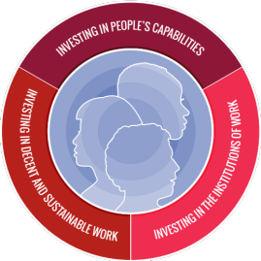
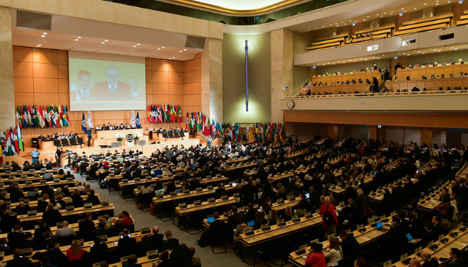
Shaping the Future of Work
2019
Report of
Global Commission on FoW
What is happening in the world of work?
What implications for workers, institutions, and the economy as a whole?
Analysis
108th ILC
Centenary Declaration
for the FoW
Compass
Notes:
Understand very well what is happening now, and the opportunities and challenges that are opening up – so that we can stir a bit that future in the way we want, towards the opportunities. And this is what the report does
We want to have our high-level objectives and values very clear, and our responsibilities as governments, workers and employers representatives, we accept them and we fulfil them during the confusion of uncertainty. Our Deputy Dir General just reminded us there will be hard choices to make. We want to have a compass And this is what the Declaration does for us.
The report provides a very thorough analysis of the issues that are emerging now, the challenges and the opportunities related to them, particularly looking at these implications for workers, for institutions, and for the economy and macrosystem as a whole. It analyses the issue of technology for instance, going into how digital technology has created new challenges for the application of labour protection, think of digital labour platforms for instance. But also analyzing how automation can significantly improve occupational safety and health at the workplace (videos of Vietnamese factories where the use of a machine now avoids that workers have to put their hands close to the blade of a metal cutter. Skilsl and rapid changes and shift from obtaining a qualification to skills and the opportunity to develop a real lifelong approach to learning, and WOMEN. If the future of 20 years from now is probably hard to predict, for sure the report provides a comprehensive picture of what is happening and gives us all an analytical base to then discuss policy responses and in doing this for us, it takes away a good part of the uncertainty.
this is relevant to VN and diversification of economy > the report

Slide 16
Shaping the Future of Work
In times of transformative change….
The ILO will pursue with unrelenting vigour social justice for everyone, everywhere
Fundamental for sustainable development that ends poverty and leaves no one behind
People at the heart of economic, social, and environmental policy
Call for action for all member states
108th ILC
Centenary Declaration
for the FoW
Compass
Notes:
The ILO enters its second century at a time of transformative change in the world of work. Now the Declaration says that in times of exceptional change, the fundamental constitutional mandate of the ILO remains unchanged – pursue social justice for everyone, everywhere, and that’s because social justice remains a central aspirations of workers across the world. The fact that we respond to change with tripartite action and normative action. This remains unchanged.
This is fundamental…
The ILO will further develop its human centred approach that puts people are at the heart of economic, social and environmental policies.
The Declaration issues a call to action for all member States – as they navigate uncertainty and make policy choices on how to move forward, their compass is to ensure all people benefit from the changing world of work, that the employment relationship remains fully relevant, that all workers are guaranteed the protection they need, and that economic growth is sustainable, inclusive and aimed at the promotion of full employment and decent work.
THIS is a roadmap to take countries forward in the Future of Work and to take the ILO forward in its future, because to quote our Director General, The Future of Work is the future of our organization

Slide 17
Shaping the Future of Work in Viet Nam
Voices from the world of work
What is happening in the world of work in Viet Nam?
What implications for workers, institutions, and the economy as a whole?
Viet Nam’s Labour Forum
Future of Work: The Choice of Viet Nam
Leaders of ILO Constituents in Viet Nam
What compass for a way forward in Viet Nam?
Today
November 2019
Notes:
Compass and how we can work together to shape the Future of Work in Viet Nam

