Slide 1
Disparities in the COVID Crisis
Prepared for the DC LERA
William E. Spriggs
May 27, 2020

Slide 2
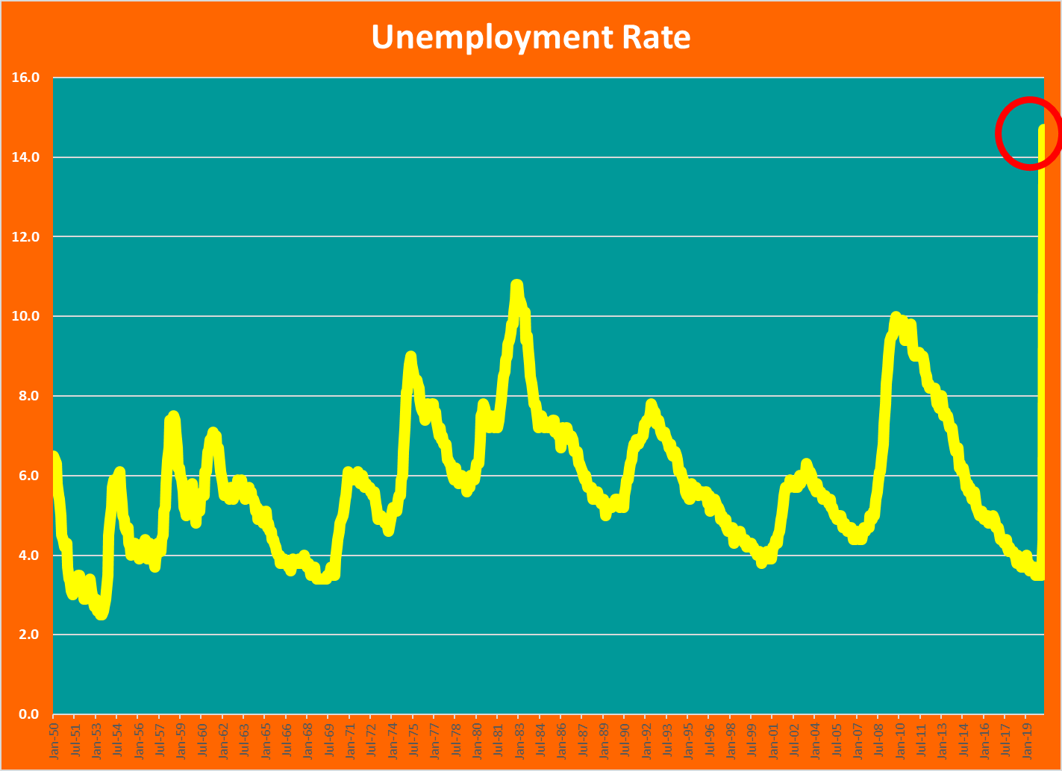

Slide 3
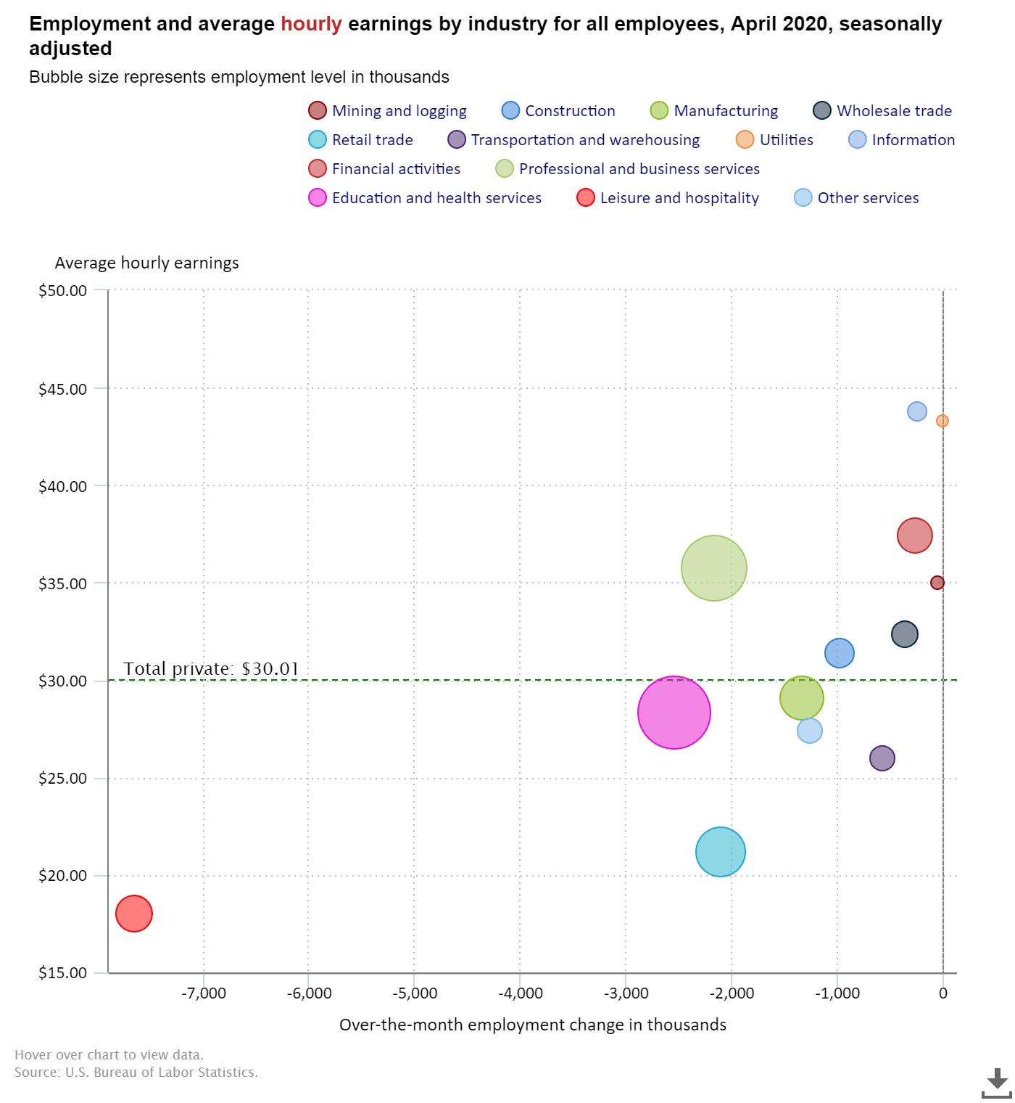

Slide 4
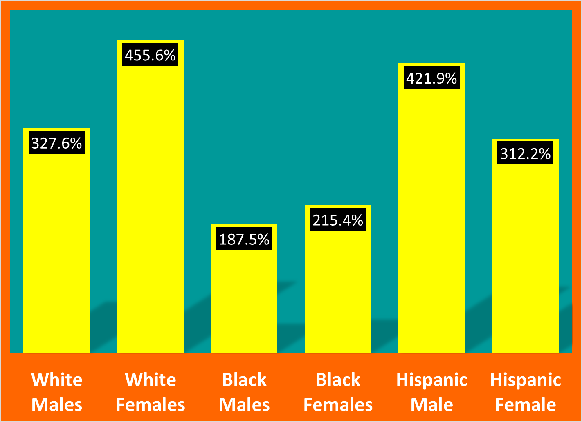
% Changes in Unemployment Rates for Adults
By Race, January to April 2020

Slide 5
Black and White Male Unemployment Rates
1972-2020

Slide 6
Historically the Black to White Male Unemployment Rate has averaged 2.2-to-1 in April it is 1.3-to-1

Slide 7
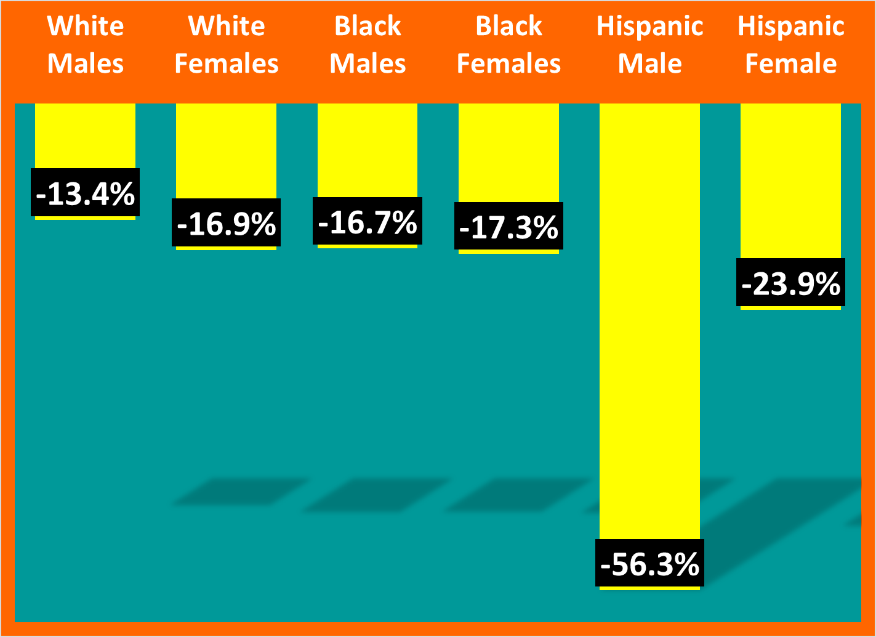
% Changes in Adult Employment to Population Ratios,
By Race, January to April 2020

Slide 8
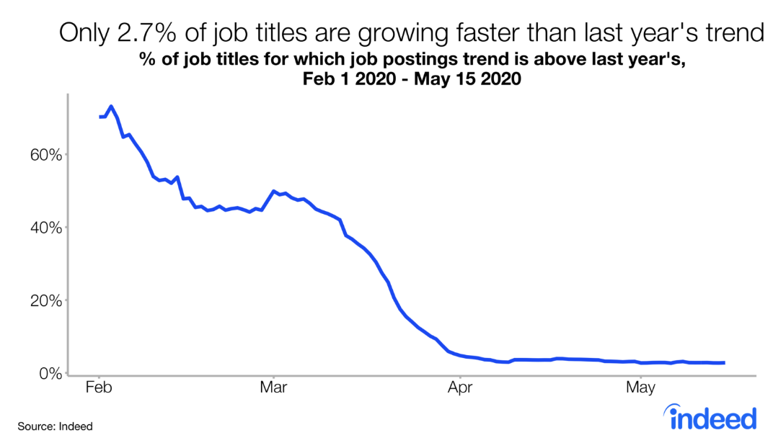
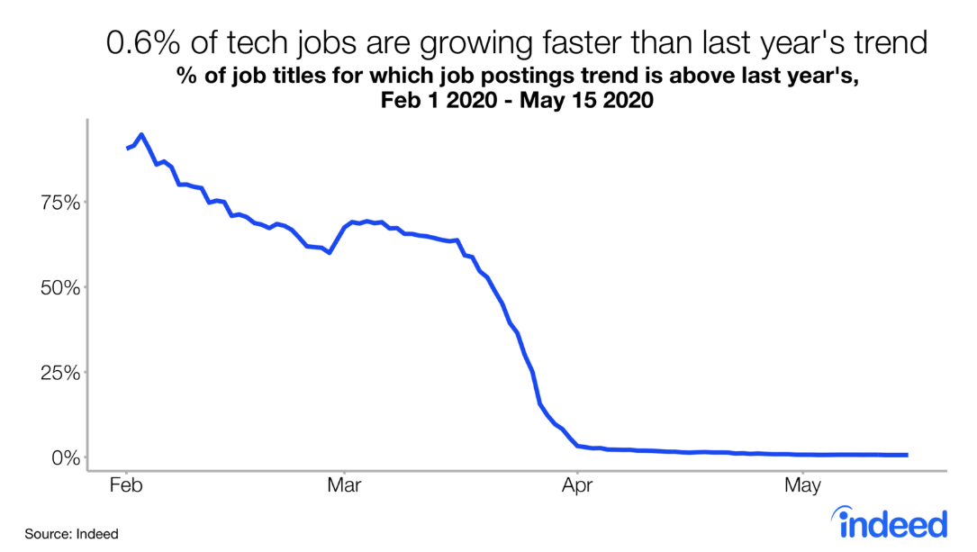
Job Openings are grinding to halt, and it is widespread across occupations
Source: Bunker, Decline in Job Postings Trend Across Nearly All Job Titles, Indeed Hiring Lab, https://www.hiringlab.org/2020/05/20/universal-decline-across-job-postings/

Slide 9
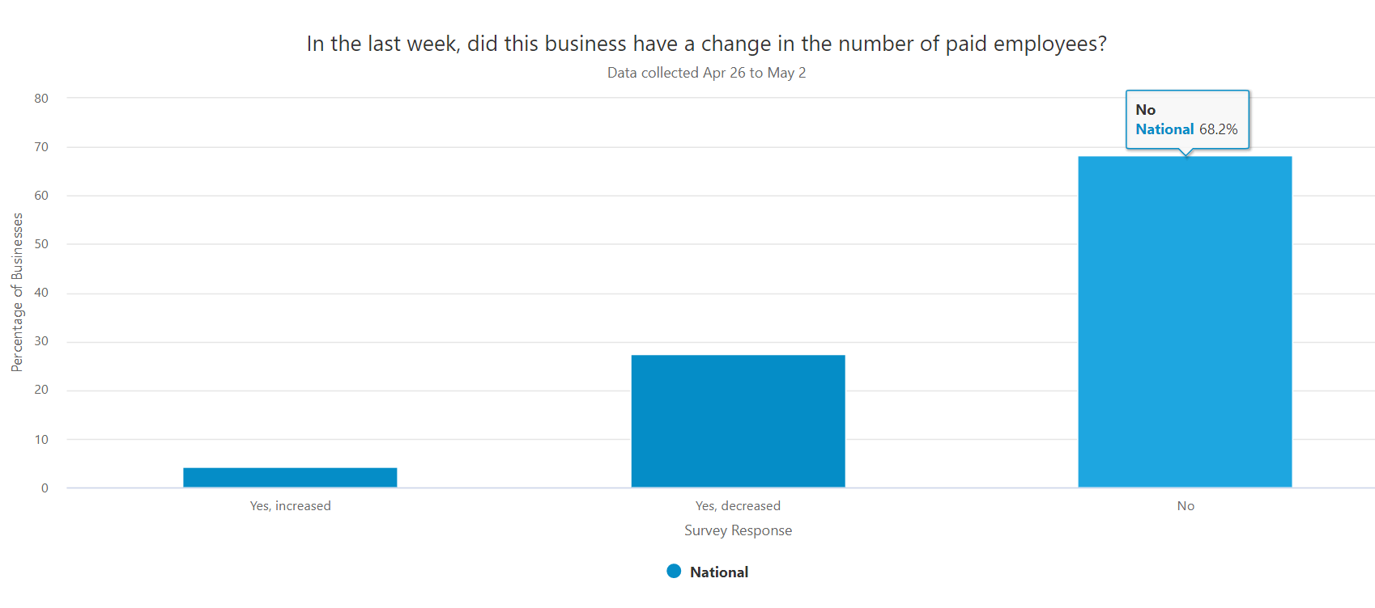
Census Bureau Flash Survey of Small Businesses

Slide 10
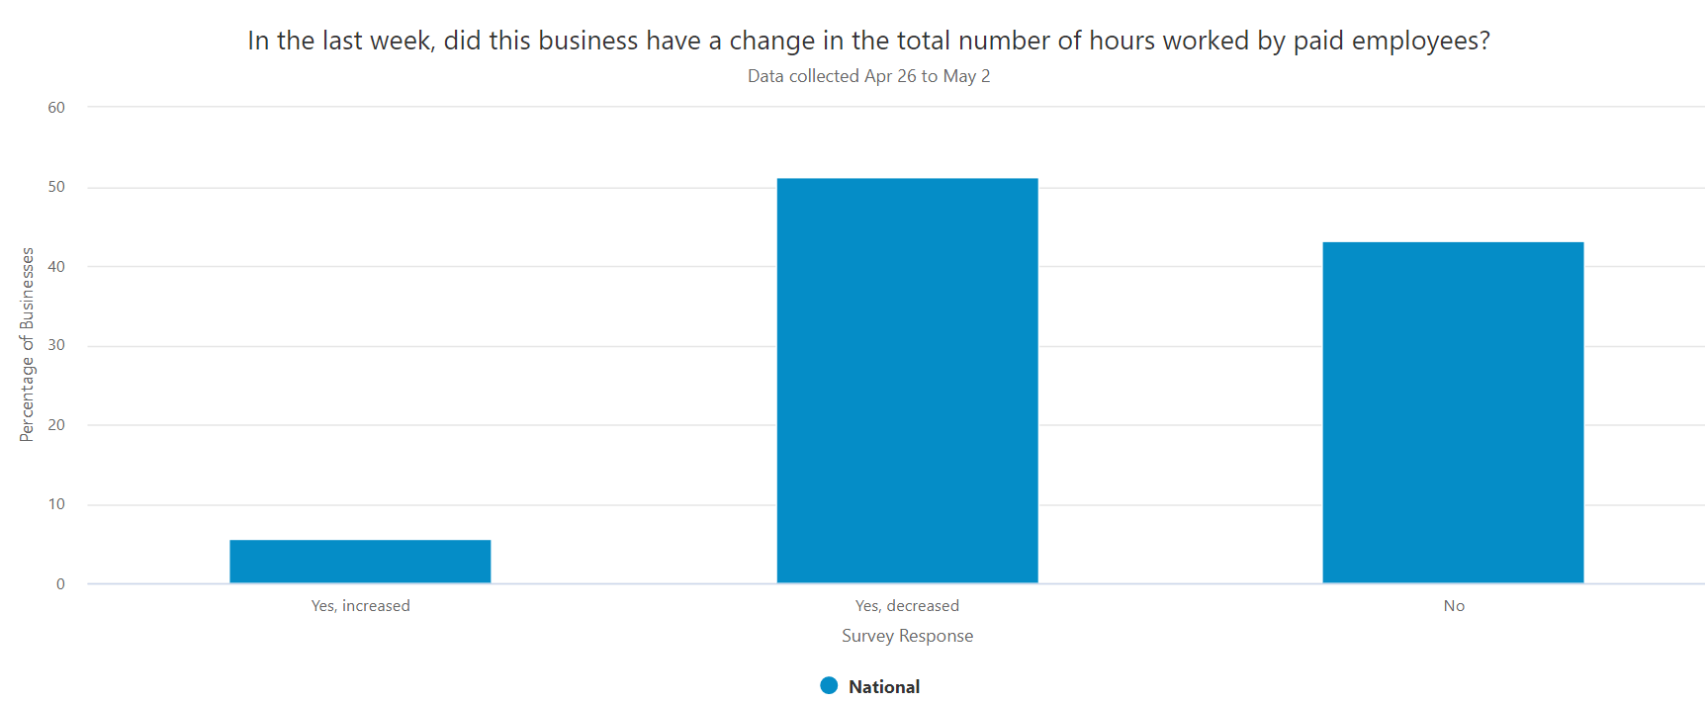
The big effect was the drop in hours, much bigger than the drop in employees

Slide 11
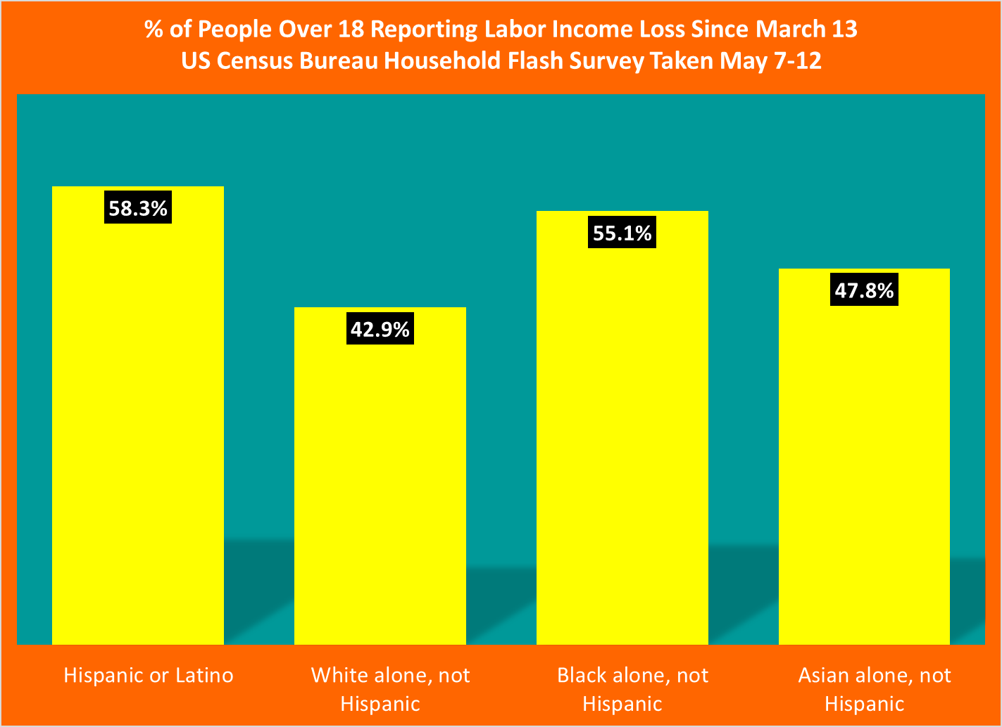

Slide 12
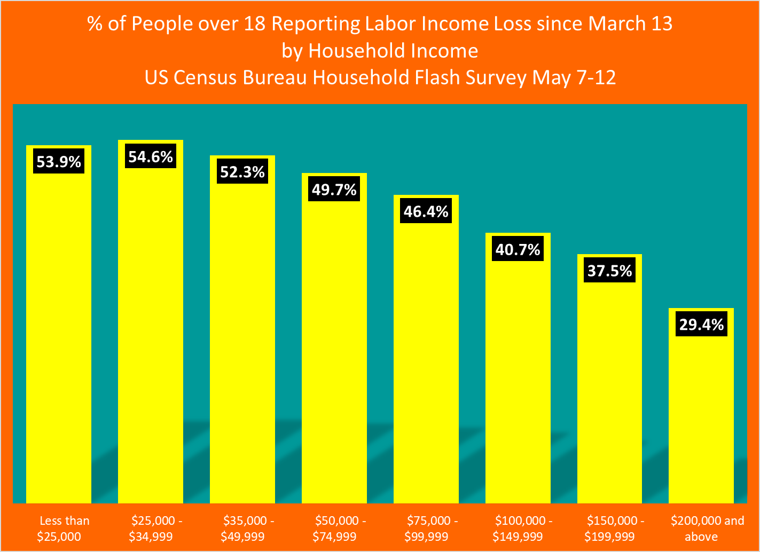

Slide 13
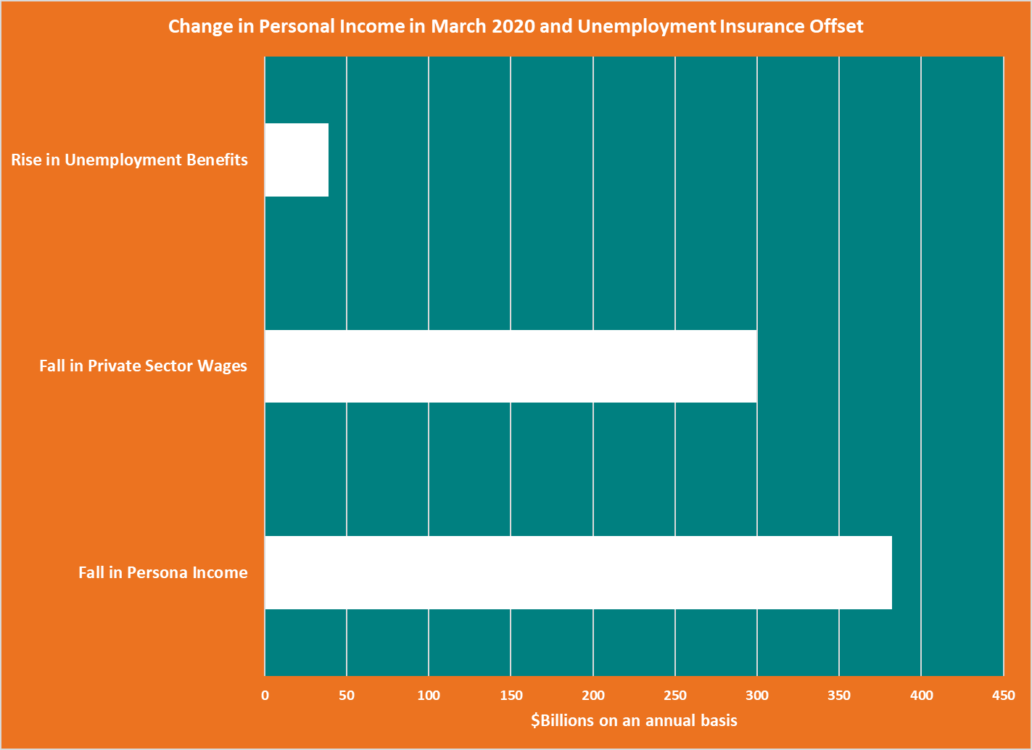

Slide 14
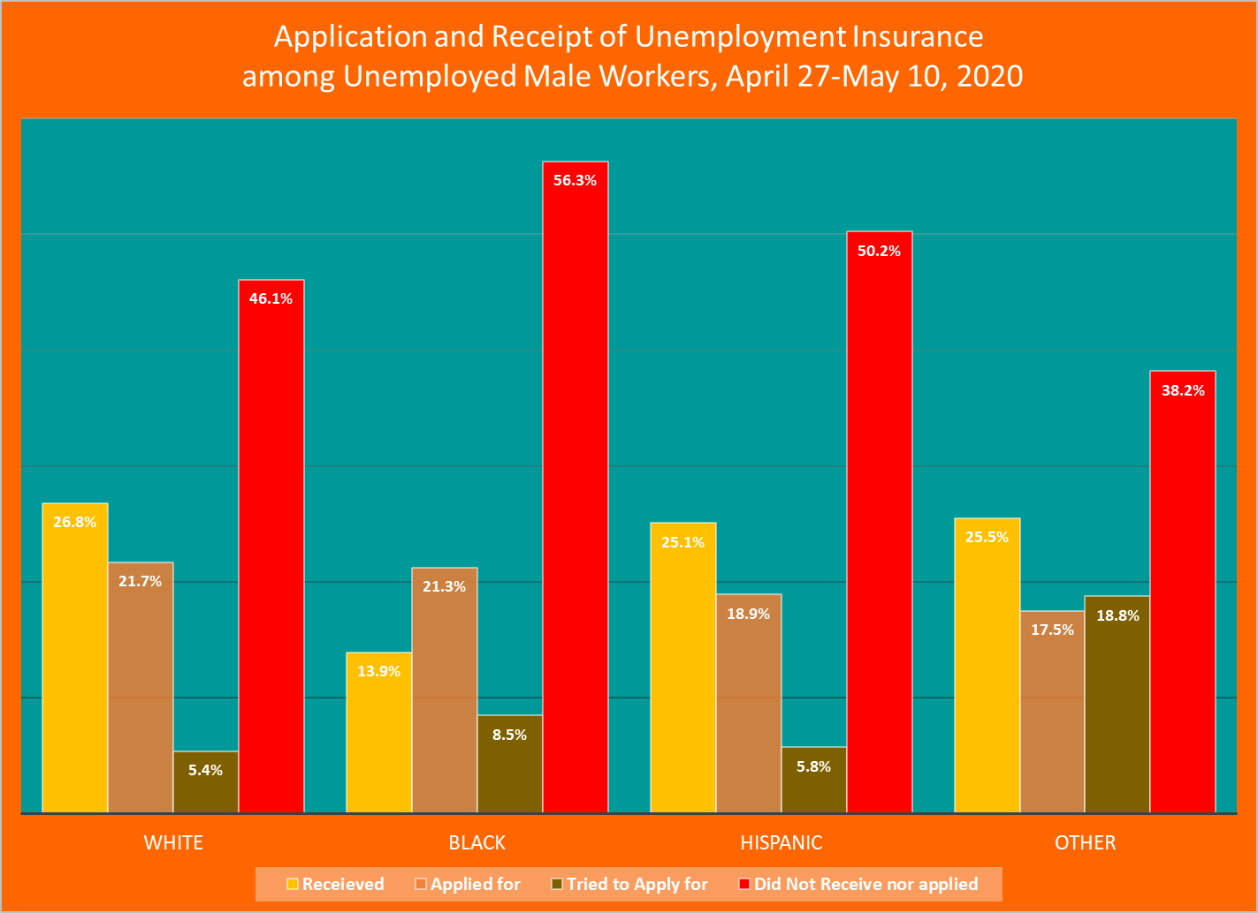
Source: Calculations by Brown and Spriggs using Abigail Wozniak, Joe Willey, Jennifer Benz, and Nick Hart. COVID Impact Survey: Version 1 [dataset]. Chicago, IL: National Opinion Research Center, 2020.

Slide 15
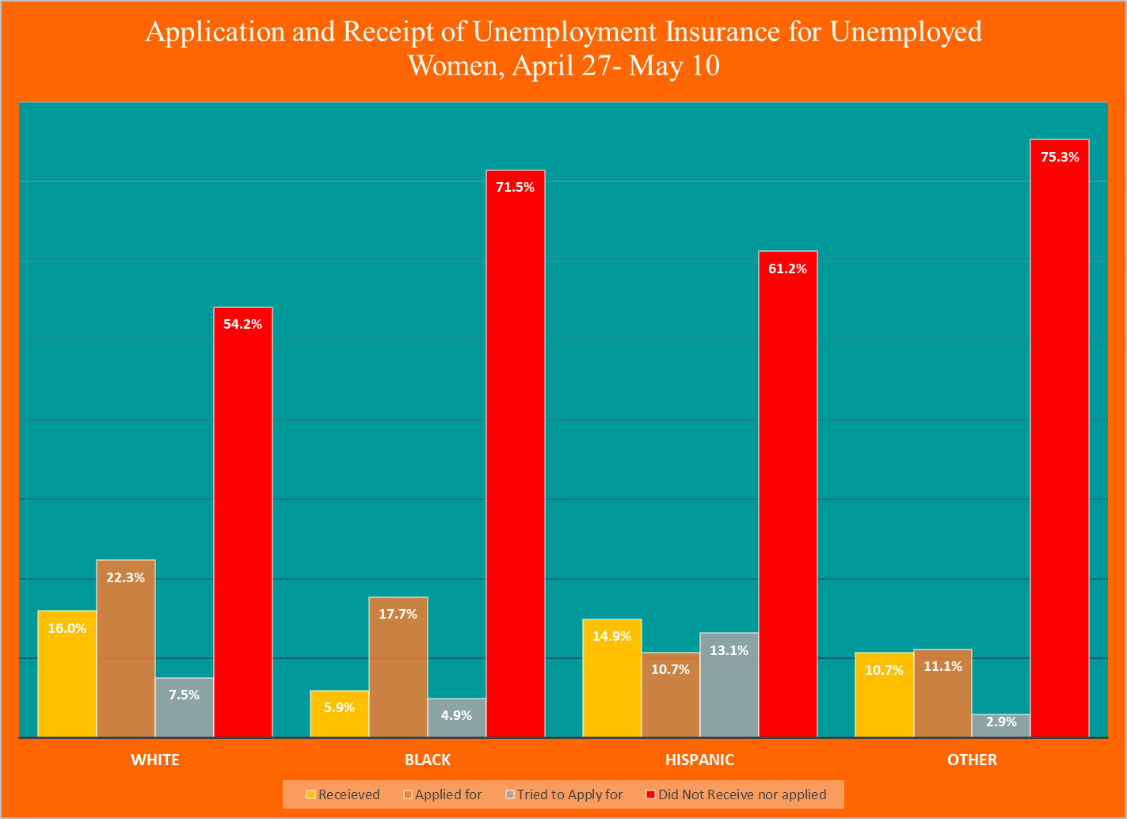

Slide 16
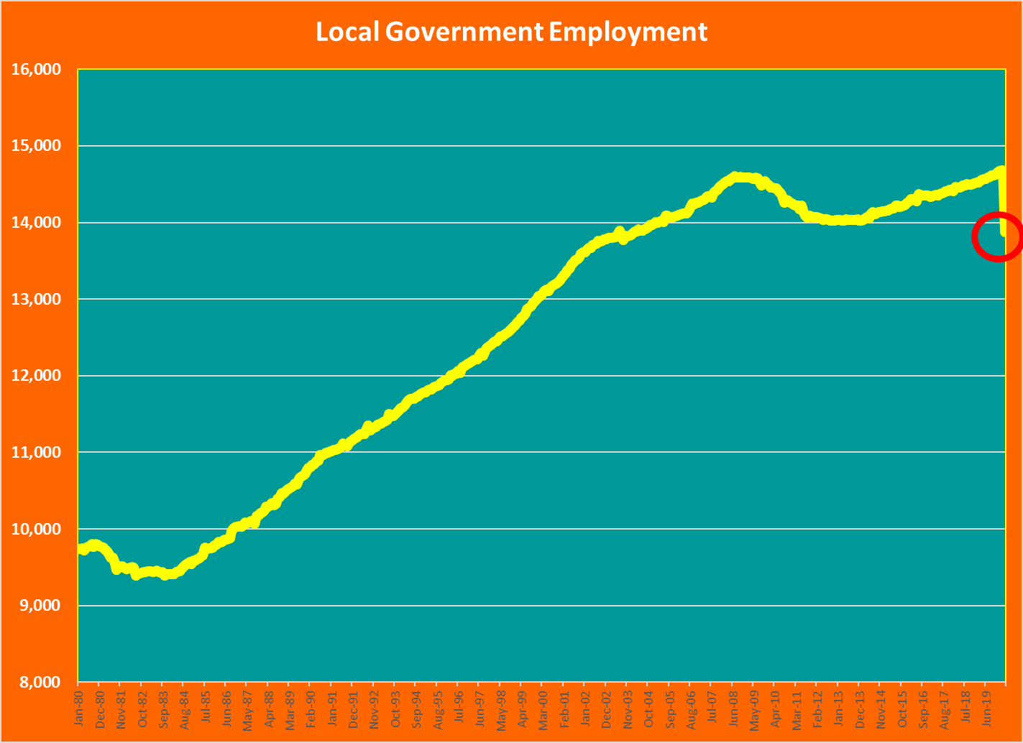

Slide 17
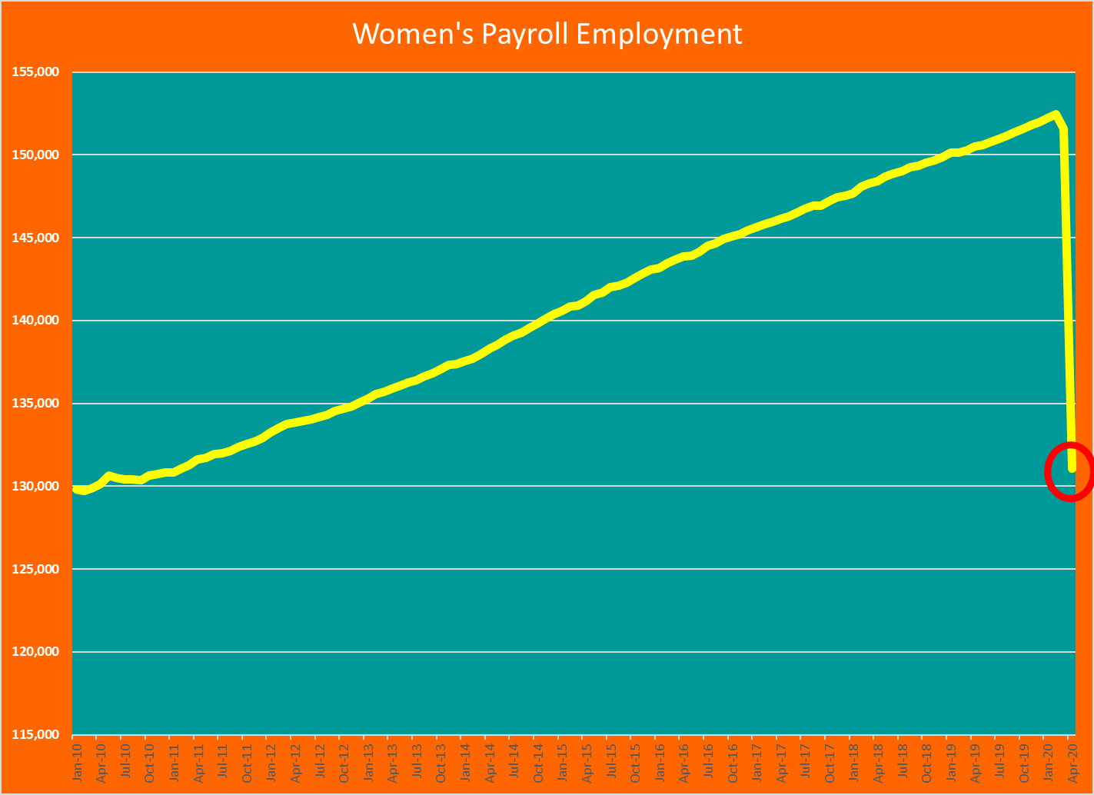
Dramatic Decline in Women’s Payroll dropped Women back to less than half the work force

Slide 18
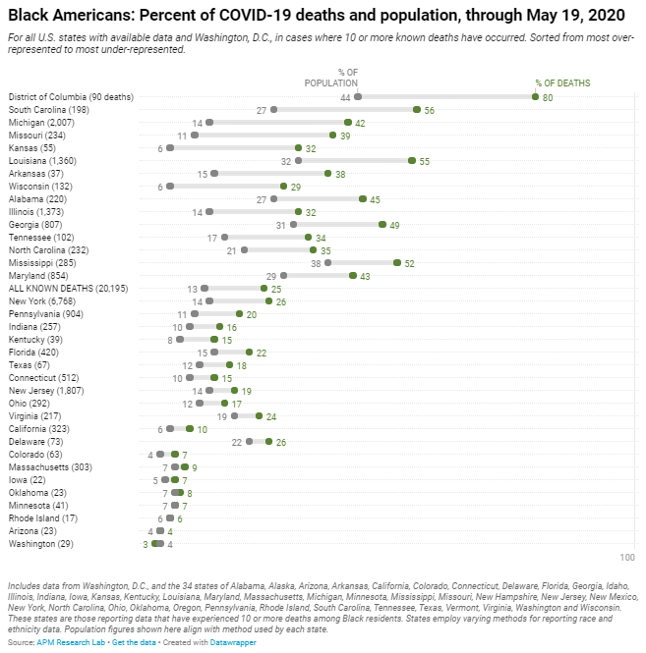
Amp Research Lab Staff, THE COLOR OF CORONAVIRUS: COVID-19 DEATHS BY RACE AND ETHNICITY IN THE U.S., https://www.apmresearchlab.org/covid/deaths-by-race

Slide 19
CDC Study of adult cases in Georgia
305 patients from 7 hospitals in metropolitan Atlanta and one community hospital in southern Georgia over age 18 with laboratory-confirmed COVID-19 during March 1 – March 30, 2020
Median Age 60
83.2% were Black (compared to 47% of all patients)
73.8% had conditions considered high-risk for severe COVID-19

Slide 20
Comorbidity factors in Georgia study
Diabetes was documents in 39.7% of patients
  BUT WAS NOT SIGNIGICANTLY MORE COMMON IN BLACK THAN NONBLACK PATIENTS
Cardiovascular disease was documentd in 25.6% of patients
  PREVALENCE WAS SIMILAR IN BLACK AND NONBLACK PATIENTS

Slide 21
Only hypertension (not considered a high-risk condition) showed racial differences
Chronic lung disease was documented for 20.3% of patients
  Asthma in 10.5% of patients
  Chronic obstructive pulmonary disease in 5.2% of cases
  NO SIGNIFICANT DIFFERENCES BY AGE OR RACE
Severe obesity (BMI>40) present in 12.7% of patients
  DID NOT DIFFER SIGNIFICANTLY BY RACE
Only Hypertension, 67.5% of patients, was more common among Black versus nonblack patients

Slide 22
Key outcome variable
THE FREQUENCY OF Invasive Mechanical Ventilation AND FATALITY DID NOT DIFFER BY RACE
25% OF PATIENTS HAD NO HIGH-RISK CONDITIONS, BUT 5% OF THESE PATIENTS DIED
Source: Gold JA, Wong KK, Szablewski CM, et al. Characteristics and Clinical Outcomes of Adult Patients Hospitalized with COVID-19 — Georgia, March 2020. MMWR Morb Mortal Wkly Rep 2020;69:545–550. DOI: http://dx.doi.org/10.15585/mmwr.mm6918e1

Slide 23
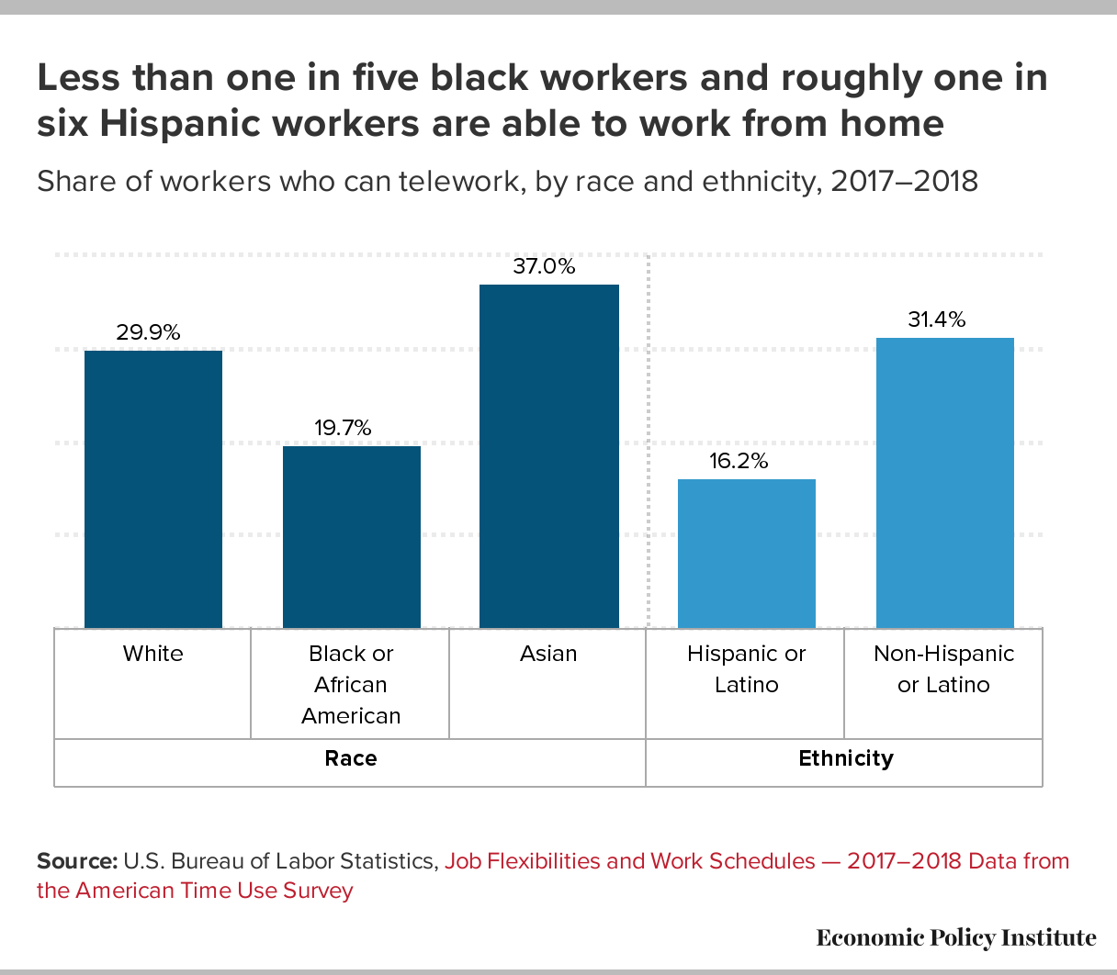
Gould and Shierholz, Not everybody can work from home: Black and Hispanic workers are much less likely to be able to telework, Economic Policy Institute https://www.epi.org/blog/black-and-hispanic-workers-are-much-less-likely-to-be-able-to-work-from-home/

Slide 24
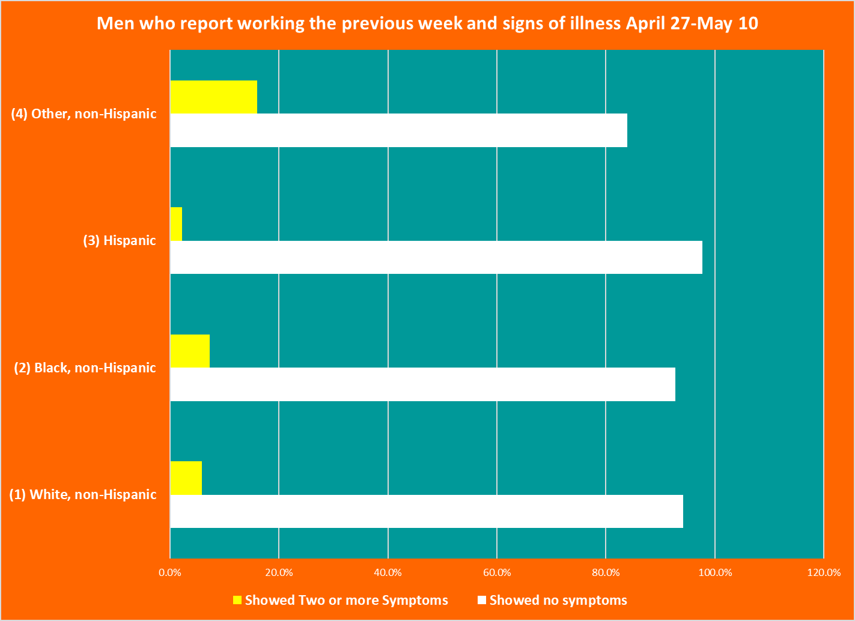
Source: Calculations by Brown and Spriggs using Abigail Wozniak, Joe Willey, Jennifer Benz, and Nick Hart. COVID Impact Survey: Version 1 [dataset]. Chicago, IL: National Opinion Research Center, 2020.

Slide 25
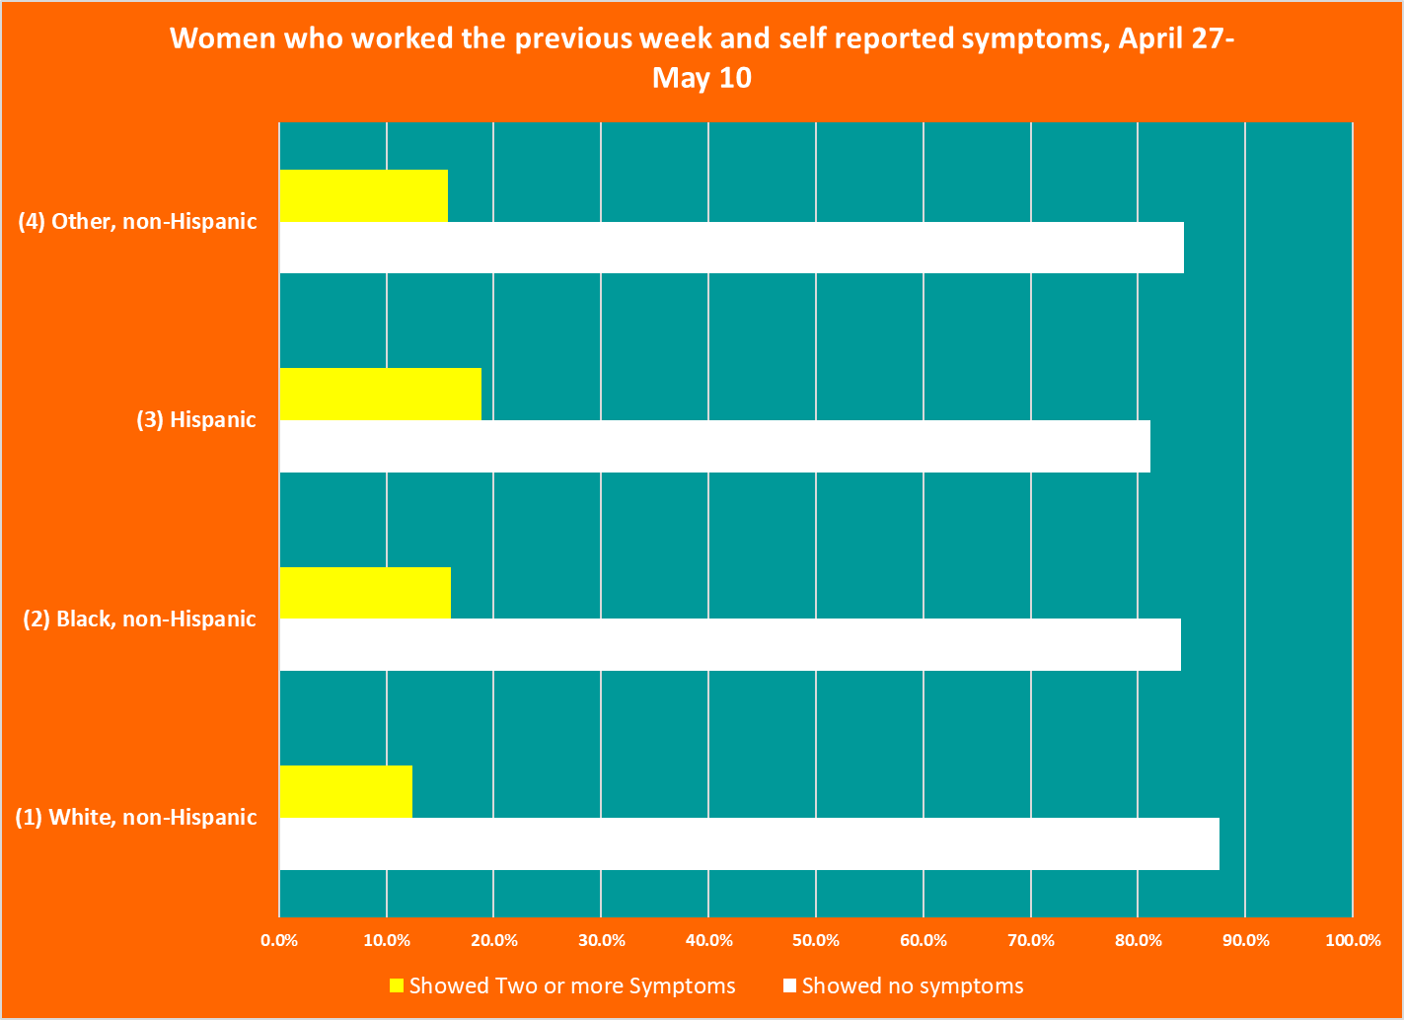
Source: Calculations by Brown and Spriggs using Abigail Wozniak, Joe Willey, Jennifer Benz, and Nick Hart. COVID Impact Survey: Version 1 [dataset]. Chicago, IL: National Opinion Research Center, 2020.

Slide 26
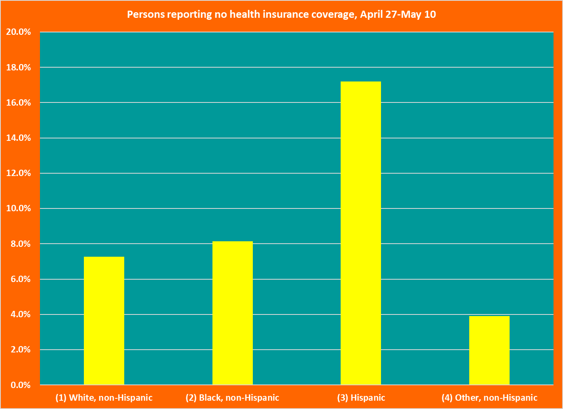
Source: Calculations by Brown and Spriggs using Abigail Wozniak, Joe Willey, Jennifer Benz, and Nick Hart. COVID Impact Survey: Version 1 [dataset]. Chicago, IL: National Opinion Research Center, 2020.

Slide 27
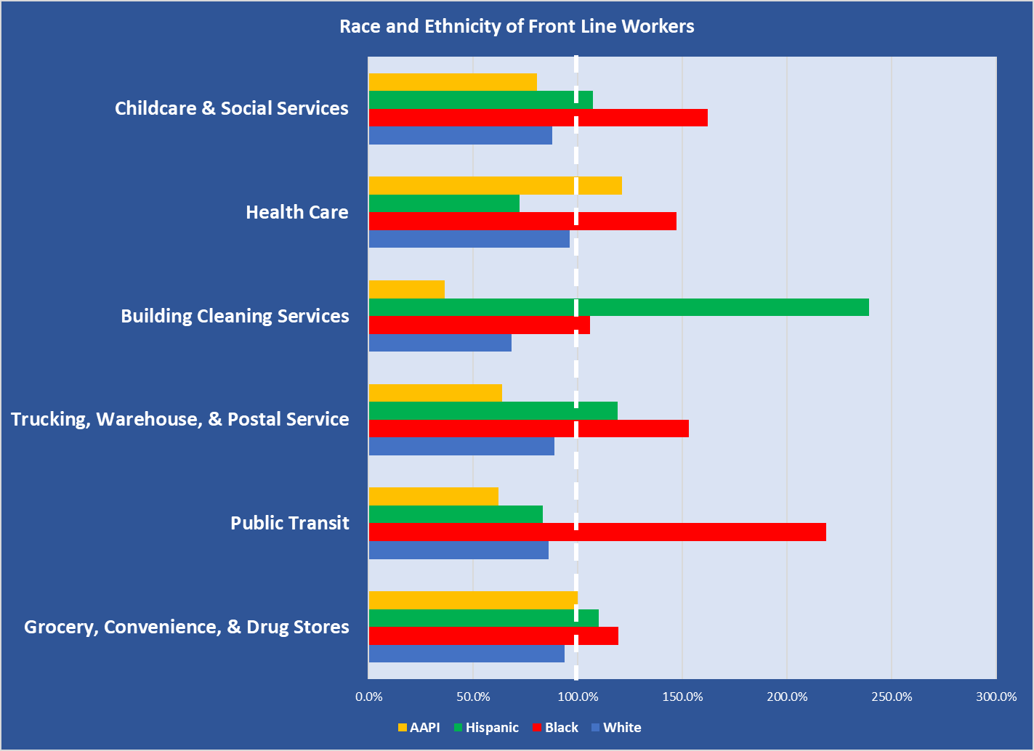
Source: Rho, Brown and Fremsted, A Basic Demographic Profile of Workers in Frontline Industries, Center for Economic Policy and Research, https://cepr.net/a-basic-demographic-profile-of-workers-in-frontline-industries/

Slide 28
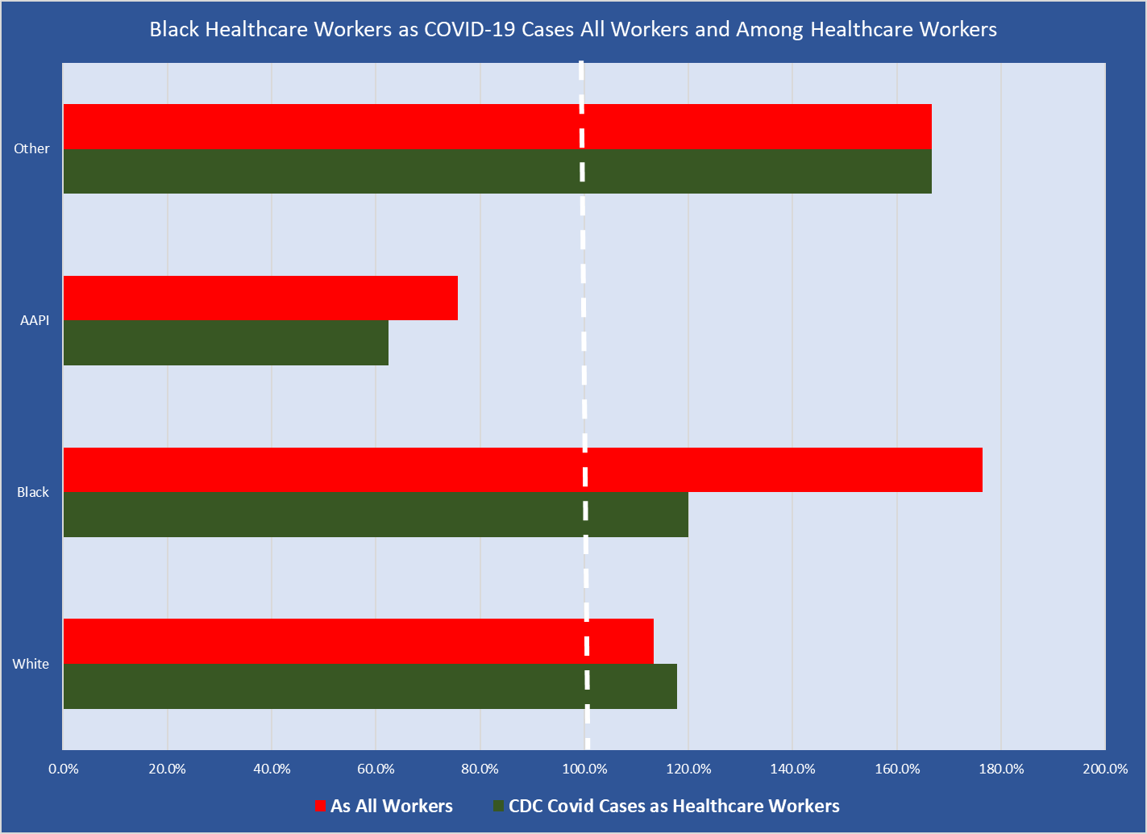
Source: Characteristics of Health Care Personnel with COVID-19 — United States, February 12–April 9, 2020. MMWR Morb Mortal Wkly Rep 2020;69:477–481. DOI: http://dx.doi.org/10.15585/mmwr.mm6915e6external icon

Slide 29
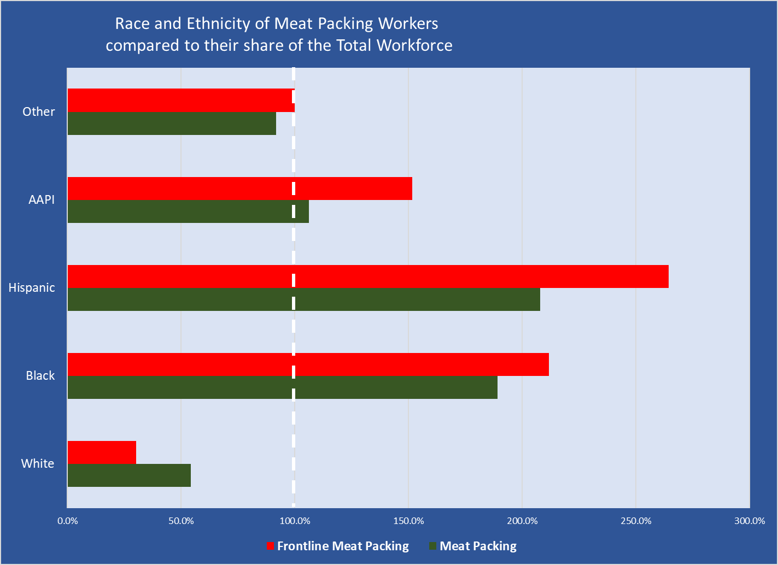
Source: Fermstad, Rho and Brown, MEATPACKING WORKERS ARE A DIVERSE GROUP WHO NEED BETTER PROTECTIONS, https://cepr.net/meatpacking-workers-are-a-diverse-group-who-need-better-protections/

Slide 30
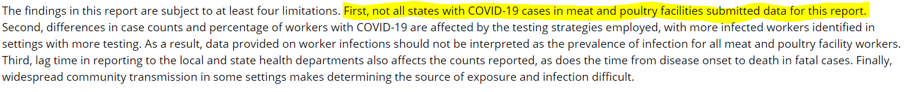
An embarrassing lack of data
Given the spread of COVID in workplaces, this from the Center for Disease Control is shocking
Among 315,531 U.S. COVID-19 cases reported to CDC during February 12–April 9, data on HCP occupational status were available for 49,370 (16%), among whom 9,282 (19%) were identified as HCP

Slide 31
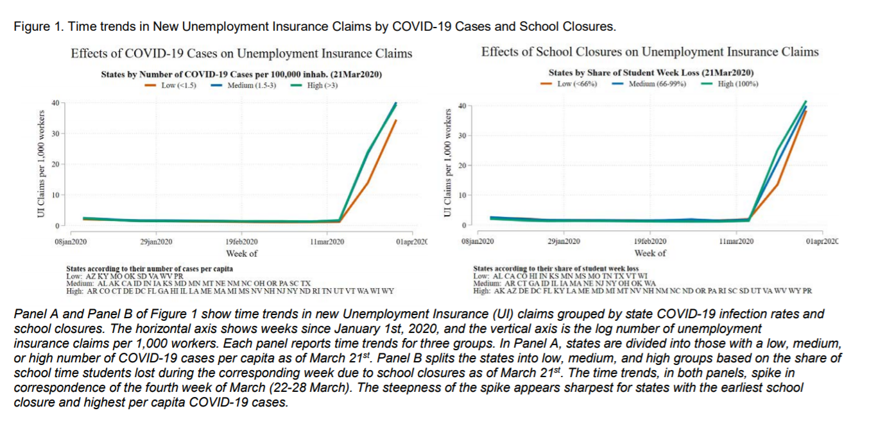
The dominant effect of rising COVID infections drove the spike in UI claims much more than school closure policies
Source: Roja, Jeing, Montenovo, et. al. IS THE CURE WORSE THAN THE PROBLEM ITSELF? IMMEDIATE LABOR MARKET EFFECTS OF COVID-19 CASE RATES AND SCHOOL CLOSURES IN THE U.S., NBER Working Paper 27127 https://www.nber.org/papers/w27127.pdf

