Slide 1
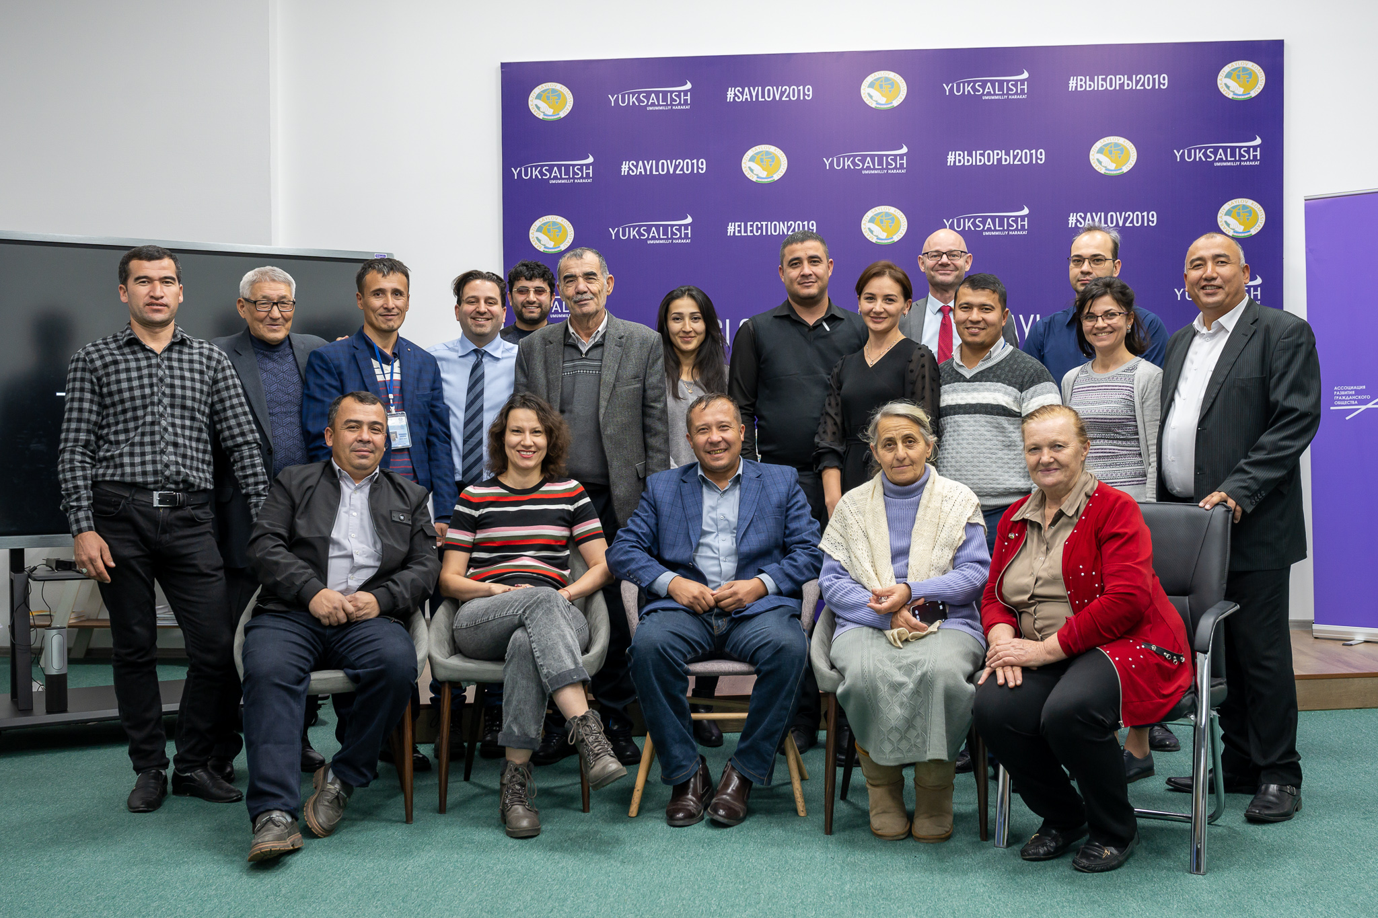
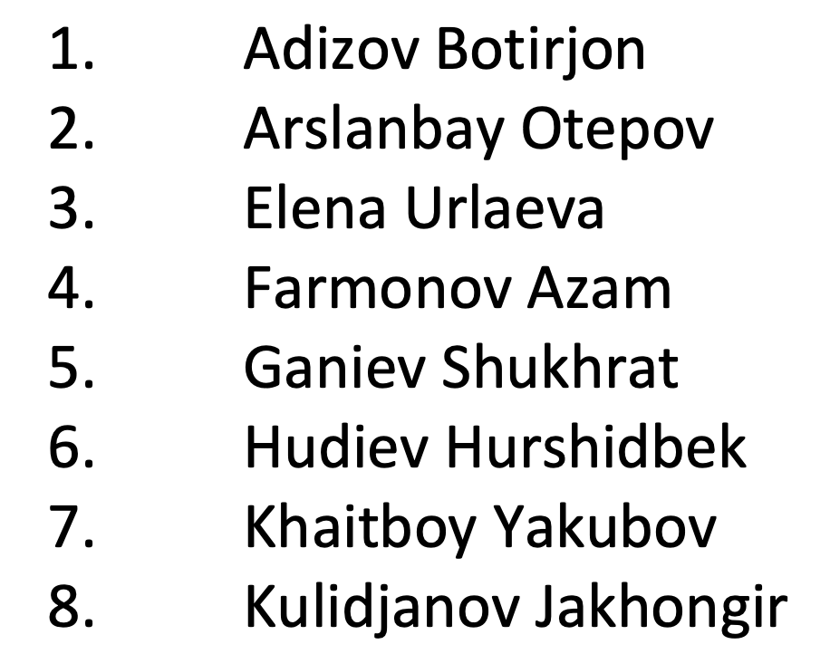
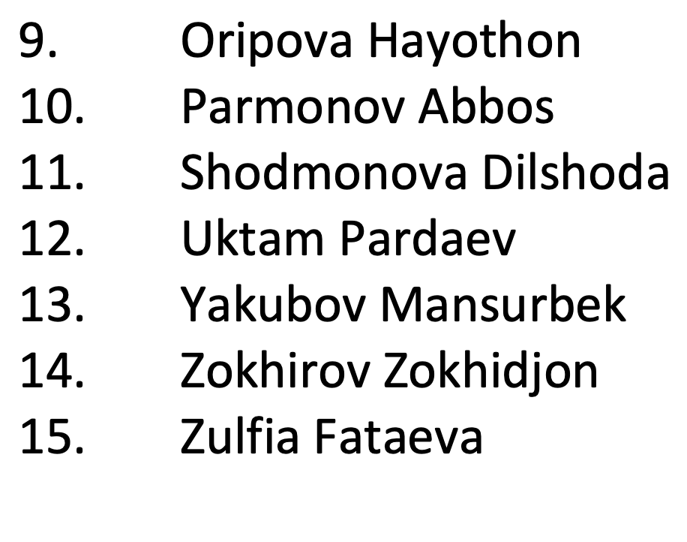
ILO THIRD-PARTY MONITORING IS CONDUCTED BY LOCAL HUMAN RIGHTS ACTIVISTS
Over 7,000 interviews across all provinces and districts. Over 2,000 cases tracked through feedback mechanisms. Network of investigative journalists.

Slide 2
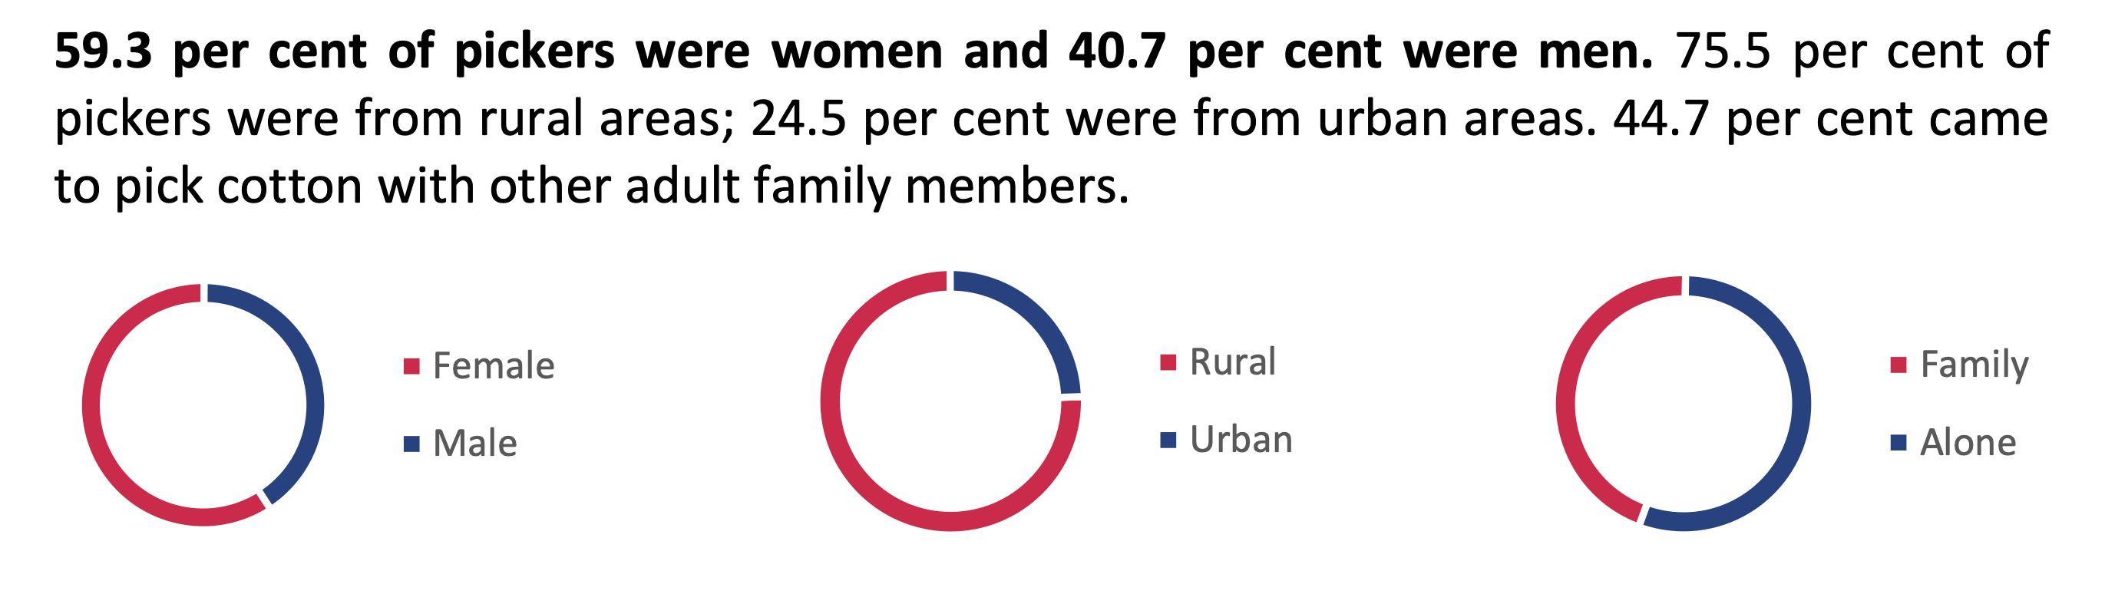
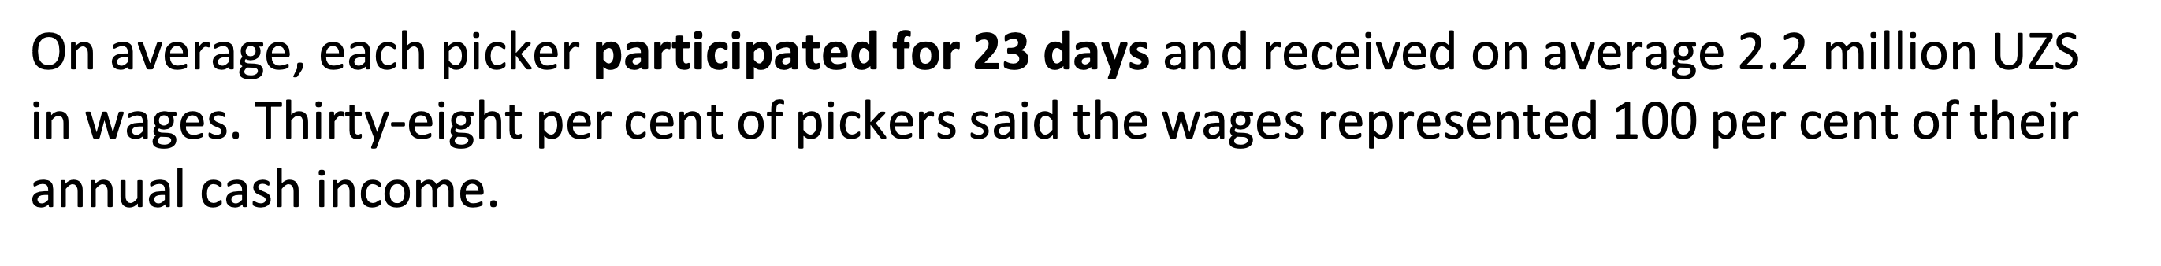
WHO ARE THE 1.8 MILLION PEOPLE PICKING COTTON?

Slide 3
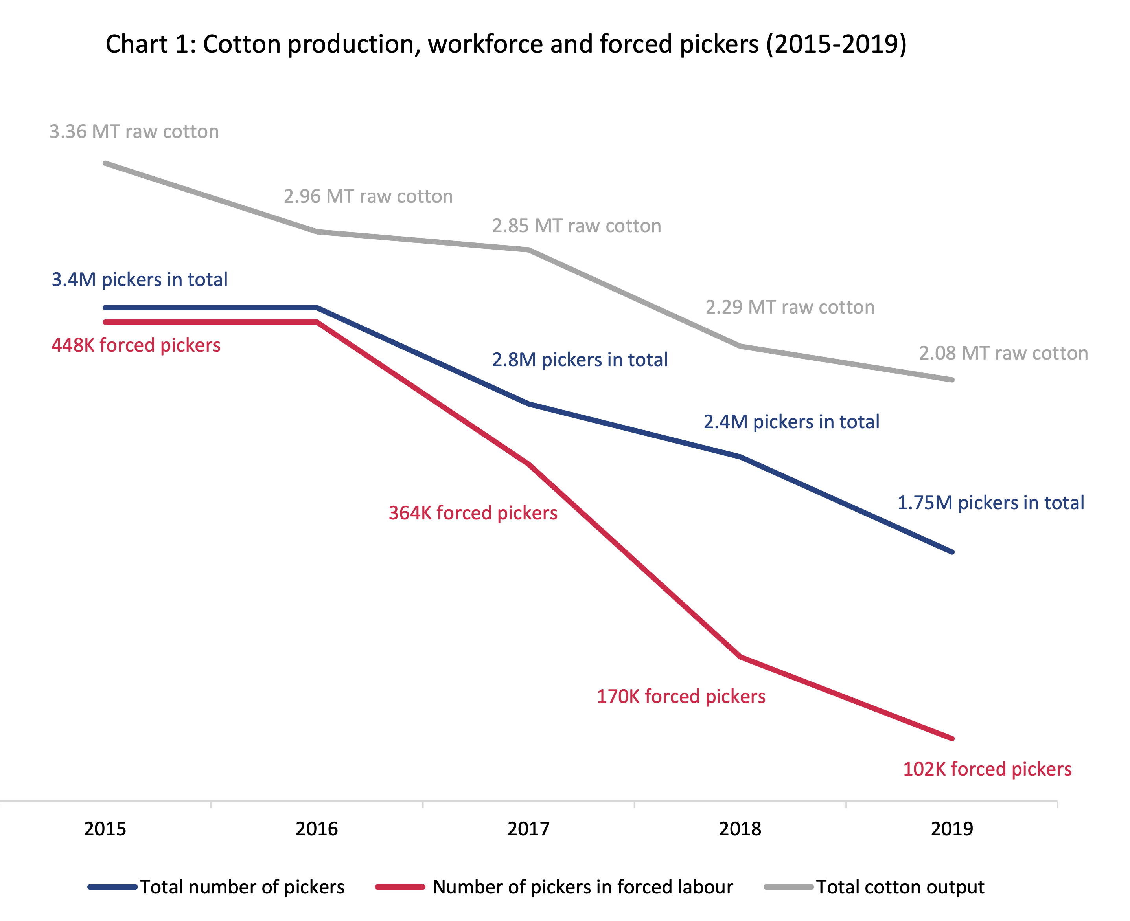

Slide 4
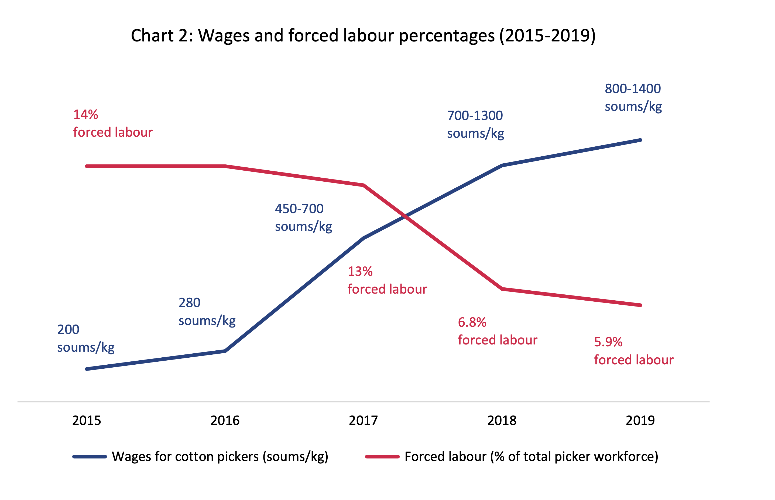

Slide 5
KEY DEVELOPMENTS FOR THE 2020 HARVEST
Abolishment of state order system for cotton production
Criminalization of forced labour
Registration of independent civil society organizations
Doubling of labour inspector capacity
Ongoing privatization of cotton sector
ILO recommends and supports trade and investment by responsible international investors in Uzbekistan
COVID-19 Impact

