Slide 1
Building a Foundation for Continued Progress
Webinar, “Beyond Cotton: Lessons Learned and Next Steps in Uzbekistan”
May 28, 2020

Slide 2
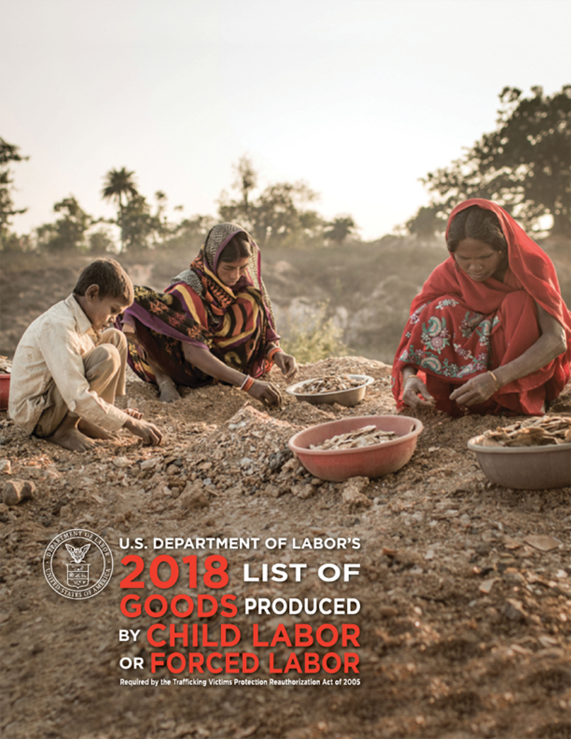
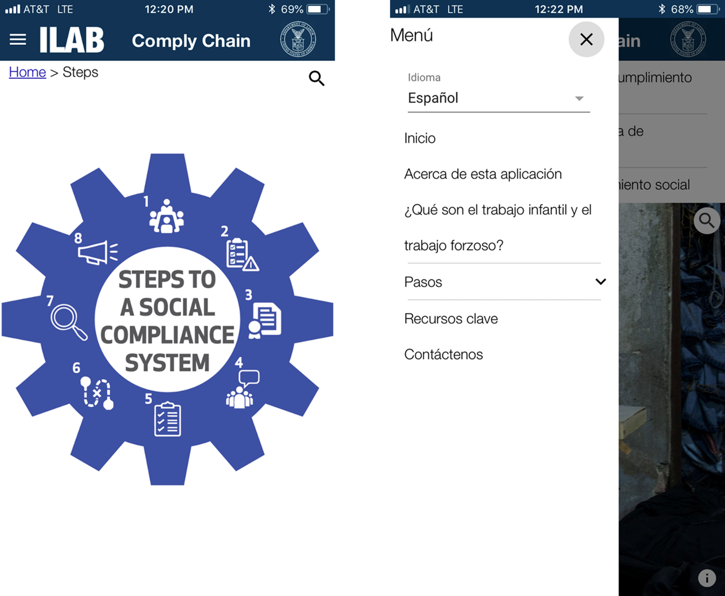
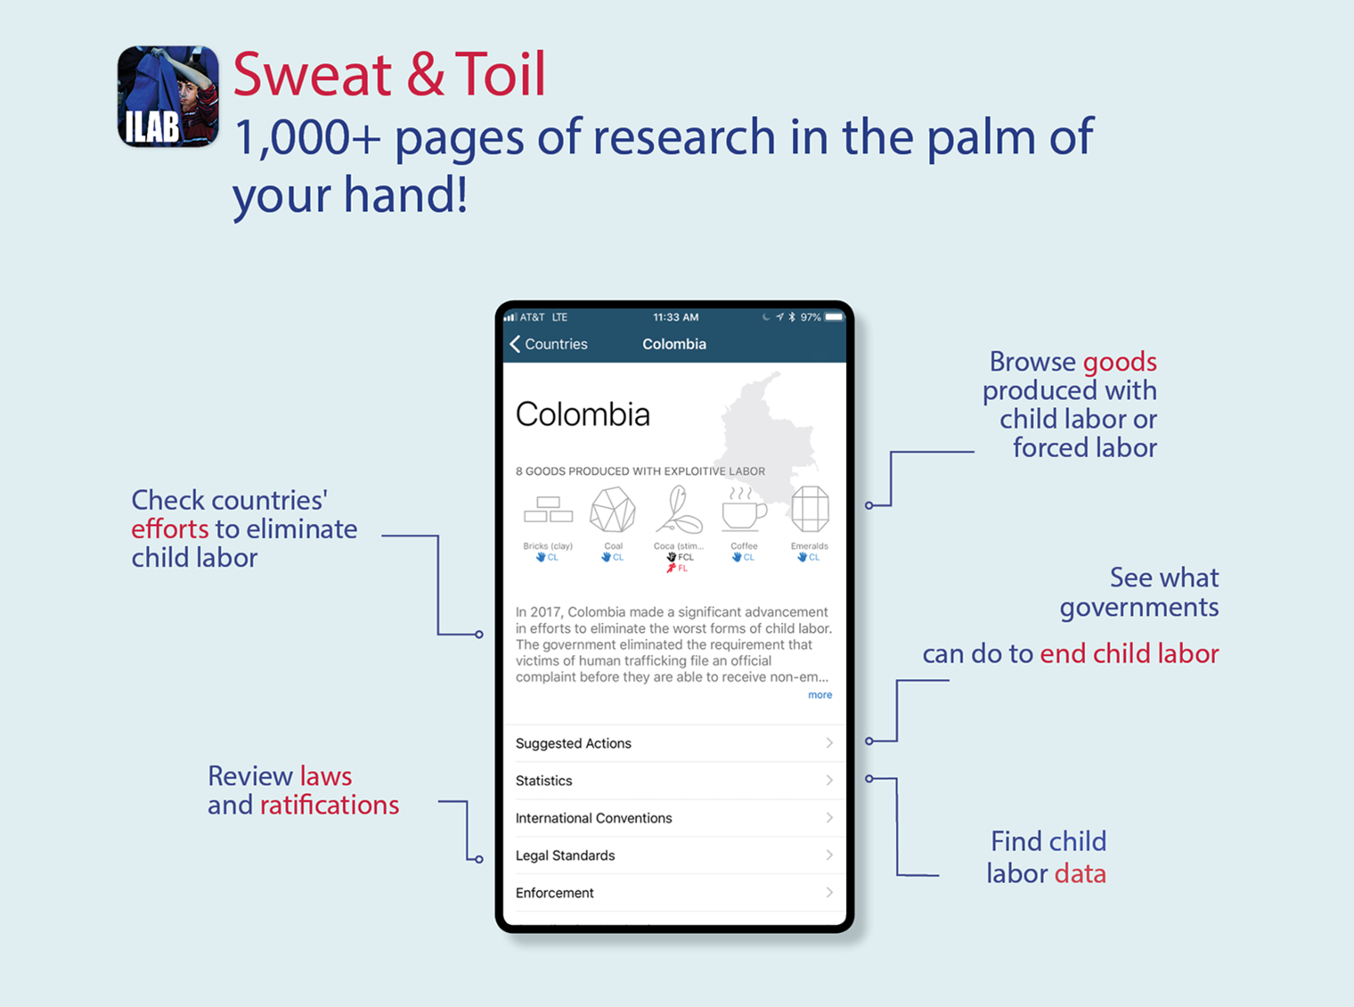
ILAB
Office of Child Labor, Forced Labor, & Human Trafficking

Slide 3
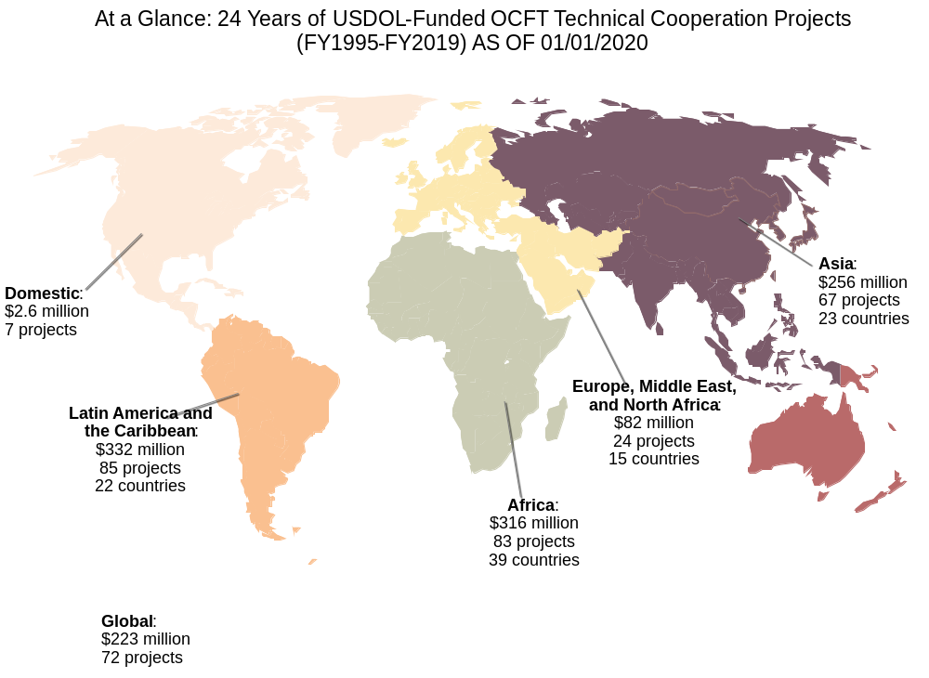

Slide 4
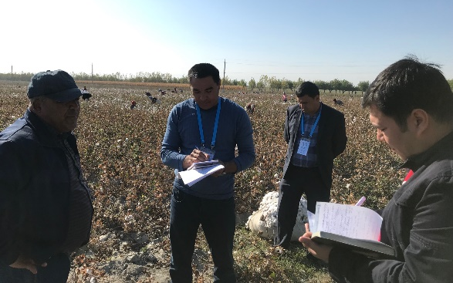
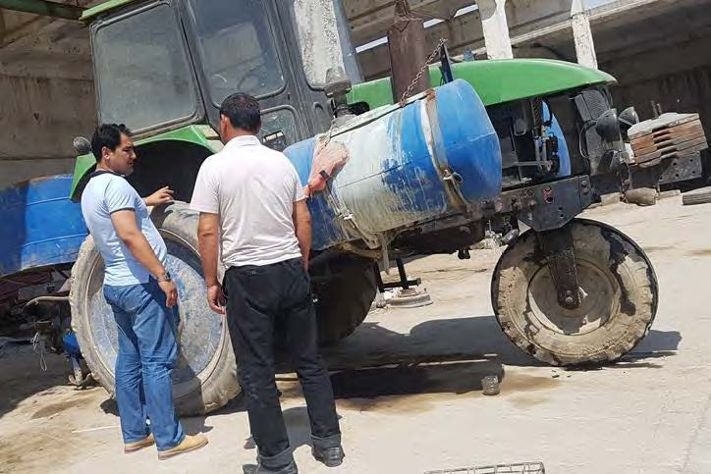
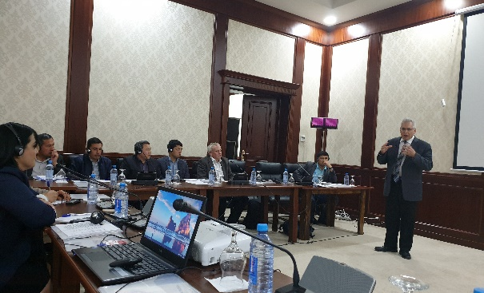
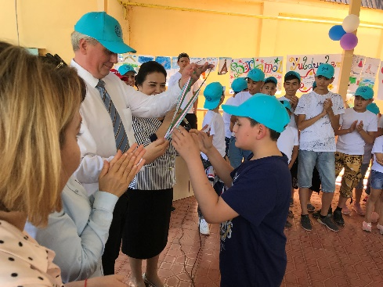
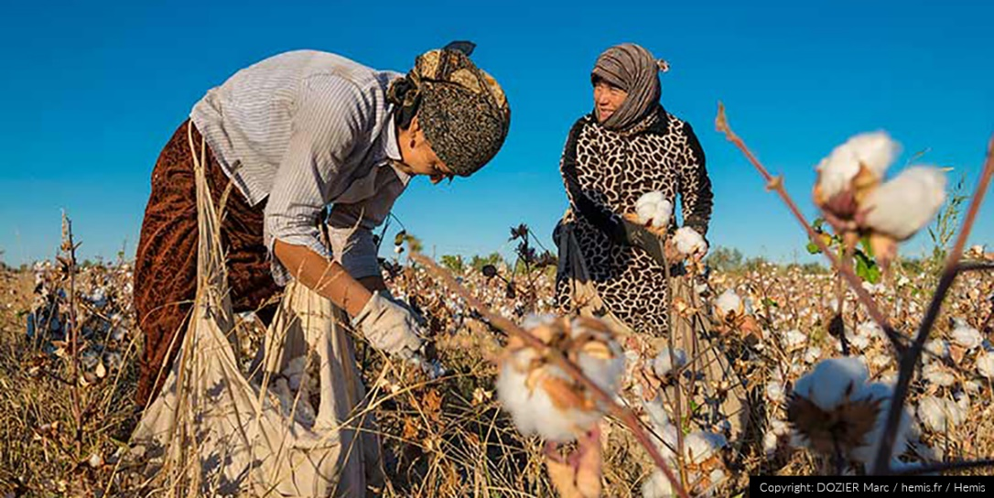
ILAB Engagement in Uzbekistan
Research, Diplomacy, Technical Assistance

Slide 5
Looking Forward
Next Steps to Eliminate Child Labor and Forced Labor

Slide 6
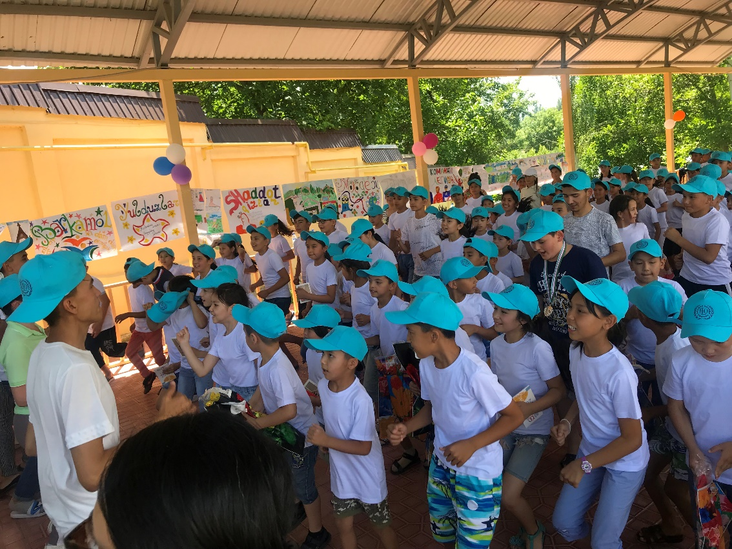


globalkids@dol.gov
THANK YOU
ILAB in Uzbekistan

