Slide 1
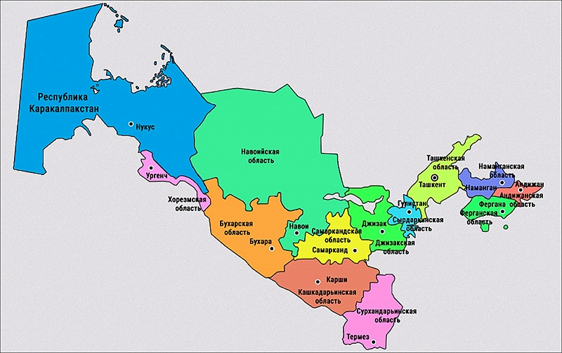
We unite 15 independent monitors - representing all regions of Uzbekistan and Karakalpakstan

Slide 2
Why this monitoring scheme is effective ?
The work experience with target groups adjusted for the last season of the monitoring showed :
Efficient feedback mechanism for instant problem solving scheme: defect on the field – hand over Inspection – see the result
To use technical means and coordination of monitoring online
Flexible response to changing needs during monitoring
May create opportunities for interaction with target groups (agricultural groups, farmers) in the subsequent and at the end of monitoring

Slide 3
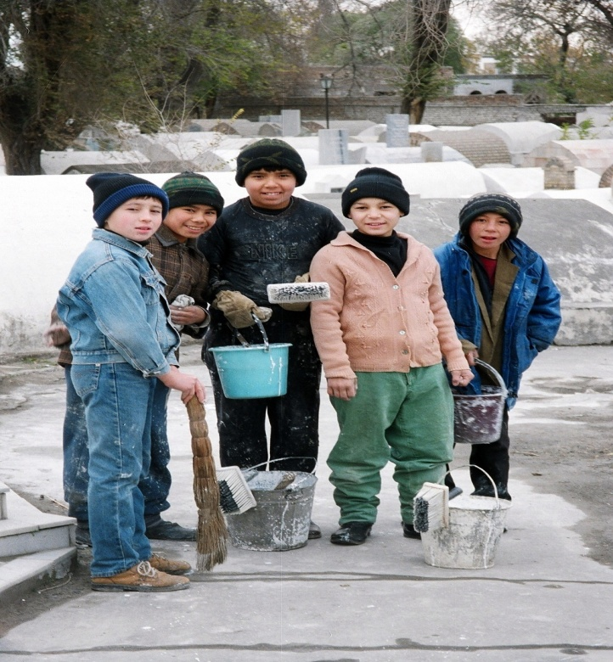
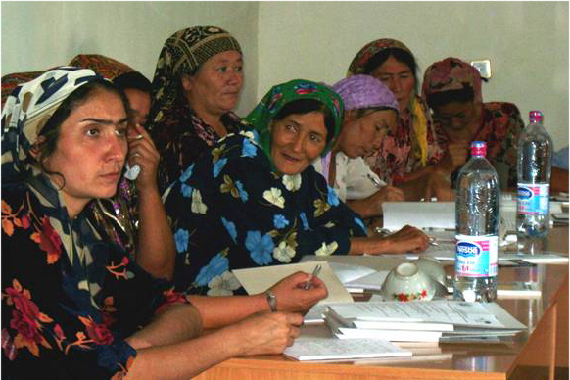
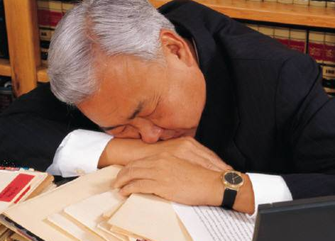
Monitor groups
FARMERS’ RIGHTS
FARMERS’ RIGHTS
Politics
CHILD LABOR

Slide 4
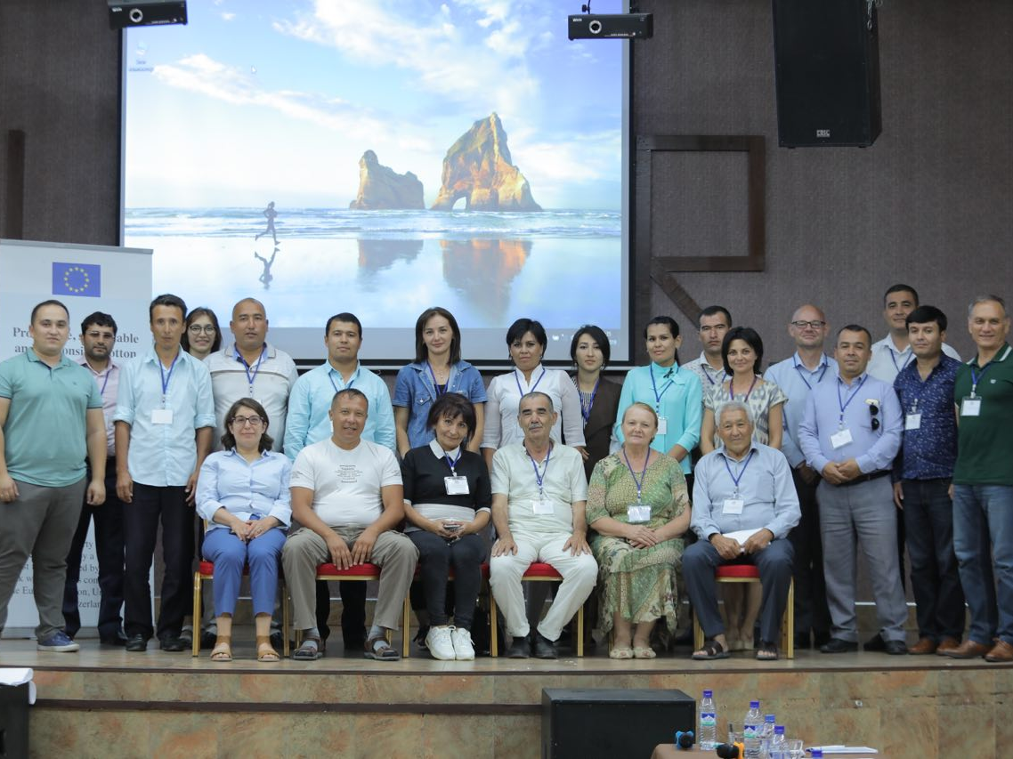
But our main advantage is:
We are ready for collaboration and open to EVERYBODY!
thanks everyone…..

