Slide 1

Tashkent 2020
MOVING FORWARD WITH TRANSFORMATIVE POLICIES
Erkin Mukhitdinov
First Deputy Minister of Employment and Labor Relations of the Republic Uzbekistan

Slide 2





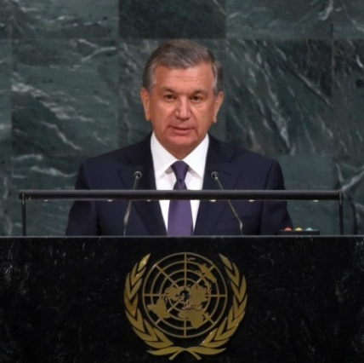
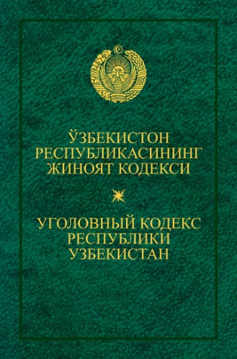
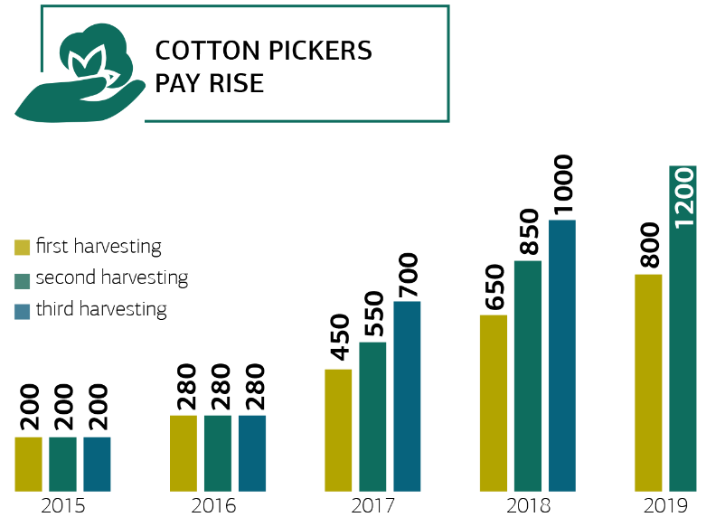
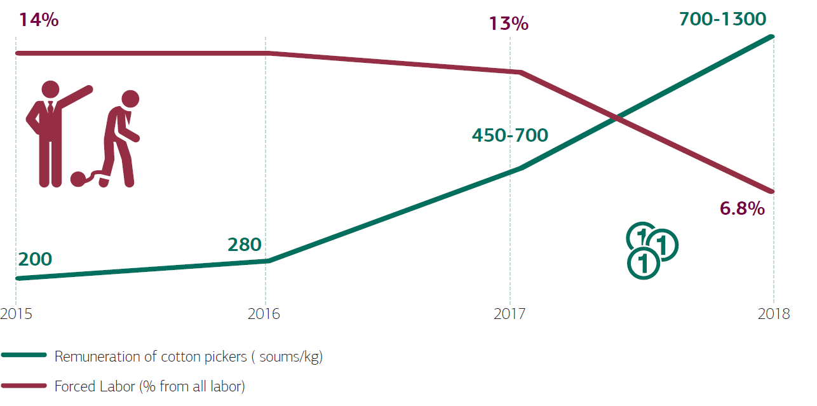

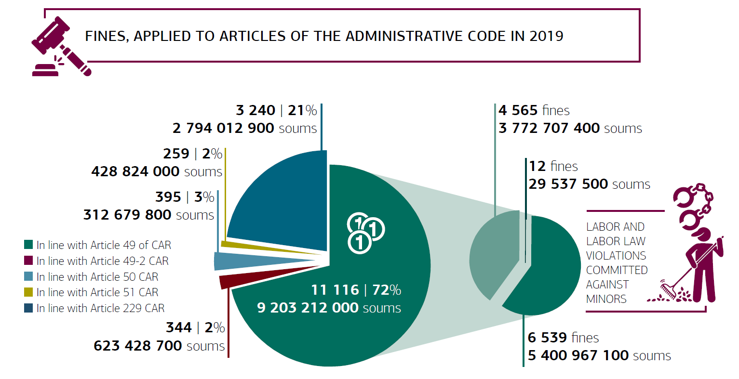


Lessons learned from past cotton campaigns
Strong political will to eradicate all forms of forced labour
Commitment to the complete eradication of all forms of forced labor
Cotton industry
Statement by the President during 72nd Session of the United Nations General on 19th September 2017
The law CRIMINALIZING forced labour was adopted
Punished by punitive work up to TWO YEARS, and in case forcing minors – UP TO THREE YEARS
Dynamics of salary increase for manual cotton picking
Adoption of the resolution of the Cabinet of Ministers of the Republic of Uzbekistan “On additional to eradicate forced labour in the Republic of Uzbekistan” №349 dated 10th May 2018;
Adoption of Presidential Decree “On increasing liability for coercion to labour” dated 29th October 2018
Administrative fines for forced labor were increased for 30 - 50 TIMES
Adoption of Presidential Decree “On additional measures to further improve the system of combating trafficking in persons and forced labor” dated July 30, 2019
Administrative penalties applied to 259 OFFICIALS (132 of them were penalised during the cotton campaign)
18 CITY AND REGIONAL MAYORS and their deputies were punished, 2 MAYORS AND 7 LEADERS OF THE REGIONAL LEVEL were dismissed or demoted
On March 25, 2019, the U.S. Department of Labor made the final decision to WITHDRAW UZBEK COTTON FROM THE LIST OF EXECUTIVE ORDER prohibiting government purchases in the United States of goods produced using forced child labor.
Incomes of individuals involved in agricultural work on harvesting raw cotton works are not subject to taxation
225 REGULATIONS, 25 SUBMISSIONS AND 16 WARNINGS issued to mayors of the regions
Safety and decent working conditions are provided for cotton pickers (accommodation, food, transportation and other necessary conditions)
The Cabinet of Ministers of the Republic of Uzbekistan approved a temporary regulation on hiring cotton pickers, which reflects the procedure and standards for hiring pickers
The decision to exclude cotton from the list makes it possible for any US government agency to PURCHASE THE PRODUCT WITHOUT ITS CERTIFICATION.
Reforms in agriculture
Cooperating with civil society activists
Presidential Decree "On measures to widely introduce market principles in the sphere of cotton production" dated March 6, 2020 №PD-4633
Press conference with human rights activists and government bodies
CANCELING STATE REGULATION OF THE PRICE AND PRODUCTION PLAN
LIBERALIZATION OF PURCHASE PRICES OF RAW COTTON
Implementation of price announcement practices for farmers BEFORE VEGETATION
Meeting between the Ministry of Employment and Labour Relations and national human rights activists
A feedback channel has been created in the social messenger
Issuance of a specialized certificate to human rights activists giving unhindered access to cotton fields and the cotton picking process

Slide 3

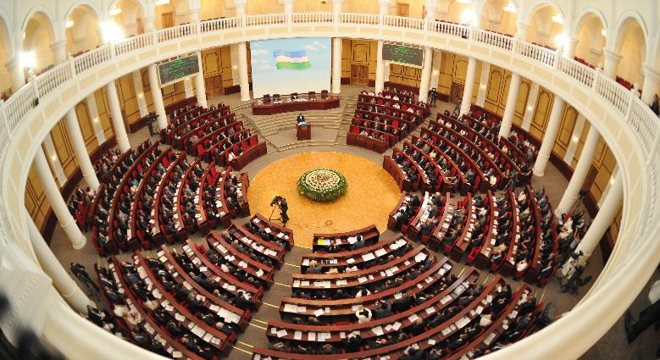
Implementation of International Standards
Ratified Conventions of the International Labor Organization
No. 29 Convention on Forced Labor
No. 47 Convention on the Forty-Hour Work week
No. 52 Convention on Holidays with Pay
No. 87 Convention on Freedom of Association and the Protection of the
Right to Join Trade Unions
No. 98 Convention on Freedom of Association
No. 100 Equal Remuneration Convention
No. 103 Convention for the Protection of Maternity
No. 105 Convention on the Abolition of Forced Labor
No. 111 Convention on Discrimination
No. 122 Convention on Employment Policy
No. 135 Convention on the Representatives of Workers
No. 154 Collective Bargaining Convention
No. 138 Minimum Age Convention for Admission to Employment
No. 182 Convention on the Prohibition and Immediate Action
for the Elimination of the Worst Forms of Child Labor
RATIFIED IN 2019:
No. 144 Convention on Tripartite Consultation to Promote the Application
of International Labor Standards
Protocol to Convention No. 29 concerning Forced Labor
No. 81 Convention on Labor Inspection in Industry and Trade
No. 129 Convention on Labor Inspection in Agriculture
The Republic of Uzbekistan has ratified 17 ILO Conventions and 1 Protocol to the Convention. In 2019, 3 Conventions and 1 Protocol of the Convention were ratified.

Slide 4
Further actions for the upcoming cotton season
1
LARGE-SCALE AWARENESS RAISING ACTIVITIES AMONG LOCAL AUTHORITIES ON THE UNACCEPTABILITY OF FORCED LABOUR IN AGRICULTURE AND IN THE ECONOMY
2
STRENGTHENING COOPERATION WITH
THE OFFICE OF THE PROSECUTOR
GENERAL AND OTHER BODIES
Taking effective measures to implement changes in the Criminal Code
Large-scale trainings program for local authorities, employers including textile clusters, farmers, lawyers, judges, prosecutors, labor inspectors
3
DIRECT INTERACTION WITH RESPONSIBLE PRODUCERS WITH A VIEW TO RESPECTING CITIZENS’ LABOUR RIGHTS
Raising local awareness, Implementation of fair employment principles and practices. Implementing Better Work global tools in Uzbekistan
4
5
STRENGTHENING COOPERATION WITH
CIVIL SOCIETY REPRESENTATIVES, INCLUDING STRENGTHENING DIALOGUE
AT DISTRICT LEVEL
STRENGTHENING THE CAPACITY OF DISTRICT PUBLIC EMPLOYMENT CENTRES
Assisting employees and employers: advance payments, organizing the transportation, ensuring decent living conditions at field accommodation
Rapid response to violations of labor rights
identified by activists. Organizing regular meetings of all
stakeholders

Slide 5
Quadripartite mechanism for the total eradication
of forced labour
GOVERNMENT
Ministry of Labour,
Ministry of Agriculture,
Ministry of Investment and
Foreign Trade
International Brands
INTERNATIONAL BUYERS
Brands
Associations
Councils
LOCAL MANUFACTURERS
Clusters, Farmers
Associations of textile companies “Uztextileprom”
Chamber of Commers and Trade
DECENT WORK IN THE SUPPLY CHAIN
CIVIL SOCIETY
National Human Rights Activists
International Human Rights NGO
Trade Unions

Slide 6

Thanks for watching
Engage: www.mehnat.uz Contact: +998 71 239 41 21
Follow: @mehnat_vazirligi

