Slide 1



Slide 2
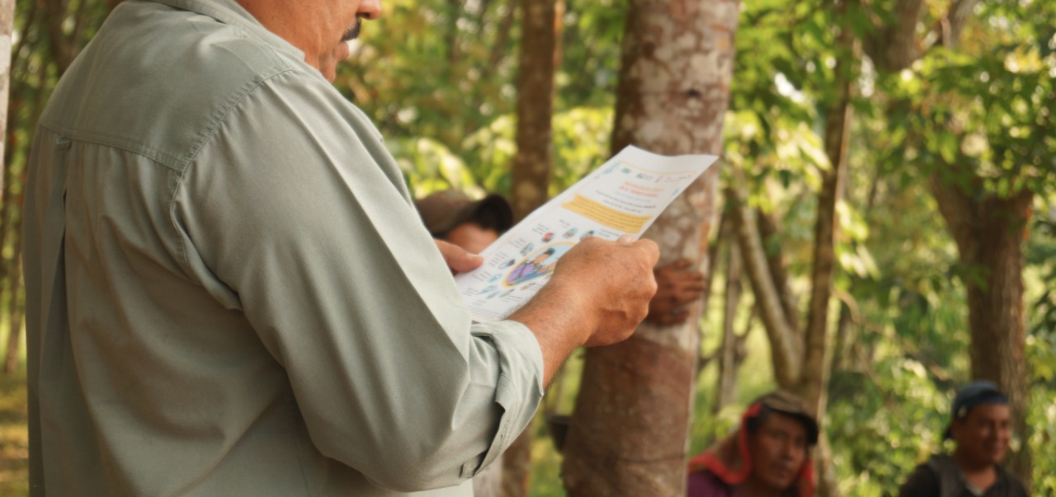
Campos de Esperanza

Slide 3
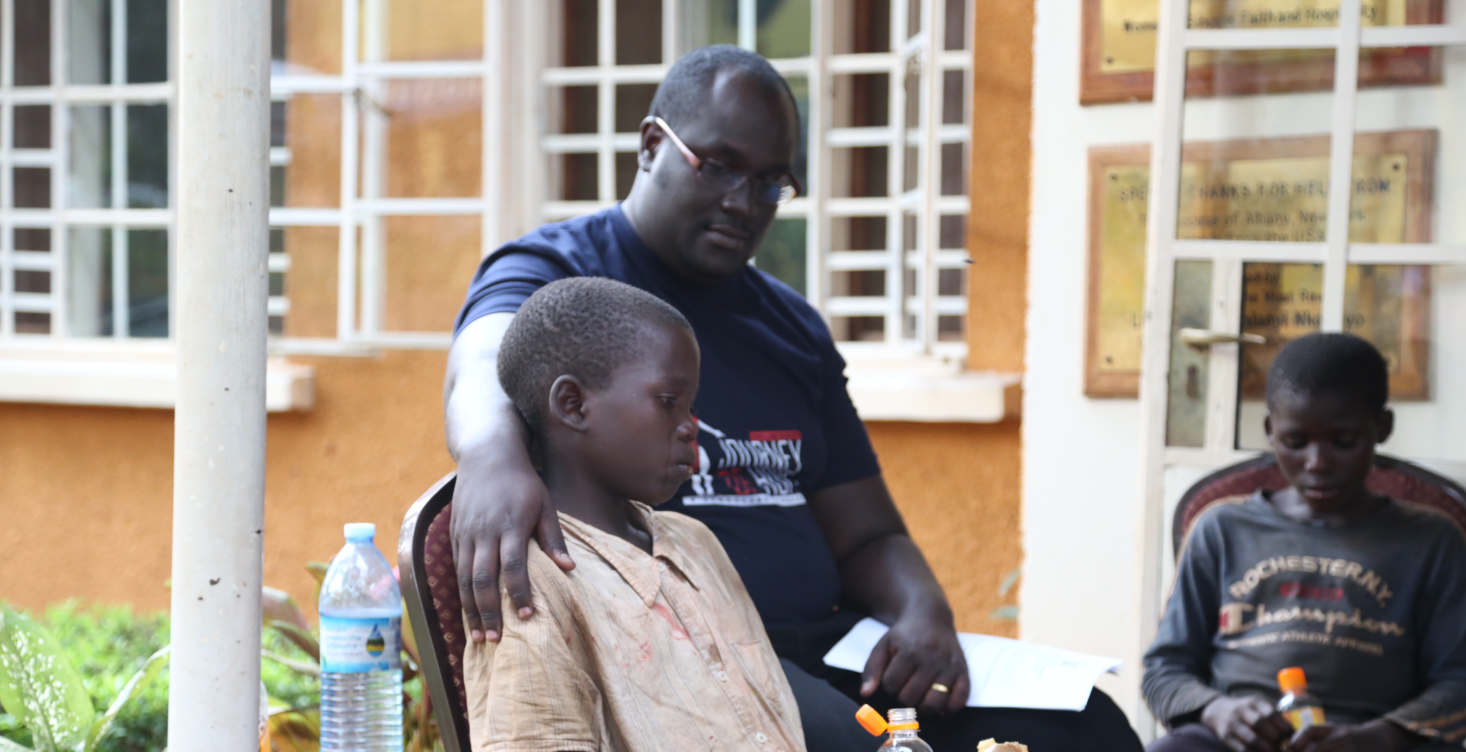
Damon Wamara
Dwelling Places
Uganda

Slide 4
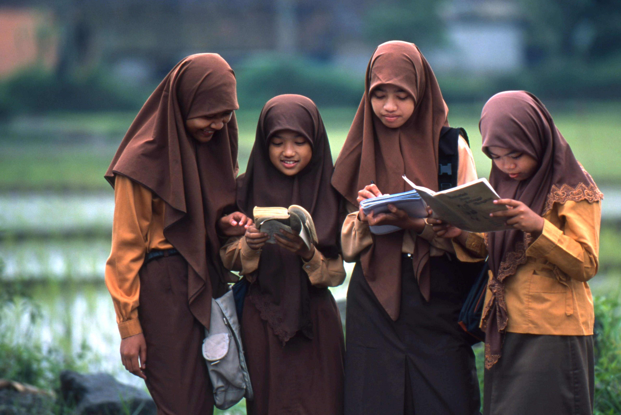

Thank You

