Slide 1

The Measurement, Awareness Raising, and Policy Engagement (MAP) project aims to build and apply the critical knowledge needed to inform policy choices and to support measures to reduce child labor and forced labor.

Slide 2

The project has four priority areas of focus:
1
Research
2
Knowledge mobilization
3
Capacity building
4
Partnerships

Slide 3
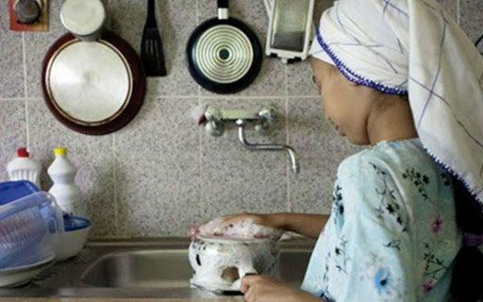
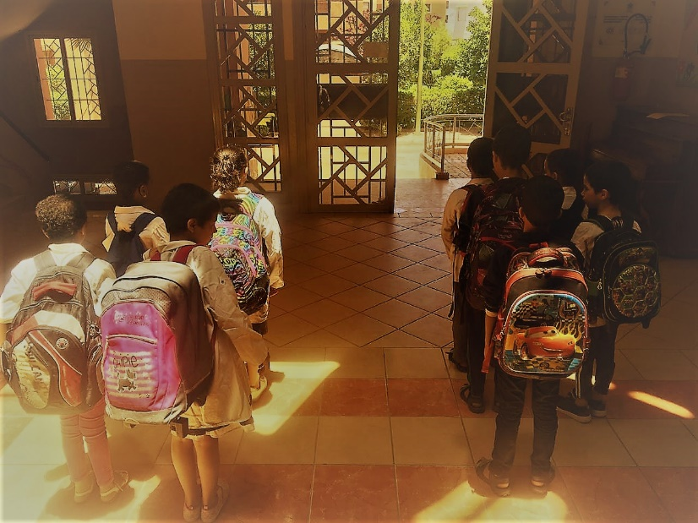
«Petite bonne»
Child domestic labor
Going to school
Law 19-12 on domestic work

Slide 4



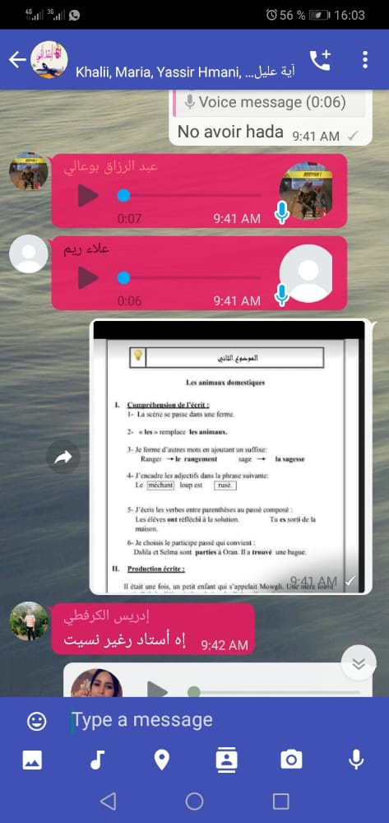

COVID 19 – To protect your country, stay at home !
Distance support for a group of project beneficiaries
At distance tools to support children’s motivation

Slide 5
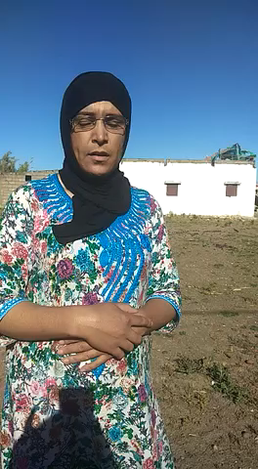
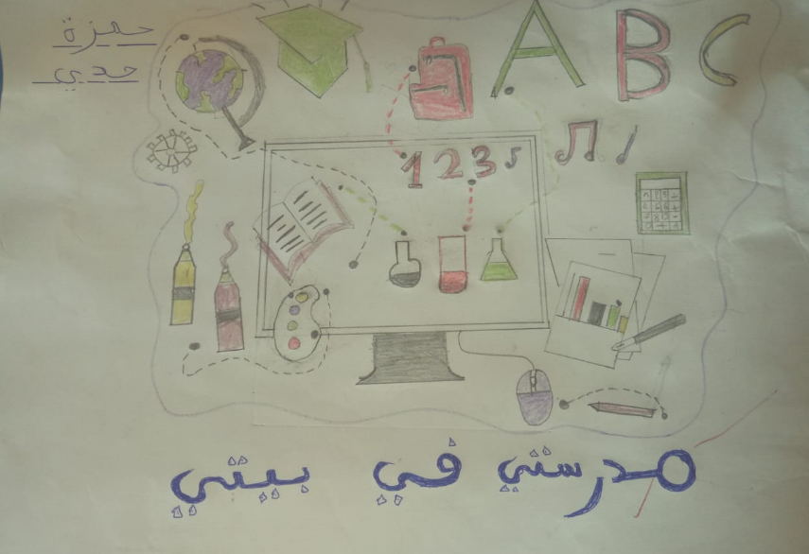
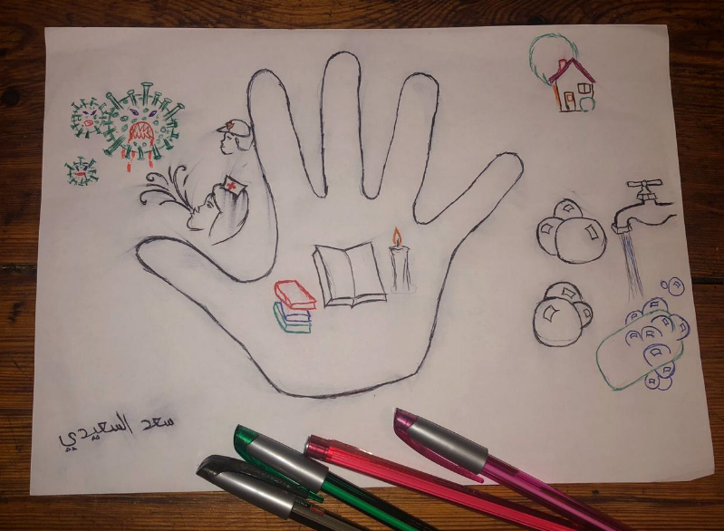
My Home – My School
Thanks from a mother
I am responsible for my own health protection and my future

Slide 6


Funding is provided by the United States Department of Labor under cooperative agreement number IL-30147-16-75-K-11. 100% percentage of the total costs of the project is ﬁnanced with federal funds, for a total of 22.4 million dollars.
This material does not necessarily reﬂect the views or policies of the United States Department of Labor, nor does mention of trade names, commercial products, or organizations imply endorsement by the United States Government.
International labor Organization
Route des Morillons
4 CH-1211 Geneva 22
Switzerland
Project Manager: Laurence DUBOIS
ilo.org/map16E: fundamentals@ilo.org

