Slide 1
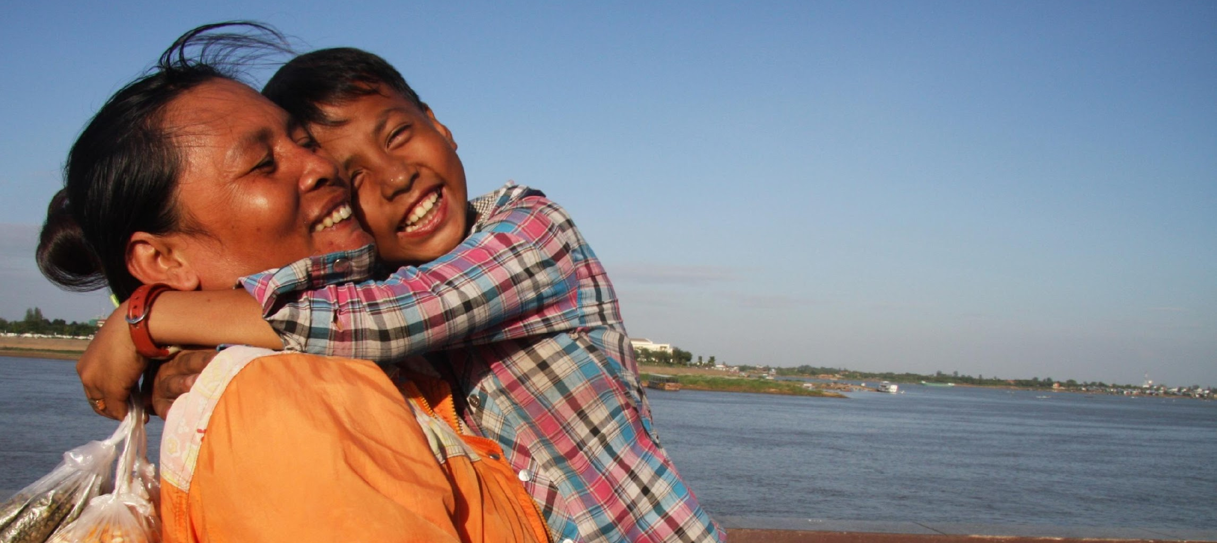


Advancing Protection and Care for Children in Adversity (APCCA)
A U.S. Government Strategy for International Assistance
Sarah Gesiriech, U.S. Government Special Advisor on Children in Adversity
International Labour Organization Webinar
June 11, 2020

Slide 2
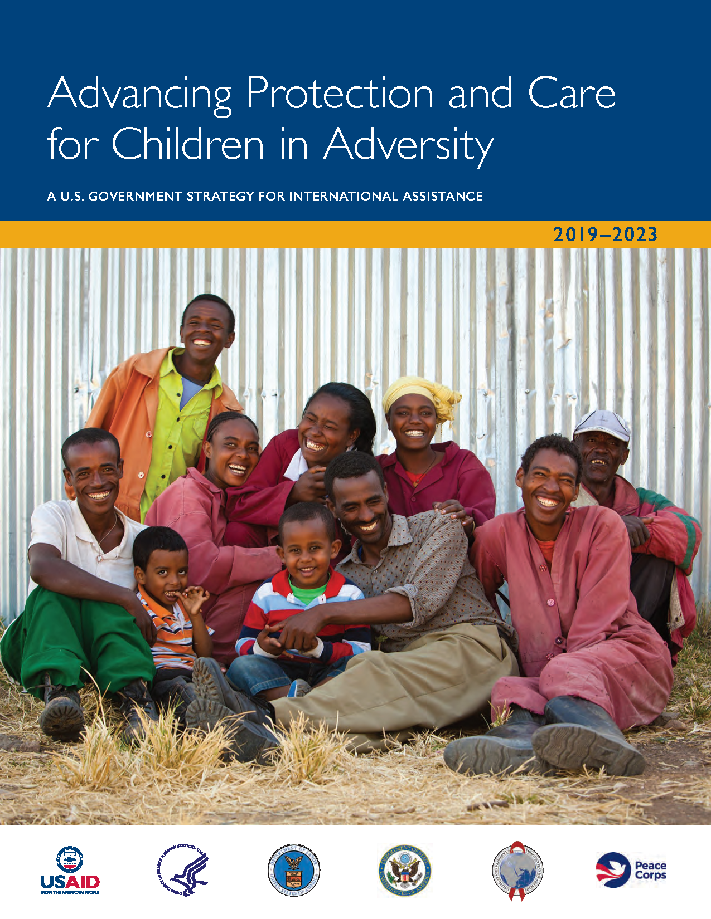
The APCCA Strategy
Responds to Public Law 109-95.
Whole-of-government commitment and approach to investing in the development, care, and safety of the world's most-vulnerable children and their families.
In addition to the U.S. Department of Labor, USG partners include the U.S. Departments of Health and Human Services and State; the U.S. Agency for International Development; and Peace Corps.
Notes:
Comprehensive
Coordinated
Effective

Slide 3
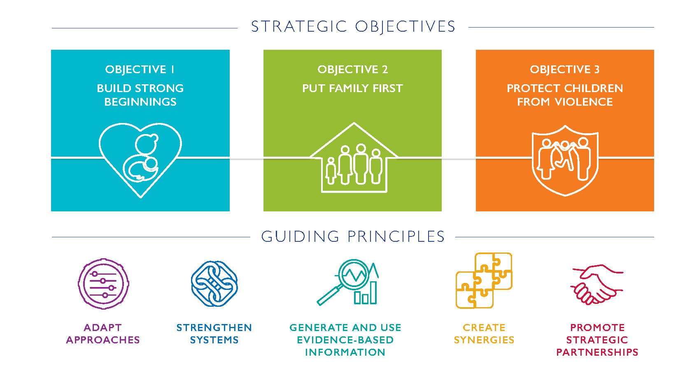
Notes:
APCCA’s 3 Objectives
Interrelated, interdependent, and mutually reinforcing, evidence-based strategic objectives.
(1) Build Strong Beginnings; (2) Put Family First; and (3) Protect Children from Violence.

Slide 4

www.childreninadversity.gov
ChildrenInAdversity@USGforChildren

