Slide 1

Q&A
Ilo.org/rta
RTA fellowships and seed grants
  From Research to Action (RTA):
  Using Knowledge to Accelerate Progress in the Elimination of Child Labour and Forced Labour

Slide 2
House keeping rules
    Please take note the webinar will be recorded.
    Please use the chatbox and send them to "panelists and participants”.
    We will open the floor for questions in the last 30 mins.
    Please raise your hand and we will enable their mic.

Slide 3
Background
Supporting Organizations
    ILO – Fundamental Principles and Rights at Work Branch, Research and Evaluation team
    Partnering with IOM – Migrant Protection and Assistance Division
    Supported by the US Department of Labor
Overall project objectives?
  To accelerate the use of rigorous research by policymakers and practitioners to tackle issues of child labour, forced labour, and human trafficking around the world.

Slide 4

The From Research to Action (RTA) project
There is a lack of research on policies in the global fight against child labour, forced labour, and human trafficking.
  This is critical to achieving SDG 8.7.
The project has 4 intended outcomes:
    Increase access to evidence.
    Facilitate understanding of available research and knowledge gaps.
    Improve the capacity of researchers.
    Engage researchers and promote new interest.

Slide 5
The RTA fellowships and seed grants
The deadline is on
April 16
at 4 pm (GMT+1) !!!
Awards
    3 Research fellowships of $18,000 USD each for 12 months.
    10 Seed grant projects of up to $10,000 USD each for 9 months.
Eligibility
    The Research Fellowship is open to PhD degree holders, PhD students, or Master’s degree
    holders with 5 years of relevant research and teaching experience.
    The Seed Grant is open to PhD degree holders, PhD students, or Master’s students.
    Candidates from the Global South, female candidates, and underrepresented
    populations in the research community are encouraged to apply.

Slide 6
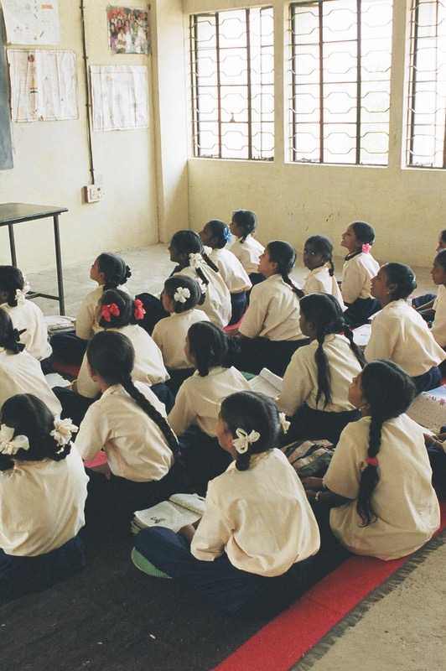
How can I increase the chance to be selected?
    Meeting the eligibility criteria.
    Developing research of direct relevance for policies relating to child labour, forced labour, and human trafficking.
    Developing a well structure research proposal.
Ilo.org/rta

Slide 7
Research Proposal (3-5 pages)
  A key part of an application for funds or studentship is the research proposal.
  A well-structured research proposal help increase the chance to get the award.
  Regardless of your research problem and methods, all proposals should be presented following a clear structure and addressing the:
WHAT
  Defining the research problem.
WHY
  Convincing that the research topic is worthy to be studied.
How
  How the research will be conducted.

Slide 8
Research Proposal (3-5 pages), cont’d
Title
    It should indicate the research question and approach.
Introduction
    It should state the research question.
    It should guide the reader about the scope of research: the problem, what is known, and what is the knowledge gap.
Literature Review
    A literature review is an overview of current knowledge: relevant theories,
    methods, and gaps in the existing research.
    It helps support the What and Why.

Slide 9
Research Proposal (3-5 pages), cont’d
Research design
    The research approach should detail the steps to conduct the research.
    Explain how the research will be designed:
    Quantitative or Qualitative.
    Original data collection; Primary sources (statistical data); Secondary sources (e.g., journal articles, reviews, academic books, etc.)
    Type of study: descriptive, correlational, or causal/experimental.
Research methods
    Description of the tools and procedures to analyse data.
    Discuss any potential obstacle and limitation.

Slide 10
Research Proposal (3-5 pages), cont’d
Implications and contributions to knowledge
    Emphasise why your proposed project is important and how it will contribute to practice or theory.
    Practical Implications
    Will your findings help improve a process, inform policy, or make a case for concrete change?
    Theoretical Implications
    Will your work help strengthen a theory or model, challenge current assumptions, or
    create a basis for further research?
References
    A complete list of reference.

Slide 11
Research Proposal (3-5 pages), cont’d
Include a research plan with a clear time frame / timeline.
For example:
Research phase | Objectives | Timeframe
Literature review | Situate the research within the existing knowledge. | 15 days
Data collection | Data collection including data cleaning. | 60 days
Data analysis

Slide 12
Research Proposal (3-5 pages), cont’d
Or a Gantt chart
For example:
Research phase | Month
 | 1 | 2 | 3 | 4 | 5 | 6 | 7 | 8 | 9 | 10 | 11 | 12
Literature review
Data collection
Data cleaning and analysis
Developing the 1st Draft

Slide 13
Research Proposal (3-5 pages), cont’d
Include a budget
  List the activities, indicate the estimated cost,
  justify each item cost.
    Knowledge exchange and dissemination: Conferences (registration, travel, etc.)
    Data collection and analysis:
    Software licenses, printing, etc.
Include a dissemination strategy
    Seminars, videos, social media, etc.
Budget items | Quantity | Unit Cost per item (USD) | Total cost (USD) | Description
Interviews | 60 | 20 | 1200 | Conduct 60 interviews
Conference | 1 | 250 | 250 | Air Ticket cost «from» - «to»
Personnel / month | 3 | 600 | 1800 | Time devoted to conduct the analysis
Total |  |  | 2,170

Slide 14

Common pitfalls to avoid
    Lack of Clarity (The paragraphs / sentences are too long or too vague).
    Be concise, clear, and go straight to the point in your writing.
    Weak support (or the argument justifying the research is lacking).
    Provide a thorough literature review to show you have investigated the topic to see what kind of research is out there.
    Poor planning.
    Offer a concrete plan including all the necessary aspects for launching the project.
Ilo.org/rta

Slide 15

Common pitfalls to avoid, cont’d
    The concept and methodology aren’t well elaborated.
    The idea behind the work / research question and the chosen methodology should be demonstrated clearly, so that the reviewer can easily understand how the goals can be achieved.
    A proposal not well structured and formatted.
    Follow the guidelines presented on proposal writing, develop the proposal, so the reviewer can identify the ”what, where, and how”.
    The communication and dissemination plan isn’t well-thought out.
    Start with a timeline and budget to figure out the steps.
Ilo.org/rta

Slide 16

Check out the evaluation criteria and our 8 priority research areas!

Slide 17
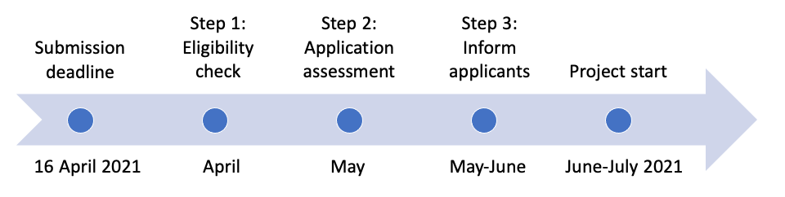
Next steps

Slide 18
Q&A

Slide 19
Eligibility
    Who qualifies as junior / senior researchers?
    What are the criteria to define ‘eligible university / research institutions’?
    Can an NGO be considered as an eligible institution?
    I am about to graduate. Do I need have an university-affiliation for the full period of fellowship / seed grant?
    Do the supervisor and I need to be affiliated with the same institution? No.
    Can the supervisor be based at a research department or NGO? Yes.
    Are medical school students qualified as PhD students? Please justify your research experience.

Slide 20
Proposal
    What are the priority research areas?
    Do I need to cover all three topics (child labour, forced labour, human trafficking)? No.
    Is the award for US-based research only? No.
    Any specific criteria for the budget?
    What constitutes a ‘proof of enrolment’?
    Can non peer-reviewed research count as publications? Yes, but specify they are reports.

Slide 21
Other
    I am eligible for both fellowship and seed grant. Can I apply for both with the same proposal? No.
    When will I know the results, and when am I expected to start?
    Can I apply for the seed grant with other researchers? Yes.
    Am I eligible to receive the award if I have other income? Please check with your home institution.

Slide 22


Thank you for your interest in the RTA fellowships and seed grants!
We are excited to read your proposals!
Please use the chatbox if you have further questions.
Or email us at rtaproject@ilo.org

