Slide 1


The impact of the 3Ds on
G7 labour markets
Key issues
  Directorate for Employment, Labour and Social Affairs, OECD
  Social, Economic and Employment Policies, ILO

Slide 2
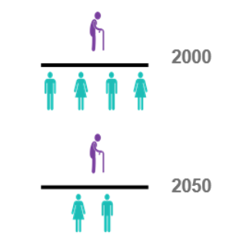
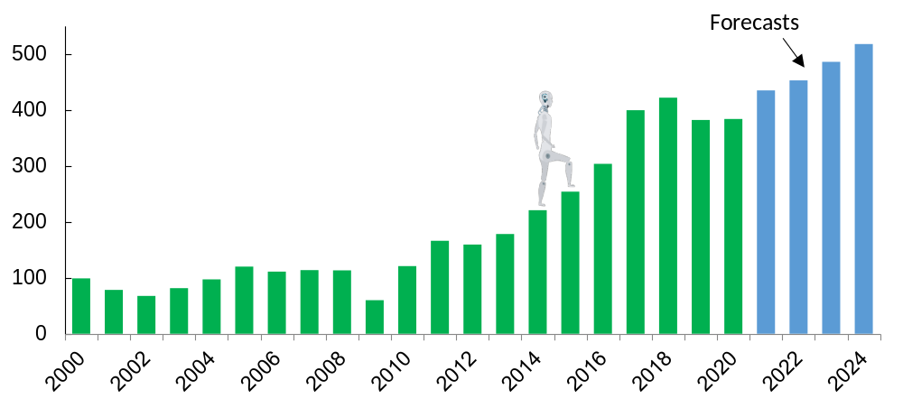


3Ds + COVID driving substantial labour market change
1. Digitalisation is changing the workplace
3. Demographic change slowing workforce growth
The robots are coming:
Global annual installations of industrial robots (thousands)
Old-age dependency ratio 65+/(20-64),G7 average
2. Decarbonisation will change jobs and skills
4. COVID-19 crisis has accelerated change
Notes:
The world of work is undergoing substantial change.
The 3Ds of Digitalisation, Decarbonisation and Demographic change are global trends driving shifts in how we work, where we work and what we work on.
These shifts have been amplified and accelerated by the COVID-19 pandemic.

Slide 3
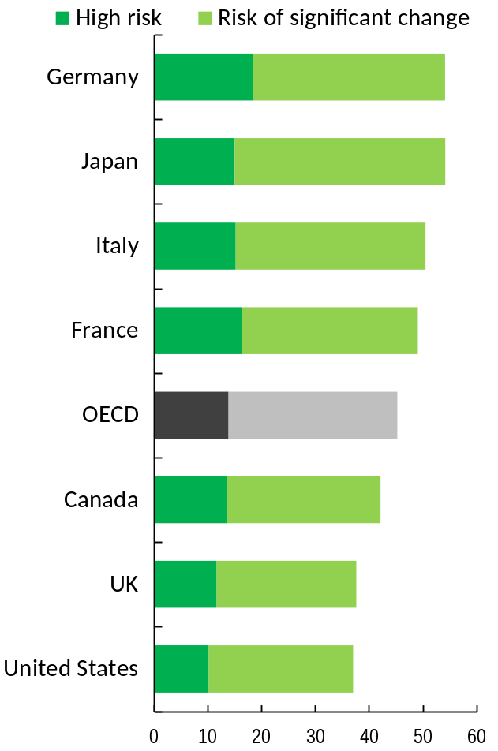
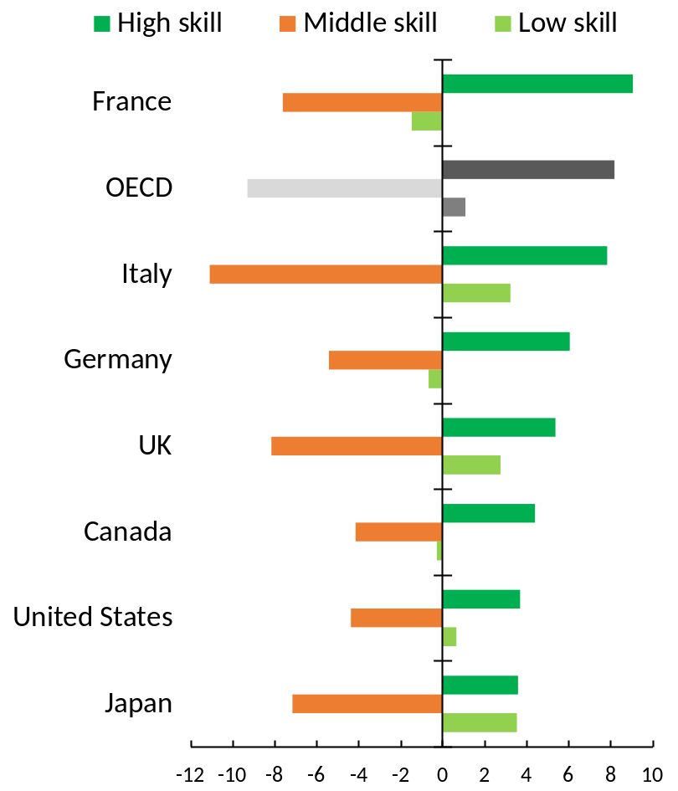
Digitalisation is leading to stronger demand for high-level skills
Many jobs will undergo large transformations
But not all low-skilled jobs will disappear
% of all jobs by risk of automation or significant change
% point change in share of all jobs by skill level, 1998-2018
+ changes in consumer demand
Source: OECD Survey of Adult Skills (2012, 2015)
Source: OECD Employment Outlook, 2021.
Notes:
Even prior to the COVID-19 pandemic, the digital revolution and the rise of the use of robots and AI have been having a profound effect on the type of jobs that are being created and their content.
In the initial stages of digitalisation, automation has primarily occurred of routine manual tasks but has since expanded to routine cognitive tasks, particularly through rapid advances in Artificial Intelligence (AI.)
OECD analysis has shown that, on average, about 14% of today’s jobs in the OECD could disappear due to automation. Another 32% of jobs could see significant change in the way they are performed.
While some jobs will be replaced by technology, the bigger challenge is responding to changing skill requirements within existing jobs.
As shown in the chart, these challenges are larger for some G7 countries than for others.
[Click] Overall, the digital revolution has led to a rising demand for high-level skills. We see this in the chart to the right that shows changes in the share of jobs by skill level over the past two decades.
In most G7 countries, the bulk of the shift in jobs has been away from middle-skilled jobs to high-skilled jobs.
In other words, there has been a process of skills upgrading.
However, there has also been an increase in low-skilled jobs, mainly spurred on by rising demand for personal care services that may not require a high level of skills to carry out but do require the performance of non-routine tasks that rely on good social and communications skills.

Slide 4
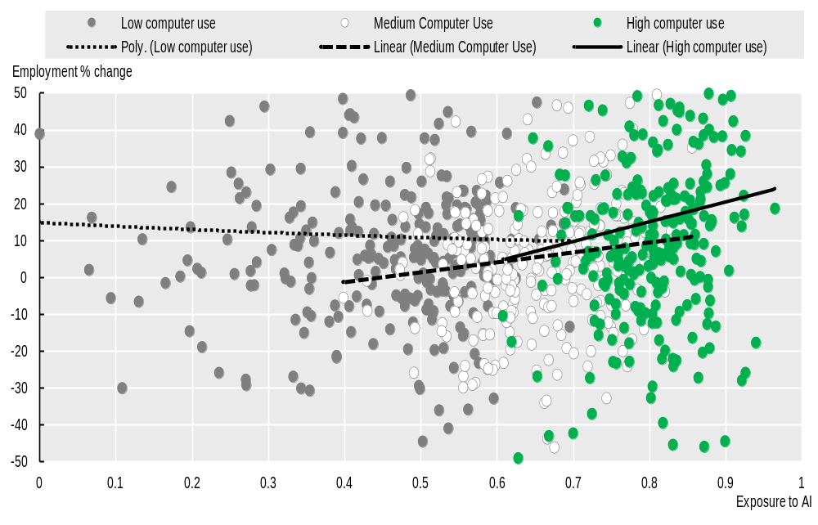
AI risks increasing labour market disparities
AI tends to complement rather than replace high-skilled jobs
Employment growth for each occupation/country combination, by level of computer use
Key challenges for policymakers:
Strengthen efforts to help affected workers manage transitions to new jobs, especially the low-skilled, including:
  Better training opportunities.
  Greater employment support through the PES.
  Ensuring that skill investments match labour market needs.
  Adequate income support and health care.
Note: Each dot represents an occupation/country pair. The colours represent different levels of computer use (low, medium, high). Linear lines of best fit have been drawn through each computer use group.
Source: Based on Georgieff, A. and R. Hyee (2021), “Artificial intelligence and employment : New cross-country evidence”, OECD Social, Employment and Migration Working Papers, No. 265, OECD Publishing, Paris, https://dx.doi.org/10.1787/c2c1d276-en.
Notes:
Some concerns have been expressed that rapid developments in AI may lead to deskilling – as more non-routine cognitive tasks are able to be performed by robots.
However, the evidence to date suggests that rather than AI displacing high-skilled workers, it tends to complement their skills and results in higher productivity and higher wages.
Therefore, the risk is rising inequalities with high-skilled workers earning increasingly more than low-skilled workers.
The key challenge for skills policies, therefore, is to help workers upgrade and update their skills in an environment of substantial change in skill needs.
Moreover, the COVID-19 crisis may have worsened long-term prospects for low-skilled workers by accelerating automation but also given their lack of digital skills or even access to the digital tools required to perform their job remotely.
Going forward, policymakers should strengthen their efforts to help affected workers manage transitions to new jobs, especially the low-skilled, through:
Strengthened training opportunities to reskill; and
Effective employment support through Public (and private) Employment Services to find new jobs.
With declining opportunities for young people to enter the labour market through low-skilled jobs, it is even more important for policymakers to: ensure that
Skills investments for younger workers match the needs of the labour market, including by forecasting skills needs in light of automation trends; and.
Adequate income support and access to health care is available to these groups while transitioning to new jobs.

Slide 5
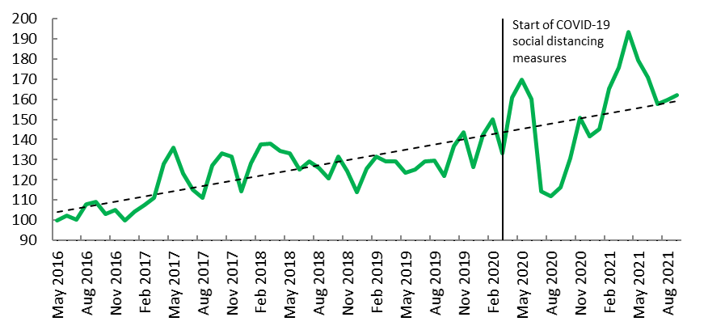
Non-standard forms of employment have become more common
Online gig work is growing rapidly from a small base
Key challenges for policymakers:
New forms of work can lead to more job opportunities and flexibility.
But concerns that these jobs are concentrated among vulnerable groups and lack adequate labour and social protection, including through collective representation
Need for more sustainable solutions to improve job quality, while not squashing innovation
Monthly averages of global new vacancies in English for online gig work, May 2016=100
Source: , Oxford Internet Institute's Online Labour Index, see Kässi and Lehdonvirta (2019).
Notes:
Digitalisation has brought many new opportunities – not just in terms of creating new jobs, but also in terms of job quality. Many dangerous and tedious tasks have been taken over by algorithms and robots, while more jobs have been created with a focus on human-centred tasks requiring social, caring, creativity and team-working skills.
However, digitalisation and AI have also contributed to another key trend in the labour market, namely the increased use of new forms of work arrangements, including platform work. This trend has been accelerated by regulatory change, the emergence of new business models and, in some cases, incentives embedded in the tax system.
[Click] The rise of new forms of work arrangements brings some benefits, including new employment opportunities and more flexibility for both employers and workers, but there are also concerns about job quality, a higher concentration of more vulnerable groups in some of these jobs and in some cases a lack of adequate labour and social protection, including through collective representation
Even prior to the Covid-19 crisis, there had been calls for adequate regulation, social protection, workers’ voice and training opportunities for workers in non-standard forms of employment (i.e. those not involving full-time wage and salary work).
During the initial stages of the crisis, many of these workers faced a high risk of income loss as well as exposure to the virus, without coverage from the labour and social protections afforded to full-time wage and salaried workers.
While many governments (and some employers/platforms) put in place emergency measures to help workers, there is a clear need for more sustainable solutions to improve job quality in new forms of work arrangements, while mindful not to squash innovation. This is particularly pressing, given that new forms of work arrangements, including platform work and teleworking, were boosted by the Covid-19 pandemic.

Slide 6
Decarbonisation: challenges & opportunities
The green transition has become a central policy priority
In the face of the job reallocation required and higher costs, inclusive or “just” transition policies are needed to maintain public support
By integrating environmental considerations into recovery plans, governments can meet environmental goals while boosting economic activity and job creation.
  However, the OECD Green Recovery Database shows that only around 20% of recovery spending has so far been allocated to environmentally positive measures.
Notes:
The green transition has become a central policy priority as countries seek to rebuild their economies, enhance resilience against future shocks and most importantly address the pressing challenges of climate change.
Decarbonisation of the economies involves changing methods of production across several as well as the industries that supply their inputs and depend on their outputs.
The localised and sometimes concentrated job losses associated with decarbonisation plus higher costs associated with higher energy prices or a switch to greener products and services could derail public support for climate change policies.
However, by integrating environmental considerations into recovery and fiscal stimulus measures, governments can make decisive inroads towards meeting environmental goals while boosting economic activity and job creation in the shorter and longer term.
There is potentially scope to do more -- the OECD Green Recovery Database shows that only around 20% of recovery spending has so far been allocated to environmentally positive measures.

Slide 7
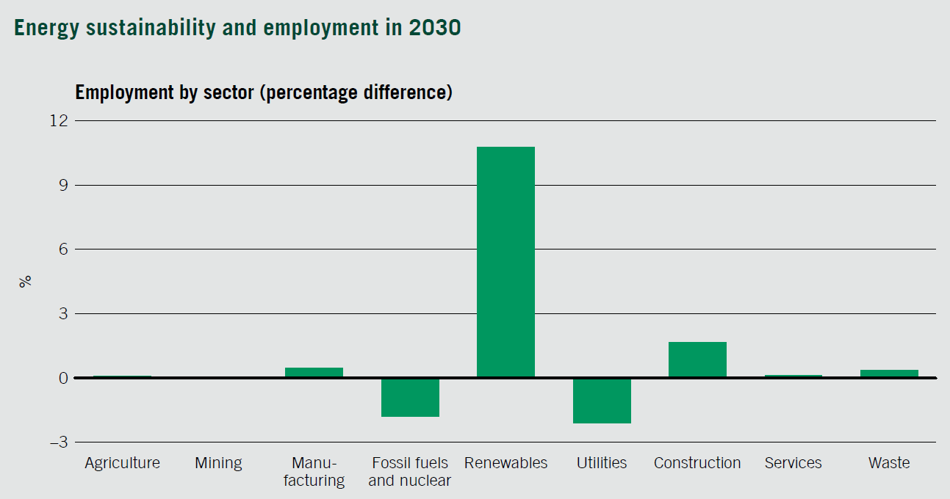
Green transition: A positive but highly uneven impact on employment
18 million net job gain with implementation of Paris Agreement in energy sector
    Important reallocation:
        Away from fossil fuels towards renewables
        Within the mining and manufacturing sector towards inputs for electrical machinery and electric vehicles
Source: ILO (2018) Greening with jobs – World Employment and Social Outlook
Notes:
It has been projected both by the ILO and OECD that the green transition will have a small net positive impact on overall employment in G7 economies. The exact magnitude of these projections depend on the assumptions and methodology of the models used to generate them.
More importantly, is the finding that underlying this small overall net impact are much larger employment shifts by sector, occupation and region.
Moreover, many more jobs other than those in high-emitting sectors or involved in renewable energy production and recycling will be affected by changes in the tasks that are performed as greener methods of production and the provision of services are introduced.
A key challenge for policymakers is to facilitate this reallocation of labour.
There will also be distributional consequences that policymakers will need to consider arising not only from these job shifts but also as a consequence of higher energy prices or costs of purchasing greener products and services.

Slide 8





Action required on a broad front
Strengthening scale and responsiveness of adult learning.
Connecting people to good jobs.
Maintaining strong public support and adequate financing.
Strengthening measurement frameworks and evaluation.
Ensuring social dialogue with social partners.
Notes:
To enable and reap the full benefits of decarbonisation on labour markets and support negatively affected workers, industries and entire economies, action will be required on a broad front to promote a resilient and inclusive green transition, as set out in the ILO Guidelines for a Just Transition and the OECD’s policy approach for a human-centred green transition.
[Click] First, successful reallocation of workers to green jobs will depend on providing more opportunities for upskilling and reskilling throughout working careers. This will include: Identifying transferable skills, standardising skills certifications, establishing well-funded retraining programmes aligned with transition plans, and ensuring adequate income support for workers during retraining.
[Click] A second priority must be to invest in connecting people to jobs. This involves supporting job creation but also expanding active labour market policies to quickly connect jobseekers to available jobs. Acting early, before plant closure and reconversion will be critical to achieving better outcomes for displaced workers. In addition, better labour market information and its dissemination is needed on skill needs arising from the green transition.
[Click] Third, it is important to maintain strong public support for climate change mitigation policies. This requires more individualised employment and training support. It also requires policies to offset any adverse effects of these policies on income inequality because of the cumulative impacts on worker displacement and incomes in response to, for example, price hikes in energy or the introduction of a carbon tax. Reinforcing social protection along with other income-compensating measures will be a crucial building block of governments’ strategies to prevent or cushion any damaging disruptions of people’s livelihoods
[Click] Fourth, there needs to be a strengthening of measurement frameworks and evaluation to monitor the outcomes of climate-change mitigation policies on economic, social and environmental outcomes.
[Click] Lastly, better results can be achieved by consulting with and ensuring social dialogue with employers' and workers' representatives in policy-making on this issue.

Slide 9
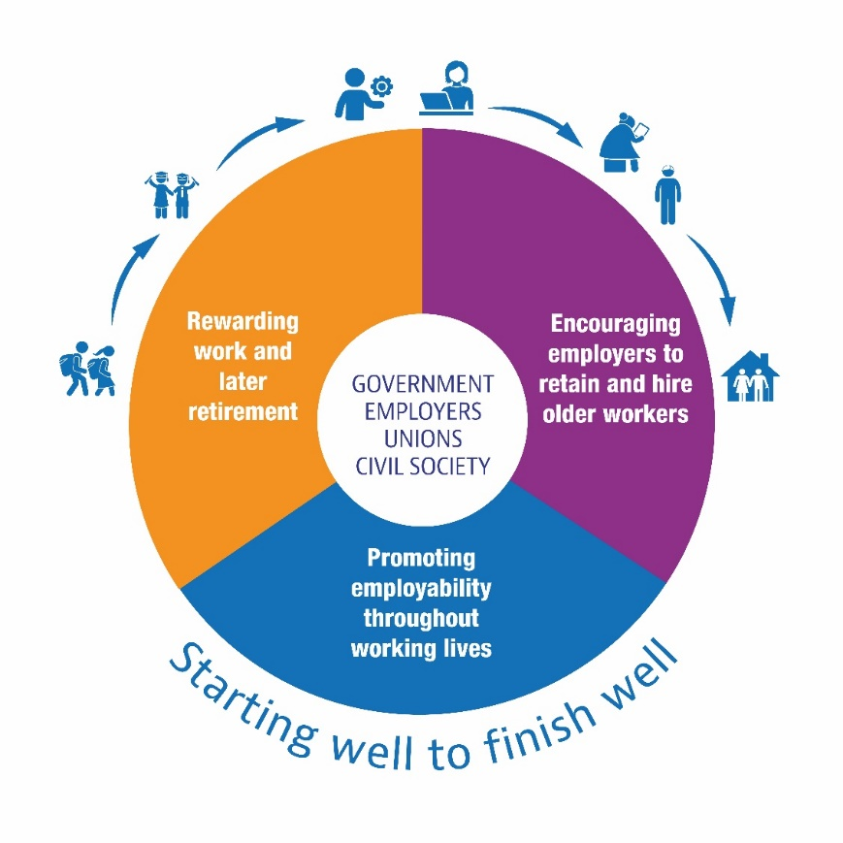
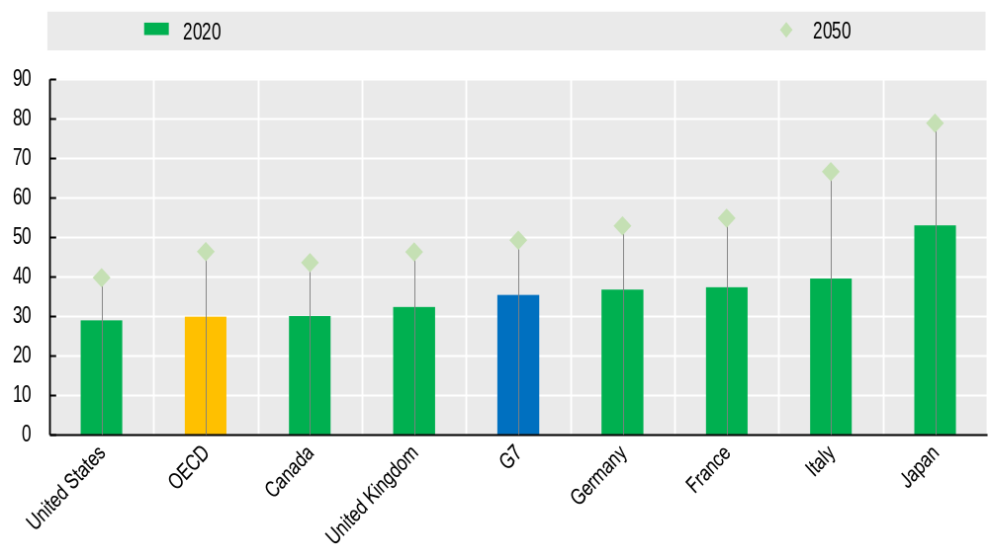
Demographic change calls for a more inclusive labour market
G7 countries are ageing rapidly
A framework for promoting longer working lives
Projected change in the old-age dependency ratio, 2020-2050
Note: The old-age dependency ratio is defined as the number of people aged 65 and over per 100 people aged 20-64.
Source: OECD Population and Labour Force Projections Database
Notes:
The transformation of the labour market because of digitalisation and decarbonisation is occurring against the backdrop of rapid population ageing in G7 countries, reflecting longer and healthier lives and low fertility rates.
As show in the chart on the left, between 2020 and 2050, the number of persons aged 65 and over is projected to rise from 35 for every 100 people aged 20 to 64 on average across the G7 economies to 49
As with the other megatrends, population ageing comes with challenges and opportunities.
Longer and healthier lives can be powerful drivers of greater lifetime well-being.
However, rapid population ageing will put pressure on the sustainability of public expenditures on pensions, health-care and long-term care.
Ageing will also have a direct impact on consumption patterns: demand is likely to shift from durable goods (such as cars) towards services (such as health care).
All of these factors will have an impact on skill demands and the types of jobs that will be created.
Promoting higher employment rates (especially among women) and longer working lives will help share the benefits of longer life expectancy more fairly and ensure that adequate incomes in retirement are sustainable.
Fostering more age-inclusive workforces can also result in productivity gains for employers (OECD, 2020, Promoting an Age-Inclusive Workforce:).
[Click] Achieving this objective will require taking a lifecycle perspective to policy making, as shown in the figure on the right. This includes: rewarding work at an older age and later retirement, promoting employability throughout working lives, and encouraging employers to retain and hire older workers.
This requires concerted action by governments, employers, trade unions and civil society.

Slide 10
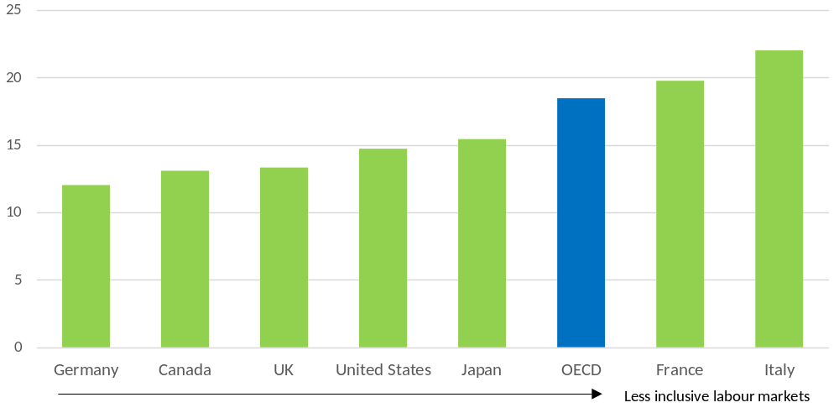
A more inclusive labour market would boost the workforce
Potential gain in employment of greater inclusion
Promoting inclusion
Difference between the employment rates of men aged 25-54 and all persons aged 15-64, 2020 (% points)
Key challenges for policymakers:
Tackling discriminatory practices.
Promoting flexible (but voluntary) work options.
Strengthening training lifelong learning, especially for the low skilled.
Tackling gender gaps through better care polices and incentives for more equitable gender distribution of paid and unpaid work.
Early interventions for youth.
Joined up policies for integration of people with disabilities or mental health conditions.
Note: The data indicate the percentage point increase in the share of the working-age population (15-64) employed if all groups in the population had the same employment rate as for prime-age men (25-54).
Source: OECD calculations based on data from: Eurostat, European Labour Survey for EU countries and the UK; and national labour force surveys for Japan and the United States.
Notes:
Beyond promoting longer working lives, the drag on overall employment and growth as a result of population ageing can be countered by ensuring the widest participation of all adults in productive and good quality employment irrespective of age, gender and gender identity, sexual orientation, ethnic background, religious belief, and disability and physical and mental health status.
This can be illustrated in a simple way by calculating how much employment rates would increase if all groups in the working-age population had the same employment rate as prime-age men (aged 25-54) -- typically the group with the highest rate.
Across the G7 economies, the increase would range from 12 percentage-points in Germany to 22 percentage-points in Italy.
[Click] However, achieving a more inclusive labour market requires tackling discriminatory practices, and other employment barriers faced by different groups in the labour market. It also requires policies and practices covering entire working careers.
Offering flexible working options can support workers across the life course to prevent burnout, manage family responsibilities and engage in learning.
Training should be based on an all-age training policy that takes into account the skills needs of workers of all ages.
Gender gaps in the labour market remain large. Flexibility in work arrangements is especially important, as women, on average, continue to take on more unpaid caring responsibilities than men do. Paid parental and paternity leave, childcare and long-term care policies are key to ensure a more equitable distribution of work and family obligations while contributing to closing the gender employment gap. Tackling still large gender gaps in pay and gender segregation by occupation would also help to encourage women to enter and remain in the workforce.
Young people were particularly hit by the COVID-19 and reinforced and early action is the best way to prevent long-term damage to their career prospects.
Cutting across both age and gender, people with disabilities or experiencing mental health conditions deserve particular attention as well as other groups such as migrants, indigenous people and those living in rural or remote areas.

Slide 11
Interlinkages matter
Digitalisation
Demographic change
Decarbonisation
Notes:
The global trends of digitalisation, decarbonisation and demographic change are not independent of each other and their impact on the world of work reflects interlinkages that are complex and depend on regional, national and sector specificities.
For example, the decrease in working-age population because of an ageing population brings a risk for declines in innovation and productivity. Decarbonisation and digitalisation present opportunities for promoting innovation and higher productivity.
Some common policy measures are also required in response to all 3Ds. For example, a scaled up and more responsive adult learning system is essential in the face of changing skill needs arising from all three megatrends. This includes better labour market information on how the supply of and demand for skill needs are changing as a result of the 3Ds.
Strengthening social protection and closing coverage gaps are also important for facilitating the increased job mobility that will occur. However, achieving sustainability in the financing of social protection will require more inclusive labour markets, especially in the face of rapid population ageing.
Successful decarbonisation and digitalisation transitions also require updating and carefully implementing Occupational Safety and Health regulations. With digitalisation and especially automation, some dangerous tasks no longer have to be executed by workers. However, the new types of tasks that are developing need to be evaluated regarding their effect on workers’ health. Similar consideration apply to new tasks and jobs in green sectors or as a result of greener production and service provision.
More generally, working conditions should be adapted to workers’ needs, especially in the context of ageing workforces. This includes greater use of robots and performing tasks remotely, not just in manufacturing but also in services provision, e.g. health care.

Slide 12
Taking a more integrated policy approach to the 3Ds
Digitalisation
Demographic change
Decarbonisation
Notes:
The challenges for governments, firms and workers arising from the 3Ds are manifold and cut across all areas of labour market and social policy as well as other policy areas.
Early insights from responses to the questionnaire that was circulated on behalf of the German G7 Presidency confirm that the 3Ds are high up on G7 countries’ policy agenda.
Canada, France, Germany, Italy and the United Kingdom have all major initiatives under way with the aim to help the labour market, firms and workers adjust to the demographic, digital and green transitions.
However, the answers to the G7 questionnaire also suggest that countries often treat the challenges arising from each of the 3Ds in isolation and have undertaken relatively few assessments of their joint impact on the labour market.
For example, the right skills policy, for example, ought to take into account the skills that will be needed in a world with rapidly rising numbers of digital and green jobs and more older workers and consumers all at the same time.
As reported by Germany’s Federal Ministry of Labour and Social Affairs, in this case, their skills monitoring does give due account to digitalisation trends, climate change as well as the outcomes of the COVID-19 pandemic.
The Ministry complements these evidence-based tools with strategic foresight and futures scenarios to improve further its understanding of the joint impact and interplay of the 3Ds.
Now may be the moment for governments to embrace a more integrated policy approach to the 3Ds along such lines and ensure that the labour market of the future works for all.

Slide 13
Thank you!
‣ Contacts
Organisation for Economic Co-operation and Development
Stefano Scarpetta Mark Keese
Director of Employment, Labour and Head of Skills and Employability Division
Social Affairs Director of Employment, Labour and Social Affairs
stefano. scarpetta@oecd.org mark.keese@oecd.org
ILO
Claire Harasty Moustapha Gueye
Special Adviser to the Deputy Director- Head of Green Jobs Programme
General for Policy Enterprises Department
harasty@ilo.org gueye@ilo.org

