Slide 1
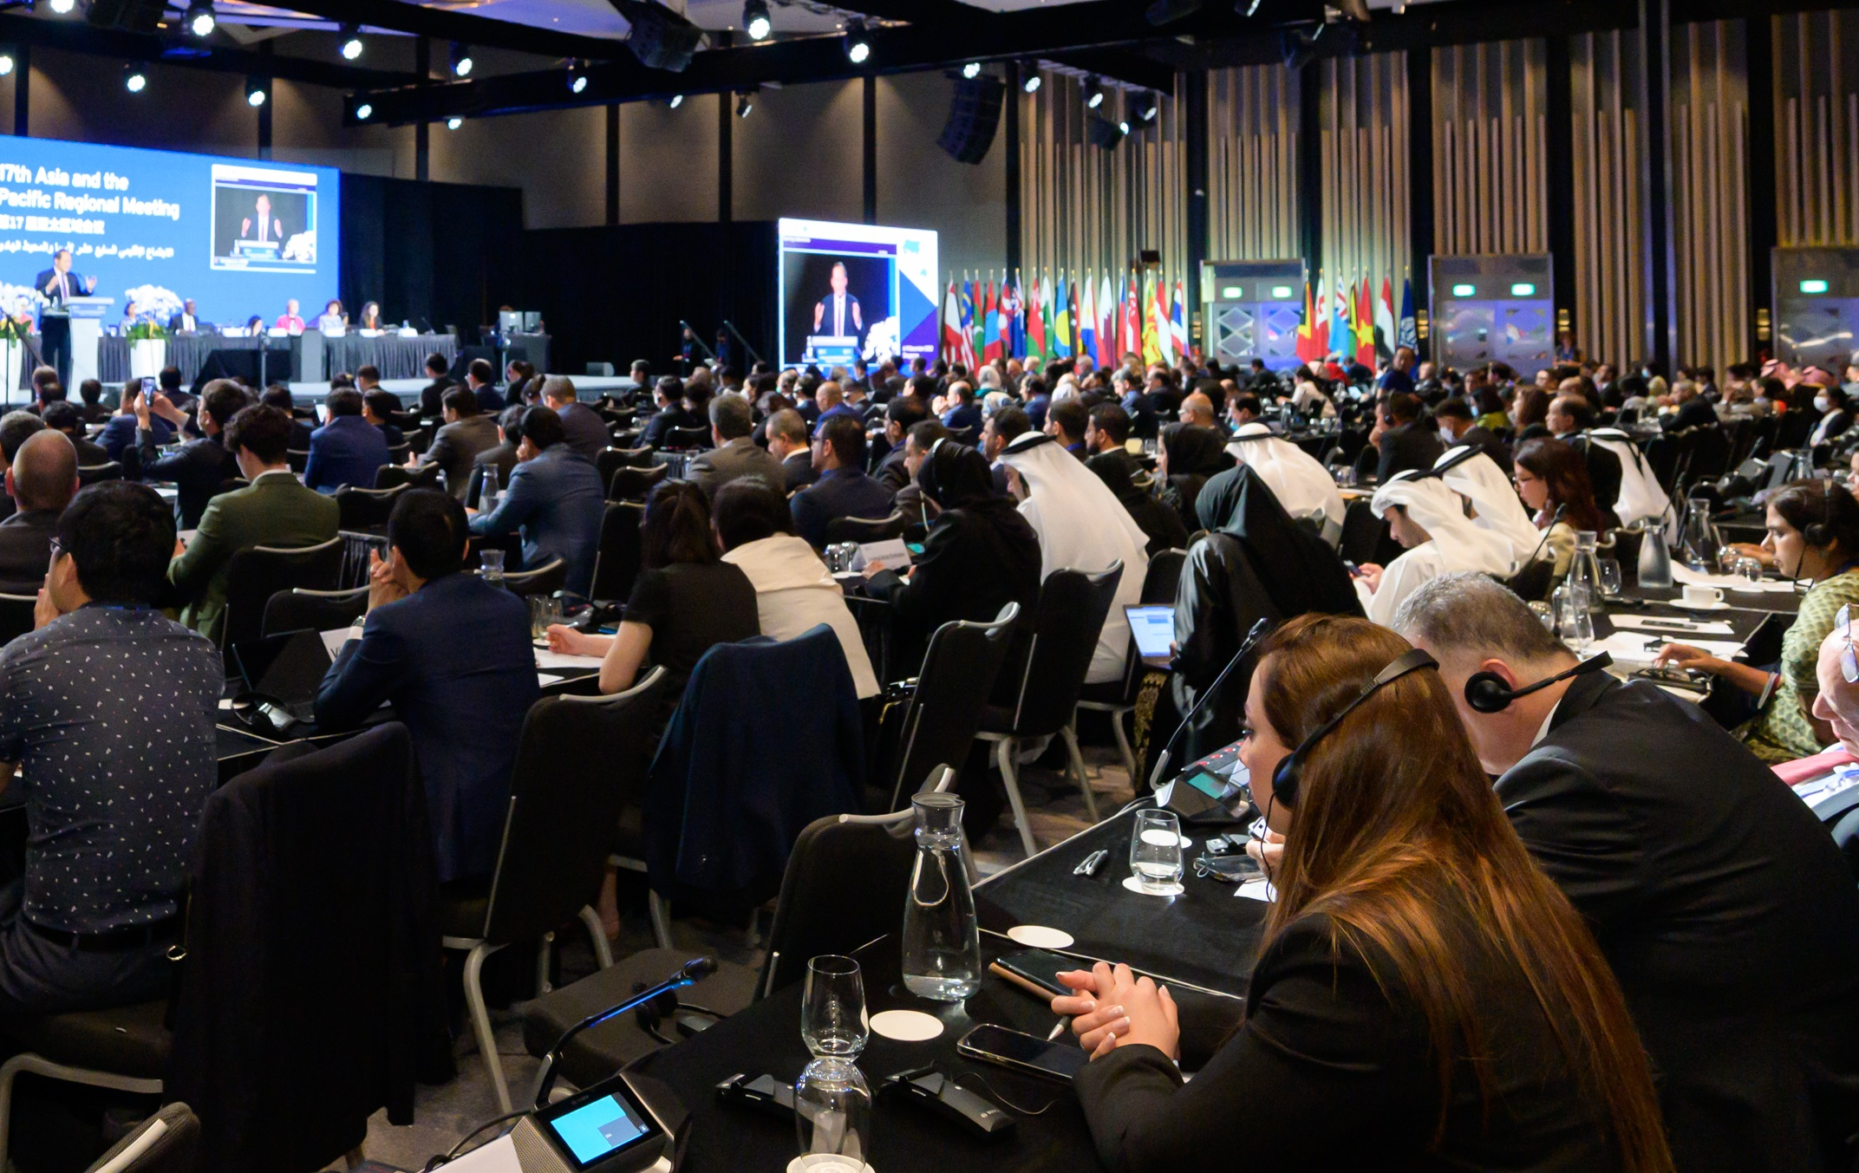

High-Level Tripartite Regional Seminar on Industrial Relations in Southeast Asian Countries

Slide 2
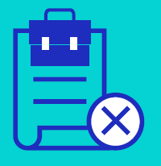




Structural barriers underpin decent work deficits
2
1.3 billion
people in informal employment
60 million
workers in extreme poverty
Less than 2 in 5
economically active are women
51 million
children aged 5-17 engaged in child labour
1.2
million
deaths attributable to occupational risks in Asia-Pacific
174 million
youth not in employment, education or training

Slide 3
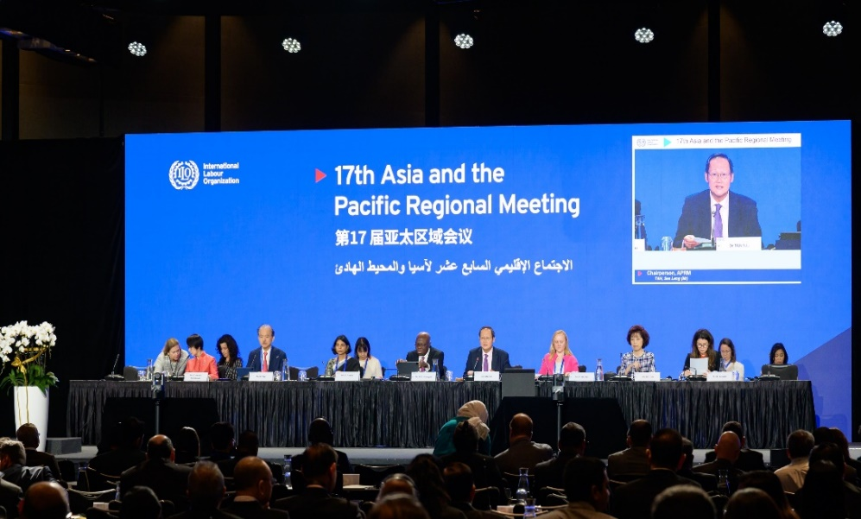
Singapore Statement
6-9 December 2022, Singapore
17th Asia and the Pacific Regional Meeting (APRM)
3
17th APRM, Singapore, 6-9 December 2022
Eliminating forced & child labour
Fostering sustainable enterprises
Closing gender gaps in the world of work
Enhancing labour migration policies
Developing policies for decent jobs
Extending social protection
Building resilience in crises through employment promotion
Fundamental principles and rights at work
Reversing inequalities
Strengthening labour market institution
(Strengthening) Social Dialogue

Slide 4
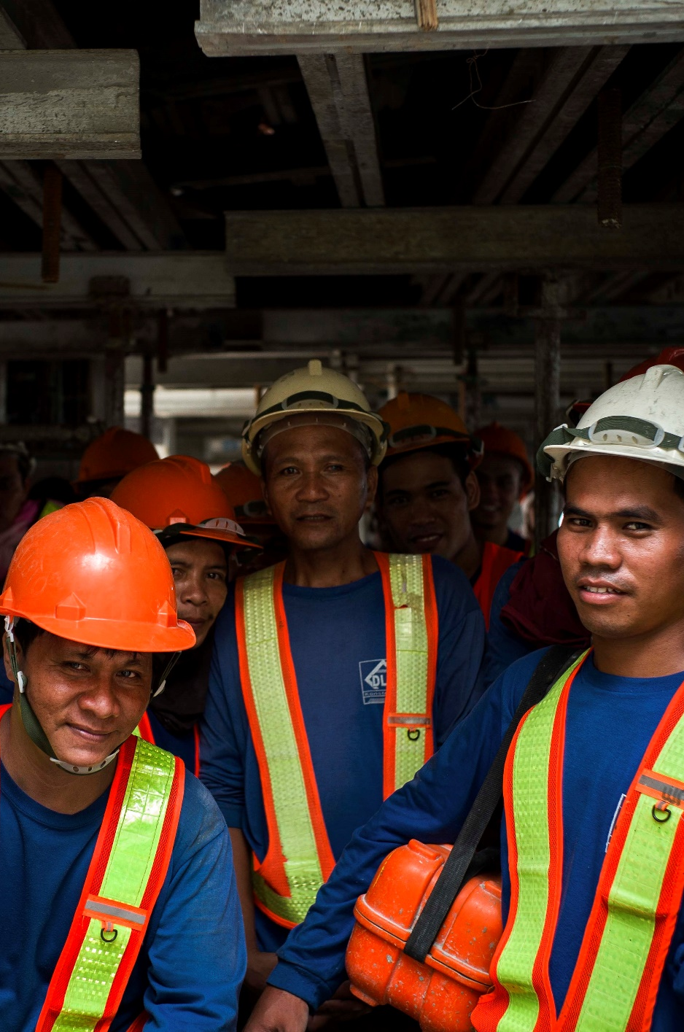
IR Seminars (ILO Japan Programme)
Organized since 2009
4
Theme:
    Building better Industrial Relations towards ASEAN integration
Goal:
    Strengthening the capacity of social partners to engage in social dialogue and improving industrial relations
Asian workers in construction industry

Slide 5
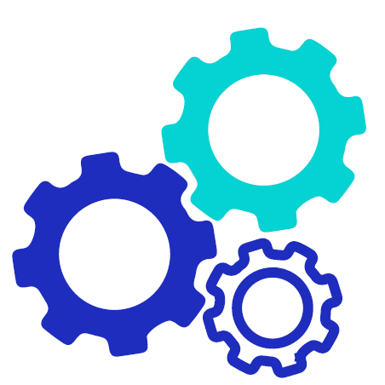

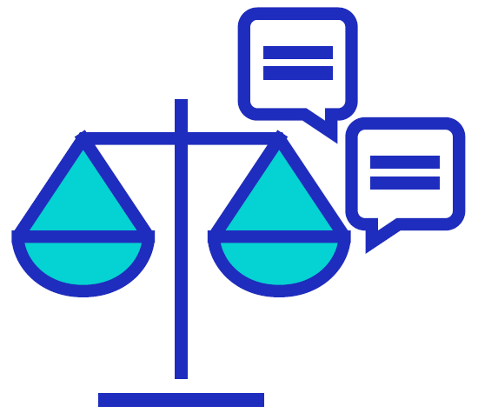


Past IR seminars in the region
5
1st
(Bogor, Indonesia,
26-27 Feb 2009)
4th
(Bangkok, Thailand, 29 Feb-1 Mar 2012)
6th
(Chiba, Japan,
26-27 Feb 2014)
8th
(Hoi An, Vietnam,
8-9 Nov 2017)
9th
(Chiba, Japan,
18-19 Sep 2019)
“Promoting good practices for sound & harmonious industrial relations”
“Wage setting mechanisms through social dialogues in ASEAN countries”
“Trends & good practices of collective bargaining and dispute resolution in ASEAN countries”
“Industrial relations and bipartite social dialogue within enterprises in ASEAN Countries”
“Promotion of sound industrial relations through social dialogue on skills development in the context of the future of work”
Social Dialogue
Notes:
194 words

Slide 6
10th High-Level Tripartite Regional Seminar on IR
6
PANEL discussion: Moving from conflict to cooperation
PANEL discussion: Labour management relations in Japan from Keidanren, Rengo
Society 5.0 & the role of social partners
Guidance from
ACTRAV & ACTEMP
Group discussion:
Revitalization of social dialogue & promoting productive industrial relations
Project intervention
1) Business & human rights
2) Fundamental (OSH & child labour)
3) Triangle project (Migrant)
4) Business & human rights project
Country situation review &
Joint presentation by tripartite representatives from each country
Joint agenda for strengthening social dialogue & industrial relations
Notes:
117 words

Slide 7
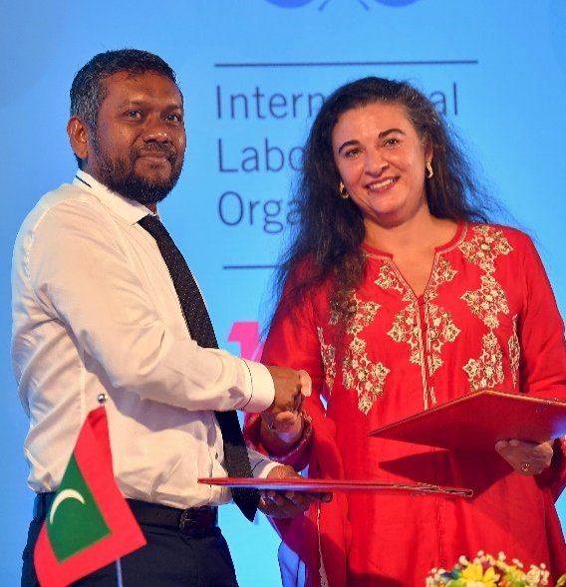
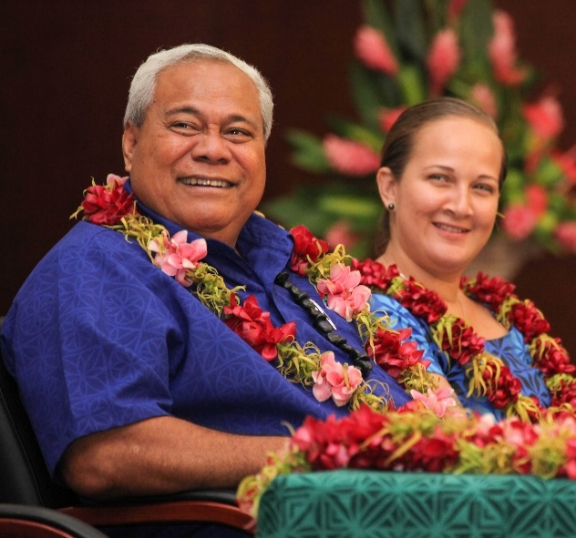
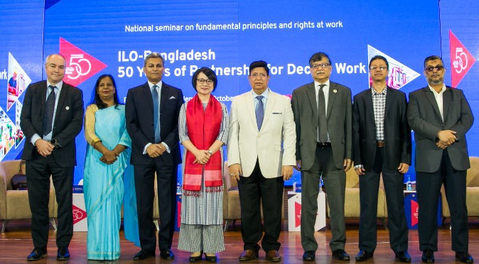
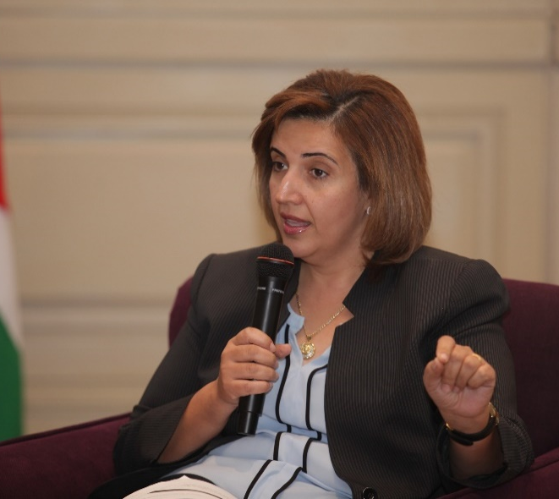
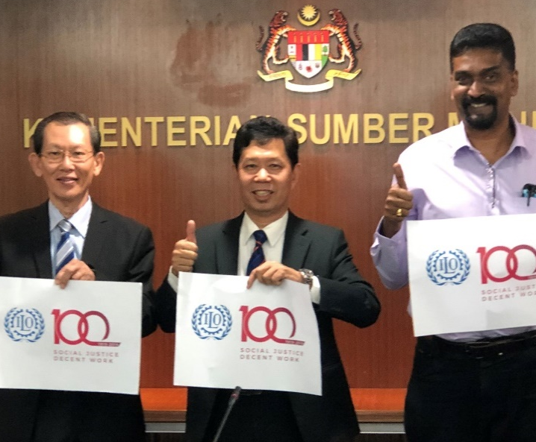
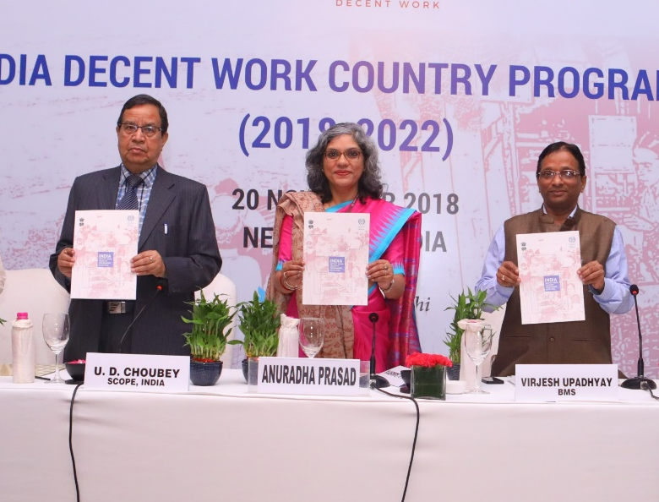
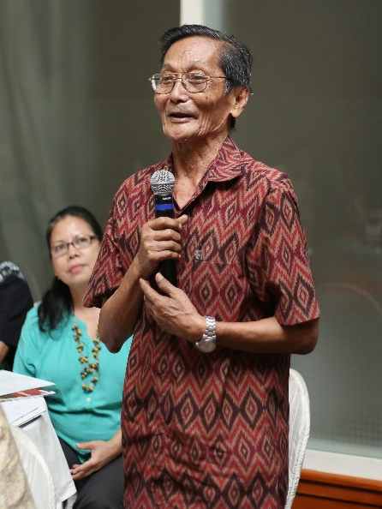
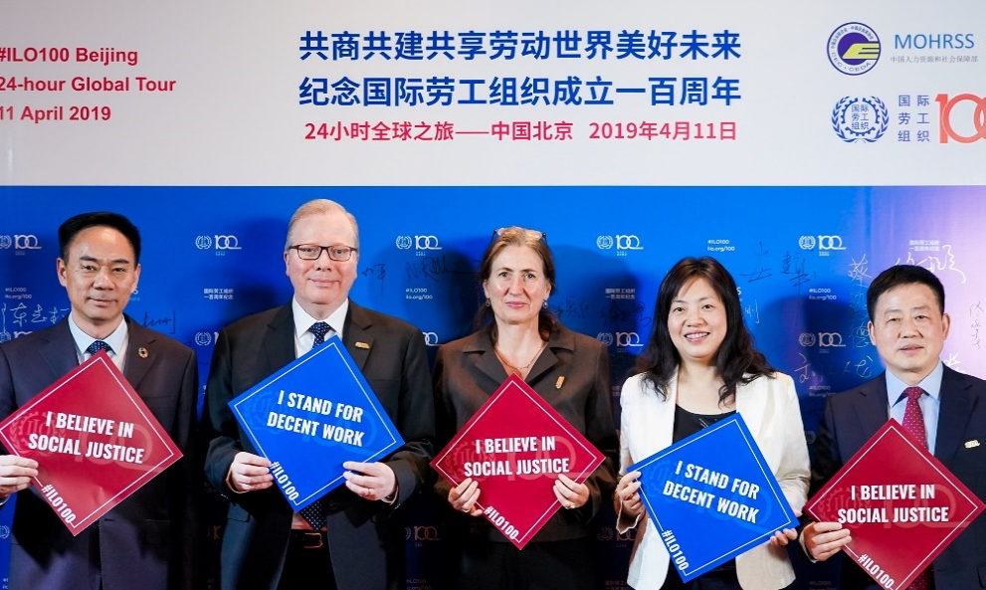
Strengthening social dialogue
7
Notes:
154 words

Slide 8
Asia & the Pacific countries
(with Asian countries)
8
ILO Japan Partnership Programme
(Million USD)
(*)
Voluntary contributions to the ILO
    Social security
    Skill and vocational training
    Global supply chains
    Occupational safety & health
    Child labour
    Crisis response etc
(Year)

Slide 9
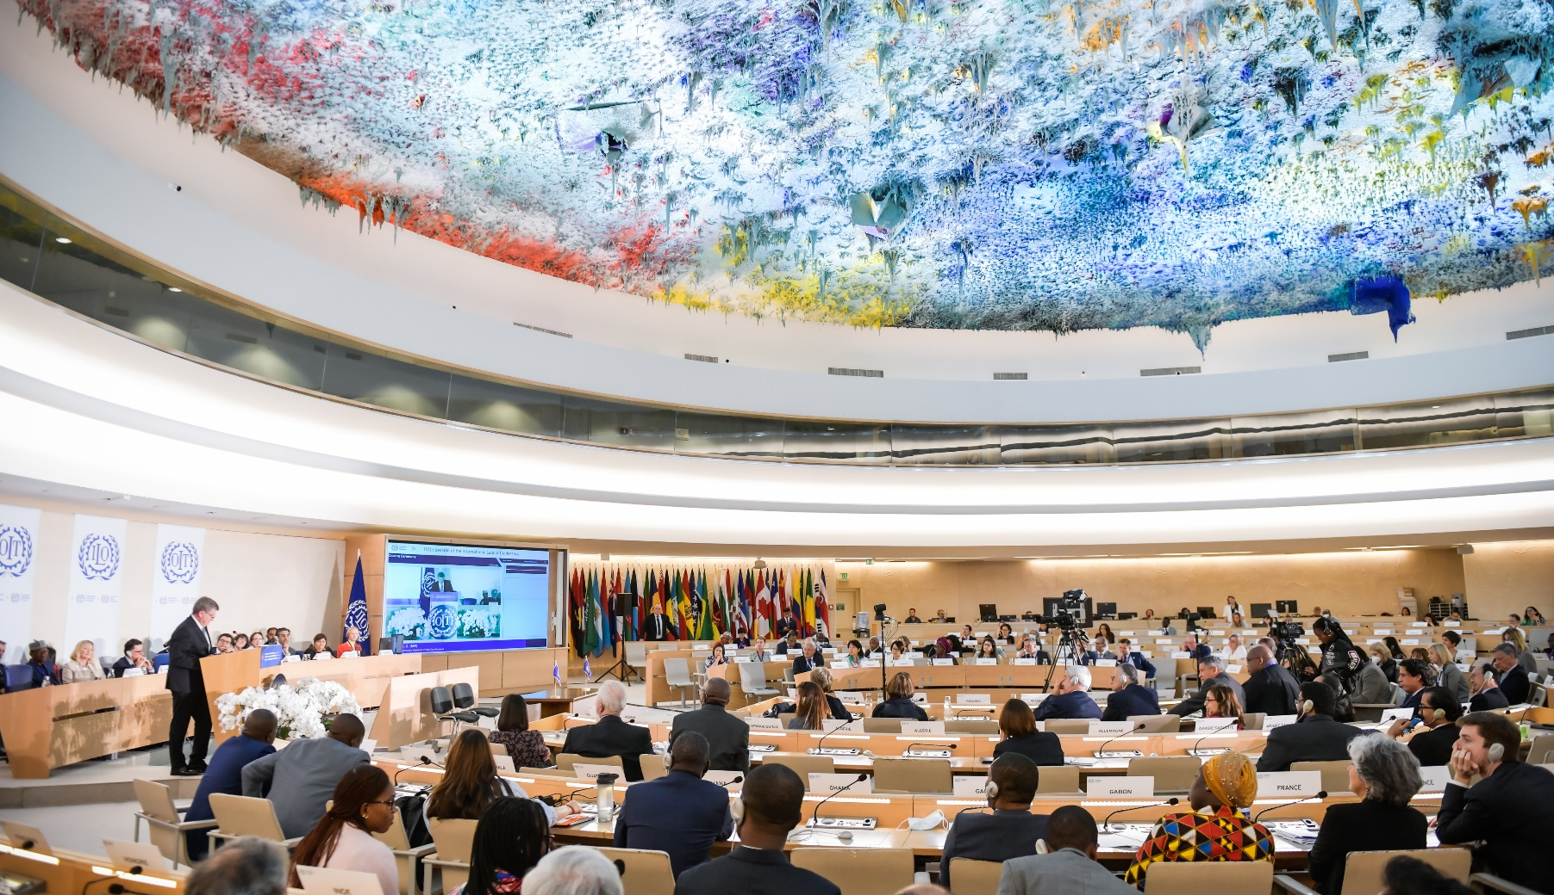
Thank you very much

