Slide 1
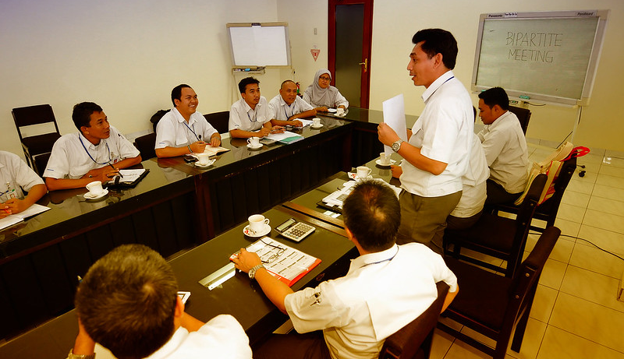
Industrial Relations: Moving from Conflict to Cooperation… for Productive Businesses and Decent Work!
Arun Kumar
Collective Bargaining & Social Dialogue Specialist

Slide 2
Recovery & Growth require social dialogue & cooperation
We are meeting at a time where Covid crisis has affected many businesses, economies AND also affected workers livelihoods & incomes – in the process labour disputes have also arisen;
Now…. It is true that workplace practices are not a cure-all for all problems but these do impact enterprise performance. (history of past crises shows) Countries & Companies with culture of social dialogue & cooperation have tended to address economic & social challenges better and recover faster from crisis;
Industrial relations are not merely a question of addressing labour-management problems but sit at the heart of the productive processes – impact costs & productivity of investments, economic activities and Employers capacity to address workers demands. Necessary therefore to build shared understanding of the challenges facing the businesses, workers & the economy - otherwise conflicts will affect implementation of policies, reduce productivity of investments and become hurdles in the recovery process;
This session is therefore to discuss and understand the views of tripartite constituents on – how we view industrial relations in South East Asian countries and what should be done to move IR from conflict to relationship based on dialogue and cooperation for promoting growth and sharing in gains of growth.

Slide 3
Issues for Discussion
(to the Government Rep): If we see Asian countries, we find different models and approaches to industrial relations – What do you think are the main factors that have influenced the development of industrial relations in your country? in ASEAN region?
(to the Workers Rep): Managing labour relations: In case of disagreements/ disputes, employers and workers in this region tend to resort to ‘power contests (strikes, lockouts, take it or leave it approach) or judicial adjudication’ INSTEAD OF making all efforts for a negotiated settlement – would you say this is true? What can be done to promote greater role for negotiations and collective bargaining culture in managing labour relations?
(to the Employer Reps): Looking towards the future, what main changes you expect in times ahead when it comes to industrial relations? What can be done to promote greater role for collective bargaining in managing labour relations?
(a general question for all and to the audience): in labour relations – what should be the role for law and what should be role for collective bargaining?

Slide 4
Rethinking Industrial Relations: Concluding Remarks
Conflict in industrial relations is inevitable, but costs and consequences need not be!
Disagreements do not mean that relations have to be disagreeable and non-cooperative!
Important also to realise that there are many areas of collaboration between employers’ & workers’ organizations!
Arrangements for workplace consultations, cooperation and collective bargaining are important means for creating conditions for collaborative Industrial Relations – these help Managements and Trade Unions to look beyond their positions and come to settlements based on their interests;
Relationship – is a product of history/past actions; relationships change when we find new ways of relating!
We hope we can discuss more on all this and plan for follow up during this meeting.

