Slide 1
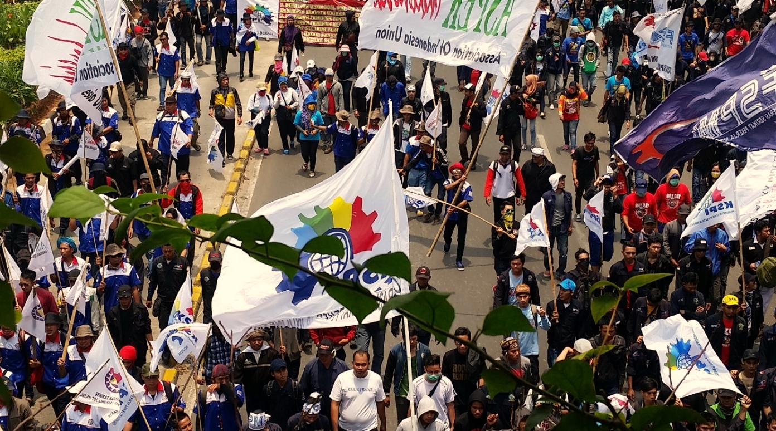
Preventing & Resolving Labour disputes: Key ILO Principles for
Disputes Prevention & Resolution
  Arun Kumar
  Collective Bargaining and Social Dialogue Specialist
  ILO Bangkok

Slide 2
Addressing Grievances & Disputes necessary for sound & productive employment relations
Employee grievances & labour disputes are inevitable in employment relationships BUT costs & consequences need not be. How an enterprise manages conflict(s) can make all the difference:
    Between a minor issue and a costly dispute,
    For worker commitment and motivation towards work and company goals,
    For building trust between workers and managers,
    For productivity, value added and profitability of the enterprise.
Its not just workers problem but also management’s as it affects Company performance;
This session is about discussing what approach, arrangements and practices countries have for labour disputes prevention and resolution and how effective these are;

Slide 3
Preventing & Resolving Labour disputes
Preventing & Managing Industrial Disputes requires:
    Creating the environment to promote mutual respect between employees and managers (Ex practices like: culture of information sharing, recognizing workers as stakeholders, respecting rules & rights at work, what else do companies do for trust building?
    Tools for dispute prevention & resolution: workplace consultation & cooperation arrangement(s), collective bargaining, HR policy that promotes social dialogue for establishing the rules, rights & obligations of the parties, grievance handling procedure;
ILO does not prescribe any specific model of dispute resolution, but tripartite constituents have discussed this issue and come to recommend a number of principles relevant to designing dispute resolution system;

Slide 4
Key ILO Principles for prevention and settlement of industrial disputes
the best way to govern a relationship between parties is to allow them to regulate it themselves – that’s why ILO constituents agreed to develop & adopt C 87 & C 98 (to provide for Freedom of Association, Right to Organise & Collective Bargaining;
Dispute Resolution: bodies & procedures for the settlement of labour disputes should be so conceived as to contribute to the promotion of Collective Bargaining (C. No 154);
Conciliation/Mediation can be part of bargaining process provided they are voluntary (R 92 recommends free, speedy & voluntary conciliation/mediation/arbitration services);
Right to organize protests, including strike: necessary part of right to organize & collective bargaining and relevant to dispute resolution; Where legitimate restrictions can be imposed (Ex. essential services), these should be accompanied by compensatory guarantees including conciliation and arbitration procedures that are: Adequate, Impartial, Speedy & Enjoy the confidence of the parties;

Slide 5
Other measures relevant to dispute resolution
R. 130 on the Examination of Grievances: Encourages establishment of a grievance procedure at enterprise level as a first step before resorting to other procedures, such as courts or arbitration (applies to rights disputes);
R. 94 on Co-operation at the Level of the Undertaking: encourages setting up consultation & cooperation arrangements at enterprise level to promote labour-management dialogue for mutual benefit (on issues that are NOT within the scope of collective bargaining or dealt with by other machinery concerned with the determination of terms and conditions of employment);
  R. 129 on Communications within the Undertaking: recommends formulating communication policy – in consultations with workers' representatives – to create an environment of mutual understanding and confidence within undertakings.

Slide 6
Assessing Dispute Resolution Mechanisms
Most Asian countries have labour dispute settlement arrangements and procedures;
How effective are these? Possible criteria for comparing:
    transaction costs (time, money, emotional energy expended in disputing);
    satisfaction with outcome(s) - parties mutual satisfaction with the result;
    effect on the relationship (causes bitterness/resentments or cooperation, improved motivation to work, etc);
    recurrence of disputes;
    Any other criteria?
  What is the experience of the countries in regard to the above? Is there any DRS that meets all of the above criteria?

Slide 7
Issues for discussion:
In most South East Asian countries – 3 levels and procedures of dispute resolution: bipartite, intervention of MoL and Judicial/legal adjudication – most disputes are resolved at what level? Which is most effective?
Labour disputes should be negotiated, not litigated – do you agree? If yes, what obstacles hinder the use of collective bargaining as a dispute resolution mechanism?
Labour Mediation as a dispute resolution method: Do Employers and workers prefer labour mediation? Or they prefer going to the court for settlement of disputes? how can labour mediation be made more effective?

Slide 8
Concluding Remark:
What kind of conflicts we have on hand is not important. How the parties conduct themselves while resolving it is more important. The values we declare and adhere to while resolving conflicts set the tone for building workplace culture and relations.
          - Vivek S Patwardhan, Specialist, Human Resources and Employee Relations

