Slide 1
OSH as a Fundamental Principle and Right at Work
Yuka Ujita MD PhD
ILO DWT/CO-Bangkok

Slide 2
The right to safe and healthy working conditions
ILO Constitution (1919)
“protection of the worker against sickness, disease and injury arising out of his employment” as a fundamental element of social justice
Philadelphia Declaration (1944)
“adequate protection for the life and health of workers in all occupations” as ILO’s “solemn obligation”
Centenary Declaration for the Future of Work (2019)
“safe and healthy working conditions are fundamental to decent work”

Slide 3
Safe and healthy working conditions in international laws
The Universal Declaration of Human Rights (1948)
Everyone has the right to life, to work, to free choice of employment, to just and favourable conditions of work and to protection against unemployment
The International Covenant on Economic, Social and Cultural Rights (1976)
Recognize the right of everyone to work; the right of everyone to enjoyment of just and favourable conditions of work which ensure in particular, safe and healthy working conditions
UN Committee on Economic, Social and Cultural Rights (2016)
Preventing occupational accidents and diseases is a fundamental aspect of the right to just and favourable conditions of work

Slide 4
Why OSH as FPRW?

Slide 5
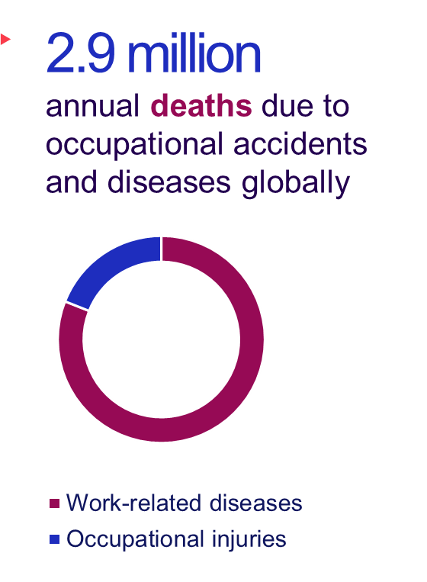
Impact of OSH deficits is high
402 million
  non-fatal occupational injuries globally
5.4 %
  annual global GDP lost due to occupational accidents
Data from the International Commission on Occupational Health (ICOH)

Slide 6
International Labour Standards in the area of OSH
C155 + Protocol
Occupational safety and health
C161
Occupational health services
Others
Sectoral, specific hazards
C187
Promotional framework on OSH

Slide 7
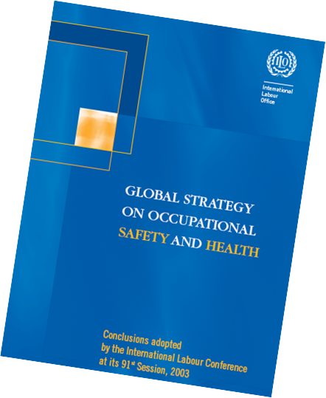
Global Strategy on OSH (2003 ILC Conclusions)
Main pillars:
Preventative safety and health culture
Systems approach to OSH

Slide 8
Developments/progresses towards the 110th ILC decision
First proposed in 2017 during recurrent discussion on FPRW
Report of Global Commission on the Future of Work, 2019: Draft declaration indicated that OSH is a FPRW in addition to those specified in the 1998 Declaration
108th ILC session:
  Centenary Declaration for the Future of Work: Safe and Healthy Working Conditions are fundamental to Decent Work
  Resolution requesting the Governing Body to consider, as soon as possible, proposals for including safe and healthy working conditions in the ILO’s framework of FPRW
Four GB discussions (November 2019 to March 2022)
Informal tripartite consultations on the draft resolution

Slide 9
ILO Declaration on Fundamental Principles and Rights at Work (1998)
as amended in 2022
Freedom of association and the right to collective bargaining;
Elimination of all forms of forced or compulsory labour;
Abolition of child labour;
Elimination of discrimination at work
A safe and heathy working environment

Slide 10
Fundamental Conventions in the area of OSH
C155 + Protocol
Occupational safety and health
C161
Occupational health services
Others
Sectoral, specific hazards
C187
Promotional framework on OSH

Slide 11
Why are C155 and C187 important?
General principles of OSH are defined
e.g. applies to all workers in the all branches of economic activity
Systems approach to the management of OSH is provided
Four inter-related principles
    Prevention-based approach to occupational injuries and diseases
    Progressive realization
    Dialogue and consultations at al levels of OSH management
    A system of defined rights, duties and responsibilities

Slide 12
What are the next actions?

Slide 13
Strengthening OSH legal/policy framework and improving workplace practices
OSH laws and regulations
Enforcement and compliance
Tripartite advisory body
OSH management system – risk assessment and control
OSH training and information
Workers-employers cooperation / social dialogue

Slide 14
OSH as a Fundamental Principle and Right at Work
Yuka Ujita MD PhD
ILO DWT/CO-Bangkok

