Slide 1
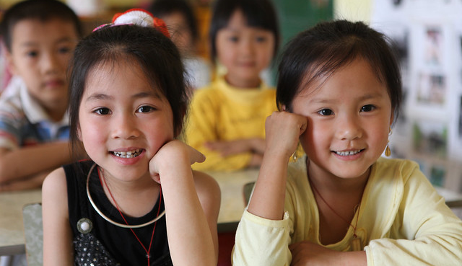
The Fundamental Principles and Rights at Work - Child Labour
Bharati Pflug
Senior Specialist Fundamental Principles and Rights at Work

Slide 2
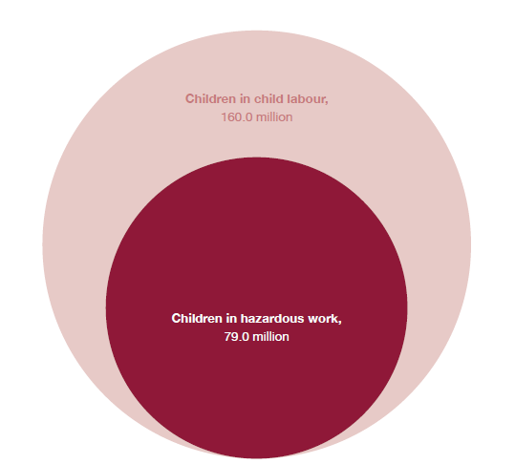
The Big Numbers
Worldwide, 160 million children are engaged in child labour
79 million of them are performing hazardous work
First increase in 20 years

Slide 3
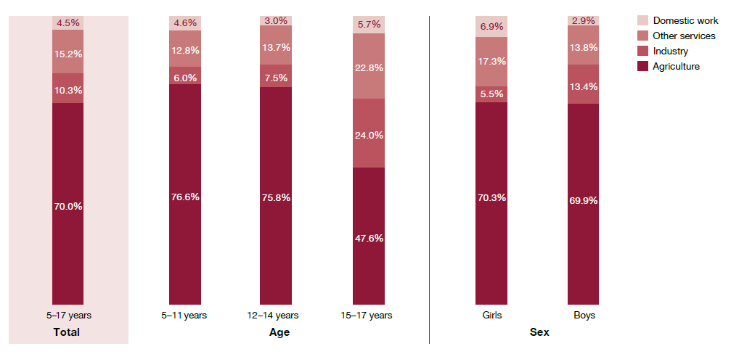
Child Labour in Agriculture Remains a Main Concern
Most child labour – for boys and girls alike – continues to occur in agriculture
More than 70% in agriculture
112 million children in total
over three quarters of those aged 5 to 11

Slide 4
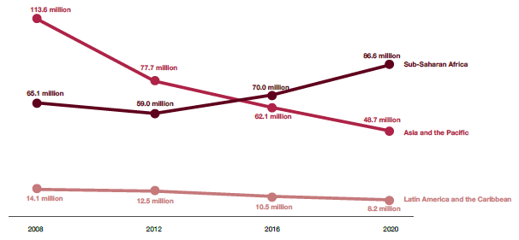
Regional Differences
2008: Asia and the Pacific 113 million children in child labour
2016: 62 m, 28 m in hazardous child labour
2020: 48,7 m (22,2 m in hazardous child labour), significant reduction
Asia and the Pacific kept up the same decline rate from 2012 to 2016 to 2020
But it is still very far away from achieving the SDG Target
Africa: increase of 20 million, 27%

Slide 5
Global and Regional Frameworks
International Labour Standards (C138, C182)
SDG Target 8.7
Durban Call to Action
Singapore Statement
ASEAN Roadmap on the Elimination of the Worst Forms of Child Labour

Slide 6
Durban Call to Action
Make decent work a reality for adults and youth above the minimum age for work by accelerating multi-stakeholder efforts to eliminate child labour, with priority given to the worst forms of child labour
End child labour in agriculture
Strengthen the prevention and elimination of child labour, including its worst forms, forced labour, modern slavery and trafficking in persons, and the protection of survivors through data-driven and survivor-informed policy and programmatic responses
Realize children’s right to education and ensuring universal access to free, compulsory, quality, equitable and inclusive education and training
Achieving universal access to social protection
Increasing financing and international cooperation for the elimination of child labour and forced labour

Slide 7
Singapore Statement
Among priorities for national action:
Strengthen the foundations for social and employment protection and resilience, including:
(b) extending labour protections through the strengthening of labour inspections systems and enhancing occupational safety and health (OSH) through the ratification and effective implementation of the OSH conventions that are now part of the fundamental principles and rights at work;
(e) eliminating all forms of forced and child labour, including through the ratification and implementation of the fundamental principles and rights at work Conventions
https://www.ilo.org/wcmsp5/groups/public/---ed_norm/---relconf/documents/meetingdocument/wcms_863606.pdf

Slide 8
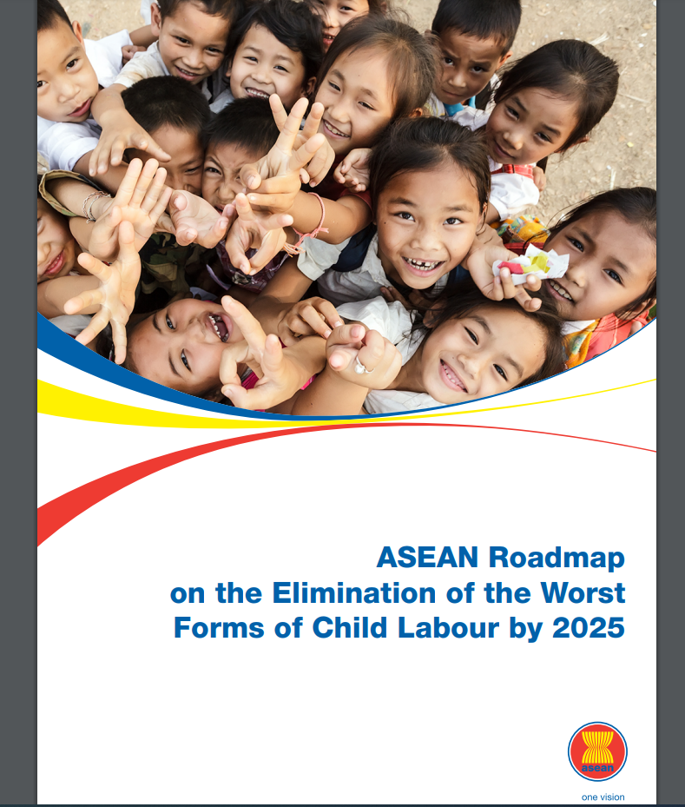
ASEAN Roadmap on the Elimination of the Worst Forms of Child Labour by 2025
Guide ASEAN in collectively supporting its AMS in working towards the elimination of the worst forms of child labour in the region
by building upon achievements and lessons learnt from the implementation of the previous ASEAN Roadmap and similar policy initiatives
Region-wide framework of cooperation that complements the commitments and actions of AMS against child labour at national and global levels

Slide 9
ASEAN Roadmap on the Elimination of the Worst Forms of Child Labour by 2025
Prohibition of child labour practices and promoting good governance for elimination of child labour including:
Labour inspection, especially in hard-to-reach sectors
Institutional capacity for law enforcement
Strengthening good governance for CL elimination
Strengthening coordination and cross-sectoral collaboration
Prevention of child labour practices including:
Addressing root causes of CL
Access to education, especially in rural and remote areas
Rural development and poverty reduction
Decent work for young workers
Public awareness raising; understanding modern forms of child labour (e.g. web-based exploitation)
Protection of children including:
Social protection.
Improvement of systems to identify, withdraw and support children from child labour

Slide 10
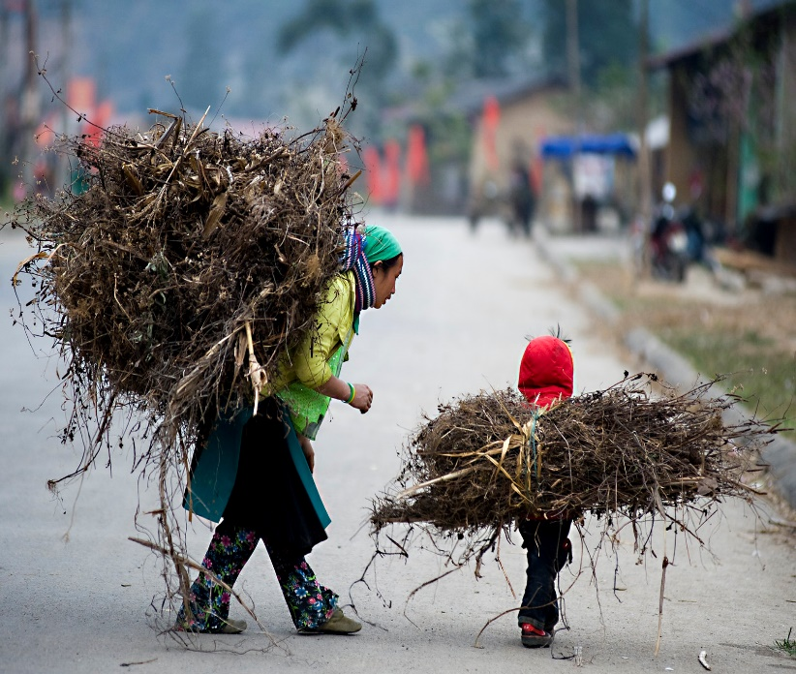
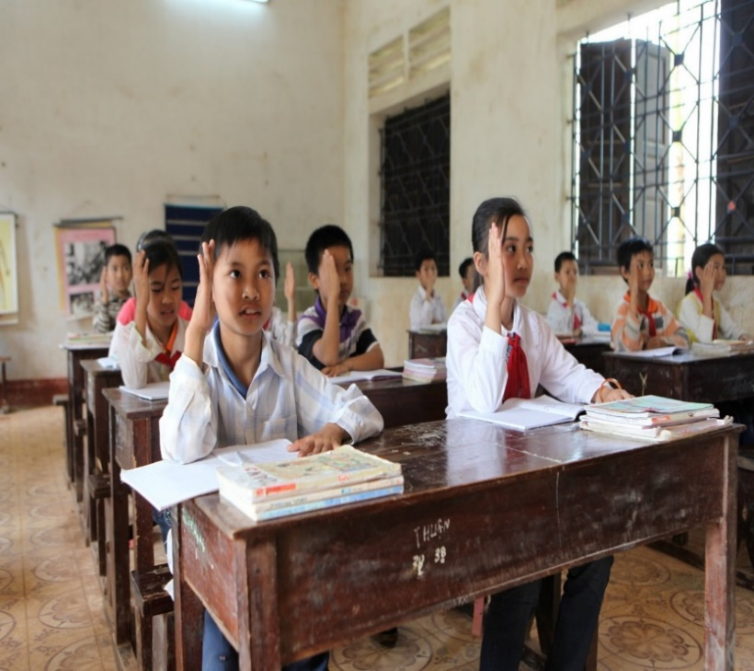
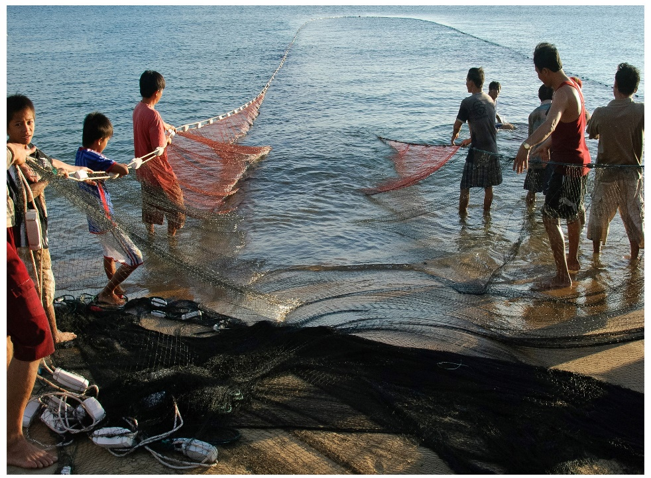
Whatever the figures tell us: we all have a responsibility to ensure that no child is left behind in child labour

