Slide 1
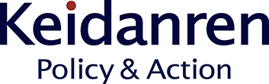
- Co-creating the future –
Society 5.0
23 February 2023
NAKAJIMA Koh
Deputy Director, Industrial Technology Bureau
Keidanren (Japan Business Federation)

Slide 2
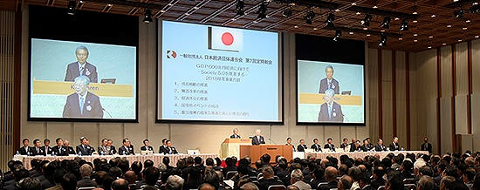
About Keidanren
KEIDANREN (Japan Business Federation) is a comprehensive economic organisation with a membership comprised of 1,494 representative companies of Japan, 108 nationwide industrial associations and the regional economic organisations for all 47 prefectures (as of 1 April 2022).
Our mission as a comprehensive economic organisation is to draw upon the vitality of corporations, individuals and local communities to support corporate activities which contribute to the self-sustaining development of the Japanese economy and improvement in the quality of life for the Japanese people.

Slide 3
Today’s Contents
Chapter 1: Concept of Society 5.0 for SDGs
Chapter 2: To Create a Data-Driven Society
Chapter 3: For the Well-being of People
Chapter 4: The Role of Social Partners

Slide 4
Chapter 1
Concept of Society 5.0 for SDGs
- Theory and Application

Slide 5

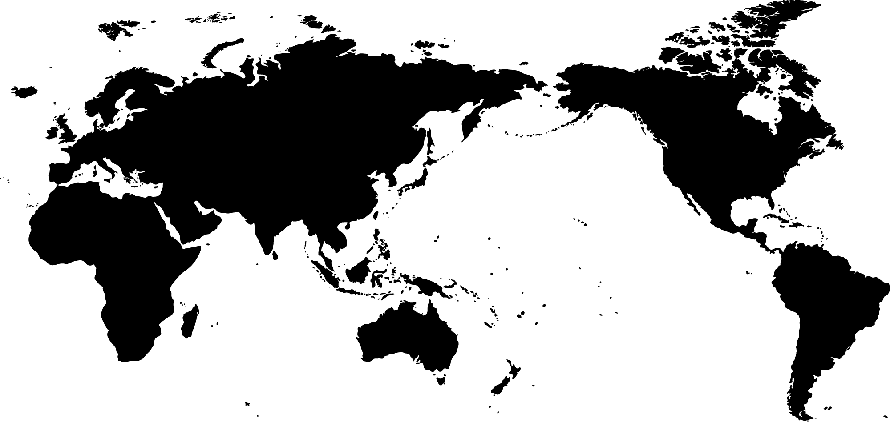



Background: Great Tide of Change
Technological change
The world is facing an even greater tide of change against a backdrop of rapidly advancing innovation in digital technologies such as AI, the Internet of Things (IoT), robotics, and blockchains, as well as biotechnologies.
Economic and geo-political change
The world economy’s centre of gravity will shift from the West to Asia.
While some countries are facing rapid ageing of the population amid extremely low birthrate, the global population is growing explosively.
Change in mindset
Problems such as global environmental issues and social disparity are worsening, and in 2015 the United Nations adopted SDGs aimed at addressing these issues.
Every change brings opportunities as well.
Imagination is the key to shaping the future.

Slide 6
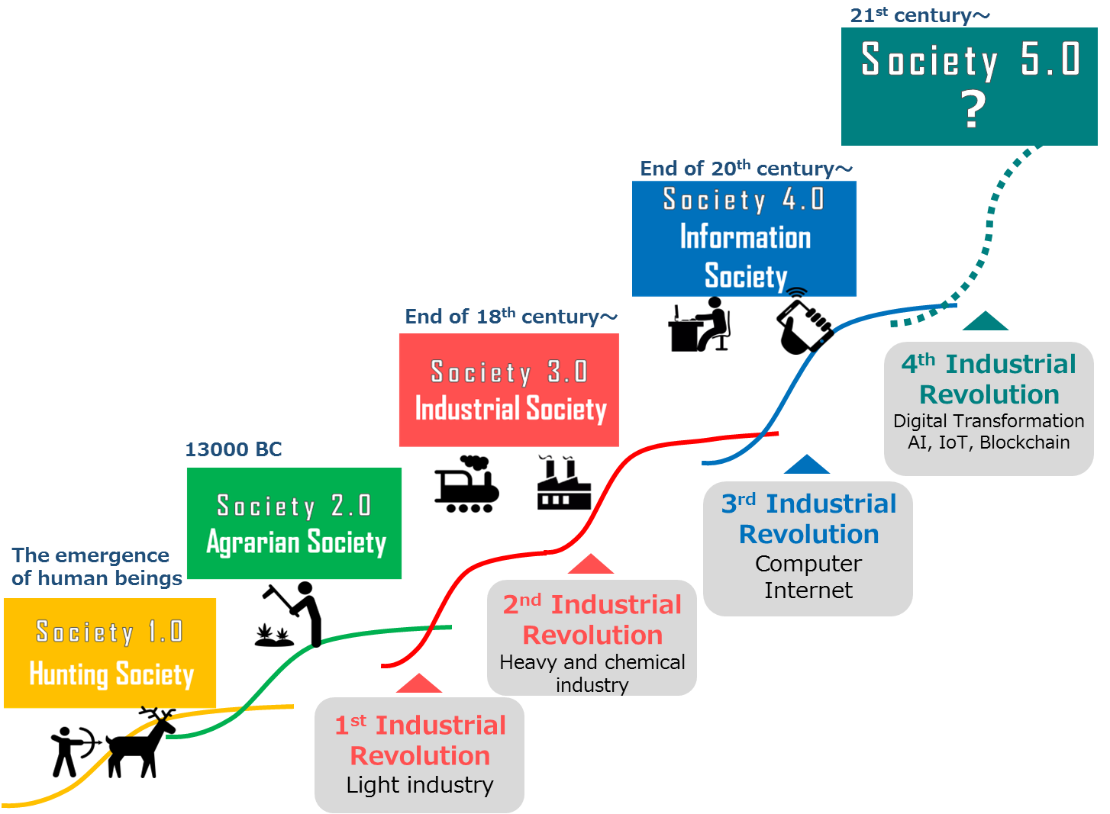
Development of Human Society
To date, humankind has lived in four types of society:
① Hunting ⇒ ② Agrarian ⇒ ③ Industrial ⇒ ④ Information
Digital transformation heralds a fifth stage.

Slide 7
Digital Transformation
Digital transformation will dramatically alter many aspects of society, including private lives, public administration, industrial structure, and employment.
Utilisation of data and AI will open up new possibilities.
The important question is what to use these technologies for.
Digital transformation : Advances in digital technology and data utilisation drastically changes aspects of society including private lives, public administration, industrial structure, and employment.
IoT | IoT means that every "thing" is connected to the Internet. Improved technologies for sensing precise data from physical real world will enable appropriate data to be gathered in real time and deployed in cyberspace.
AI | One essential aspect of AI can be viewed as “distribution and commoditisation of abilities.”
Robotics | AI exerts its capabilities not only in cyberspace, but also in physical real world via robots.
Distributed Ledger Technology | Distributed ledger technologies such as blockchains do much to improve transaction efficiency and traceability.

Slide 8
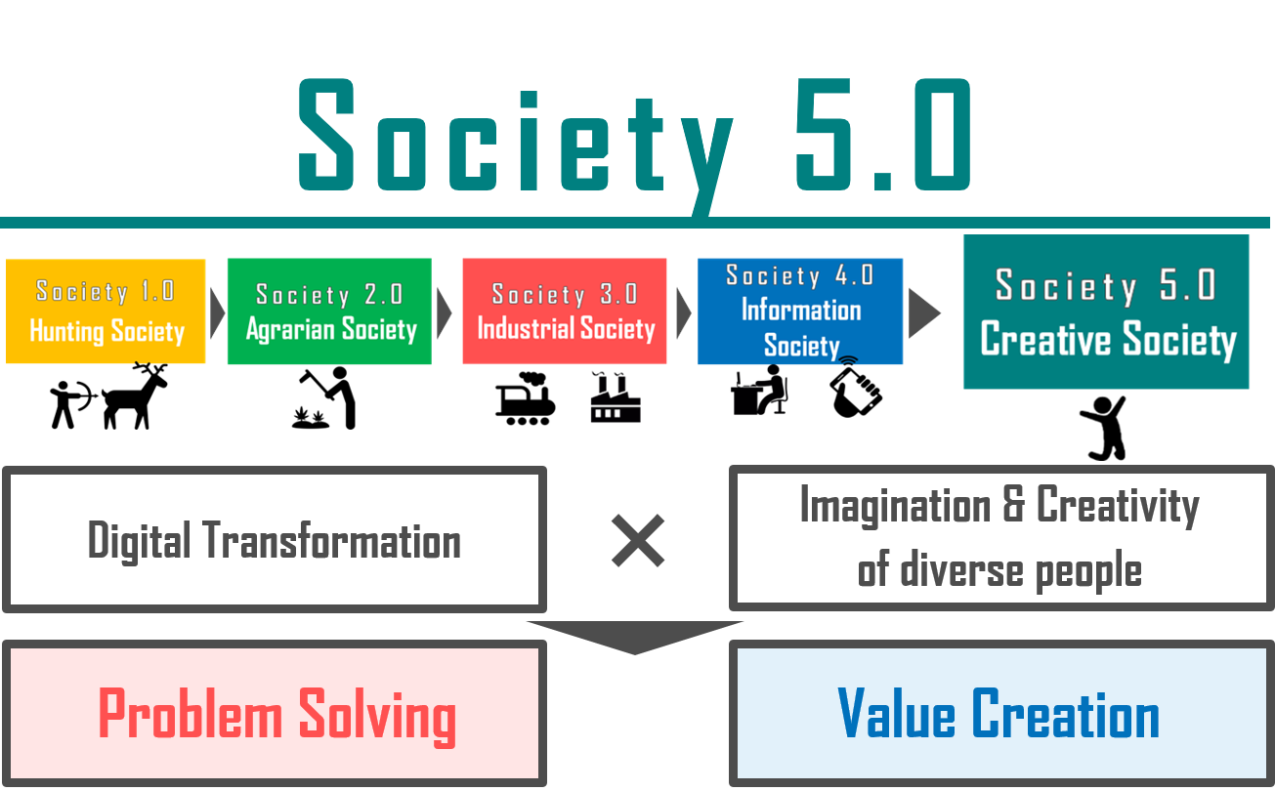
The Nature of Society 5.0
Digital technologies and data should be utilised to create a society where people lead diverse lifestyles and pursue well-being in their own ways.
In the future, humans will require imagination to change the world and creativity to materialise their ideas.
Society 5.0 will be a Creative Society.

Slide 9
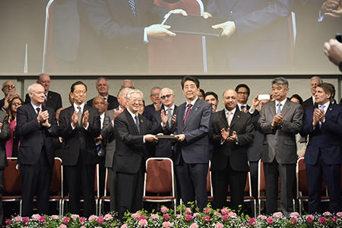





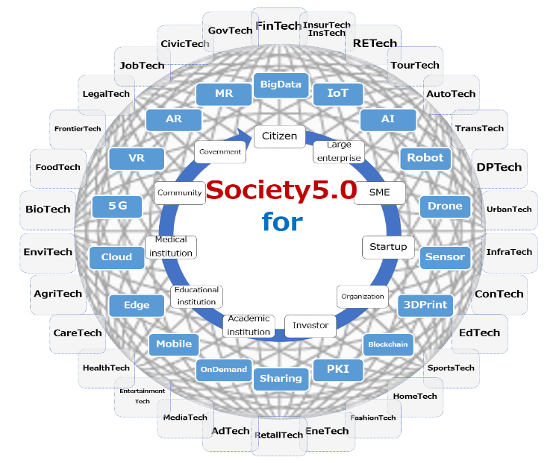







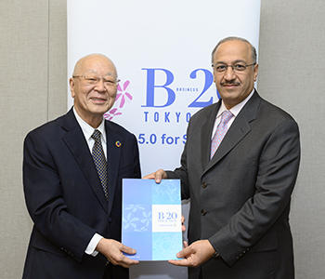






B20 Tokyo Summit (14-15 March 2019)
- Society 5.0 for SDGs, our future society to create together -
8

Slide 10
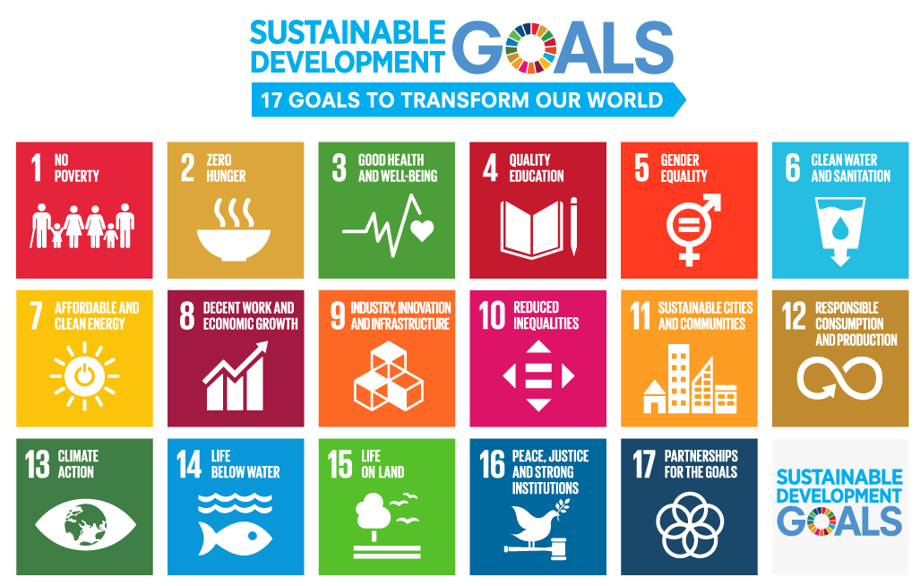
Blueprint of Society 5.0 for SDGs
Aiming to resolve social issues in harmony with nature, Society 5.0 will contribute to delivering on United Nations SDGs.
The two reforms share a common direction.
Society 5.0
① Cities and Regions
② Energy
③ Disaster Prevention
④ Healthcare
⑤ Agriculture and Food
⑥ Logistics
⑦ Manufacturing and Services
⑧ Finance
⑨ Public Services
Source: http://www.unic.or.jp/activities/economic_social_development/sustainable_development/2030agenda/sdgs_logo/

Slide 11















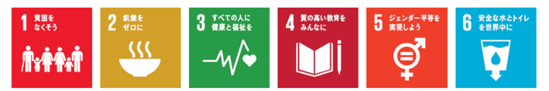
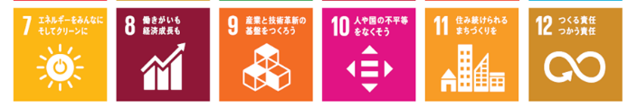









① Cities and Regions
１
Data will be shared to facilitate smarter solutions.
２
Decentralised communities will be created in suburbs and rural areas.
３
Such developments will enable diverse lifestyles and create a society where diversity is respected.

Slide 12









② Energy
１
Reliable energy will be available to anyone.
2
Clean and sustainable energy will be supplied.
3
Decentralised micro grids will be developed with local conditions.

Slide 13
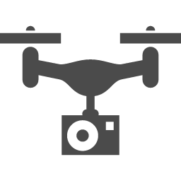

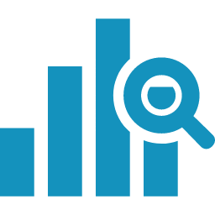



③ Disaster Prevention and Mitigation
１
Sharing disaster information across organisations will facilitate swift responses to disasters.
２
Digital technologies will be used for disaster mitigation.
３
Medical services will be maintained even in the event of disasters.

Slide 14
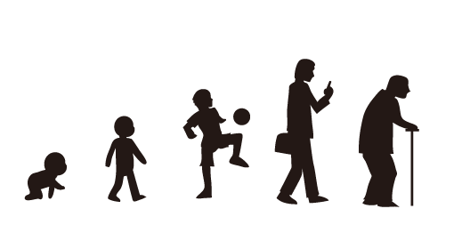





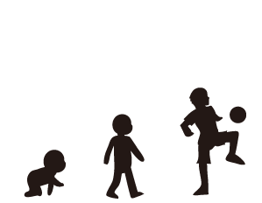



④ Healthcare (health, medicine, and nursing)
１
New approaches will provide care tailored to individual health at the preventive stage.
2
Individuals will use and manage life-stage data on their own initiative.

Slide 15

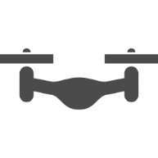


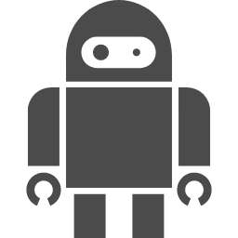








⑤ Agriculture and Food
１
Full use will be made of cutting-edge technologies.
２
Data and technologies will also be used to optimise the food value chain (FVC).
３
Diverse players including private corporations, youth, and agritech ventures will participate.

Slide 16








⑥ Logistics
１
Players will optimise entire supply chains by sharing data on procurement, production, transportation, and sales.
２
Most work substitutable by autonomous driving, drones, and robots will be automated.
３
Diverse customer needs will be identified to realise logistics that create new value.

Slide 17











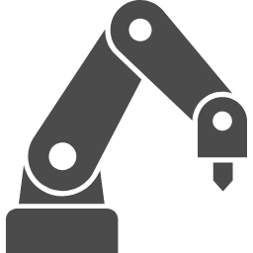



⑦ Manufacturing and Services
１
Distribution of abilities will enable individuals and small companies to provide high-level goods and services.
２
Systems will be established to enable consumers to easily and affordably make one-of-a-kind items.
３
Business models will be based on services, not hardware.

Slide 18















⑧ Finance
１
Digital transformation will make available diverse, custom-made financial services.
２
Financial systems will allocate funds efficiently and effectively across society.
３
Improved access to financial services will contribute to economic independence and greater income equality.

Slide 19














⑨ Public Services
１
By quickly sharing data among diverse actors, they will provide more creative public services.
２
Public bodies will make timely and appropriate preparations and provide necessary services.
３
Safety nets established by governments will enable anyone to tackle a variety of challenges with security.

Slide 20
Chapter 2
To Create a Data-Driven Society
- Regulatory Reform, Data, and Cyber Security, etc.

Slide 21
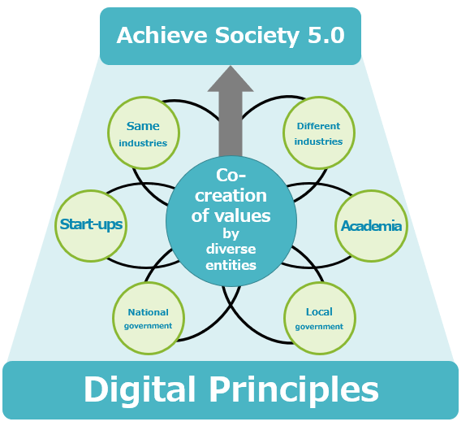

Basic Approach
In the ideal society in 2025, everyone is confident that
“we have entered a new era where we can feel the advent of Society 5.0.”
With a view to Society 5.0, the Digital Principles need to permeate all corners of society.
2025
Expo 2025 Osaka, Kansai, Japan
2022
20

Slide 22



Towards a Digital/Regulatory Reform
A detailed roadmap involving
the following STEPS 1〜3
needs to be implemented
in all areas.
Building a digital technology-oriented framework
・Embed a scheme that allows government to autonomously keep pace with cutting-edge technologies (shift to goal-based regulations, establish a digital legislation bureau, consider the introduction of a monitoring organisation)
03
Developing new institutions and infrastructure
・Develop institutional frameworks for safety standards, etc. regarding cutting-edge technologies
・Compile and disclose data for semi-public areas
・Link various data to My number
・Introduce user-friendly public service IDs
02
Comprehensive review of existing regulations and a package of digital technology-related law amendments
01
・Transform regulations that do not befit to Society 5.0
・Achieve real "end-to-end digital execution,”
with no single paper intervention in all procedures

Slide 23

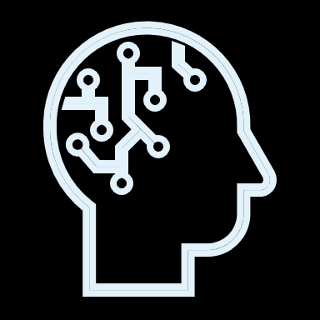

Keidanren’s Basic Stance on Data-Flow Policy (1)
As revealed by the corona disaster, data utilisation in Japan is still in progress. In addition to the immediate issues such as the digitalisation of administration and the development of a data distribution infrastructure promoted by the Digital Agency, fundamental issues such as the ideal state of rights related to data and the balance between the protection and distribution of cross-border data should be confronted.
Accordingly, it is necessary to realise trustworthy free data flow under the concept of DFFT (Data Free Flow with Trust).
In order to maximise the value of data towards the realisation of Society 5.0, it is important to promote the free flow of data across borders under the DFFT concept.

Slide 24
Keidanren’s Basic Stance on Data-Flow Policy (2)
In addition to the consistent development of rules and infrastructure, it is essential to understand the entity providing the data. In order to expedite data utilisation, it is necessary to flexibly respond to changes in the environment through repeated trial and error, rather than seeking perfection from the beginning, on the premise of ensuring security and privacy.
The government should deliver a message directly to the public about data utilisation.
The business community will accelerate the development and implementation of new products and services through the utilisation of data to present concrete convenience and consumer value in a visible manner, thereby contributing to understanding and earning trust in data utilisation.

Slide 25


What is DFFT (Data Free Flow with Trust) in the first place?
PM ABE Shinzo
23 January 2019, World Economic Forum Annual Meeting
“ We must, on one hand, be able to put our personal data and data embodying intellectual property, national security intelligence, and so on, under careful protection, while on the other hand, we must enable the free flow of medical, industrial, traffic and other most useful, non-personal, anonymous data to see no borders, repeat, no borders. The regime we must build is one for D.F.F.T., Data Free Flow with Trust--non-personal data, needless to say.”
24

Slide 26

October 2022
In conjunction with the advance of digital transformation (DX) and changes in social and economic activity brought about by the COVID-19 pandemic, cyberspace and physical spaces are merging, not only in industries, but throughout society as a whole.
At the same time, damage from cyberattacks is impinging on physical spaces, and there are endless examples of huge impacts on business activities and people’s lives. Cyberattacks via supply chains—such as those targeting business partners and overseas subsidiaries—are also on the rise.
Moreover, as heightened geopolitical tensions extend into cyberspace, cybersecurity is becoming a crucial domain for national security.
Under these circumstances, from the perspectives of creating value and building value chains aimed at realising Society 5.0 for SDGs, as well as managing risk, it is no exaggeration to say that effective cybersecurity measures are now a key management priority for all companies.
All businesses will implement cybersecurity measures and contribute to making cyberspace safe and secure. To this end, business leaders pledge to address the following points:

Slide 27
Declaration of Keidanren Cyber Security Management 2.0
Recognise Cybersecurity as a Management Issue
１
Enhance their own understanding of the latest cybersecurity circumstances and actively engage in management by positioning cybersecurity spending as an investment essential to promoting DX.
Take responsibility themselves for cybersecurity measures while recognizing that enhancing cybersecurity throughout the entire supply chain is a critical management issue, addressing risks associated with digitalization, and exercising leadership.
Develop Management Policies and Declare Intentions
２
Develop management policies and business continuity plans aimed at prompt recovery from security incidents while prioritizing detection, response, and recovery in addition to identifying and protecting against risks.
Take the lead in declaring companies’ intentions to internal and external stakeholders and make every effort to voluntarily disclose recognised risks, and measures to deal with them, in corporate reporting.
Build Internal and External Systems and Implement Security Measures
３
Ensure sufficient resources including budgets and personnel, establish internal systems, and take necessary human, technical, and physical measures.
Develop human resources and conduct training required for those at every level, including the management, corporate planning staff, technical specialists, and other employees.
Manage cybersecurity throughout domestic and international supply chains, including business partners and outsourcing contractors, by utilizing guidelines and frameworks for cybersecurity measures and cooperating with government support programs for such measures.
Contribute to Widespread Use of Cybersafe Products, Systems, and Services
４
Manage cybersecurity across the full spectrum of corporate activity, including development, design, production, and supply of products, systems, and services.
Contribute to Building Safe and Secure Ecosystems
５
Collaborate with relevant government agencies, organizations, industry associations, and other bodies to actively share information, engage in dialogue, and build human networks, both in Japan and internationally.
Contribute to reinforcement of cybersecurity in the entire supply chain and throughout society by raising awareness of measures taken on the basis of such information.

Slide 28
Chapter 3
For the Well-being of People

Slide 29
Workstyle in Society 5.0
Workstyle changes according to changes in society.
Society 3.0 Industrial Society | Society 4.0 Information Society | Society 5.0 Creative Society
Physical labour with machines and equipment
Standardised and manualised work
Homogeneous production
Work hours directly linked to production
Skills obtained by experience
Kaizen on site
Hierarchical organisations
Labour-saving, automation, remote control by ICT
Shift to software and services
Rapid technological innovation and change in issues
Rapid change in required skills
Rapid increase in the amount of knowledge and information, open innovation
Disruptive innovation, denial of traditional knowledge and experience
Characteristics of Information Society (Society 4.0) will be strengthened
Routine work will be substituted by AI and robots
Organisations and human resources should be AI-Ready
It will be required to meet diverse needs in society
Diverse imagination and creativity to materialise it will create values

Slide 30


Human Resources in Society 5.0
As most of routine work will be substituted by AI and robots, requirements for human resources will be different.
Those who can find and solve issues in use of AI etc. will be needed.
Leaders who can manage teams with diversity will also be indispensable.
Those who can solve issues on their own making use of AI
Those who dare to try fundamental reform of social system
AI-Ready
Diversity
Those who can demonstrate leadership in teams with diversity

Slide 31
What Japan Should Aim For
In order to realise Society 5.0, Japan should aim for a successful platform that has led digital innovation and included diversity.
People with diverse backgrounds find opportunities in Japan for success.
Digitalisation
×
Diversity
The AI x data make the most
of people who prepare
a system for change
（AI-Ready）
Everywhere in Japan
people with diverse backgrounds
take on the challenge of changing society one after another
（Inclusion of diversity）
Japan as a platform for success
A variety of people take on various challenges in Japan and grasp opportunities for success
New values ​​are created from Japan one after another, and through this we will realise Society 5.0

Slide 32
Take advantage of strengths and turn challenges into opportunities
Having experienced a variety of social issues to date, Japan can become an advanced problem-solving country (Lead by examples).
Should lead the international standardisation of "Society 5.0 for SDGs".
Scattered issues
Falling birthrate, aging population, local decline, fiscal deterioration, energy problems, etc.
History that suddenly changed society
Imagination in person to solve the problem
Ability to incorporate and develop new things into culture and language
Overwhelming catch-up ability, spirit to keep learning
Harnessing Japan's strengths
Opportunity to lead problem solving
Society 5.0
for
Worldwide spread of "Society 5.0 for SDGs“
Leading platform and international standardisation
Actual system development and operation

Slide 33
Chapter 4
The Role of Social Partners

Slide 34
Towards Industrial Relations That “Co-create” the Future
Amid drastic changes in the environment surrounding workers and companies, it is important to “invest in people” through wage increase, overall improvement of working conditions, human resource development, etc.
It is particularly necessary to make steady efforts to enhance engagement and implement various measures based on workers’ wishes and needs in employment for overall improvement of working conditions and human resource development to support the growth and performance of diverse workers.
Cooperation by workers and unions as important stakeholders is essential
Companies need to actively promote labor-management communication at different levels and through various channels.
Based on good and stable industrial relations, many companies engage in discussions on broad-ranging issues about companies and workers each spring or at regular intervals.
Other venues shall be created for both sides to discuss throughout the year issues that take time to consider and implement, such as wage policy, overall improvement of working conditions, and the expansion of human resource development measures.
Labour-management negotiations in spring 2023 amid price increases, a situation significantly different from recent years
⇓
Critical juncture to be litmus test for industrial relations in Japan
Labour and management not “adversaries” but business partners in
value co-creation.
Keidanren aims at industrial relations that work for resolving Japan’s social issues to “co-create” the future.
Notes:
Amid drastic changes in the environment surrounding workers and companies, “investment in people” through wage increase, overall improvement of working conditions, human resource development, etc. has become even more important. It is necessary to make steady efforts to enhance employee engagement and implement various measures.
To achieve these goals, cooperation by workers and labor unions as important stakeholders is essential. Since many workers are employed by small and mid-sized companies or as fixed-term and other forms of non-regular employees, it is necessary to actively promote labor-management communication at different levels and through various channels.
Based on good and stable industrial relations, many companies share information on their business environment and profitability between labor and management and engage in discussions on broad-ranging issues about companies and workers each spring or at regular intervals.
In many companies, both sides also discuss throughout the year issues that take time to consider and implement, such as wage policy, overall improvement of working conditions, and the expansion of human resource development measures. It is hoped that efforts will continue to be made through labor-management cooperation to build and implement the optimum system for each company.
I would like to repeat that this year’s spring labor-management negotiations and consultations will be held under a condition of price increases that is significantly different from that of recent years, and so will be a litmus test for Japan’s industrial relations at a critical juncture. As stated in the box at the bottom, based on the understanding that labor and management are not “adversaries” but business partners in value co-creation, Keidanren aims at building industrial relations that work for resolving Japan’s social issues to “co-create” the future.

Slide 35
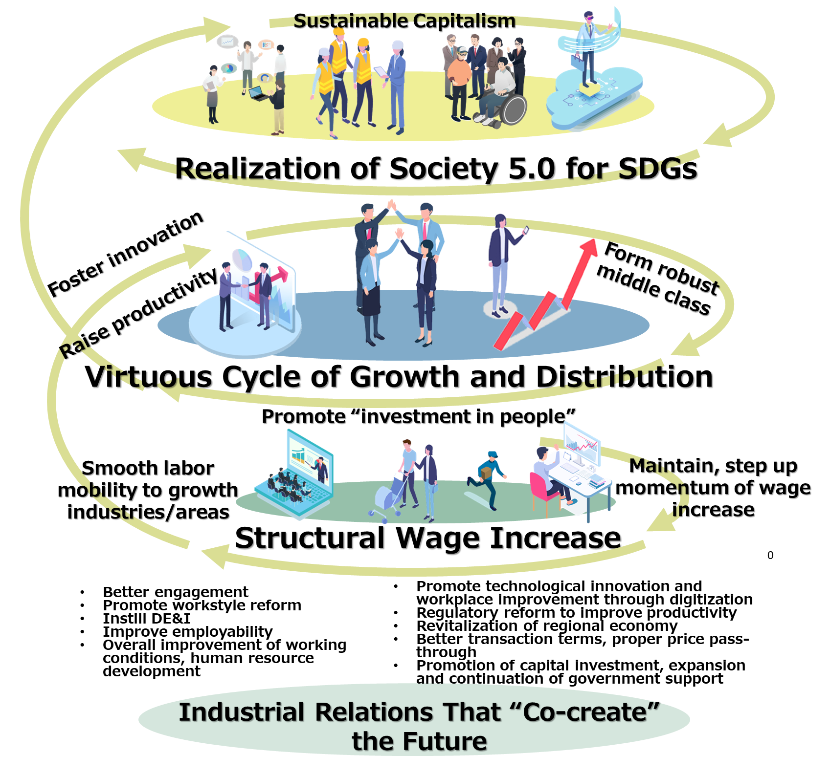
Conceptual Diagram
Notes:
About the conceptual diagram, Based on “industrial relations that ‘co-create’ the future” at the bottom of the page, achieve “structural wage increases” and “form a robust middle class” through the promotion of “investment in people,” the maintenance and strengthening of the momentum of wage increases, and smooth labor mobility to the growth industries and areas, as well as realize a “virtuous cycle of growth and distribution” by fostering further innovation and improving productivity.
By sustaining this virtuous cycle continuously, Keidanren envisions the realization of “sustainable capitalism” and “Society 5.0 for SDGs” that it advocates.

Slide 36

Conclusion
Society 5.0 is not something to come, but something to co-create.
Japan, as the originator of Society 5.0, wishes to bring the concept to fruition in partnership with players all over the world.
We believe it is our mission to contribute to sustainable global development by sharing problem-solving know-how gained in the process.

Slide 37
Thank you for your attention.
For further enquiries, please contact:
NAKAJIMA Koh (Mr)
Deputy Director, Industrial Technology Bureau
Keidanren (Japan Business Federation)
Tel: +81 (0)3-6741-0642
e-mail: k-nakaji@keidanren.or.jp

