Slide 1
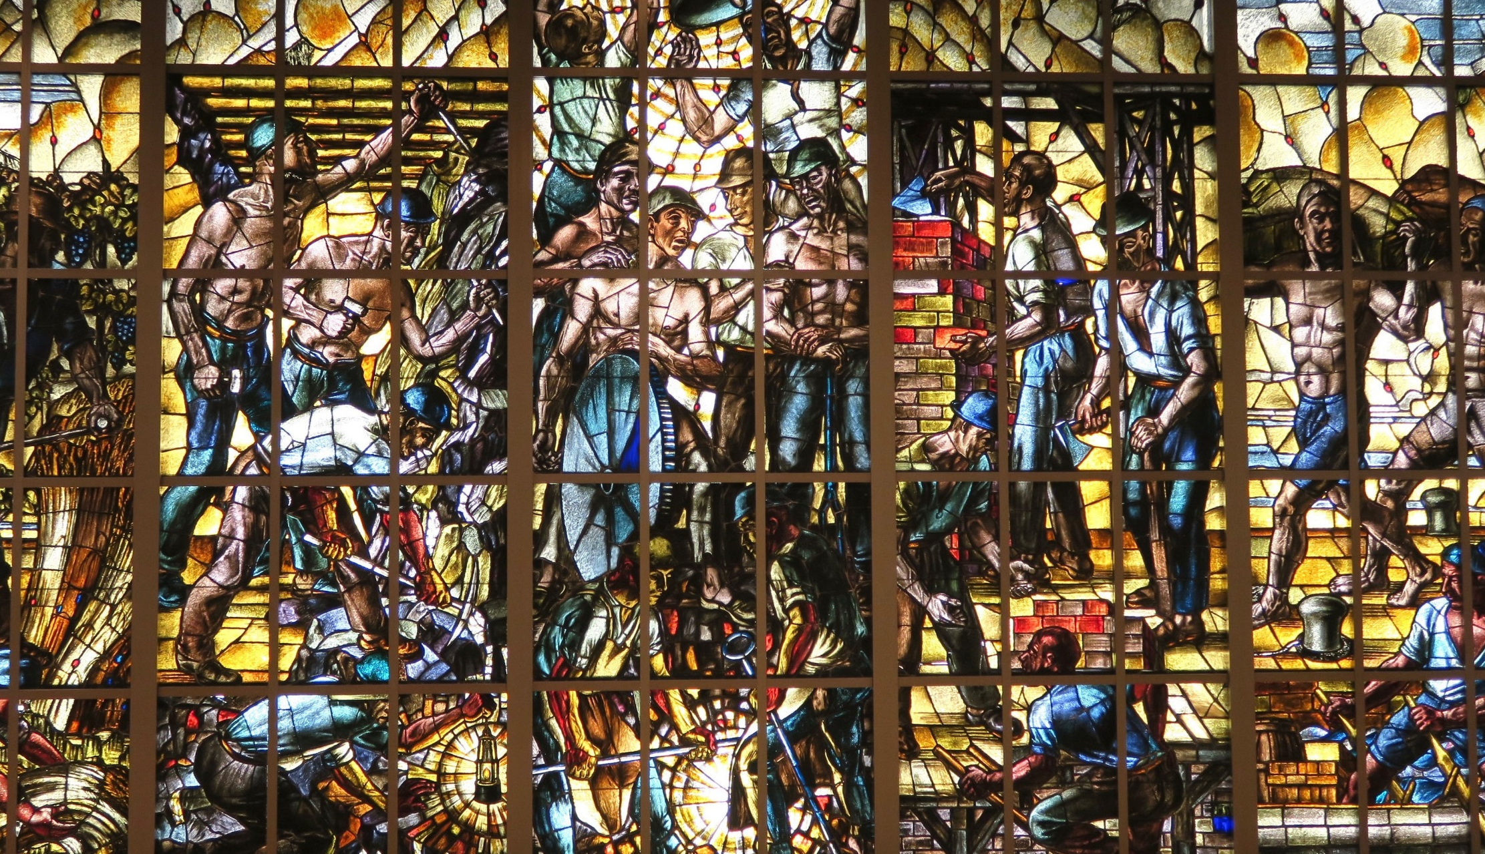
Introducing New Development from Japan - Business and Human Rights
  Yuki Kobayashi
  Programme Coordinator “Building Responsible Value Chains in Asia”
  ILO Office in Japan

Slide 2
Table of contents
    Policy development around Responsible Business Conduct, Business and Human Rights and Human Rights Due Diligence in Japan
    ILO-Tokyo’s support to constituents
    Recent and upcoming three projects on RBC/ Business and Human Rights/ HRDD

Slide 3
Policy development around Responsible Business Conduct, Business and Human Rights and Human Rights Due Diligence in Japan

Slide 4
Business and Human Rights as emerging trend in Japan: WHY?
New laws and requirements related to HRDD/ RBC in Europe and US
Industrial disputes in the supply chains and more media coverage
Governance Gap
in operating countries / between countries
Focus on ESG investment – expectations from investors
More expectations from consumers and NGOs to do business more responsibly and sustainably

Slide 5
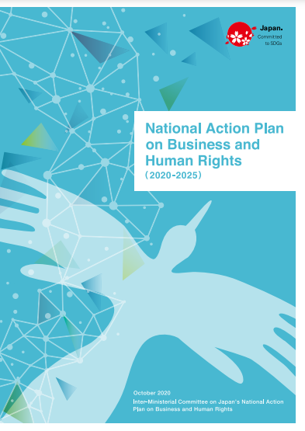
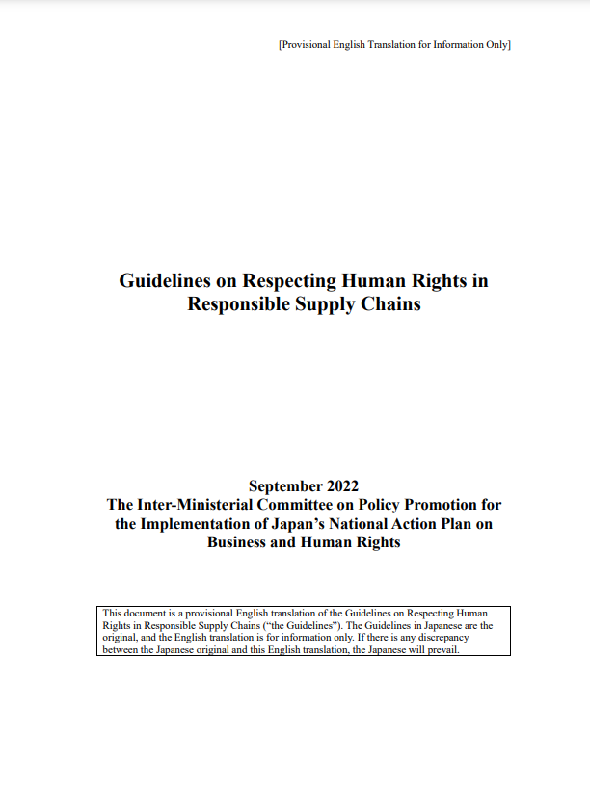
Key developments in Japan (Government)
National Action Plan on
Business and Human Rights
(October 2020)
Guidelines on Respect for Human Rights in Responsible Supply Chains (September 2022)
Developed based on UN Guiding Principles on BHR (UNGP)
Focus on the state duty to protect human rights
Expectation for companies, regardless of their size and sector to respect internationally recognized human rights and the ILO Declaration
Clear expectation for companies to respect human rights, including conducting HRDD
Elaborated how to conduct HRDD with reference to UNGP, OECD guidelines and ILO MNE declaration, as well as the ILO declaration as a part of scope of human rights

Slide 6

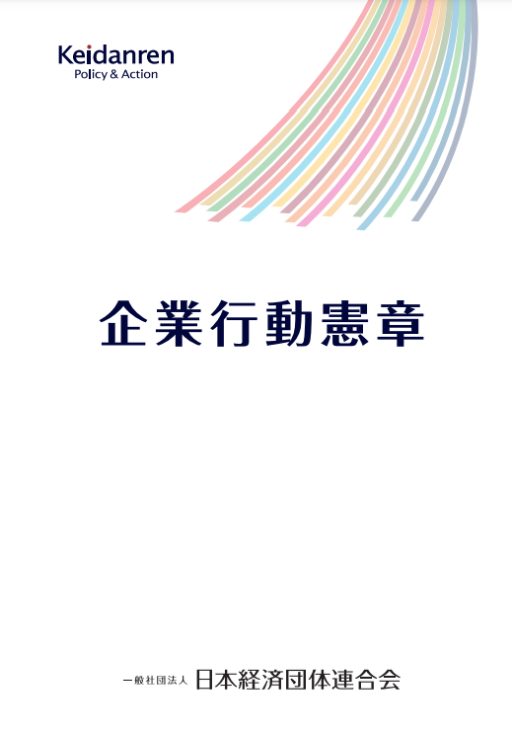
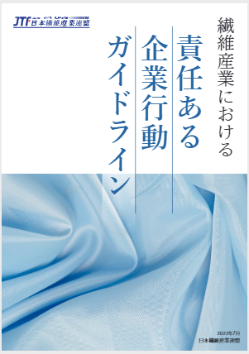
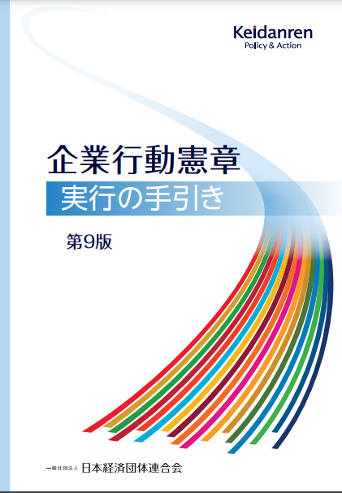
Key developments in Japan (Employers)
Keidanren
Charter of Corporate Behaviour, and Implementation Guidance (Updated in Dec. 2022)
Japan Textile Federation
Guideline for Responsible Business Conduct for the Textile and Clothing Industry of Japan (Aug. 2022)
Further enhancement of the language on the respect for human rights and stakeholder engagement including with trade unions
Conducted dialogue with Rengo in the process
Focusing on the labour aspect of RBC
Providing guidance for companies, including SMEs to review the business conduct in their own enterprise and in the supply chains
Conducted dialogue with UA Zensen in the process
Ref: Keidanren website

Slide 7
ILO-Tokyo’s support to constituents
    Participated in the expert group during the drafting of the Government guidelines, and supported to enhance the coherence with international standards
    Provided technical support to Japan Textile Federation in the drafting of the sector-wide guidelines
    Creating a pool of specialists to support the implementation of HRDD guidelines, particularly in SMEs in collaboration with the Japan Federation of Labour and Social Security Attorney’s Associations
    Raising awareness on RBC/ HRDD/ BHR through conducting seminars and creating communication contents

Slide 8
Recent and upcoming projects on RBC/ HRDD/ BHR

Slide 9
Building Responsible Value Chains in Asia through Promotion of Decent Work in Business Operations (funded by METI for 2022-2024)
    Target countries and sectors: Bangladesh (garment), Cambodia (garment), Vietnam (garment and electronics), Japan (textile, electronics and parts industries)
    Key focus areas:
Supportive measures for enterprises toward improvement in compliance with national laws and respect the principles of ILS (through Better Work programme in three countries and through training in Japan)
Tripartite capacity and dialogue to creating an enabling environment for more productive and sustainable enterprises that implement responsible business practices
Research and awareness-raising to promote responsible business and labour practices

Slide 10
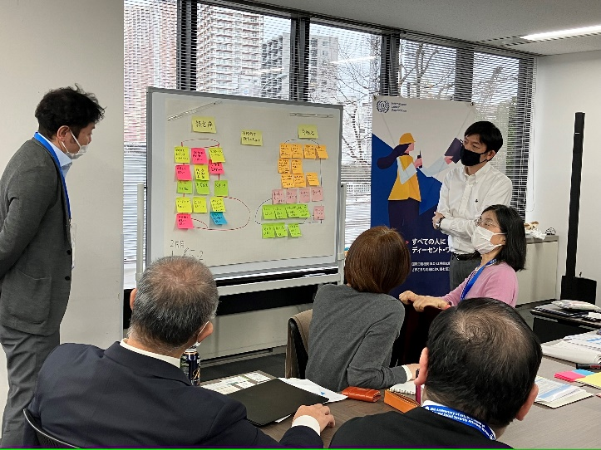
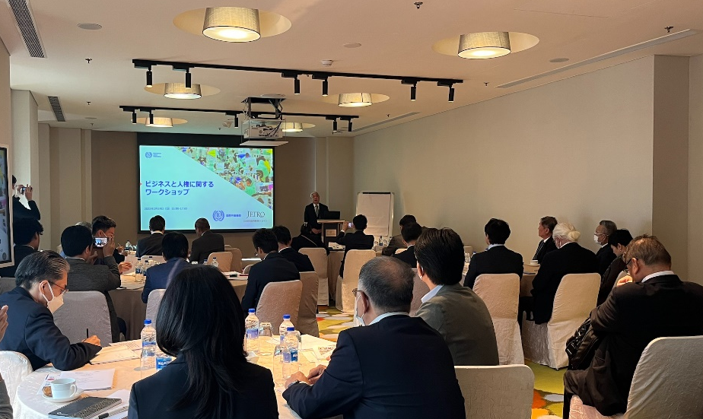
Building Responsible Value Chains in Asia through Promotion of Decent Work in Business Operations (funded by METI for 2022-2024)
Training for Labour and Social Security Attorneys
Joint Seminar with JETRO for Japanese companies operating in Bangladesh

Slide 11
Resilient, inclusive and sustainable supply chains: Advancing decent work in global supply chains to ensure no one is left behind (funded by MHLW Japan for 2022-25)
    Target countries and sectors: Thailand - Automotive manufacturing, Indonesia - Electronics manufacturing, Philippines – Aquaculture, Japan
    Key focus areas
Research & Awareness on decent work opportunities and challenges and the COVID-19 impacts
Policy advice & Training: decent work and gender equality in more resilient, inclusive and sustainable supply chains
Policy guidance and social dialogue: Build forward better more resilient, inclusive and sustainable GSCs
Awareness & Capacity Building in Japan: effective implementation of BHR-NAP
*ILO-Tokyo will lead activities under the Outcome 4.

Slide 12
Skills Development and Responsible Business Conduct for Transition (funded by METI Japan for 2023-25)
    Target countries and sectors: Indonesia, Thailand and Japan - Machinery industry, particularly Electrical & Electronics (E&E) and automotive sectors
    Key focus areas:
Skills development: for increased productivity and responsiveness to just transitions
- reskilling and upskilling training for government institutions and enterprises
RBC: respect for the FPRW and principles of ILS and harmonization with the country’s development priorities - tools development & training
Enabling environment: trade and investment policy and practice towards a transition to resilient supply chains - awareness raising for investors, trade companies and MNEs, promote policy commitment

Slide 13
In Closing…
  What opportunities do the renewed focus on RBC and the emerging trend on Human Rights Due Diligence present?
  How can we promote dialogue among different stakeholders around responsible business conduct and business and human rights?

Slide 14
Thank you!

Slide 15
Link to documents
  National Action Plan on Business and Human Rights (2020-2025)
  https://www.ohchr.org/sites/default/files/Documents/Issues/Business/NationalPlans/Japan-NAP.pdf
  Guidelines on Respect for Human Rights in Responsible Supply Chains https://www.meti.go.jp/policy/economy/business-jinken/guidelines/guidelines.pdf
  Keidanren: Charter of Corporate Behavior
  https://www.keidanren.or.jp/en/policy/csr/charter2022.pdf
  Keidanren: Implementation Guidance on Charter of Corporate Behavior (ver.9)
  https://www.keidanren.or.jp/en/policy/csr/tebiki9.html (Table of contents is available at this point)
  Japan Textile Federation: Guidelines for Responsible Business Conduct in the Textile and Clothing Industry of Japan
  https://www.jtf-net.com/wp/wp-content/uploads/Guidelines_for_Responsible_Bussiness_Conduct_in_the_Textile_and_Clothing_Industry_of_Japan_EN_hp230213.pdf

