Slide 1
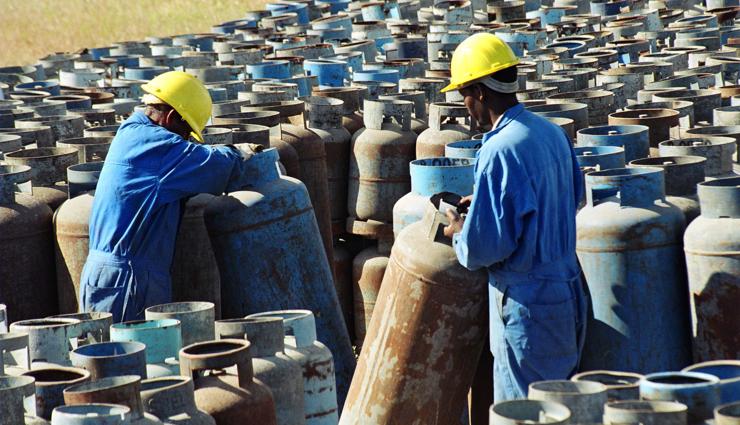
Intro to Chemical Safety
Spotlight on the Globally Harmonized System of Classification and Labelling of Chemicals (GHS)
Notes:
INSTRUCTIONS:
This session will look at the GHS in detail. It has already been mentioned in previous sessions.
Can anybody in the group tell me what the GHS is?

Slide 2
Session objectives
    At the end of the session, you will be able to:
  Understand the linkages with the world of work.
  Define the GHS.
  Understand why the GHS is needed.
  Explain the history of the GHS.
  Identify the different label elements.
  Recognize the different GHS pictogram symbols.
  Describe the synergies between the ILS and the GHS.
  Provide areas for future action.
Nepal
Notes:
INSTRUCTIONS:
Go through the objectives of the session.

Slide 3

What is the GHS and why was it created?

Slide 4
Question:
Can you think of any chemical accidents that have happened in the past?
Notes:
INSTRUCTIONS:
Discuss in a group for 5 minutes.
Some examples – Bhopal and Beirut

Slide 5
Preventable accidents
Throughout the 20th century and since, the world of work witnessed a series of preventable industrial accidents, most of which share the inaccessibility of information as a common contributor to the ensuing tragedy.
    1974 - Vapour cloud explosion of cyclohexane took 28 workers’ lives in Flixborough, UK.
    1976 - Reactor in a chemical manufacturing plant exploded in Seveso, Italy, releasing a large volume of toxic chemicals (dioxin).
    1984 - Bhopal disaster in Madhya Pradesh, India, where methyl isocyanate instantly killed more than 3,000 workers and local community members.
    1989 - Phillips disaster caused 23 fatalities in Pasadena, Texas when chemicals were released from a complex, wounding around 300 workers.
Notes:
INSTRUCTIONS:
All of these deaths, injuries and long-term health impacts for workers, their families and broader communities, were preventable.
These major industrial accidents, among others, prompted the international community to focus on achieving the sound management of chemicals with increasing urgency in the 1980s.
Common to several of these catastrophes was the deficiency of information about chemical hazards.
As a result, international efforts on chemicals management devoted considerable efforts to the development of a global system to ensure everyone in the world of work had access to necessary and timely information about chemical hazards.

Slide 6
What is the GHS?
    The Globally Harmonized System of Classification and Labelling of Chemicals (or GHS) is an internationally agreed upon system to standardize chemical hazard classification and communication.
    Implemented in over 60 countries globally.
    While the GHS is a voluntary international instrument, implementation is typically done through legislation.
    All chemicals are included in the scope of the GHS, with few exceptions.

Slide 7
What is the GHS?
    System of harmonized labels with symbols (pictograms).
    Can be interpreted by people across linguistic and national boundaries.
    Safety data sheets (SDS) are part of the hazard communication system for chemicals used in the workplace.
    The ILO has also contributed to the development of the International Chemical Safety Cards (ICSCs). This project was undertaken between the ILO and the WHO, with the cooperation of the European Commission.
    ICSCs provide information in over 10 languages on over 1,700 chemicals, which are being updated to reflect GHS standards.

Slide 8
Case study: Agricultural works and pesticide labelling in Punjab
    In 2015, a report was filed with FAO on inadequate labelling of pesticides in Punjab.
    Labels lacked adequate safety advice or health warnings.
    Omitted phrases about possible reproductive damage.
    Pesticides didn’t have Punjabi on the label and many farmers were illiterate anyway.
    Products didn’t use GHS compliant symbols, but rather a colour code system that was confusing to users.
    Users interviewed did not know the correct order or understand the logic of the system.
    One worker believed that products with a green colour “increased the yield” or that yellow was the most dangerous as it “worked from the outside”.

Slide 9
Why is the GHS needed?
    To ensure all countries are “speaking the same language” in the classification of chemicals and hazard communication.
    To inform and protect people involved in chemical production, handling, transport, use and disposal.
    To enable education and training for employers and workers on chemical hazards and risk reduction.
    To facilitate global trade by enabling the communication of hazard information about chemicals to those at risk, and to promote regulatory efficiency.
    To help users understand the information provided, national programs on GHS have included mandatory workplace training.

Slide 10
History of the GHS
    1952 – The ILO called on its Chemical Industries Committee to study the classification and labelling of dangerous substances.
    1956 - The first internationally recognized classification and labelling system for the purpose of transporting dangerous goods was published the UN Committee of Experts on the Transport of Dangerous Goods (UN CETDG).
    1989 - The ILO adopted a Resolution concerning the harmonization of systems of classification and labelling for the use of hazardous chemicals at work.
    1990 - ILO Convention No. 170 and Recommendation No. 177 concerning safety in the use of chemicals at work were adopted, containing explicit provisions on core elements of what later became the GHS, namely classification, labelling, safety data sheets and training.

Slide 11
History of the GHS
    1992 - the UN Conference on Environment and Development (UNCED), identified harmonization of classification and labelling of chemicals by the year 2000 as one of six action programs on hazardous chemicals as part of the pivotal outcomes of the Rio Conference.
    1994 - The Intergovernmental Forum on Chemical Safety (IFCS) adopted a resolution calling for the completion of classification criteria and hazard communication elements, as well as an international framework to translate the technical work of harmonization into an instrument or recommendations applicable legally at the national level.
    2002 - the GHS was adopted by the United Nations and has been identified as one of the main tools to achieve sound management of chemicals.
    Starting from the 2002 World Summit on Sustainable Development, to the 2006 Strategic Approach to International Chemicals Management (SAICM) and 2015 UN Sustainable Development Goals (12.4), governments continue to be encouraged to implement the GHS as soon as possible.

Slide 12
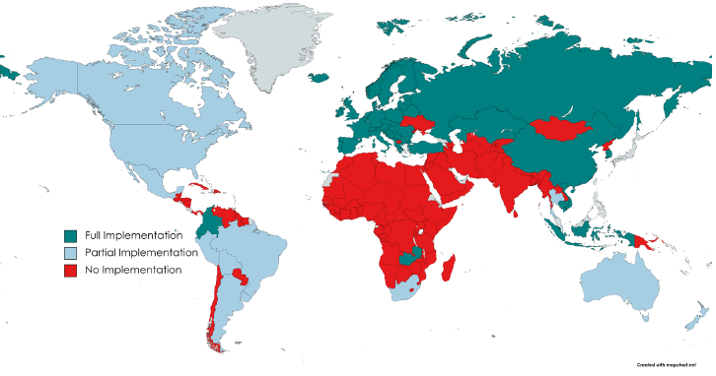
Global GHS implementation status
The boundaries shown on this map do not imply endorsement or acceptance by the ILO
Source: UNITAR, as at 19 April 2021; adapted and updated, based on the GCO-II, UNEP, 2019 and Explaining the Legal Implementation Gap, Stockholm Environment Institute, Persson et al. 2017. Updates are based on information received from partners and stakeholders and is presented as an indicator of implementation status, verified to the extent possible.
Notes:
EXTRA INFORMATION:
The GHS is the global standard on hazard classification and communication for the sound management of chemicals. To a significant degree, it has been implemented in countries of the Americas, Europe and parts of Asia, including all members of the OECD (it is a requirement of the OECD). In the EU, the Classification and Labelling of Chemical Products Regulation (No 1272/2008) implements the GHS.

Slide 13
GHS partnership: ILO, UNITAR and OECD
    Partnership since 2002 to support implementation of the GHS.
    The partnership aims to re-energise commitment and scale up implementation of the GHS.
    Works alongside a coalition of stakeholders including governments, regional economic integration organizations, trade unions, NGOs and the private sector.
    The Partnership and the coalition meet informally, to provide updates and agree on priority activities.
    UNITAR/ILO GHS training programme has provided a range of capacity building services, including:
  Regional workshops in Africa, Latin America and Caribbean, the Asia-Pacific and Central and Eastern Europe.
  National projects for the development of capacities and GHS implementation strategies
  An e-Learning GHS course (12 editions run0, focusing on technical skills for classification and labelling; and publication of guidance documents to support national GHS implementation.

Slide 14
GHS partnership: ILO, UNITAR and OECD
    Key elements of a national GHS adoption and implementation roadmap (2020).
  General guide for the main steps and activities for adoption and implementation.
  Provides suggestions to countries for developing national GHS roadmaps.
  Includes preparatory steps, legal and policy frameworks and implementing activities, such as classification and labelling, awareness raising, technical training, communication, emergency response and monitoring.
    The GHS in the world of work: Mapping synergies between ILO Instruments and the Globally Harmonized System of Classification and Labelling of Chemicals (GHS) (2021).
  ILO report exploring critical synergies between the GHS and the ILO’s instruments on chemicals and occupational safety and health.
  Aims to further promote GHS implementation and an even greater engagement of the world of work in global efforts toward the safer management of chemicals.
Notes:
INSTRUCTIONS:
These two slides give some examples of work done to date by the partnership.
REFERENCES:
UNITAR. 2020. Key elements of a national GHS adoption and implementation roadmap. Available at: https://unitar.org/sites/default/files/media/file/Key%20elements%20of%20a%20national%20GHS%20roadmap_FINAL%2006.11.2020.pdf.
ILO. 2021. The GHS in the world of work: Mapping synergies between ILO Instruments and the Globally Harmonized System of Classification and Labelling of Chemicals (GHS). Available at: https://www.ilo.org/global/topics/labour-administration-inspection/resources-library/publications/WCMS_818521/lang--en/index.htm.

Slide 15
GHS partnership: ILO, UNITAR and OECD
    GHS Implementation: Experiences and lessons learned (2021).
  Identification of lessons learned and good practices from GHS activities and capacity development projects.
  Key determinants which fostered successful GHS implementation, as well as factors impeding success.
    Options for legislation and standard setting to implement the GHS (2021).
  Guidance document to support implementation of the Globally Harmonized Systems of Classification and Labelling of Chemicals.
    A Selection and Summary of Case-Studies of Countries or Regions with Experience in Adopting and/or Implementing the Globally Harmonized System (GHS) of Classification and Labelling of Chemicals (2019).
  Some perspectives and examples that may be useful to countries that have not yet adopted GHS.
Notes:
REFERENCES:
UNITAR. 2021. GHS Implementation Experiences and lessons learned. Available at: https://unitar.org/sites/default/files/media/file/GHS%20Implementation%20Experiences%20and%20lessons%20learned%20-%20FINAL%208.7.2021.pdf.
UNITAR. 2021. Options for legislation and standard setting to implement the GHS. Guidance document to support implementation of the Globally Harmonized Systems of Classification and Labelling of Chemicals. Available at: https://unitar.org/sites/default/files/media/file/GHS%20Legislation%20document_final_14Dec21_0.pdf.
Bond G. 2019. A Selection and Summary of Case-Studies of Countries or Regions with Experience in Adopting and/or Implementing the Globally Harmonized System (GHS) of Classification and Labelling of Chemicals. Available at: https://unitar.org/sites/default/files/media/file/Case%20Studies%20to%20Suppport%20GHS%20Implementation%20-%20ICCA%2C%202019.pdf.

Slide 16

What does a GHS label look like?

Slide 17
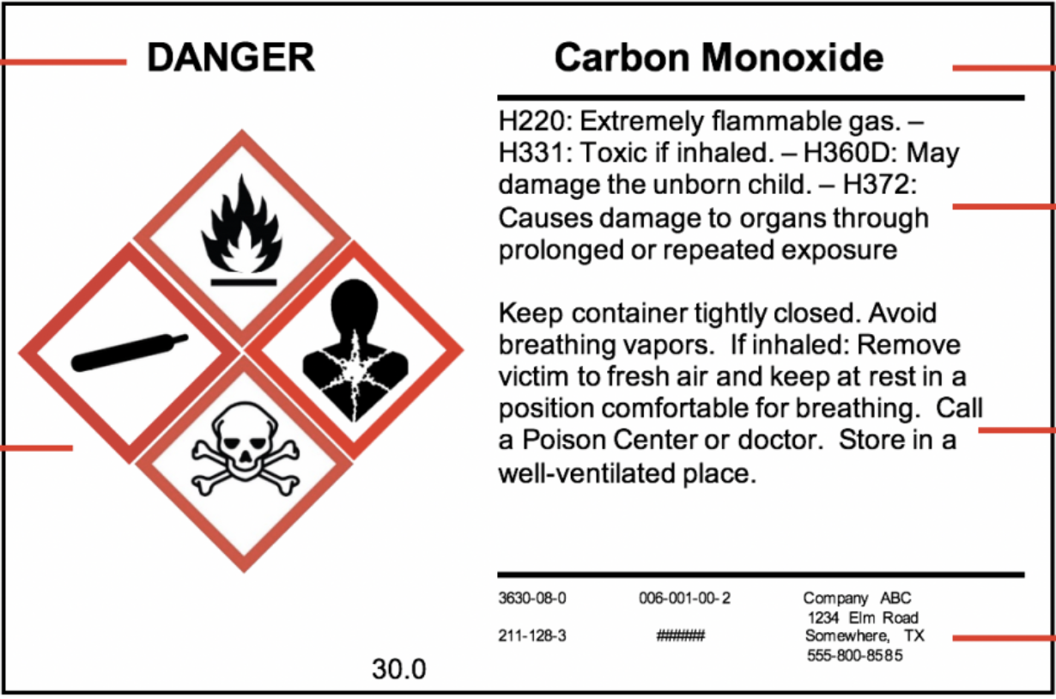
GHS label elements
Product name
Signal word
Hazard statements
Hazard pictograms
Precautionary statements
Manufacturer info
Notes:
INSTRUCTIONS:
Signal word: Indicated relative level of the hazard. Danger is most severe, followed by warning.
Hazard pictograms: Convey health, physical and environmental hazard information. Many use a combination of one to five symbols.
Product name: For example, carbon monoxide or mercury.
Hazard statements: Phrases that describe the nature of hazardous products and the degree of hazard.
Precautionary statements: Phases associated with each hazard statement, that describe general preventative, response, storage or disposal precautions.
Manufacturer info: Company name and contact details.

Slide 18
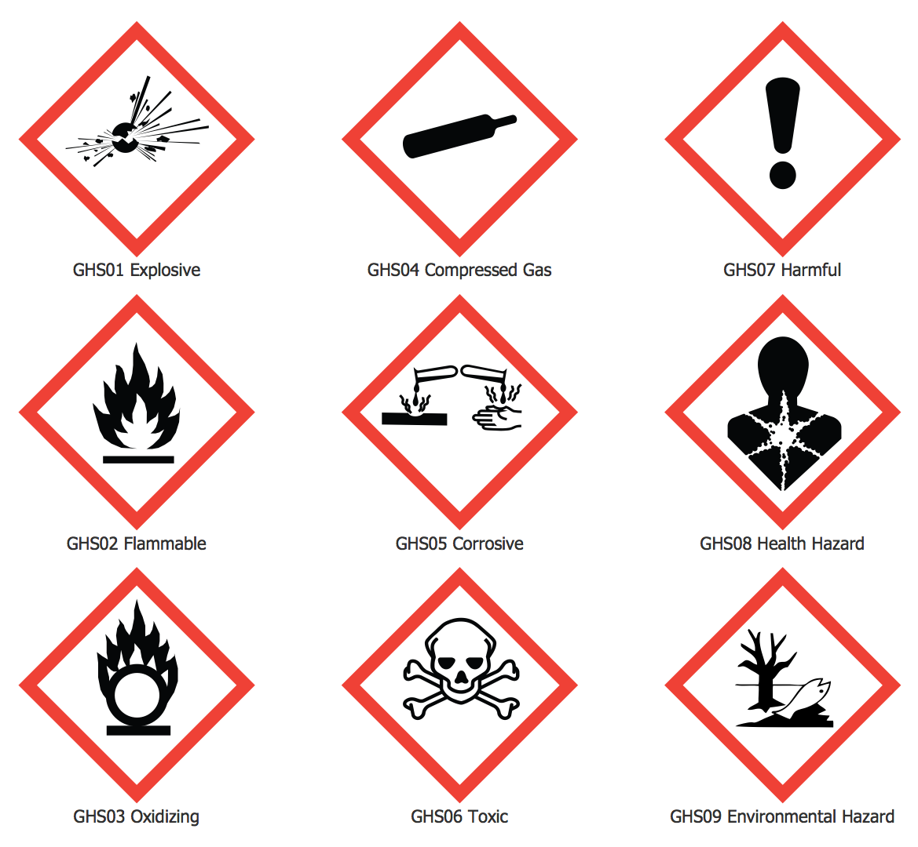
GHS pictograms
    Hazard symbols are standard symbols used in the GHS.
    Used on chemical labels and safety data sheets.
    Used to alert users of risks and precautionary steps needed.
    Consist of black symbols on a white background with a red diamond-shaped border.
Notes:
INSTRUCTIONS:
These hazard symbols are the standard symbols used in the GHS.
These pictograms are used on chemical labels appearing on chemical products and on their accompanying safety data sheet.
The purpose in using these pictograms is to visually alert those who come in contact with hazardous chemicals of the risks they may be exposed to and their need to take precautionary steps to protect themselves from harm.
Each GHS pictogram consists of a distinctive black symbol appearing on a white background framed inside a red diamond-shaped border.

Slide 19
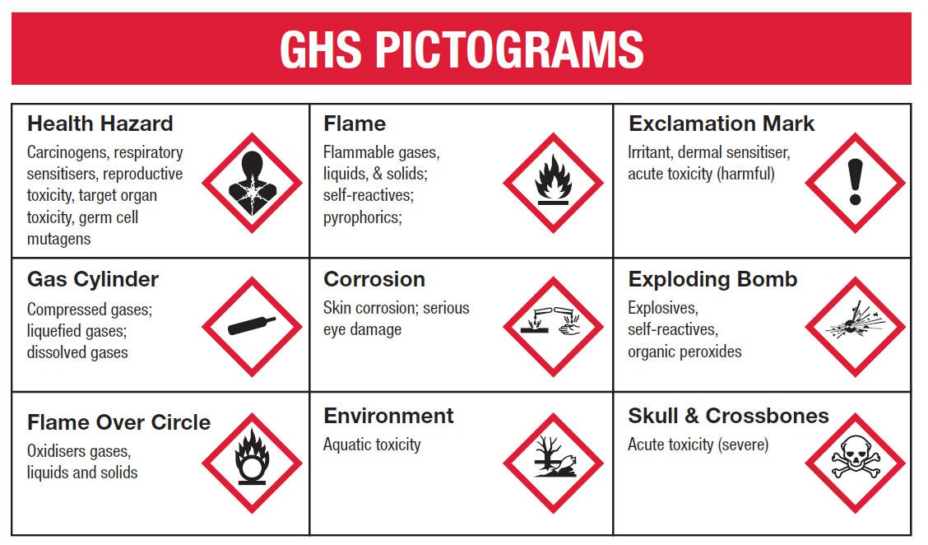
Some examples of hazards and pictograms
Notes:
INSTRUCTIONS:
These are just some examples of hazards. There are others not listed here.

Slide 20
Synergies between the ILS and the GHS
Many ILO instruments, including conventions, recommendations and codes of practice have clear synergies with the GHS.
  The GHS is relevant for the implementation of over 25 ILO conventions, recommendations and codes of practice:
    Chemicals Convention, 1990 (No. 170): includes obligations for ratifying states that cover components of the GHS such as classification, labelling and provision of SDS.
    Convention on Major Industrial Accidents (No. 174): includes provisions on requiring hazard identification and training.
    The GHS is fundamental for the objectives of ILS for specific hazardous substances and sectors including asbestos (Convention No. 162), carcinogens in general (Convention No. 139), agriculture (Convention No. 184), mining (Convention No. 176) and construction (Convention No. 167).
By implementing the GHS, States work toward fulfilling obligations in ILS, at the same time by ratifying and implementing many ILS, States work toward fulfilling obligations of the GHS.

Slide 21
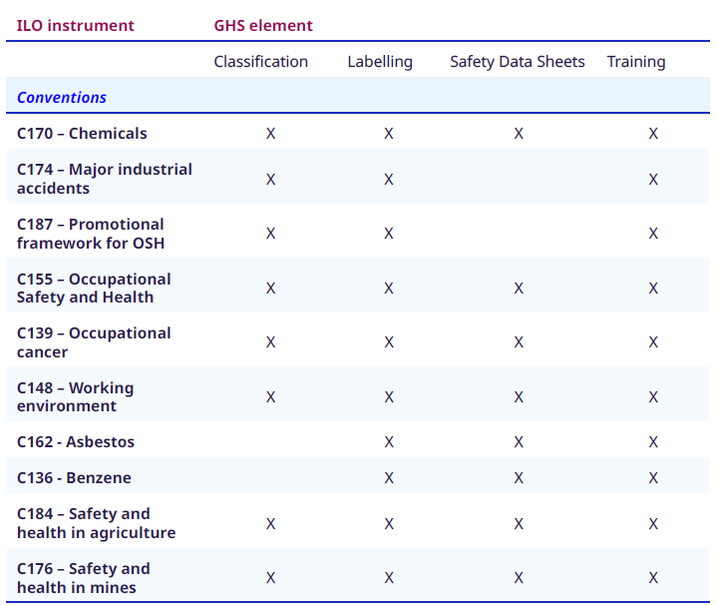
Synergies between the GHS and ILS

Slide 22
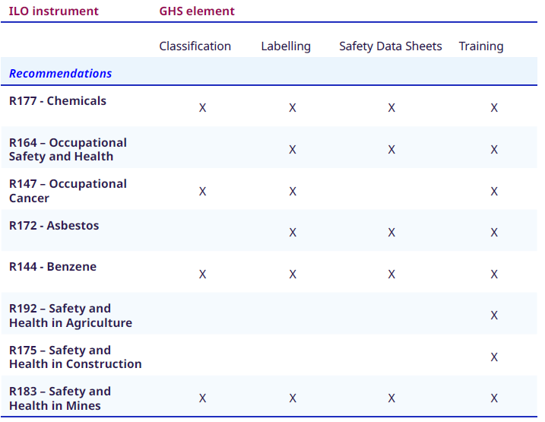
Synergies between the GHS and ILS

Slide 23

ILO report on GHS in the world of work:
Mapping synergies between ILO Instruments and the GHS
Overview
    Introduction and Development of the GHS.
    GHS and the world of work in the 21st century.
    Agricultural workers and pesticide labelling.
    GHS in the garment sector.
    The world of work as a driver of GHS development and implementation.
    Synergies between ILS and GHS.
    Includes an annex with ILO instruments which contain GHS elements.

Slide 24
Areas for action
    All States should implement the GHS.
    States should also ratify and implement Convention No. 170, Convention No. 174, Convention No. 155 and Convention No. 187.
    National labour authorities should consider enhancing international cooperation, both bilaterally and regionally.
    Businesses should ensure that hazard communication and training procedures are GHS compliant and consider including due diligence responsibilities.
    Employers should ensure that chemical hazard information is available in workplaces and workers are properly trained.
    Governments, employers organizations and workers organizations should engage in social dialogue on GHS implementation.
Notes:
INSTRUCTIONS:
All States should fully implement the GHS, as a matter of urgency, and as part of their implementation of International Labour Standards.
States that have or are in the process of implementing the GHS should ratify and implement Convention No. 170, Convention No. 174, Convention No. 155 and Convention No. 187, among others listed in table 1, capitalizing on the clear synergies between the GHS and these ILS.
To help countries with less resources and to take advantage of lessons learnt from implementation, national labour authorities may wish to consider enhancing international cooperation, both bilaterally and regionally. To this end, international organizations serve as a resource for GHS implementation, which States may consider in their implementation plans.
Businesses should strive to ensure that hazard communication and training procedures are GHS compliant and consider including due diligence responsibilities.
Employers and other businesses should ensure that chemical hazard information is available in workplaces and workers are properly trained in understanding health and safety hazards and precautionary measures to be taken.
Governments, employers organizations and workers organizations should engage in social dialogue on GHS implementation, as it is an “essential element” of occupational safety and health.

Slide 25
Case study: The GHS in the garment sector in Vietnam
    The garment sector utilizes many different types of hazardous chemicals in its operations.
    In 2012, prior to implementation of the GHS, chemical labelling was not standardised in factories:
  Containers were not labelled with contents in a third of the factories.
  Hazard pictograms were not indicated on secondary containers in most factories.
  Other defects: wrong chemical on the label, chemicals stored in water bottles, the wrong pictogram was used or pictogram was missing.
    Since 2016, Vietnam has fully implemented the GHS through legislation.
    However, practical application of the GHS can take time after reform, with manufactures having existing stocks of chemicals with old labels.

Slide 26
Case study: The GHS in the garment sector in Vietnam
    The ILO/IFC Better Work program was developed to monitor conditions in garment factories and conduct assessments on factory compliance with national legislation and international labour standards.
    The program worked with Vietnamese authorities and businesses to provide regular individual advisory visits to participating factories to help them improve working conditions, as well as joint classroom training sessions (including on chemical management).
    The advisory visits and training cover aspects such as chemical management systems, the role of OSH, good practices on labelling and SDS and restricted substances lists.
    By 2018 significant progress was achieved in GHS implementation in the Vietnamese garment sector.
    Non-compliance related to chemical labelling and SDS concerns were significantly reduced.
    The experience illustrates the potential of the labour sector to be a critical partner in GHS implementation and highlights the potential for expanding this good practice to other countries and regions.
Notes:
INSTRUCTIONS:
The advisory visits and training cover the following aspects:
chemical management systems for understanding chemical risks and hazards, how to track and store chemicals properly, communication and training requirements, control measures following the hierarchy of controls;
the role of the OSH/chemical/environmental officers;
responsibilities of various procedures (e.g. who controls and translates labels and SDS on receipt from supplier, decisions about storage and use, etc.);
how to read SDS, training for workers working with chemicals, and regular internal inspections;
good practices on labelling and SDS, such as visual posters; and
introduction of restricted substance list from brands and list of prohibited chemicals from the applicable law.

Slide 27
Key ILO resources
    The GHS in the world of work: Mapping synergies between ILO Instruments and the Globally Harmonized System of Classification and Labelling of Chemicals (GHS).
    Exposure to hazardous chemicals at work and resulting health impacts: A global review (2021).
    ILO Instruments on Chemical Safety – Analysis and synergies with other international frameworks on the sound management of chemicals (2020).
    The Sound Management of Chemicals and Waste in the World of Work (2019).
    All You Need to Know: Convention No. 170.
    Guidelines on occupational safety and health management systems (2001).
    Major hazard control: A practical manual (1993).
    Safety in the use of chemicals at work: code of practice (1991).
    Prevention of major industrial accidents: code of practice (1991).
    ILO indicators of progress in implementing SAICM (2021).

