Slide 1
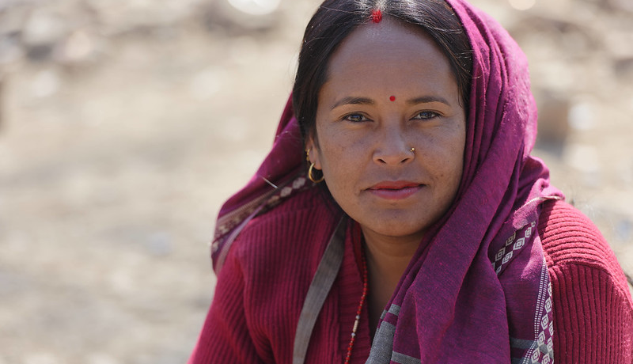
Youth at Work in the G20:
Progress towards the Antalya Goal and Policy Action in 2022
Gilbert F. Houngbo, Director-General, ILO
Advancing social justice, promoting decent work
1

Slide 2

The Antalya Youth Target
In 2015, G20 Leaders agreed to “reduce the share of young people who are most at risk of being permanently left behind in the labour market by 15% by 2025”.
Ministers of Labour and Employment agreed to monitor the achievement of this target by focusing on young people who are Neither in Employment, nor in Education or Training (NEET)
Date: Monday / 01 / October / 2019
Notes:
Dear Ministers, let me start with a reminder of the commitment Leaders made in Antalya in 2015.
They agreed to to reduce the share of young people who are most at risk of being permanently left behind in the labour market by 15% by 2025.
They subsequently agreed that this would be monitored by focusing on the share of young people aged 15 to 29 who are Not in Employment, Education or Training (the soc-called NEET rate).
Achieving this target was rendered extremely challenging by the COVID-19 crisis.
As I will discuss further, the good news is that youth labour markets in advanced G20 countries have largely recovered from the economic impacts of the COVID-19 pandemic thanks to extensive fiscal responses, with more mixed results in emerging countries.
Nevertheless, young people have seen their long-term prospects scarred by the interruptions to employment and education, increasing inequalities.
Despite progress, policy options to support youth employment in G20 countries are increasingly facing reduced fiscal spaces and high debt levels.
Thus, the bottom line is that G20 countries faces multi-dimensional challenges in reaching the Antalya target and improving durably labour market prospects for all young people..

Slide 3
Unequal progress towards the Antalya Target
Actual versus required decline in NEET rate for 15 to 29-year-olds, 2014-2022 (% points)
Source: National Labour Force Surveys.
Date: Monday / 01 / October / 2019
Date: Monday / 01 / October / 2019
Notes:
The degree of progress in achieving the Antalya goal is assessed in this chart by comparing the actual decline in the NEET rate in each G20 economy between 2014 and 2022 with the required decline to reach the Antalya goal.
If the actual decline is greater than the required decline, the country/economy concerned is on track or ahead of schedule in reaching the goal.
This can be illustrated with the situation in the US.
Overall, 12 G20 economies out of 19 for which data are available were back on track in 2022 to meet the Antalya goal.
Progress in reaching the Antalya goal would have been even stronger in most G20 economies iif the pre-pandemic trend decline had not been interrupted by the absence of the COVID-19 pandemic and the influence of the cost-of-living crisis.
Brazil, India, Korea and South Africa face the considerable challenge of reversing the trend rise in the NEET rate which occurred prior to the pandemic

Slide 4
Further progress is needed:
NEET rates remain higher for women, 2022 (%)
Greater outreach needed for inactive youth
Unemployed & inactive NEETs as a % of all young people, 2022
Source: National Labour Force Surveys.
Date: Monday / 01 / October / 2019
Date: Monday / 01 / October / 2019
Notes:
Further progress will require addressing several structural challenges.
In nearly all G20 economies, the NEET rate is higher for young women than for young men.
Young women often face additional barriers to entering the labour market and finding good quality jobs..
In addition, most young people who are NEETs are inactive, in other words they are not actively looking for work even though not employed.
This group may be particularly hard to reach through traditional employment services and a range of employment barriers may need to be addressed.
The COVID-19 pandemic has also left a legacy of disrupted learning and increased mental health problems that will need to address to prevent negative impacts on the long-term labour market prospects of young people.
Finally, improving the quality of young people’s jobs remains a key challenge for all G20 economies.

Slide 5
Initiatives implemented in 2022 by G20 countries to achieve the Antalya Target
Mixed initiatives – 7%
Labour supply
Improving education and skills of youth – 49%
  Ensuring basic skills for all – 2%
  Ensuring school completion – 25%
  Providing greater choice in educational pathways – 64%
  Promoting access to higher education – 9%
Labour demand
Improving youth employment – 44%
  Strengthening job opportunities – 20%
  Tackling unemployment – 64%
  Avoiding prolonged periods out of work – 10%
  Improving job quality – 6%
Source: G20 Employment Plans submitted in 2023
Date: Monday / 01 / October / 2019
Date: Monday / 01 / October / 2019
Notes:
A reminder of the areas and actions for promoting better youth employment outcomes in your countries as agreed in the Antalya Goal.
G20 Policy Principles for Promoting Better Youth Employment Outcomes

Slide 6
The way forward
Improve access to more and better employment for young women and men
  Invest in economic sectors with high youth employment potential and advocate for macroeconomic policies that target full employment
  Invest in improving work quality through strong labour institutions
Improve the employability of the youth most at risk of being permanently left behind
  Invest in education and training, especially TVET and quality apprenticeships
Tackle youth inactivity and gender inequalities
  Invest in active labour market policies combined with income support
Date: Monday / 01 / October / 2019
Notes:
Increase investments with potential for youth job creation, such as in the green, digital and care economies. This not only creates direct employment opportunities but also spurs economic activity, leading to job creation in related industries.
Implement active labour market policies in combination with income support to tackle youth unemployment and inactivity. To be more effective, they can be in the form of integrated packages that combine employment services, job creation programmes, subsidized employment and wages, as well as training, entrepreneurship promotion and self-employment. In addition, they could be linked to income support to reach the most disadvantaged youth – such as many young women – who could otherwise not participate in these programmes.
Provide access to affordable credit to young entrepreneurs. This facilitates business start-ups and their expansion, supporting job creation and entrepreneurship by young people. Accessible credit can be vital for young entrepreneurs who may face challenges in obtaining financing through conventional channels such as commercial banks.
Invest in public education and training for expanding sectors. This includes investing in quality public educationn and TVET, especially quality apprenticeships. Equipping young people with relevant competencies and skills will facilitate their transition into and within the labour market.
Consider youth employment in macroeconomic policies: Support job creation for young people through macroeconomic policies. Maintaining countercyclical expansionary policies until there is evidence of recovery creates an enabling environment to create decent jobs for young people and to reduce youth NEET rate.

