Slide 1


Recent Global Employment Trends
  Gilbert F. Houngbo, Director-General, ILO
Advancing social justice, promoting decent work

Slide 2
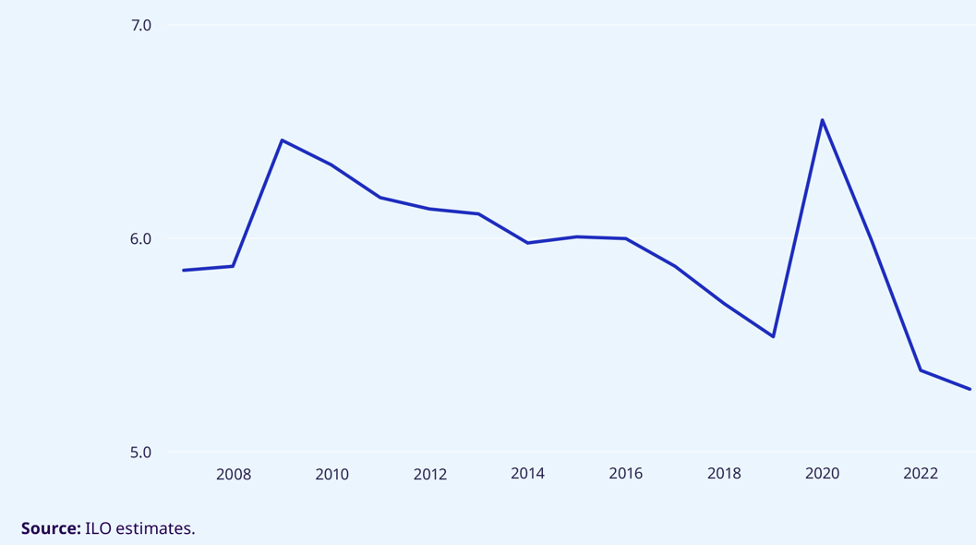
Unemployment is falling globally...
Unemployment rate, 2007–23, world (percentage)

Slide 3
... but with regional differences: the risk of a further employment divide
Unemployment rates, world and by country income group and G20, 2019, 2022 and 2023 (percentage)
Note: *G20 data has been calculated for this presentation, Indonesia not included
Source: ILO Estimates

Slide 4
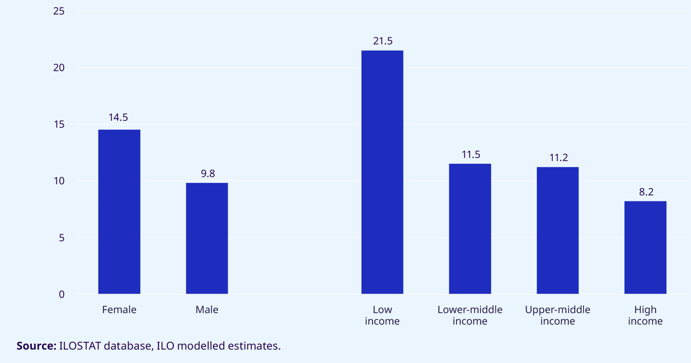
The global jobs gap: Confirming the employment divide and gender gap
Jobs gap rate, 2023, by gender and country income group (percentage)

Slide 5
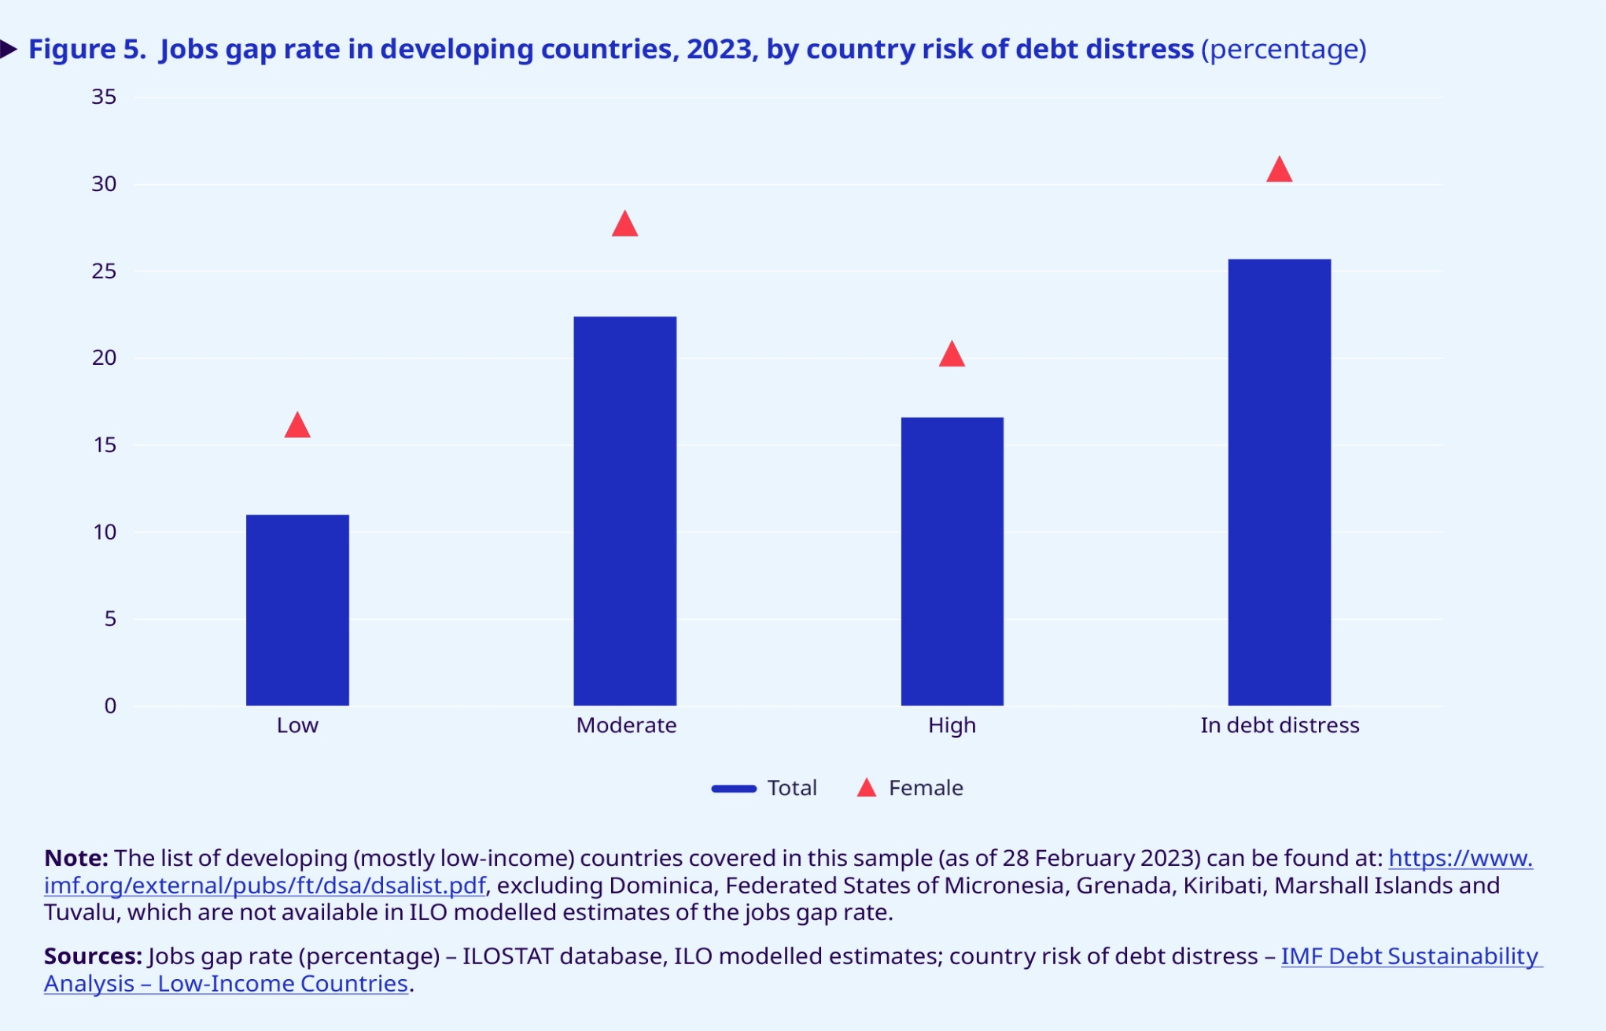
Countries in debt distress face highest jobs gap
Jobs gap rate in developing countries, 2023, by income and by risk of debt distress (%)

Slide 6
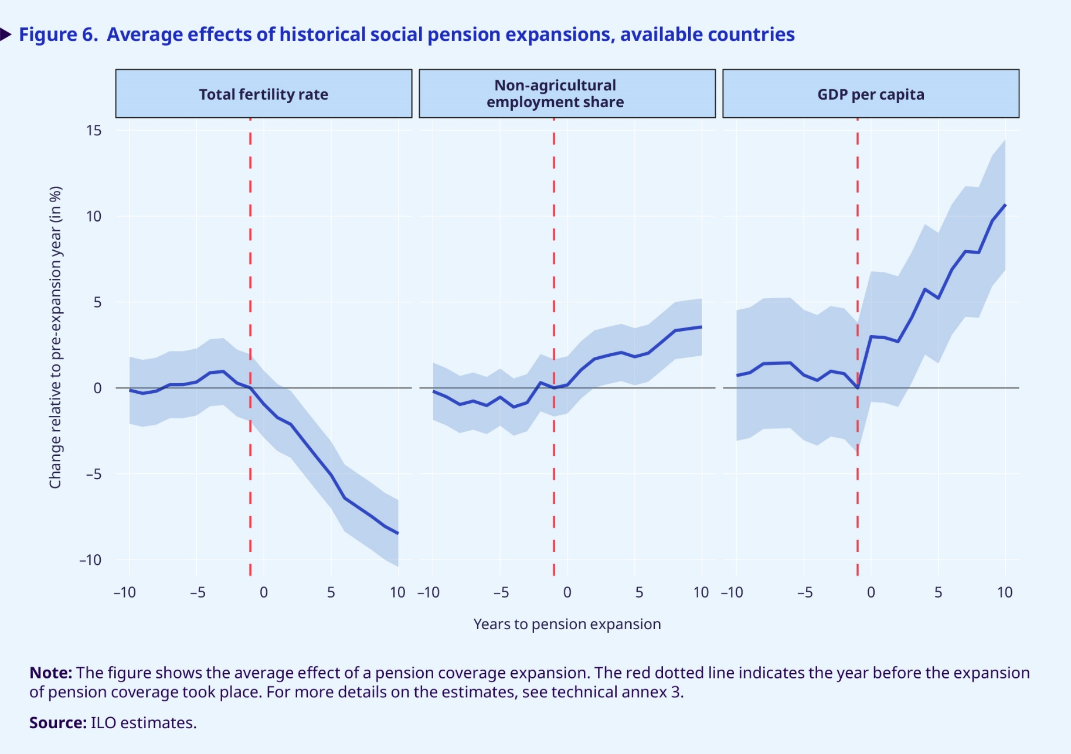
The positive impact of old-age pensions
Average effects of historical social pension expansions, available countries

Slide 7

In conclusion
Global resources must be mobilized…
    The UN Global Accelerator on Jobs and Social Protection for Just Transitions
    Broader reform of the international financial architecture
    … to enable that we collectively:
    Address the jobs gap, including by tackling skill gaps
    Invest in social protection systems for all
    Embrace sustainable financing mechanisms for employment and social protection policies

