Slide 1

Introduction to the ILO and
International Labour Standards
  Session 3
  ILO Subregional Labour Law Training Workshop
  Nadi, Fjii

Slide 2
Only two of the subjects below are NOT the subject of an ILO instrument. Which two are these?
Child labour
Vocational guidance and training
Violence and harassment at work
Seafarers
Money laundering
Wages
Social security
Trade in agriculture
Working time
Labour inspection
Tripartite consultation
Migrant workers
HIV/AIDS
Employment policy
Freedom of association

Slide 3
Session Objectives
    To refresh participants’ knowledge of the ILO
    To consolidate understandings of International Labour Standards (ILS)
    To explain the main elements of the ILO supervisory system
    To better equip participants to play a role in preparing regular reports to the ILO through a Spotlight on Article 22 Reporting

Slide 4

Guest Speaker: Emerita Professor Rosemary Owens
Professor Rosemary Owens
Emerita Professor, University of Adelaide, Australia
ILO Committee of Experts on the Application of Conventions and Recommendations Member (2010 – 2023)

Slide 5
Introduction to the ILO

Slide 6
What do you already know about the ILO?
    When was it created and why?
    What do you think are some of the key values underpinning the ILO?
    How is the ILO’s structure unique from other intergovernmental organisations (IOs)?

Slide 7
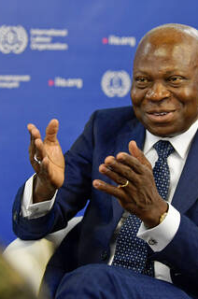
ILO values
Principles underpinning the ILO are found in key ILO documents such as the Philadelphia Declaration of 1944, the Declaration on Fundamental Principles and Rights at Work of 1998 (amended 2022) and the Declaration on Social Justice for a Fair Globalization of 2008 (amended 2022). These values include:
Promoting social justice and internationally-recognised labour and human rights
Decent work for all
Sustainable development
Tripartism (dialogue/ cooperation between government, employers and workers)

Slide 8
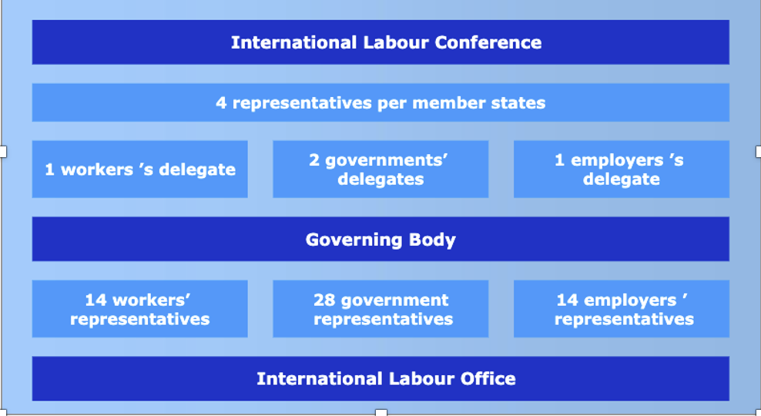
ILO Structure
Source: International Training Centre of the ILO/ Turin

Slide 9
Introduction to International Labour Standards (ILS)

Slide 10
What are international labour standards (ILS)?
Legal instruments drawn up by the ILO’s constituents (governments, employers and workers) setting out basic principles and rights at work.
Three types:
    Conventions = legally binding international treaties that can be ratified by member States
    Protocols = legally binding international treaties that may be ratified only by ILO member States already bound or simultaneously ratifying and becoming bound by the Conventions they revise or amend.
    Recommendations = non-binding guidelines.
ILS are adopted at the annual International Labour Conference (ILC).
Backed up by a supervisory system to address problems arising in their application at the national level.

Slide 11
Why do we have international labour standards?
    An international legal framework for a fair and stable globalization
    A level playing field in the global economy
    A strategy for reducing poverty
    A means of improving economic performance
    A safety net in times of economic crisis
    The sum of international experience and knowledge.

Slide 12
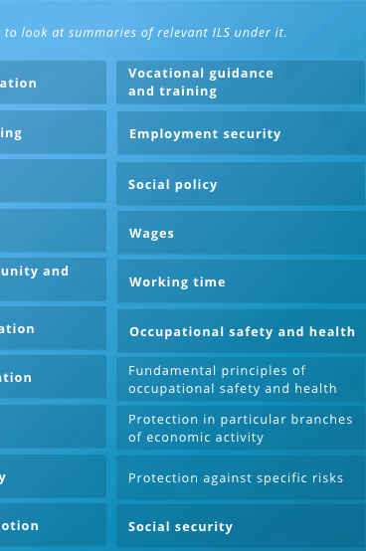
What types of matters do ILS cover?
    All matters relating to work!
    There are over 400 ILO instruments, including 190 Conventions, six Protocols and 206 Recommendations
    The ILO has a tripartite Standards Review Mechanism to help ensure ILS are clear, robust and up-to date, and respond to changing patterns of the world of work.

Slide 13
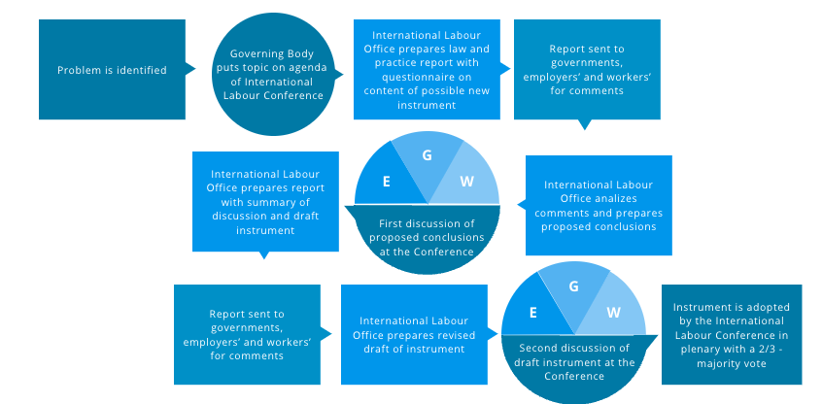
How are ILS made?

Slide 14
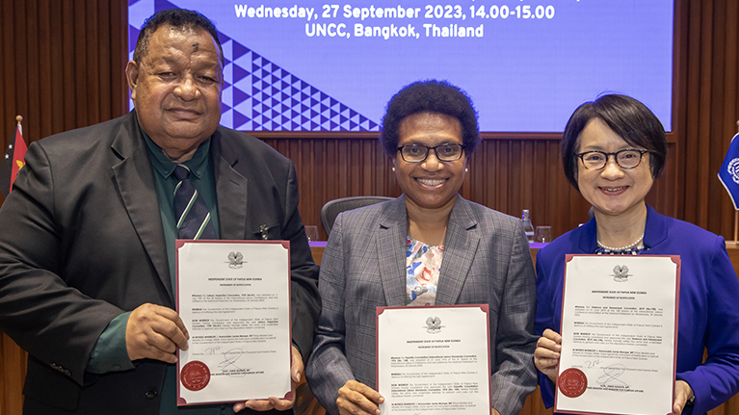
What happens once an ILS is adopted?
    Member States are required under the ILO Constitution to submit them to the competent authority (usually the Parliament) within a period of 12 months for consideration.
    In the case of Conventions or Protocols, this means consideration for ratification.
    Once ratified, a Convention or Protocol usually comes into force for that country one year after date of adoption.
    Ratifying countries undertake to apply the Convention (or Protocol) in national law and practice and to report on application at regular intervals.
    Technical assistance is provided by the International Labour Office if necessary. In addition, representation and complaint procedures can be initiated against countries for violation of a Convention they have ratified.
PNG depositing instruments of ratification for three ILO Conventions earlier this year. Source: ILO in the Pacific.

Slide 15

How can ILS be relevant to all countries, given economic, cultural and legal diversity?
    As ILS are adopted by a two-thirds majority vote of ILO constituents (from all over the world), they are considered an expression of universally acknowledged principles.
    Many ILS have been formulated to be flexible enough to be translated into national law and practice by member States with diverse cultural and historical backgrounds, legal systems and levels of economic development (e.g., minimum wage standards).
    Reservations to ILO Conventions are not permitted.
    Some ILS contain flexibility clauses. These clauses allow States to lay down temporary standards that are lower than those normally prescribed, to exclude certain categories of workers from the scope of application, or to apply only certain parts of the instrument. E.g., Minimum Age Convention, 1937 (No. 138).

Slide 16
How are ILS used?
Governments
Courts
Civil Society
Business
Other international organisations

Slide 17
The ILO Supervisory System

Slide 18
The ILO supervisory system has two channels
Regular system of supervision
Special procedures

Slide 19
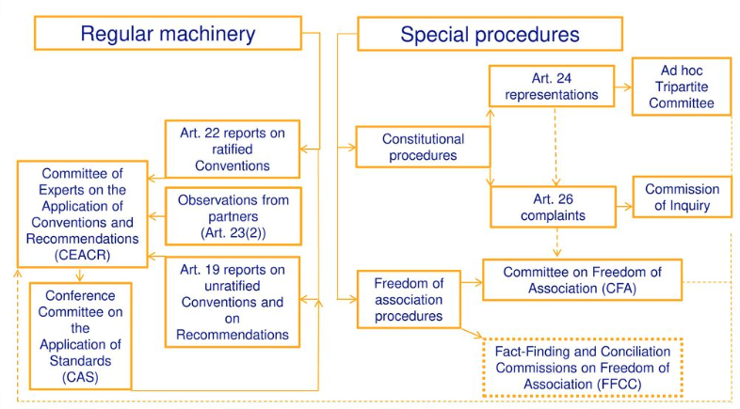
The ILO supervisory system
Source: International Training Centre of the ILO/ Turin

Slide 20
ILO regular system of supervision
Article 19 reports
Under article 19 of the ILO Constitution, member States are required to report at regular intervals on measures they have taken to give effect to any provision of certain conventions or recommendations, and to indicate any obstacles which have prevented or delayed ratification. This is a way that the ILO keeps track of developments in all countries (even if they haven’t ratified certain instruments).
Article 22 reports
Under article 22 of the ILO Constitution, each member State that has ratified an ILO convention is required to regularly report on measures it has taken in law and in practice for its implementation.

Slide 21
ILO Special Procedures
Constitutional procedures
Representations (art 24 ILO Constitution)
Complaints (art 26 ILO Constitution)
Freedom of association procedures
For infringements of freedom of association and collective bargaining only
Complaints considered by Committee on Freedom of Association (CFA)
Note: can be used irrespective of whether state has ratified relevant convention.
Note: Can be used for non-observance of any ratified Convention

Slide 22
Spotlight on article 22 reporting

Slide 23
Once a member State has ratified a convention, it is required to regularly report on its compliance with the instrument
Every three years for the fundamental and governance Conventions ratified.
Every six years for ‘technical’ (all other) Conventions ratified (except for Conventions that have been “shelved”, ie. no longer supervised on a regular basis).
Reports on the application of Conventions may be requested at shorter intervals.
States don’t have to report on Conventions that have been ‘shelved’, abrogated, or withdrawn.

Slide 24

Employers’ and workers’ organizations play a role in article 22 reporting
    Governments are required to submit copies of their reports to employers’ and workers’ organizations.
    The Tripartite Consultation (International Labour Standards) Convention (No. 144) requires ratifying States to consult the representative organizations of employers and workers on questions arising out of reports to be made on ratified Conventions.
    Employer and workers’ organizations may comment on the government’s reports or send observations on the application of ratified Conventions directly to the Office.
    Where the Office receives observations from employers’ and workers’ organizations, it will forward these to the government concerned so it can respond.

Slide 25
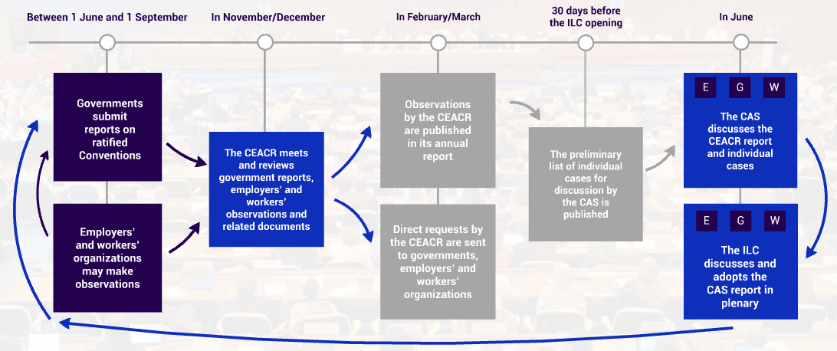
The regular supervisory process
Source: ITCILO

Slide 26
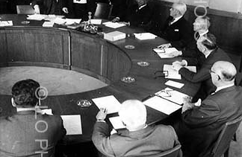
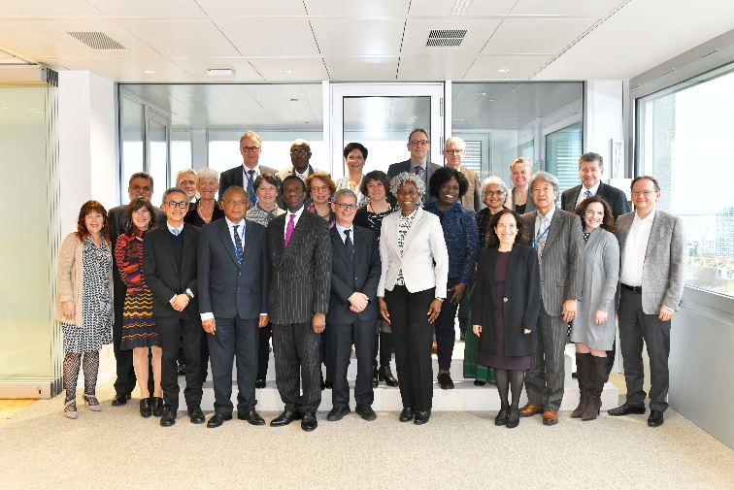
The ILO Committee of Experts on the Application of Conventions and Recommendations
Role is to provide impartial & technical evaluation of application of ILS in ILO member States
Composed of 20 eminent jurists appointed by Governing Body for renewable 3-year terms. Appointed in personal capacity.
Experts come from different geographic regions, legal system and cultures

Slide 27
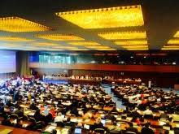
The ILO Conference Committee on the Application of Standards (CAS)
A Standing Committee of the International Labour Conference comprised of Government, Employers’ and Workers’ delegates.
Identifies cases of serious failure to comply with reporting obligations.
Examines annual report produced by Committee of Experts in a tripartite setting and selects a number of observations (or ‘cases’) for discussion. The list of cases (usually 24) are agreed upon by the social partners before the ILC.

Slide 28
The ILO Conference Committee on the Application of Standards (CAS)
    Individual cases are discussed at the CAS.
    The governments concerned are invited to respond before the CAS and to provide information on the situation in question.
    CAS usually draws up conclusions for each case, recommending that governments take specific steps to remedy a problem or accept ILO missions or technical assistance.
    Discussions and conclusions of the cases examined by the Conference Committee are published in its report.
    Situations of special concern are highlighted in special paragraphs of its General Report.

Slide 29
ILO Assistance and Support
    Requests for assistance to report on ILS should be directed to the ILO Office of Pacific Island Countries
    The ILO Office can advise you what assistance may be available. This may include:
      Capacity bridging trainings (such as this one!)
      Technical support for staff drafting reports
      Examples, templates and feedback on draft reports
    Reach out to the Office well ahead of deadlines for reporting for assistance
    Office staff may also have ideas on how to fund longer-term capacity and organizational development at your office

Slide 30
Group work activity
Instructions: You have been tasked with preparing your Government’s Article 22 reports for next year. In small groups, discuss and sketch out a work plan for completing the reports. Your work plan should answer the following questions:
What conventions are your country scheduled to report on in 2024? Hint: go to ILO’s website www.ilo.org – scroll down to bottom of page and select NORMLEX database –select Country profiles from column on left.
What are the key stages you will go through to produce the reports? Hint: try to list all stages from start to submission to the ILO.
What resources will you use to prepare your article 22 reports? Hint: these resources can be types of documents, sources of advice and assistance etc.

Slide 31
Suggested resources
    ILO, Rules of the Game: An introduction to the standards-related work of the International Labour Organization (2019).
    International Labour Standards – A glossary
    The ILO Supervisory System: A Guide for Constituents
    ILO Office for Pacific Island Countries, Reporting on ILO Standards: Guide for Labour Officers in Pacific Island Member States

Slide 32
After the break:
ILO Fundamental Principles and Rights at Work

