Slide 1
ILO Fundamental Principles and Rights at Work
  Session 4
  ILO Subregional Labour Law Training Workshop
  Nadi, Fjii

Slide 2
Session Objectives
    To consolidate participants’ understanding of the Fundamental Principles and Rights at Work (FPRW)
    To discuss how the FPRW relate to ILO Conventions (and Protocols)
    To encourage participants to engage directly with Fundamental Conventions and to discuss challenges in their application to the Pacific Island Countries.

Slide 3
What are the Fundamental Principles and Rights at Work?
    The 1998 Declaration of Fundamental Principles and Rights at Work identified four principles that are considered fundamental because they protect basic workers’ rights.
    All ILO member States have an obligation to respect, to promote and to realise these rights. This obligation arises from the very fact of membership of the Organization and applies even if the state has not ratified the relevant Conventions.
    In 2002, the ILO added a fifth principle to this list.

Slide 4
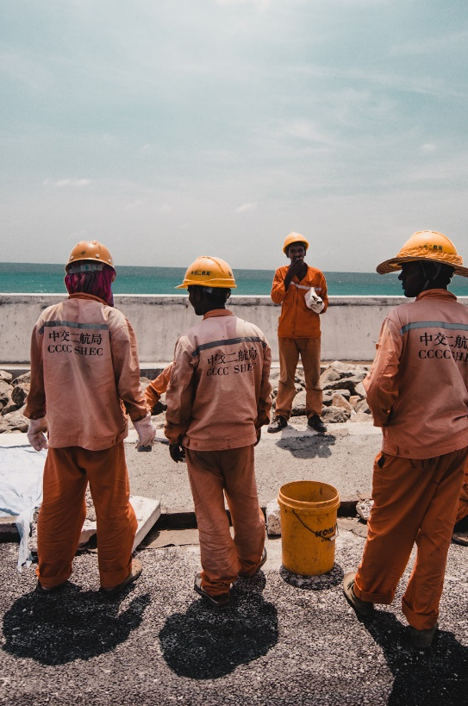
There are five Fundamental Principles and Rights at Work:
Freedom of association and the effective recognition of the right to collective bargaining
The elimination of all forms of forced or compulsory labour
The effective abolition of child labour
The elimination of discrimination in respect of employment and occupation; and
A safe and healthy work environment

Slide 5
How does the ILO promote the Declaration on Fundamental Principles and Rights at Work?
The 1998 Declaration includes a ‘follow-up’ with three elements:
Member States are required to submit annual reports for all of the fundamental rights to which they have not ratified the corresponding instruments. The reports are examined by the Governing Body in an annual review.
Each year the ILO produces a Global Report on one of the fundamental principles and rights at work. This report informs the recurrent discussion at the Conference on the needs of the Members, the ILO action undertaken, and the results achieved in the promotion of the fundamental principles and rights at work.
Development Cooperation Projects are another way that the ILO seeks to promote the Declaration as these projects are designed to address identifiable needs in relation to the Declaration and to strengthen local capacities thereby translating principles into practice.

Slide 6
The Fundamental Principles and Rights at Work are one of the four strategic objectives central to achieving social justice through decent work
    The ILO’s Decent Work agenda includes:
    Promoting full, productive, and freely chosen employment
    Social protection
    Social dialogue
    Realizing fundamental principles and rights at work.

Slide 7
The Fundamental Principles and Rights at Work are underpinned by eleven ‘fundamental’ Conventions
C029 - Forced Labour Convention, 1930 (No. 29) and P029 - Protocol of 2014 to the Forced Labour Convention, 1930
C087 - Freedom of Association and Protection of the Right to Organise Convention, 1948 (No. 87)
C098 - Right to Organise and Collective Bargaining Convention, 1949 (No. 98)
C100 - Equal Remuneration Convention, 1951 (No. 100)
C105 - Abolition of Forced Labour Convention, 1957 (No. 105)
C111 - Discrimination (Employment and Occupation) Convention, 1958 (No. 111)
C138 - Minimum Age Convention, 1973 (No. 138)
C155 - Occupational Safety and Health Convention, 1981 (No. 155)
C182 - Worst Forms of Child Labour Convention, 1999 (No. 182)
C187 - Promotional Framework for Occupational Safety and Health Convention, 2006 (No. 187)

Slide 8
Four Governance (or Priority) instruments
    The ILO has also identified four Conventions as governance (or priority) instruments.
    Member States are encouraged to ratify these because of their importance to the functioning of the ILS system:
      C081 – Labour Inspection Convention, 1947 (No. 81)
      C122 – Employment Policy Convention, 1964 (No. 122)
      C129 – Labour Inspection (Agriculture) Convention, 1969 (No. 129)
      C144 – Tripartite Consultation (International Labour Standards) Convention, 1976 (No. 144)

Slide 9
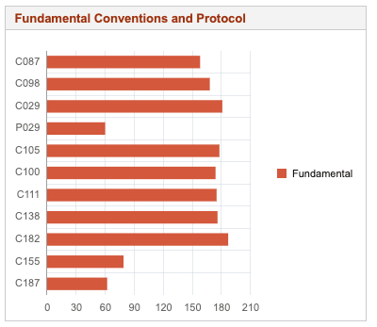
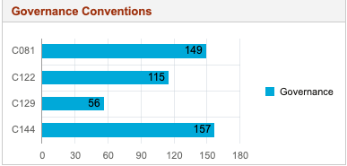
Global ratification of the ILO’s Fundamental Instruments and Governance Conventions
Source: Normlex

Slide 10
Ratification of ILO Fundamental Instruments in the Pacific
 | Freedom of association |  | Forced labour |  |  | Discrimination |  | Child labour |  | Occupational safety & health
 | C087 | C098 | CO29 | PO29 | C105 | C100 | C111 | C138 | C182 | C155 | C187
Cook Islands |  |  | 2015 |  | 2015 |  |  |  | 2018
Fiji | 2002 | 1974 | 1974 |  | 1974 | 2002 | 2002 | 2002 | 2002 | 2008
Kiribati | 2000 | 2000 | 2000 |  | 2000 | 2009 | 2009 | 2009 | 2009
Marshall Islands |  |  |  |  |  |  |  |  | 2019
Palau |  |  |  |  |  |  |  |  | 2019
PNG | 2000 | 1976 | 1976 |  | 1976 | 2000 | 2000 | 2000 | 2000
Samoa | 2008 | 2008 | 2008 |  | 2008 | 2008 | 2008 | 2008 | 2008
Solomon Islands | 2012 | 2012 | 1985 |  | 2012 | 2012 | 2012 | 2013 | 2012
Tonga |  |  |  |  |  |  |  |  | 2020
Tuvalu |  |  |  |  |  |  |  |  | 2019
Vanuatu | 2006 | 2006 | 2006 |  | 2006 | 2006 | 2006 | 2019 | 2006

Slide 11
Ratification of ILO Governance Conventions in the Pacific
 | Labour Inspection |  | Employment Policy | Tripartite Consultation
 | C081 | C129 | C122 | 144
Cook Islands |  |  |  | 2018
Fiji | 2008 | 2010 | 2010 | 1998
Kiribati |  |  | 2000 | 2009
Marshall Islands
Palau
PNG |  |  | 1976 | 1991
Samoa |  |  | 2008 | 2008
Solomon Islands | 1985
Tonga
Tuvalu
Vanuatu | 2006 |  | 2006 | 2006

Slide 12
Group work activity
Instructions: Each small group will be assigned to ONE of the Fundamental Principles and Rights at Work. Your group will be given copies of the relevant Conventions (and Protocols). Work together to answer the following questions. Be prepared to briefly explain your answers to all workshop participants.
What is the main purpose(s) of the conventions?
What are the key terms used in the conventions and how are these defined?
What do you think are some of the challenges or obstacles to realising these rights for Pacific Island Countries? Note: these challenges can relate to law and/or practice.

Slide 13
Suggested resources
    ILO, Declaration on Fundamental Principles and Rights at Work and its Follow-up
    ILO Freedom of Association and Collective Bargaining and Labour Relations
    ILO, Forced Labour, Modern Slavery and Human Trafficking
    ILO, Child Labour
    ILO, Equality and Discrimination
    ILO, Safety and Health at Work

Slide 14

Reflections and feedback on Day 1
    What did you find most interesting today?
    What would you liked to have learnt more about?
    What would you liked to have had more time to discuss?
    Pace of learning? Level of detail?

Slide 15
Thank you and enjoy your evening!

