Slide 1
Labour Law Drafting
  Session 5
  ILO Subregional Labour Law Training Workshop
  Nadi, Fjii

Slide 2
Session Objectives
    To reflect on some of the features of a well-drafted labour law statute
    To learn from an experienced labour law drafter - Guest speaker/ Q&A: Professor Sean Cooney
    To discuss how to avoid common pitfalls when drafting labour law statutes

Slide 3
Important!
    This is not a workshop (or session) on legislative drafting. Legislative drafting is a specialist skill, and each Pacific Island country will have its own rules and ways of undertaking legislative drafting.
    However, there are certain pitfalls found in many labour law statutes that can be avoided or minimized during the drafting process.
    We will focus on three issues: complexity, scope and compliance/ enforcement.
Notes:
Helpful for those instructing a legislative drafter, as well as engaging in legislative drafting, to be aware of and understand these issues.

Slide 4

Guest Speaker: Professor Sean Cooney
Consultant (ILO) and Professor, Centre for Employment and Labour Relations Law, Melbourne Law School
Expertise in international and comparative employment law.
Former Legal Specialist in the Labour Law and Reform Unit at the ILO in Geneva, where he provided advice to governments in countries such as China, India, Myanmar and Pakistan.

Slide 5


Question for discussion
What do you think are some of the features of a well-drafted labour law statute?

Slide 6
Reducing complexity

Slide 7

What’s the problem?
    Labour laws may use complicated, out-dated and/or use very legalistic language.
    The structure of a labour law may be complex and difficult to navigate.

Slide 8
Why is this a problem?
    Complex legislation makes it difficult, time-consuming and expensive for people to understand their legal rights and obligations.
    As employers, employees and others are expected to comply with the law, they are entitled to expect that it is drafted in such a way that they can readily navigate their way around the law and understand what it contains.

Slide 9
Why is this a problem?
    Complex laws can lead to confusion and inconsistent decision-making, creating unnecessary regulatory burden for business, and restricts access to justice.
    Complex laws can also impede labour inspection and enforcement. Labour inspectors need to be able to understand the law to explain it and enforce it, and this may be difficult, even impossible, when the law is incomplete, inconsistent, too vague, out-of-date, or when there are inadequate definitions.

Slide 10
Using plain language
    Using plain language when drafting can help make laws easier to navigate and understand.
    The aim of plain language drafting is to make laws as simple and easy to understand to the greatest number of people possible, without taking away from precision or omitting necessary information or unintentionally changing the legal effect.
    Plain language drafting is not just about the language used. It covers language, structure and design of the document.

Slide 11
Example: Towards simpler unfair dismissal provisions in Australian labour law
Subdivision B of Division 4 of Part 12 of the Workplace Relations Act 1996 (Cth)
Subdivision B started with the right to apply to the Commission (s 643) and focused on the process to be followed in applying for redress.
The rules about which employees could apply, and in what circumstances redress would be available, were dealt with either as details within procedural provisions (such as section 643) or as scoping or definition provisions in Subdivision A.
Part 3-2 of the Fair Work Act 2009 (Cth)
Division 2 creates a concept of a person who is “protected from unfair dismissal”;
Division 3 describes when a person is “unfairly dismissed”
Division 4 sets out what remedies are available for an unfair dismissal;
Division 5 deals with procedural matters.

Slide 12
Clarifying and broadening scope

Slide 13
What’s the problem?
    Labour laws may explicitly exclude certain groups of workers from protections.
    Labour laws may implicitly exclude certain groups of workers because they only apply only to an ‘employer’ and an ‘employee’.
    Labour laws may not provide adequate clarity around the existence of an employment relationship.
    Labour laws may have scope clauses that are poorly or ambiguously formulated so that it is unclear who the law (or specific provisions) apply to.
    Where workers excluded from the scope of general labour laws are not covered by laws providing equivalent specific coverage, these limitations in scope are often inconsistent with ILS.

Slide 14
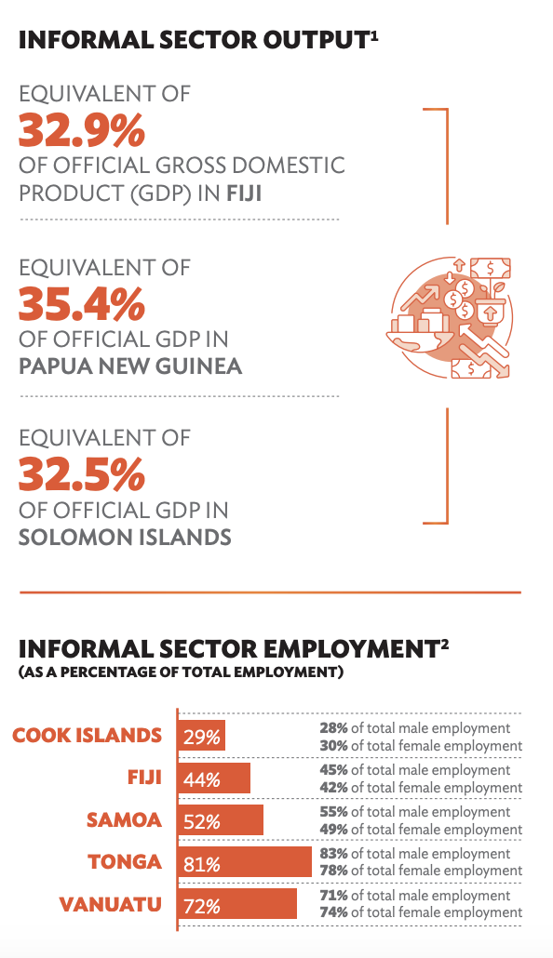
Labour law scope and the informal economy
    Explicit and implicit exclusions from the scope of labour laws contributes to vulnerability and decent work deficits, particularly for workers in the informal economy.
    The ILO uses the term ‘informal economy’ to refer to ‘all economic activities that are – in law or practice – not covered or insufficiently covered by formal arrangements.’ It is job-based concept that comprises all jobs in the informal sector as well as informal jobs in formal sector enterprises and in private households.
    Workers and economic units in the informal economy are highly diverse, including wage workers, employers, own account workers and contributing family workers; small and micro-enterprise owners/employers but also larger enterprises; and unrecognized employment relationships and undeclared work.
    While the main challenge to achieving decent work in the informal economy relates to compliance, legal coverage is also important!

Slide 15
Common explicit exclusions
    Part time workers
    Home workers
    Domestic workers
    Employees in enterprises with below a certain number of employees
    Informal workers.

Slide 16
Implicit exclusions
    Many labour laws recognise the employment relationship as the main vehicle through workers gain access to the rights and benefits afforded by labour law. It is the key point of reference for determining the nature and extent of employers' rights and obligations towards their workers.
    An employment relationship is formed where an individual works under the authority of an employer in return for payment (a wage or salary).
    While it may be appropriate for labour laws to restrict the application of some rights and responsibilities to employers and employees, many rights and protections can and should be afforded to other categories of workers.

Slide 17
Exclusion through ambiguity
    Workers can also be excluded from labour law protections where scope clauses are ambiguous.
    This may arise where labour law does not provide sufficient guidance as to the existence of an employment relationship.
    This can mean that it is not easy to determine whether a workers is or is not an employee.
    Employment status ambiguity is a particular problem in the informal economy.

Slide 18
Many explicit and implicit exclusions in labour law statutes are inconsistent with ILS
    The Committee of Experts has consistently raised concerns with labour laws that explicitly exclude groups of workers from scope in a manner inconsistent with ILS.
    Most ILS apply to workers rather than to the legally narrower category of employees, and do not contain wording limiting their application to the formal economy. Some explicitly refer to the informal economy.
    The ILO encourages member countries to review their labour laws and labour administration practices and seek to extend their coverage to workers in the informal economy.

Slide 19
Addressing explicit exclusions
    Consideration should be given when drafting or reviewing labour laws to removing explicit exclusions so that protections are extended to as many workers as possible.
    E.g., some countries have extended their legislation to cover homeworkers, in some cases (e.g. Morocco, Chile, New Zealand).
    The ILO has Conventions and Recommendations that deal specifically with categories of workers who are in ‘non-standard’ employment relationships such as part-time workers, home workers, agency workers and domestic workers.
    Fishers are another category of worker where employment status may be unclear, or workers may not be engaged in an employment relationship– the ILO has developed specific standards for these workers: the the Work in Fishing Convention, 2007 (No. 188) and the Work in Fishing Recommendation, 2007 (No. 199)

Slide 20
Addressing implicit exclusions
    Consideration should be given when drafting or reviewing labour laws to extending the definition of an employee or extending protection to workers who are economically dependent yet are not regarded as employees (for example home workers and agency workers).
    For example: Morocco has amended its labour code to extend protection to salespersons and home workers, and the Labour Relations Act of Ontario (Canada) deems ‘dependent contractors’ to be ‘employees’.

Slide 21
Addressing ambiguity as to the existence of an employment relationship
    The ILO encourages member States to review laws and codes of practice to ensure that there is clarity in relation to the legal status of workers and effective means of determining the status of individual workers or groups of workers
    The ILO’s Employment Relationship Recommendation, 2006 (No. 198) provides important guidance to member States on measures that may be adopted to guard against disguised employment relationships.

Slide 22
Compliance and enforcement

Slide 23
What’s the problem?
    Some labour laws pay insufficient attention to compliance and enforcement.
    As a result, it may be unclear how a specific provision can be enforced, by whom and with what consequences.
    This may also lead to ‘legal loopholes’ that enable parties to engage in practices that are lawful but contrary to the policy objectives underpinning the law (e.g., imposing caps on duration of fixed term contracts but no cap on the number of times a fixed-term contract can be renewed).
    Unless effectively administered and enforced, the formal laws will have little meaning.

Slide 24
Compliance and enforcement
    Ensure sufficient attention is paid to the need for, and nature of, compliance and enforcement provisions in labour laws.
    It may be effective for a law to address compliance and enforcement in a separate chapter or part.
    Tables can be used to make the law easier to navigate and use (e.g. provision/ person with standing/ court/ maximum penalty)

Slide 25
Suggested resources
    ILO. Women and men in the informal economy: A statistical picture, Third Edition, 2018
    ILO, Transition from the Informal to the Formal Economy Recommendation, 2015 (No. 204)
    ILO, ‘Extending the scope of application of labour laws to the informal economy: A Digest of Comments of the ILO’s supervisory bodies related to the Informal Economy’ 2010.
    Pacific Islands Law Officers’ Network (PILON), Pacific Toolkit: From Policy to Legislation

Slide 26
After the break:
Labour law reform

