Slide 1
Labour Law Reform
  Session 6
  ILO Subregional Labour Law Training Workshop
  Nadi, Fjii

Slide 2
Session objectives
    To encourage participants to reflect on the reasons for labour law reform
    To discuss the importance of social dialogue, and how this makes labour law reform different to other types of law reform
    To reflect on the process of labour law reform
    To provide an opportunity for participants to reflect on labour law reform processes in their own countries.

Slide 3
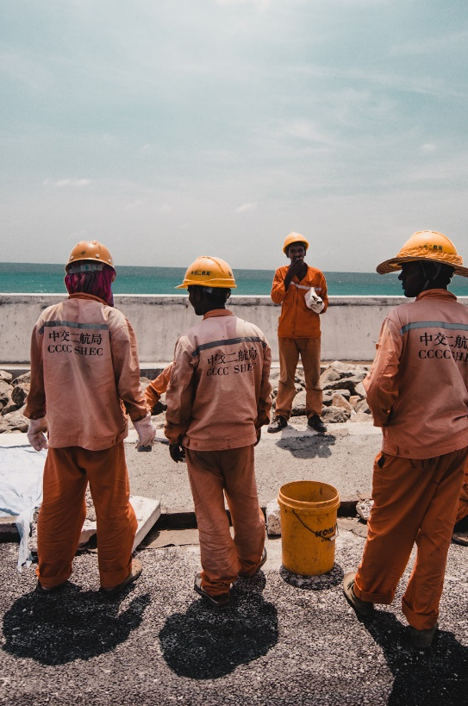

Question for discussion
What are some of the reasons a country may engage in labour law reform?

Slide 4
Why engage in labour law reform?
    Labour laws may be failing to achieve their objectives because they do not ‘fit’ well with labour market conditions. This may be because they were inherited or borrowed.
    To address concerns/ problems that have emerged in the labour market because of changes to employment practices (e.g., growth in indirect, temporary employment) and that need to be addressed through law reform
    To reflect changes in societal values (e.g., discrimination at work, work/ family balance)
    To address deficiencies in the law that have been highlighted by legal cases or practices
    To improve compliance with fundamental and ratified ILO Conventions

Slide 5
Labour law reform and social dialogue
    Social dialogue plays an important role in designing, implementing and evaluating successful labour law reforms. This feature distinguishes labour law reform from other types of law reform engaged in by the executive branch of government.
    According to the ILO, social dialogue includes:
    “all types of negotiation, consultation and exchange of information between and among representatives of governments, employers and workers on issues of common interest relating to economic or social policy” (ILO, 2013: 39).

Slide 6
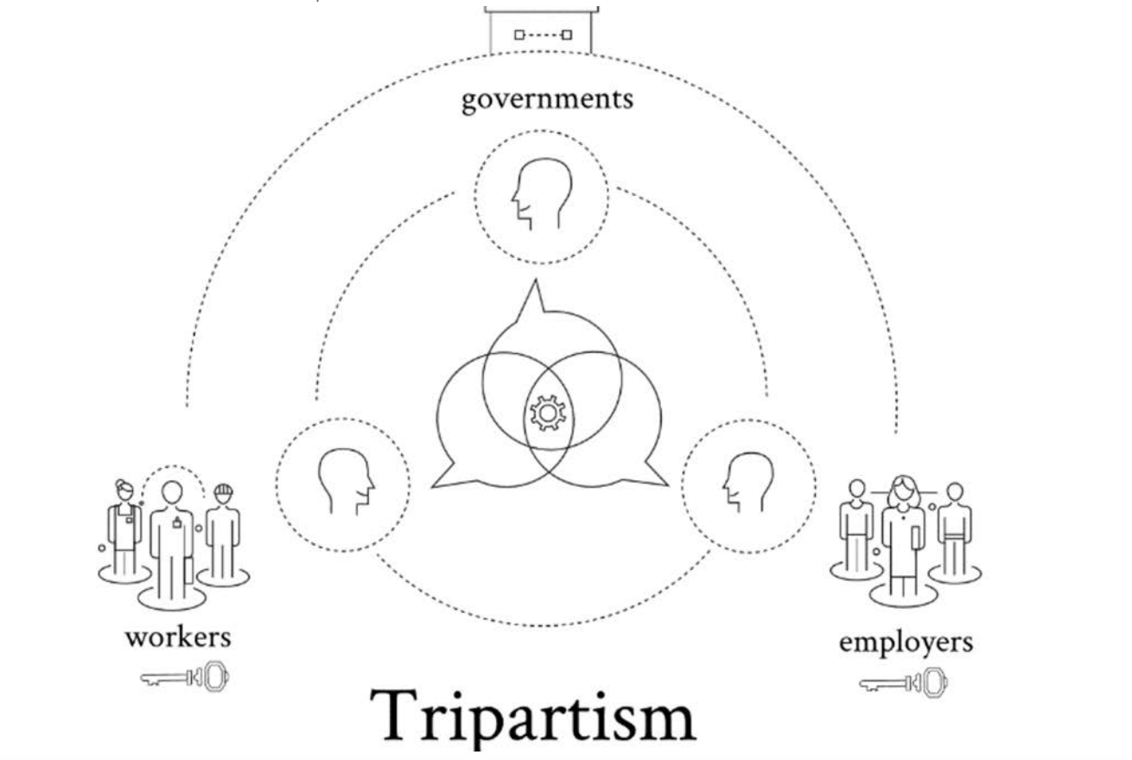
Bipartite and tripartite social dialogue
    Social dialogue can be bipartite or tripartite
    Bipartite social dialogue refers to dialogue between the social partners (employer and employee organisations).
    Tripartite social dialogue involves the participation of the State and is most relevant in national law reform and policy discussions.

Slide 7
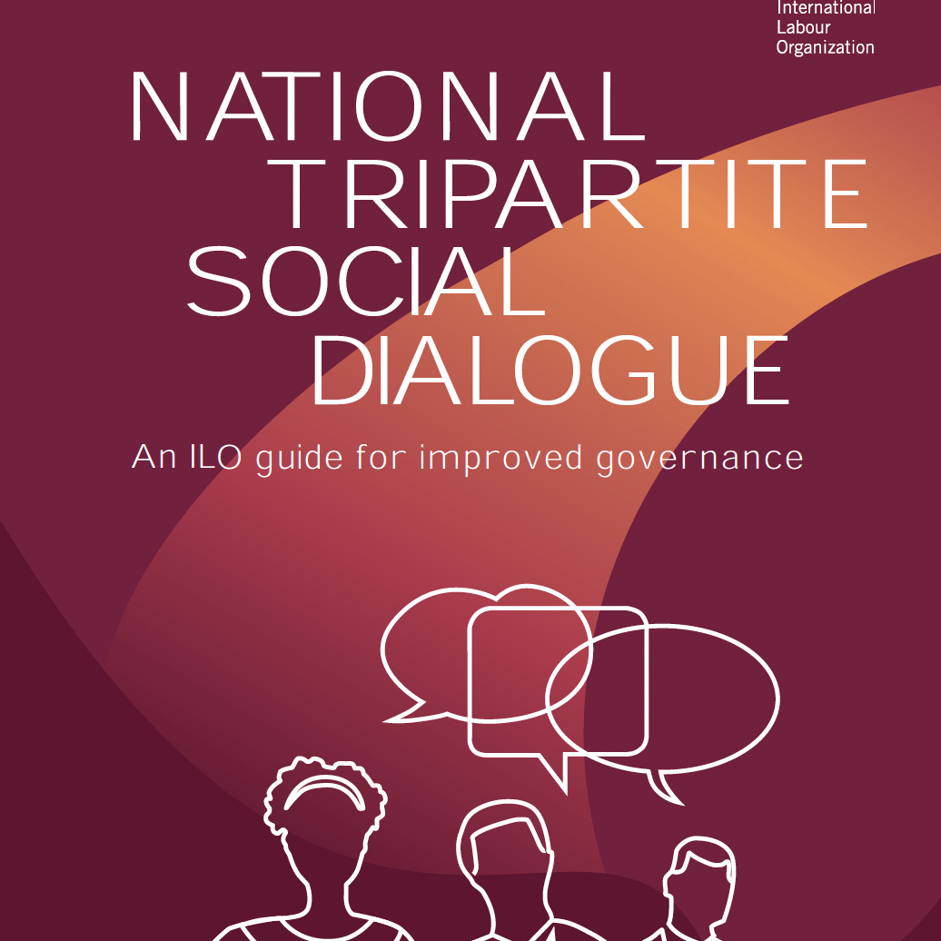
Social dialogue and law reform
ILO experience shows that labour law reforms that have been crafted through an effective process of tripartite consultation prove more sustainable, since they take into consideration the complex set of interests at play in the labour market. Also, they can ensure a balance between the requirements of economic development and the social needs.

Slide 8
How does social dialogue help produce better labour laws?
    Law are informed by information and experiences provided by the social partners (e.g., real problems encountered in the workplace).
    Social dialogue helps legitimise laws and policies and increase transparency around policy-making and build trust in, and commitment to, new policies which can make them easier to implement.
    Laws made in consultation with all the social partners can minimize uncertainty and avoid conflict.
    Conversely, labour law reforms imposed without effective consultations not only often meet with resistance on the part of the labour market actors, but also, more importantly, will lack legitimacy and support and thus will face problems at the implementation stage.

Slide 9
Social dialogue and ILO standards
    Social dialogue is a key pillar of the ILO’s Decent Work Agenda (along with social protection, rights at work and employment). It is widely recognised as an essential building block of sustainable and inclusive growth and development.
    The importance of social dialogue was reaffirmed in the preamble to the ILO Centenary Declaration for the Future of Work (2019) which states that “social dialogue contributes to the overall cohesion of societies and is crucial for a well-functioning and productive economy.”

Slide 10
Social dialogue and ILO standards
    Of particular importance for social dialogue are the Freedom of Association and Protection of the Right to Organise Convention, 1948 (No. 87) and the Right to Organise and Collective Bargaining Convention, 1949 (No. 98), both of which are fundamental Conventions.
    Most ILO standards call for the involvement of the social partners in their implementation, and usually require consultation with the most representative organizations of employers and workers at the national level.
    Some ILO standards focus specifically on tripartite social dialogue, in particular the Tripartite Consultation (International Labour Standards) Convention, 1976 (No. 144), its accompanying Tripartite Consultation (Activities of the International Labour Organisation) Recommendation, 1976 (No. 152).

Slide 11
Social dialogue and ILO standards
    The Consultation (Industrial and National Levels) Recommendation, 1960 (No. 113) specifically encourages public authorities to
      “… seek the views, advice and assistance of employers’ and workers’ organisations in an appropriate manner, in respect of such matters as – (i) the preparation and implementation of laws and regulations affecting their interests”.

Slide 12
Social dialogue and tripartite labour advisory bodies
    The Tripartite Consultation (International Labour Standards) Convention, 1976 (No. 144) and supporting ILO recommendations promote tripartism and social dialogue at the national level by ensuring the involvement of employers’ and workers’ organizations at each stage of ILO’s standards-related activities.
    The practice of regular consultation at the national level can foster trust and facilitate social dialogue between tripartite partners not only in relation to ILO matters, but also promote the principle of engagement on wider social and economic issues.

Slide 13
Social dialogue and tripartite labour advisory bodies
    Tripartite labour advisory bodies, often established to give effect to Convention No. 144, provide an important focal point for dialogue on broader labour policy issues, including labour law reform.
    Recent years have seen the establishment of tripartite labour advisory bodies in a number of Pacific island countries:
      Solomon Islands Labour Advisory Board
      Kiribati Decent Work Agenda Steering Committee
      Vanuatu Tripartite Labour Advisory Council
      PNG National Tripartite Consultative Council
      Fiji Employment Relations Advisory Board
      Samoa National Tripartite Forum
      Tuvalu Tripartite Maritime Labour Convention Committee

Slide 14

Questions for discussion
What are some of the challenges to effective social dialogue in Pacific islands countries?
What steps could be taken to help address these challenges?

Slide 15
The challenge of social dialogue and the informal economy
    The ILO has emphasised that workers in the informal economy have the right to organise and to represent their members in various tripartite bodies and social dialogue structures.
    Formal tripartite social dialogue institutions, and informal social dialogue practices, often fail to adequately include representation of informal economy actors.
    Good practices include:
    Involving informal economy representatives, either directly or indirectly, in formal institutions for tripartite and bipartite social dialogue
    Specific outreach by employers’ and workers’ organizations to informal economy economic units and workers
    Setting up new, informal social dialogue forums involving a broad range of concerned stakeholders, which lend themselves to more direct participation by informal economy actors at the local level.

Slide 16
The labour law reform process
    There is no blueprint or “one-size-fits-all” labour law reform process.
    Labour law reform processes will differ by country, and according to the scope of the reform project, the range of stakeholders, the complexity of the laws and the time allotted for the process.
    The ILO emphasises that consultation of social partners start early in the law reform process and take place at every step. Consultations can take place through central bodies, specialized committees or ad hoc procedures, or a combination of all these channels. It can also take place in a more informal way.

Slide 17
Common stages in labour law reform
Identification of policy issue that requires law reform
Public consultations
Draft bill
Public consultations and/ or tripartite ad hoc review of draft bill
Revised bill submitted to Parliament
Further review and/or public consultations (e.g., parliamentary committee)
Parliament adopts bill

Slide 18

Group work activity
Based on your existing knowledge and our discussion today, work in small groups to map out the key stages in a (hypothetical) labour law reform project in your country.
Your flowchart should cover key stages and actors in the law reform process, starting from identification of priority issue(s) for law reform and finishing with adoption of a bill by Parliament.
Tip: Consider at what stages and how the social partners and other key stakeholders may be engaged in the law reform process.

Slide 19
Lessons learnt from labour law reform processes in other countries
    Social partners need to be given sufficient time and information to engage in the process meaningfully. This should include time to consult with their members.
    Civil society organizations often have expertise that is relevant to certain types of labour laws, or certain provisions within the law. They can provide quality feedback on draft laws and increase awareness about proposed reforms among relevant populations.
    Labour law reform efforts must be accompanied by efforts at information and awareness raising, and at building institutional and technical capacity among government and private sector actors.
    Labour law reform can help drive and support tripartite social dialogue.

Slide 20
Labour law reform and the ILO
    The International Labour Office has a constitutional mandate to assist member States in framing their labour legislation (art 10, para 2(b) of the ILO Constitution)
    The ILO’s Labour Law and Reform Unit (LABOURLAW) is available to give an independent view of the content of a draft law, not only in terms of compliance with ILS but, in principle, as labour law.
    The ILO also offers capacity building for social partners.

Slide 21
Suggested resources
    ILO, National Tripartite Social Dialogue: An ILO Guide for Improved Governance, 2013.
    ILO, Dialogue in Brief: Transition to Formality: the Critical Role of Social Dialogue, 2017.

Slide 22
After the break:
Case Study Part I

