Slide 1
Case Study Part I: Towards a world of work free from violence and harassment
  Session 7
  ILO Subregional Labour Law Training Workshop
  Nadi, Fjii

Slide 2
Let’s start with a quick quiz
Using your phone or laptop, go to the link below.
Complete the quiz to see how much you know about sexual harassment at work.
Your answers are private and confidential. You will not be asked to share your results with anyone.
https://en.breakingthecircle.org/quiz/8m/

Slide 3
Session Objectives
    To introduce our case study
    To encourage reflection on existing knowledge about, and attitudes towards, violence and harassment at work
    To provide an overview of the ILO Violence and Harassment Convention, 2019 (No. 190) and Violence and Harassment Recommendation, 2019 (No. 206)
    To lay the foundations for the group activity to be undertaken in Session 8.

Slide 4
Our case study
    Sessions 7 and 8 of this workshop involve a case study of the ILO’s Violence and Harassment Convention, 2019 (No. 190).
    This case study is intended to:
    (i) consolidate your understanding of the role of the ILO and ILS
    (ii) introduce you to the subject of violence and harassment at work and encourage you to consider the nature and extent of associated challenges in the Pacific islands region
    (iii) provide you with an opportunity to contextualise and apply your learning on ILS and labour law reform to a contemporary and highly relevant topic.
    Acknowledgements: Material presented in this case study is drawn principally from ILO’s Ending Violence and Harassment in the World of Work: A Guide on Convention No. 190 and Recommendation No. 206 and UNI Global’s Toolkit on the Violence and Harassment Convention (No. 190) and Recommendation (206).

Slide 5
Why have we chosen to focus on the Violence and Harassment Convention No. 190?
    Violence and harassment at work is a major issue across the world, including in our region
    Convention No. 190 is the most recent Convention adopted by the ILO
    Australia, Fiji and PNG have all recently ratified Convention No. 190 and other Pacific Island countries are working towards ratification.

Slide 6
What is Convention No. 190 and why do we need it?

Slide 7

What is Convention No. 190 and Recommendation No. 206?
    Convention No. 190 is an international treaty passed in June 2019 at the ILO’s International Labour Conference.
    It is a comprehensive instrument that covers all instances of violence and harassment for all workers and other persons in the world of work.
    Governments that ratify C190 will be required to put in place the necessary laws and policy measures to prevent and address violence and harassment in the world of work.​
    Recommendation No. 206 provides guidance on implementing the Convention.

Slide 8
Violence and harassment in the world of work is a global problem
    According to a global study conducted by the ILO, Lloyd’s Register Foundation (LRF) and Gallup in 2021, more than one in five people (almost 23 per cent) in employment have experienced violence and harassment at work, whether physical, psychological or sexual.
    Nearly one in ten (8.5 per cent or 277 million) persons in employment has experienced physical violence and harassment at work.
    One in fifteen (6.3 per cent or 205 million) people in employment has experienced sexual violence and harassment at work in their working life. Women were particularly exposed to sexual violence and harassment at work.
    In Asia and the Pacific, sexual harassment and violence against women workers is alarmingly high. UNFPA reports that 47.3 percent of women workers in Nauru, 18.5 percent of women workers in Indonesia and 14 percent of women workers in Mongolia experienced sexual violence perpetrated by non-partners, including co-workers and supervisors (UNFPA 2020).

Slide 9
Thinking about our understandings of violence and harassment in the world of work
We are going to watch a brief video on violence and harassment at work.
UNI Global, Violence at Work (2010)
Does this video challenges any of your pre-existing understandings about the causes and types of violence and harassment that workers face?

Slide 10
Group Activity: Thinking about violence and harassment in the world of work
In small groups, discuss and note down your answers to the following questions.
What are some of the different types of violence and harassment that workers face?
Who are the perpetrators (persons who commit the violence)?
Who are the victims?
Which workers are more vulnerable or face greater risk?
What are the power inequalities that lead to violence and harassment at work?

Slide 11
What is the impact of violence and harassment in the world of work?
    On workers and their families?
    On businesses and economies?
    On society?

Slide 12
Why is Convention No. 190 needed?
    Violence and harassment can constitute a human rights violation or abuse.
    Violence and harassment can harm the health, dignity and wellbeing of everyone at work. ​
    Violence and harassment threatens equal opportunities; is unacceptable and incompatible with decent work.
    It prevents persons, particularly women, from accessing, remaining and advancing in the labor market.​
    Working environments that are free from violence and harassment are more productive. ​
    Businesses that ensure the wellbeing of workers are more secure, in both social and financial terms.
​A world of work that is free from violence and harassment is better for everyone.​

Slide 13
Why is Convention No. 190 needed?
    Some international labour standards refer directly to various manifestations of violence and harassment in the world of work, and others have been considered by the ILO CEACR to cover certain manifestations of violence and harassment.
    ILO instruments relating to occupational safety and health (OSH) set out to protect workers’ safety and health, including from the risk of violence and harassment.
    However, ILS cover the issue in a fragmented manner, protecting only certain groups and only from certain manifestations of violent and harassing behaviours.
    There was a need for a comprehensive instrument that could cover all instances of violence and harassment for all workers and other persons in the world of work.

Slide 14
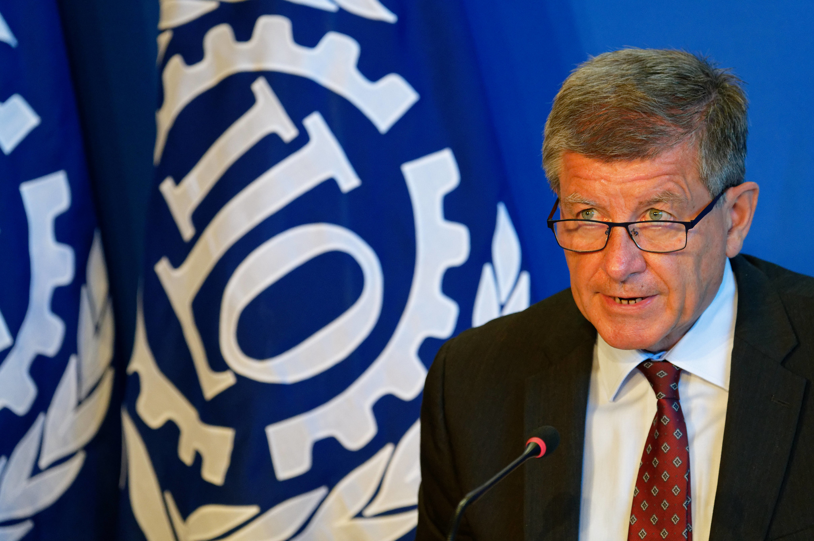


“For the first time, the right to a world of work free from violence and harassment has been articulated in an international treaty. For the first time, there is a clear and common framework to prevent and address violence and harassment, based on an inclusive, integrated and gender-responsive approach.”​
Guy Ryder
ILO Director-General​
International Labour Organization (ILO) | C190

Slide 15
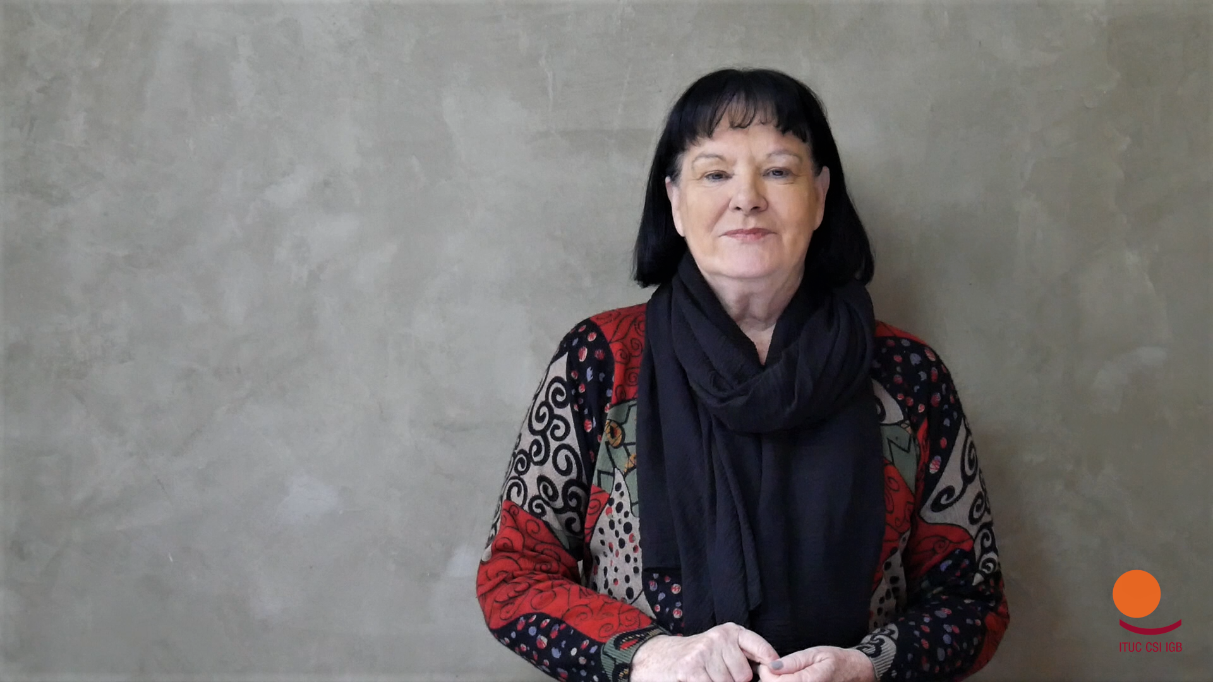

“The ratification of C190, and its effective implementation along with R 206, will provide every worker the right to a world of work free from violence and harassment. Whatever the form of their contractual relationship, whether they work in the formal or informal economy, or in a rural or urban setting.”
Sharan Burrow
General Secretary
International Trade Union Confederation
International Labour Organization (ILO) | C190

Slide 16
Ratification of Convention 190 – All regions
Africa | Americas & the Caribbean | Asia and the Pacific | Arab States | Europe and Central Asia
Central African Republic | Antigua and Barbuda | Australia |  | Albania
Lesotho | Argentina | Fiji |  | Belgium
Mauritius | Bahamas | PNG |  | France
Namibia | Barbados |  |  | Germany
Nigeria | Canada |  |  | Greece
Somalia | Chile |  |  | Ireland
South Africa | Ecuador |  |  | Italy
Uganda | El Salvador |  |  | North Macedonia
 | Mexico |  |  | Norway
 | Panama |  |  | San Merino
 | Peru |  |  | Spain
 | Uruguay |  |  | UK & Northern Ireland

Slide 17
Ratification of Convention No. 190 - Asia Pacific
Countries that have ratified C190 | Countries that started (or plan to undertake) a pre-ratification analysis | Countries that have expressed a general interest to work on the issue/ ratify in the future
Fiji (2020) | Samoa
Australia (2023) | Vanuatu
PNG (2023)

Slide 18
Key elements of Convention No. 190

Slide 19
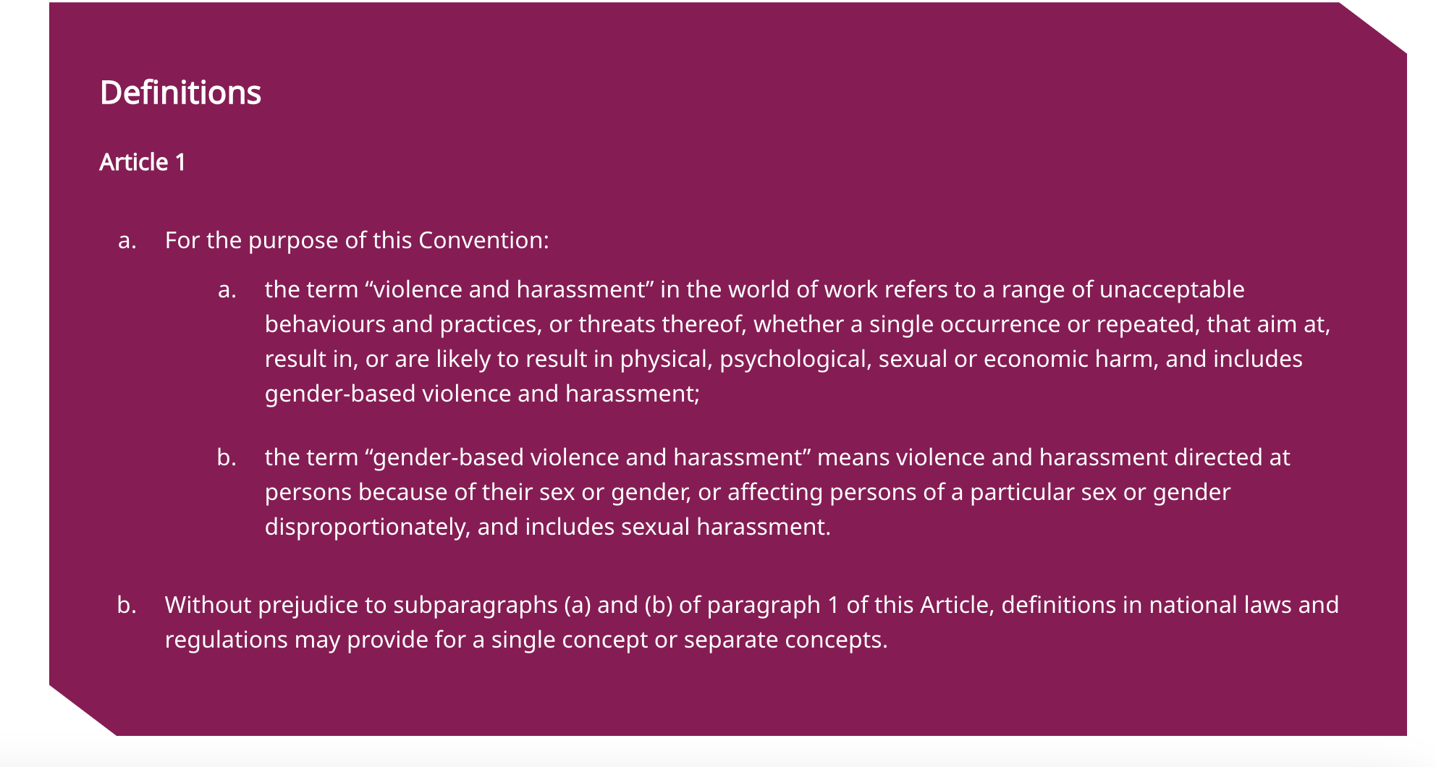
What is violence and harassment at work?

Slide 20
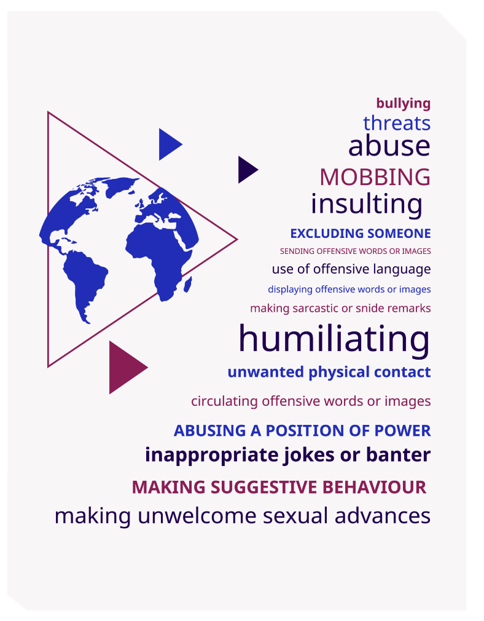
A broad and flexible definition
    Covers various manifestations of violence and harassment and capable of covering new ones that emerge over time.
    Allows for “violence and harassment” to cover a wide range of terms found in different legislation to describe the same or similar phenomena. These laws often acknowledge that there is no clear line between violence and harassment .
    Intent is not a constitutive element

Slide 21
A broad and flexible definition
The Convention covers all violence and harassment at work, whether it be:
by or against individuals exercising the authorities, duties or responsibilities of an employer (vertical)
directed toward one’s peers (horizontal), or
involving third parties, such as clients, patients, passengers or customers.

Slide 22
Gender-based violence and harassment
    The notion of violence and harassment outlined in Article 1(a) of the Convention, explicitly includes ”gender-based violence and harassment”.
    Gender-based violence and harassment is “violence and harassment directed at persons because of their sex or gender, or affecting persons of a particular sex or gender disproportionately, and includes sexual harassment” (Art. 1(b))

Slide 23
Gender-based violence and harassment
    The reference to “persons” is significant, as it broadens the definition of gender-based violence compared to other international and regional instruments. While gender-based violence and harassment disproportionately affects women and girls, Convention No. 190 seeks to protect everyone.
    The reference to “sex or gender” makes both the biological functions and characteristics that differentiate men from women (that is, sex) and the sociological differences between men and women that are learned and changeable over time (that is, gender) relevant to Convention No. 190 and Recommendation No. 206 (ILO 2012).
    The definition of gender-based violence and harassment explicitly includes “sexual harassment”.

Slide 24
Convention No. 190 and domestic violence
    Convention No. 190 recognizes the link between domestic violence and the world of work, since domestic violence can affect people’s ability to get to work, to perform adequately in their job duties, and can affect time off work to access medical, psychosocial and justice services.
    Domestic violence can also affect employment, productivity and health and safety, and governments, employers’ and workers’ organizations, and labour market institutions can help – as part of other measures – to recognize, respond to and address the impacts of domestic violence.

Slide 25
Who is protected?
Article 2 makes clear that the Convention applies to all sectors, whether private or public, in the formal and informal economy, and whether in urban or rural areas.
The Convention protects workers and other persons in the world of work:
Employees as defined by national law and practice
Persons working irrespective of their contractual status
Persons in training, including interns and apprentices
Workers whose employment has been terminated
Volunteers
Jobseekers and job applicants
Individuals exercising the authority, duties or responsibilities of an employer
The Convention requires Members to take into account violence and harassment involving third parties, where applicable, when adopting an inclusive, integrated and gender-responsive approach
International Labour Organization (ILO) | C190

Slide 26

And where and when?
Violence and harassment occurring in the course of, linked with or arising out of work
The workplace
Public and private spaces, where they are a place of work
Places where worker is paid, takes a rest break or a meal
Sanitary, washing and changing facilities
Work-related trips, travel, training, events or social activities
Through work-related communications
Employer-provided accommodation
Commuting to and from work
International Labour Organization (ILO) | C190

Slide 27
C190: Core Principles
Respect, promote and realize the right of everyone to a world of work free from violence and harassment.
Adopt an inclusive, integrated and gender-responsive approach
Recognize different and complementary roles and functions of governments, employers and workers, with the varying nature and extent of their responsibilities
Respect, promote and realize the fundamental principles and rights at work and promote decent work
Ensure right to equality and non-discrimination, including for women workers, as well as for vulnerable groups or groups in situations of vulnerability disproportionately affected by violence and harassment in the world of work
International Labour Organization (ILO) | C190

Slide 28
C190 adopts an inclusive, integrated and gender-responsive approach
Addressing violence and harassment through labour, equality and non-discrimination, OSH, migration and criminal law and policies
Addressing discrimination, abuse of power relations and gender norms that support violence and harassment and mitigate its harmful effects.
Protecting those in all sectors, in the formal and informal economy, and in urban or rural areas
Recognizes different and complementary roles and functions of governments, employers and workers, with the varying nature and extent of their responsibilities in ensuring accessibility of information, tools and trainings.
International Labour Organization (ILO) | C190

Slide 29
Key parts of Convention No. 190
    In addition to definitions (Part I), scope (Part II) and core principles (Part III), the Convention includes parts on:
    Prevention and protection (Part IV)
    Enforcement and remedies (Part IV)
    Guidance, training and awareness-raising (Part IV
    The Convention emphasises the importance of collaboration between governments, employers' and workers' organizations

Slide 30
Prevention and Protection
    Adoption of laws and regulations to define and prohibit violence and harassment
    Taking of appropriate measures to prevent violence and harassment in the world of work
    Adoption of laws and regulations requiring employers to take appropriate steps, commensurate with their degree of control, to prevent violence and harassment, including gender-based violence and harassment, in the world of work.
    Specific obligations in relation to workers and other persons in the world of work who are particularly vulnerable to violence and harassment. Members are to recognise the important role of public authorities in the case of informal economy workers.
    Members are, in consultation with employers’ and workers’ organisations, to identify sectors or occupations and work arrangements ‘in which workers and other persons concerned are more exposed to violence and harassment’ and take measures to ‘effectively protect’ these persons.
    Imposes certain requirements on employers (e.g. to have relevant policy).

Slide 31
Enforcement and remedies
    Safe, fair effective and gender-responsive reporting and dispute resolution mechanisms (both internal and external to the workplace level)
    Appropriate and effective remedies
    Support and protection against retaliation
    Workers’ right to remove themselves in case of imminent and serious danger
    Confidentiality
    Empower labour inspectors and other authorities
    Sanctions and counselling
    Collection and publication of statistics

Slide 32
Guidance, training and awareness-raising
    Including violence and harassment in relevant policies​
    Raising awareness​
    Gender-responsive education curricula​
    Providing guidance, resources and training to workers, employers and other relevant authorities (judges, labour inspectors…)​
    Developing materials for journalists and other media personnel

Slide 33
Suggested resources
    ILO, Convention No. 190 concerning the elimination of violence and harassment in the world of work, 2019
    ILO, Recommendation No. 206 concerning the elimination of violence and harassment Recommendation
    ILO Topic Portal on the Eliminating Violence and Harassment in the World of Work
    ILO, Ending Violence and Harassment in the World of Work: A Guide on Convention No. 190 and Recommendation No. 206
    ILO, Campaign Toolkit for the Ratification of No. 190 on Violence and Harassment

Slide 34
After the break:
Towards C190 ratification and compliance – country case studies

