Slide 1
Case study II: Towards implementation of
C190 in the Pacific
  Session 8
  ILO Subregional Labour Law Training Workshop
  Nadi, Fjii

Slide 2
Session Objectives
    To consider the challenges and opportunities that ratification and implementation of Convention No. 190 presents for Pacific Island countries
    To encourage participants to begin to apply their knowledge of Convention No. 190 to critically evaluate laws and practices in their own countries
    To provide an opportunity for participants to reflect and provide feedback on the 2-day workshop.

Slide 3
Violence and harassment in the world of work in the Pacific – what do we know?
    Comprehensive statistics are unavailable. But the available evidence suggests high levels of violence and harassment in Pacific island countries.
    A 2016 study by The Fiji Women’s Rights Movement revealed that out of one thousand women surveyed, 20 per cent had experienced sexual harassment in the workplace – one in every five women. The sectors reporting the highest incidence of harassment were the tourism industry (accommodation, hotels, restaurants and bars), followed by the Public Service, Health, and Retail sectors.
    The Pacific has one of the world’s highest rates of domestic and sexual violence, with the regional average of 2 in 3 women experiencing intimate partner violence across their lifetimes.
    Women in the informal sector are at increased risk of abuse and violence. A UN Women study in Port Moresby, Papua New Guinea, found that over half of women and girls experienced violence in marketplaces. At the same time, 22% of female vendors faced multiple instances of sexual violence within a year.

Slide 4
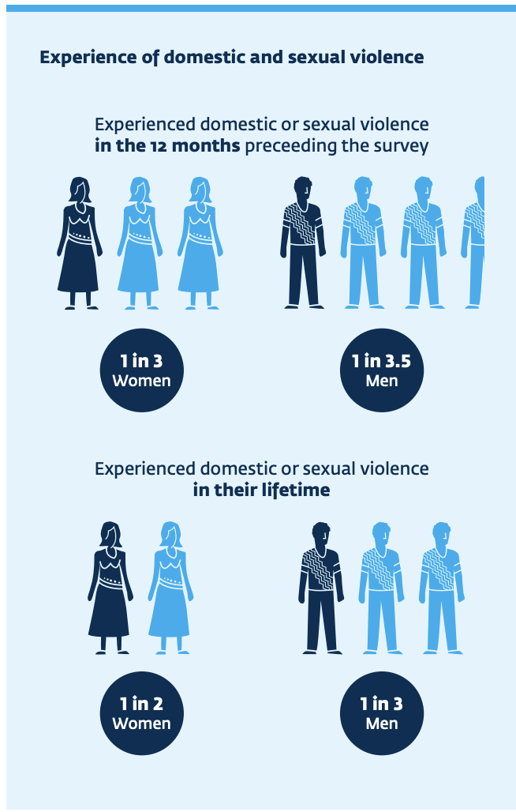
Violence and harassment in the world of work in the Pacific – what do we know?
    A 2018 survey of employees in some of the Solomon Islands' largest companies found that one in three of surveyed employees experienced domestic or sexual violence in the 12 months preceding the survey. In two companies, the rate was even higher, with approx. half of employees reporting domestic or sexual violence in the preceding 12 months.
    Of those who reported experiencing domestic or sexual violence, 81 percent reported at least one workplace impact. This represents 35 percent — or one in three — of all employees who participated in the survey.
Source: IFC 2019

Slide 5
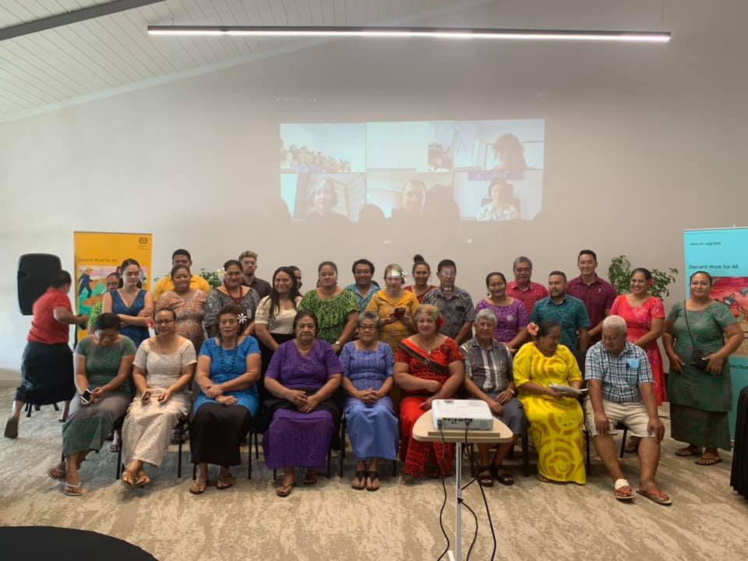
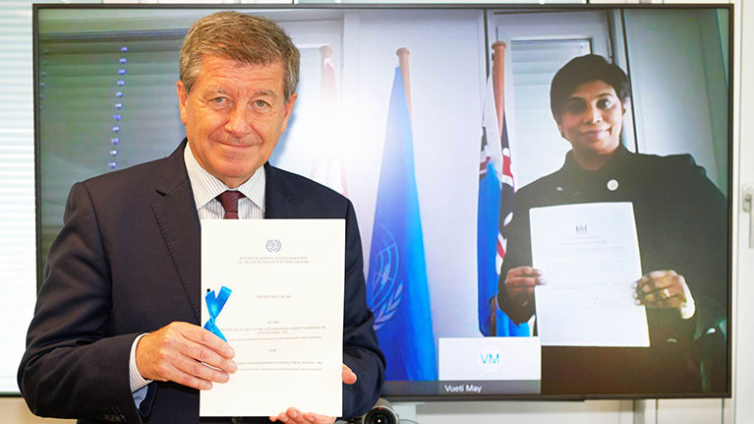
Progress is being made
    In recent years, across the Pacific Islands, Member States have made progress in improving laws and policies in addressing violence and harassment, particularly on sexual harassment
    Fiji has ratified Convention No. 190 and, with the assistance of the ILO, Samoa and Vanuatu have undertaken legal reviews to assess compliance of national legislation, policies and practice with the Convention.
    But many challenges in bringing national law and practice in Pacific Islands countries into compliance with Convention 190 remain.
Validation workshop on C190 legal report, Samoa (ILO 2020)
ILO Director-General Guy Ryder and Nazhat Shameem Khan (ILO 2020)

Slide 6
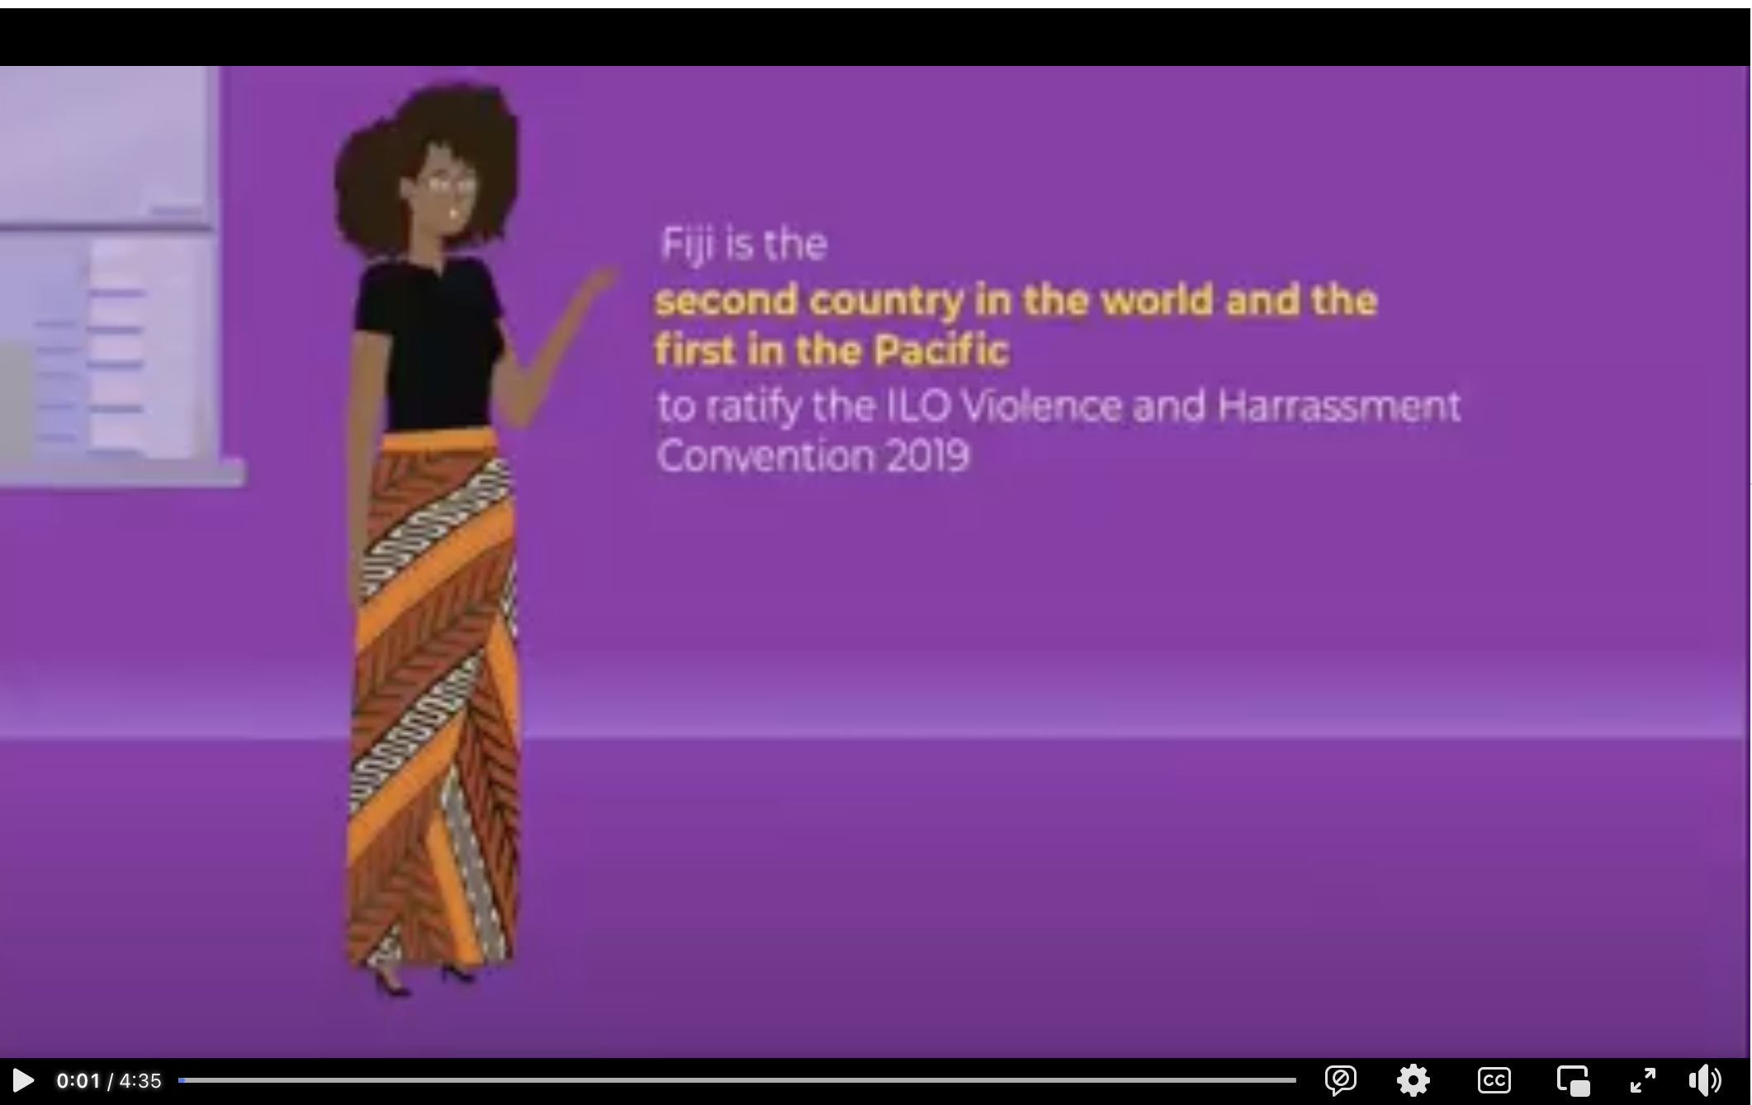
Watch: Fiji Women’s Rights Movement (FWRM)’s C190 Campaign video

Slide 7
Group activity
    A common first step in the process of bringing national laws and practices into compliance with an ILO convention is to conduct a legislative survey and gap analysis to determine the extent to which existing national laws, regulations, policies and other measures implement the requirements of the Convention.
    We are going to begin engaging in this process with respect to Convention No. 190.
    We are going to focus on assessing compliance with Article 1 of the Convention: defining violence and harassment and gender-based violence and harassment.
    You are asked to begin to: (i) identify laws and (if possible) provisions of national laws that are relevant to Article 1; and (ii) identify any ‘gaps’ in national laws that would need to be addressed to achieve compliance with C190. Please see worksheet for additional details.

Slide 8
Defining violence and harassment at work
    Under Convention No. 190, States must adopt laws and regulations to define and prohibit violence and harassment, including gender-based violence and harassment (Art. 7).
    States can opt for a single concept or separate concepts in their definitions in national laws and regulations (Art. 1(2)) – what is important is that all the elements of the definition provided by Convention No. 190 are respected.

Slide 9
In what type of statutes might we find relevant definitions and prohibitions?
    Constitutions
    Labour laws (including employment laws, labour relations laws, OHS laws)
    Laws regulating the public service
    Human rights laws
    Criminal laws

Slide 10
Example
    Q1. In Australia, the following Commonwealth legal instruments include definitions that are relevant to Article 1 of the Convention:
    Anti-discrimination statutes
    the Fair Work Act
    the Work Health and Safety Act
    the Criminal Code Act
    Q2. In general, it would appear from preliminary analysis that Australian laws cover everyone in the world of work. The most likely challenges for Australia with respect to compatibility of national law and practice with Convention 190 relate to (i) lack of comprehensive data on violence and harassment in the world of work; and (ii) the complexity of our laws (particularly potential for complexity and inconsistency in federal and state/ territory laws constituting a barrier to access to justice).

Slide 11
Group activity
    Working in groups, please discuss your answers to the following questions:
    Can you think of anything we covered in this workshop that you would like to learn more about?
    How will you apply the knowledge you have gained in this workshop?
    What needs to happen in order for you to apply this knowledge?
    Is there anything you hope will be different as a result?

Slide 12
Thank you
Email: ingrid.landau@monash.edu
LinkedIn: www.linkedin.com/in/ingridlandau

