Slide 1

Inspection campaigns: key challenges and factors for success
J. Pintado nunes, dwt and co for central and eastern europe
Skopje, 29/30 November 2011
Inspection Campaigns on Safety and Health at Work and Undeclared Work

Slide 2
summary
Campaigns as a modern strategy of inspection campaigns as a useful resource for constituents
SUCCESSFUL EXPERIENCES on which to benchmark key factors for success on each step on the organization of a campaign
Inspection Campaigns on Safety and Health at Work and Undeclared Work

Slide 3
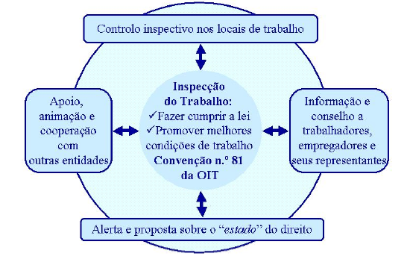
Inspection campaigns: key challenges and factors for success
Enforcement through control
Sanctions approach
Influence perception through control and sanctions
Compliance approach
Persuasion and collaboration
Traditional and
innovative
approaches
Information and
counseling
Cooperation
with relevant
stakeholders
Enrichment of the legal framework

Slide 4
Resolution concerning LA and LI (100th session of the General Conference of the ILO) - 2011
“20. In promoting a prevention culture and securing compliance, labour inspectors use a wide variety of interventions and tools including prevention initiatives as well as enforcement
(…) An appropriate mix of preventive measures such as risk evaluation, promoting a culture of leadership and best practice, implementing occupational safety and health measures, information guidance and awareness campaigns combined with sanctions should be adopted.”

Slide 5
Why is a communication and inspection campaign a good tool?
Labour inspection system
Set of actors, institutions, organizations, policies, relations that in a given environment participate on the improvement of working conditions
Better RESULTS
THINK
AND ACT
SMART
Participatory
Approach
Management
cycle logic
Need to

Slide 6
Strategic options: campaigns
Why is a campaign a good strategy?
Clear and open provision of information in plain language
Helps enterprises by advising on and assisting with compliance
Raises awareness not only for workers and employers, but also for the civil society
Ensures a balance between the sanctions approach and the compliance approach
consistence of enforcement practices, with transparency and coherence at national level
Campaigns involve providing services through a combination of co-ordinated measures using a variety of resources over a fixed period of time and in a specific sequence or with a specific interrelationship, in order to achieve a particular impact on a defined target group at a particular cost.
Dr Thomas Kohstall / Dr Annekatrin Wetzsteir

Slide 7

Many successful examples
Medium sized business initiative (Queensland)
Senior Labour Inspectors’ Committee (EU)
Safe Behaviour/ Sicurezza di Lavoro (Italy)
Decent work campaigns for forced labour (Paraguay)
Sectoral undeclared campaigns in Romania
European campaigns on OSH (OSHA)
(…)

Slide 8
Strategic options: campaigns
Experience in the EU: Senior Labour Inspectors Committee
Year | Campaign
2003 | Risk of falling from heights in construction
2004 | Safety management in the construction sector
2005 | Construction in New Member States
2006 | Asbestos
2007 | Manual Handling of Loads in the Transportation and Healthcare sectors
2008 | Manual Handling of Loads in construction and retail trade
2010 | Risk Assessment in the use of dangerous substances: bakeries, woodworking, cleaning and motor vehicle repair
2012 | Psychosocial risks

Slide 9
Communication and inspection campaigns key ideas on the management cycle
Inspection Campaigns on Safety and Health at Work and Undeclared Work

Slide 10
Step by step: STRATEGIC PLANNING
WHAT?
Selection of priority areas
Selection of specific subject (economic sector, hazard, social problem…)
WHERE?
Geographical scope
Economic coverage
TO WHOM?
BY WHOM? WITH WHOM?
WHY?
Justification/ reasons
WHEN?
FOR WHAT?
strategic objectives
HOW?
  Better understanding of a problem
  Provide stakeholders with relevant information
  Raising awareness on the benefits or negative effect of a given subject
  Enforce compliance with the law
  Prevention/ Reduction of work accidents or occupational illnesses
  Reduction of undeclared work
  (…)

Slide 11
Framework programme
MINIMUM RECOMMENDED CONTENT
Identification of main stakeholders
Strategic and operational guidelines
Objectives, organization and timeline
Resources
Responsibilities
Monitoring
Evaluation
Helps to make things clear
to the organization and external
actors (TRANSPARENCY)
Facilitates implementation and
evaluation

Slide 12

Step by step: OPERATIONAL PLANNING
Breakdown the planning of
inspections
Methods of inspection
Criteria for selecting establishments
Tools
Indicators of achievement
Internal and external resources to involve
Sources of information
Expertise (existing/ new)

Slide 13
Relevant question
WHEN TO INVOLVE EXTERNAL STAKEHOLDERS? How? For what?
  Pre-planning stage
  Planning stage
  Communication stage
  Enforcement stage
  Evaluation stage
Different stakeholders for different moments?
What inter-relationship?
Joint? Collaboration? Coordination?
Do we all share the same objectives? Values?

Slide 14

Step by step: Implementation
Communication stage? What? Using which channels?
Inspection stage? Integrated visits? Blitz visits? Joint visits? Different visits according to the stage of the campaign?
Both?
Simultaneous?
Monitoring (How? When? By whom? Whith whom?)
Resources (staff, vehicles, tools)

Slide 15
Step by step: Implementation
Communication
  to whom, when and how?
Activities:
production/ dissemination of information materials (which?)
supporting tools for management and visits
workshops, seminars, conferences, open days, radio and tv programmes
visits
capacity building of LI, social partners, other stakeholders
preventive programmes (voluntary participation of companies)
promotion (competetions, awards, best practices…)
legislative initiative
(…)

Slide 16

Step by step: Monitoring
Who to involve?
  Labour inspectors?
  Managers?
  national coordination team?
  participatory council or committee?
What role for the monitoring staff/ bodies?
  assistance in solving problems
  monitor implementation against objectives, goals?
  prepare evaluation?

Slide 17
Step by step: Evaluation
What? When? How?
  based on a checklist?
  number of distributed materials?
  number of visits?
  number of procedures?
How to measure?
  quantitative results
  quality
  cost effectiveness balance
  impacts
final evaluation report?
partial assessments?
internal/ external assessment?
To whom?
With which purposes?
HOW TO MEASURE SUCCESS?

Slide 18
CASE STUDY: EUROPEAN CAMPAIGN ON RISK ASSESSMENT IN THE USE OF DANGEROUS SUBSTANCES
Inspection Campaigns on Safety and Health at Work and Undeclared Work

Slide 19

Case study: EU campaign on dangerous substances
Overall objectives
to promote awareness and good practices in risk assessment on the use of chemicals
to develop general guidelines, information materials and easy
to use tools for labour inspectors
to develop a common training for labour inspectors
to promote general awareness
to bring closer inspection approaches in 26 EU member states
to better enforce the EU legislation

Slide 20
Case study: EU campaign on dangerous substances
27 countries
(26 EU +
Norway)
SME
Furniture production
Motor Vehicle Repair
Bakeries
Industrial cleaning
Dry cleaning
Sectoral indicators
Dry cleaning
- Perchloethylene
(Tetrachloethylene)
- Other clothes cleaning agent
- Surfactors
- Organic solvents
- Other cleaning agents
Industrial cleaning
- Acids
- Hypochlorites
- Ammoniac
- Hydroxides
Furniture
- Wood dust
- Solvents
- Paints, glues, varnishes
- Preservatives
MVR
- Paints with isocyanets
- Other respiratory risks (dusts, fumes and gases)
- Skin risks (e.e. oils and solvents)
Bakeries
- Flour dust
- Liquid ingredients
- Cleaning agents

Slide 21


Case study: EU campaign on dangerous substances
a mascot was created (CHEMY)
Information is based in traditional materials
    8 posters
    general flyer about the campaign and on risk assessment
    4 brochures
a website (http://www.chemicalscampaign.eu)

Slide 22




Case study: EU campaign on dangerous substances

Slide 23
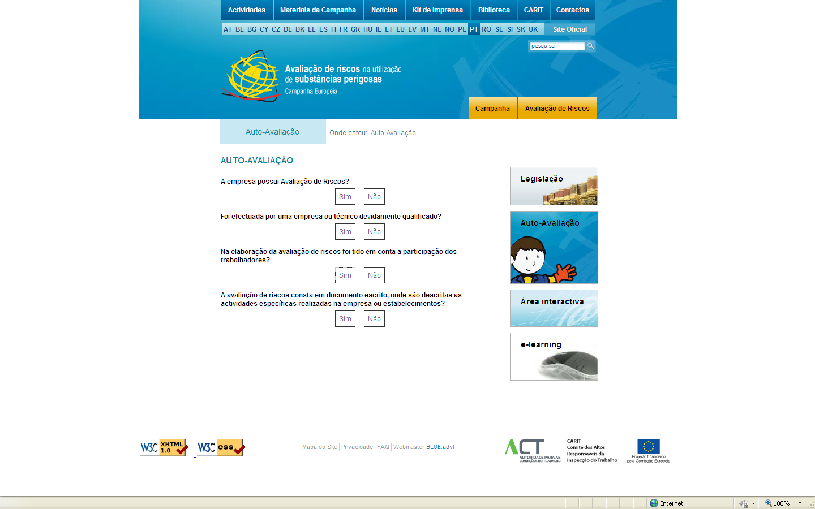
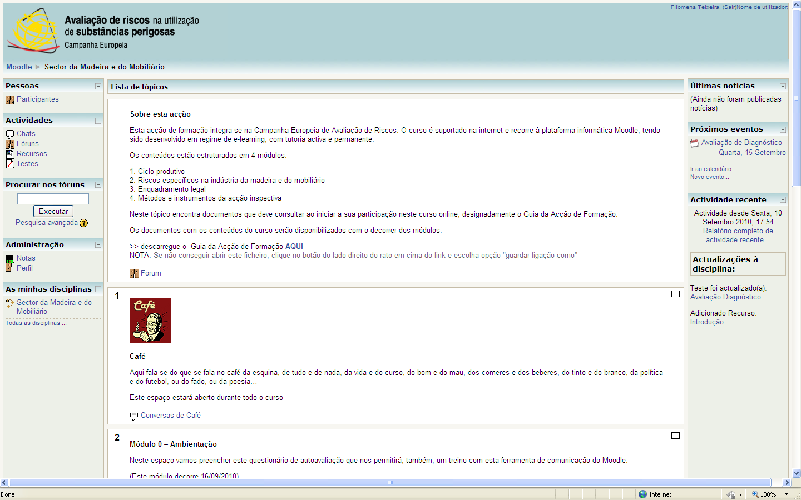
Case study: EU campaign on dangerous substances

Slide 24
Case study: EU campaign on dangerous substances
ENFORCEMENT METHOD
Objectives:
small companies would be faced with the need to collect data on risk assessment
“trigger” for companies unwilling to comply with OSH regulations
multiplier effect
preventive approach (companies were
expected to adapt accordingly with legal requirements before the visits)
It also wanted to provide important data to update SLI’s databases
Questionnaire sent in a pack
with:
official letter
flyer on risk assessment
informative brochure for the
sector
ACT develops the questionnaire
Identification of companies through LI databases (sample)
Local inspectorates receive instructions on how to use the instrument
Questionnaires are sent by local inspectorates with an official letter (end of May)
Answers requested from companies till 15 July

Slide 25
Thank you for your attention
nunesjp@ilo.org

