Slide 1
Belgian Labour Inspection Campaigns
Occupational Health and Safety
Undeclared work
Karel Van Damme
ILO Skopje 2011

Slide 2
I Occupational safety and health

Slide 3
European campaigns
Bilbao Agency for safety and health at work
2010-2011: Maintenance
2008-2009: Risk Assessment
2007: Musculoskeletal disorders
2006: Youngsters
2005: Noise
2004: Construction sector
2003: Dangerous substances
2002: Stress
2001: Accident prevention
2000: Musculoskeletal disorders

Slide 4
Recent Belgian campaigns
15 September - 15 November 2011: Welding fumes
June- September 2011: Safe and healthy maintenance
January – May 2011: Rental of working equipement for lifting persons
5 September - 15 November 2010: Carriage work ateliers
April-August 2010: Public services as master builders
February-March 2010: Woodworkers
Novembre 2009 till January 2010: Garages
September-November 2009: Contruction projects
May-June 2009: temporary work
February-March 2009: Vibration linked back pain

Slide 5
Campaigns on construction safety in common
National Action Committee for Safety and Hygiëne in Construction Work and Labour Inspection
October 2010 till June 2012: Silica dust
September 2008 till December 2009: Finishing
April 2007 till December 2008: Road works
April 2006 till December 2007: Roof works

Slide 6
Stages of campaign
Deciding
Planning
Procedure-Responsibilities
Documents-Material
Training
Try out
Execution
Evaluation
Reporting

Slide 7
II Undeclared work

Slide 8
Manufacturing industry
Core activity
Cleaning services
Security/ Surveillance
Independent workers
Construction
(new building)
Company A
Company B
Company C
Company B1
Company B2
Company C1
Company D
A1
OWNER
B1
CONTRACTOR
SUBCONTRACTOR C
(masonry)
SUBCONTRACTOR
D
(ellectrical instalation)
Company C1
Company C2
Company D1
SUBCONTRACTOR D
(Roofs)
Subcontracting chain on
a construction site

Slide 9
A1
OWNER
B1
CONTRACTOR
SUBCONTRACTOR C
(masonry)
SUBCONTRACTOR
D
(ellectrical instalation)
Company C1
Company C2
Company D1
SUBCONTRACTOR D
(Roofs)
47 workers on site
owner: safety coordinator
contractor: supervision team
10 bogus independent workers
contracted by C1/ 8 bogus contracted
by C2/ 2 by D
13 undeclared workers: 1 for C1, 2
for D2, 9 for D and 1 hired from an
alleged independent worker rendering
services to D1
4 immigrant workers with illegal
residence (3 working for D and 1 for C1)
5 temporary workers placed by company
ABC, which was contracted by B1
No workers representatives for OSH
Company D1 not authorized to render
services in construction
From Joaquim Pintado-Nuñes

Slide 10
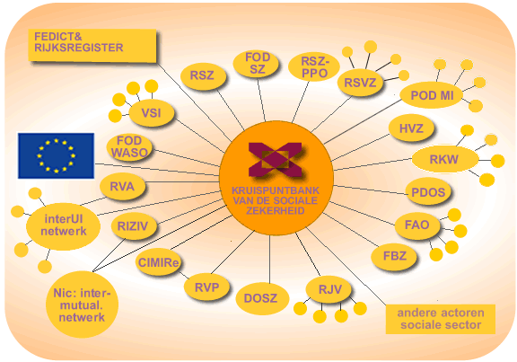

The crossroad bank of social security:
http://www.ksz.fgov.be/En/CBSS.htm (= the electronic database cross-link platform)
SOCIAL SECURITY OFFICE
LABOUR INSPECTION
Notes:
Social security network, Cross- road bank of enterprises & national database of civil persons & foreigners:
These are the main daily communication platforms where labour inspectors perform all their on-line verifications of the data of employers, employees & citizens. (See point 6.2.).
This way of acting may look like a “big brother” situation, but in fact is not.
Inspectors have authorised access after LI having fulfilled a heavy list of conditions concerning software, hardware, control measures, etc. The rule of proportionality applies: the so-called Sector-Committee (the watchdog for privacy protection), directing the cross-road bank gavel only permission to the whole labour inspection because all strict conditions were met.
The authorisation to consult the data concern only those who are in direct relationship to the missions attributed to them by law. For instance: the inspector has access to the composition of the family of a person, but not on their agreement or disagreement on organ – donation, because this has nothing to do wit his function.
There is an automatic control of all the logins: all search requests are registered automatically and for every consultation the LI must mention a code or file number so that at any time the direct link with an enquiry can be traced post factum.

Slide 11
LI TOOLS FOR REACHING THE TARGETS
  GENESIS (sharing information between several inspections)
= a program open to four inspections. It includes two parts:
a) The registry of the investigations: Each day, the services of social inspection transmit the information on the enquiries: opening or closing, identification of the investigation, incumbent, reason, etc and also the results of the survey.
b) Enrichment: The program will automatically seek essential information for the processing of the investigation (= links to other databases). That avoids the inspector in making search in several databases apart.
Information is presented in a format usable: Pdf, Excel, CSV, HTML…
Genesis gives also all the coordinates of the inspectors who can thus contact themselves (email, GMS, office…)
The inspectors have the right to consult constantly the complete information in most data-processed databases of Social Security

Slide 12
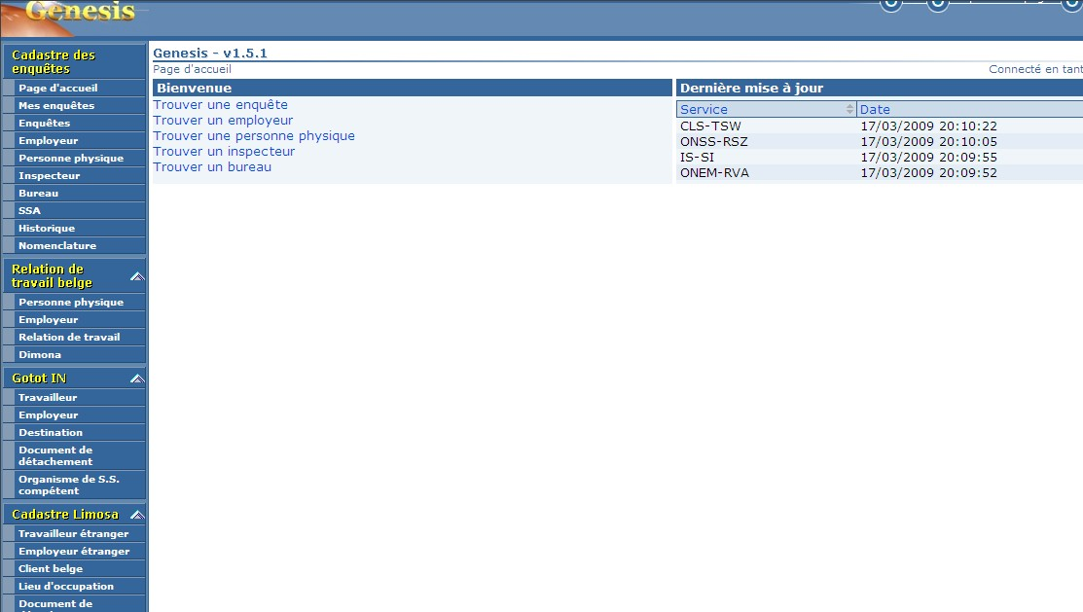
LI TOOLS FOR REACHING THE TARGETS
  GENESIS

Slide 13
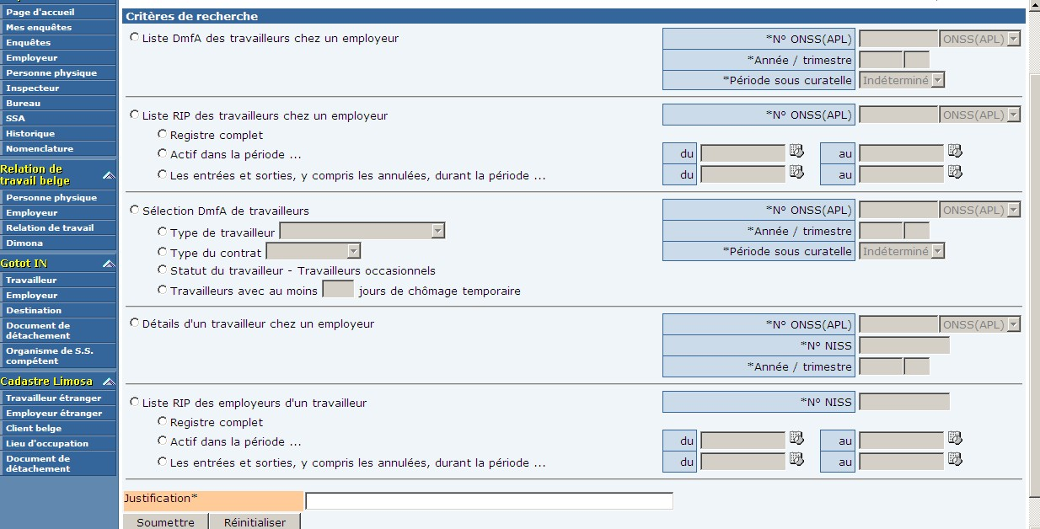
LI TOOLS FOR REACHING THE TARGETS
  GENESIS

Slide 14
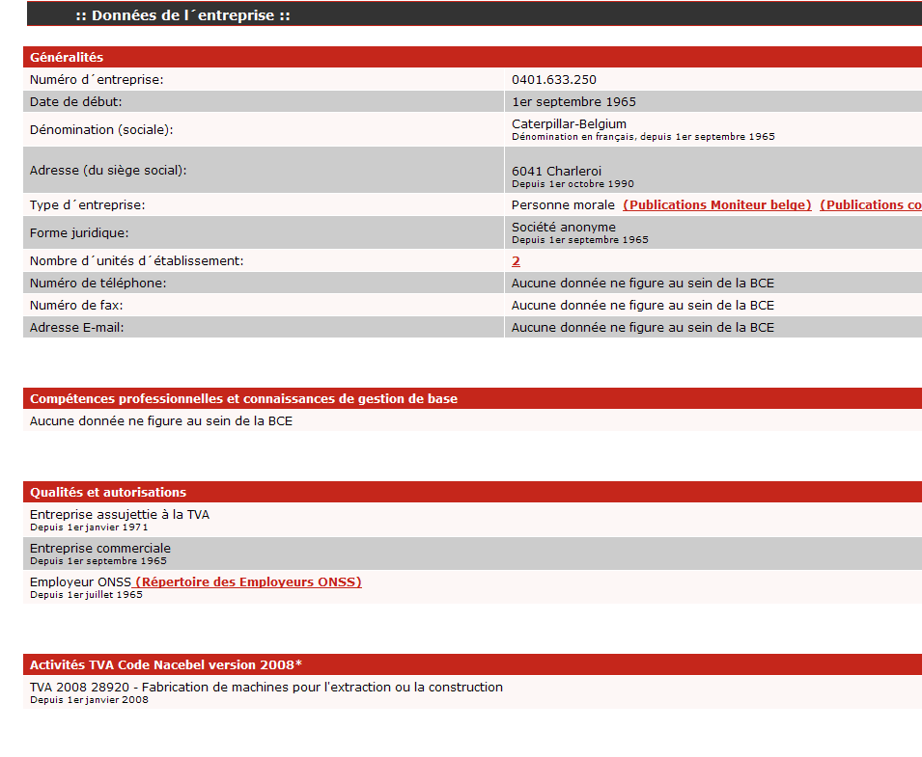
LI TOOLS FOR REACHING THE TARGETS
  CROSSROAD BANK OF THE UNDERTAKINGS
The official register of the companies (identification, administrator, history, addresses, type of activity…):

Slide 15
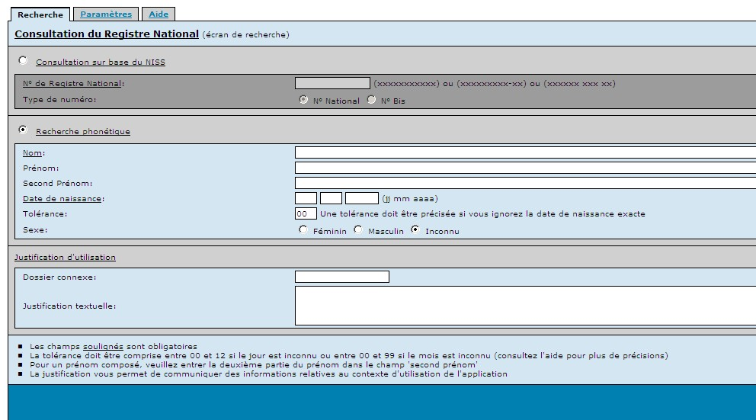
LI TOOLS FOR REACHING THE TARGETS
  NATIONAL REGISTER OF THE NATURAL PERSONS (CIVILIANS)
  identifies any Belgian or overseas person on the Belgian territory and contains information on the family structure, the history of the addresses.

Slide 16
LI TOOLS FOR REACHING THE TARGETS
  “DMFA”:
  The declaration of the wages to the social security. These statements are made in general by social secretariats of employers and are transmitted by a data-processed way to the social security system.
  DATABASE OF THE EMPLOYERS: contains all the employers
  STATEMENT OF THE SOCIAL RISKS:
  The statement of the accidents, of the periods of disease, the layoffs.
  The electronic statement in the system is not yet obligatory.

Slide 17
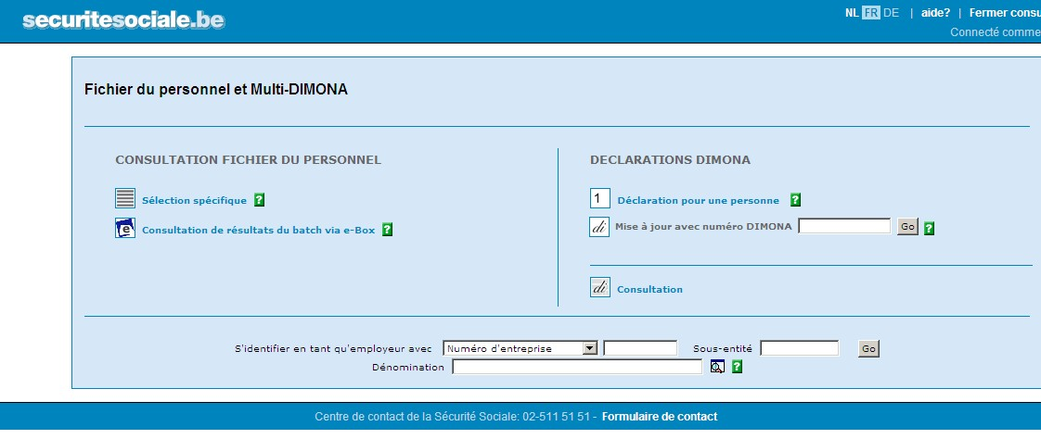
LI TOOLS FOR REACHING THE TARGETS
  “DIMONA”:
  This application program is related to the electronic register of the personnel.
  Each employer must compulsory register his new employees in the electronic register (centralized) before the beginning of the job. He must also indicate the coming out date. It is one of the most important databases as in most cases it replaces the former paper personnel register.

Slide 18
LIMOSA
  Mandatory declaration of all activities by foreign nationals in Belgium;
  Centralised record of all of the relevant information;
  Available for consultation by the relevant inspectorates;
  Statistical information on cross-border employment in Belgium;
  Simpler administrative procedures for foreign workers and self-employed persons;
  Coordinated flows of information between competent institutions in Belgium.

Slide 19
LI TOOLS FOR REACHING THE TARGETS
  “LIMOSA”:
  This program records information on the posting of the foreign workers and the self employed ones.
  It currently manages the movements of the workers in the framework of the posting inside the European Economic Union (Directive 96/71) but is extended to the workers of the whole world.
  Limosa is also extended to the aspects of the social security in the posting (E101/A1 file forms and application program of other international agreements).
  The overseas inspections can obtain accurate information on the workers posted by questioning their Belgian colleagues.
  Web site: http://www.limosa.be.

Slide 20
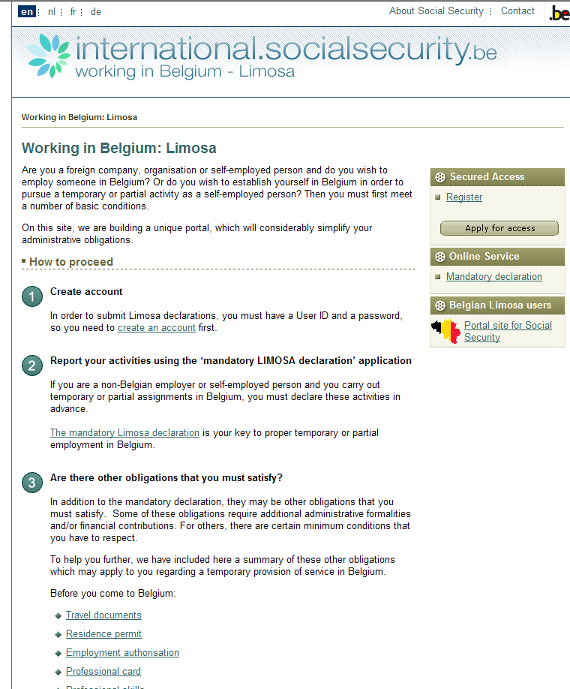
“LIMOSA”:

Slide 21
LI TOOLS FOR REACHING THE TARGETS
“DUC”:
Data bank of the building sites in the construction sector, with the identification of the companies on the building site, the persons in charge, the subcontractors, the number of workers, the nature of the building site and the foreseeable duration of the work
“OASIS”:
This particular program is only accessible to some inspectors.
It is used to detect the suspicious behaviour. It crosses and analyses social and financial data (Dimona, Debt on the social security, unemployment… VAT, amount of business…).
It gives a list of companies which set off alarms and which have an abnormal behaviour, perhaps/possibly fraudulent. For example, it detects the corporations which have an amount of business in growth but which does not engage personnel and have an important level of registered temporary unemployment. One can suppose that those workers work without being declared in these companies and even cumulate wages and unemployment fees.

Slide 22
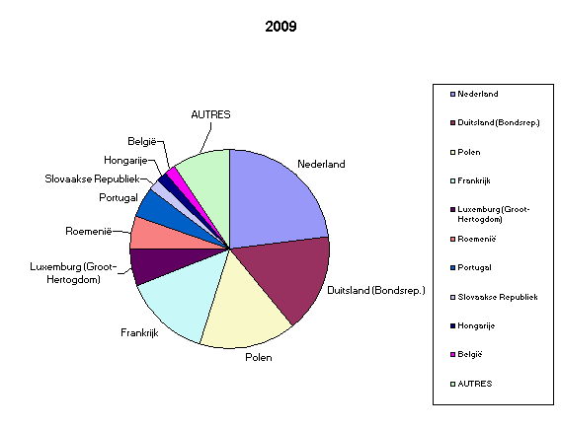
11

Slide 23
LIMOSA

Slide 24
LIMOSA evolution notifications
 | Total number of notified | employees | Self-employed | Trainees | Self-employedtrainee
2007 (1 apr – 31 dec) | 158.226 | 144.898 | 12.392 | 808 | 128
2008 | 224.905 | 203.867 | 19.896 | 1.038 | 104
2009 | 217.115 | 194.550 | 21.575 | 859 | 131
2010 | 260.595 | 229.251 | 30.436 | 799 | 109
2011 (jan-juni) | 162.999 | 138.597 | 23.897 | 426 | 79

Slide 25
(mandatory) SOCIAL DOCUMENTS to be kept by employers
Keeping up social documents by the employer is a condition sine qua non for efficient LI enquiries.
It responds to multiple purposes:
  it mentions for the worker all useful information about labour time, working conditions, contractual status, and salary
  it holds information collectable by the LI which is essential for his enquiries
  it is also an instrument for fighting social fraud.
Notes:
Keeping up social documents by the employer is a condition sine qua non for efficient LI enquiries.
It responds to multiple purposes:
it mentions for the worker all useful information about labour time, working conditions, contractual status, and salary which he is entitled to and even it could be interesting for checking his social security status;
it holds information collectable by the LI which is essential for his enquiries and
it is also an instrument for fighting social fraud.
In Belgium, the combination of two kind of sources (the social documents of the employer and the e-gov databases of the social security) gives the LI the opportunity to easy - check compliance of the employer with:
a) the protection of the employees (their rights) and
b) the protection of social security and fair competition amongst undertakings.
For example: comparing the data mentioned on the salary slip with the declaration “DIMONA” and the “DMFA” (electronic declaration of wages and working time at the end of a quarter).

Slide 26
(mandatory) SOCIAL DOCUMENTS in Belgium
The register of the personnel
The work rules and the work rosters
The documents concerning part-time work
The payslip , individual account on the payment of the wages
Notes:
1. The register of the personnel
which contains the identity of each worker, with dates of coming in and out. It’s format should be such that tampering or fraudulent manipulating is easily observed by the LI.
The modern data-processing of the e-gov system means reduce the cost and offer great possibilities of management.
The register of the personnel is now an electronic register. Each employer is obliged to declare in a central system each worker before the beginning of work. He must also register the coming out date (this system is called DIMONA). Information is controlled and then transferred towards the register from the electronic personnel from the employer.
Electronic or not, the register of the personnel is a basic instrument for checks on the spot. Most often, workers that are not registered in this document are not declared to the social security (black work) and are more exploited than registered workers, even to a greater extend when the undeclared worker is undocumented and from foreign origin.

Slide 27
Social dialogue at all levels
OD
CEC
Unempl
Government
OA
YH
PENS
SI
HCPPW
Child
NLC
CITIZENS
JC
JC
JC
JC
JC
JSubC
Ent
Enterprise
Ent

