Slide 1
THE NATIONAL INSPECTION CAMPAIGN IN AGRICULTURE
Republic of Moldova

Slide 8
NATIONAL INSPECTION CAMPAIGN IN AGRICULTURE
„PREVENTION AND FIGHTING AGAINST UNDECLARED WORK , RISKS REFERRED TO THE USE OF MECHANIZED MACHINES AND PESTICIDES IN AGRICULTURE”
Tools used in campaign:

Slide 9
NATIONAL INSPECTION CAMPAIGN
Disposal
“19” September 2011
National Campaign on Labour Inspection in Agriculture entitled „Prevention and fighting against undeclared work, risks referred to the use of mechanized machines and pesticides in agriculture”.
Taking in consideration:
The Law on Labour Inspection nr. 140-XV from 10 May 2001;
Regulation of Labour Inspection, approved by the Republic of Moldova Government Decision nr. 1481 from 27 December 2001;
Annual Reports “Occupational Safety and Health” presented by the National Bureau of Statistics of the Republic of Moldova for 2002-2010.
For:
Prevention and fighting against undeclared work and the violation of labor laws, safety and health laws in agriculture,
I order:
1. From September 26 to November 11, 2011, the Labour Inspection will run the National Inspection Campaign in Agriculture entitled „ Prevention and fighting against undeclared work, risks referred to the use of mechanized machines and pesticides in agriculture”.

Slide 10
2. is approved:
1) informational and awareness materials :
Brochure "Decent Work ”;
Poster "declared work";
Banner "declared work ”;
The booklet "Prevention of risks related to pesticide use in agriculture”
Poster "Prevention of risks related to pesticide use in agriculture”
Banner "Prevention of risks related to pesticide use in agriculture”
Leaflet "Prevention of risks related to the use of agricultural machinery”
Calendar "Prevention of risks related to the use of agricultural machinery”
Banner "Prevention of risks related to the use of agricultural machinery ”
2) List of questions to identify hazards and risks of using mechanized machines and pesticides in agriculture
3) Indicators for assessing campaign results.

Slide 11
3. Territorial labour inspectorates in the campaign will :
1) perform action information and awareness about the damage caused by the undeclared work and the risks related to use of mechanized machines and pesticides in agriculture, spreading information and awareness materials and disseminated through the mass-media information campaign ongoing .
2) provide advice to employers and employees regarding labor law and occupational security and health enforcement ;
3) organize and carry out monitoring visits in agricultural economic units .
4. Labour inspectors during the inspection visits will:
a) check:
-how legal provisions are observed to employment ;
-how hazards are identified and assessed risks of use of mechanized machines and pesticides ;
b) takes measures to comply with the law ;
c) recommend measures to prevent risks related to use of mechanized machines and pesticides in agriculture ;
d) found administrative contraventions in the sphere of labour and occupational safety and health

Slide 12
5. Chief-inspectors of the Territorial labour inspectorates will prepare and present, until 18 November 2011, in Department monitoring enforcement of labour and labour protection rules, reports on actions and indicators for assessing the results of the campaign, at the inspectorate level.
6. Department monitoring enforcement of labour and labour protection rules will systematize and analyze reports and campaign assessment indicators presented by the chief-inspectors of the Territorial labour inspectorates and produce report that will reflect the results of the campaign at national level and will contain the necessary conclusions and proposals .
7. The control of the execution of this disposal is put to the Deputy State General Labour Inspector.
State General Labour Inspector

Slide 13
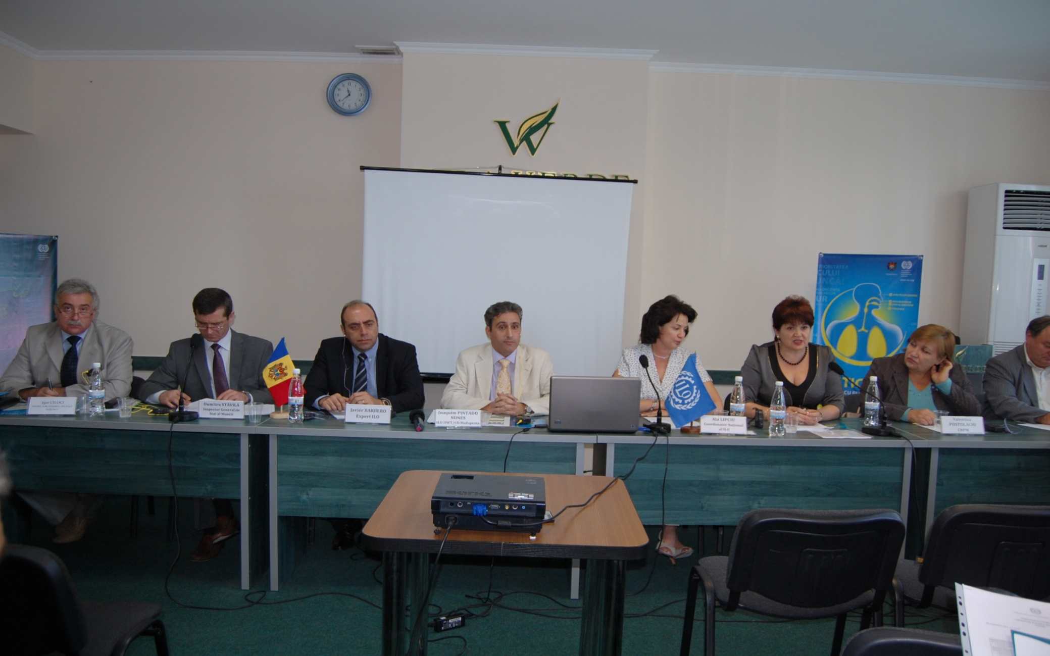
Press Conference with the participation of heads of the Ministry of Labour, Social Protection and Family, Labour Inspection, the National Confederation of Employers, the National Confederation of Trade Unions of Moldova and the ILO

Slide 14
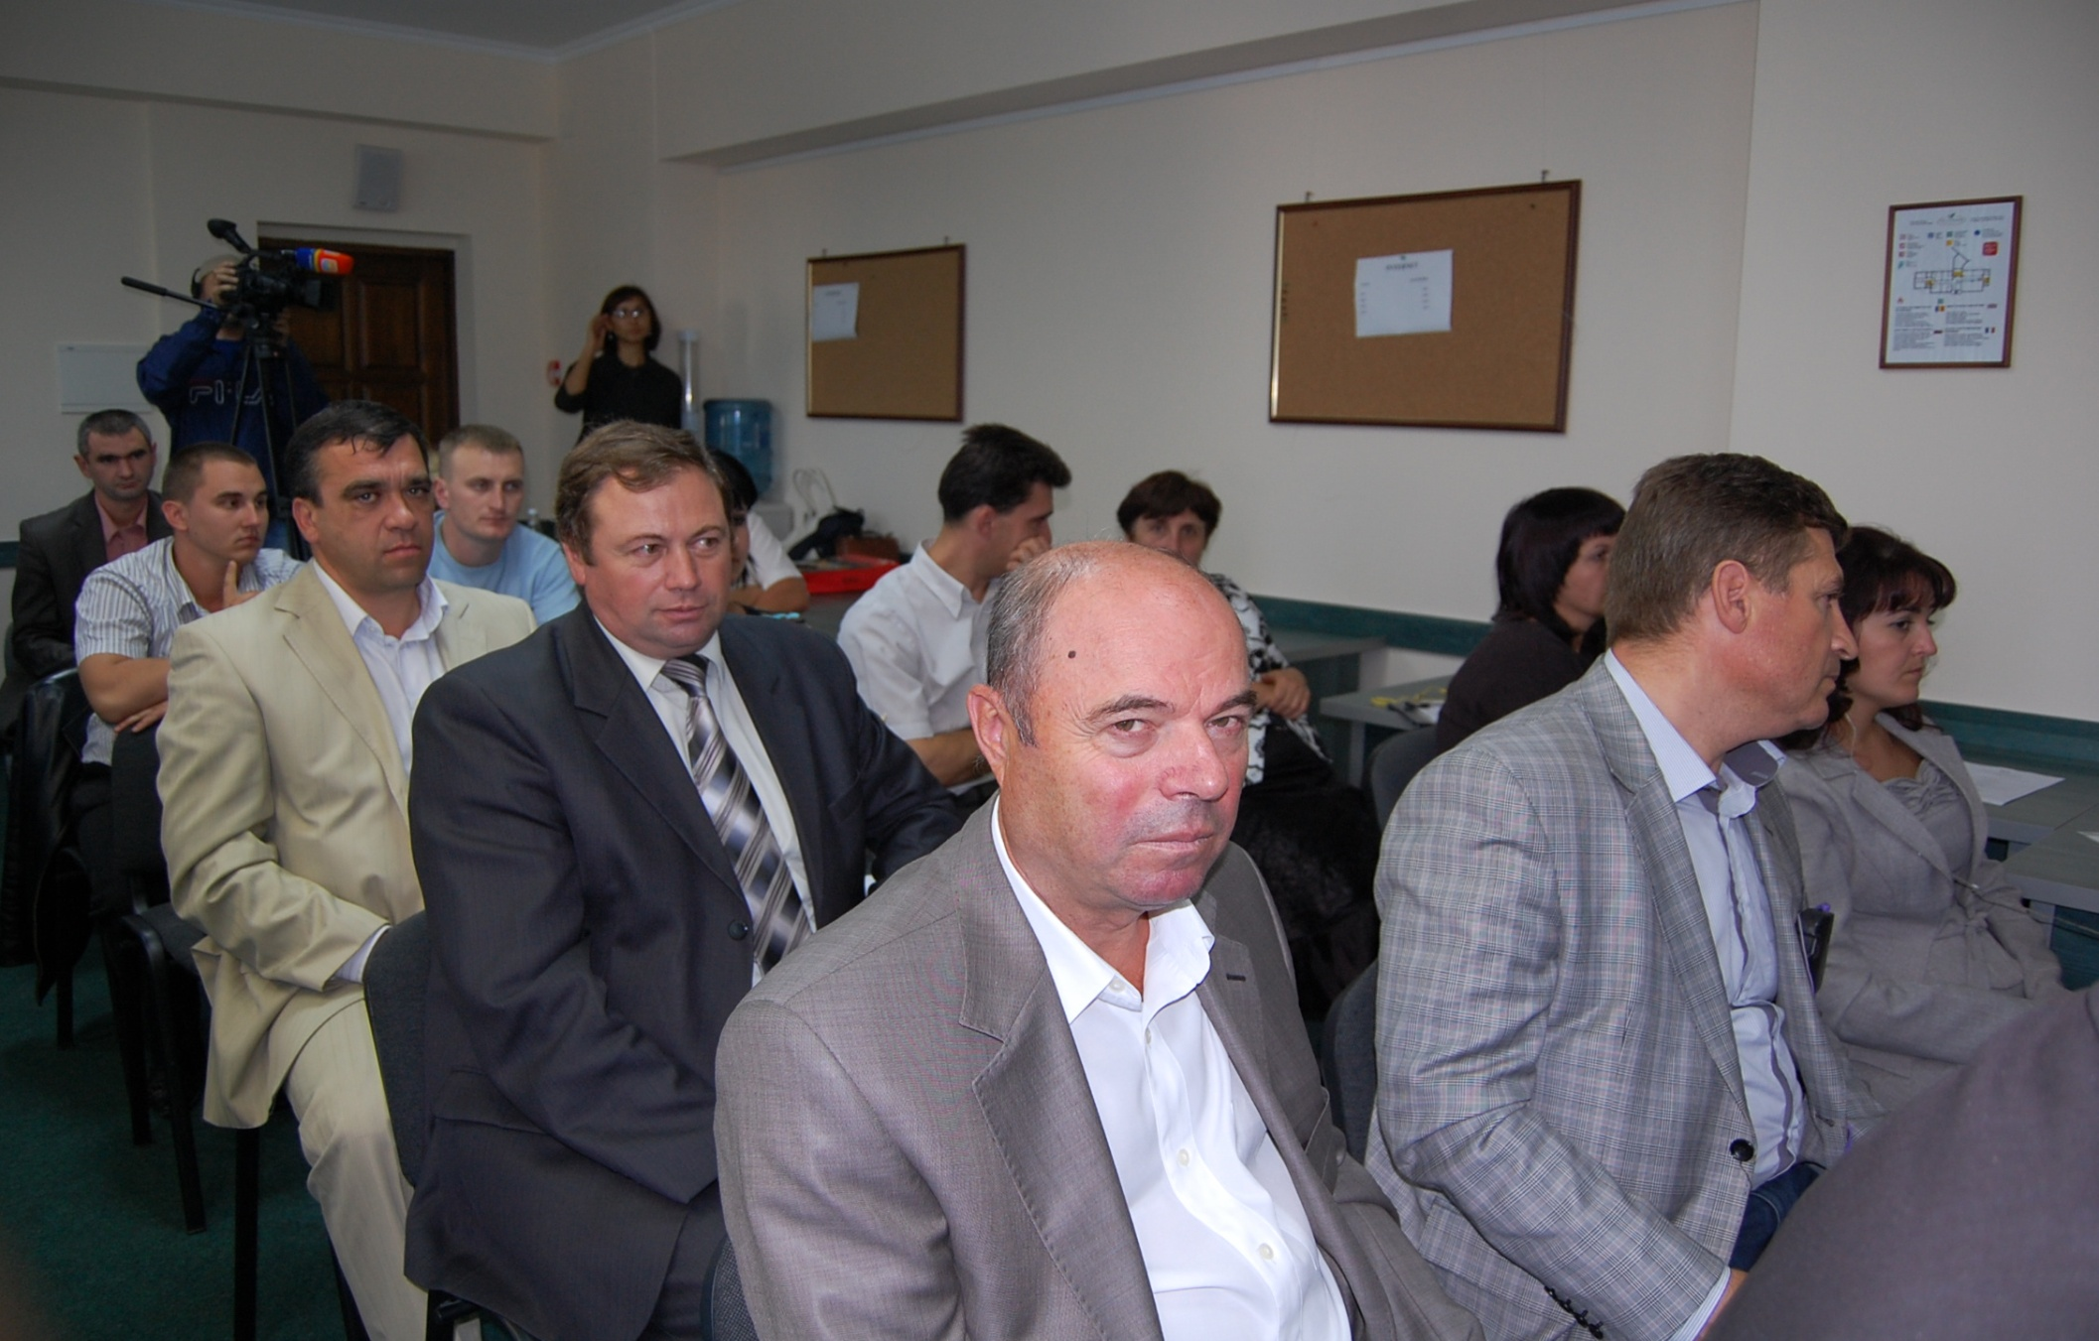

Slide 15
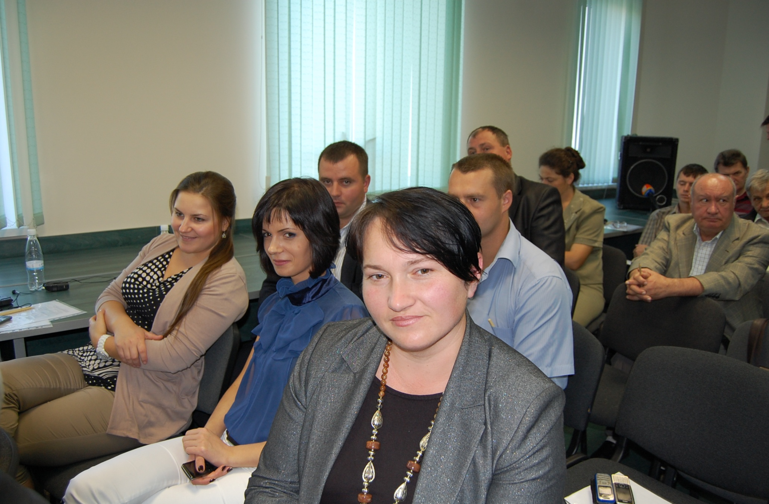

Slide 16
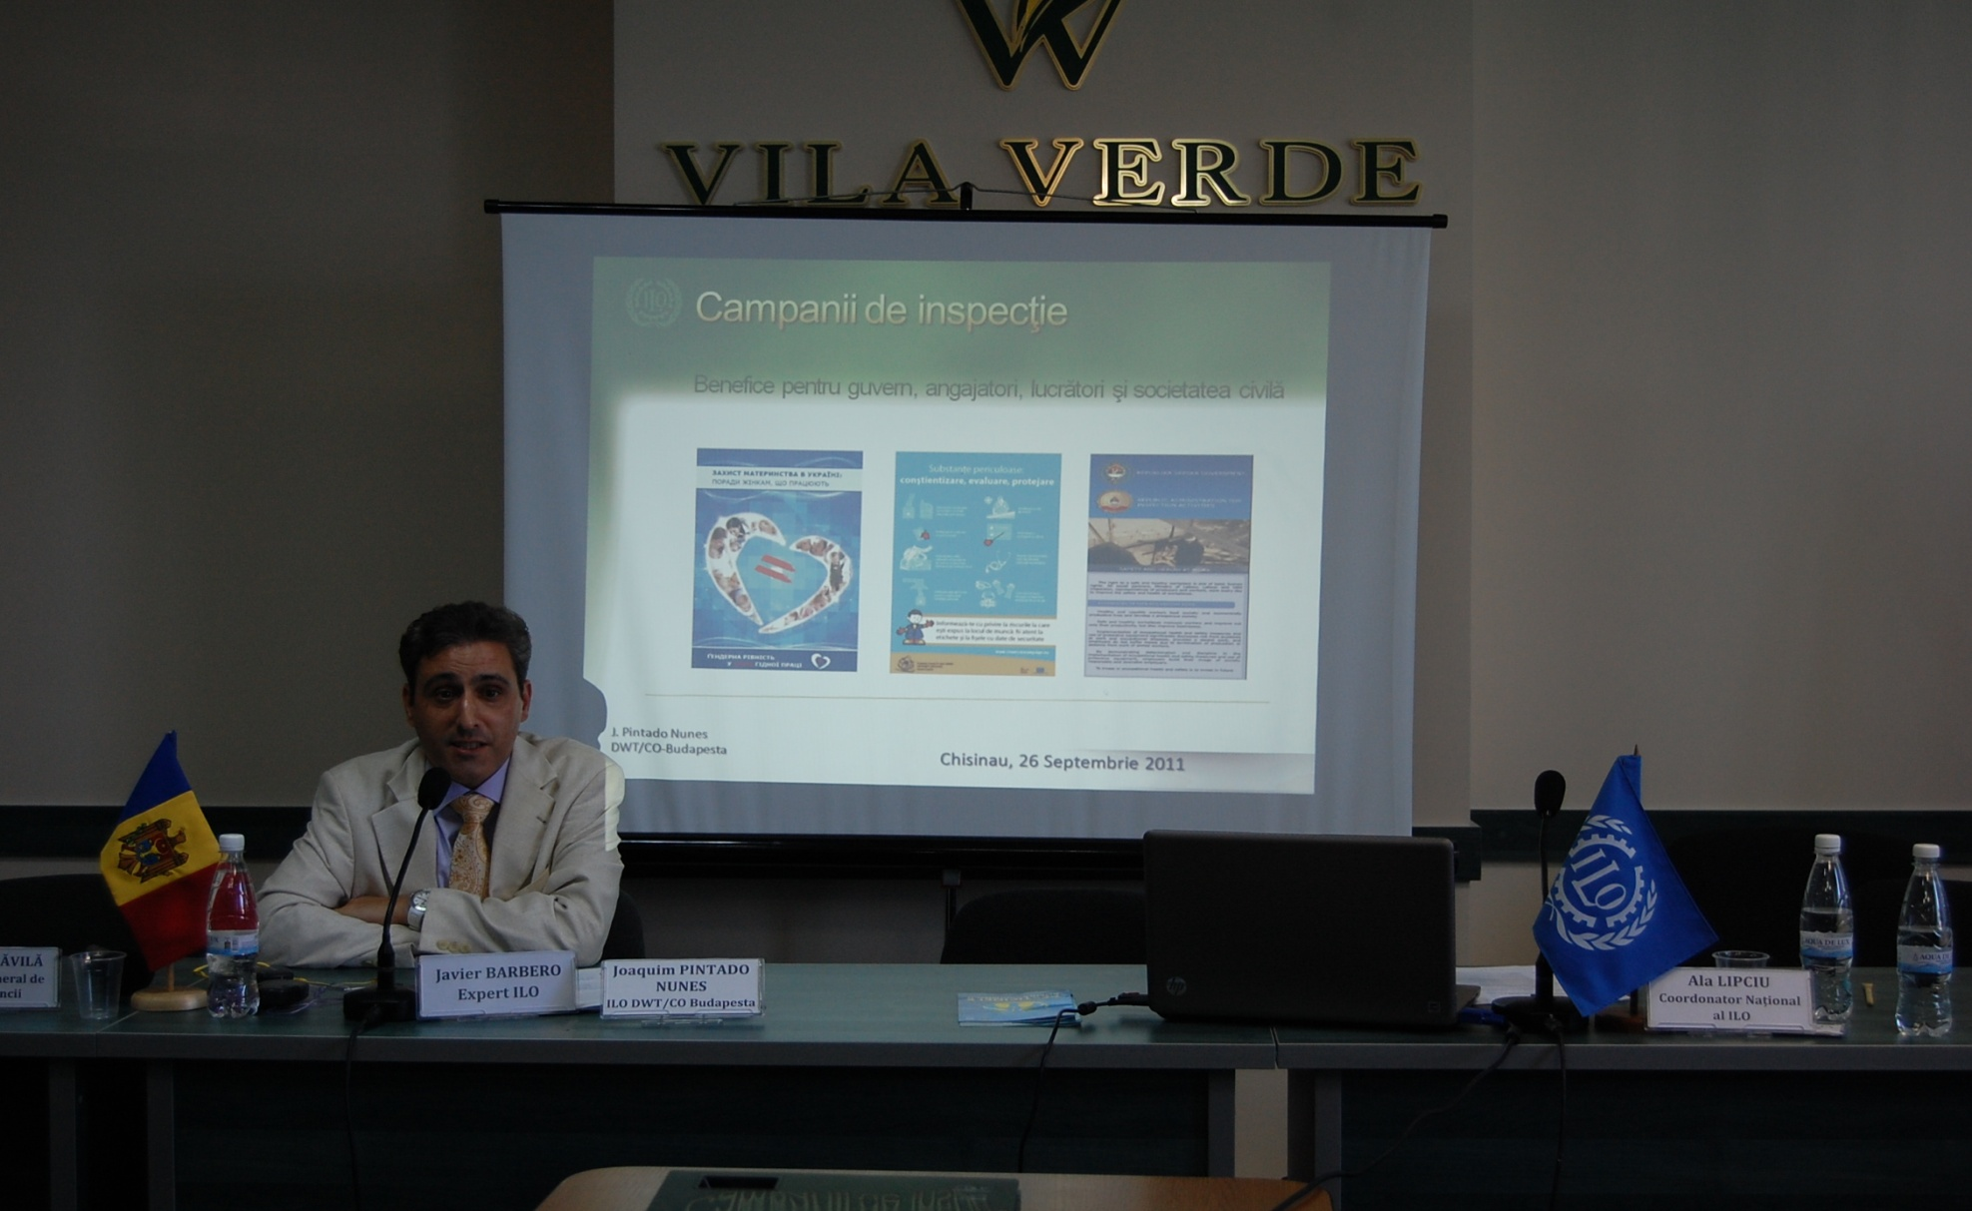
Ongoing of the Training course for participants to the Campaign

Slide 17
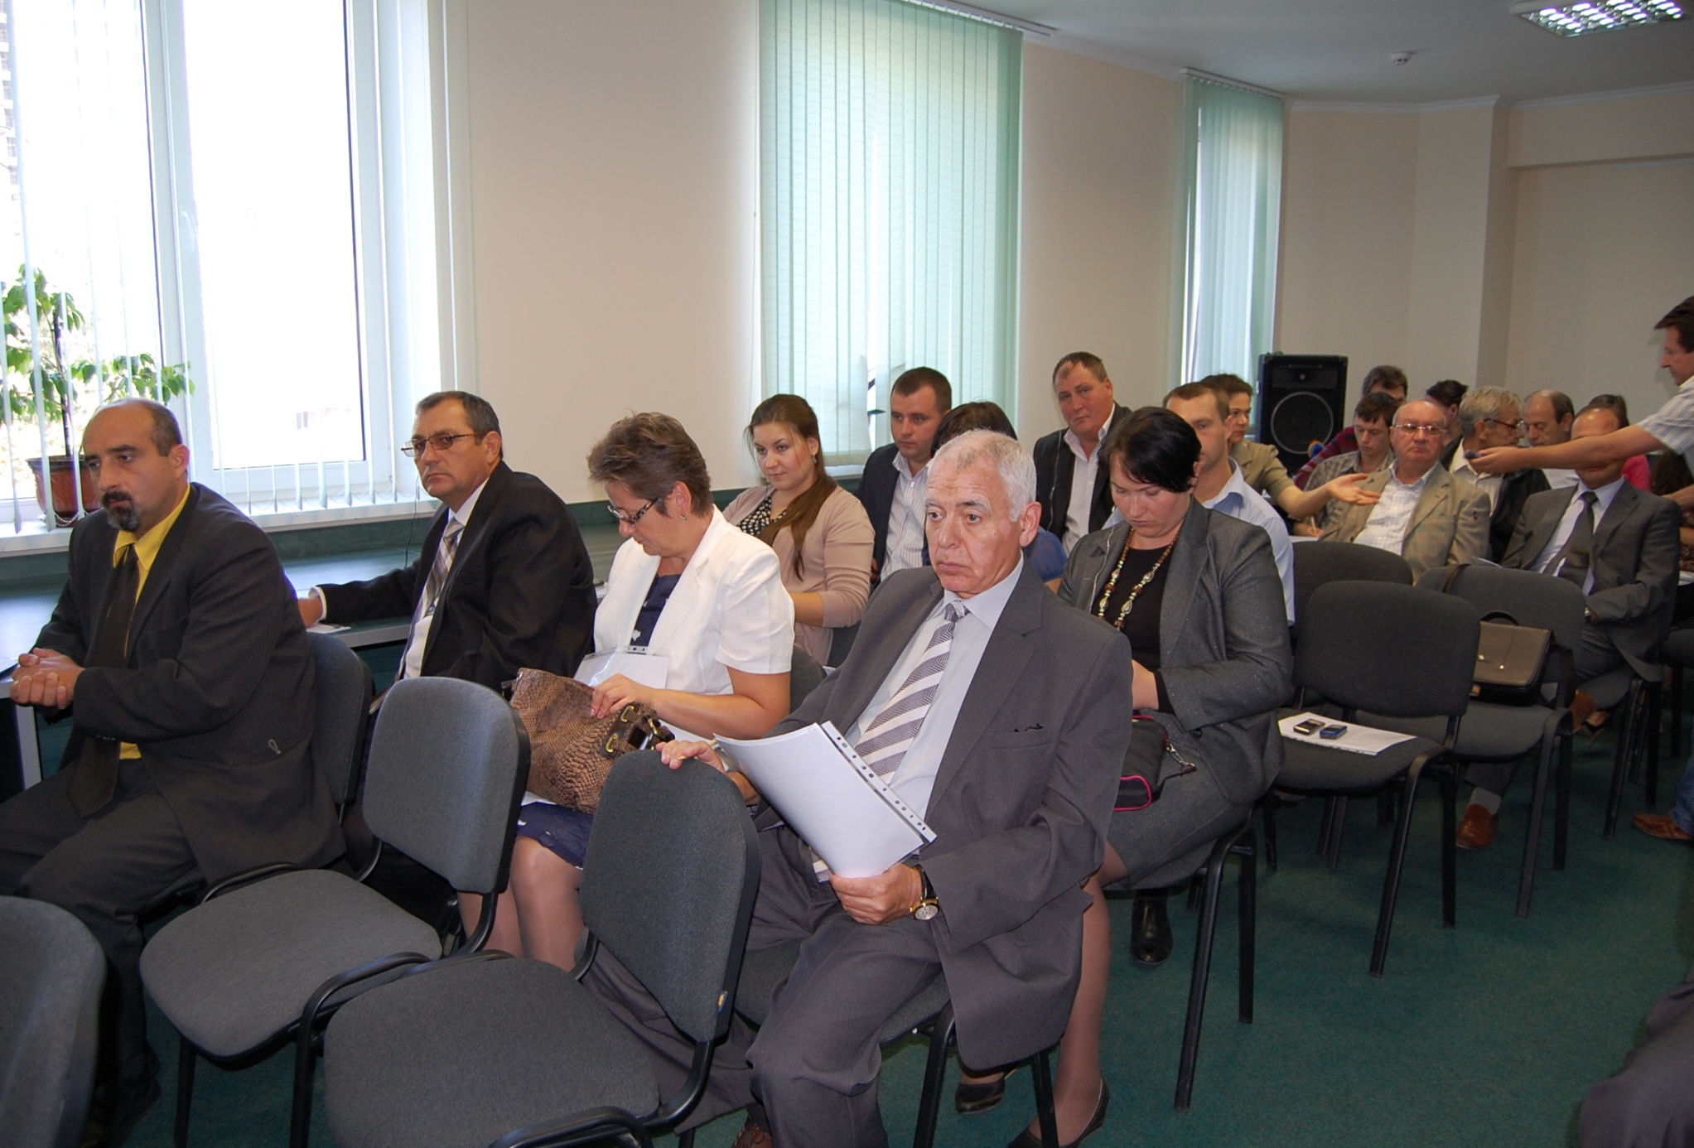

Slide 18
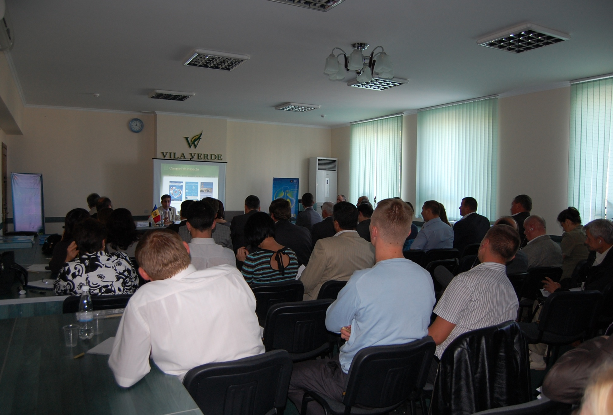

Slide 19
Tools used in Campaign
Mass-media,
Leaflets, posters and other awareness materials
Consultation and information seminars
Inspection visits

Slide 20
Mass-media
Thematic articles
Current information
Participation in radio and tv

Slide 21

Brochures, leaflets, posters and other awareness materials
Booklet
“Risk prevention
about using pesticides in agriculture”

Slide 22

Brochures, leaflets, posters and other awareness materials
Calendar
“Prevention of risks related to the use of agricultural machinery”

Slide 23
Inspection visits
Control visits
Repeated visits

Slide 24
Inspection visits
Control disposal
Control protocol
Checklist
Prescription to stop
Protocol of finding administrative contravention
Campaign assessment indicators

Slide 25
Checklist for labour inspectors
(attached to the control protocol)
Territorial labour inspectorate ______________________________________________
Inspector ________________ | 1-st Visit date:____/____/____, time: ____ 2-nd Visit date:____/____/____, time: ____
1. – General information
Employer (economic unit) ______________________________________________ Address of the economic unit : __________________________________________________ Address of the workplace :___________________________________________________ No. of unit workers :_______ No. of workers at the workplace: _____
Permanent: Men___ Women ___ Temporary: Men ___ Women ___ | People aged under 18 : Boys ___ Girls___ Undeclared: Men ___ Women___

Slide 26
Checklist
2. Security of mechanical machines
Tractors / agricultural machinery | Yes | No | recommended action
Are the safety features in good condition?
Are the tractors equipped with locks starter, if the gearbox is engaged?
………………………………………… |  |  | ………………………………………….

Slide 27
Checklist
3. Safety in use of chemicals
Storage and use of chemicals | Yes | No | recommended action
Was a risk assessment conducted on the storage and use of chemicals?
Are there chemical storage warehouse?
Place of storage, only for storage of these products?
Is the storage area properly isolated, with limited access?
…………………………………………………… |  |  | ………………………………………………………

Slide 28
Checklist
4. Social facilities and first aid
Social facilities and first aid | Yes | No | recommended action
Is there adequate first aid equipment, including eye drops and skin antiseptics, easily accessible?
Is the first aid equipment easily accessible?
Are there lockers?
Are there showers with hot and cold water?
Are changing rooms well lit and ventilated?
…………………………………………………… |  |  | ………………………………………………

Slide 29
Checklist
5. Risks of general nature
General risks | Yes | No | recommended action
Is there a risk of falling (trenches, pier, ramps, tanks) unprotected?
Are the workers working with heavy, bulky?
Are the workers aware of the occupational hazards they are exposed to, and security measures that must be followed?
……………………………………………. |  |  | ………………………………………………….

Slide 30
Campaign assessment indicators
Inspector
Inspectorate
No. of visited workplaces (10 workers or more)
No. of visited workplaces (<10 workers)

Slide 31
Safety and health |  |  | Inspection procedures
machines
 |  |  | Preventive | sanctions | suspension of works
Tractors
Other machines
Dangerous substances |  |  | Preventive | sanctions | Suspension of works
pesticides
others
Other risks |  |  | Preventive | sanctions | Suspension of works
admissible
others
Employment relationships |  |  | Inspection procedures
 |  |  | Preventive | sanctions | Suspension of works
Total number of workers
Men
Women
Undeclared workers
Migrant workers
Minors

Slide 32
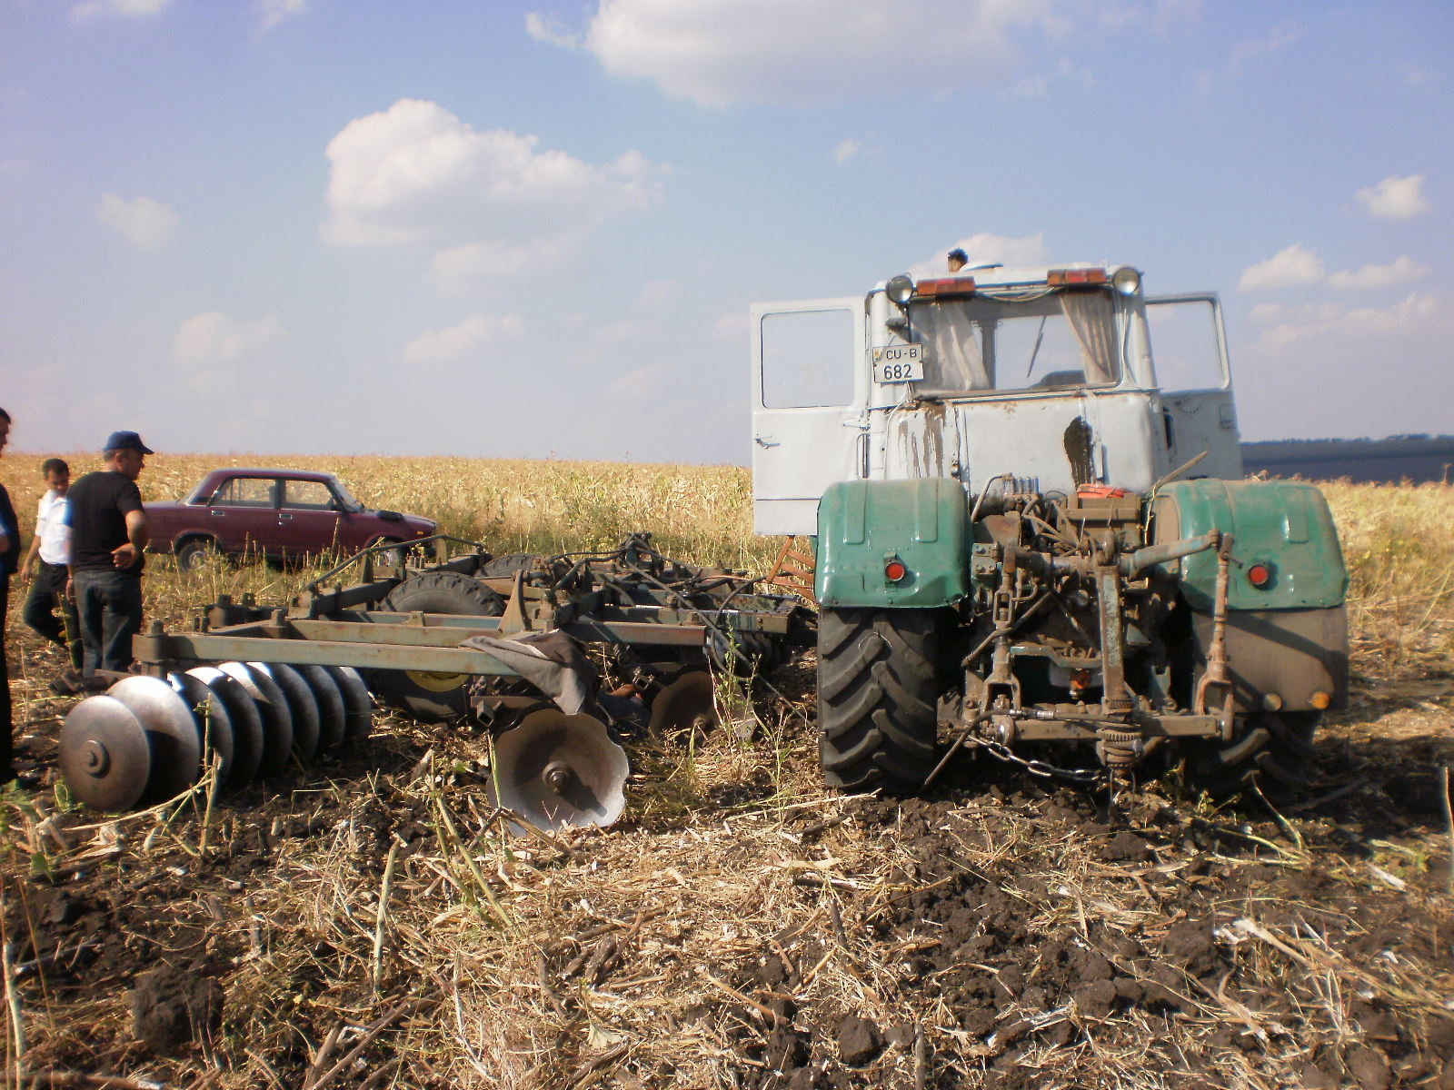
Event of work accident investigated during the campaign

Slide 33
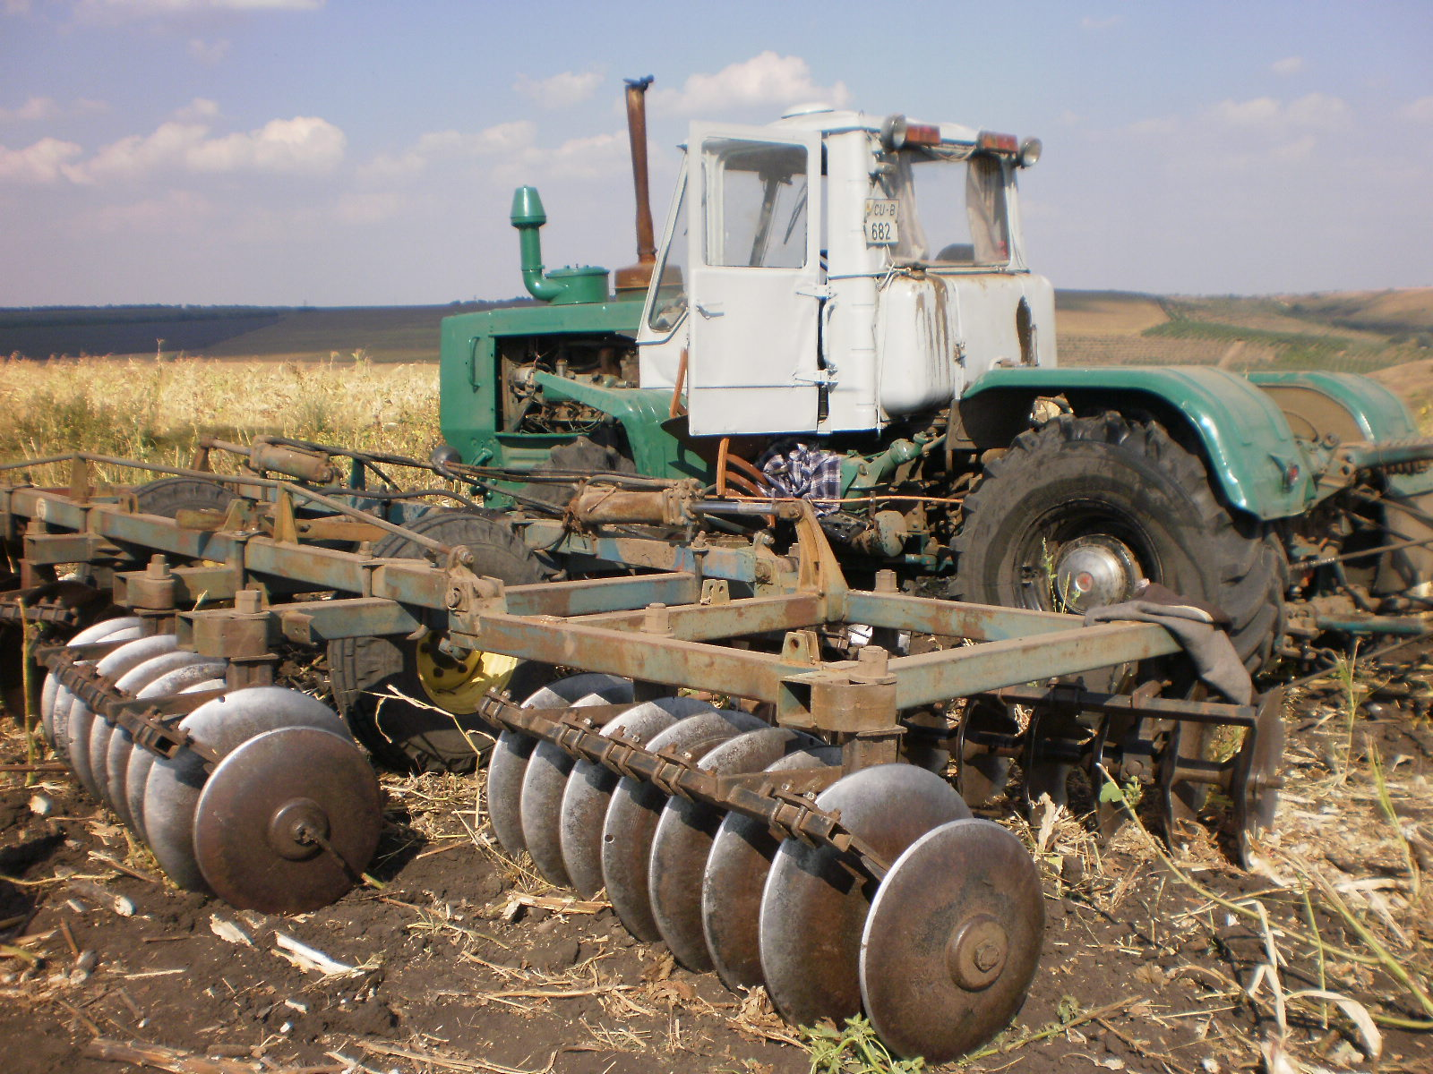

Slide 34
Operative assessment indicators of the National Campaign of Labor Inspection in Agriculture
From 26 September 2011 to 11 November 2011 were controlled 205 economic units in the agricultural sector where were working 14 520 employees, of which 5293 women and 3 minors. Of the total number of workers, 183 were working illegally.
Were visited 577 jobs with a number of 10 or more workers, and 496 jobs with more than 10 workers. During the campaign was considered the technical condition of over 2000 tractors and about 3500 other agricultural machines.
Following the checks were recorded over 3000 violations. Same time for not conforming to the provisions of legislative acts and other regulations of law legislation were drawn 29 contravention protocols and submitted to the court for examination. It also was suspended the operation of 35 work-equipment that presented imminent danger of injury.

Slide 35
THANK YOU FOR YOUR ATTENTION !

