Slide 1
The International Labour Organization (ILO)
AA Career Fair
26th January 2013
Sabine Baun
Director ILO Berlin

Slide 2
Contents
About the ILO
Strategic Objectives
Who we’re looking for
Internship Programme
Associate Expert Programme
Recruitment Practices
Notes:
What do you know about the ILO?

Slide 3
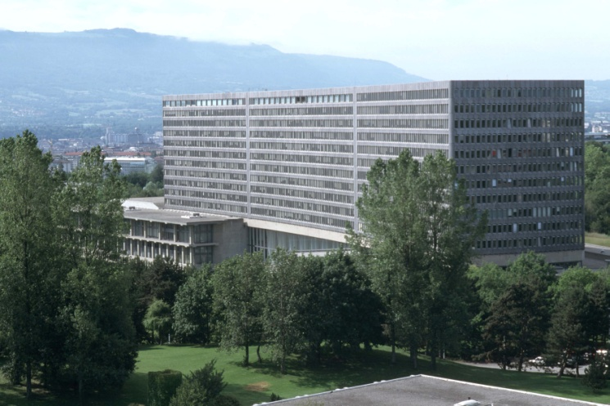
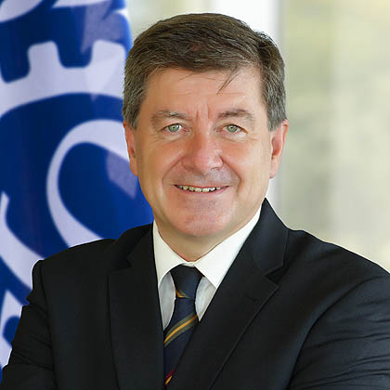
The ILO is…
…the first specialized UN Agency
...devoted to advancing opportunities for women and men to obtain decent and productive work in conditions of freedom, equity, security and human dignity
Notes:
The International Labour Organization is the UN specialized agency which seeks the promotion of social justice, decent work and internationally recognized human and labour rights.
Headquarter in Geneva, Switzerland
More than 2500 staff at HQ and over 50 field offices
International Training Centre in Turin, Italy

Slide 4
The ILO is…
…responsible for drawing up and overseeing international labour standards
…the only tripartite UN agency - it brings together representatives of governments, employers and workers to jointly shape policies and programmes
…made up of 185 Member States
Notes:
New UK DG Guy Ryder

Slide 5
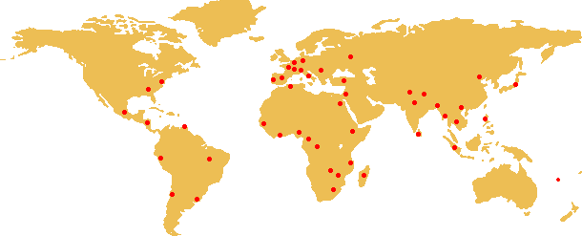
The ILO around the World
…over 45 offices
…5 regional offices.
Notes:
The ILO has five Regional offices in:
Africa (Addis Ababa)
Asia (Bangkok)
Europe (Geneva)
Latin America (Lima)
The Arab States (Beirut)
The ILO has over 45 offices all over the world
Approx. 2500 staff of 100+ nationalities serving in 45+ countries

Slide 6
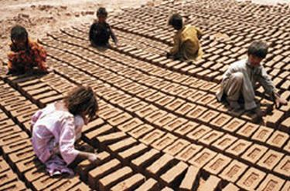
ILO Strategic Objectives
1. Fundamental principles and rights at work and international labour standards
Notes:
The ILO Works extensively throughout the world to promote a solid legal framework for respecting basic economic and social rights.
plays a central role in responding to the current global economic and jobs crisis and is involved in major multilateral initiatives to confront the crisis and its impact in the world of work.
International Labour Standards (NORMES)
International Programme on the Eliminiation of Child Labour (IPEC)
Program for the Promotion of the Declaration (DECLARATION)
Relations, Meetings and Document Services (RELCONF)
Activities:
1. Forced Labour
12 million people are victims of forced labour
Includes debt bondage, trafficking and other forms of modern slavery
Generates $32 billion in profits
Declaration on Fundamental Principles and Rights at Work
Elimination of Child Labour
250 million children work, many full-time
126 million exposed to hazardous forms of child labour
Convention 182, Worst Forms of Child Labour
Programmes in over 80 countries

Slide 7
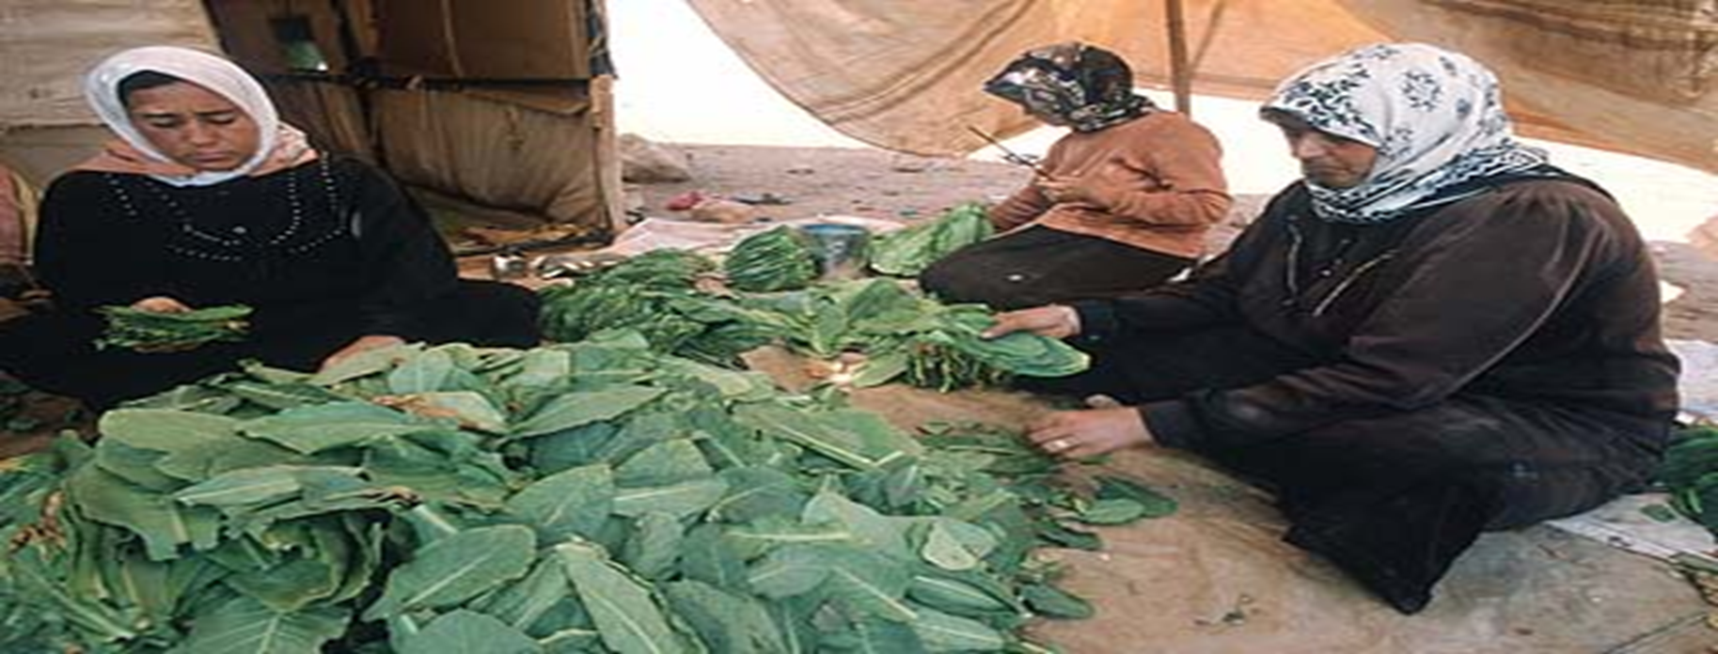
ILO Strategic Objectives
2. Employment and income opportunities
Notes:
The ILO works to create greater opportunities for women and men to secure decent employment and income.
Employment:
1 billion people unemployed or underemployed
One-third of global workforce
EMPLOYMENT
Crisis Response & Reconstruction (CRISIS)
Economic & Labour Markets Analysis (EMP/ELM)
Employment Policy (EMP/POLICY)
Job Creation and Enterprise Development (EMP/ENTERPRISE)
Skills Development (EMP/SKILLS)
Social Finance

Slide 8

ILO Strategic Objectives
3. Social protection and social security
Notes:
The ILO works to enhance the coverage and effectiveness of social protection for all.
SOCIAL PROTECTION
Labor Protection Department (PROTRAV)
- Programme on Safety and Health at Work and the Environment (SAFEWORK)
- Conditions of Work and Employment Programme (TRAVAIL)
- International Migration (MIGRANT)
- HIV/AIDS – ILO AIDS
Social Security Department (SECSOC)
Social Protection
Social Security: Only 20% of world’s population covered
Occupational Safety & Health: Each year, 2 million deaths from accidents or diseases
Conditions of Work: Wages, working time, work organization
International Migrant Workers: 175 million migrants; half are economically active
HIV/AIDS and the Workplace: 40 million people of working age have HIV, 28 million workers lost to AIDS in last 20 years, Economic impact on their families

Slide 9
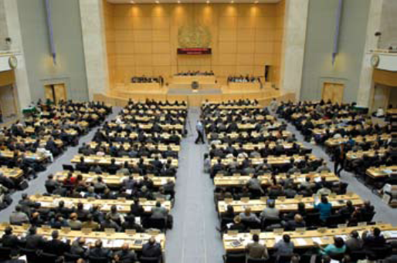
ILO Strategic Objectives
4. Social dialogue and tripartism
Notes:
Dialogue
Strengthen Dialogue between workers, employers and government groups
The ILO brings together representatives of governments, employers and workers to foster cooperation and to deliver "real world" knowledge about employment and work.
SOCIAL DIALOGUE
Employers’Activities (ACT/EMP)
Industrial and Employment Relations Department (DIALOGUE)
Labour Administration and Inspection Programme (LAB/ADMIN)
Sectoral Activities (SECTOR)
Workers’ Activities (ACTRAV)

Slide 10
Who we are looking for?
Employment promotion
Child Labour
Freedom of Association
Safety and Health at Work
Social Security
Social Dialogue
Youth Employment
Multinational Enterprises / CSR
Microfinance
Green Jobs
Notes:
MANAGEMENT AND ADMINISTRATION
Bureau of Programming and Management (PROGRAM)
Department of Central Services, Security and Protocol (SERVSEC)
Department of Facilities Management (FACILITIES)
Department Financial Services (FINANCE)
Department of Human Resources Development (HRD)
Department of Information Technology and Communications (ITCOM)
Evaluation Unit (EVAL)
DG REPORTS
Department of Communication and Public Information (DCOMM)
Department of Statistics (STATISTICS)
Ethics Office (ETHICS)
Bureau for Gender Equality (GENDER)
International Institute for Labour Studies (INST)
International Training Centre of the ILO (TURIN)
Office of Internal Audit and Oversight (IAO)
Office of Legal Services (JUR)
Department of Partnerships and Development Cooperation (PARDEV)
Policy Integration Department (INTEGRATION)
ILO Administrative TRIBUNAL

Slide 11
Entry points
International recruitment
Internship Programme
Associate Expert Programme
Consultancy
Temporary positions (Technical cooperation projects)
Regular Professional positions
Notes:
Useful experience:
research institutes
NGOs
Workers and employer associations
UN environment
National labour ministry

Slide 12

The ILO internship Programme
Notes:
The ILO Internship Programme is very unique among the UN system in many senses and also extremely popular.
Objective: provide a first working experience as well as a learning opportunity for mostly graduate and postgraduate students
Internship has proven to be a useful and interesting opportunity for the interns and the organisation. You are a valuable asset to the Office: The young talents who come for a limited period of time to the ILO are a source of potential future recruits. Moreover, they bring the most recent thinking and research experience in their area of academic study. Through the internship programme interns will disseminate the knowledge and understanding of ILO principles throughout your future professional careers as “ILO Ambassadors”
They can apply for vacancies in the ILO and any other agencies as external candidates during and after the internship. There are many UN agencies which have “an embargo” for their interns and they may not be able to apply for vacancies in the serving organization during and after 3 to 6 months of their internship.
Start date is 1 or 15th of each month

Slide 13
Qualifications required
Interns should…
be enrolled in the final year of a graduate degree programme, or in a higher degree programme in areas relevant to the work of the Office, or have completed such programme in the year preceding the application
have a working knowledge (both oral and written) of at least one of the ILO's official languages (English, French or Spanish)
be able to adapt to an international, multicultural, multilingual environment and have excellent communication skills.
Notes:
13
You might think:
Now is the questions which way to go now next? Only you can answer best
Do I want to continue to study or change studies?
Do I like the UN system as a possible employer for me in the future? What are alternatives?
When would be a good moment to apply and for which positions?
Should I look internally within the ILO? Very few opportunities! P profile – 60 positions per year posted due to retirement, international competition…
What external alternatives are out there? Show you some links
Where do I see my career path continue? Talk to others
Or you do not know which path to go? Then any path will be fine to get further experiences.
Generation Y comes into increasingly old labour market. Changing careers become normal today. 29 times in a life time! High ambitious, open to better opportunities, not at any price! Life balance is important.
ILO is an expert organisation that often has highly specialised positions. The average age is around between 45-50 and often regular positions are published at a senior level. The good news is that there will be around150 positions coming up in 2015 due to retirements. ILO recruits often national specialists that have experience within a particular geographical region, with other relevant institutions, governments, NGO, or with experience in a specific labour related field or more general project management experience and a network that can help the organisation in its advisory role to the governments, representatives of workers and employers. If this is your long term career perspective, you can start now to build on your experience to get there at a later stage. A short-term decision towards an administrative role at ILO now, might not be the right step.

Slide 14
The programme
  Duration: The length of an internship is between 3 and 6 months
  Stipend: Where an intern is not supported by an institution (university, government or otherwise), the ILO pays a stipend of 1,850 CHF per month to cover basic subsistence costs for internships in Geneva
  Cost of travel, accommodation as well as living expenses and visa/passport arrangements for entering Switzerland are the responsibility of the intern or sponsoring institution.
  Insurance: Interns are responsible for their own insurance for illness and accidents.
Notes:
14

Slide 15
How to apply?
Apply through the Roster that is published for two weeks, three times a year (January, May and September): https://erecruit.ilo.org/public/index.asp
There are 21 current Internship Programme profiles in the areas of: Legal services, Development Cooperation, Statistics, Finance, Human Resources, Communication and Public Information, Library and Information Management, Translation Services, Computer and Information technology, Public and Business Administration, Regional Office for Europe and Central Asia, Monitoring and Evaluation, Skills and Employability, Procurement Contracts, Knowledge Management, Working Conditions and Labour Protection, Facilities Management, Industrial and Employment Relations, Comparative Labour Law, SME Development and Entrepreneurship Promotion, Research.
The closing date for applications is 31 January 2013.
Further information on our internship programme can be found at: http://www.ilo.org/public/english/bureau/pers/vacancy/intern.htm
Contact: internship@ilo.org
Notes:
Selection process
Step 1: Hiring Department/Field Office screens submitted CVs and Cover letter
Step 2: Department/field office interviews selected candidates (usually by phone)
Step 3: Successful Applicants receive an Internship agreement by HR Officers or field office
-Maybe add that the roster is opened for a short period of time (2weeks).

Slide 16
FIGURES FOR 2011
2011 review of the internship programme
  At Headquarters:
  279 interns
  Average internship duration: 4.4 months
  72% received a monthly stipend
  28% received external funding
  In the Field:
  35 in Latin-America
  49 in Asia and the Pacific
  19 in the European offices (exc. HQ)
  15 in New York, Tokyo, Washington offices
  13 in Arab States
  33 in Africa
Notes:
Generation Y comes into increasingly old labour market. Changing careers become normal today. 29 times in a life time! High ambitious, open to better opportunities, not at any price! Life balance is important.
ILO is an expert organisation that often has highly specialised positions. The average age is around between 45-50 and often regular positions are published at a senior level. The good news is that there will be around150 positions coming up in 2015 due to retirements. ILO recruits often national specialists that have experience within a particular geographical region, with other relevant institutions, governments, NGO, or with experience in a specific labour related field or more general project management experience and a network that can help the organisation in its advisory role to the governments, representatives of workers and employers. If this is your long term career perspective, you can start now to build on your experience to get there at a later stage. A short-term decision towards an administrative role at ILO now, might not be the right step.

Slide 17
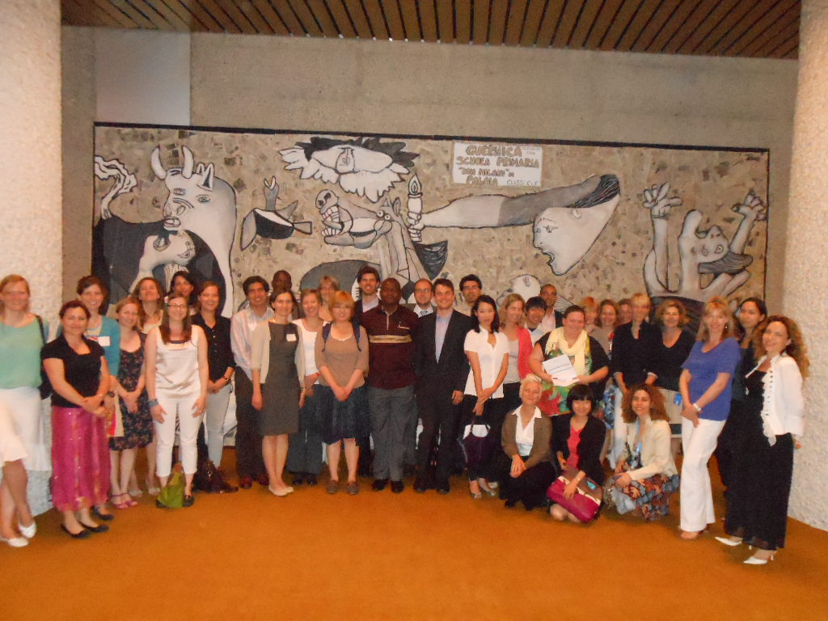
Junior Professional Officer/
Associate Expert Programme
at the ILO

Slide 18
Objectives
An entry programme for young professionals to a UN career
Programme funded and candidates selected by donor countries for over 35 years
Train young professional who have completed their academic or equivalent studies, by giving them the opportunity to participate in the UN technical cooperation programmes and its specialized agencies for 2 to 4 years;
Contribute to ILO multi-/bilateral technical cooperation programme;
Render technical assistance to developing countries;
Gain a source of potential future experts and officials for the UN system and for donors’ bilateral programmes.

Slide 19
Donor countries
Australia
Austria
Belgium
Canada
Denmark
Finland
France
Germany
Italy
Japan
Republic of Korea
Luxembourg
The Netherlands
New Zealand
Norway
Poland
Spain
South Africa
Sweden
Switzerland
Turkey
* current ILO partners
Notes:
We currently have between 20 and 30 Associate Experts from 13 countries in orange.
1/3 in field offices - 2/3 HQ
Since the pre-selection is done by the respective governments and each donor has specific requirements, please check the websites of their Ministry of Foreign Affairs if you would like to learn more about this programme.
If you are from developing country, you might be eligible for the programme funded by EU and the Netherlands. (3 years stop of funding) – new donors are planned.
For more information, again, please check their websites.

Slide 20
Requirements
  Minimum one to three years of experience
  Maximum 32 years of age at time of application
  Master or Bachelor degree or an equivalent technical qualification
Notes:
20
The ILO submits a list of vacancies to its donor countries on a quarterly basis.
Governments then select the posts of interest in accordance with their policies and priorities.
A preliminary selection of candidates is mostly made by donors at national level
Final decision is taken in close consultation with the ILO, which is usually involved in the interview for the final short-listed candidates.
It takes approximately one year from the moment of application to the official start date.

Slide 21
Review
2000 - 2010
    255 Associate Experts finished the programme between 2000-2010
    Currently 30 Associate Experts (2/3 at HQ;1/3 in the field)
    31 % of former Associate Experts were retained by the ILO
Notes:
21
Predominant reasons for leaving: further studies, family reasons, transfers to other agencies, career opportunities in home country

Slide 22
Further information
Overview on JPO / AE donor countries in general:
http://www.jposc.org/
Associate Experts Programme:
http://www.ba-auslandsvermittlung.de/lang_de/nn_468734/DE/Home/Arbeitnehmer/BFIO/internationale-organisationen-knoten.html__nnn=true
ILO specific:
http://www.ilo.org/public/english/bureau/pers/vacancy/aexpert.htm
Contact:
associateexperts@ilo.org

Slide 23

Recruitment Practices at ILO

Slide 24
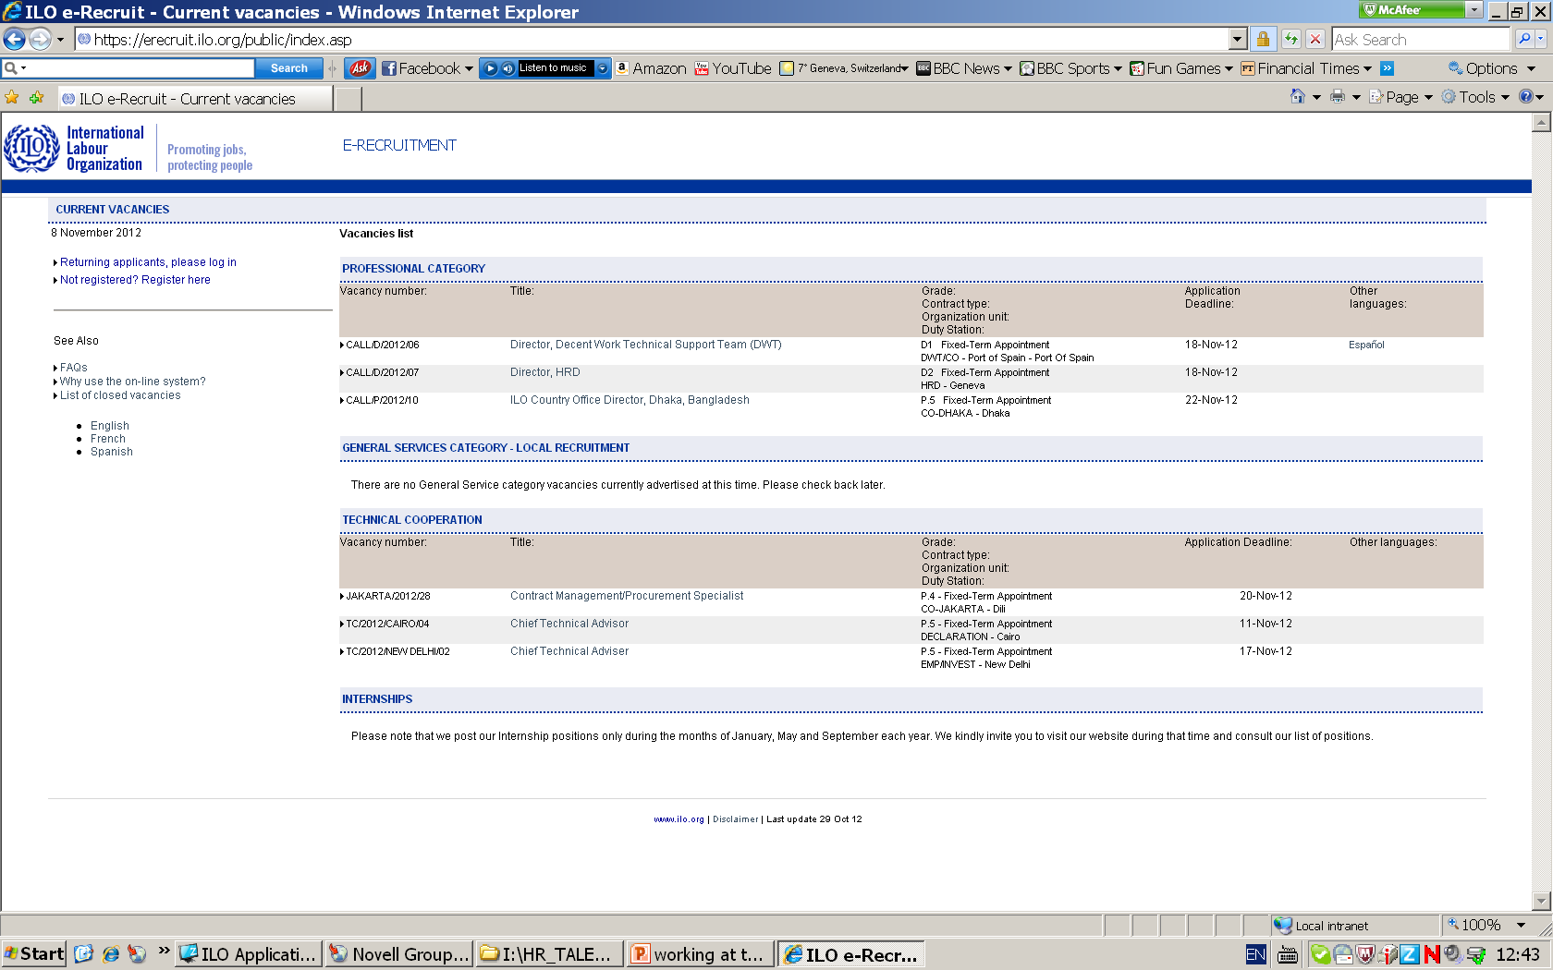

Slide 25
International staff
General Staff
“G” levels (G-1 through G-7)
Professional positions
“P” levels (P-1 through P-5)
Director positions
“D” levels (D-1 and D-2)
United Nations System Staff Category and Grade Structure

Slide 26
Professional staff
Requirements
Grade | Language | No. Years experience | Minimum Qualifications
P.1 | Excellent command of one working language and good knowledge of another. (E, F, S) | 1 year in the occupational area | First university degree in a relevant field
P.2 | Excellent command of one working language and good knowledge of another. (E, F, S) | 2 years in the occupational area | First university degree in a relevant field
P.3 | Excellent command of one working language and good knowledge of another. (E, F, S) | 5 years in the occupational area. 3 years at international level | Advanced university degree in a relevant field
P.4 | Excellent command of one working language and good knowledge of another. (E, F, S) | 7 years in the occupational area. 5 years at international level | Advanced university degree in a relevant field
P.5 | Excellent command of one working language and good knowledge of another. (E, F, S) | 10 to 15 years in the occupational area. 7 years at international level | Advanced university degree in a relevant field
Notes:
Internship does not count as professional experience
G position experience does not qualify for P position

Slide 27
Professional Vacancies
1. Announcements available around February & August each year through the website
2. Application screening
3.Test & Interview
  Assessment Centre:
    Competency Based Interview
    Analytical Exercise
4. Recruitment Offer

Slide 28
Professional Staff salary
Net Base Salary
- Dependency rate
- Single rate
Post Adjustment
- % of net base salary to cover cost-of-living at a specific duty station

Slide 29
To sum it up…
ILO is an exciting place to work in
The internship programme is a great opportunity to experience the daily work, culture and mandate of the ILO
If you would like to join the UN now or at a later stage, keep on building
your international experience
your language skills
your niche/ expertise
your network!

Slide 30
“Universal and lasting peace can be accomplished only if it is based upon social justice.”
Thank you!

