Slide 1

The Global Role of Wages:
Productivity, Employment and Equity
Sandra Polaski
Deputy Director General for Policy
International Labour office (ILO)

Slide 2
Global Context for Wage Developments
Over the last decade, overall global growth in real monthly average wages has been positive, but trended down after the crisis.
Annual average global real wage growth, 2000–11 (%)
*Annual growth rates published as “provisional estimates” (based on coverage of c.75%).
Notes: Global wage growth is calculated as a weighted average of year-on-year growth in real average monthly wages in 124 countries, covering 94.3% of all employees in the world (for a description of the methodology, see the appendix I of the Global Wage Report 2012/13). Estimates prior to 2006 are based on a higher proportion of secondary series wage data.
Source: ILO Global Wage Database

Slide 3
Global Context for Wage Developments
In the Eurozone, wage growth has been modest or negative for over a decade.
Annual average real wage growth in the Eurozone, 2000–11 (%)
Note: The Eurozone includes: Austria, Belgium, Cyprus, Estonia, Finland, France, Germany, Greece, Ireland, Italy, Luxembourg, Malta, the Netherlands, Portugal, Slovakia, Slovenia, and Spain.
Source: ILO Global Wage Database

Slide 4
Global Context for Wage Developments
Comparative annual average real wage growth globally and in the Eurozone, 2000–11 (%)
*Annual growth rates published as “provisional estimates” (based on coverage of c.75%).
Notes: Global wage growth is calculated as a weighted average of year-on-year growth in real average monthly wages in 124 countries, covering 94.3% of all employees in the world (for a description of the methodology, see the appendix I of the Global Wage Report 2012/13). Estimates prior to 2006 are based on a higher proportion of secondary series wage data. The Eurozone includes: Austria, Belgium, Cyprus, Estonia, Finland, France, Germany, Greece, Ireland, Italy, Luxembourg, Malta, the Netherlands, Portugal, Slovakia, Slovenia, and Spain.
Source: ILO Global Wage Database

Slide 5
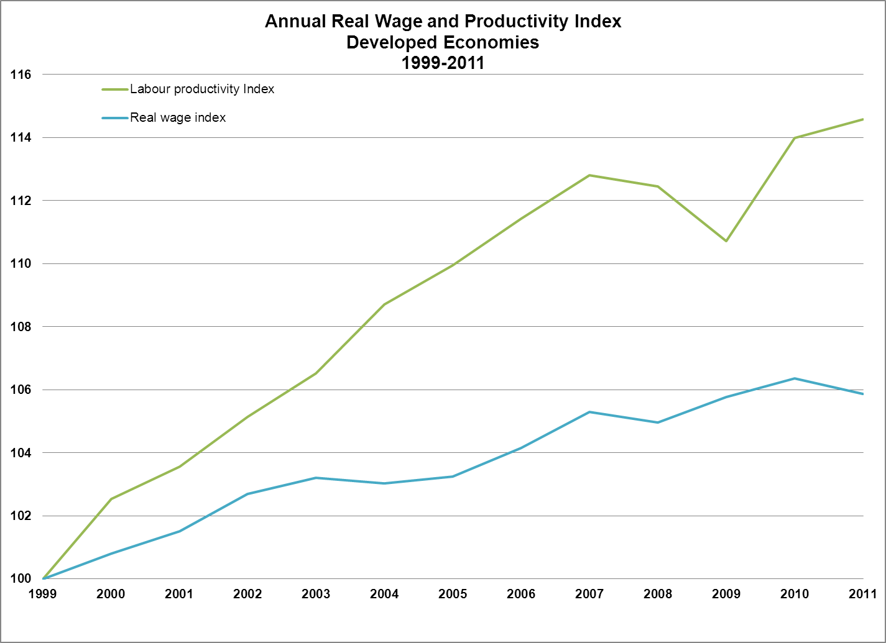
(a)Wages and productivity
Trends in developed economies, 1999-2011
Note: Since the indices refer to a weighted average, developments in the three largest developed economies (United States, Japan, and Germany) have a particular impact on this outcome. Labour productivity is measured as output per worker.
Source: ILO Global Wage Report 2012-13

Slide 6
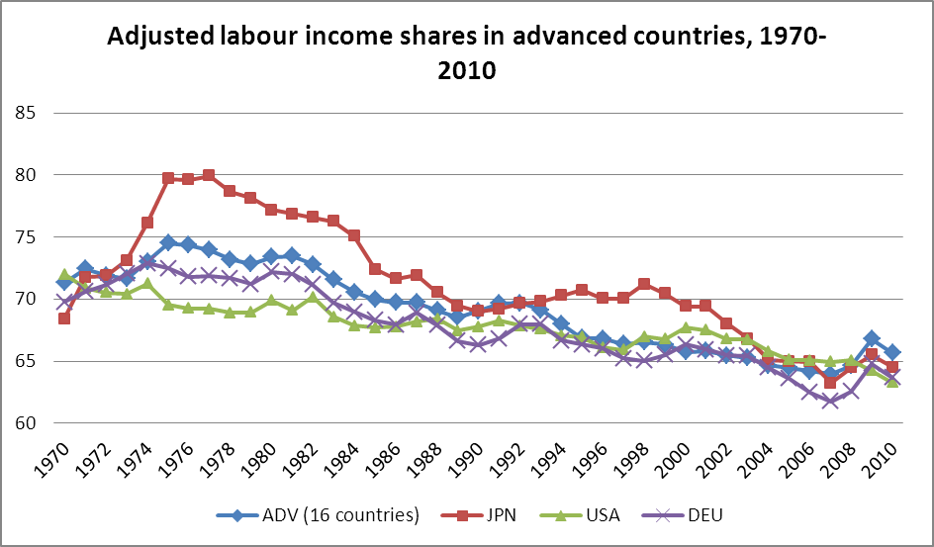
(b) Wages and productivity
Fall in the labour share
In developed countries as a group, real wages have lagged productivity for several decades. This is also a distributional issue: a declining labour income share indicates that a smaller part of national income is going to labour compensation and a larger share to capital income.
Source: ILO Global Wage Report 2012-13

Slide 7
(c) Wages and productivity
Effects of decrease in labour income share
Hurts household consumption and can thus create shortfalls in aggregate demand.
  In some countries these shortfalls can be compensated by increasing net exports, but not all countries can run a current account surplus at the same time. A strategy of cutting unit labour costs may run the risk of depressing domestic consumption more than it increases exports at home and can have beggar-thy-neighbor effects on trading partners.
Can undermine social cohesion.
  Creates a perception of unfairness, particularly given the strong pay growth among executives and in the financial sector.

Slide 8
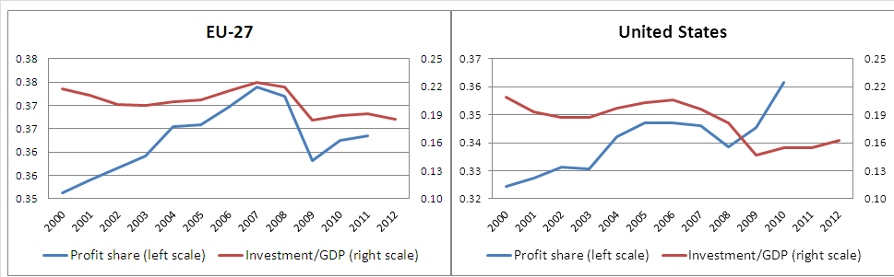
Lower labour shares have not translated into greater productive investment
In the EU and the United States higher profit shares have not led to higher investment. For the period 2000-06, investment as a share of GDP was lower than in other leading economies and has fallen further since 2007.
Profits (per cent of value added at factor cost) and investment (per cent of GDP)
Source: IILS (2013) Labour incomes and employment: empirical links and policy options, forthcoming joint report with the European Commission.

Slide 9
Wages and employment
Wages play a dual role affecting the demand and the supply of labour:
  Higher real wages increase costs of production, can reduce profitability and may affect international competitiveness → decreasing output and demand for labour →unemployment;
  Higher real wages stimulate consumer demand → increasing output and demand for labour → employment
The balance of these opposite effects on employment depends on:
  the level of the labour share (if too high will lead to a predominance of costs effects, if too low will undermine aggregate demand);
  features specific to each country at a particular point of time (wage-led vs export led regime, non-price competitiveness);
  multi-country context; (wage moderation pursued by many countries simultaneously to raise competitiveness will drive down aggregate demand and will hurt employment).

Slide 10
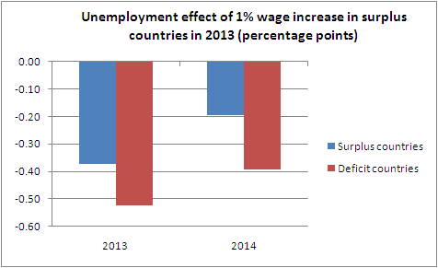
Making wages grow with productivity, along with other measures, would facilitate job recovery
Notes:
A real wage increase in surplus Eurozone economies boosts domestic demand in those countries. The model shows that this positive effect outweighs the negative effect arising from a deterioration in cost-competitiveness associated with the wage increase. The size of the shock (1 per cent in 2013) is such that wage increases would grow in line with productivity gains in surplus economies, and not less as had happened before the global crisis.
In deficit Eurozone economies, the real wage increase of surplus economies translates into higher exports. The model simulations assume that deficit economies are in a position to take advantage of improved export opportunities. The overall profitability situation of enterprises in most of these countries and their recent export performance lend support to this assumption. However this may be less the case in economies like Greece where supply constraints may be significant.
In all cases, the wage policy cannot be taken as a panacea. It should be complemented with measures to boost the ability of deficit countries to respond to new opportunities. However, within that context, the simulations suggest that a wage policy which ensures that wages grow in line with productivity in surplus Eurozone economies will help boost employment while addressing some of the underlying imbalances.
The Source of these simulations is the Global Economic Linkages (GEL) model.

Slide 11
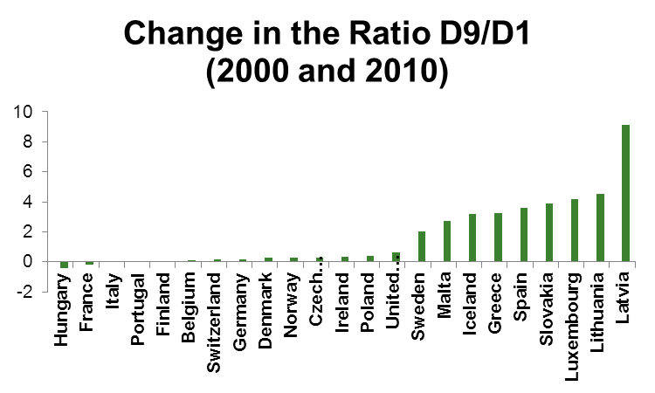
(a) Wages and inequality
Low pay and increased wage disparity
The distance between the top 10% and the bottom 10% of wages has increased in 17 out of 30 countries with available data, and the proportion of wage earners with low pay (less than two-thirds of median wages) has increased in 25 out of 37 countries. The graphs below show the evolution for the European economies for which we have data.
Source: ILO Global Wage Report 2010-11

Slide 12
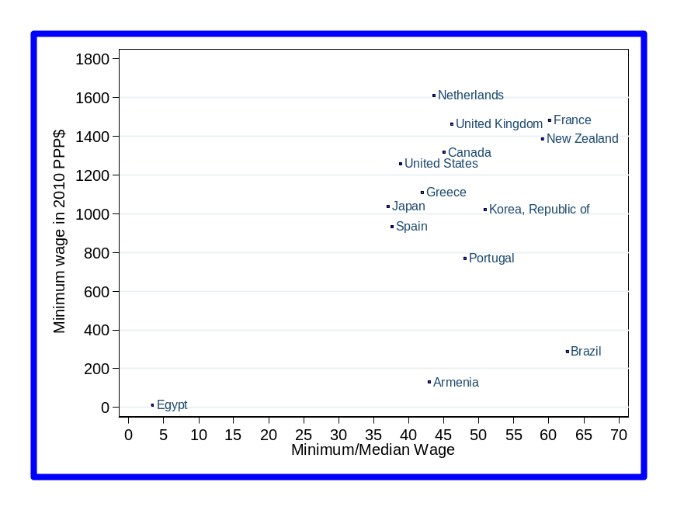
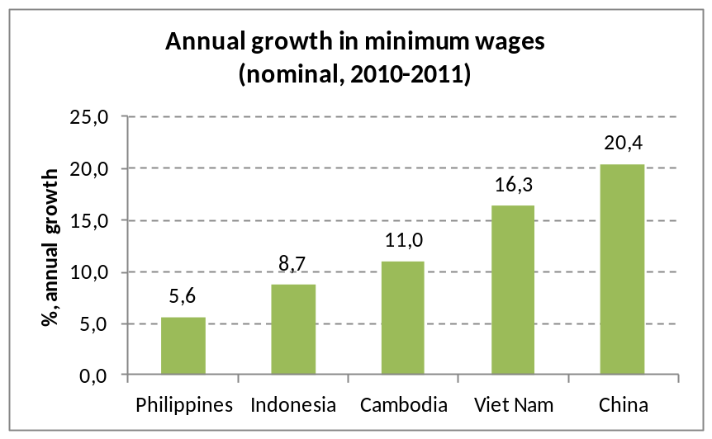
(b) Wages and inequality:
The increasing role of minimum wages
Studies (EC-ILO) have shown that minimum wages contribute to reduce wage disparity and limit the number of low paid workers in European countries that used it.
Globally, around 85% of ILO Member States use minimum wages as a tool of social protection, including the BRICs. Brazil and China using this tool aggressively for addressing inequality.
The level of the minimum wage relative to median wages varies greatly.
Growing importance in Asian countries
Minimum wage levels in selected economies, in PPP$ and as a share of the median wage, 2010
Notes: Nominal minimum wage growth is an average of the minimum wage growth between 2009-10
and 2010-11. Data for Viet Nam refer to data between 2008-2010.
Notes: Data on developing economies is limited as few have data on median wages. Data from Egypt refer to 2009. Data for developed economies, the Republic of Korea and Egypt refer to full-time employees. Data for Brazil and Armenia refer to income received from the main job.
Sources: UK Low-Pay Commission; ILO Global Wage Database

Slide 13
Some policy conclusions
Policy-makers should pursue policies and create institutions that promote a close connection between the growth of labour productivity and the growth of workers’ compensation.
In a number of EU countries, there is room to increase wages as a means to stimulate domestic demand and with spillover benefits to other EU countries.
Institutions matter:
  Social dialogue and collective bargaining are powerful instruments to reach balanced and consensual outcomes.
  Minimum wage policies positively influence wage distribution, reduce incidence of low-paid workers while having no marked effect on employment.

