Slide 1

TACKLE SOUTH SUDAN
END OF PROJECT WORKSHOP
OCTOBER 2008 TO JUNE 2013
PRESENTATION BY HELLEN LOTARA ACHIRO
UNDERSECRETARY, LABOUR
MINISTRY OF LABOUR, PUBLIC SERVICE & HUMAN RESOURCE DEVELOPMENT

Slide 2
TACKLE South Sudan: Background Info
  European Commission to support African, Caribbean and Pacific countries
  TACKLE S. Sudan Partnership Protocol signed October 16, 2008 by MOL, MOGSW, MOE, EU, ILO
  First ILO/IPEC (and child labour specific) project in the country

Slide 3
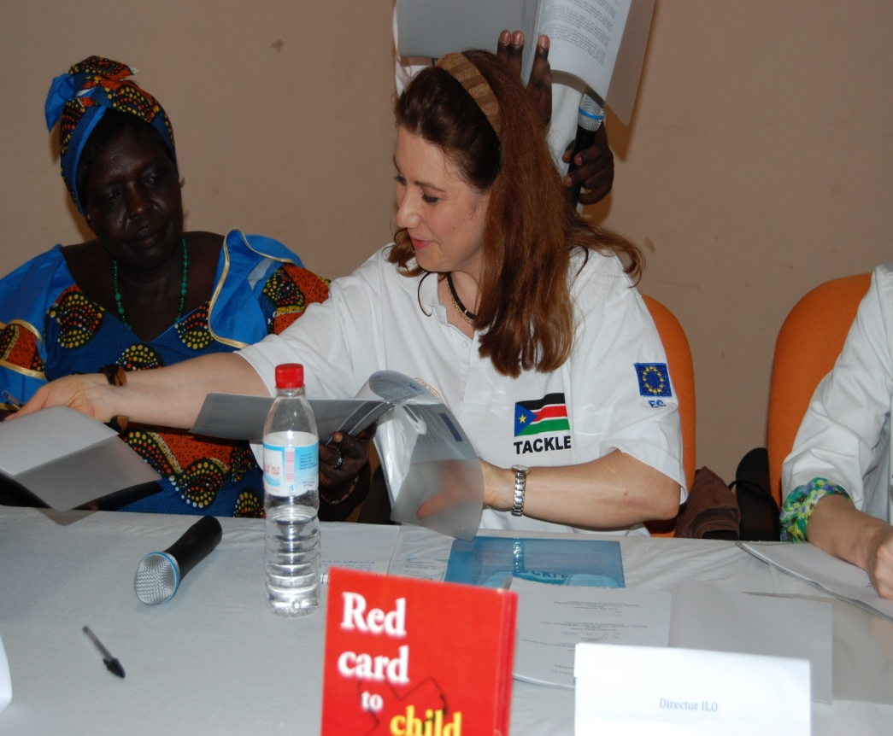
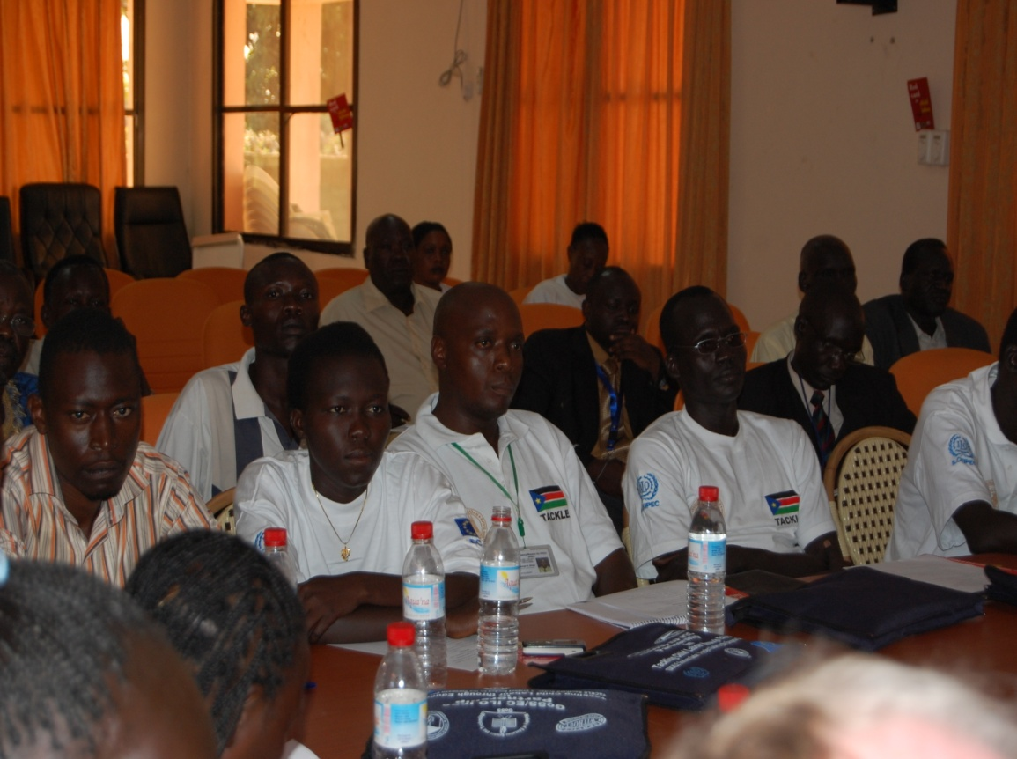
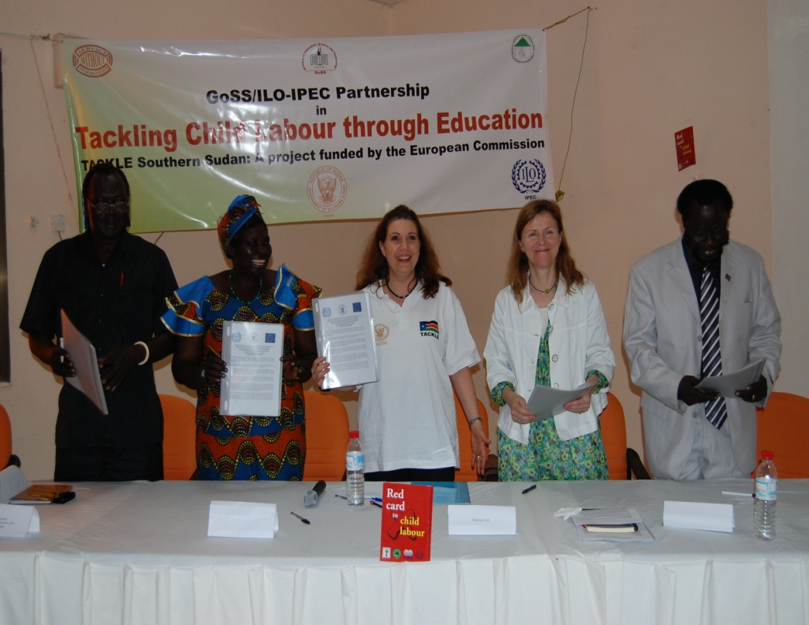
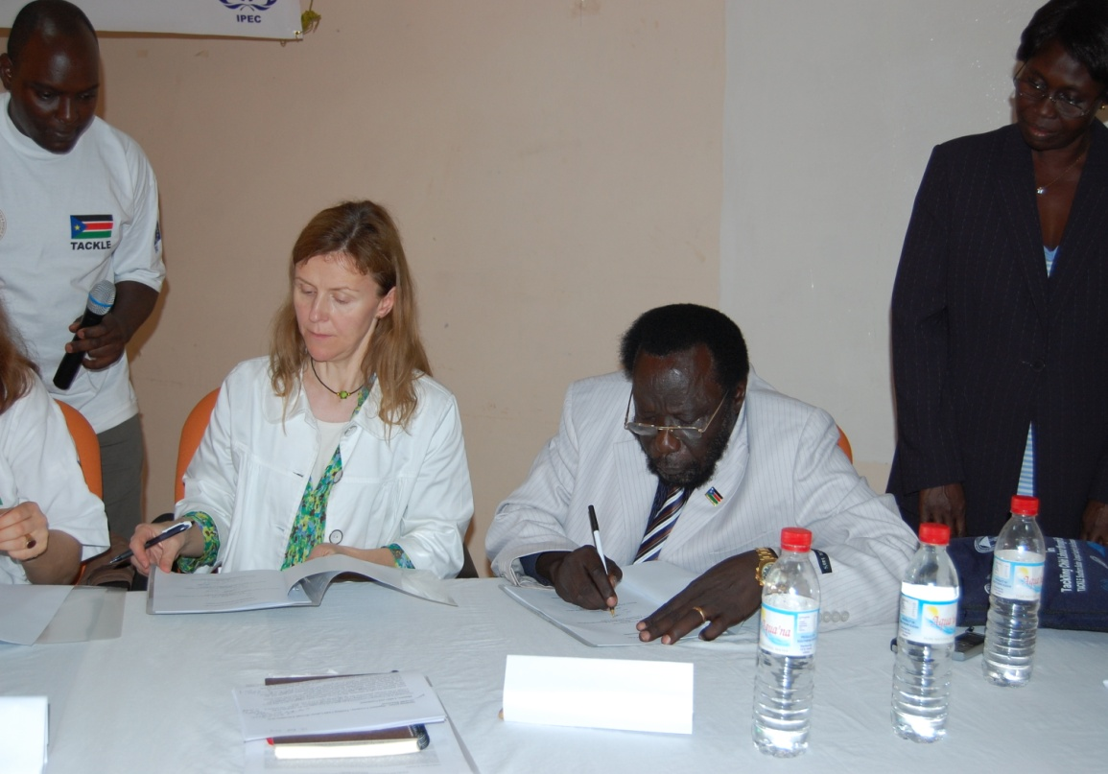

Slide 4
Result on Legal framework
ILO Conventions 138 and 182 ratified in 2012
African Charter on the Rights and Welfare of Child (ACRWC) signed 2008
The draft Labour Bill is currently on process to the parliament. The has a section on child labour, WFCL and minimum age of entry into employment. Will complement the Child Act 2008
Sensitization of stakeholders on the two ILO conventions and other international and national instruments e.g. CRC, Child Act has been undertaken

Slide 5
Results on Legal framework cont…
Draft list of hazardous work developed, and validated by stakeholder
Child Labour has been integrated in the Decent Work Country Programme (under review)
CL integrated into MOL’s 5 years strategic plan
National Steering Committee established and capacity on combating child labour enhanced
Labour advisory working group formed in a tripartite manner to enforce National Steering Committee for Labour
Child Labour Division within the Ministry of Labour established, provided with basic office equipments
National Action is currently being worked on

Slide 6
Lessons learnt
Appropriate legal framework important for enforcement hence urgent need to pass the Labour Bill and develop supporting Regulations
Legal framework alone not adequate there is need to have various forms of direct intervention
Awareness raising is part and parcel of legal framework and hence need to scale up
Political will to end child labour is key to the fight against the vice and political leaders need to be fully engaged as education is the key
Participation of opinion shapers, community leaders, church leaders, Women Groups, Imams and general populace very key

Slide 7
Lessons learnt
Withdrawal of children without relevant alternative not enough, vocational training is important
Research and reliable central data to guide Child Labour policy and intervention areas
Coordination and monitoring of child labour matters by a multi sectoral coordination committee is important
Key Child Labour institutions to be established in all levels of government in the 10 states not only at the national level

Slide 8
Way forward
As most of the results were achieved towards the end of project, it is essential to enhance implementation and continuity of the project support
More capacity building required to ensure efficiency of the national steering committee members
Additional support required for formulation of legal framework (e.g. regulations) and its dissemination
Support is required for more regional cooperation and coordination to learn from good practices
Building capacity of Media and making a documentary for awareness creation.

Slide 9

THE END – THANK YOU

